Slide 1
Movie Recommender System：Learning Outcomes Summary
Jiayi Zheng | 50039453

Slide 2

Project Overview
Built a movie recommender system in three stages
From heuristics to feature-based to latent-factor models
Goal: Improve robustness and personalization

Slide 3
Part 1

Slide 4
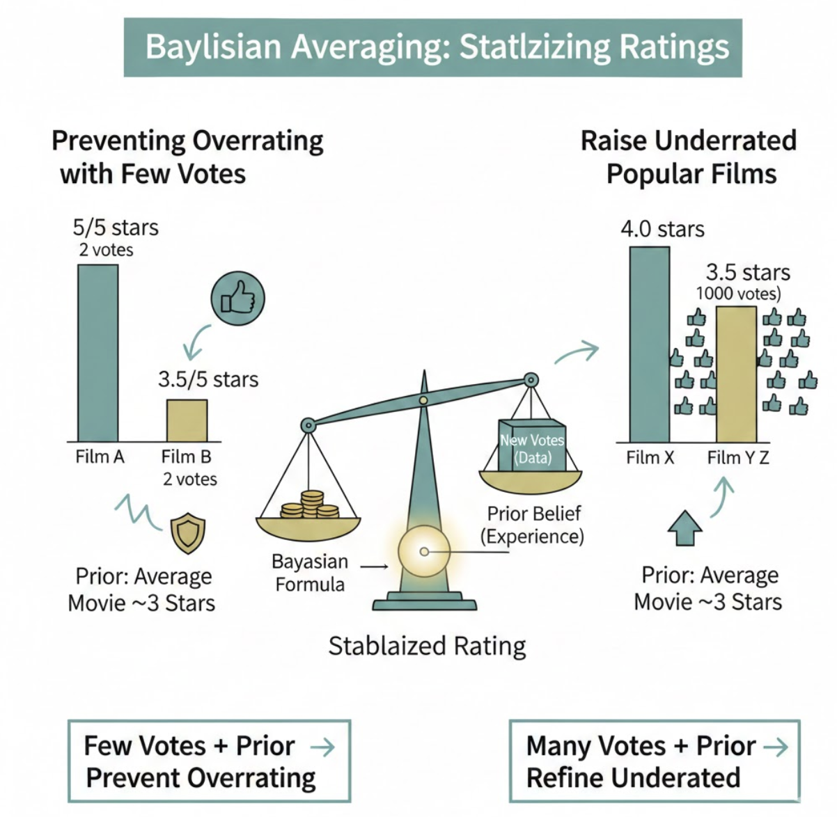
Bayesian Rating
Learned Bayesian averaging to stabilize ratings
Prevent overrating with few votes; raise underrated popular films

Slide 5
User-Movie Matrix & KNN
Constructed interaction matrix
Applied KNN for similarity-based recommendations
Toy Story 2 (1999)
Honey, I Shrunk the Kids (1989)
Mission: Impossible (1996)
Independence Day (a.k.a. ID4) (1996)
Toy Story (1995)
Bug's Life, A (1998)
Nutty Professor, The (1996)
Willy Wonka & the Chocolate Factory (1971)
Babe (1995)
Groundhog Day (1993)
Mask, The (1994)

Slide 6
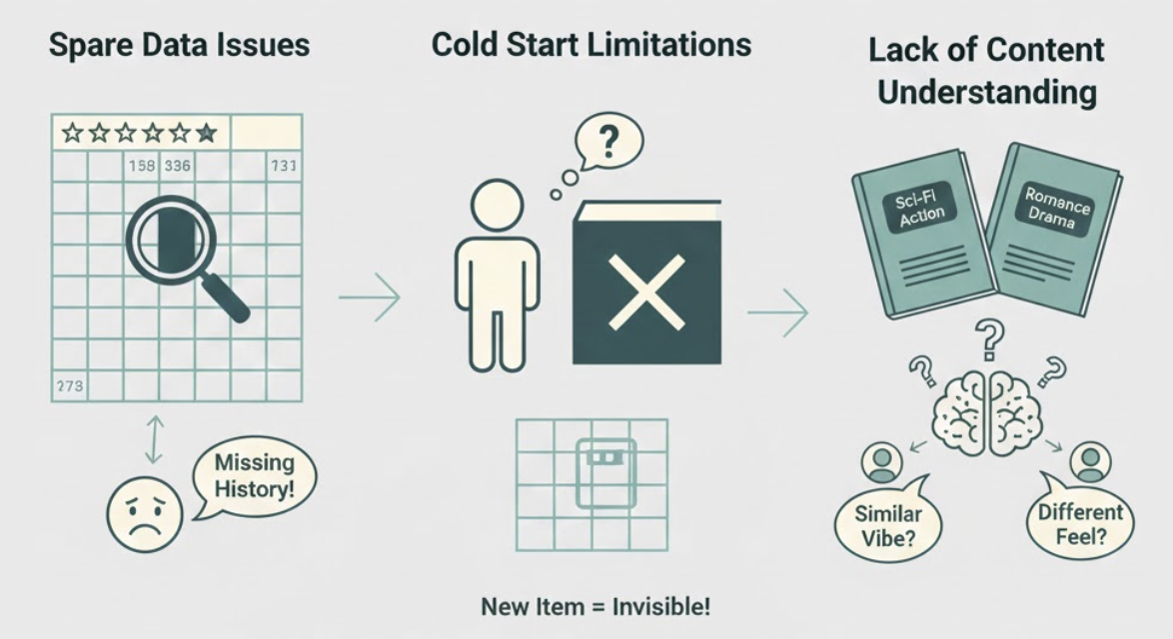
Limitations Found in Part 1
Sparse data issues
Cold start limitations
Lack of content understanding

Slide 7
Part 2

Slide 8
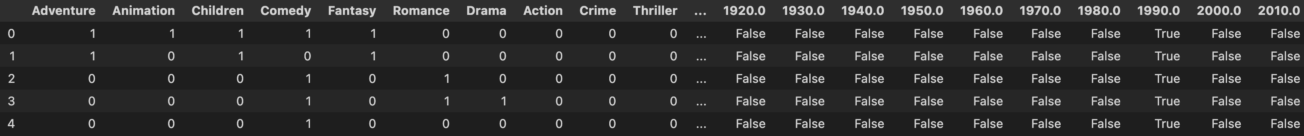
Adding Movie Features
Added genres, release year, metadata
Created explicit feature vectors

Slide 9
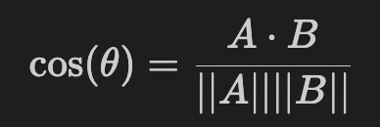
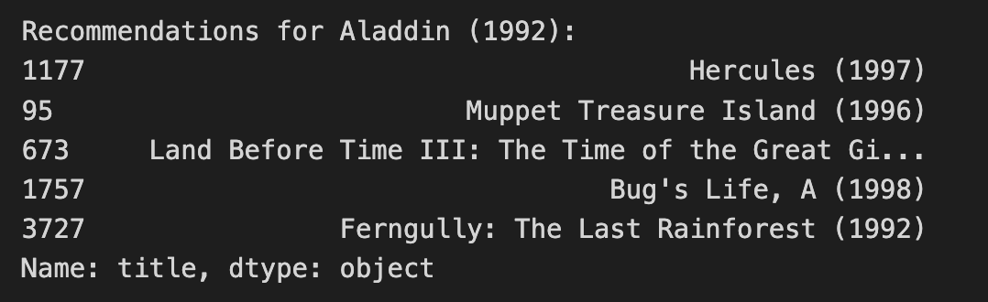
Cosine Similarity Search
Computed movie similarity using cosine distance
Performed content-based recommendations

Slide 10
Part 3

Slide 11
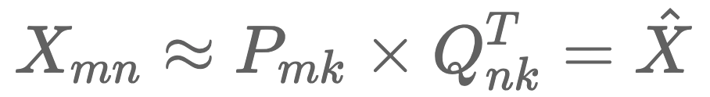
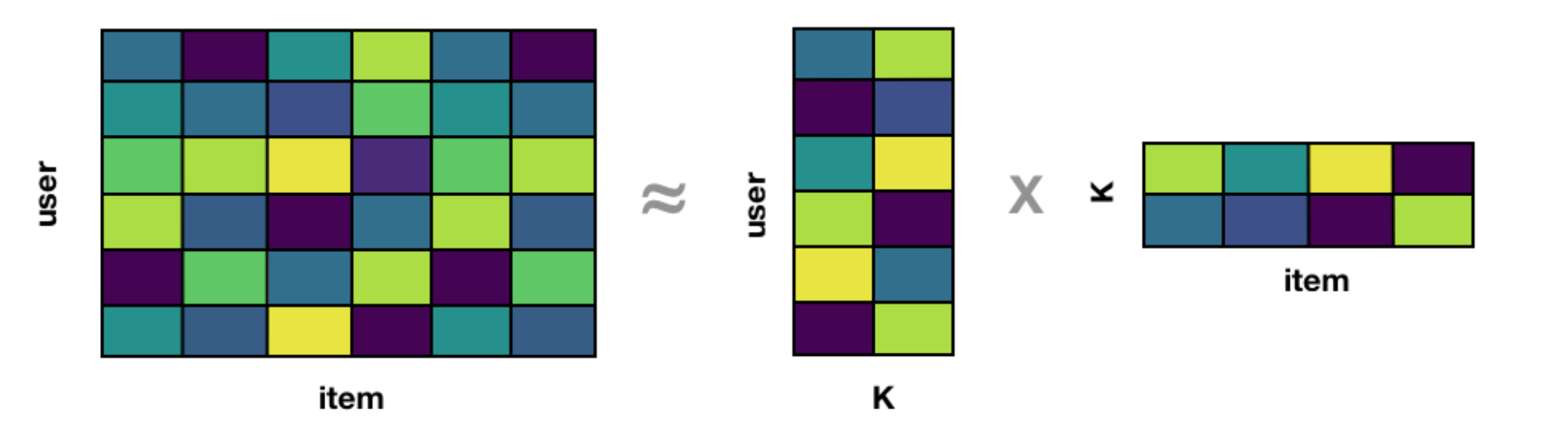
ALS with Implicit Feedback
Interpreted rating as watch frequency
Used ALS to learn user and movie vectors
P: User vector
Q: Item vector
k: Vector dimension P·Qᵀ is the predicted rating / degree of preference

Slide 12
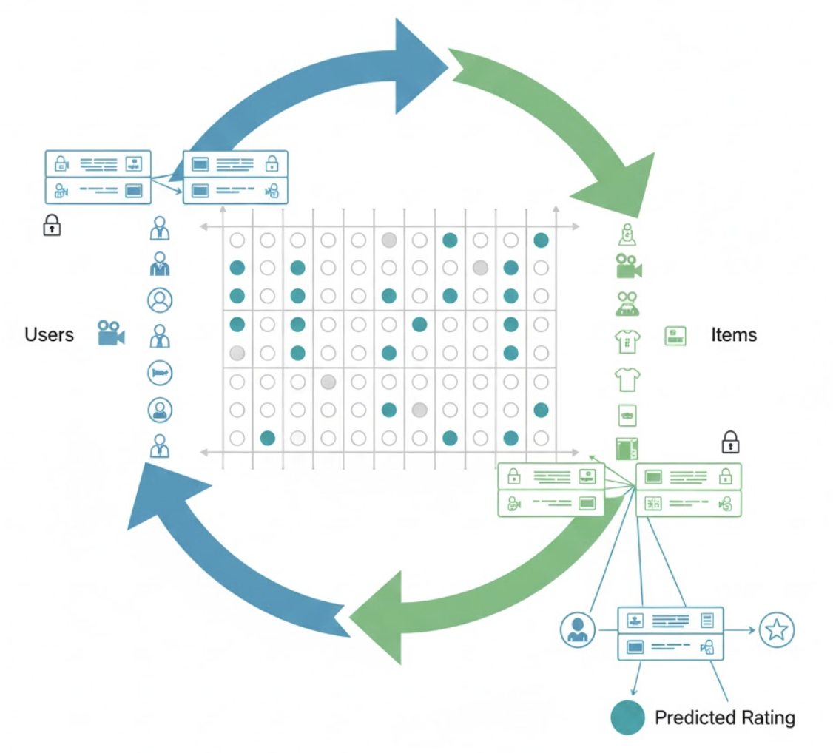
Latent Factor Recommendations
Predicted user preference via dot-product scores
Generated fully personalized movie lists

Slide 13
Overall

Slide 14
Comparison of All Three Parts
Part 1: Simple heuristics + KNN
Part 2: Content-based similarity
Part 3: Latent factor personalization

Slide 15
Overall Learning Outcomes
Bayesian smoothing & collaborative filtering
Feature engineering & similarity search
Matrix factorization & implicit modeling

