Slide 1
IMAGE2LOC
Convert tiff images to simulated localisation data

Slide 2
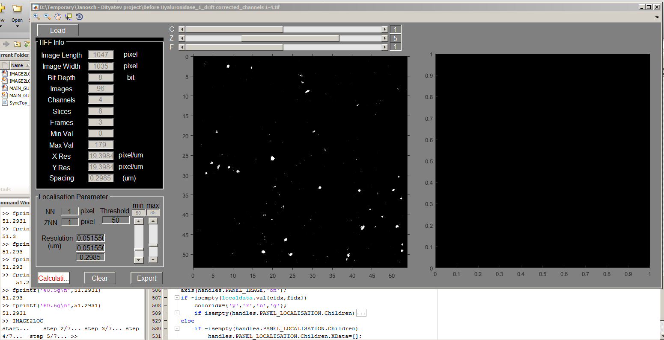
Title bar shows current file name
Slider to chose
C (Colour-channel)
Z (Z-slice)
F (Time-frame)
Click to load tiff file
Panel for localised scatter image
Panel for tiff intensity image
Info from tiff for your benefit. Cannot alter.
Parameters for localisation
NN=XY nearest neighbour, usually 1 is sufficient
ZNN=Z axis nearest neighbour
Threshold=minimum intensity to discard when display/localise
min/max=use slider to change left panel image display range
Resolution=default resolution (shouldn’t change)
Click to localise
Current selected Channel and Frame
Display current calculation progress
Click to clear localisation data for selected Channel and Frame
Export to csv file to be used
For localisation analysis

Slide 3
LOCSUPRES
Localised super resolution cluster analysis

Slide 4
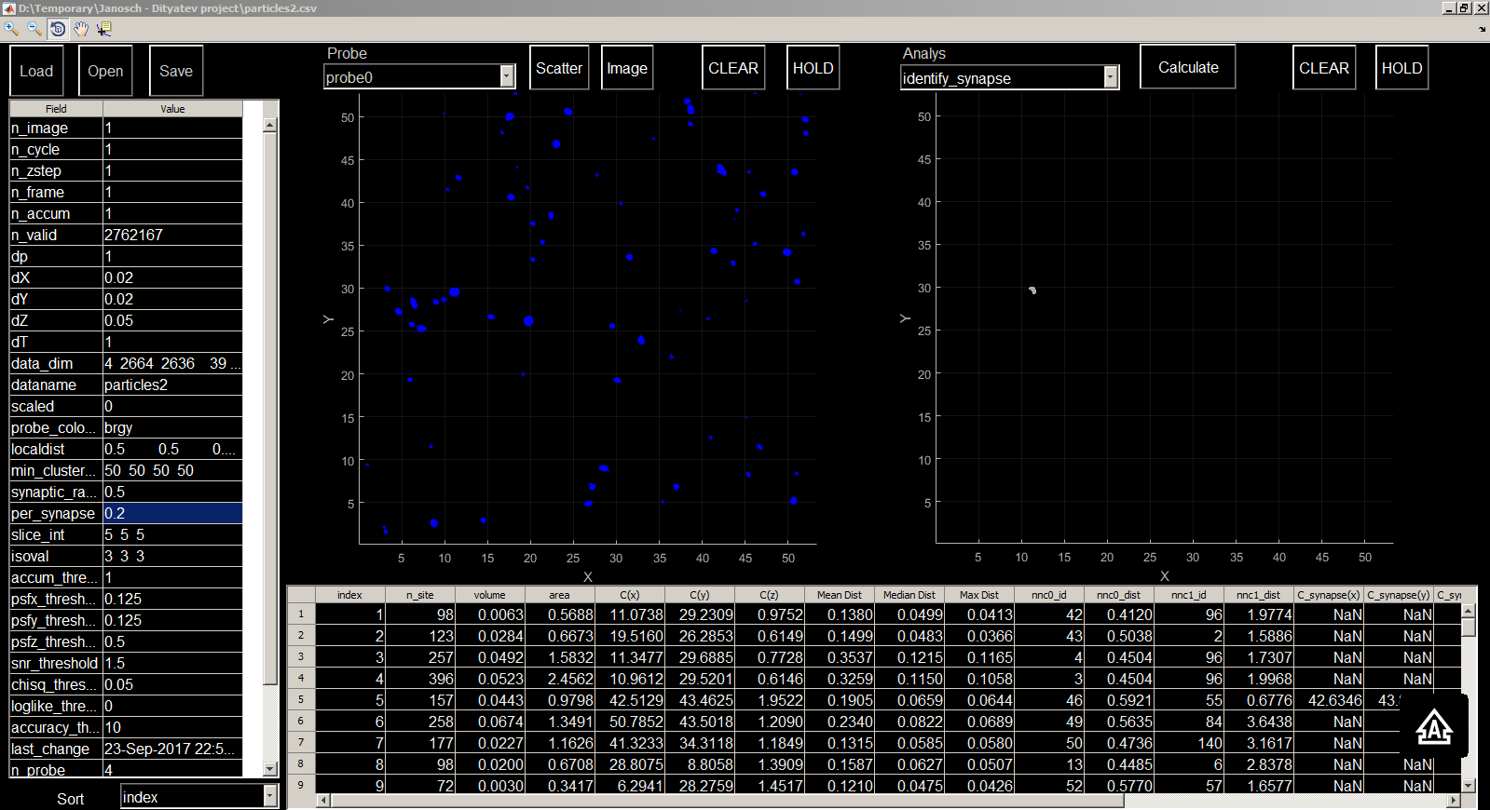
Load raw csv file
Title bar shows current file name
Rendered surface plot
Clear/Hold scatter plot
Select analysis function
Click to apply analysis function
Clear/Hold cluster plot
Open saved localisation file
Save current localisation data
Scatter plot
Probe
Select probe
Figure toolbar
Analysis parameters table
Scatter plot Panel
cluster plot Panel
Sort cluster table with respect to selected column
Cluster information table

