Slide 1
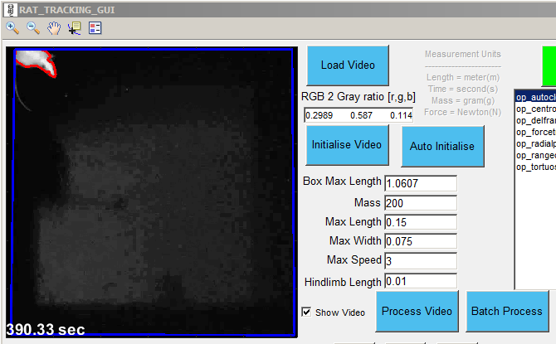
Video processing overview
Title Bar
Load raw video
RGB 2 Gray ratio
Conversion algorithm from RGB video to gray scale video
Semi-automated procedure to initialise video
Select box to crop excess part of the image
Select floor to set movement boundary
Select rat to initialise position
Graph tool bar
Zoom tool
Move tool
Data cursor
Legend toggle
Same as ‘Initialise Video’ by all done automatically
Maximum length the rat can run inside the box (e.g. diagonal distance)
Mass of the animal, help estimate force
Maximum length and width of the animal to help establish rat area for detection
Maximum running speed of the animal, useful to determine frame rate
Hindlimb length, will be used in future for more accurate force calculation
Whether to view the live video during process or batch process
Automated batch processing of multiple videos as selected
Take the initialised values and process the currently loaded video

Slide 2
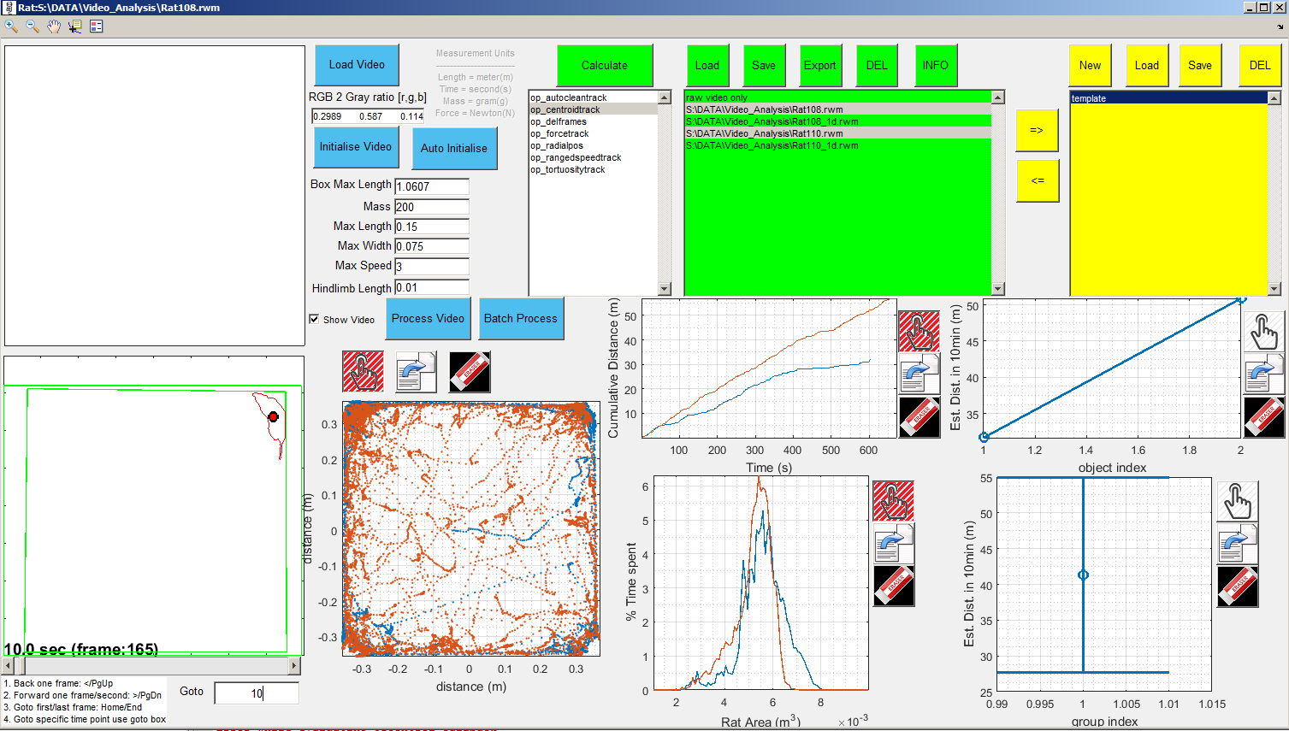
Object Calculation Overview
save rat objects to rwm file
Export object boundary to video
Remove object from list
Select operation
Apply selected operation on selected objects
Load rat processed rwm file
Select rat objects
Object data plot
Group data plot
Wired Boundary plot
Hold plot
export plot
erase plot
Control frames using sliderbar
Group data plot
Goto time point in seconds
Object data plot
Object data plot

Slide 3
Object Grouping Overview

