Slide 1
21 Secrets to Becoming A Good Speaker
Kai-Fu Lee
Corporate Vice President
Microsoft Corporation
Notes:
*** Glass Ceiling Question ***

Slide 2
We Present Every Day!
Not just giving formal talks talks….
  Discuss ideas of a project.
  Influence a friend, colleague, or boss.
  Tell people what you did, and why it matters.
  Get people’s “mindshare”.

Slide 3
Presentation Skills: Talent or Skill?
Presentation skills can be acquired.
  Anybody can be a good speaker!
Examples:
  Bill Gates
  Kai-Fu Lee

Slide 4
What You’ll Learn Today:
Communication skills.
Preparing the Talk.
Delivering the Talk.
Handling Q&A.
21 secrets to becoming a good speaker.

Slide 5
What is Communication Skills?
(Skills means can be learned!)
Verbal (words spoken).
Vocal (tone, range, appeal, credibility of voice).
Visual (physical appearance, clothing, gestures, eye contact).
7%
38%
55%
Communication
Skills

Slide 6
The Importance of Communication Skills
“Without effective delivery,
a speech of the highest mental capacity
can be held in no esteem.
With effective delivery,
even one with moderate abilities may
surpass those of the highest talent.”
-- Cicero
“The man who can think and does not know
how to express what he thinks
is at the level of him who cannot think.”
-- Pericles

Slide 7
Communication Skills = Fake?
Most important factor is PASSION!
  If you’re passionate, your vocal & visual skills will come naturally.
    Passion could come from subject, experience, or environment.
  “There is just one sure cure for bad speeches –
Get truly excited on the subject, and 99 percent
of the faults of your speaking will disappear.”
-- Robert Montgomery
But there are skills to be learned.
  Like reading, writing, typing….
  Must learn this, if you want your work to be understood!

Slide 8


Verbal Skills
Be simple and clear!
  Don’t ramble .
  Stop to think if you need to.
  Example one: Dan Quayle celebrates democracy:
  Example two: Dan Quayle trying to say
  “A mind is a terrible thing to waste”.

Slide 9
Verbal Skills
Speaking is not like writing!!!
  Use simple words.
  Don’t use complex sentences.
  Can you understand this:
Text:
  The development of this frightful means of destruction was ardently demanded by the perils of the time and situation. Simultaneously, however, a new paradoxical situation has been…. is upon us continually. One cannot defend oneself effectively any more.

Slide 10
Vocal Skills
Project & resonate your voice.
No “UM”s and “ER”s. (Pause instead).
Silence is a tool (To draw attention).

Slide 11
Vocal Skills
Play your voice with pitch and tempo.
To amplify a point, slow down, speak loudly, exaggerate intonation, pause in the right places.
  “You are right. I am wrong.”
  – Stalin to Trotsky
  “Ask not what your country can do for you; ask what you can do for your country.”
  -- John F. Kennedy
  BAD EXAMPLE : “I welcome this kind of examination, because people have to know whether their president is a crook. Well, I’m not a crook.”
  -- Richard M. Nixon
Don’t use it everywhere!

Slide 12

Vocal Skills : Same message; many ways to deliver
John Kennedy:
  “You need to contribute to your country”’
  “Ask not what your country can do for you; ask what you can do for your country”.
Quayle vs. Benson Debate:
  Quayle: "I have as much experience in the Congress as Jack Kennedy did when he sought the presidency."
  Answer 1: “Jack Kennedy is better than you.”
  Answer 2: "Senator, I served with Jack Kennedy.
  I knew Jack Kennedy.
  Jack Kennedy was a friend of mine.
  Senator, you're no Jack Kennedy.“

Slide 13
Vocal Skills : Enthusiasm
Passion & Enthusiasm!
  If you’re not passionate, why should we care?
Example: Martin Luther King.
  I have a dream…
  that one day
  this nation will rise up;
  live up to the true meaning to its creed:
  We hold these truths to be self-evident
  that all men are created equal.

Slide 14
Visual Skills
Visual Skills – THE most important:
  Appear trustworthy & respectful.
  US Election 1960 was won on visual skills.
Components of Visual Skills:
  Eyes.
  Body.
  Hands.
  Face.

Slide 15
Visual Skills – Eyes
Look forward at audience (trust).
  Don’t shift eyeballs; don’t look in corner.
  Don’t look too much at computer screen or your notes.
Look at people’s faces (not eyes).
  3-6 seconds per person.
  Shift randomly.
  Nod, smile, use facial expression.

Slide 16
Visual Skills – Body
Stand up when talking.
Walk around = informal.
Don’t:
  Rock, shake, lean too much.

Slide 17
Visual Skills – Hands
Gesture complements talk.
  Should come naturally, without thinking.
  Make sure they match!
Need to exaggerate a little
  Especially with large audience.
Don’t fidget or put in pocket.
Videotape whole talk & watch.
  Can improve hand gesturing!

Slide 18
Visual Skills – Face
Show emotion!
Most of the time:
  “I care a lot about this.”
  “I really believe in this.”
  “I love my work.”
Sometimes (in response to questions).
  “This is the most outrageous thing I’ve ever heard.”
  “I will have nothing to do with this.”

Slide 19
What You’ll Learn Today:
Communication skills
Preparing the Talk
Delivering the Talk
Handling Q&A
21 secrets to becoming a good speaker.

Slide 20
Preparing the Talk
Always OVERPREPARE!!!!!
Preparation includes:
  Researching the background.
  Organizing the talk.
  Writing the slides.
  Rehearsing the talk.
  Last minute things….

Slide 21
Researching the Background
When you’re invited, find out:
  How long is the talk?
  What’s the topic?
    (Say no if you don’t care about the topic).
  Who’s the audience.
Once you say yes, you are COMMITTED to do a great job.

Slide 22
Organizing the Talk
You’re the salesman.
First lesson for salesmen:
  “Tell them what you’re going to say.
  Say it.
  Tell them what you said”
Very similar to a term/research paper!

Slide 23
The Central Message (it)
People will not remember everything.
Have ONE clear walk-away message.
  What do you want people to remember in 3 months?
  The answer to the question:
  “How was the talk?”
Repeat it!

Slide 24
The Opening
Say something provoking!
Give a (very short) outline/overview.

Slide 25
The Substance
Logical.
Convincing.
  Help them remember the message!
  Anticipate doubts & remove them.
Smooth transitions
  Don’t lose the audience
  OK to re-order the sub-topics.
Keep repeating the message!

Slide 26
Example:
6 “P” of Microsoft Research
  6 P’s:
    People
    Programs
    Publications
    Patents
    Prototypes
    Product Impact
  Helps people remember, track, and follow the presentation.

Slide 27
The Ending
End with a BANG!
Repeat the message.
Say thank you.

Slide 28
Writing the Visuals (PowerPoint)
Preparation (80% time)
  First prepare outline (recommend : Word).
  Then modify outline for:
    Logic, convincing, flow, transitions….
Actual Slide Writing (20% time)
  Should come almost directly from the outline.

Slide 29
Use of Visuals (PowerPoint)
Visuals only support your talk.
  Spend more time on your talk!
Simple and clear.
  1 idea; 3 sub-concepts; <= 6 lines.
  Readable – Big & color-coordinated.
    Use 2 colors if you are not color-coordinated!
Don’t read from the slides!

Slide 30
What if Talk is Complex
Don’t lose people.
  Use grayed out outline.
If idea is complex:
  Try really hard to avoid complex slides, but…
  If you must use it, use layers (prevent read-ahead & lack of focus).
    Use right types of animation (natural, not ostentatious).
    Remember to change slides for printing.
    Example….

Slide 31

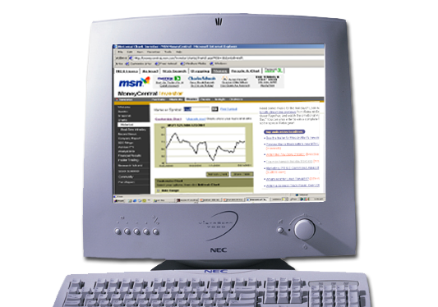
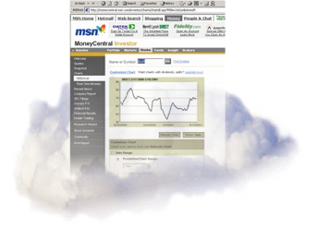



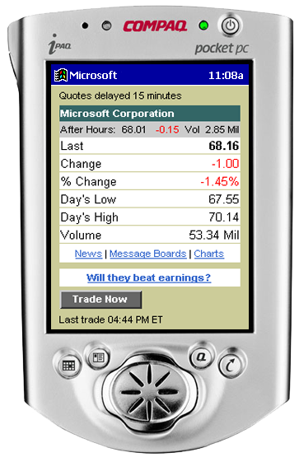
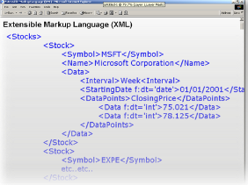
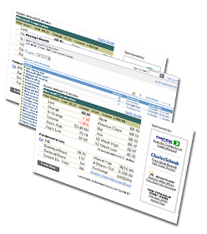

On PC
On Pocket PC

Slide 32
Use of Demos / Multimedia
Keeps the talk interesting.
Don’t overdo it.
  Should be tied to content.
Ordering :
  2,N, N-1, N-2,….3, 1

Slide 33
Rehearsing Your Talk
Record & listen to every talk at least twice!
Record:
  Best : PowerPoint features.
  OK : Tape recorder.
  Must do sometime :
    Video
    Ask experienced speaker to critique.
Improve:
  Style, logic, timing per slide.

Slide 34
Get the Timing Right!
Running out of time is a disaster.
  Write how much time should remain on each slide.
After you’re more experienced….
  No longer necessary to record.
  Every new talk still must be rehearsed.
  Bring notes if you aren’t confident.

Slide 35
Just Before the Talk….
Prepare something matching the occasion.
Make sure you’re not too tired:
  Get enough sleep the previous night.
  Drink 3 cups of coffee!

Slide 36
What You’ll Learn Today:
Communication skills
Preparing the Talk
Delivering the Talk
Handling Q&A
21 secrets to becoming a good speaker.

Slide 37
Delivering the Talk
Overcoming language barrier.
Overcoming nervousness.
Art of good opening & ending.
Humor
Audience participation

Slide 38
Overcoming Language Barrier
Perfect English not necessary.
Know your limitations.
  Don’t use fancy words, complex sentences.
  Don’t take any chance of looking silly.
OK to bring cheat notes!

Slide 39
Outline & Script
Always make an outline.
  PowerPoint notes; Word Outline.
  Don’t have to use it.
It may be best to READ a speech.
  No excuse not to be fluent! (practice!)
  Don’t stare at paper.
  (Memorize it if you’re prefer).

Slide 40
Overcoming Nervousness
“Do the thing you fear
and the death of fear is certain.”
-- Ralph Waldo Emerson

Slide 41
Hiding Nervousness
It is possible to hide nervousness!
Don’t let the shaking show!
  Make a fist; hold the lectern.
  Speak loudly.
  Take a deep breath.
Look at a friendly face.
Look above people’s heads.

Slide 42
Art of Good Opening & Ending
Opening
  Say something relevant to the occasion.
  Need to research background before the talk.
    Shows respect.
    Breaks the ice.
Ending
  “If you remember only one thing from this talk, then you should remember XXX”.

Slide 43
Humor
Good humor:
  Respectful.
  Relevant (better yet: original).
  Short.
Plan your jokes:
  Remember what worked.
  Use it again!
Examples….

Slide 44
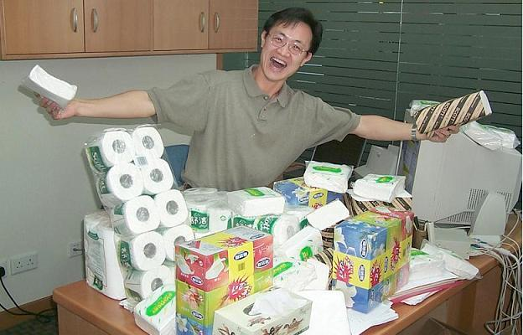
“Relevant Humor Example” : 6P : Papers
Paper
大大的有！

Slide 45
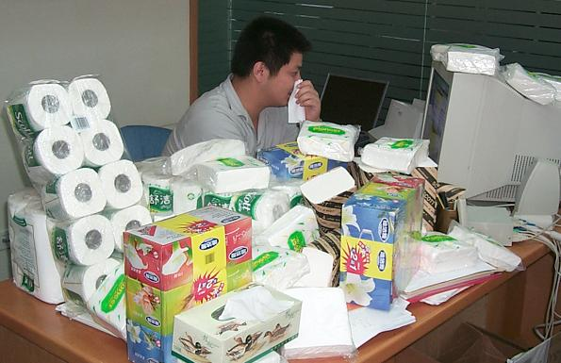
“Relevant Humor Example” : 6P : Papers
我搞出这些paper容易么！

Slide 46
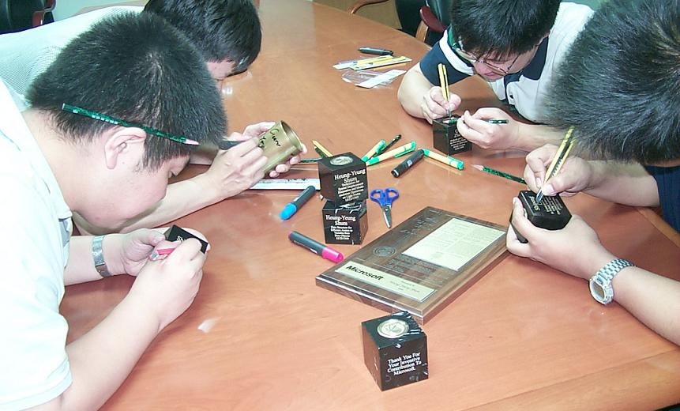
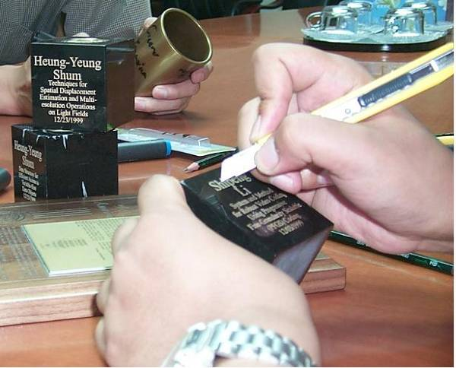
“Relevant Humor Example” : 6P : Patents
快点刻！这么多怎么忙得过来哪？

Slide 47
Humor
How to tell a joke?
  Set up (people should know a joke is coming up).
  Pause after climax (punch line).
  Best to do it in the beginning (to break the ice).
Move on naturally if no reaction!

Slide 48
Audience Participation
Best way for people to remember!
Ask audience a question.
  Anticipate their answer(s)!
  Respond with something interesting AND relevant.

Slide 49
Be Yourself
Learn the skills; don’t copy the styles.
You must be yourself to be credible.
Many styles could be effective:
  Bill Gates – Brilliant technologist.
  Steve Ballmer – Powerful salesman.
  Steve Jobs – Passionate evangelist.
You can adapt your style, but don’t exceed your “comfort zone”:
  Bill Gates – Brilliant technologist → great strategist.
  Steve Ballmer – Powerful salesman → trustworthy CEO.
  Steve Jobs – Passionate evangelist → technology visionary.

Slide 50
What You’ll Learn Today:
Communication skills
Preparing the Talk
Delivering the Talk
Handling Q&A
21 secrets to becoming a good speaker.

Slide 51
Q&A
Q&A is your chance to:
  Amplify your points.
  Increase your credibility.

Slide 52
Dealing with Questions
Easy Questions.
  Amplify your points!
Hard Questions.
  No need to answer directly.
  But don’t hide!
Narrow Questions.
  Take offline.

Slide 53
Q&A – Giving A Good Answer
Respect the listener.
Right body language.
Repeat the question.
  Complete if people cannot hear.
  Paraphrase to help amplify your point.
If people are too shy, you start!
Don’t argue or dismiss a question.

Slide 54
21 Secrets
#1 Anybody can learn to give a good talk.

Slide 55
21 Secrets
#2 Don’t give a talk unless
you’re passionate.

Slide 56
21 Secrets
#3 Use simple and clear words.

Slide 57
21 Secrets
#4 Play your voice to focus on key points.

Slide 58
21 Secrets
#5 Silence is a great tool.

Slide 59
21 Secrets
#6 Over-prepare every talk.

Slide 60
21 Secrets
#7 Tell them what you’re going to say.
Say it.
Tell them what you said.

Slide 61
21 Secrets
#8 Have ONE clear central message for:
the question “How was the talk”

Slide 62
21 Secrets
#9 Open your talk with
something thought-provoking

Slide 63
21 Secrets
#10 Slides should be simple & clear.

Slide 64
21 Secrets
#11 Don’t read from your slides.

Slide 65
21 Secrets
#12 Order your demos.

Slide 66
21 Secrets
#13 Rehearse & listen to each talk
at least twice!

Slide 67
21 Secrets
#14 Time your talk on every slide.

Slide 68
21 Secrets
#15 It may be OK to read from a script.

Slide 69
21 Secrets
#16 Stay awake!
Drink 3 cups of coffee before your talk.

Slide 70
21 Secrets
#17 It is possible to hide nervousness.

Slide 71
21 Secrets
#18 Tailor your opening remarks
to the occasion.

Slide 72
21 Secrets
#19 “If you only remember one thing from
this talk, you should remember XXX”

Slide 73
21 Secrets
#20 Humor & Interactivity must be
relevant and well-planned.

Slide 74
21 Secrets
#21 Q&A can help you
more than the audience.

Slide 75
Conclusion
Giving a talk is easy.
It just takes:
  A little passion.
  A lot of practice!

