Slide 1
Enhancing Underwater Imagery using Generative Adversarial Networks
Cameron Fabbri , Md Jahidul Islam , and Junaed Sattar
ICRA 2018
vision@ouc

Slide 2
ISSUE
Underwater environments pose unique challenges to visual sensing,
as light refraction, absorption and scattering from suspended particles
can greatly affect optics.
Often times, these networks require large amounts of data, either
labeled or paired with ground truth. However, underwater images
distorted by either color or some other phenomenon lack ground
truth, which is a major hindrance towards adopting a similar approach
for correction.
vision@ouc

Slide 3
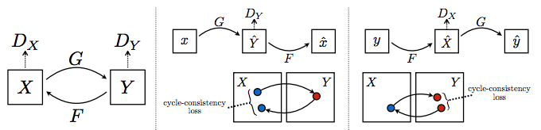
Methodology
Dataset Generation
be an underwater image with no distortion
be the same image with distortion
vision@ouc

Slide 4
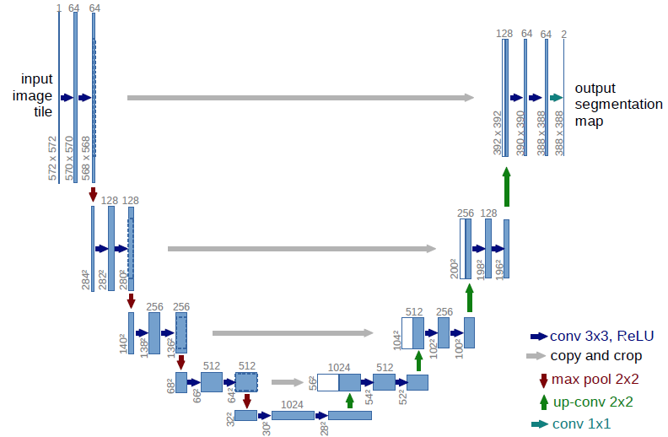
Methodology
Network Architecture
Our generator network is a fully convolutional encoder-decoder,
similar to the work of “U-Net”.
vision@ouc

Slide 5

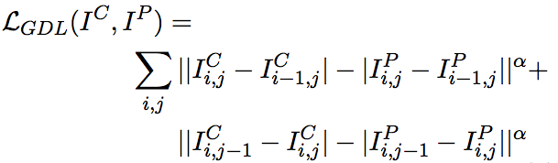
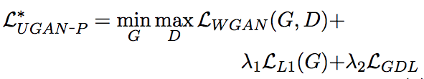
Methodology
Loss Function
http://ice.dlut.edu.cn/valse2018/ppt/2018ValseDChao.pdf
vision@ouc

Slide 6
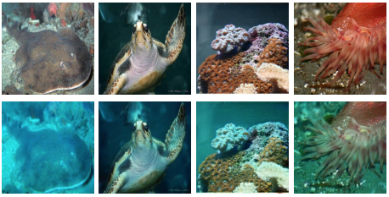
Experiments
CycleGAN
vision@ouc

Slide 7
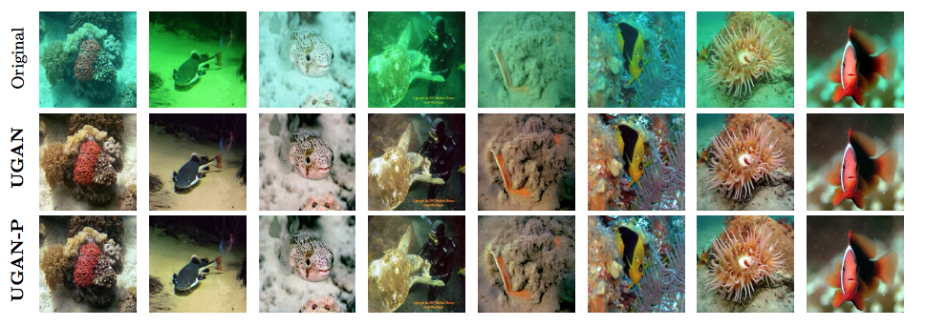
Experiments
UGAN、UGAN-P
vision@ouc

Slide 8
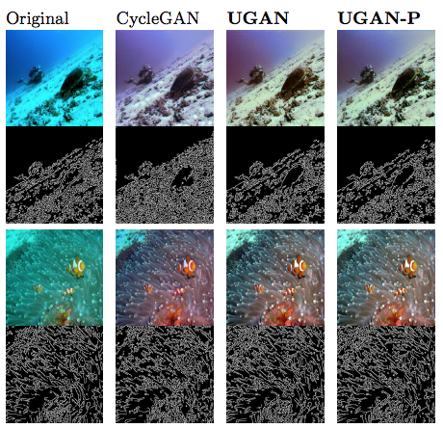
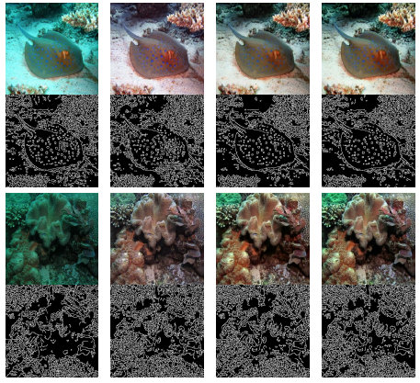
Experiments
Canny Edge Detector
vision@ouc
Notes:
边缘检测，ugan,ugan-p包含较少的噪声，比cyclegan

Slide 9
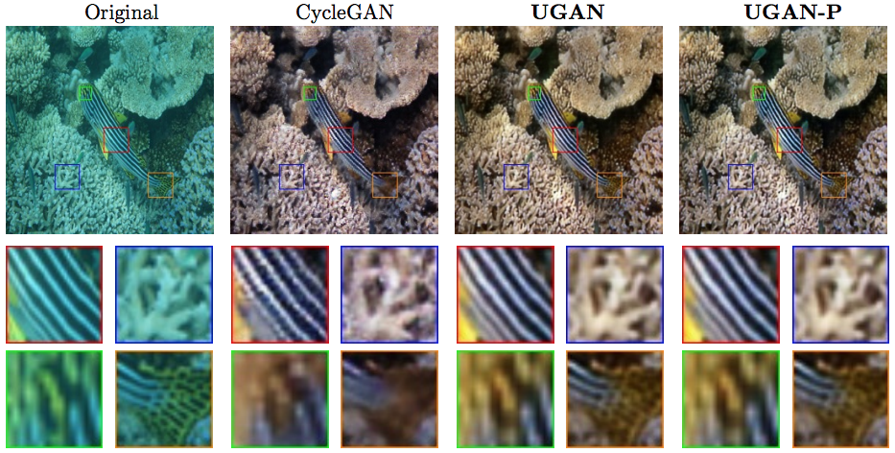
Experiments
Local image patches
vision@ouc

Slide 10
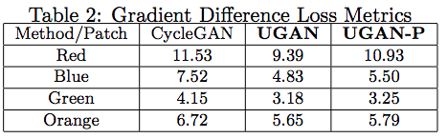
Experiments
Local image patches
vision@ouc
Notes:
我们来看一下这个结果，这是早期SRCNN的工作，他生成的图像时比较模糊的。SRGAN EnhanceNet生成的图看上去还是ok的，
但其实细节没有那么真实。，本文的方法，砖块恢复的都是特别漂亮。集合所有的textture都是正确的

Slide 11
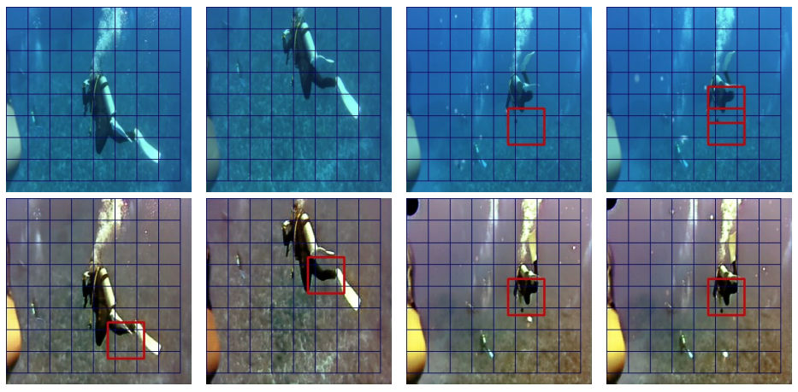
Experiments
Diver Tracking using Frequency-Domain Detection
vision@ouc

Slide 12

Experiments
Diver Tracking using Frequency-Domain Detection
vision@ouc

Slide 13
vision@ouc

