Slide 1
DIP Chap2 & Scientific Writing
Some of the researches of DIP Chap2
The course Presentation Techniques & Scientific Writing
Work arrangement in latter period

Slide 2
Digital Image Fundamentals
Vary the number of intensity levels
Addition of noisy images
Image rotation & intensity interpolation
Image registration

Slide 3
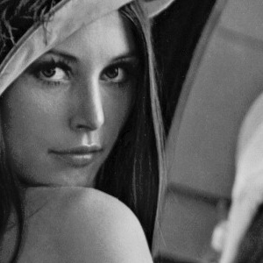


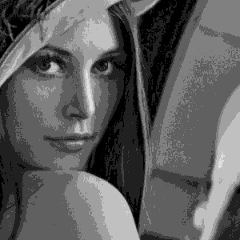
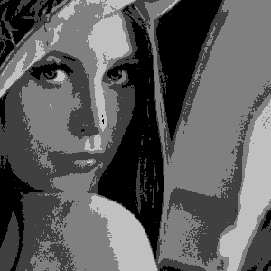

Vary the number of intensity levels
256-level image
64-level image
16-level image
8-level image
4-level image
2-level image

Slide 4
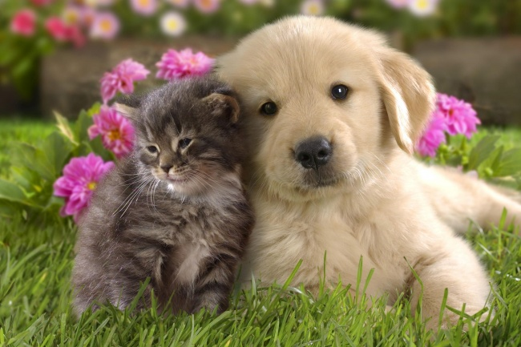


Addition of noisy images

Slide 5




Image rotation & intensity interpolation

Slide 6
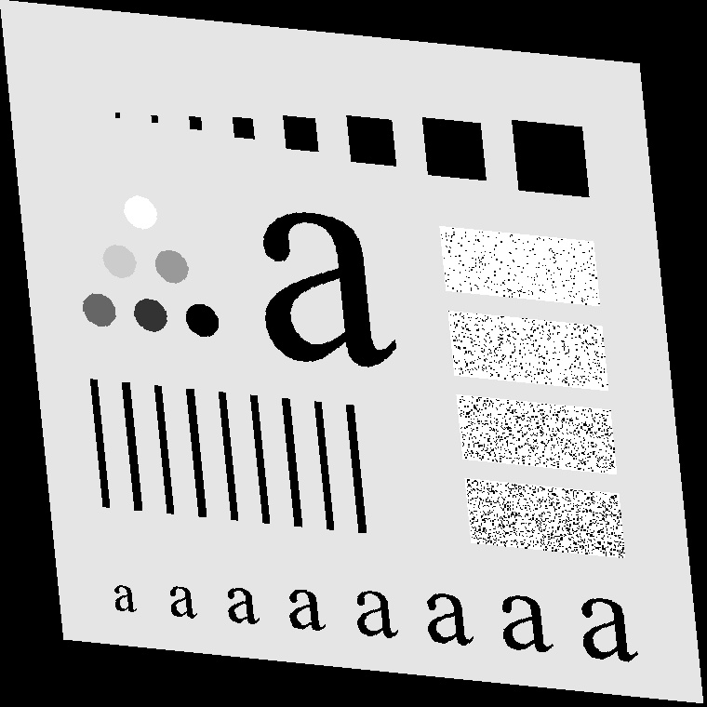


Image registration

Slide 7
Presentation Techniques & Scientific Writing
Introduction in presenting science
Rules on how to write
Guidelines on how to edit
Peer-review process

Slide 8
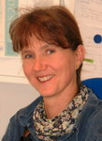
Dr. Annette Ladstätter-Weißenmayer
Chemistry and Physics of the Atmosphere
1982 – 89: Studies of Chemistry, at University of Mainz, Germany, Diploma Thesis in Atmospheric Chemistry, Max Planck Institute for Chemistry, Department of Airchemistry in Mainz, Germany (Thesis Title: Providing of reference spectra of stratosoheric trace gases in UV/VIS wavelenght region 1993: Ph.D. Max-Planck Institute for Chemistry, Department of Airchemistry in Mainz, Germany, (Thesis Title: Spectroscopic analysis of nitrogen compounds using the DOAS system) since 1993: Post doc, Institute of Environmental Physics and Remote Sensing, University Bremen,Germany, with Prof. Dr. John P. Burrows 1998 – now: “Habilitation” in Physics, Institute of Environmental Physics and Remote Sensing, University Bremen, Germany, with Prof. Dr. John P. Burrows
Email: lad@iup.physik.uni-bremen.de
Homepage: http://www.iup.physik.uni-bremen.de
Research Interests
Environmental Analytical Chemistry
Atmospheric Chemistry and Physics
Analysis of satellite based GOME (Global Ozone Monitoring Experiment) data with respect to tropical tropospheric O 3 and pollution events

Slide 9
Writing & reading
“To understand why we write we must understand why we read.
The writer who understands why people read will understand how to write.”
(Martin, 2005)

Slide 10
Basic writing rules
Plan for writing daily
Draft & review thoughts before writing
Brevity
Read other papers
logic & clarity
organize around key sentences
structure your paper
clean & attractive presentation

Slide 11
How to prepare for a presentation?
Complete your research
Set up a timetable
Select journal
Objective&title
Structure
Reading
Searching
Writing
Define title & key word
Abstract
Format
Submit

Slide 12

How to select a journal
Step 1:
Search, browse
& identify potential
journals
Step 2:
Select a small
number of journals
Step 3:
Rank selected
journals
Identify & browse
a
b
c
d
e
f
g
h
i
j
k
select
c
f
i
rank
1
2
3

Slide 13
Objective & title
Start with an explicit statement or use bullets
Objectives should have a clear focus
- rather narrow than broad
- better answer 1 question well than 3 superfically
Write objectives in one separate paragraph

Slide 14

Structural elements
Title
Discussion
Subtitle&cataloge
Conclusion
Key words
Acknowledgement
Abstract
References
Introduction
Appendix
Methods
Figures
Results
Tables
Author state

Slide 15
Title
Most frequently read part of a paper!
Title should be:
Short
informative
include subject of your study (= main keyword)
should tell what the paper is about

Slide 16
Key words
identify 5-10 words that help to characterize your paper
content
use synonyms
avoid duplication with title
test your keywords in a keyword search/database

Slide 17
Abstract
write abstract as last part of the paper
summarize each section of your paper in 1-3 sentences below
the following five headings:
- Introduction
- Methods
- Results
- Discussion
- Conclusions
remove headings & restructure into one paragraph

Slide 18
Introduction
Background – what is the problem?
Motivation – why is it important?
State-of-the-art – what has been done before?
Knowledge gaps – what is currently missing?
Aims & objectives – what is the paper doing?
Definitions – what unfamiliar terms does the paper
use?

Slide 19
Methods
describe what you have done in such a detail as needed so
that it is replicable by a colleague
follow chronological order
use sub-headings to describe individual steps
be as precise and concise as possible
provide exact numbers where possible

Slide 20
Results
Refer to objectives
Select those results from your data, which reflect the
objectives
Structure the section, use headings and subheadings
Identify information that can be displayed in figures and tables
Fill in each heading, describe results short and precisely
Do not discuss results, do not present new methods

Slide 21
Discussion
What can be generalised from your results?
What are unexpected results?
What are methodological limitations?
How do own results relate to other findings?
What are theoretical/practical implications?

Slide 22
Conclusion
• State your overall objective in one sentence
again
• State your key message
• Write conclusions according to your list
• Should be understandable when read in isolation
• Give to a colleague to read and comment

Slide 23
Acknowledgement
optional section
no influence on acceptance or rejection
keep short
always give credit for financial support
ask people whether they agree to be acknowledged

Slide 24
References
Passive use:
“... as previous results have shown (Miller, 2006).”
Active use:
“Miller (2006) has shown in her study ... The results of
Peterson (2007) confirm these results...”

Slide 25
Appendix
to present additional data that are not critical to understanding the manuscript
can include example of a questionnaire, complex equations, calculations or a data table with detailed results that are of interest to the expert
optional section, most papers do not need appendix

Slide 26
Author statement
Include author statement to certify that:
the work is all original research carried out by the authors
all authors agree with the content of the manuscript and its submission to the journal
no part of the research has been published elsewhere, unless it is fully acknowledged in the manuscript
the manuscript is not being considered for publication elsewhere while it is being considered for publication in this journal
any research in the paper not carried out by the authors is fully acknowledged in the manuscript

Slide 27
Guidelines on how to edit
• Keep writing and editing separate
• Come with a fresh mind to editing & revising
• easier to edit once you have some distance to the paper
• You will need several rounds of editing & revision

Slide 28
Language & style revision
Rule 1: good English
Rule 2: inclusive language
Rule 3: active vs. passive
Rule 4: abbraviations
Rule 5: avoid use of “often” , “and/or” , “only”, “quite”
Rule 6: one expression
Rule 7: read out loud
Rule 8: provide evidence
Rule 9: use of tenses
Rule 10: use of numbers
Rule 11: shorten

Slide 29
Cover letter
Include:
corresponding author’s full name, affiliation and the address that can be used for correspondence (all in English)
address the letter to the responsible journal editor (state name – “avoid “clear editor”)
submission date
manuscript title
name of co-authors
journal section where the manuscript should be published (if applicable)
2 sentences describing the manuscript (main findings)

Slide 30
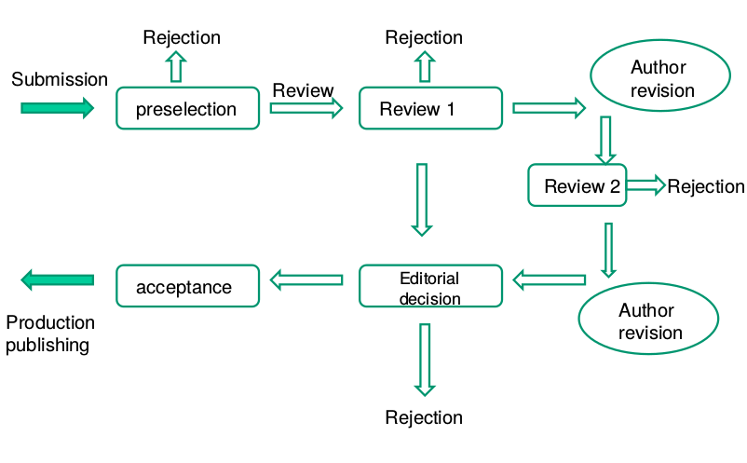
Peer-review process

Slide 31
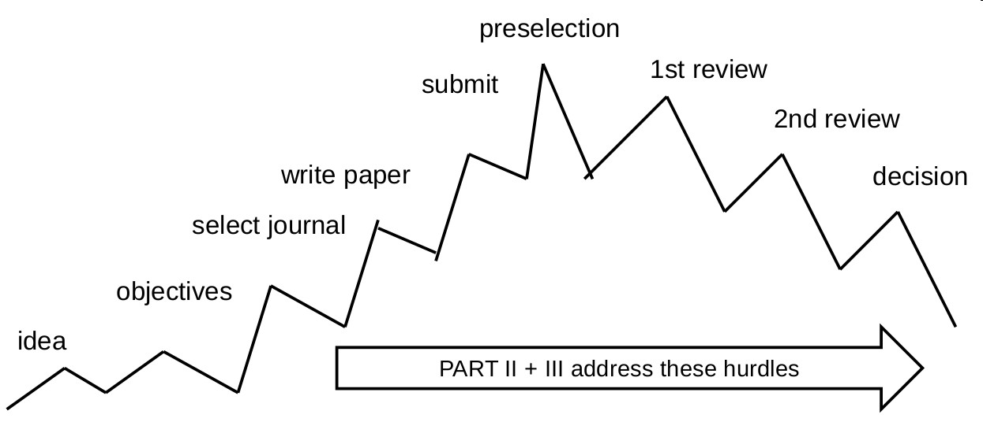
Peer-review process

Slide 32
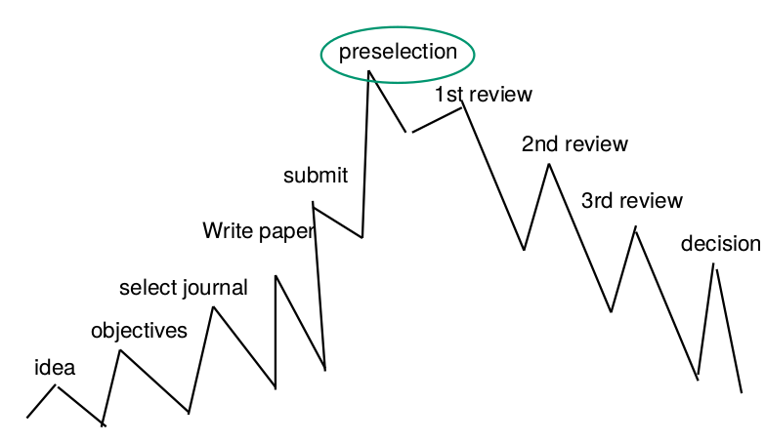
Preselection
• formal criteria (submission complete, proper formatting of manuscript)
• within scope of the journal
• new and original contribution
• relevance for international audience
• sufficient quality
40-50% of papers fail already here: rejected!
Biggest hurdle!

Slide 33
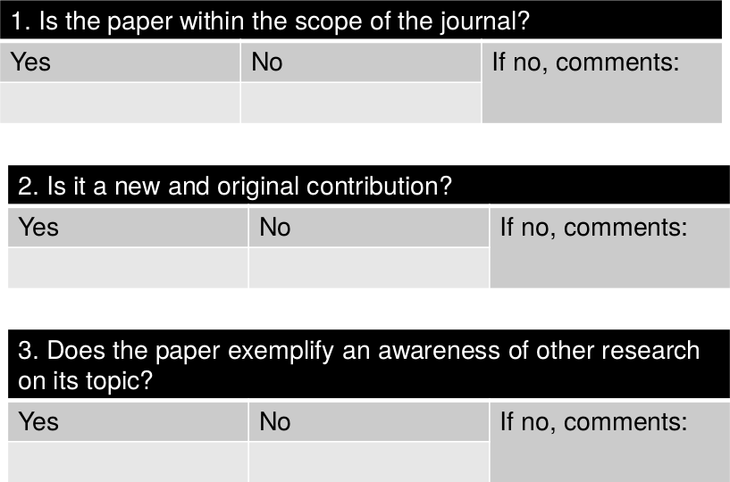
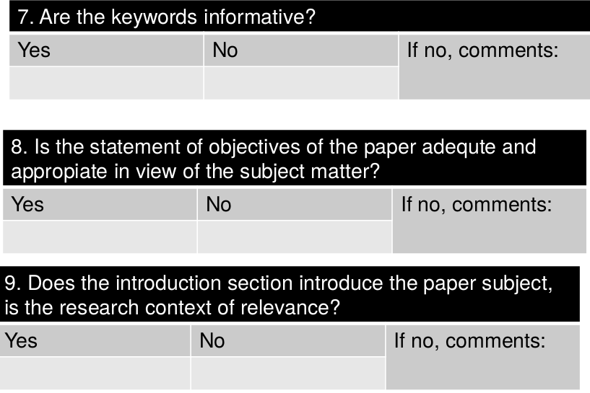
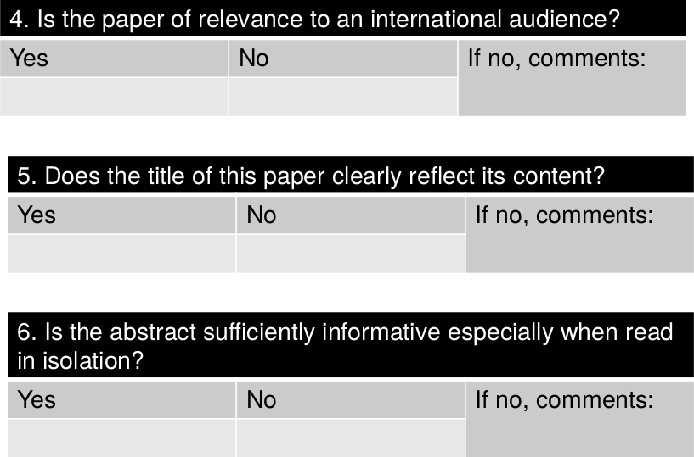
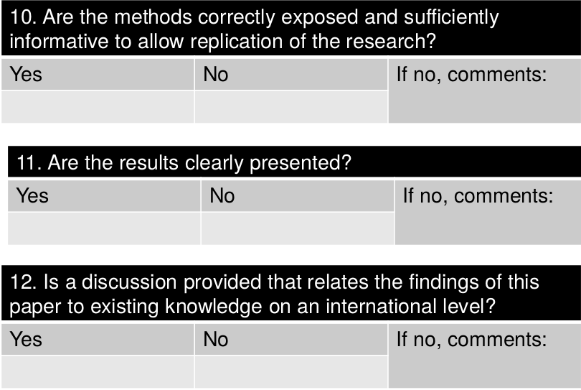
Review sheet

Slide 34
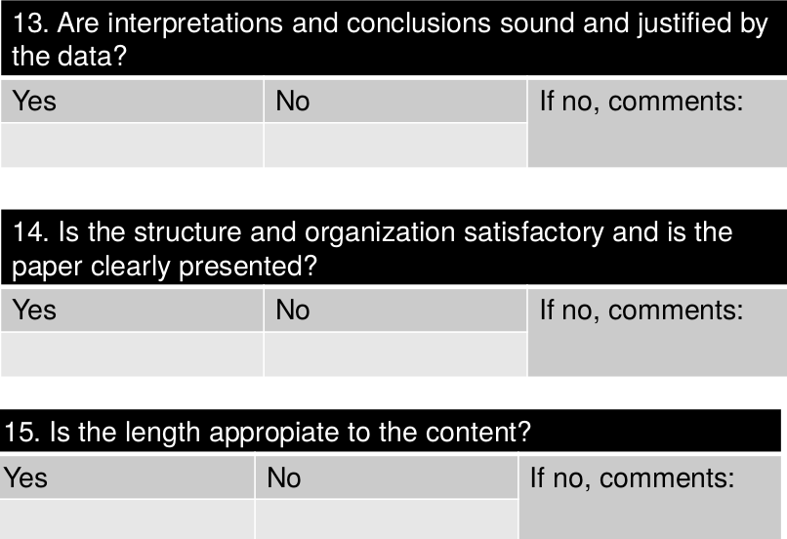
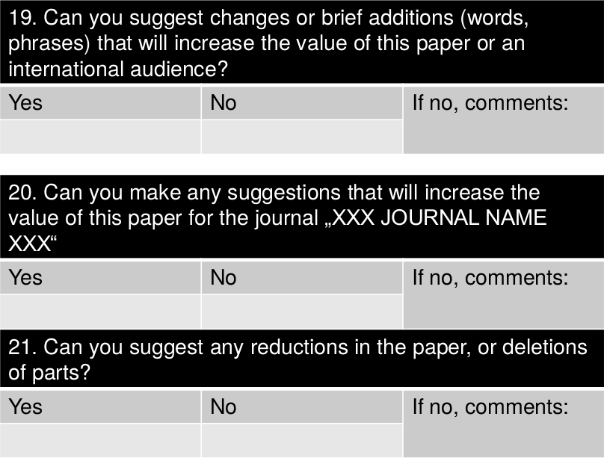
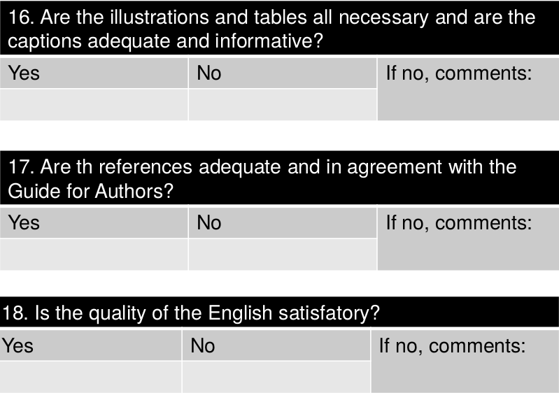
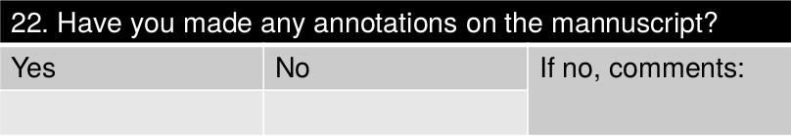
Review sheet

