Slide 1
Summary
谭琳
DIP group
Dec 5.2016

Slide 2
CONTENTS
The Knowledge of Underwater Image Restoration
Future Work

Slide 3
I. The knowledge of Underwater Image Restoration
Seawater absorbs, scatters and organic matter (micelles, bacteria, plankton, etc.) and inorganic substances (quartz sand, clay minerals, metal oxides, etc.)

Slide 4
I. The knowledge of Underwater Image Restoration
Jaffe-McGlamery Model [1][2]
Scattering includes forward scatter and back scatter. Backscattering (light source to camera) results in image fogging, limiting image contrast while forward scattering (target to camera) results in image blur.
[1] B. L. McGlamery. “A computer model for underwater camera systems.” Ocean Optics, 1980.
[2] J.S. Jaffe. “Computer modeling and the design of optimal underwater imaging systems.” IEEE Journal of Oceanic Engineering, 1990.

Slide 5
I. The knowledge of Underwater Image Restoration
｝

Slide 6
I. The knowledge of Underwater Image Restoration—back-scatter
He[1]:
When J is a haze-free image J=0
[1]K. He, J. Sun, and X. Tang, “Single Image Haze Removal Using Dark Channel Prior,” in proc. IEEE Conference on Computer Vision and Pattern Recognition, 2009, pp. 1956-1963.

Slide 7
I. The knowledge of Underwater Image Restoration---back-scatter
Yang[1]:
Lu[2]:
Guided Trigonometric Bilateral Filter
[1]Yang HY, Chen PY, Huang CC, and Zhuang YZ. Low complexity underwater image enhancement based on dark channel prior. Pages 17 – 20, 2011.
[2]H Lu, Y Li and S Serikawa. Underwater image enhancement using guided trigonometric bilateral filter and fast automatic color correction. Pages 3412– 3416, 2013.

Slide 8
I. The knowledge of Underwater Image Restoration—back-scatter
Choose below 10%

Slide 9
I. The knowledge of Underwater Image Restoration—forward-scatter
Fourier transform:
Cheng[1]
[1]Cheng Chia-Yang, Sung Chia-Chi, and Herng-Hua Chang. Underwater image restoration by red-dark channel prior and point spread function deconvolution. Pages 110 – 115, 2015.

Slide 10
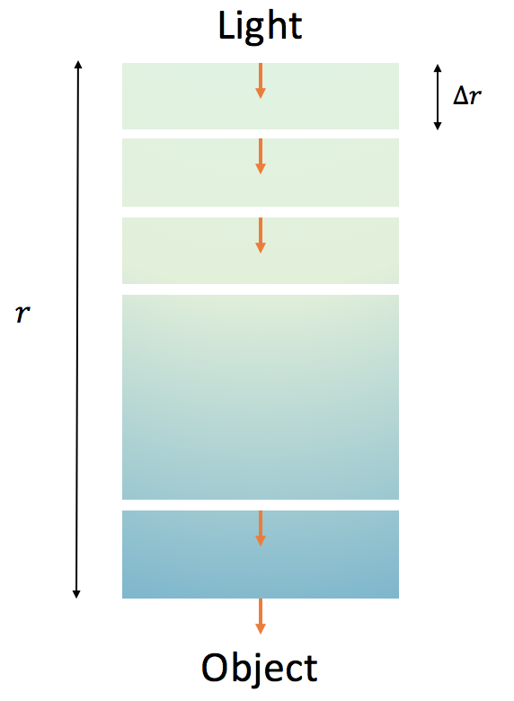
I. The knowledge of Underwater Image Restoration—forward-scatter
Cheng[1]
[1]Cheng Chia-Yang, Sung Chia-Chi, and Herng-Hua Chang. Underwater image restoration by red-dark channel prior and point spread function deconvolution. Pages 110 – 115, 2015.

Slide 11
I. The knowledge of Underwater Image Restoration—forward-scatter
My opinion:
(1) Cheng [1]
(2)
[1]Cheng Chia-Yang, Sung Chia-Chi, and Herng-Hua Chang. Underwater image restoration by red-dark channel prior and point spread function deconvolution. Pages 110 – 115, 2015.

Slide 12
I. The knowledge of Underwater Image Restoration—forward-scatter
Deconvolution function:
deconvwnr, deconvreg, deconvlucy, deconvblind,

Slide 13
Ⅱ. Future work:
1.Recurrence the code of deconvolution
2.Understand the code of DCP
3.Estimate the
4.Modify the code of white balance

Slide 14
THANKS

