Slide 1
content
I CNN
II Depth map from a single image

Slide 2
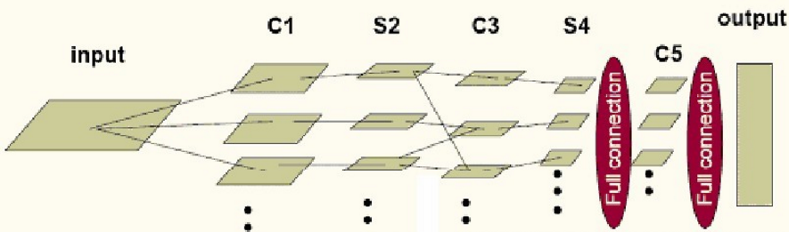
CNN
Simple architecture:
Convolution
Pooling

Slide 3
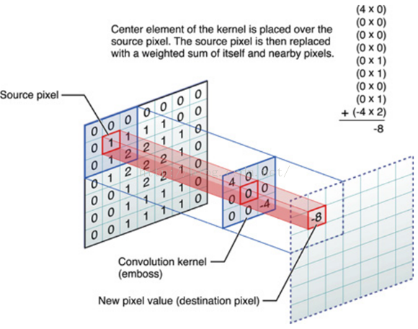
What is convolution ?
http://cs231n.github.io/assets/conv-demo/index.html

Slide 4
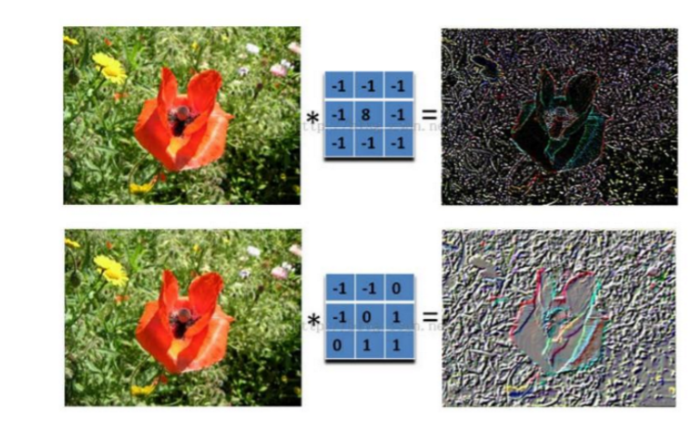
Different kernel get different feture map

Slide 5
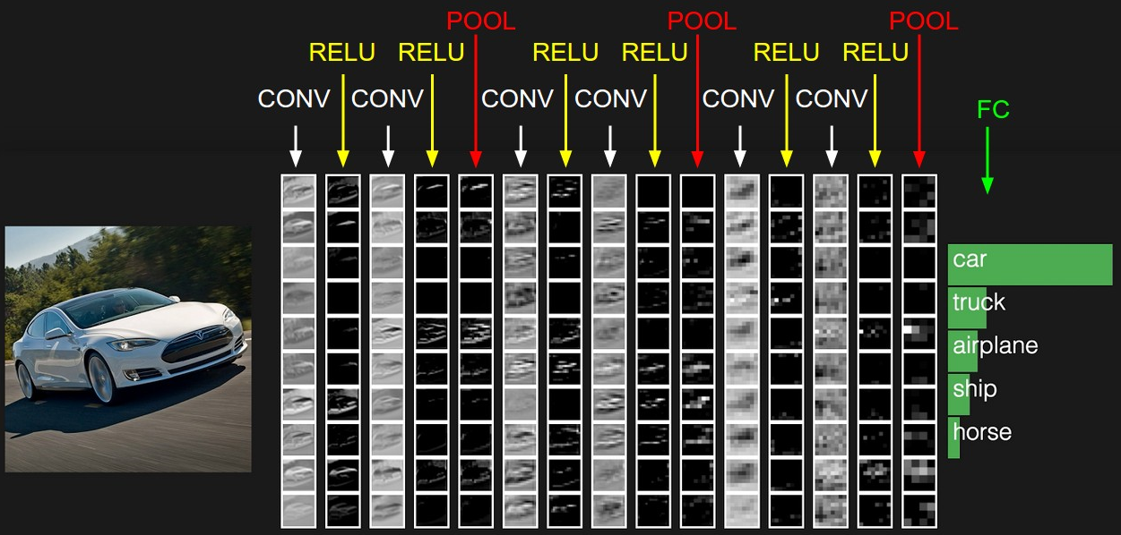

Slide 6
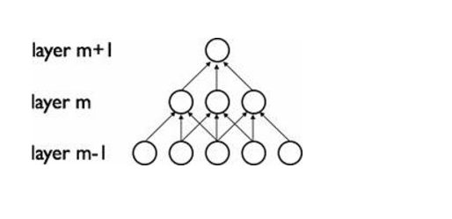

Slide 7
Pooling
Invariance
Lower overfitting
Reduce calculation and parameters

Slide 8
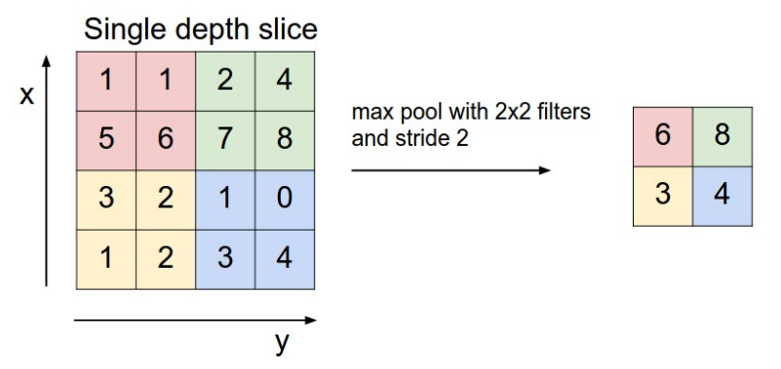
pooling

Slide 9
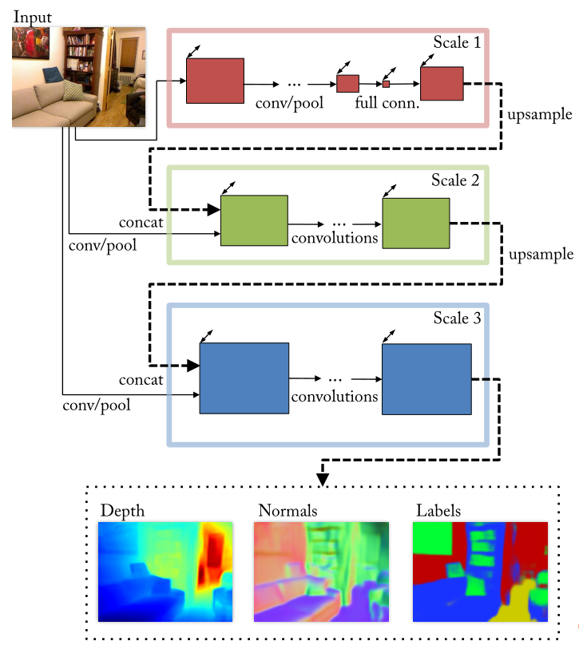
Depth map from a single image
Scale 1: Full-Image View
Scale 2: Predictions
Scale 3: Higher Resolution

