Slide 1

KinGUI2 Secrets
Zhenglei Gao
Mar 15, 2012

Slide 2

Outline
Documentation for the Source Functions
Package Structure
Step Through an Example Source Function
Debugging in R
RStudio Experience
Programming in R
Notes:
Topics might be interesting for maintaining KinGUI2.

Slide 3
Documentation
We follow the R package documentation system.
Help Files(man/.Rd=>manual.pdf)
Brief or detailed descriptions of the source functions.
Input arguments and returned values.
Usage and examples
Other information: author, references.
Vignette(KinGUI2.Rnw=>KinGUI2.pdf)
A few technical details like how the formation fraction is handled.
Examples of using the source functions.
Package and function structures are explained.
Notes:
Where to find what?

Slide 4
Documentation
Where to find them?
Under the Repository: S:/Software & EDV/Models/FOCUS Kinetics/KinGUIIDev/Repository/DevSF/dev/doc/
./KinGUI2 as a package
How to maintain and update them?(Require packages like roxygen2, devtools, take a look at “pkg.r” )
For Manual:
Update the source functions with roxygen2 documentation style.
Use roxygenize("/path/to/copy/on/your/machine") to update the .Rd file
R CMD Rd2dvi --pdf --title="Package KinGUI2" -o KinGUI2_help.pdf man/*.Rd
For Vignette:
Update kinGUI2.Rnw
Generate the pdf using Sweave
Notes:
How to keep them updated?

Slide 5
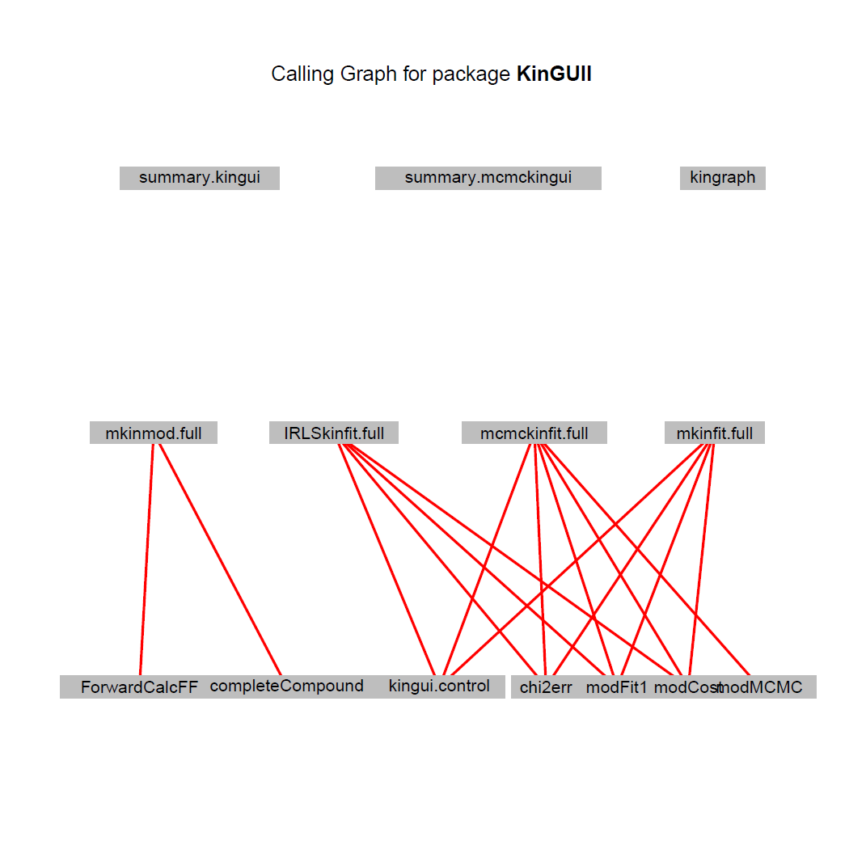
Package Structure
Main Functions
mkinmod.full()
IRLSkinfit.full()
mkinfit.full()
mcmckinfit.full()
summary()
kingraph()
Called functions from mkin:
mkin_wide_to_long()
modelType.solution()
e.g, SFO.solution.

Slide 6
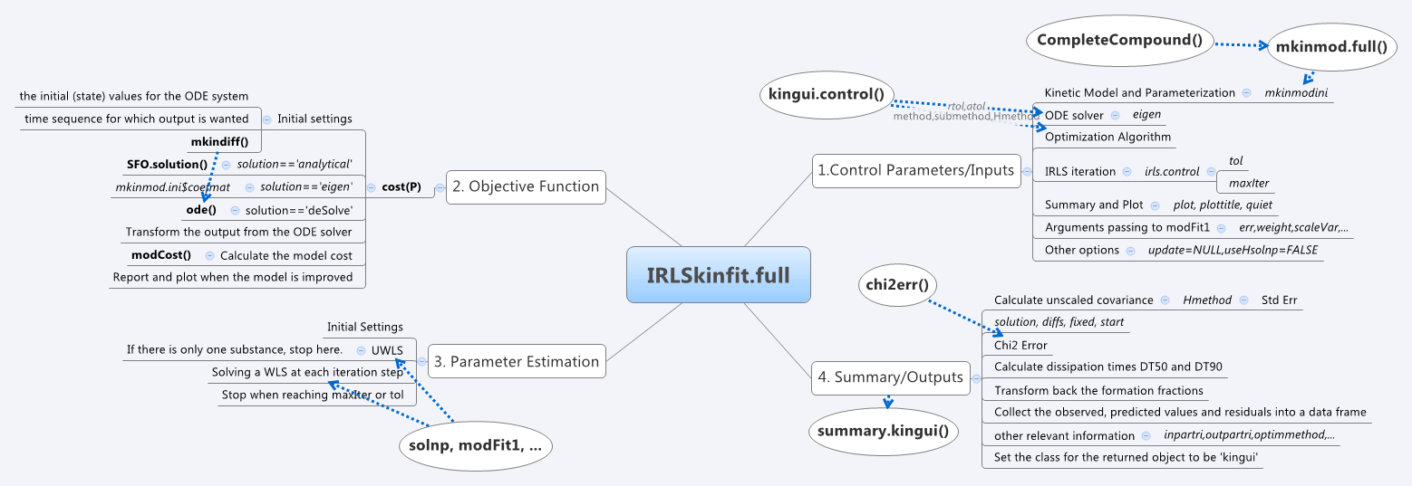
An Example Function
Step through it using RStudio.
Notes:
Step through it using Rstudio, debug(fname).
You are now in what is called the \browser". Here you can enter one of four basic debug
commands. Typing n executes the current line and prints the next one. At the very beginning
of a function there is nothing to execute so typing n just prints the first line of code. Typing
c executes the rest of the function without stopping and causes the function to return. This
is useful if you are done debugging in the middle of a function and don't want to step
through the rest of the lines. Typing Q quits debugging and completely halts execution of
the function. Finally, you can type where to show where you are in the function call stack.
This is much like running a traceback in the debugger (but not quite the same).
Besides the four basic debugging commands mentioned above, you can also type other
relevant commands. For example, typing ls() will show all objects in the local environment.
You can also make assignments and create new objects while in the debugger. Of course,
any new objects created in the local environment will disappear when the debugger finishes.
If you want to inspect the value of a particular object in the local environment, you can
print its value, either by using print or by simply typing the name of the object and hitting
return. If you have objects in your environment with the names n, c, or Q, then you must
explicitly use the print function to print their values (i.e. print(n) or print(c)).

Slide 7
Debugging in R
My General Strategy
traceback() obvious issues
options(error=recover) step into the call stack on error
When I know where the error/warnings possibly occur, I use browser() and print()
Other Tricks
Package: debug
findLineNum() and setBreakpoint()
options(warn=2) treat warnings like errors
Some Nice Guides:
R Debug Tools
Duncan Murdoch's page on Debugging in R

Slide 8
RStudio Experience
Advantages
An IDE bringing the R console, graphics devices, coding windows, workspace, etc, together. Works with subversion.
Key shortcuts: e.g, Ctrl+Enter, Ctrl+Shift+F,Ctrl+I
Open, compatable, and professional.
Ther server version provide a browser based interface (the RStudio IDE) to a version of R running on a remote Linux server, opens up all sorts of possibilities.
Using Amazon Cloud
RStudio in the cloud for dummies
R+EC2+RStudio Server
Notes:
I did not use Rstudio intensively but as an Emacs + ESS user, I liked it, especially the loading packages, source functions, data part.
Server version:
The ability to access your R workspace from any computer in any location;
Easy sharing of code, data, and other files with colleagues;
Allowing multiple users to share access to the more powerful compute resources (memory, processors, etc.) available on a well equipped server; and
Centralized installation and configuration of R, R packages, TeX, and other supporting libraries.

Slide 9
Outline
Documentation
Package Structure
Example Source Function
Debugging in R
RStudio Experience
Programmin in R

Slide 10


Programming in R
A very brief introduction
S:\Projects\ongoing\Gao\Rtutorial
Materials: Some nice tutorials and guides from the internet.
Rtutorial.pdf: R Basics(programming, graphics), Advanced Topics(debugging, package), Resources.
Rtutorial.r: R scripts used in the tutorial, which can also be extracted from Rtutorial.Rnw.
Notes:
I think the most important thing is to go through the sample scripts(either the ones I provided, or other nice ones from the internet) by yourself, then you will know how R works.

Slide 11

Thank you!
Questions?
March 15, 2012

