Slide 1
Data compression
LIU Yan
(liuyan@hit.edu.cn)
Lecture 1 Introduction

Slide 2
Course Objective
To provide a good conceptual overview of various components of a data compression.
To give good insight into several key principles and techniques used in data compression.

Slide 3
Course Outline
Introduction to Data Compression
Encoding Techniques for compression
Predictive coding
Transform Coding, Wavelet based Coding
Scalar Quantization and Vector Quantization
Compression Standard:
jpeg, mpeg …

Slide 4
Data Compression: Why
Multimedia data need
  Huge Storage Space
  Large Transmission Bandwidth
Storage, Bandwidth Requirements are usually much greater than Availability
Compression is a viable technique

Slide 5
Storage Requirements for Images
 | Size (pixels) | bits/pixel | Storage
Gray-scale | 1024 x 768 | 8 | 768 KB
Color | 1024 x 768 | 24 | 2304 KB

Slide 6
Storage Requirements for Video
30 frames/sec
720 x 480 pixels/frame
24 bits/pixel
=> 237.3 Mbps

Slide 7
Data compression
Data compression is the art or science of representing information in a compact form.
We create these compact representations by identifying and using structures that exist in the data.
Redundancy: similar or identical structures that exist in the data.
Data compression : removing redundancy

Slide 8
Example
Data sequence:
  x: 0,101,1,102,2,103,…,100,201
  need 8 bits/sample
structures: x_{i}=x_{i-2} + 1
removing redundancy: y_{i}= x_{i} - x_{i-2} -1
  y: 0,101,0,0,0,0,…,0,0
  need 1 bit/sample

Slide 9
Compression technique
When we speak of a compression or compression algorithm, we are actually referring to two algorithms
One is a compression algorithm that takes an input X and generates a representation Xc that requires fewer bits
Another is a reconstruction algorithm that operates on the compressed representation Xc to generate the reconstruction Y.
Data X
Data Xc
Data Y
  compression
  reconstruction

Slide 10
Lossless and Lossy Compression
Lossless: X = Y
Lossy: X ≠ Y
Data X
Data Xc
Data Y
  compression
  reconstruction

Slide 11
Lossy and Lossless Compression
Lossless Compression:
  No loss of information
  Original data exactly recovered from compressed data
  Lower compression ratio
Lossy Compression:
  Loss of information
  Perceptual loss of information reduced (controlled)
  Higher compression ratio

Slide 12
Nature of Multimedia Data and Digital representation

Slide 13
What is Sound?
Perception by the ear (and brain) of vibrations of the medium.
Sound Waves are (usually) a Complex Mixture of Several frequencies
Audible frequency range:20 Hz – 20KHz
Complex sound waves can be analyzed Mathematically using Fourier Analysis
Sound measured in Decibels (logarithmic Scale)
  20Log₁₀(E/E₀)
    E: measured amplitude
    E_{0:} reference amplitude

Slide 14
Sound representation
Analog
  Waveform
Digital
  waveform sampling
    16bits/sampl
    Sampling frequency:>40Khz

Slide 15
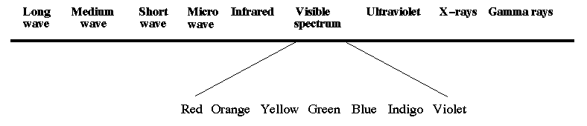
What are Images?
(Sets of) Objects perceived by Human Visual System (HVS)
Light waves Emitted or Reflected from Objects are Received and Processed by Eye and Brain.
Light waves are Electro Magnetic waves

Slide 16
Image Classification
Analog
  Continuous variation of color or gray scale
    e.x. Photo prints
Digital
  Fixed number of colors / gray scale levels
    e.x. Scanned images

Slide 17
What is Video?
Combination of Images and Sound
3D Signal: Spatio-Temporal Signal
Representation:
  Analog Video: Set of Scan Lines
    Sequential Scan
    Interlaced Scan
  Digital Video: Set of Frames in sequence
    Frame: 2D Array of Pixels

Slide 18
Multimedia data are usually:
Generated in Analog form
Captured in Analog form
Processed in Digital form
Stored in Analog/Digital form
Transmitted in Analog/Digital form

Slide 19
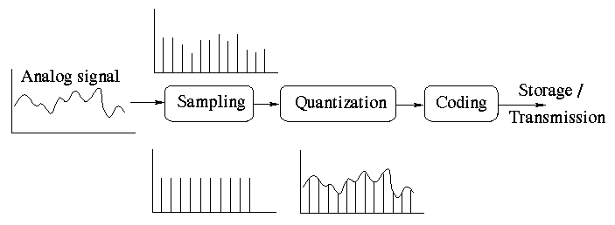
Analog to Digital Conversion
Two major steps:
Sampling
  Sampling frequency should satisfy Nyquist Criterion
Quantization

Slide 20
Coding and Compression

Slide 21
Two Kinds of Coding of Information
Source Coding: Coding for efficient representation of information. (Also called Compression)
Channel Coding: Coding for error free transmission of information through a noisy medium

Slide 22
Two Kinds of Compression
Two kinds of compression: Lossless and Lossy
Compression techniques take advantage of redundancy in data
Lossy techniques, in addition, take advantage of psycho-visual redundancy: due to Human Visual Systems (HVS) properties

Slide 23
Types of Redundancies
Statistical structure
  Due to the frequency of occurrence of single samples
Spatial Redundancy
  Due to the correlation between neighboring sample values
Spectral Redundancy
  Due to the correlation between different color planes or spectral bands
Temporal Redundancy
  Due to the correlation between successive frames in video
Psychological redundancy
  Due to the sensitivity of human perception

Slide 24
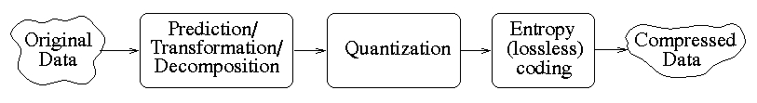
Compression System
Redundancy analysis
( removing redundancy)
, No loss of information
Reduce information
and entropy,
loss of information

Slide 25
Performance Metrics for Compression techniques

Slide 26
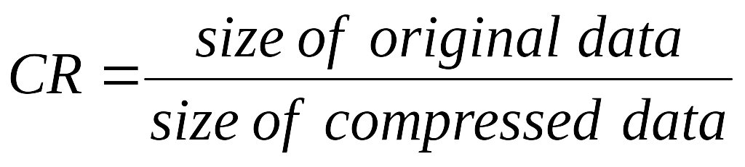
Performance Metrics for Compression techniques
Compression Ratio (CR)
MSE : Mean Square Error between the original and reconstructed data
Signal to Noise Ratio (SNR)
Speed (Complexity) of encoding and decoding

Slide 27
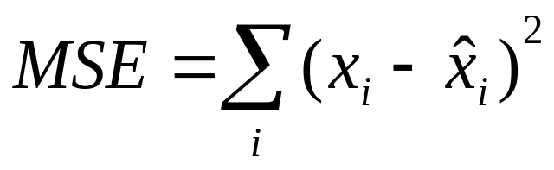
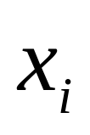
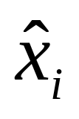
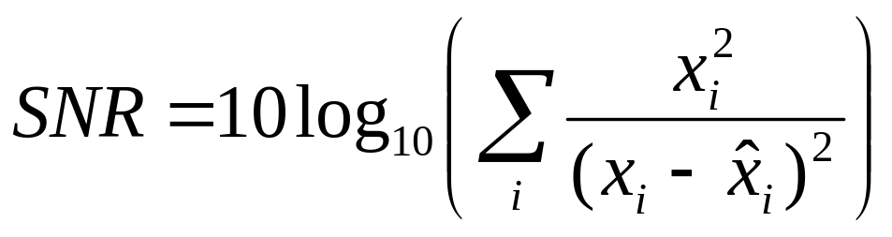
MSE and SNR
  Mean Square Error (MSE)
  Signal-to-Noise-Ratio
:original pixel value . :reconstructed value

Slide 28
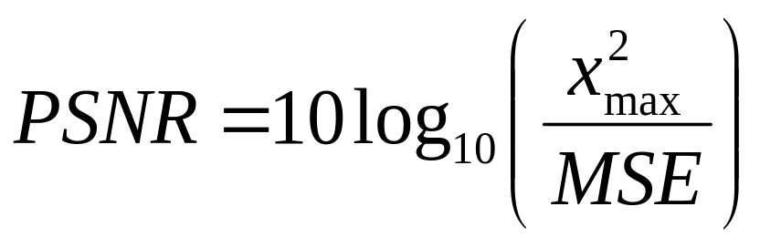
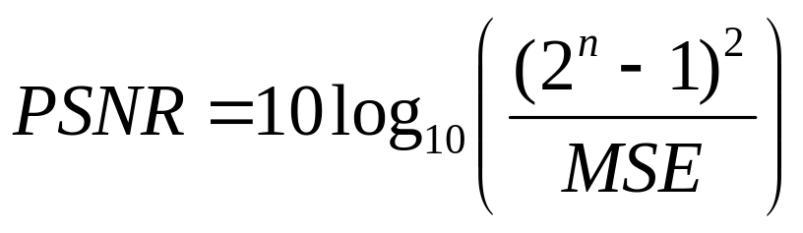
PSNR
  Peak Signal-to-Noise-Ratio

Slide 29
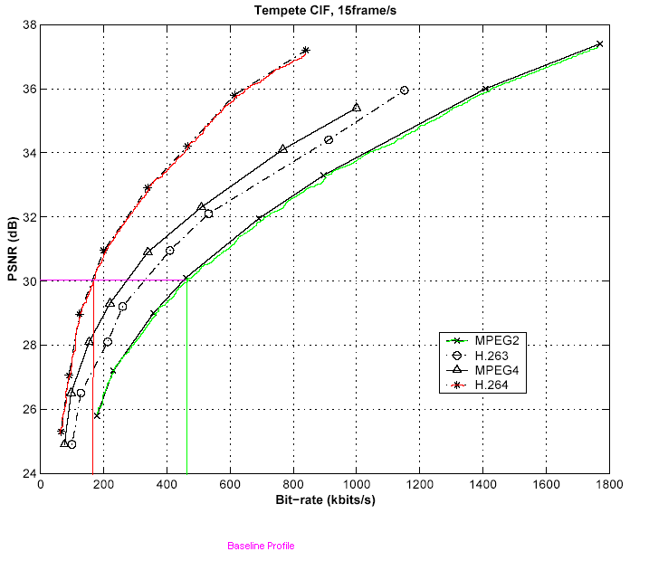

Slide 30
Elementary Information Theory

Slide 31
Quantification of Information
Information content is directly related to the uncertainty of the event
Less probable event (symbol) conveys more information
Information content of an event (or symbol) is proportional to number of bits needed for its representation.

Slide 32
Definitions of Terms
Alphabet: Set of Symbols
Source: Generator of Symbols
Coding: Assignment of Codewords to Symbols
Codeword: Binary Sequence
Code: Set of Codewords
Bitrate: Average Number of Bits per Symbol.
Ex. ASCII Code, EBCDIC Code (Fixed Length Codes) Morse Code, Huffman Code (Variable Length Codes)

Slide 33
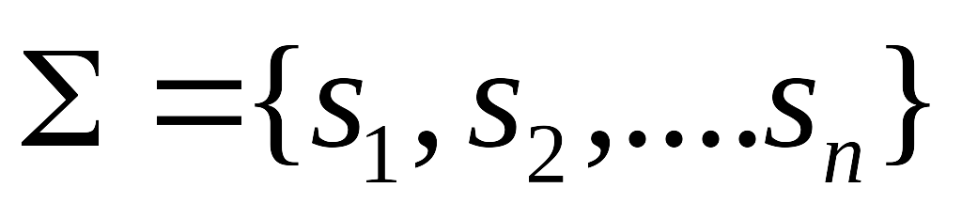
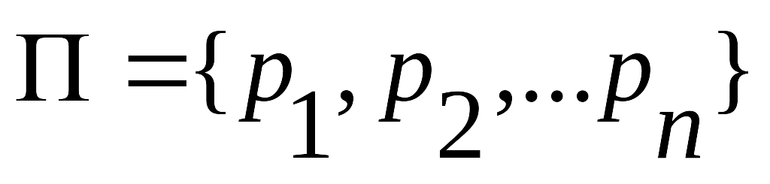
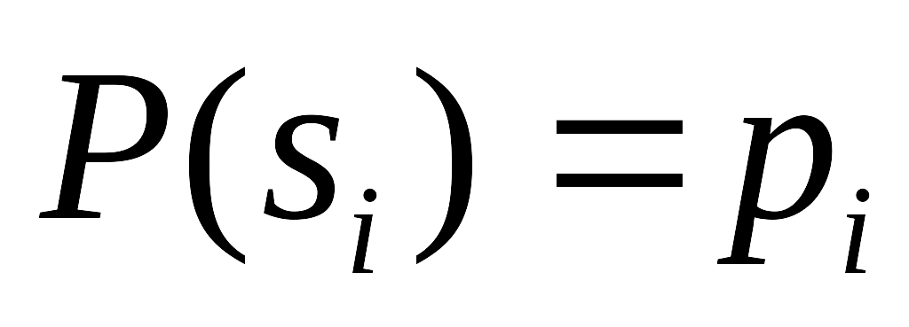
Discrete Memoryless Source (DMS)
The discrete memoryless source (DMS) has the property that its output at a certain time does not depend on its output at any earlier time.
Simplest form of information source
DMS,S is specified by:
alphabet of symbols
symbol probabilities
Where

Slide 34
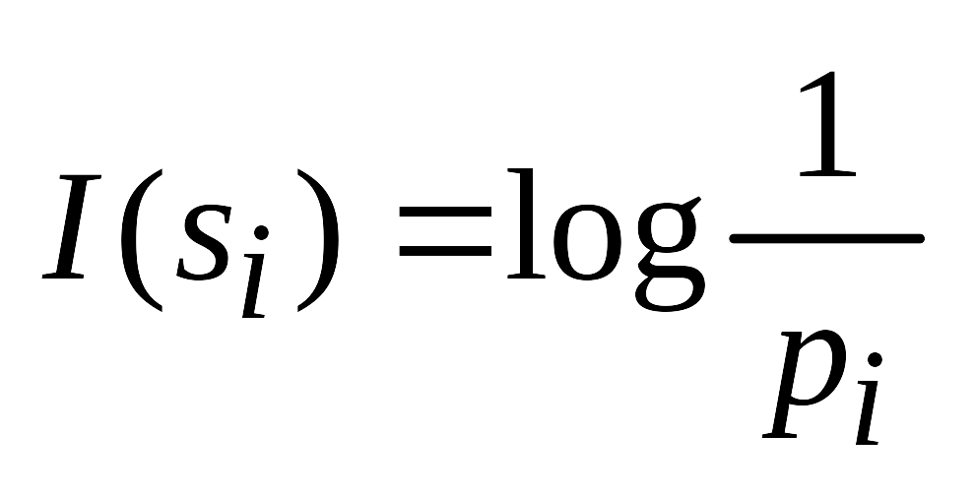
Self-information
For a set of messages S with probability p_{i}= (s_{i}), s_{i} ∈S, the self information of s_{i} is:
Measured in bits if the log is base 2.
The lower the probability, the higher the information

Slide 35
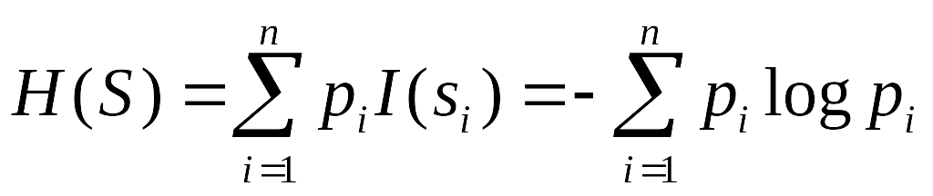
Entropy (熵)
Average amount of information per source symbol is Entropy, H(S)
bits/symbol
Average uncertainty of the source

Slide 36




Entropy Example

Slide 37
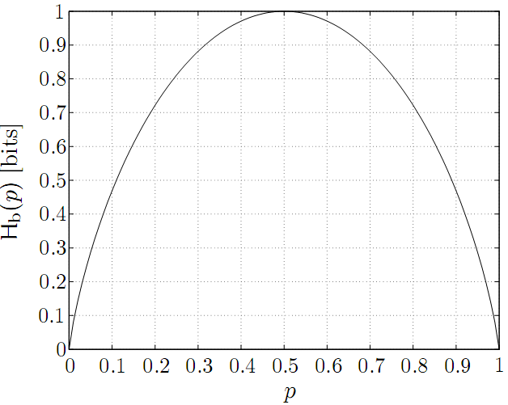
Binary Entropy Function
If S is binary with two possible values s1 and s2, S = {s1, s2}, such that Pr[S = s1] = p and Pr[S = s2] = 1 − p,then

Slide 38

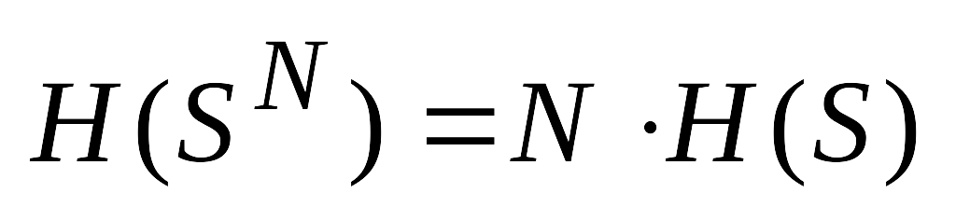
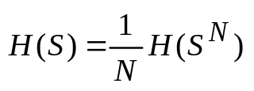
Nth extension of DMS
Nth extension of DMS, S: S^{N} obtained by considering groups of N symbols of ∑
DMS – i.i.d. (independent and identically distributed) :

Slide 39
Entropy: properties
If S has n possible values, then 0 ≤ H ≤ log n.
Maximum entropy (H_{max}= log n) is reached when all symbols are equiprobable, i.e.,
p_{i} = 1/n.
The difference log n – H is called the redundancy of the source.

Slide 40
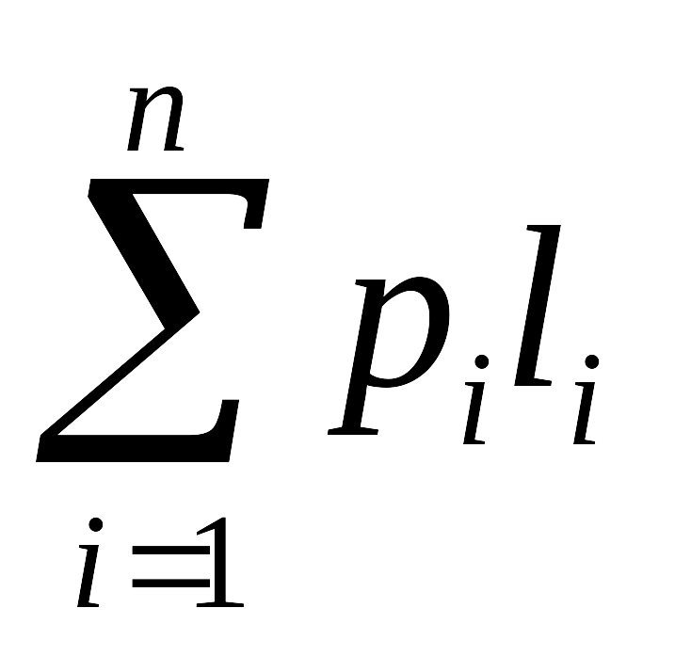
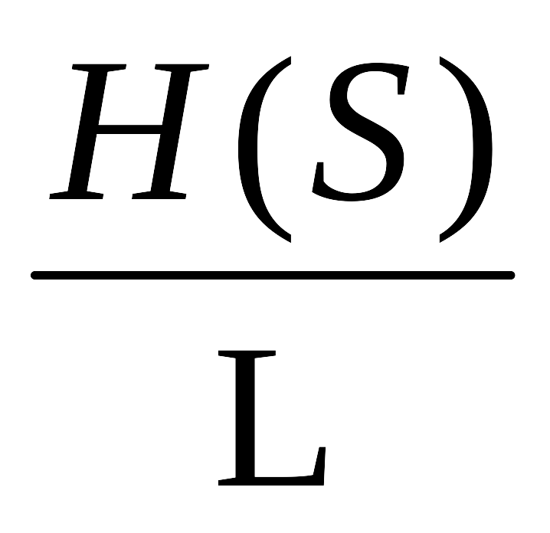
Code Efficiency
s_{i} : Symbols in the Alphabet , i=1,2,3,…n
p_{i} : Probability of Occurrence of Symbol i
l_{i} : Length of Symbol I ( in bits)
L : Average Code length =
Code Efficiency η =

Slide 41
Shannon's source coding theorem
known as noiseless coding theorem or Shannon's 1st theorem
Given a discrete memoryless source of entropy H(S) , the average code-word length L for any lossless source coding is bounded as L≥H(S)
N i.i.d. random variables each with entropy H(S) can be compressed into more than N H(S) bits with negligible risk of information loss, as N → ∞; but conversely, if they are compressed into fewer than N H(S) bits it is virtually certain that information will be lost.

Slide 42
Markov Sources
DMS is too simple and restrictive in several situations
In general, current symbol depends on one or more previous symbols
Markov source model is better suited for most sources
In an m th – order Markov source, the probability of occurrence of symbol depends on the preceding m symbols
An m th – order Markov source has n^{m} states for an
n – symbol alphabet.

Slide 43
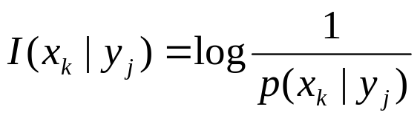

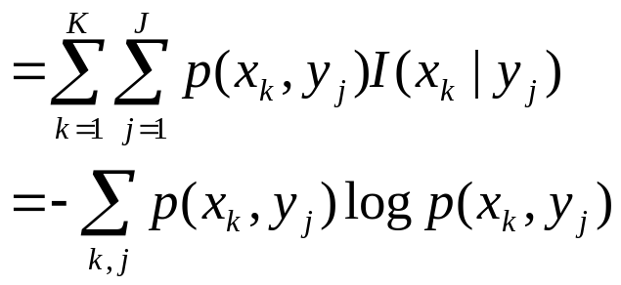

Conditional Entropy
Conditional Self-information
Conditional Entropy

Slide 44

Conditional Entropy (cont.)
For any two discrete random variables X and Y,
with equality if, and only if, X and Y are statistically independent.
the conditional entropy quantifies the remaining entropy (i.e. uncertainty) of a random variable X given that the value of a second random variable Y is known

Slide 45
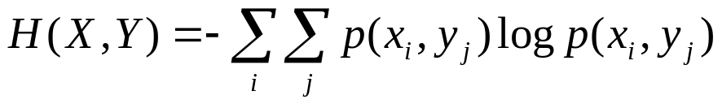
Joint Entropy
Joint entropy
- Uncertainty of two random variables together

Slide 46
N-th order Joint Entropy
N-th order entropy
- Uncertainty of N random variables together

Slide 47

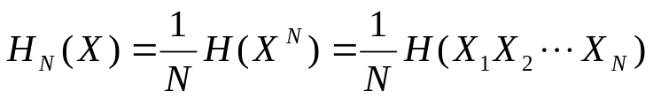
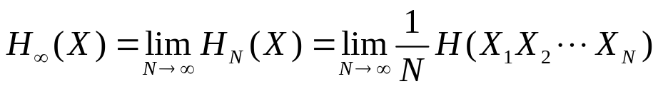


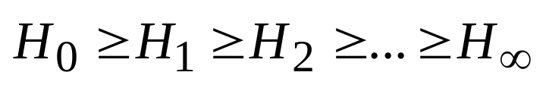
Entropy for memory source
Bits/symbol
Bits/symbol
Bits/symbol

