Slide 1
Data Compression
LIU Yan
Lecture 2
Lossless Compression
Entropy coding

Slide 2
Lossy and Lossless Compression
Lossless Compression:
  No loss of information
  Original data exactly recovered from compressed data
  Lower compression ratio
Lossy Compression:
  Loss of information
  Perceptual loss of information reduced (controlled)
  Higher compression ratio

Slide 3
Taxonomy of Image Compression
Lossless Coding techniques (Entropy Coding)
Repetitive Sequence Encoding
StatisticalEncoding
Lossless Predictive Coding
Bitplane Encoding
RLE
Huffman ArithmeticLZW
DPCM

Slide 4
Taxonomy of Image Compression
Lossy Coding techniques (Source Coding)
Block Truncation Coding
Lossy PredictiveCoding
Vector Quantization
Transform Coding
Subband Coding
Fractal Coding
DPCM ADPCM Delta modulation
Subbands Wavelets

Slide 5
Run Length Encoding (RLE)
A run is a subsequence of the same symbol value
RLE replaces each maximal run by the length of the run followed by the repeating symbol of the run
00001001111000111111000
4,0;1,1;2,0;4,1;3,0;6,1;3,0
0 & 1 can be removed if the alphabet is binary
→ 4,1,2,4,3,6,3
The RLE sequence can then be coded using Entropy Coding

Slide 6
Entropy coding
Variable-Length Code
Shannon–Fano Coding
Huffman Coding
Arithmetic Coding
Lempel-Ziv Coding

Slide 7
Uniquely Decodable Codes
A uniquely decodable code is a variable length code in which bit strings can always be uniquely decomposed into its codewords.
Consider the following code with four codewords:
Whenever we receive a zero(or the code has reached length 3), we know that the codeword has finished.
c₁ = 0
c₂ = 10
c₃ = 110
c₄ = 111

Slide 8
Prefix-Free codes
A prefix-Free code is a variable length code in which no codeword is a prefix of another codeword
e.g., a = 0, b = 110, c = 111, d = 10
Also called prefix codes or Instantaneous Codes
All prefix codes are uniquely decodable

Slide 9
Prefix Codes: as a tree
Can be viewed as a binary tree with message values at the leaves and 0s or 1s on the edges:
a = 0, b = 110, c = 111, d = 10
0
1
1
0
a
0
1
d
b
c

Slide 10
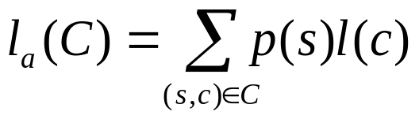
Average Length
For a code C with associated probabilities p(s) the average length is defined as
We say that a prefix code C is optimal if for all prefix codes C’, l_{a}(C) ≤ l_{a}(C’ )

Slide 11
Noiseless coding theorem or Shannon's 1st theorem
Given a discrete memoryless source of entropy H(S) , the average code-word length L for any lossless source coding is bounded as L≥H(S)

Slide 12
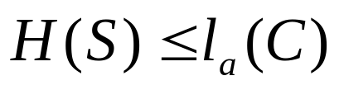

Relationship to Entropy
Theorem (lower bound): For any probability distribution p(S) with associated uniquely decodable code C,
Theorem (upper bound): For any probability distribution p(S) with associated optimal prefix code C,
Theorem: If C is an optimal prefix code for the probabilities {p₁, …, p_{n}} then p_{i} > p_{j}
implies l(c_{i}) ≤ l(c_{j})

Slide 13
Shannon-Fano Coding
Sort set of symbols S in order of non-increasing probabilities.
Divide S into two parts S₁, S₂ such that each part has approximately equal probability
Assign ‘0’(‘1’) to symbols of S₁(S₂)
Continue (2) and (3) on each of the parts until each part contains only one symbol

Slide 14
An Example of Shannon-Fano Coding
Ordered Symbols
Code Design Procedure
Codes
0.3
0.3
0
s₃
s₂
s₁
0.51
00
01
100
101
1100
1101
1110
1111
0.21
0
0.21
1
0.19
0.19
0
0.1
0.29
1
s₀
s₆
s₅
0
0.1
0.07
0.07
0
0.49
0.05
0.12
1
0
0.05
1
0.05
0.05
0
s₄
0.2
1
0.08
s₇
0.03
0.03
1
1

Slide 15
Huffman Coding
Statistical Coding
Popular Technique
Builds a Code Tree
Many Variations
  Adaptive Huffman Coding

Slide 16
Building Huffman Tree
Make a list L of all symbols
Create a node for each symbol
Find the two smallest probability symbols s_{j}, s_{k}
Create a ‘new’ node as the parent of s_{j},s_{k}
with probability p_{j} + p_{k}
Remove s_{j},s_{k} from L
Repeat the above three steps until L is empty
Label left edges with ‘0’ and right edges with ‘1’
Huffman Encoding
Code symbol s_{i} with the binary sequence obtained using the labels on the path from the root to the node s_{i}

Slide 17
An Example of Huffman Coding
Probability List
Code Design Procedure
Codes
1
p(s₀)=0.1
0011
11
10
01
0001
00101
0000
00100
1
p(s₁)=0.19
0.4
1
p(s₂)=0.21
0
0.18
1.0
1
1
p(s₃)=0.3
0.6
0.3
0
1
0
p(s₄)=0.05
1
0.12
p(s₅)=0.05
0.08
0
0
p(s₆)=0.07
0
p(s₇)=0.03
0

Slide 18

HUFFMAN ENCODE (in: )
begin
  Create a node labeled s_{i}, 1≤ I ≤ n
  F ← { s_{i} |1≤ I ≤ n }
  for i = 1 to n-1 do
  Find the two smallest probability symbols s_{j}, s_{k} ∈ F
  Create a new node with label si` as the parent of s_{j}, s_{k} with probability p_{j} + p_{k}
  F ← (F - {s_{j}, s_{k}} U {s_{i}‘}
  endfor
  (Label left edges of tree with ‘0’ and right edges with ‘1’)
  for i = 1 to n do
  code s_{i} with the binary sequence labeling the path from the root to the node s_{i}
  endfor
end

Slide 19

Problem with Huffman Coding
Huffman codes are “optimal”, but Using Huffman codes we require at least one bit per message,.
Consider a message with probability .999. The self information of this message is
If we were to send 1000 such messages we might hope to use 1000*.0014 = 1.44 bits.
Using Huffman codes, so we would require 1000 bits.

Slide 20
Extended Huffman Codes
Under the following Conditions:
  Small Alphabet Size.
  Skewed distribution of Probabilities.
  Huffman Code Could become inefficient( Compared
  to Entropy).
Coding rate could be reduced by:
  Blocking ( Grouping) more than one symbol
  together.
  Assigning codewords to the groups of symbols.

Slide 21
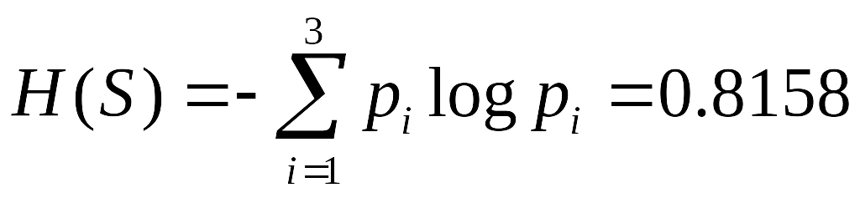
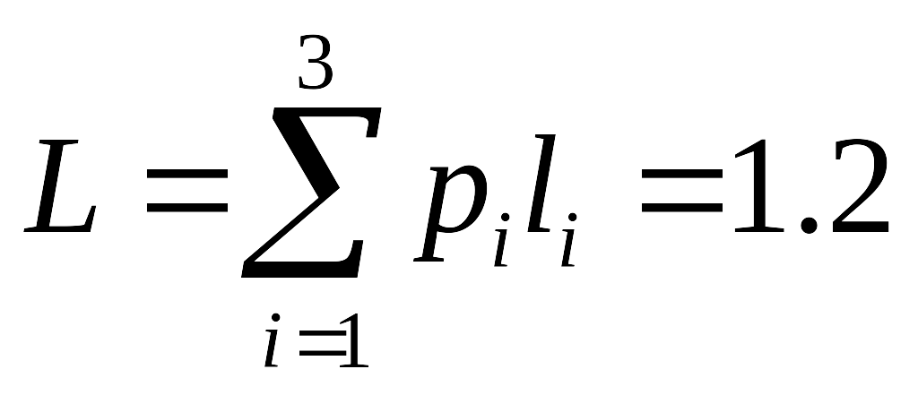

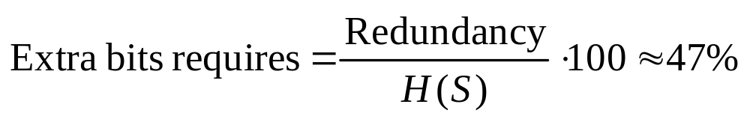
Huffman Code: Example
S = { s₁,s₂,s₃ }
P = { 0.8,0.02,0.18 }
1 0
1 0
s₁
s₂ s₃
Symbol | Code
s₁ | 0
s₂ | 11
s₃ | 10

Slide 22
Extended Huffman Code: Example
S = { s₁,s₂,s₃ } ; P = { 0.8,0.02,0.18 }
S² = { s₁s₁, s₁s₂, s₁s₃, s₂s₁, s₂s₂, s₂s₃, s₃s₁, s₃s₂, s₃s₃ }
P² = { 0.64,0.016,0.144,0.016,0.0004,0.036,0.144,0.0036,0.0324 }
Huffman Code is derived based on S² and P²
L = 1.7228 bits/symbol
In Terms of Original Alphabet,
L = 0.8614 bits/symbol
Redundancy = 0.045 bits/symbol
Extra bits required = 5.5%
Letter | Probability | Code
s₁s₁ | 0.64 | 0
s₁s₂ | 0.016 | 10101
s₁s₃ | 0.144 | 11
s₂s₁ | 0.016 | 101000
s₂s₂ | 0.0004 | 10100101
s₂s₃ | 0.0036 | 1010011
s₃s₁ | 0.144 | 100
s₃s₂ | 0.0036 | 10100100
s₃s₃ | 0.0324 | 1011

Slide 23
Adaptive Huffman Coding
Huffman Coding requires prior knowledge of probabilities of symbols.
In Cases where symbol probabilities are not known priori:
  Use two-pass procedure:
    Collect Statistics in One Pass.
    Derive Codewords in Second Pass.
  Use an Adaptive Scheme:
    One-Pass Procedure.
    Update tree ( and Codewords) dynamically.

Slide 24
Adaptive Huffman Tree
External nodes ( leaves) correspond to symbols of alphabet.
Weight of a leaf node is the number of times the corresponding symbol has appeared so far in the input.
Weight of an interval node is the sum of the weights of its children.
Node number is a unique number assigned to each ( internal and external ) node.

Slide 25
Adaptive Huffman Tree: Node Numbering
Alphabet size ( no. of symbols ) = n
Total number of nodes = 2n-1
  External = n
  Internal = n-1
x_{i} : Weight of node i.
All the nodes that have the same weight are said to be in the same block.
y_{i} : Node number of node i.
Node Numbering is such that for y₁<y₂<…<y_{2n-1}, we have x₁≤x₂≤…≤x_{2n-1}
Further, nodes y_{2i-1} and y_{2i} are offspring (children) of the same parent node.

Slide 26
Initial Code For symbols
Alphabet S = { s₁,s₂,…s_{m} }
Choose e and r such that
m = 2e + r and 0 ≤ r < 2e
For 1 ≤ k ≤ 2 r,
Code for a_{k} : binary representation of k-1 using (e+1)
bits.
For 2r+1≤ k ≤ m,
Code for a_{k} : binary representation of k-r-1 using e bits.
Example: S = { a, b,…z} , m = 26 , e = 4 and r = 10
a= 00000 , b = 00001 , c = 00010, … , t =10011
u = 1010, v = 1011,w = 1100,..

Slide 27
Adaptive Huffman Coding: Initial Tree
Before start, both encoder and decoder will have just one node called NYT.
NYT : Not Yet Transmitted symbols.
Weight of NYT = 0.
Node number of NYT = 2n-1.

Slide 28
Adaptive Huffman Encoding
While there are symbols left in the input stream do:
Read Symbol s_{i}
If First occurrence of symbol, then
Send code for NYT node (obtained by traversing
path from root to NYT ) followed by the index of s_{i}
in the NYT list.
Else
Send code for s_{i} ( obtained by traversing path from
root to s_{i} )
3. Perform update procedure.

Slide 29
Flowchart of the encoding procedure
Code is the path from the root to the corresponding node
START
NO
NO
Read in symbol
First appearance for symbol?
Is this the last symbol
Call update procedure
STOP
YES
YES
Send the code for NYT followed by index in the NYT list

Slide 30
Adaptive Huffman Decoding
While there are bits remaining in the input stream do:
(start at root and do steps 1 to 4 )
Scan the bit and traverse the tree accordingly
[ex: traverse left (right) if bit is 0 (1) ].
Repeat 1 until a leaf node is reached.
If the (leaf) node is NYT node, then
Read off e bits from the input
Let p be the e-bit number
If ( p < r ) then
read off one more bit from input and update p to the (e+1)
bit number.
Decoded symbol is (p+1)^{th} element in NYT list.
Else
Decoded symbol is the symbol of the leaf node.
4. Perform update procedure.

Slide 31
Flowchart of the decoding procedure
Add one to p
NO
Read bit and go to corresponding node
Is the e-bit number p less than r?
Read e bits
Decode the (p+1) element in NYT list
Read one more bit
START
YES
NO
YES
Go to root of the tree
Is the node an external node
Decode element corresponding to node
Call update procedure
NO
Is the node the NYT node
Is this the last bit
YES
NO
YES
STOP
NO

Slide 32
Update Procedure for the adaptive Huffman Coding Algorithm
Switch node with highest numbered node in block
Go to parent node
START
NO
NO
First appearance for symbol
Node number max in block?
Is this the root node?
YES
Go to symbol external node
Increment node weight
STOP
YES
NO
YES
YES
NYT gives birth to new NYT and external node
Increment weight of external node and old NYT node
Go to old NYT node

Slide 33
Adaptive Huffmann Tree
1
After processing “a”
51
NYT
0
NYT
0
1
51
49
50
(a)
After processing “aar”
After processing “aa”
3
51
2
1
2
a
51
49
50
NYT
0
2
a
NYT
0
1
r
49
50
47
48
(aa)
(aar)

Slide 34
Adaptive Huffmann Tree
After processing “aardv”
4
After processing “aard”
51
2
2
a
4
49
50
51
1
1
r
2
2
a
47
48
49
50
1
1
d
1
1
r
45
46
47
48
NYT
0
1
v
NYT
0
1
d
43
44
45
46
(aard)
(aardv)

Slide 35
Adaptive Huffmann Tree
Adjustment of tree
4
5
51
51
2
2
a
a
2
3
49
50
49
50
r
1
2
r
1
2
47
48
47
48
1
1
d
1
1
d
45
46
45
46
NYT
0
1
v
NYT
0
1
v
43
44
43
44
(aardv)
(aardv)

