Slide 1
Data compression
LIU Yan
Lecture 3
Lossless Compression: Arithmetic Coding
LZ Coding

Slide 2
Arithmetic Coding
Non-block code
Codeword assigned to entire sequence of symbols.
Unique Code for each Input Sequence.
Well suited to:
  Small Size Alphabets
    E.g. Binary sources
  Alphabets with Highly Skewed Probabilities

Slide 3
Arithmetic Coding: The key idea
Hufman coding: each message is a fixed set of bits
01001
11
0001
011
message: 1 2 3 4
Arithmetic coding : bits can be “shared” among messages
010010111010
message: 1,2,3, and 4

Slide 4
Arithmetic Coding: The key idea(cont.)
The output of an arithmetic coding is, as usual, a stream of bits
However we can think that there is a prefix 0, and the stream represents a fractional binary number between 0 and 1

Slide 5
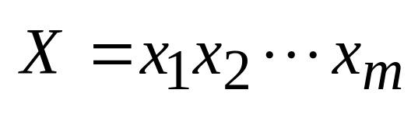
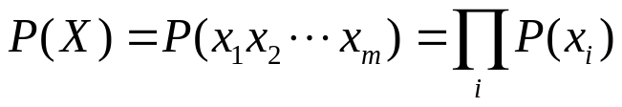
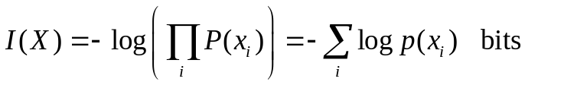
Arithmetic Coding
Map sequences of length m to a sub-interval in the interval [0,1), then select a point to Represent the sequences
0
1
Sequence interval

Slide 6
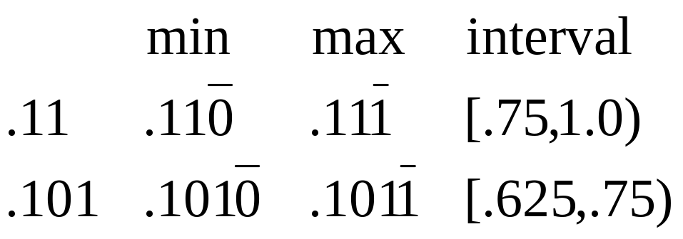
Arithmetic Coding:
Representing an Interval
Can view binary fractional numbers as intervals by considering all completions. e.g.
We will call this the code interval.
The shorter the length of coder interval, the more bits are needed
If a set of code intervals do not overlap then the corresponding codes form a prefix code.

Slide 7
Arithmetic Coding:
Selecting the Code Interval
To find a prefix code , find a binary fractional number whose code interval is contained in the sequence interval.
.79
.75
Sequence Interval
Code Interval (.101)
.625
.61

Slide 8
Arithmetic Coding: interval mapping
  message interval : interval for a single message
Alphabet S={s₁,s₂…s_{N}} Probabilities P={p₁,p₂…p_{N}}
The length of interval corresponding to s_{i} is p_{i}
Divide Interval [0,1) in proportion to p_{i}
0
1
p₁ p_{2 ….} p_{i} ….

Slide 9
Arithmetic Coding on Binary Alphabet: Procedure
Alphabet S={s₁,s₂}; Probabilities P={p,q}
Divide Interval [0,1] in the ratio p,q
  Intervals correspond to Symbols
For Successive Symbols in Input do:
  Pick Sub-interval Corresponding to symbol
  Divide the Sub-interval in the ratio p,q
Pick any Point (Usually Middle) in the final Sub-Interval.
Binary Encode this point which is the Tag (code) for the Input Sequence

Slide 10
Arithmetic Coding on Binary Alphabet:
Example
S = {0,1}; P = { p,q }; q = 1-p
(Say 0: black ; 1:white and q>>p) (Typical of printed text; fax)
Example Sequence: 1 1 1 0 0 1 1 1 1 0 1 1
p
2p-p²
0
p
2p-p²
3p-3p²+p³
1
1
1
1

Slide 11
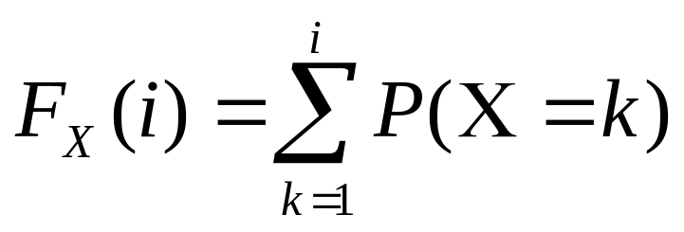
Arithmetic Coding on Non-Binary Alphabet Preliminaries
Given: Alphabet S and Probabilities P
Define a Random Variable X such that X(s_{i})=I
Probability Density Function for X: P(X=i) = P(s_{i})
Cumulative Density Function (CDF):

Slide 12
Arithmetic Coding on a Non Binary alphabet: Procedure
Alphabet S={s₁,s₂…s_{N}} Probabilities P={p₁,p₂…p_{N}}
Divide Interval [0,1] in Proportions given by F_{x}(i),1≤ i ≤ N
  Intervals Correspond to Symbols
For Successive Symbols in Input do:
  Pick Sub-Interval Corresponding to Symbol
  Divide Sub-Interval in proportions given by F_{x}(i)
Pick any point (Usually Middle) in the final Sub-Interval.
Binary Encode this point which is the Tag (code) for the Input Sequence

Slide 13
Arith. Coding on Non-Binary Alphabet: Example
S={a,b,c} P={0.7,0.1,0.2}, input: abcb…
F_{X}(1) = 0.7, F_{X}(2) = 0.8, F_{X}(3) = 1.0
CDF is used to partition the interval into sub-intervals of the form: [F_{X}(j –1), F_{X}(j)] where X(s_{i})=j
0.0
0.00
0.49
0.546
s₁
s₁
s₁
s₁
0.7
0.49
0.539
0.5558
s₂
s₂
s₂
s₂
0.8
0.56
0.546
0.5572
s₃
s₃
s₃
s₃
1.0
0.7
0.560
0.560

Slide 14
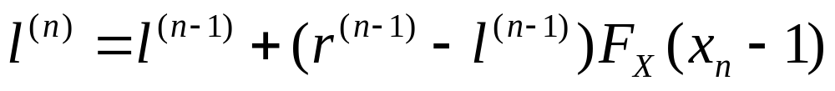
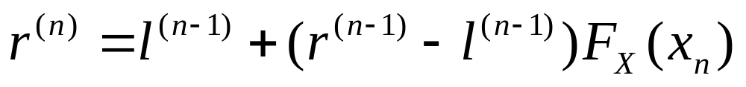
Recursive procedure
In general, we can show that for any sequence
Sequence interval: [ l^{(n)}, r^{(n)})

Slide 15
Decoding Arithmetic Code
Given: S,P, Tag, m=Length of Sequence
Start with Interval of [0,1]
Repeat the following three steps ‘m’ times
  Divide Sub-Interval in proportions given by F_{x}(i)
  Determine the Sub-Interval containing the Tag
  Output the Symbol corresponding to the Sub-Interval

Slide 16
Arithmetic Decoding: Example
S = { a,b,c}
P = { 0.7,0.1,0.2 }
Tag = 0.7665
L = 0;R = 1;
t* = 0.7665
J = 2 since
t* ε [ F_{X}(1),F_{X}(2) ]
L’ ← 0 ; R’ ← 1;
L ← 0.7; R ← 0.8
s_{m}^{k} ← b
t* = (0.7665 – 0.7)/ (0.1) = 0.665
j = 1 since t* ε [ F_{X}(0),F_{X}(1) ]
L’ ← 0.7 ; R’ ← 0.8 ;
L ← 0.7 + (0.1) 0 = 0.7 ;
R ← 0.7 + (0.1) 0.7 = 0.77 ;
s_{m}^{k} ← ba
t* = (0.7665 – 0.7)/ (0.07) = 0.95
j = 3 since t* ε [ F_{X}(2),F_{X}(3) ]
L’ ← 0.7 ; R’ ← 0.77 ;
L ← 0.7 + (0.07) 0.8 = 0.756 ;
R ← 0.7 + (0.07) 1 = 0.77 ;
s_{m}^{k} ← bac
… etc.

Slide 17
ARITHMETIC ENCODE (in: s_{m}^{k},π;out: tag)
begin
  Compute F_{X}(i);
  L ← 0; R ←1 ;
  for l = 1 to m do
    j ← i_{l} = X(s_{l});
    L’ ← L; R’ ← R;
    L ← L’ + ( R’ – L’)F_{X} (j -1);
    R ← L’ + (R’ - L’) F_{X} (j);
  endfor
  tag ← a suitable point [L, R)
end

Slide 18
Compute F_{X}
begin
  F_{X}(0) ← 0 ;
  for i = 1 to n do
    F_{X} ← F_{X}(i - 1) + P(i);
  endfor
end

Slide 19
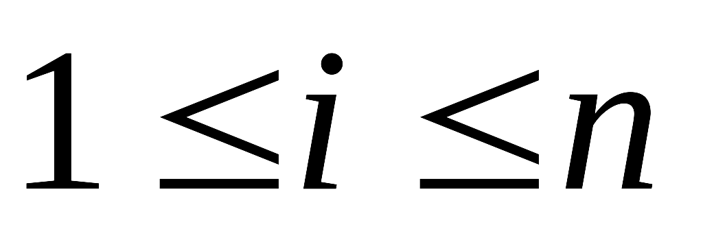

ARITHMETIC DECODE (in: tag,π;out: s_{m}^{k})
begin
  s_{m}^{k} ← ø
  COMPUTE_F_{X ;}
  L ← 0; R←1 ;
  for l = 1 to m do
    t* ← (tag - L)/(R - L);
    Find j ( ) s.t. t* [F_{X}(j - 1) , F_{X}(j));
    L’ ← L; R’ ← R;
    L ← L’ + (R’ – L’) F_{X}(j - 1);
    R ← L’ + (R’ - L’) F_{X}(j);
    s_{m}^{k} ← s_{m}^{k} o s_{j}
  endfor
end

Slide 20
Algorithm Implementation
in practice the number of numbers that can be uniquely represented on a machine is limited
in order to represent all the subintervals uniquely we need increasing precision as the length of the sequence increases.
In a system with finite precision, the two values are bound to converge, and we will lose all information about the sequence from the point at which the two values converged.

Slide 21
Rescale the interval and output
As the interval becomes narrower, we have three possibilities:
1. The interval is entirely confined to the lower half of the unit interval [0,0.5). E1
2. The interval is entirely confined to the upper half of the unit interval [0.5, 1.0). E2
3. The interval straddles the midpoint of the unit interval. E₃

Slide 22
Rescale the interval and output(cont)
The most significant bit of the binary representation of all numbers in the interval [0,0.5) is 0, (0.0xx…x)₂
and the most significant bit of the binary representation of all numbers in the interval [0.5, 1] is 1, (0.1xx…x)₂
we can map the half interval containing the tag to the full [0, 1) interval and output MSB.
→
→

Slide 23






Interval mapping
The mappings required are
For E₃ we check to see if the tag interval is contained in the interval [0.25,0.75).
[(0.01xx…x)₂, (0.10xx…x)₂).
At the time of the E₃ mapping, we do not send any information to the decoder; instead, we simply record the fact that we have used the E₃ mapping at the encoder.

Slide 24
Interval mapping
Suppose that after E₃ mapping, the tag interval gets
confined to the upper half of the unit interval. At this point we would use an E₂ mapping and send a 1 to the receiver.
Note that the tag interval at this stage is at least twice what it would have been if we had not used the E3 mapping.
Therefore, if the E3 mapping had not taken place right before the E2 mapping, the tag interval would have been contained entirely in the lower half of the unit interval. At this point we would have used an E1 mapping and transmitted a 0 to the receiver.

Slide 25
while(MSB of l and r are both equal to b or E3 condition holds)
if(MSB of r and l are both equal to b)
{
send b
shift l to the left by 1 bit and shift 0 into LSB
shift r to the left by 1 bit and shift 1 into LSB
  while(Scale3 > 0)
{
send complement of b
decrement Scale3
}
}
if(E3 condition holds)
{
shift l to the left by 1 bit and shift 0 into LSB
shift r to the left by 1 bit and shift 1 into LSB
complement (new) MSB of l and r
increment Scale3
}

Slide 26
Decoding Interval mapping
while(MSB of l and r are both equal to b or E3 condition holds)
if(MSB of r and l are both equal to b)
{
shift l to the left by 1 bit and shift 0 into LSB
shift r to the left by 1 bit and shift 1 into LSB
shift t to the left by 1 bit and read next bit from received bitstrea into LSB
}
if(E3 condition holds)
{
shift l to the left by 1 bit and shift 0 into LSB
shift r to the left by 1 bit and shift 1 into LSB
shift t to the left by 1 bit and read next bit from received bitstream into LSB
complement (new) MSB of l, u, and t
}

Slide 27
Dictionary Technique

Slide 28
Dictionary Technique
Build a list of commonly occurring patterns : Dictionary D
A pattern occurring in the input is searched in D
- if found, use its index in D in the encoding
- else code it with some (less efficient) method

Slide 29
Example
L = {a,b,.....z} P={‘ ‘, ‘,’ , ‘.’ , ‘?’, ‘;’ , ‘!’}
S=L∪P Alphabet size = 32
Consider 4-character words
- first 3 characters ∈ L
- last character ∈ P
If each character is equally likely,
→ 5 bits/character
→ 20 bits/word

Slide 30
Example (Contd.)
Size of Dictionary, D = 256
Put 256 most likely words in D
If word (pattern) ∈ D then
  transmit/store 0<8-bit index> → 9 bits
Else transmit/store 1<20-bit encoding> → 21 bits
p = probability of word ∈ D
Average number of bits/word,
R = 9p + 21 (1-p) = 21- 12p
For R to be <20, p should be ≧ 1/12 = 0.084

Slide 31
Dictionary Technique
LZ Coding Variants/Applications
Variants
  LZ77, LZ78, LZW
Applications:
  UNIX compress gzip,
  GIF,
  V.42 (Compression over modems)

Slide 32
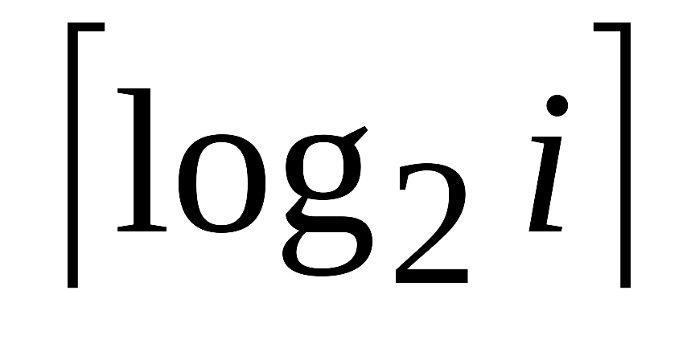
Lempel-Ziv (LZ78)Encoding
Input sequence, s_{i1},s_{i2},...s_{im}
Dictionary, D is initially empty
At step i do the following :
  read the symbols from the input sequence until the pattern is different from all the previous patterns in D. Call this pattern ws_{ik}. w is the prefix string, which may be empty.
  Say, w had occurred at step j (j < i) . Find j using dictionary search
  Code ws_{ik} as ( [ j ] ₂ [s_{ik}]₂).
    [ j ] ₂ is the binary representation of j using bits.
    [s_{ik}]₂ is the binary representation of s_{ik} (n bits)
  Insert ws_{ik} into the dictionary.

Slide 33
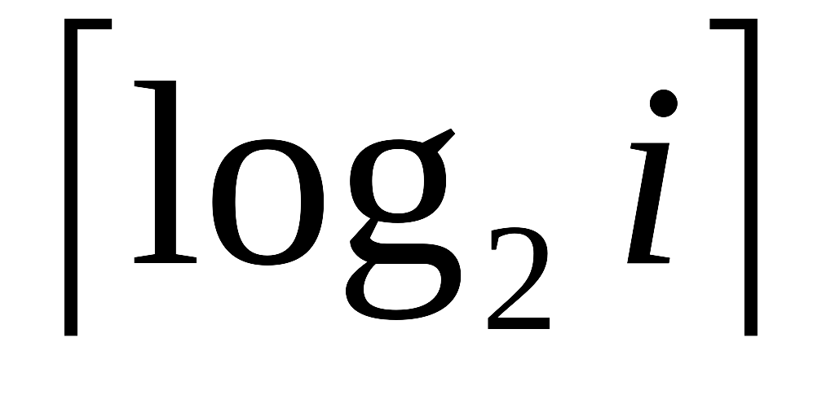
Lempel-Ziv Decoding
Dictionary, D is initially empty
Consume the first 1+n bits. Insert s=decode(n) into the first entry of D.
At each step i ≥ 2 do
  Consume + n bits
  Denote the decimal equivalent of the first bits by x, and the last n bits by b.
  Set W to the symbol in D at index x.
  Decoded symbol is Wb.
  Insert Wb into D at index i.

Slide 34
LZ Encoding Example
input : 0 01 010 011 1 0101
0 | 01 | 010 | 011 | 1 | 0101 |
i :1 2 3 4 5 6 7
(0,0) (1,1) (10,0) (10,1) (000,1) (011,1)
encoding: 001110010100010111
could be omitted since it is always zero
After enough patterns are stored in D, the
benefits start to show
Step
D
1
0
2
01
3
010
4
011
5
1
6
0101

Slide 35
LZ Decoding Example
encoded string : 00 | 11 | 100 | 101 | 0001 | 0111 |
(0,0)(1,1) (10,0) (10,1) (000,1) (011,1)
i : 1 2 3 4 5 6
: 1 1 2 2 3 3
m : 2 2 3 3 4 4
m : no. bits to be consumed at step i = +1
0 01 010 011 1 0101
at the end of step i fill entry i of D with pattern
i
D
1
0
2
01
3
010
4
011
5
1
6
0101

Slide 36
LZ78
LZ78 drawbacks
  As seen from the example, the dictionary keeps growing without bound
  Code ws_{ik} as ( [ j ] ₂ [s_{ik}]₂). Two token

Slide 37
Dictionary
When the dictionary is full
The simplest solution is to freeze the dictionary at that point. No new entries should be added, the dictionary becomes a static dictionary
Delete the entire dictionary once it gets full and start with a new one
Delete some of the least-recently-used entries, to make room for new ones

Slide 38
LZW
LZW:
Dictionary, D is initially with all the letters of the source alphabet
At step i do the following :
  read the symbols from the input sequence until the pattern is different from all the previous patterns in D. Call this pattern ws_{ik}. w is the prefix string, which may be empty.
  Encode index of w in D
  Insert ws_{ik} into the dictionary
  W=s_{ik}

Slide 39
LZ77 Outline
Encode processes portion of input under a sliding window.
Sliding window has two parts:
  Search Buffer(B1): Contains portion of recently encoded sequence.
  Look-ahead buffer(B2) contains next portion of the sequence to be encoded.
Move a Search pointer ( from right to left ) over search buffer to look for the longest match for the symbols in B2.
If match is found, encode it with < o, l, c >
o: Offset , l : Length of match,
c: Codeword of symbol in B2 that follows the match

Slide 40
LZ77: Encoding Example
Input: …….cabracadabrarrarrad….
Sliding window length = 13, length of B1 = 7, length of B2 = 6
Current Position: cabraca | dabrar
Look for a match for d in B1.
  None. Encoding: <0,0,C(d)> ( C(d) code for ‘d’)
  Slide window by 1 character
  abracad | abrarr
Matches for a:
  at offset 2,length 1
  at offset 4, length 1
  at offset 7,length 4
  Encoding : < 7,4,C(r) >
  Slide window by 5 characters.

Slide 41
adabrar | rarrad
Matches for r
  at offset 1,length 1
  (at offset 3, length 3)
  at offset 3,length 5 ( using characters in B2 also)
  Encoding : < 3,5,C(d) >
  Encoded String : ….< 0,0,C(d) > , < 7,4,C(r) >,
  <3,5,C(d) >

Slide 42
LZ77 Decoding Example
Input: < 0,0,C(d) > , < 7,4,C(r) >,<3,5,C(d) > …
cabraca
Process < 0,0,C(d) > Output d
cabracad
Process < 7,4,C(r) >
Move back 7 characters and copy 4 characters
cabracad | abrar
decoded
characters
Process < 3,5,C(d) >
Move Back 3 characters and copy 5 characters.
cabracadabrar | rarrad
decoded
characters

