Slide 1
Data Compression
LIU Yan
Lecture 4
Scalar Quantization
Uniform and Non-uniform Quantizers

Slide 2
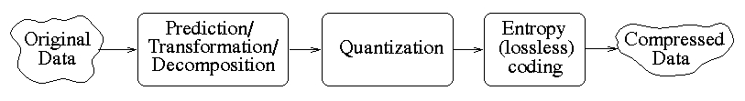
Data Compression
Reduce information
and entropy

Slide 3
Scalar Quantizer
Quantization: Function mapping a very large (possibly infinite) set of values to a much smaller (finite) set
Result in Error: Quantization Error
The values used are scalars in scalar Quantizers
Quantizer completely defined by two vectors: D,R
D : decision values = {d₀,d₁,d₂,...,d_{k}}
R : reconstruction values = {r₀,r₁,r₂,...,r_{k-1}}

Slide 4
Scalar Quantizer
d_{i}’s divide the range of values into ‘k’ intervals
k-level quantizer
i^{th} interval : [d_{i},d_{i+1})
r_{i}’s : values used in reconstruction
r₀ r₁ r₂
X X X
d₀ d₁ d₂

Slide 5
Scalar Quantizer
Two basic kinds:
- Uniform and Non-uniform
Uniform :
- Intervals are of equal widths
- r_{i}’s are mid-points of intervals
Non-uniform :
- Either or both conditions for uniform
Quantizer is(are) not true
- Ex. PDF-optimized (Lloyd-Max)
Quantizer

Slide 6
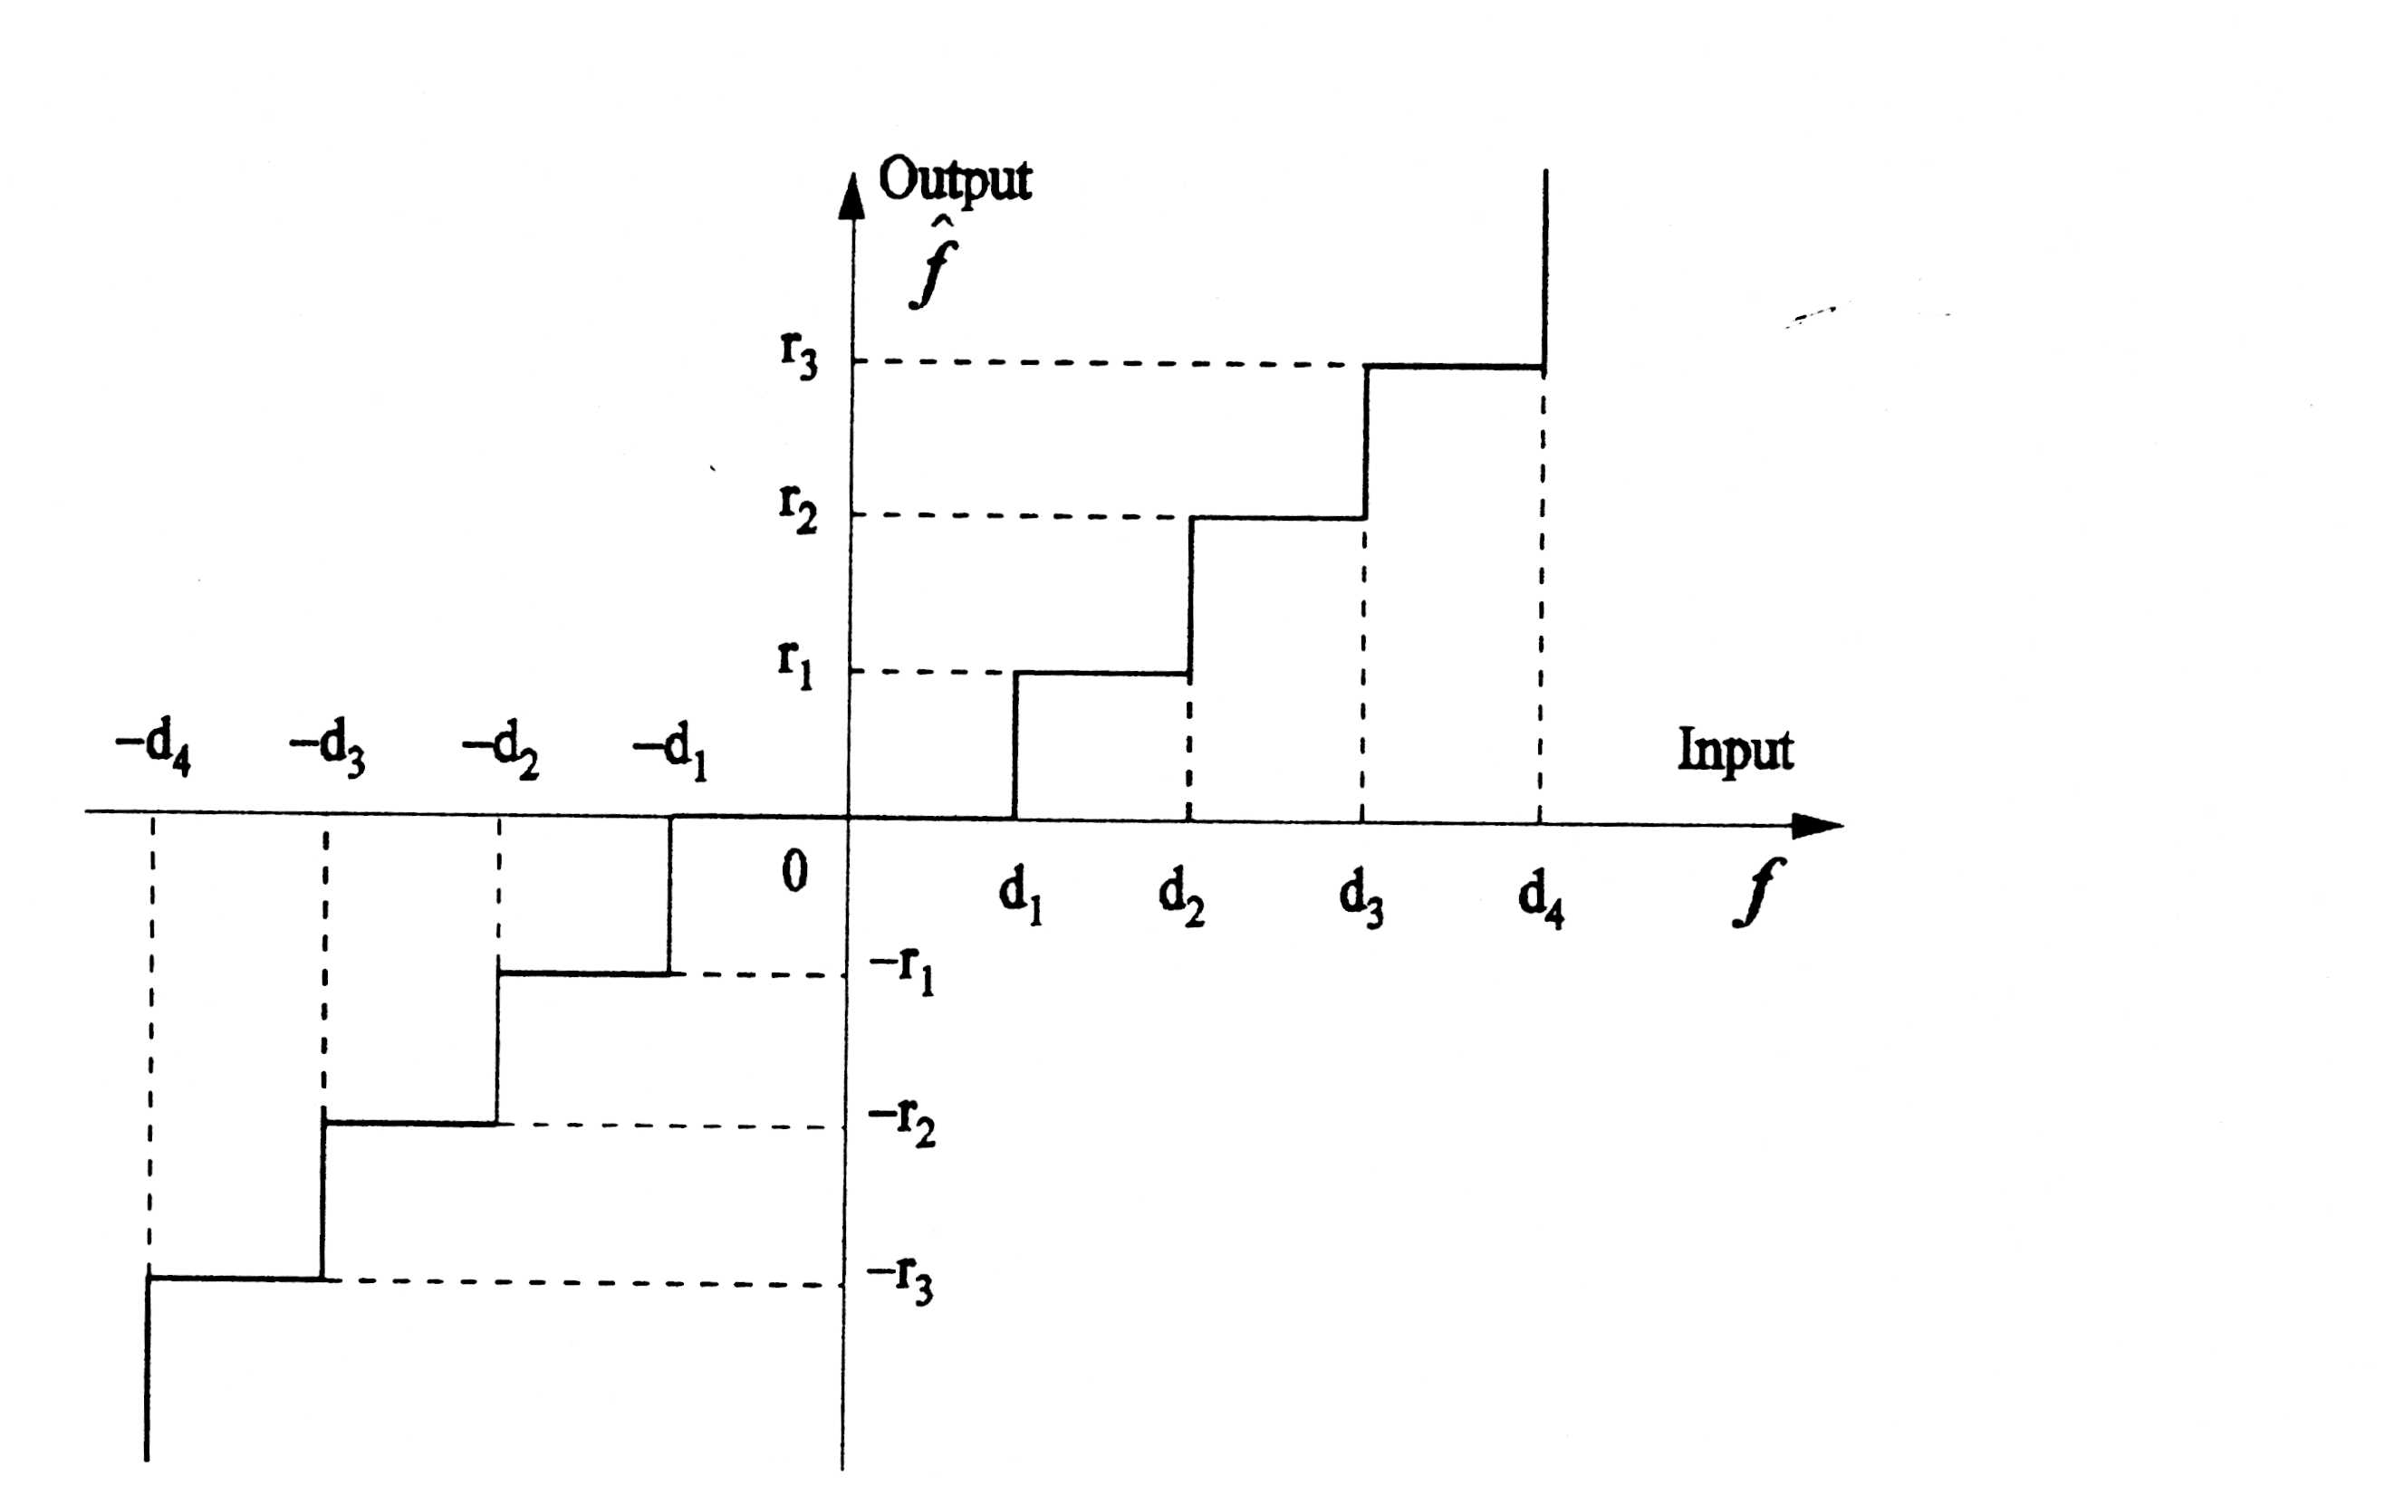
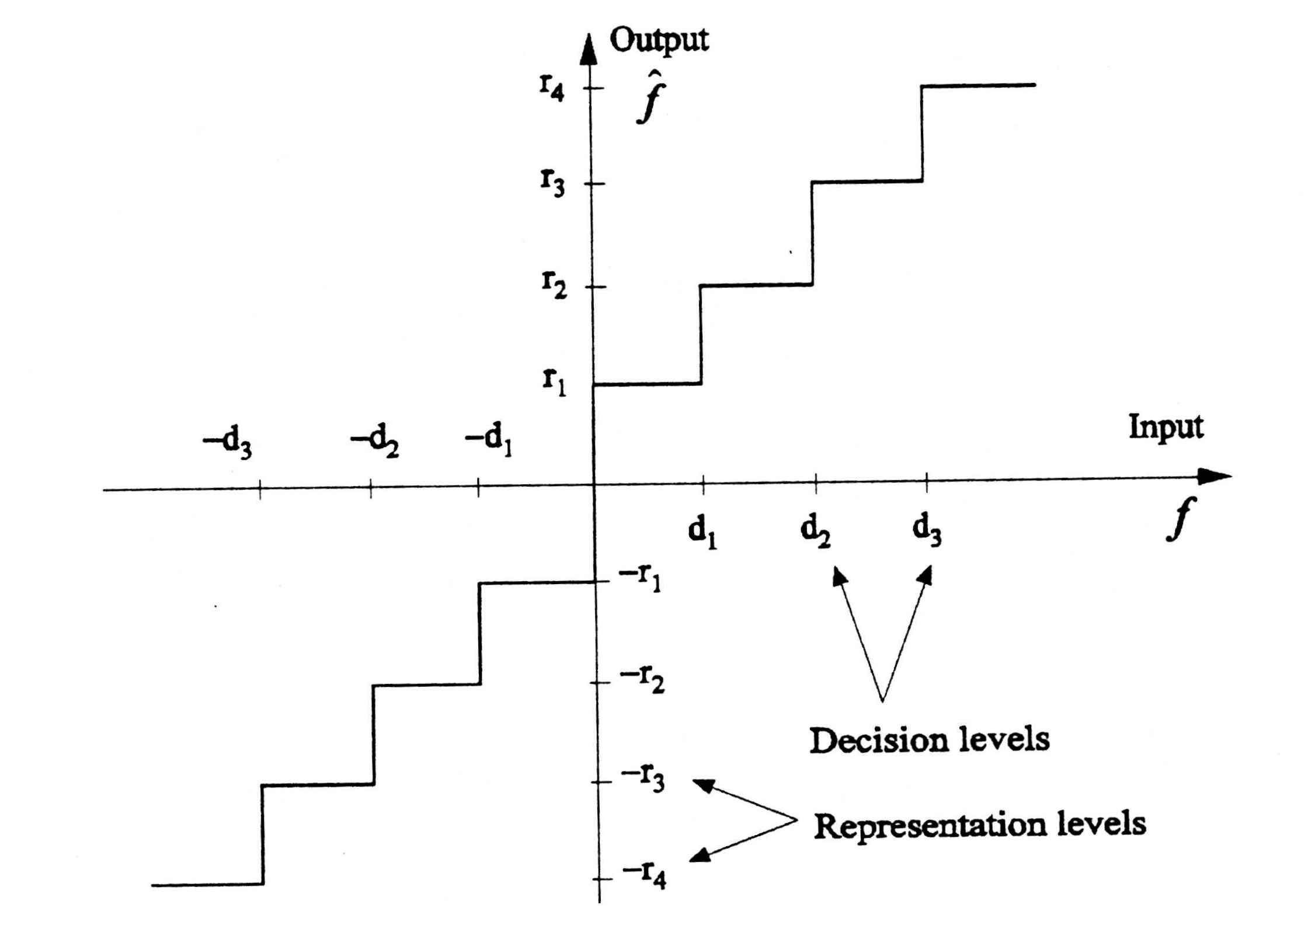
Uniform Symmetric Quantizers
Midtread
Midrise
r_{i}: output levels
d_{i}: input levels
Step size is constant

Slide 7
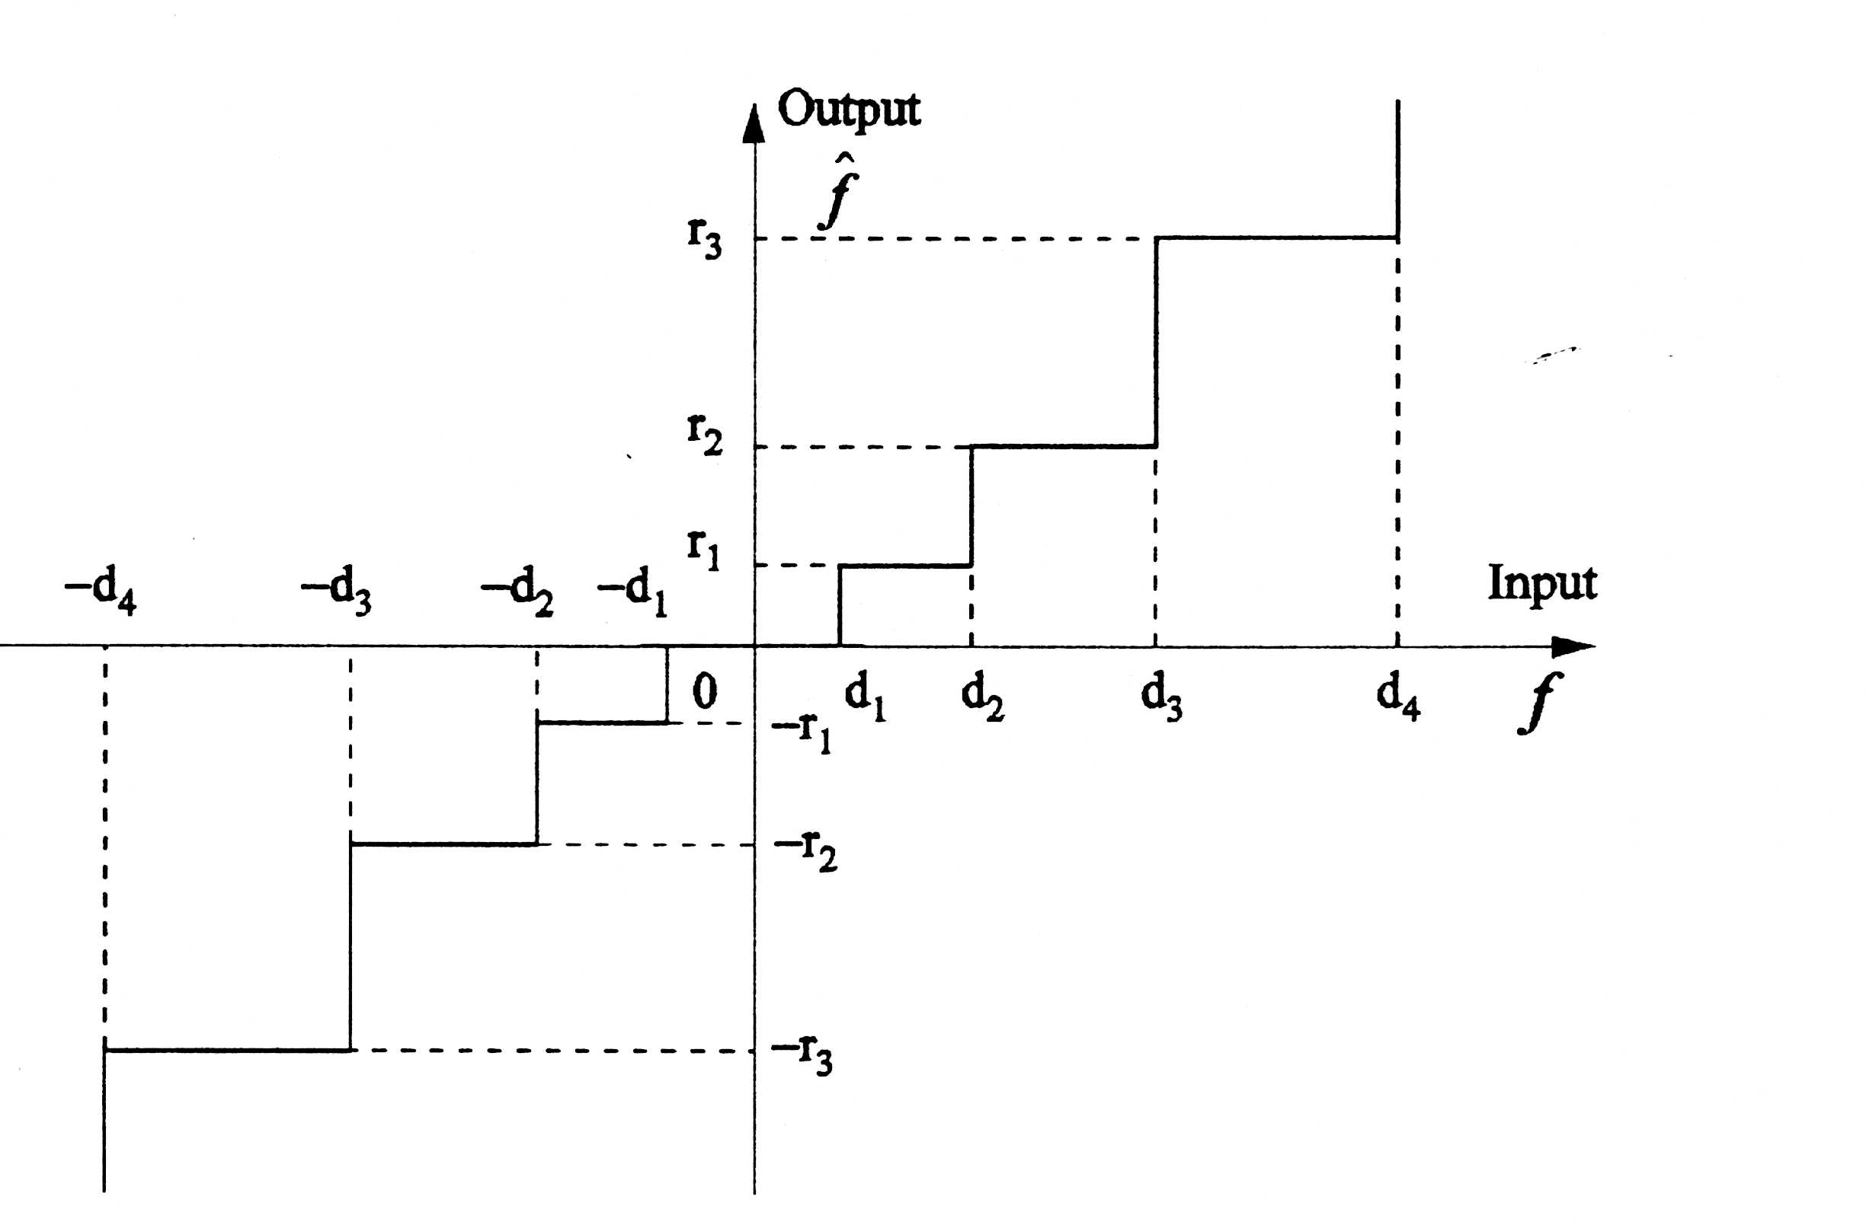
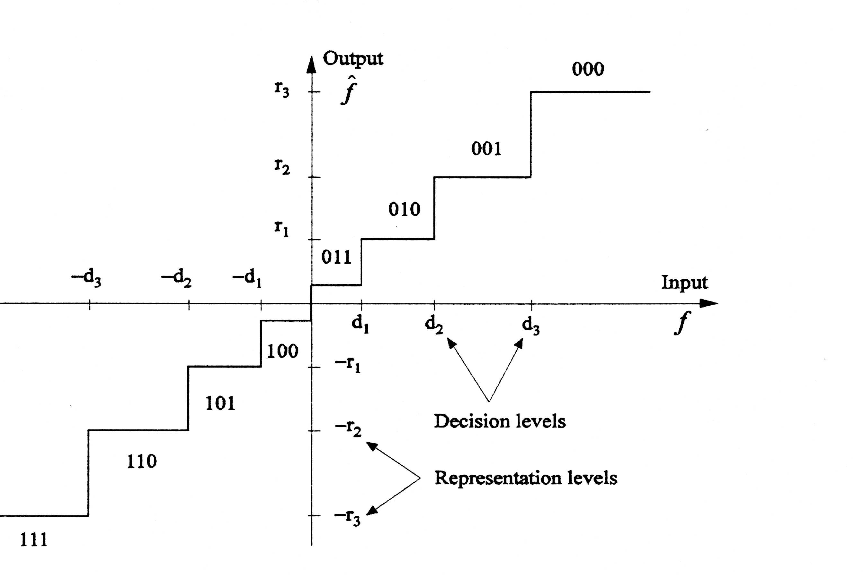
Nonuniform Symmetric Quantizers
Midtreader
Midriser
r_{i}: output levels
d_{i}: input levels

Slide 8

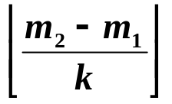


Uniform Quantizer
E: Range of Values ; D: Vector of decision boundaries
R: Vector of reconstruction Values
k: No. of Quantization Levels
begin
m1 ← MIN(E); m2 ← MAX(E);
←
D[1] ← m₁
D[i] ← D[i-1] +
D[k +1] ← m₂
R[1] ← D[1] +
R[i] ← R[i-1] +
end

Slide 9

Non Uniform Quantizer
r₀ r₁ r₂
x x x
d0 d1 d2
I: Original Image ; : Quantized Image; k: No. of Quantization Levels
Sorted array of d_{i}’s
Non-Uniform Quant (I, k, d(0:k) , )
Begin
For i = 1 to N do
For j = 1 to M do
(i,j) ← BinarySearch( I(i,j), d(0:k));
(Binary Search returns the interval number of the
interval containing the pixel I(i,j)
Endfor
Endfor
End

Slide 10

Non Uniform Dequantizer
: Quantized Image; : Reconstructed Image
k: No. of Quantization Levels
Non-Uniform Dequantizer ( ,k,r(0:k-1), )
Begin
For i= 1 to N do
For j = 1 to M do
(i,j) ← r( (i,j));
( Vector r contains Reconstruction Values )
Endfor
Endfor
End

Slide 11
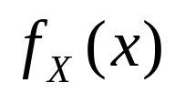
Pdf- Optimized Quantization
The Quantizer is completely specified by d(0:k), r(0:k-1).
Suppose the input is modeled by a Random Variable X
with pdf .
We wish to quantize this source using a Quantizer with
k intervals. ( need to specify k+1 d_{i}’s and k r_{i}’s).
The Quantizer needs to be ‘optimal’ (well suited) to the
source characteristics.

Slide 12
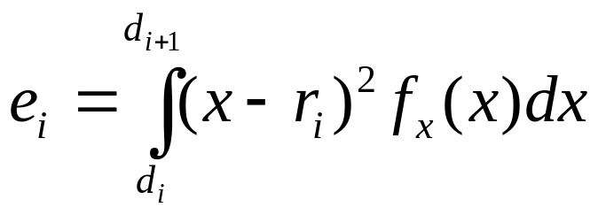
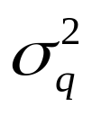
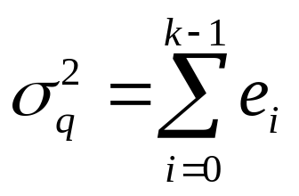
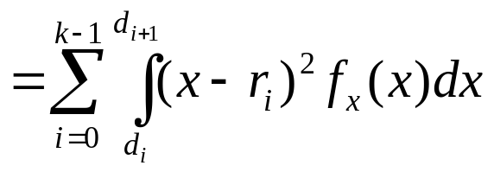
Pdf- Optimized Quantization
There are k intervals.
Interval i: [d_{i},d_{i+1}]
Quantization error e_{i} in interval i is given by:
Mean Quantization Error is:

Slide 13

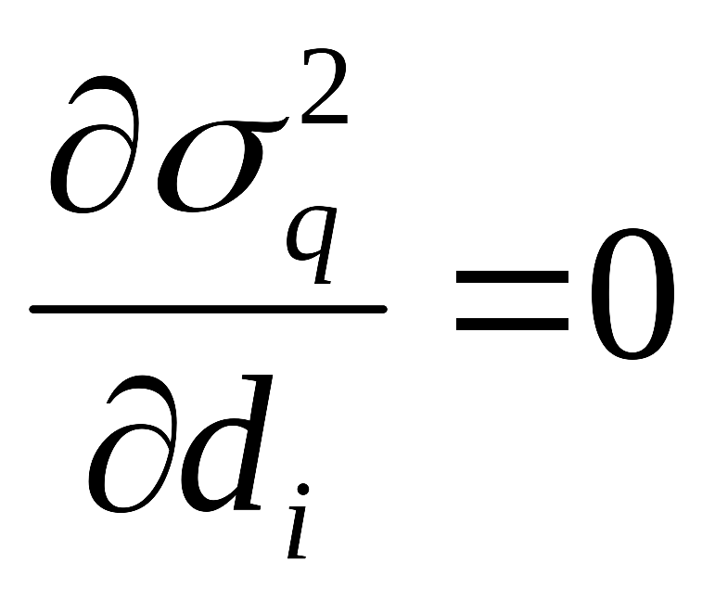
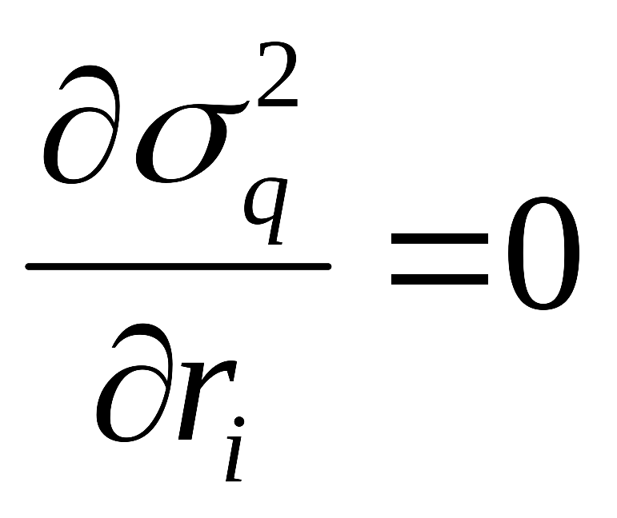
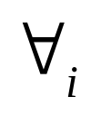
Deriving Optimal Quantizer
Given an Input Pdf and number of Quantization
levels k, find d_{i}’s and r_{i}’s so as to minimize .
In other words, given , find d_{i} (0 ≤ i ≤ k) and r_{i}
(0 ≤ i ≤ k-1) such that is minimized.
is a multivalued function (depends on d_{i} and r_{i}).
Therefore take partial derivatives

Slide 14
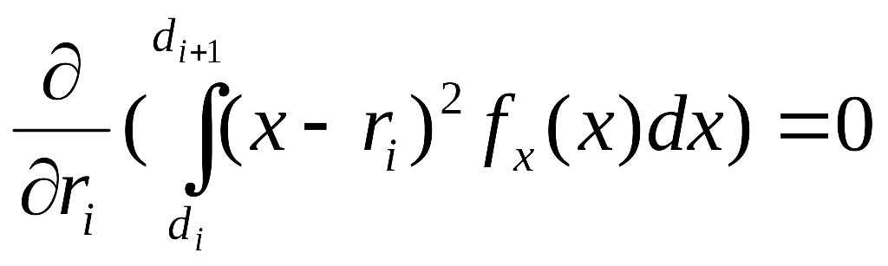
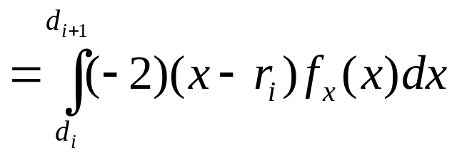
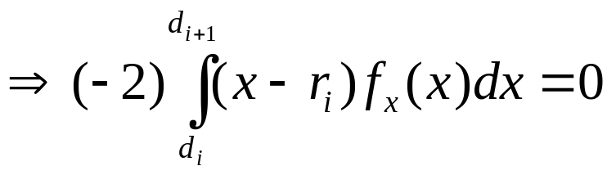
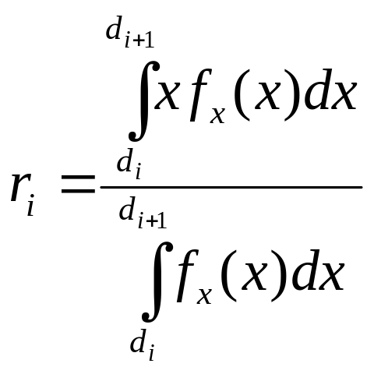
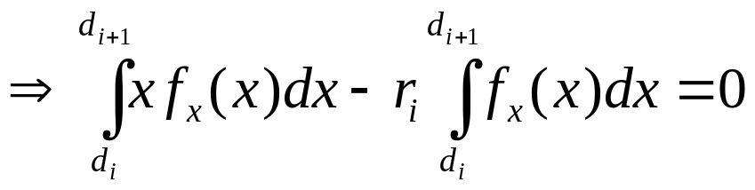
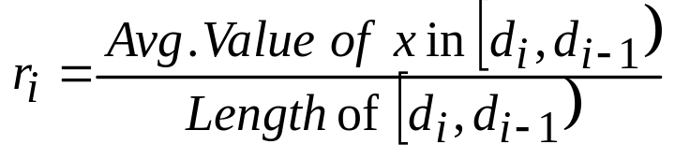
, 0 ≤ i ≤ k-1
- 1
r_{i} = Centroid of Probability Mass 0 ≤ i ≤ k-1

Slide 15
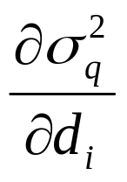
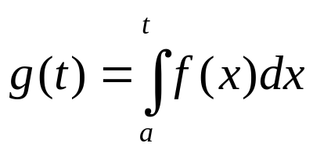
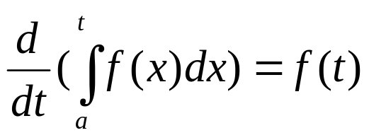
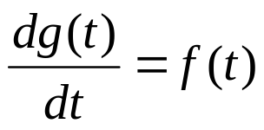
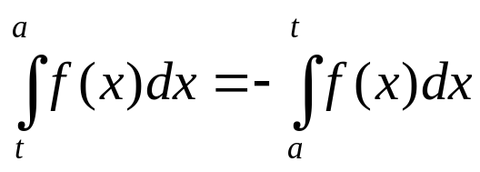
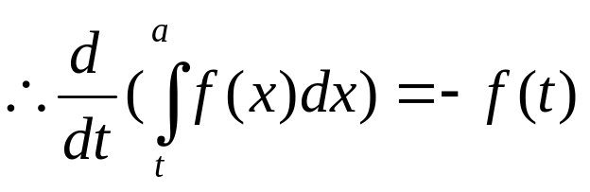
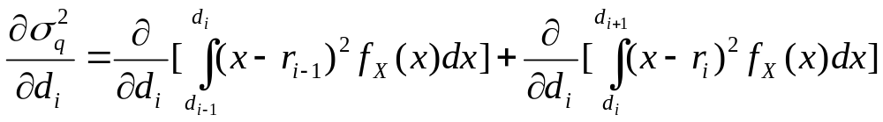
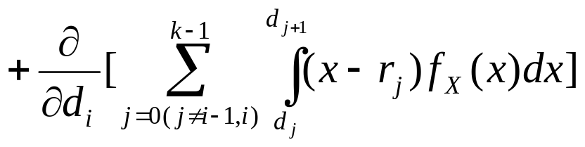
Now consider
We use the following facts.
(Consider the Summation from i=0 to k-1 as three parts as shown below)
0 ≤ i ≤ k-1

Slide 16
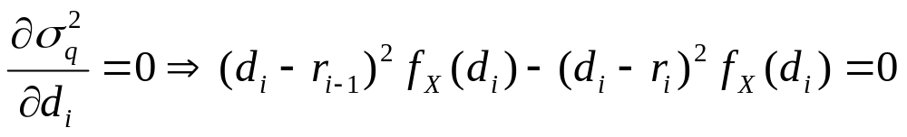
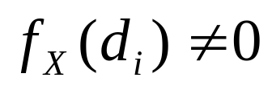
(d_{i} - r_{i-1})² = (d_{i} – r_{i})² (Assuming ).
d_{i} - r_{i-1} = r_{i} – d_{i}
d_{i} = ( r_{i-1}+ r_{i} )/2 - 2

Slide 17
d_{i} = ( r_{i-1}+ r_{i} )/2

Slide 18


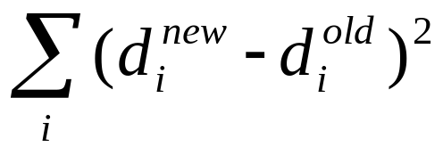
Optimal Quantizer Design
Input: I ( or derived from I).
Output : d(0:k) , r(0:k-1).
Begin
Start with an initial estimate of r_{i}’s ( ex. Take r_{i}’s as uniform recons. levels).
,d_{i} = ( r_{i-1}+ r_{i} )/2
Loop
  Update r_{i} as per 1 using numerical integration or using Update r_{i}’s function.
  d_{i} = ( r_{i-1}+ r_{i} )/2.
  Until (Error between two successive estimates < Tolerance)
End
Error :

Slide 19
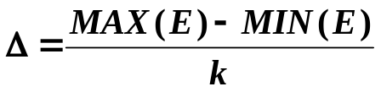
Lloyd-Max Quantization
Inputs: Image I
Outputs: D: Vectors of Decision boundaries
R: Reconstruction values
begin
E ← Image I
Start with an initial estimate of R
For example, R[i]’s could be uniform recons. levels
R[1] = MIN(E) +
R[i] = R[i-1] +
where
D_{old}[1] ← D_{new}[1] ← MIN(E)
D_{old}[k+1] ← D_{new}[K+1] ← MAX(E)
D_{old}[i] ← (R[i-1] + R[i])/2

Slide 20
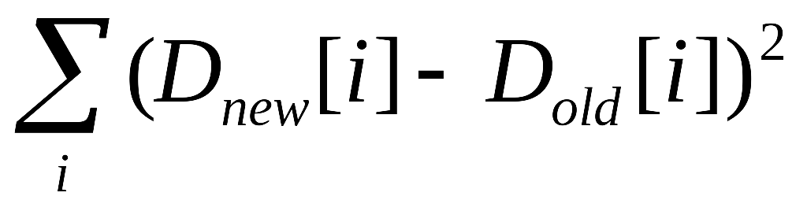

Lloyd-Max Quantization ( Contd. )
do
UPDATE_R(E,D,R)
D_{new}[i] ← (R[i-1] + R[i])2
error ←
D_{old}[i] ← D_{new}[i]
until(error < )
end

Slide 21
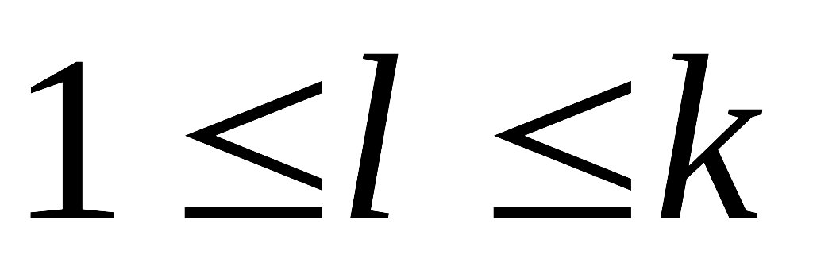
UPDATE_R(in: E,D out: R)
begin
s[1:k] ← 0 ; n[1:k] ← 0 ;
for i =1 to N do
for j = 1 to M do
l ← Locate(E[i,j], D) { l is in the range: }
{ Locate the interval in D where the pixel E[i,j] falls}
n[l] ← n[l] + 1; s[l] ← s[l] + E[i,j] ;
endfor
endfor
for l = 1 to k do
  R[l] ← s[l] / n[l]
endfor
end

Slide 22
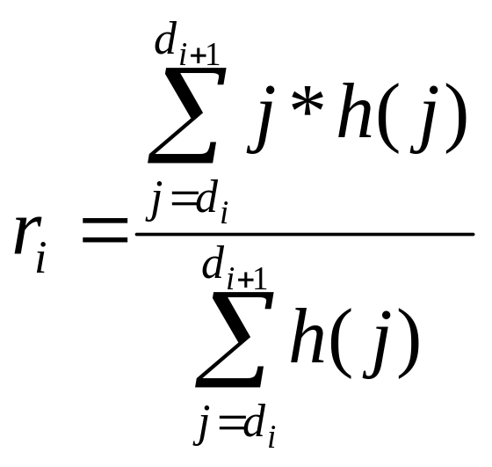
Initial Set of r_{i}’s
Build a histogram of the image for each
pixel from min to max.
m1= min(I);
m2= max(I);
h=hist(I,m1:m2);

