Slide 1
Data Compression
LIU Yan
Lecture 7
Subband Coding

Slide 2
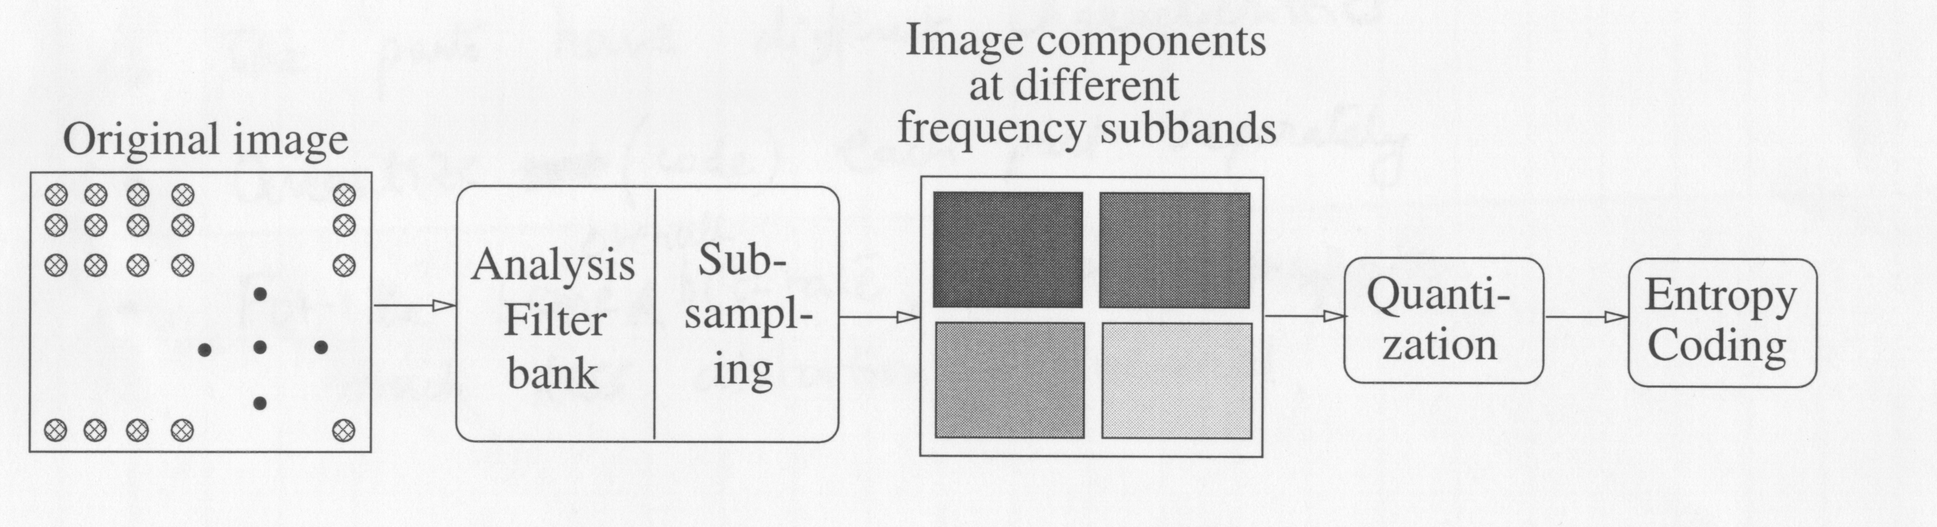
Outline of Subband Coding

Slide 3
Subband Coding : Principle
Decompose signal (input) into constituent parts (Filtering).
  The parts correspond to different frequency bands
  The parts have different characteristics.
Quantize (code) each part separately.
For the same overall bit-rate, much less distortion is incurred.

Slide 4
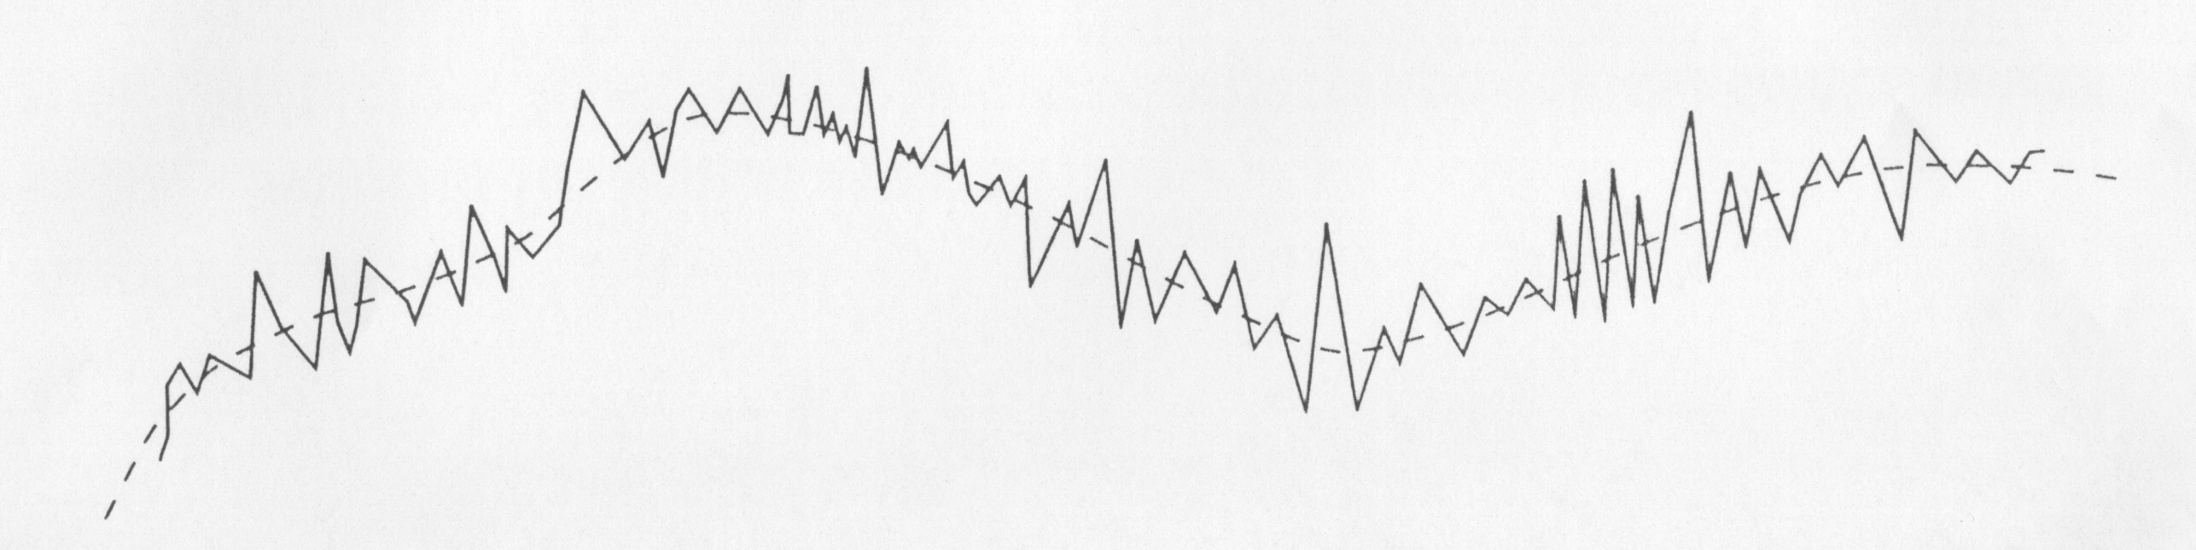
Example : 1-Dimensional signal, X
Broadly contains two components:
  Rapidly changing Component
  Slowly (‘long term’) Changing Component
  Obtained by averaging values in a moving window

Slide 5
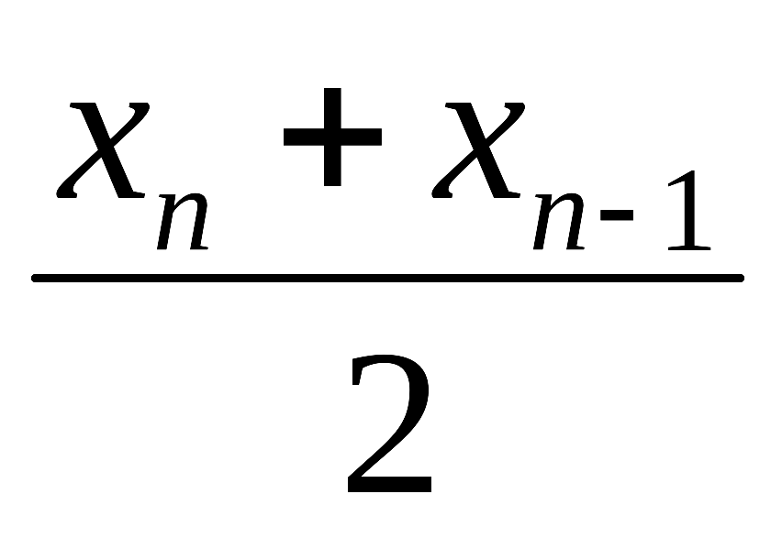
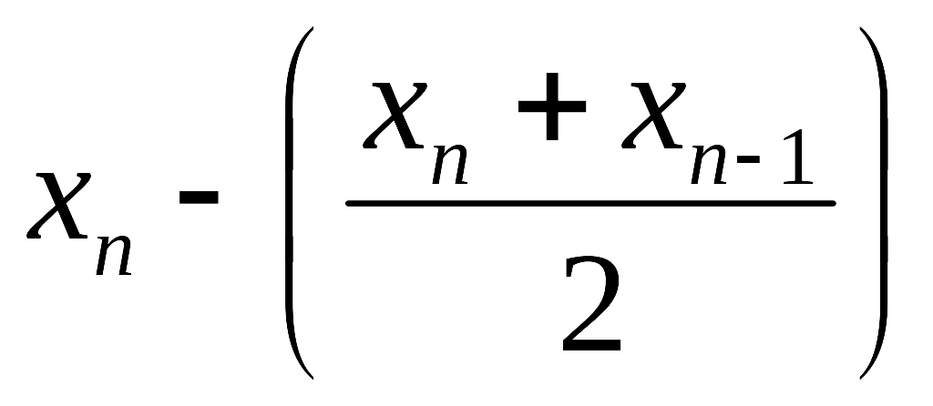
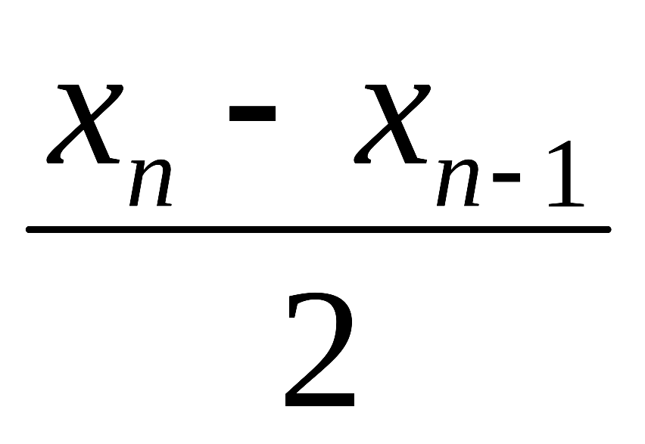
Decomposing X into Y and Z
Original Sequence : X = {x_{n}}
New Sequence (Moving average) :Y = {y_{n}}, y_{n} =
Difference Sequence : Z = {z_{n}} ,
z_{n} = x_{n} – y_{n} =
=

Slide 6
Decomposing X into Y and Z
Original data X decomposed into Y and Z
Y has smaller sample-to-sample differences
  slowly varying (low-frequency) component
Z has larger sample-to-sample differences
  fast changing (high-frequency) component
Frequency : Measure of how slow/fast a signal changes
X decomposed into two frequency components: Y (low frequency), Z ( high frequency).

Slide 7
Encoding
Code Y, Z independently using schemes best suited to each sequence.
y_{i} , y_{i-1} would be closer than x_{i}, x_{i-1}
→ DPCM better suited to Y than to X

Slide 8
Filtering and Subsampling
Low Pass Filter
Y ( frequencies 0 to F/2)
X
(Frequencies 0 to F)
High Pass Filter
Z ( frequencies F/2 to F)
Each Component ( Y and Z ) contains only one half the frequencies in the original
  Frequency range is halved.
Nyquist Criterion : Sampling rate ( number of samples per unit time) should be at least twice the highest frequency ( frequency range ).
When the frequency range of input (signal) is halved, only half as many samples in the original are adequate (no loss of information)

Slide 9
Subsampling Y and Z
Note that Y and Z have same number of samples as X.
  Encoding both Y and Z doubles the number of bits.
Since Y and Z contain one half the frequency range of X, they can be Subsampled by a factor of 2.
Y divided into Y’ and Y’’ of even and odd components of Y
Similarly Z divided into Z’ and Z” of even and odd components of Z.
Encode only Y’ and Z’ ( Discard Y” and Z” ).

Slide 10
Recovering X from Y’ and Z’
Y = {y₁,y₂, y₃, y₄, …}
Y’= {y₁’, y₂’, y₃’, …} = {y₂, y₄, y₆, …}
Y’’= {y₁”, y₂”, y₃”, …} = {y₁, y₃, y₅, …}
y_{k}’ = y_{2k} ; y_{k}” = y_{2k-1} , k=1, 2, 3, …
Similarly
z_{k}’ = z_{2k} ; z_{k}” = z_{2k-1} , k=1, 2, 3, …
y_{k}’+ z_{k}’=y_{2k} + z_{2k}=(x_{2k} +x_{2k-1})/2 + (x_{2k} -x_{2k-1})/2
= x_{2k}
y_{k}’- z_{k}’ = y_{2k} - z_{2k} =(x_{2k} +x_{2k-1})/2 - (x_{2k} -x_{2k-1})/2
= x_{2k-1}
{x_{2k} } and { x_{2k-1}} together give X.

Slide 11
Summary of Example
Original data X decomposed into its frequency components Y and Z
  Frequency : Measure of how slow/fast a signal changes
Y has smaller sample-to-sample differences
→ slowly varying (low-frequency) component
Z has larger sample-to-sample differences
→ fast changing (high-frequency) component
Coding Schemes best suited to Y and Z can be separately used.

Slide 12
Basics of Filters
Basic Elements Used to Decompose Signals
Filters decompose input signal into its frequency components
Filter is characterized by its Impulse response
Digital filters operate on discrete data
(Digital) Filter is characterized by a set of numbers: { h_{n} }
  Filter taps (Filter coefficients)

Slide 13
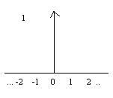
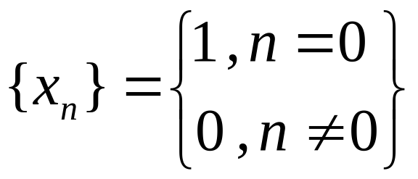

Impulse Input
1-D
2-D

Slide 14
Impulse Response
Impulse response : Output of the filter when the input is an Impulse
Impulse response of a digital filter : a sequence of numbers {h_{n}}
{h_{n}} : also called Filter taps
Notes:
Tap 抽头

Slide 15
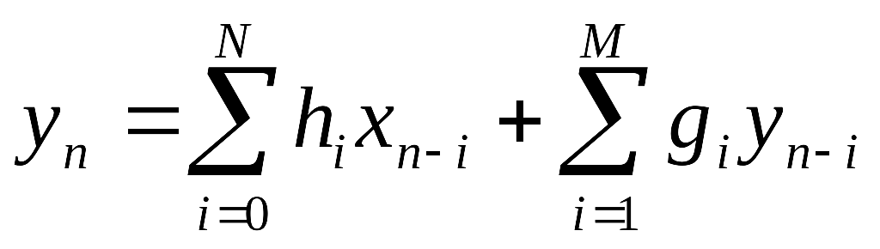
General Input-Output Relation of a Filter
{ x_{n} } : Input Sequence
{ y_{n} } : Output Sequence
{ h_{i}}, {g_{i}} : filter coefficients
If g_{i}’s are all 0, the filter is called Finite Impulse Response (FIR) filter
  Impulse response will die only after N samples.
If any g_{i} is non-zero, the filter is called Infinite Impulse Response (IIR) filter.
  Impulse response can continue forever.

Slide 16

Impulse Response of FIR Filter
Filter taps {h_{n}} : h₀ = 1.25 , h₁ = 0.5
Input {x_{n}} : Impulse → x₀ = 1, x_{n} = 0,
Output : y₀ = h₀x₀ + h₁x₋₁ = 1.25
y₁ = h₀x₁ + h₁x₀ = 0.5
y_{n} = 0 , otherwise
Output = Filter taps
      → Impulse response.

Slide 17
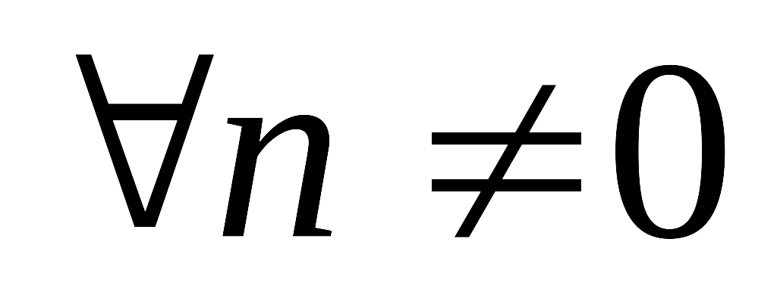
Impulse Response of IIR Filter
Filter taps : h₀ = 1.0 and g₁ = 0.9
Input { x_{n}} : Impulse x₀ = 1 , x_{n} = 0,
Output : y₀ = h₀x₀ + g₁y₋₁ = 1.0
y₁ = h₀x₁ + g₁y₀ = 0.9
y₂ = h₀x₂ + g₁y₁ = (0.9)(0.9) = 0.81
….
y_{n} = (0.9)^{n}

Slide 18
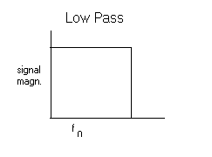
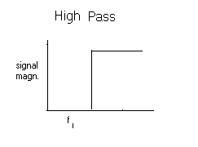
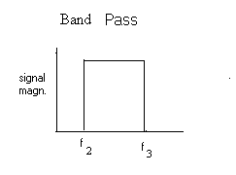
Basic Filter Types
Two basic regions : pass and stop bands
In the ideal case, no signal in stop bands
In practice, there will be some ripples in the pass and stop bands

Slide 19
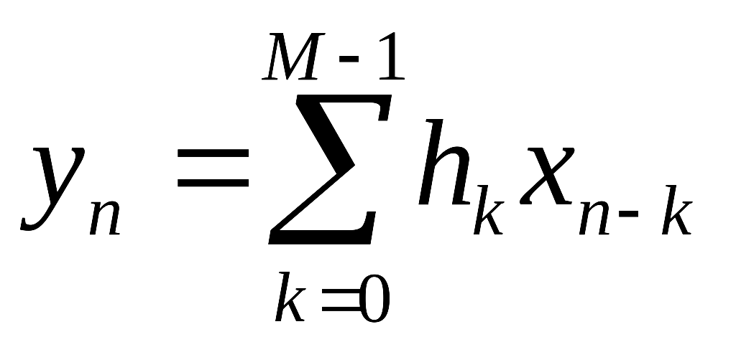

Basic Filtering Operation
input
Filter {h_{n}}
output
{h_{n}} : {h₀ , h₁, ...h_{M-1}} (Also called ‘kernel’)
(convolution operation)
Filtering operation convolution
input
output
{x_{n}}
{y_{n}}
…

Slide 20


Convolution
Filtering operation convolution
Convolution polynomial multiplication
Filtering involves convolution of input and kernel
  kernel = Filter taps

Slide 21
1 – D Convolution
Kernel , input : 1 – D sequences
Procedure:
  Reflect kernel
  Place kernel on input
  Do pair-wise multiplication
  Sum the product terms to get one output point (value)
  Slide kernel by one position and repeat
  steps 3 to 5

Slide 22
2 – D Convolution
2-D Data
Input
2-D
Kernel
2-D
Output
Procedure
  Rotate kernel 180 about center.
  Place kernel on input data.
  Move Left-to-Right and Top-to-Bottom.
  Do pairwise multiplication and the summation at each step.

Slide 23
Separable Convolution
Use 1-D convolution on rows of X (input) to get W
Use 1-D convolution on columns of W to get Y (output)
Kernel Kernel
X: input W Y: output
Compare the complexities (number of required computations ) of 2-D and 1-D separable convolutions on (N x M) size input using (n x m) size kernel
……
……
……
……

Slide 24
Condition for Separability
H : 2-D Kernel
R,C : 1-D Kernels
Condition : H is expressible as the outer product of R and C.
H R C
Note : For a given H, it may not always be possible to have separability.
………
n
1
………
.
.
.
n
=
m
X
m
1

Slide 25
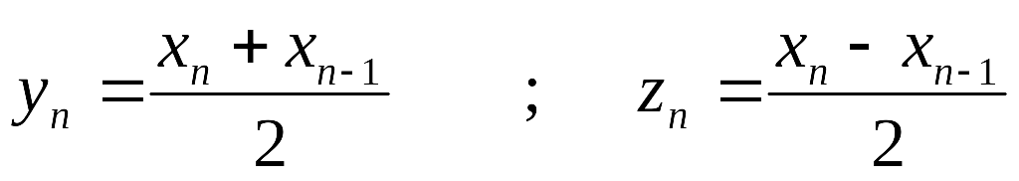
Filtering Example
X : Input
Y : Low frequency component of X
Z : High frequency component of X
y_{n} : Average → low-pass filter.
z_{n} : Difference → high-pass filter.

Slide 26
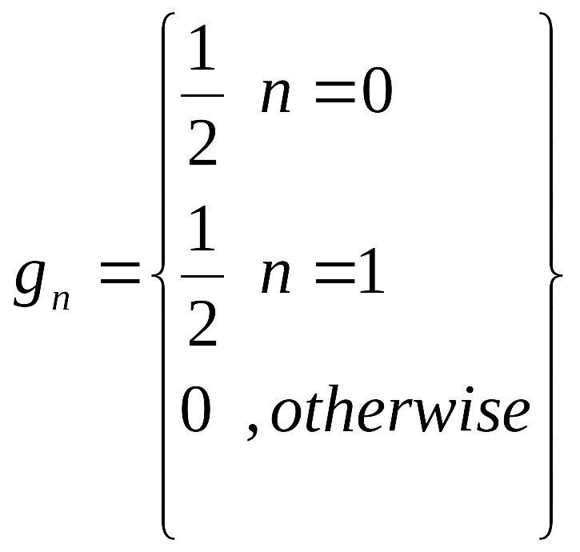
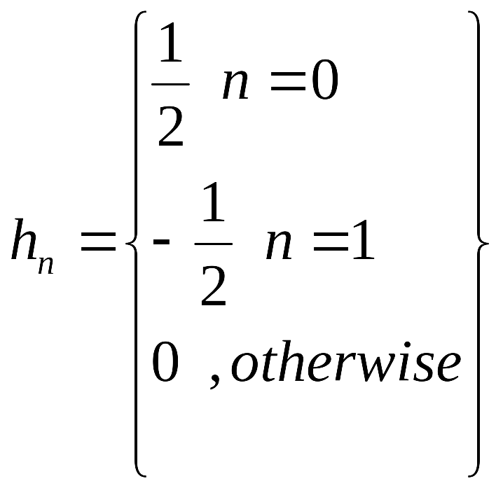
Filtering Example
Define two filters G and H as follows:
G: {g_{n}}
Y: {y_{n} }
X: {x_{n} }
H: {h_{n}}
Z: {z_{n} }
Y : Low frequency component of X.
Z : High frequency component of X.
Notes:
此处的g不同于无限冲击响应的g

Slide 27
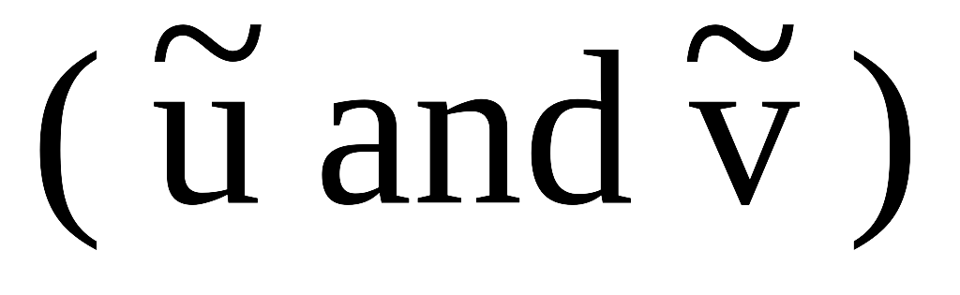
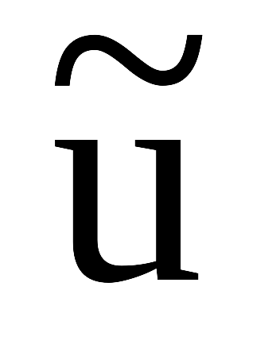


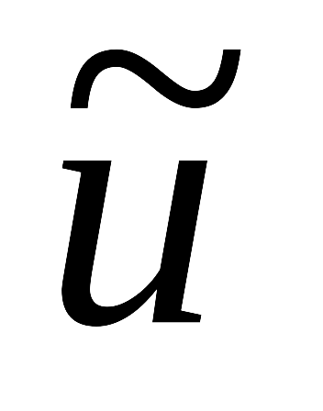

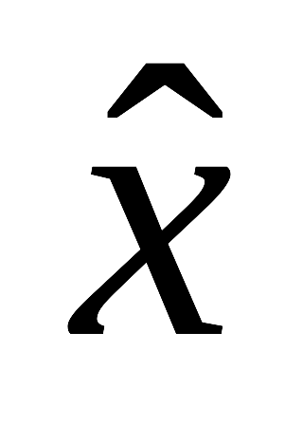
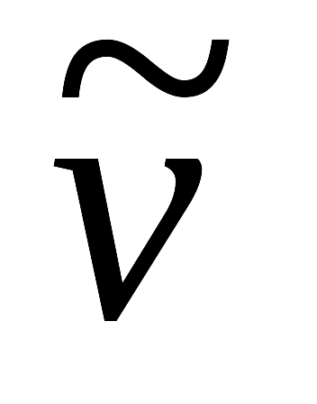

Subband Coding General Framework
input signal x ( = {x_{n}} ), is decomposed into
where - Low-frequency, - High-frequency components.
are subsampled by a factor of 2 into their even indexed elements – u and v respectively.
x can be reconstructed from u and v without loss, by applying upsampling, filtering and combining.
lowpass
lowpass
u
u’
G
2
2
P
+
x
H
2
2
Q
v
v’
highpass
highpass
Quantization/ coding
Analysis
Synthesis

Slide 28
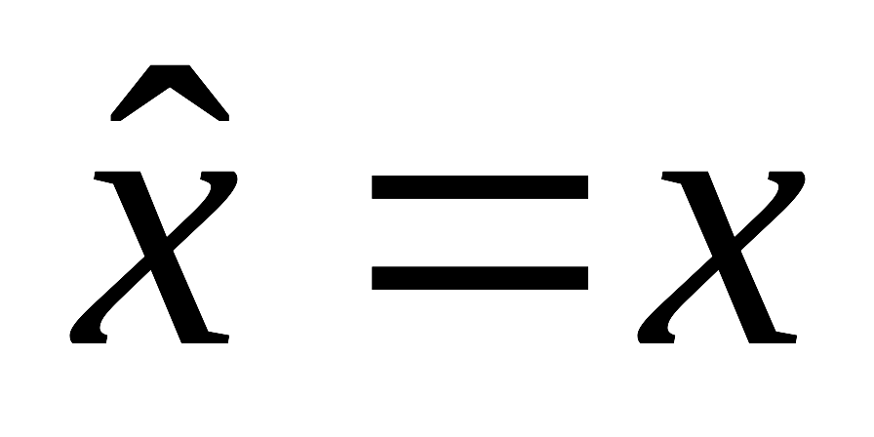
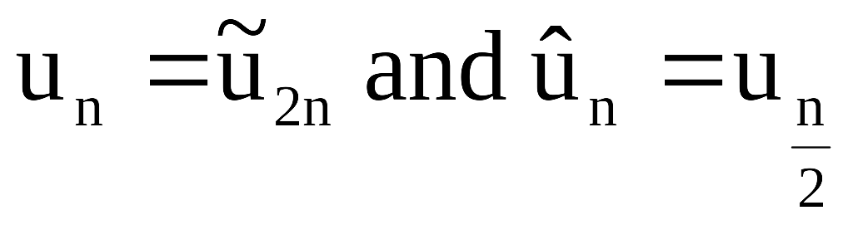
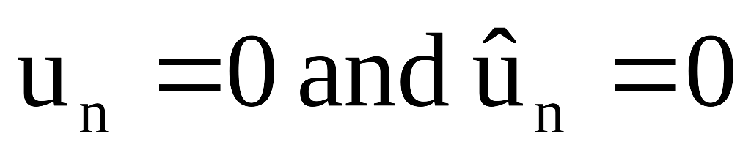
Subband Coding General Framework (Contd.)
For compression u and v are quantized followed by entropy coding.
As Human Visual System is sensitive to low-frequency components:
  u is quantized finely with more bits.
  v is quantized coarsely with less bits.
In the absence of quantization:
  Filters should be used such that
  u’ = u and v’ = v.
If n is even :
If n is odd :

Slide 29
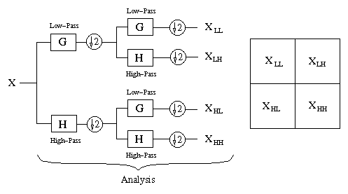
Subband coding of images

Slide 30


Slide 31
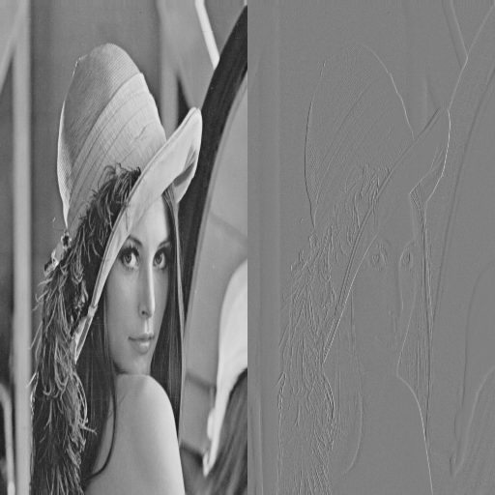

Slide 32
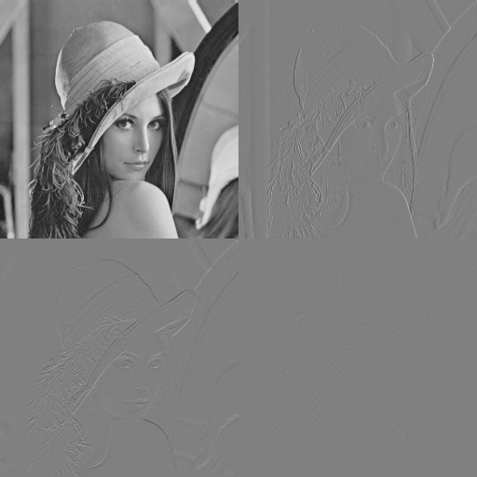

Slide 33


Slide 34
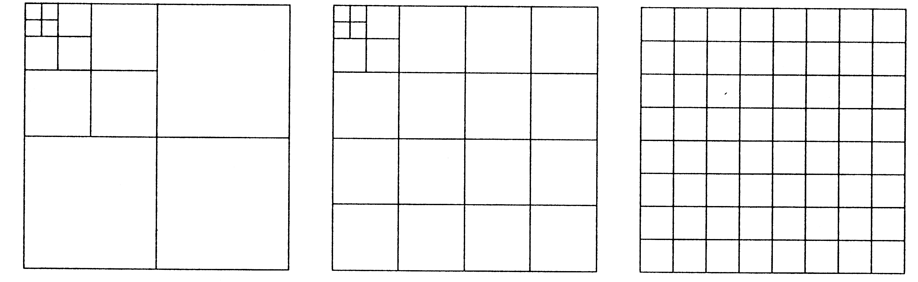
Popular Subband Decompositions

Slide 35
Encoding of Subbands
DPCM Encoding
  Each subband encoded using DPCM
  Well suited for a small number of subbands
    High pixel-to-pixel correlation in subbands.
DPCM/PCM Coding
  Only lowest subband encoded using DPCM
  ( due to high pixel-to-pixel correlation)
  PCM ( equivalent to straight quantization ) used for other subbands.
  Used for larger number of subbands.

Slide 36
Encoding of Subbands (Contd.)
VQ Encoding
  Segment subbands into blocks ( say, 4 x 4)
  Derive codebook(s) suited to specific subband(s) and encode using VQ
  (OR)
  Form vectors across subbands
  Derive appropriate (single) codebook and encode using VQ.

Slide 37
Relation between Transformation and subband decomposition
Subband Decomposition :
Uses a set of FIR analysis filters.
Produces a set of bandspaces filtered subimages.
  Localized frequency representation of the original image.
Transformation :
Uses transforms such as DFT,DCT.
Produces basis function (Vector) decompositions
  Localization of coefficients corresponding to similar frequencies.
ab cd | ab cd | ab cd | ab cd
ab cd | ab cd | ab cd | ab cd
ab cd | ab cd | ab cd | ab cd
ab cd | ab cd | ab cd | ab cd
aaaa aaaa aaaa aaaa | bbbb bbbb bbbb bbbb
cccc cccc cccc cccc | dddd dddd dddd dddd
Transform Blocks
Subbands

