Slide 1
Data COmpression
LIU Yan
Lecture 9
JPEG Image Compression Standard

Slide 2
JPEG Standard
JPEG: Joint Photographic Experts Group

Slide 3
JPEG Image Compression Standard
JPEG : Joint Photographic Experts Group
Standard for continuous tone still images
Widely used standard
New Standard : JPEG 2000

Slide 4
JPEG Modes
Lossless JPEG
Sequential (Baseline) JPEG
Progressive JPEG
Hierarchical JPEG

Slide 5
Lossless JPEG
Uses Linear Predictive Technique
Provides 8 prediction schemes
Residual Image derived from original and predicted images
Residual Image encoded using Entropy coding

Slide 6
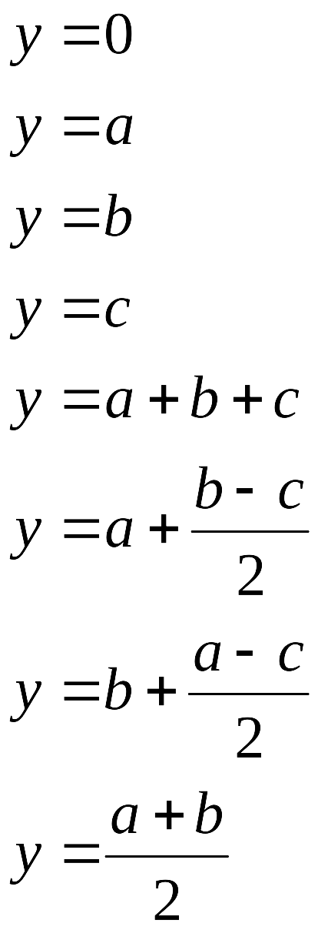
Prediction Kernel and Modes
c
b
a
x
Lossless JPEG prediction kernel

Slide 7
Baseline JPEG
Level-shift the image is by subtracting 2^{n-1} from each pixel value
  n is the number of bits used to represent each pixel
Divide the image into non-overlapping blocks of size 8 x 8
Apply DCT to each of the blocks to obtain the transform coefficients
Quantize the coefficients using a table specified by the standard, which contains the quantizer step sizes
Order the quantized coefficients using the zigzag ordering
Encode the ordered quantized values using a variable bit length entropy coder (Huffman coding tables)

Slide 8
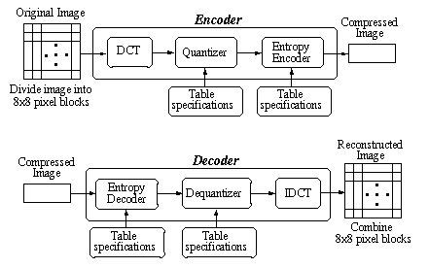
Baseline JPEG encoding and decoding

Slide 9
JPEG Quantization Table
16, 11, 10, 16, 24, 40, 51, 61,
12, 12, 14, 19, 26, 58, 60, 55,
14, 13, 16, 24, 40, 57, 69, 56,
14, 17, 22, 29, 51, 87, 80, 62,
18, 22, 37, 56, 68, 109, 103, 77,
24, 35, 55, 64, 81, 104, 113, 92,
49, 64, 78, 87, 103, 121, 120, 101,
72, 92, 95, 98, 112, 100, 103, 99

Slide 10
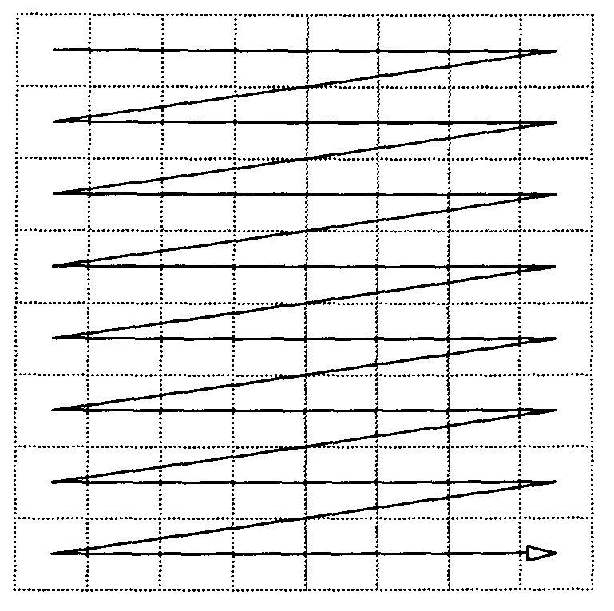
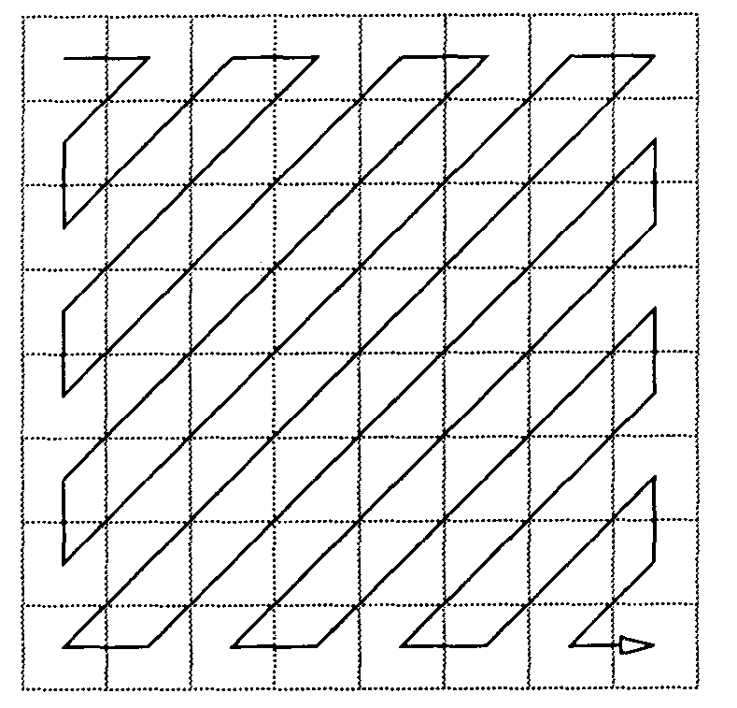
Ordering of Coefficients (left-right-top-down and zigzag ordering)

Slide 11
Baseline JPEG Coefficient Encoding
DC Coefficient:
  First coefficient in every 8 x 8 block
  Represents the average value of pixels in block
AC Coefficients: Remaining 63 coefficients in every 8 x 8 block
DC Coefficients: treated separately from the AC Coefficients
Differential values of DC coeffs. of all blocks are derived and encoded

Slide 12
DC Coefficient Encoding
For 8 bit/pixel Image, the DC Coefficient value range requires 11 bits
Differential DC value range requires 12 bits
Category Table for differential DC values available
12 entries in category Table
  SSSS : index to category table for differential DC values
  Huffman Table available for SSSS

Slide 13
Category Table for DC Coefficients
SSSS | Differential DC coef. values
0 1 2 3 4 5 6 7 8 9 10 11 | 0 -1,1 -3,-2,2,3 -7...-4,4...7 15...-8,8...15 -31...-16,16...31 -63...-32,32...63 -127...-64,64...127 -255...-128,128...255 -511...-256,256...511 -1023...-512,512...1023 -2047...-1024,1024...2047

Slide 14
Category Table for DC Coefficients
SSSS | Differential DC coef. values
0 1 . . . i . . . 11 | 0 -1,1 … ... ... -2^{i}+1 ... -2^{i-1} , 2^{i-1} ... 2^{i} -1 ... ... ... -2047...-1024,1024…2047

Slide 15
Huffman Code Table for luminance DC coefficient differences
Category Code length Code word
0 2 00
1 3 010
2 3 011
3 3 100
4 3 101
5 3 110
6 4 1110
7 5 11110
8 6 111110
9 7 1111110
10 8 11111110
11 9 111111110

Slide 16
DC Coefficient Coding
Form Differential DC coefficients, D_{i}
For each D_{i :}
  Determine category (SSSS)
  Determine Relative Magnitude of D_{i} within the category : M_{i}
  Determine Sign :
    G_{i} =1 if Di is positive (D_{i} ≥ 0)
    G_{i} = 0 if Di is negative (D_{i} < 0)
  Lookup code for SSSS in the Huffman Table, (say V_{i})
Form V_{i} . G_{i} . M_{i} ( ‘.’ : concatenation)
  V_{i} . G_{i} . M_{i} is the Encoding of D_{i}.

Slide 17
AC Coefficient Coding
Express non-zero AC coefficients as : NNNNSSSS (8 bits)
NNNN (4bits): Run length, R
  NNNN : Number of zeroes between previous and current
  non-zero AC coeffs.
  Run length 16 : 11110000
  Run length >16 : q·r , where q = Rdiv16 ; r=Rmod16
SSSS (4bits): Index into Category Table
Category Table for AC coefficients available
Huffman Table for category numbers available

Slide 18
Category Table for AC Coefficients
SSSS | AC coef. values
1 2 3 4 5 6 7 8 9 10 | -1,1 -3,-2,2,3 -7...-4,4...7 15...-8,8...15 -31...-16,16...31 -63...-32,32...63 -127...-64,64...127 -255...-128,128...255 -511...-256,256...511 -1023...-512,512...1023

Slide 19
Huffman code Table for luminance AC coefficients
16 possible Run Lengths (0-15): NNNN
10 categories for AC values: SSSS
Two special codes:
  Run length of 16: 11110000
  End of Block (EOB): 00000000
Huffman Table Size: 16 * 10 + 2 = 162

Slide 20
Huffman code Table for luminance AC coefficients
Run/Size (NNNNSSSS) | Code word
0/0 (EOB) 0/1 0/2 0/3 0/4 … 1/1 1/2 1/3 … F/0 … | 1010 00 01 100 1011 … 1100 11011 1111001 … 11111111001

Slide 21
AC Coefficient Encoding
Express AC coefficients A_{i} as NNNNSSSS
Determine V_{i} the Huffman code corresponding to NNNNSSSS
Determine M_{i} : relative magnitude of A_{i} within the category
  M_{i} = (k-1) bits of the 1’s complement of A_{i}
  k : category number
Determine Sign G_{i} : 1 if A_{i} > 0; 0 if A_{i}<0
Encoding of A_{i}: V_{i} .G_{i}.M_{i}(‘.’ = concatenation)

Slide 22
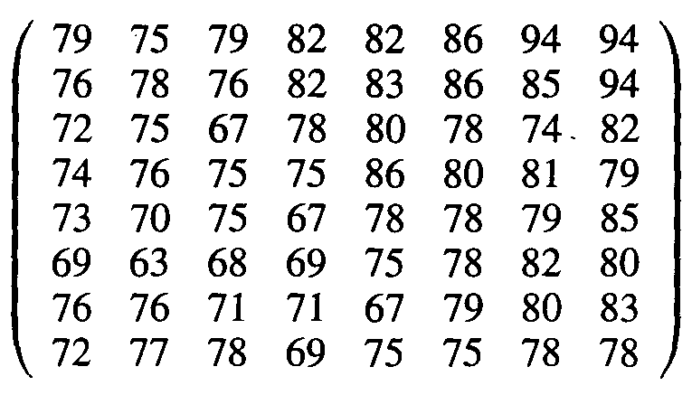
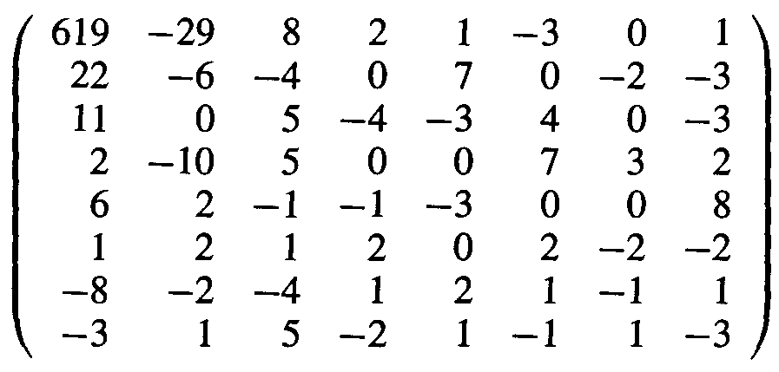
Example
X =
2-D DCT
Y =
Quantization

Slide 23
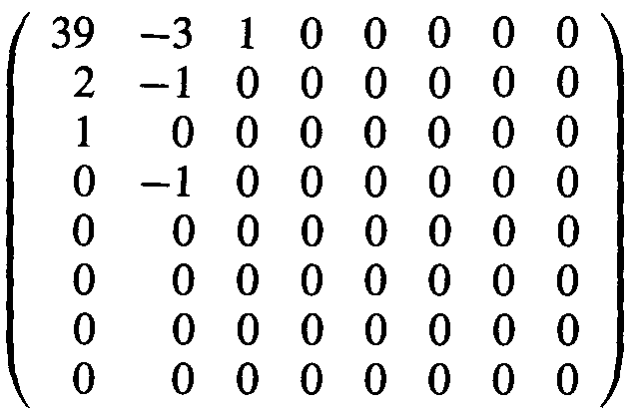
Example (Contd.)
previous DC=34
Z =
Zigzag Ordering
(5 –3 2 1 –1 1 0 0 0 0 0 –1 EOB)
Huffman Coding
(100 101/01 00/01 10/00 1/00 0/00 1/1111010 0/1010)

Slide 24
Example (Contd.)
(5 –3 2 1 –1 1 0 0 0 0 0 –1 EOB)
DC/AC NNNN/SSSS Huffman Coding G_{i}.M_{i}
5 0/3 100 101
–3 0/2 01 00
2 0/2 01 10
1 0/1 00 1
–1 0/1 00 0
1 0/1 00 1
00000–1 5/1 1111010 0
EOB 0/0 1010

Slide 25
Progressive JPEG
Facilitates decoding and viewing of a rough version first, followed by successive refinements.
Formation of coefficients and Quantization similar to Baseline JPEG
Each coefficient coded in multiple scans
Each successive scan refines Image
Two types:
  Spectral Selection
  Successive Approximation

Slide 26
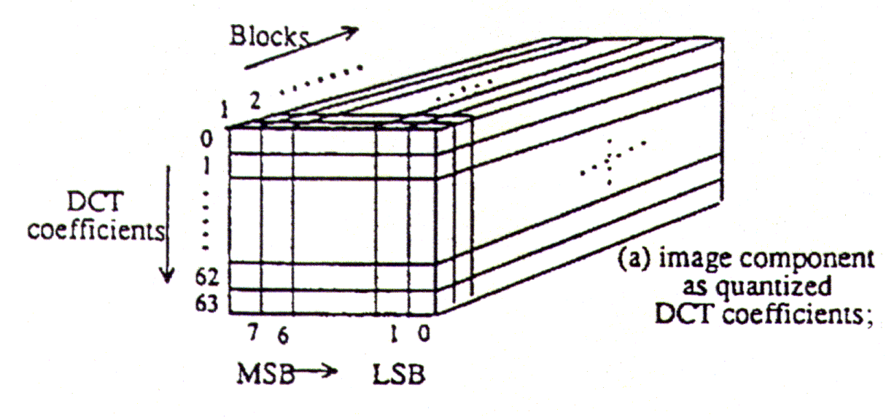
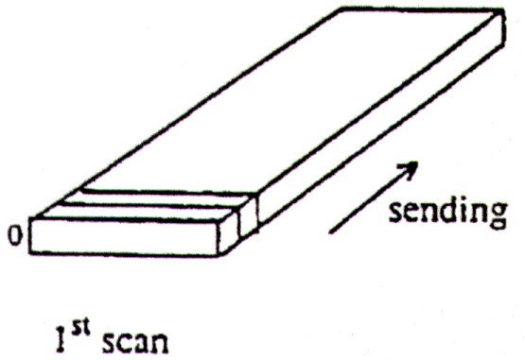
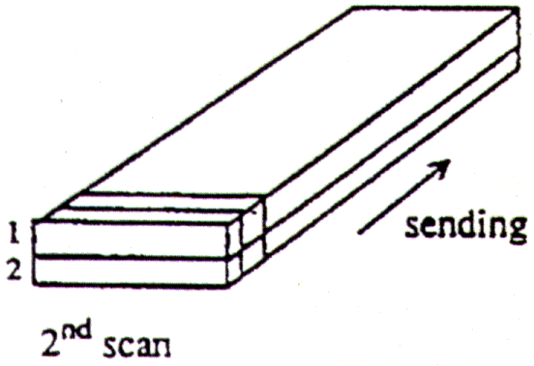
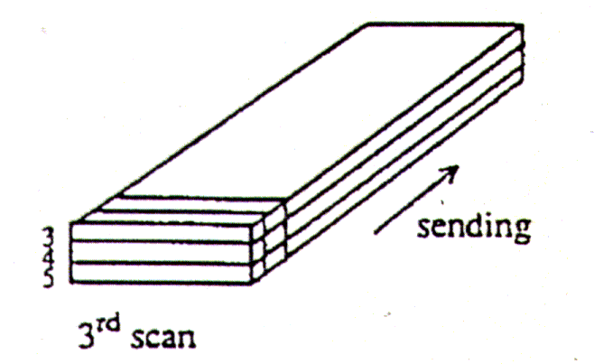
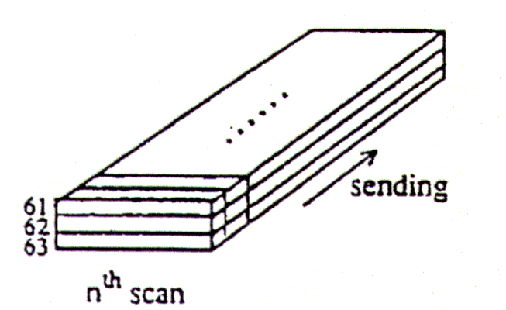
Progressive: Spectral Selection

Slide 27
Spectral Selection Outline
DCT Coefficients of all blocks of the image are computed and quantized ( similar to Baseline JPEG).
The DC Coefficients ( Coefficients at location (0,0) in each block) of all the blocks are first encoded and transmitted ( First Pass / Scan )
  Decoding these gives a coarse image.
Next, the first two AC Coefficients ( in the zigzag ordering) of all the blocks are encoded and transmitted ( Second Pass/ Scan ).
Subsequently a set of AC Coefficients of all the blocks are encoded and transmitted in each of the passes.

Slide 28
Spectral Selection Outline
Note that DC and AC Coefficients in zigzag ordering correspond to different spectral ( frequency) bands in the original image ( hence the name of this scheme.)

Slide 29
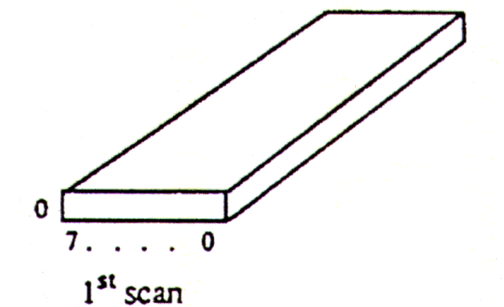
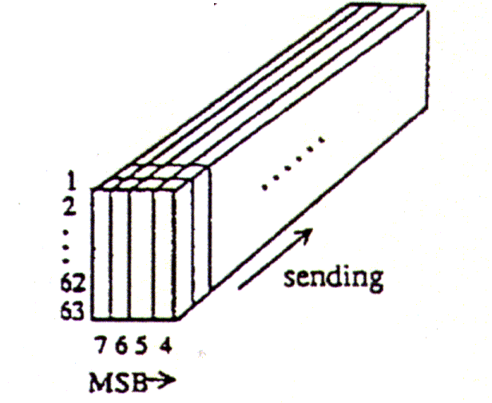
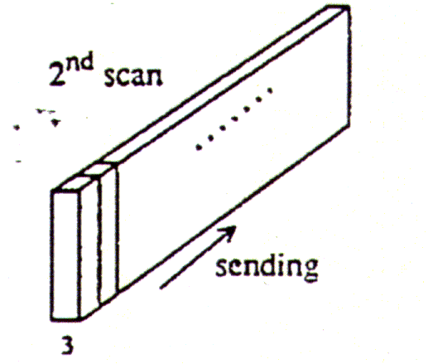
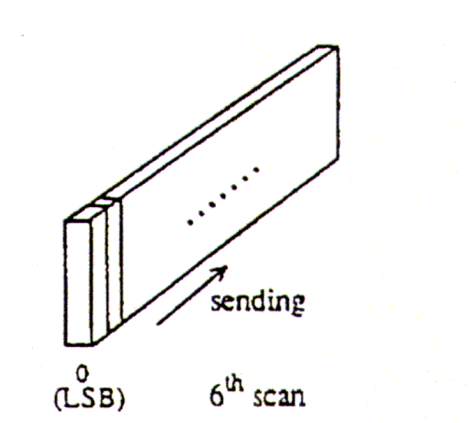
Progressive: Successive Approximation

Slide 30
Successive Approximation Outline
DCT Coefficients of all blocks of the image are computed and quantized ( similar to Baseline JPEG ).
The DC Coefficients of all the blocks are encoded and transmitted (First Pass/Scan).
Next, only the first few (ex. 4) most significant bits of all the AC coefficients of all the blocks are encoded and transmitted ( Second Pass/ Scan ).
Subsequently sets of lower significant bits of all the AC Coefficients of all the blocks are encoded and transmitted in each of the passes.

Slide 31
Successive Approximation Outline
Note that coarse values of AC Coefficients are first encoded followed by successive refinements to their values.

Slide 32
Hierarchical JPEG
Provides Progressive Representations
Provides Multiple Resolutions
Requires more space
  Since Image is encoded at various resolutions.

Slide 33
Hierarchical JPEG Outline
Filter and down sample the original image by the desired number of multiples of 2 in each dimension
Encode reduced-size image using either sequential DCT: progressive DCT , or lossless encoders
Decode this reduced-size image and then interpolate and up-sample it by 2, horizontally and/or vertically, Using the identical interpolation filter which the receiver (decoder) will use.
Use the obtained up-sampled image as a prediction of the original, and encode the image difference (error) using one of the encoders
Go to Step 1 until the full resolution is encoded

Slide 34
Hierarchical JPEG Encoding
I⁰
Filter
DSF
I¹
I^{L-1}
I^{L}
2
· · ·
DSF
+
-
USF
+
-
USF
D⁰
D^{L-1}
FDCT
FDCT
FDCT
+
R^{L}
IDCT
IDCT
+
IDCT
R^{L-1}
DCT Encode
DCT Encode
· · ·
DCT Encode
C⁰
C^{L-1}
C^{L}

Slide 35
Hierarchical JPEG Decoding
C⁰
C^{L-2}
C^{L-1}
C^{L}
…
DCT Decode
DCT Decode
DCT Decode
DCT Decode
IDCT
IDCT
IDCT
IDCT
+
D⁰
D^{L-2}
+
D^{L-1}
+
+
R¹
USF
USF
R^{L}
+
+
R⁰
R^{L-2}
R^{L-1}
R^{L}
sequential
Filter
DSF
Filter
USF
Could be
2
2
DCT Encode
Progressive
Lossless

Slide 36
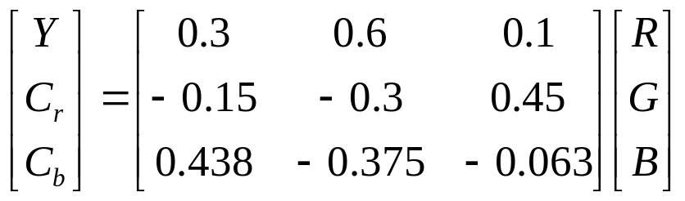
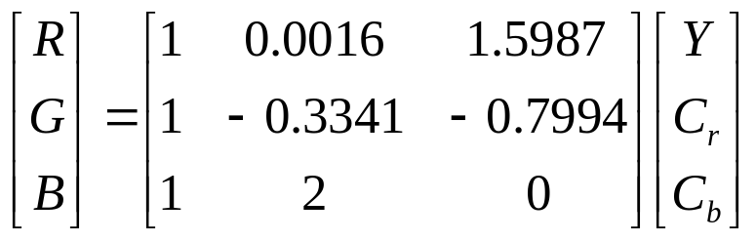
Lossy Compression of Color Images
Color-space transformation
luminance
chrominance
forward transform
inverse transform
Luminance channel can be treated just like a gray-scale image

Slide 37
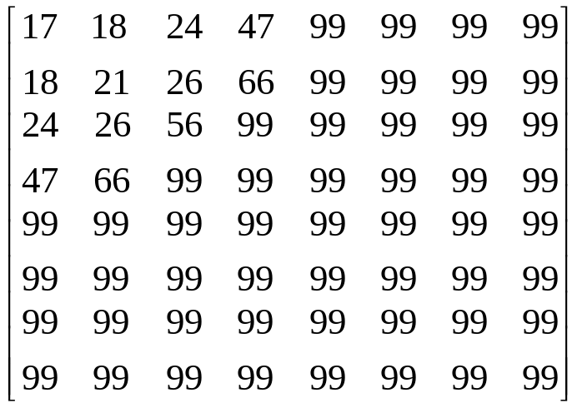
Compression of Chrominance Channels
Down-sampling
Q-Table
2
C_{r}/C_{b}
Human eye is relatively insensitive to the high-frequency
content of the chrominance channels.

Slide 38
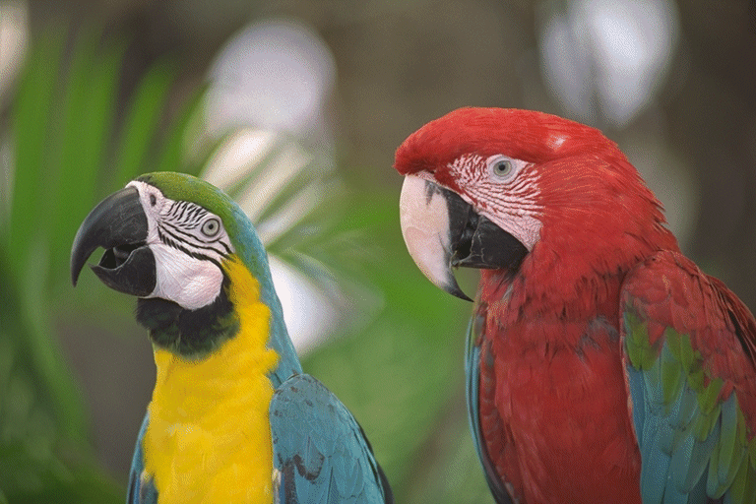
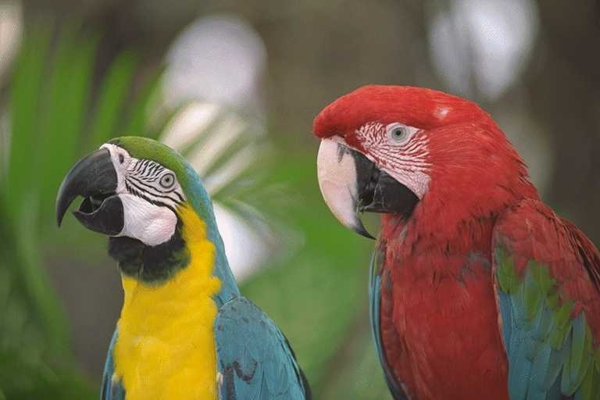
Image Example
raw image data
JPEG compressed data
768×512 ×24=1.18M bytes
26K bytes
Compression ratio=44.6

Slide 39
Summary of JPEG
Most Popular still Image compression standard
Hybrid scheme: Uses
  DCT
  Run Length Encoding
  Huffman Coding
Four Different Modes
  Lossless
  Baseline
  Progressive
  Hierarchical
coefficients are quantized and collected into ‘code-blocks’
Arithmetic coding is used on the code-blocks
  MQ coder is adopted.
Certain ROI’s are coded with higher quality than background.
Markers added in the bit stream to allow error resistance.
Code stream header contains information about ROI’s, resolutions, fidelity, etc. to aid the decoder in reconstruction.

