Slide 1
Data Compression
LIU Yan
Lecture 9
Vector Quantization
Hierarchical Coding

Slide 2
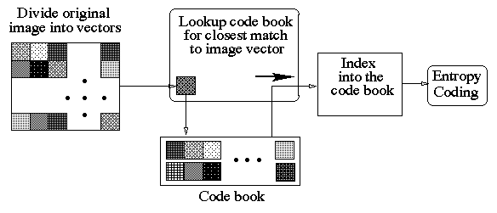
Outline of Vector Quantization of Images

Slide 3
VQ Terminology
Vector : Group of ‘n’ elements (pixels/samples)
Codevector : Vector derived from image or group of images
Codebook : (Final) set of codevectors
Training set : (Initial) set of codevectors

Slide 4
VQ Coding Outline
Divide Image (signal) into non-overlapping vectors (blocks)
(Each vector contains ‘n’ elements (pixels/samples))
For each image vector :
  Find closest vector in codebook
  Get its index in codebook
Encode the indices

Slide 5
VQ Decoding Outline
Entropy decode the indices
Lookup codebook for each index and retrieve vector
Combine vectors to reconstruct image (data)

Slide 6
Why VQ is better than scalar Quantization
Scalar Quantizer :
  Treats each pixel independently
  Does not use correlation between neighboring pixels
Vector Quantizer:
  Image (data) divided into vectors (blocks)
  Correlation among pixels in vectors is exploited
  Block size should be appropriate:
    Too large block : correlation is lost
    Too small block : More code vectors
  If no inter-pixel correlation, then no gain

Slide 7
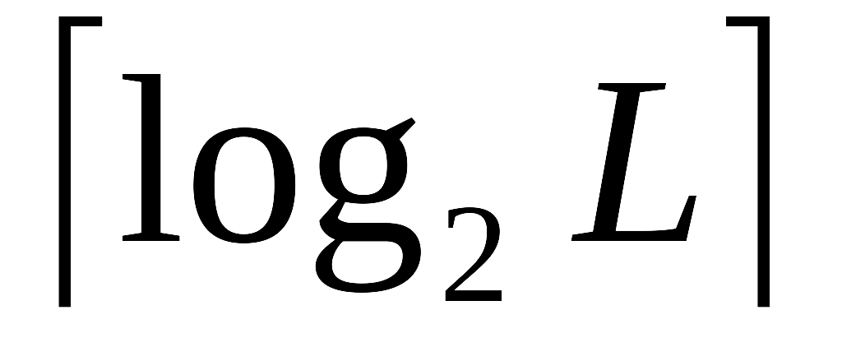
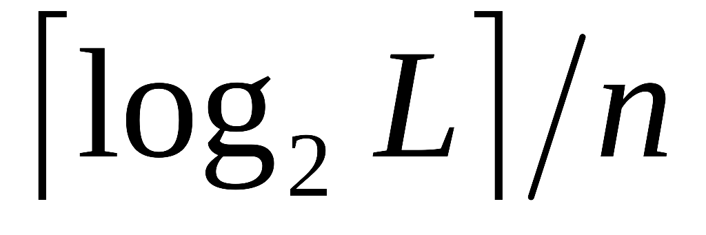
VQ Bit rate
Vector size : n (say, n = p x p) pixels
Codebook size : L vectors
Codebook index size : bits
Bit Rate of VQ : bits/pixel

Slide 8
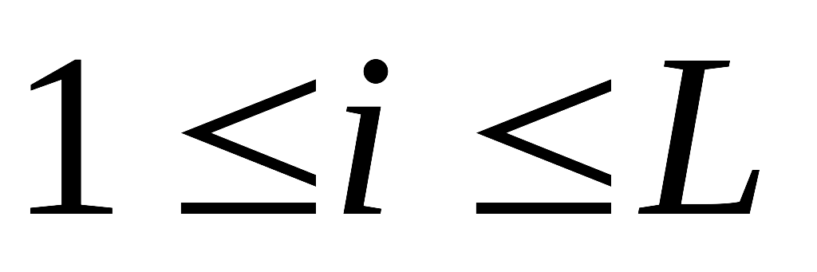
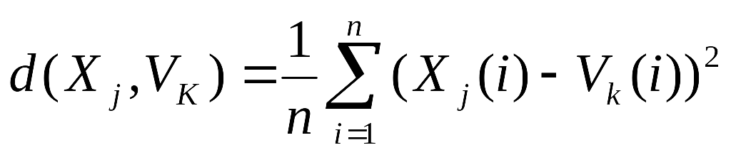
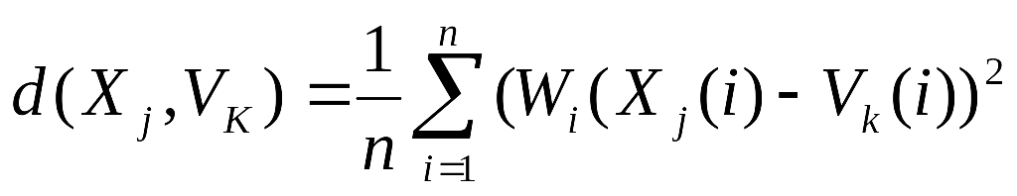
Distortion Measures
Image
Codebook
V₁
codevectors : V_{i} ,
x_{j}
V₂
.. …. ….. ..
…
closest matching code vector
V_{k}
…
Image vectors : X_{j}
V_{L}
Mean Square Error (MSE) (Euclidean Distance)
Weighted MSE

Slide 9
Two Basic Kinds of Codebook
Local Codebook
Globe Codebook

Slide 10
Local Codebook
One codebook for each image
Codebook derived from vectors of one image
Good performance (Quality of reconstruction)
More overhead :
  Computation
  Transmission of Codebook to decoder

Slide 11
Global Codebook
One codebook for a class of images
Codebook derived from vectors of all images in the class
Less overhead (compared to local codebook)
Lower performance (Quality of reconstruction)

Slide 12
Major Issues in VQ
Codebook Generation (construction)
  concerns what needs to be included in the codebook
Codebook Design (organization)
  concerns structuring codebook entries to minimize search time

Slide 13
Codebook Generation
Generate Codebook from a Training set
Training Set: Set of vectors derived from image vectors
Codevectors should minimize distortion
Most commonly used algorithm: LBG algorithm
LBG: Linde-Buzo-Gray algorithm

Slide 14
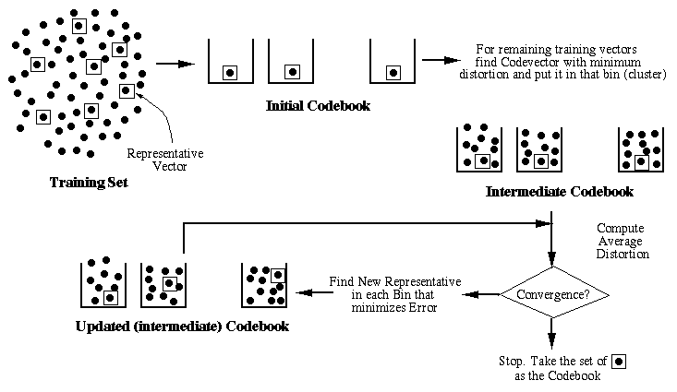
LBG Algorithm Outline

Slide 15
LBG Algorithm
Start with an Initial Codebook
Start with Initial Clusters
  Each cluster with one element of Initial Codebook
For Each training Vector:
  Find the Closest Cluster (with minimum distortion)
  Put Training Vector in that Cluster
Compute Average Overall Distortion (Across all clusters)
Test for Convergence
  If Convergence, Stop.
Update Codebook
Go to Step 3

Slide 16
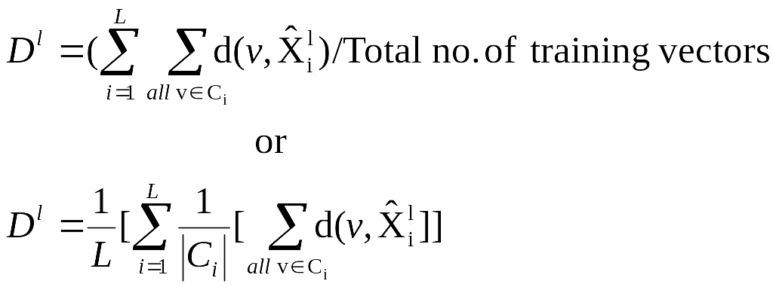
Average Distortion and Convergence Test
Average Distortion D^{l} at iteration l is:
Test for Convergence:
If ( D^{l} – D^{l-1} ) / D^{l-1} < Є then
Stop.

Slide 17
Codebook Initialization
Three basic schemes:
Random
Perturb and Split (Bottom-up)
Pair-wise Nearest Neighbor (PNN) clustering (Top-Down)

Slide 18
Random Initialization
Choose a set of random vectors from the training set to serve as the initial codebook

Slide 19
Perturb and Split Initialization
Start with the centroid of the entire training set as the initial codebook
Then perturb this by a small amount to form two codewords (split)
Apply LBG algorithm on this to get an optimum codebook of size 2
Perturb the vectors in the above set (split) and continue the procedure until the desired number of codevectors (codewords) are generated

Slide 20
PNN Initialization
Start with N clusters
  Each cluster contains one training vector
Merge two closest clusters to create the optimal (N-1) cluster codebook
Repeat the procedure until the number of clusters reaches the desired number
The centroids of the final clusters is used as the initial codebook

Slide 21
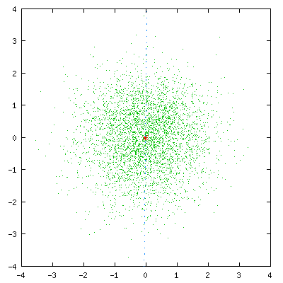

Slide 22
Codebook Design
Basic Objective: Minimize search time for Codevector
Full (Exhaustive) Search: very expensive
Design emphasis: Balance Search Time and Distortion

Slide 23
Codebook Organizations
Tree-structured codebook*
Product codebook*
Mean/Residual VQ*
Interpolative/Residual VQ*
Gain/Shape VQ
Classified VQ
Finite State VQ
(* The ones we study)

Slide 24
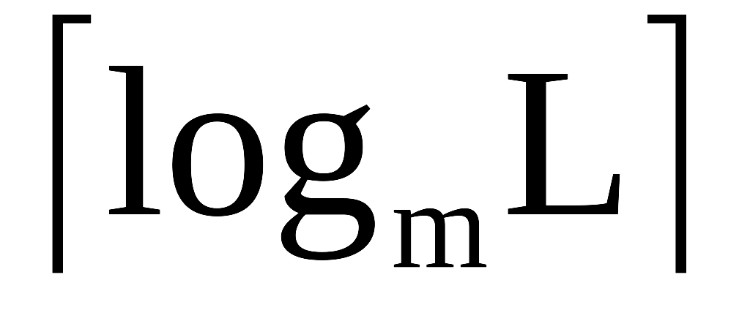
Tree–Structured Codebook
Codebook organized as m–ary tree
Number of Levels :
Code vectors stored at the leaves
Intermediate node : ‘average’ of ‘codevectors’ of children
Improved search time
Increased storage cost
Performance inferior to full search

Slide 25
Variations of Tree-Structured VQ
Tapered trees:
  Non–Uniform number of branches at nodes
  Branches per node increases going down the tree
  ( Ex: 2 branches at level 1, 3 at level 2 etc.)
Pruned Trees:
  Start with (full) large initial tree
  Remove code vectors that do not reduce distortion

Slide 26
Product Codebook
Codebook : Cartesian product of many smaller codebooks
Vector characterized by many independent features:f₁, f_{2,} ..., f_{N}
Separate codebook for each feature
Smaller codebbok sizes : L₁, L₂, ..., L_{N}
Effective codebook size : O(L₁*L₂*...*L_{N})
Actual storage and search complexity O(L₁ + L₂ + ... + L_{N})

Slide 27
Prediction/Residual Class VQ
Predict Original Image
Derive Residual Image
Data used in prediction is subjected to Scalar Quantization and Encoding
Residual Image is subjected to Vector Quantization
Major Types:
  Mean/Residual VQ
  Interpolative/Residual VQ

Slide 28
Mean/Residual VQ Idea
Image Vectors have similar variations about different mean levels
Removal of mean from vectors results in fewer code vectors

Slide 29
Mean/Residual VQ Scheme
Compute ‘mean’ of image vectors : M={m₁,m₂...,m_{N}}
Quantize M using scalar quantization :
  (Apply DPCM before Quantization for further bitrate reduction)
Subtract Quantized means from vector elements to get Residual vectors
Quantize Residual vectors using VQ

Slide 30
Interpolative/Residual VQ
Subsample original image by l in each dimension (typically, l = 8)
Quantize subsampled value using Scalar Quantization
Upsample using Quantized subsampled values
  typically, bilinear interpolation is used
  Upsampled image is used as predicted image
Form Residual : (Original – Upsampled)
Segment Residual image to form 4 x 4 vectors
Quantize Residual vectors using VQ

Slide 31
Summary of VQ
VQ uses codebook of vectors
  Vector is a group of pixels
  Codebook derived from training vectors
  Training Vectors derived from Images
  Codebook: Local or Global
Two main issues in VQ:
  Codebook Generation
  Codebook Design

Slide 32
Hierarchical Coding
Decompose Image into various (spatial) resolutions (levels)
Encode the levels suitably
Each level can have Reconstructed Image at a particular resolution
Enable access at different resolutions
Supports :
  Progressive Transmission
  Multiuse Environment

Slide 33
Progressive Transmission
Partial Image Information transmitted in stages
Coarse Information sent first
Refinement information sent subsequently
Transmission of unwanted refinements can be suppressed
  Effective Compression
Suited for low-bandwidth channels
Applications : Image/Video browsing and retrieval

Slide 34
Multiuse Environments
Devices with wide range of spatial resolutions (ex. scanner, printer, HDTV monitor etc.)
Image data available to devices at appropriate resolutions
Example : Multimedia databases, Digital libraries

Slide 35
Image Hierarchies
Images at various resolutions organized as a hierarchy
Two broad kinds
  Fixed-resolution Hierarchy
  Variable-resolution Hierarchy
Incremental Bitrate : Number of bits required to move from one level to next in the hierarchy

Slide 36
Fixed-Resolution Hierarchy
Image size at any level is the same (same spatial resolution at every level
Values of pixels refined from level to level
Incremental Bitrate is (more or less) constant
Constant Bitrate Increment does not yield Constant Improvement of Quality
Constant transmission time across levels
Better suited to Progressive Transmission
Not suited to Multiuse Environments

Slide 37
Variable-Resolution Hierarchy
Images at different levels : different spatial resolution
Original (full-resolution) Image : Lowest level (level 0)
Successively lower (spatial) resolution at higher levels
Has a (logical) pyramid structure
Incremental Bitrate increases from higher to lower level
Varying Transmission time across levels
Well suited to Multiuse Environments

Slide 38
Fixed Resolution Hierarchies
Bit planes
  K-bit Image : K bit planes
  Quality Improves : MSB to LSB
Tree-Structured VQ
  Reconstruction quality improves as the tree is descended
Transform-based Hierarchical Coding
  Transform coefficients : Different energies
  Hierarchical Organization of coefficients
  Need for Inverse Transform at each level

Slide 39
Variable Resolution Hierarchies
Subsampling Pyramid
Mean Pyramid
Prediction/Residual Pyramid

Slide 40
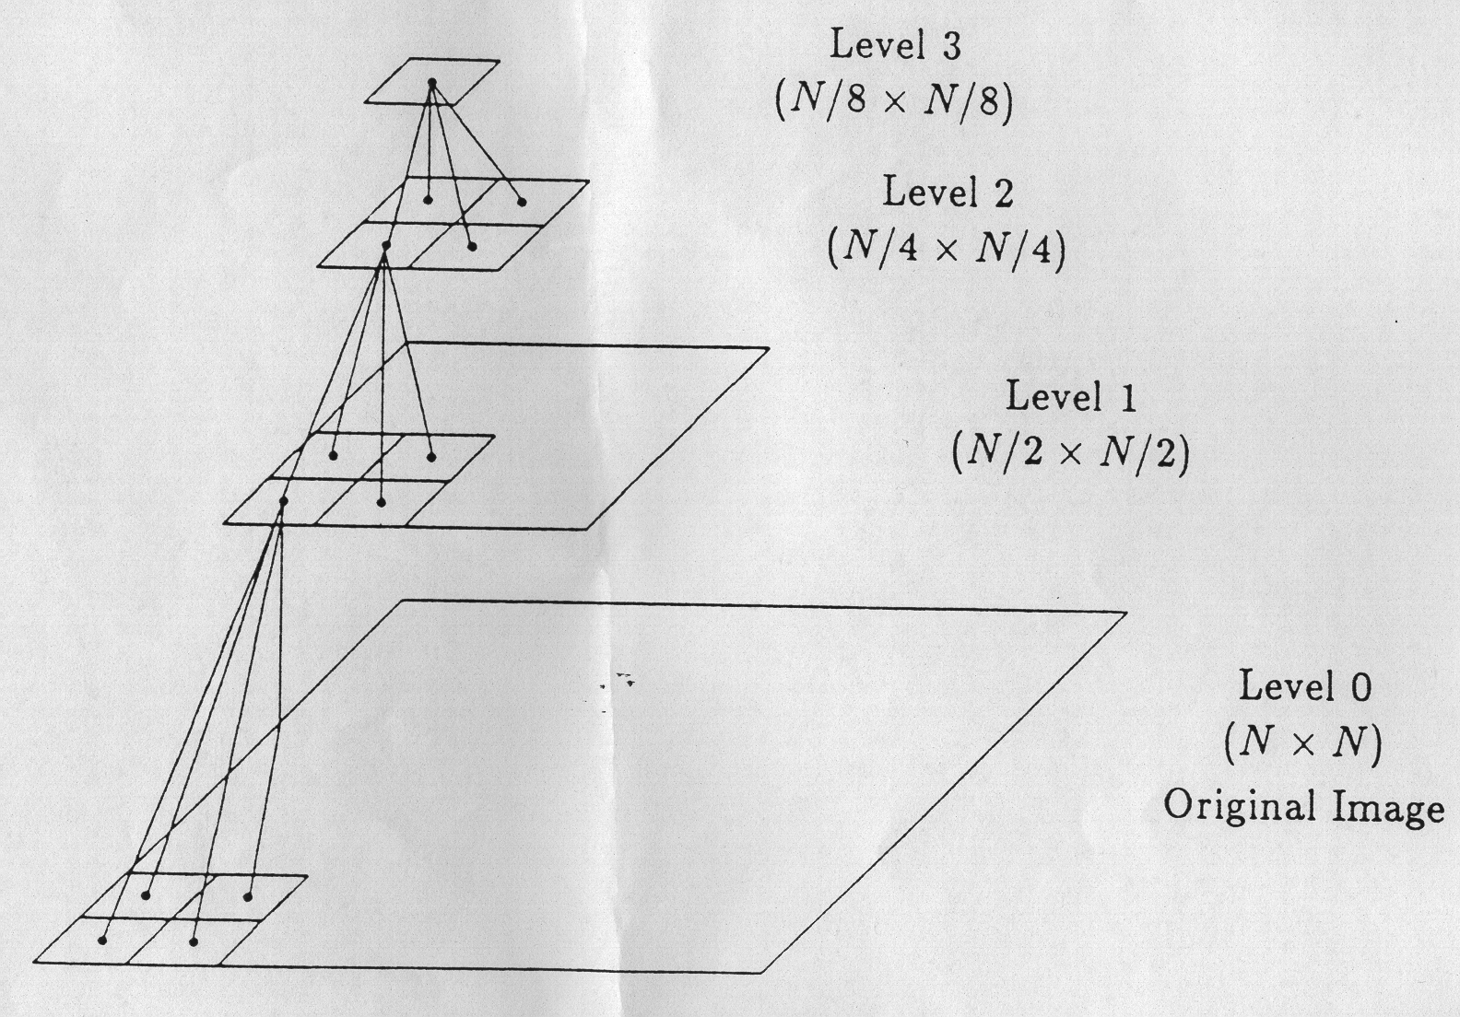
2 x 2 Subsampling Pyramid/Tree Structure

Slide 41
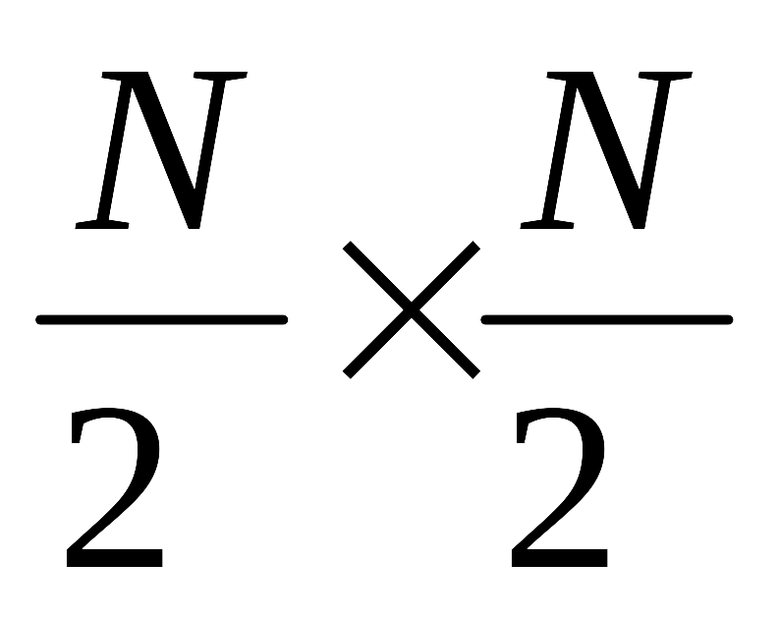
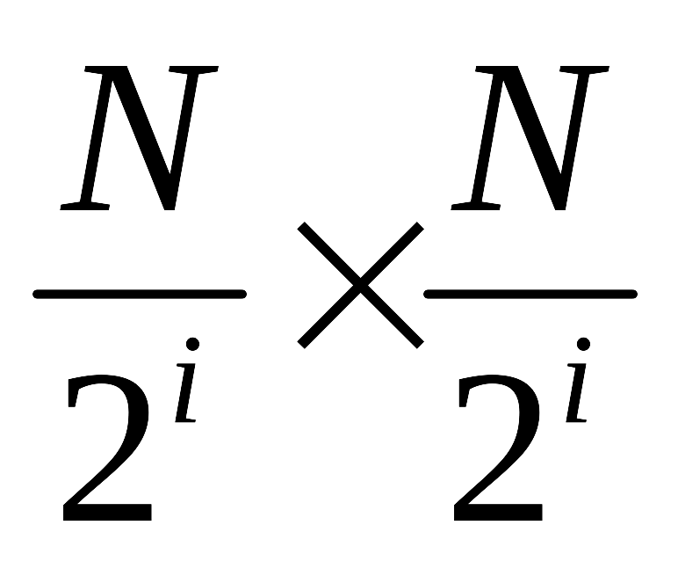
Subsampling Pyramid
Level 0 : Original N x N Image
Level 1 : Subsampled Image
Level i : Image
Max Level : L
Reconstruction at Level K :
  Use subsampled points of all previous levels: L, L-1, …, K+1
  Plus current level
  Lossless reconstruction of original image

Slide 42
Disadvantages of Subsampling Pyramid
Subsampled points may not represent areas well
Spatial correlation reduces for higher levels
  lower compression for higher levels

Slide 43


Truncated Mean Pyramid
Pixel at Level k = Average of (2 x 2) pixel block at level (k-1)
Original pixel : ‘b’ bits Each Mean value : ‘b’ bits
Variable length coding could be applied to Mean Values
Total storage for pyramid : 33% more than for original image

Slide 44


Reduced Sum Pyramid
Pixel at Level k = sum of (2 x 2) pixels at level (k-1)
Original pixel ‘b’ bits pixel at Level 1 : (b+2) bits pixel at Level 2 : (b+4) bits
s = a₁+a₂+a₃+a₄ ; with (s, a₁,a₂,a₃) , a₄ could be derived
¼ of pixels could be removed from lower levels
Total storage for pyramid : 8.3% more than for original (8-bit) image

Slide 45
Residual Difference Pyramid
Form Truncated Mean Pyramid
Form Differences:
d₁=a₁-a₂ , d₂=a₂-a₃ , d₃=a₃-a₄ , d₄=a₄-a₁
Each Difference : (b+1) bits
Retain only 3 difference values (Recover the 4th using 3 d’s and Mean)
Total storage for pyramid : 12.5% more than for
Original (8-bit) Image
Variable length codes more effective for difference values

Slide 46
Prediction / Residual Pyramid
Predict Image (using limited data)
Derive Residual Image
Iterate Prediction / Residual at different scales
Create Pyramid of Residuals : Laplacian Pyramid

Slide 47
Gaussian and Laplacian Pyramids
Gaussian Pyramid
Laplacian Pyramid
Original
_
Prediction
Residual
=
Lower
Resolutions
Low pass filter
SubSample
UpSample
Filter
_
=
Low pass filter
SubSample
=
Residual Images: Coded efficiently

Slide 48
Summary of Hierarchical Coding
Hierarchical coding supports:
  Progressive Transmission
  Multiuse environments
Uses Data (Image) Hierarchies
  Fixed Resolution Hierarchy
  Variable Resolution Hierarchy

