Slide 1
Data Compression
LIU Yan
Lecture 11
MPEG Video Coding Standards

Slide 2
MPEG
MPEG : Motion Pictures Experts Group
MPEG : ISO Committee
Widely used Standard for video coding.

Slide 3
MPEG Variants
MPEG 1 :
  For lower resolution images
  Bit streams upto 1.5Mbps
MPEG 2 :
  Support higher resolution images
  Bit streams of upto 15Mbps
MPEG 4 :
  Support interactivity
  Composed of tools, algorithms, profiles, MSDL (MPEG Syntax Description Language)

Slide 4
Prediction coding
x_{m}
d_{m}
q_{m}
-
Entropy
Coder
channel
Quantizer
p_{m}
Q⁻¹
s_{m}
Predictor
+
r_{m}

Slide 5
Mpeg coder – Hybrid coding
Prediction(inte-frame) + DCT transform(intra or residue)
Intra-frame
Residue
DCT
DCT
DCT
Q
Q
Q
Entropy
Coding
Entropy
Coding
Entropy
Coding
Q⁻¹
Inter-frame
Q⁻¹
Motion
Compensation
Motion
Compensation
Motion Vector
IDCT
IDCT
Motion
Estimation
Motion
Estimation
Frame
Memory
Frame
Memory

Slide 6
MPEG-1, MPEG-2
3 kinds of Frames:
I-Frame : Intra-Frame ; coded independently
P-Frame : Predicted Frame ; uses recently compressed I- or P-Frames
B-Frame : Bidirectional Frame; uses both past and future I- or P-Frames

Slide 7
Current Frame
Based on
I₁ B₂ B₃ P₄ B₅ B₆ P₇
I₁ | -
P₄ | I₁
B₂ | I₁,P₄
B₃ | I₁,P₄
P₇ | P₄
B₅ | P₄,P₇
B₆ | P₄,P₇
.
.
.
.

Slide 8
Encoder
Compress I-Frames
Compress P-Frames (Immediately following I-Frames)
Compress B-Frames between I- and P-Frames
Compress second P-Frame based on First P-Frame
Compress B-Frames between first and second P-Frames
And so on..

Slide 9
Frame Coding
I-Frame :
  Compression very similar to baseline –JPEG
  No Motion Estimation
P-, B-Frame :
  Prediction, Use Motion Estimation and Motion compensation

Slide 10
Decoder
Order of frames arriving at decoder different from the order of display
  Ex: -I₁P₄B₂B₃P₇B₅B₆P₁₀B₈B₉P₁₃B₁₁B₁₂ ...
Decoder needs 2 buffers for motion compensation
Previous Buffer
Future Buffer

Slide 11
Decoder
Decompress I₁; Place it in previous buffer.
Decompress P₄ using I₁; Place it in future buffer.
Decompress B₂ and B₃ using these buffers.
Display I₁, B₂,B₃,P₄ at suitable times.
Move P₄ from future buffer to previous buffer.
Decompress P₇ using P₄ ; Place it in future buffer.
And so on.

Slide 12
MPEG-1 Picture Format
Allows for picture sizes upto 4095 x 4095 pixels
However, most applications use:
  CCIR 601 Format (frames in Digital TV)
  SIF (Source Input Format)

Slide 13
CCIR 601 Format
3 components for video: Y, C_{r}, C_{b}
Two options for spatial Resolutions
Options for NTSC System (4:2:2 Subsampling)
  525 Lines/Frame, 60 Frames/sec.
  Luminance Frame: 720 x 480 Active Pixels
  Chrominance Frames: 360 x 480 Active Pixels
Option for PAL Systems (4:2:2 Subsampling)
  625 Lines/Frame, 50 Frames/Sec
  Luminance Frame: 720 x 576 Active Pixels
  Chrominance Frames: 360 x 576 Active Pixels

Slide 14
SIF (Source Input Format)
Luminance Frame
  360 x 240 pixels at 30 pictures/sec.
  360 x 288 pixels at 25 pictures/sec.
Chroma Frame
  One half of Luminance Frame in each dimension
    Therefore called 4:2:0 subsampling format
SIF Pictures derived from CCIR 601 frames by filtering and subsampling

Slide 15
MPEG-1 Macroblocks
Picture Divided into Macroblocks
Macroblock: Minimum coded Unit
Macroblock consists of:
  Four 8 x 8 pixel blocks for luminance component
  One 8 x 8 block for Cr
  One 8 X 8 block for Cb

Slide 16
Coded Video Bit Stream Structure
MPEG-1 syntax has a hierarchy of six layers:
Sequence Layer
GOP (Group of Pictures) Layer
Picture Layer
Slice Layer
Macro block Layer
Block Layer

Slide 17
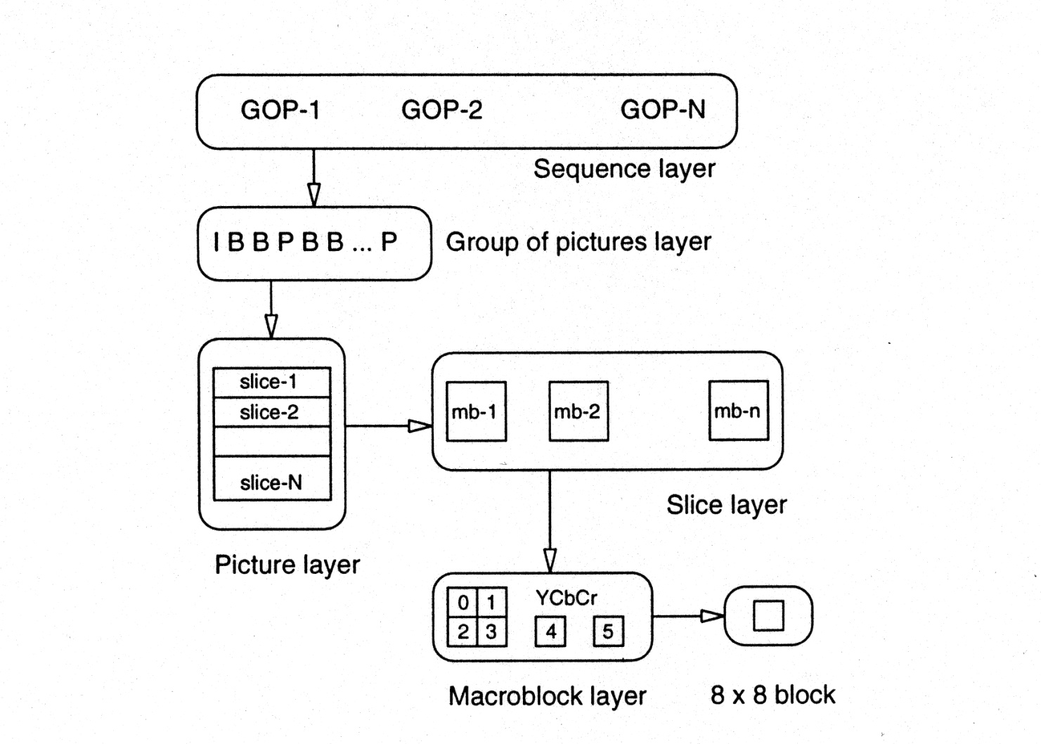
MPEG-1 Layers

Slide 18
Video Conferencing Standard : H.261/H.263
Uses 2-D DCT for Intraframe
Uses simple Motion Estimation for Inter-Frame
Provides Real-Time coding/decoding

Slide 19
MPEG Audio Compression
MPEG-1 (ISO/IEC 11172-3)
MPEG-2 BC (ISO/IEC 13818-3)
MPEG-2 AAC (ISO/IEC 13818-7)
MPEG-4 (ISO/IEC 14496-3)

Slide 20
MPEG-1 Audio provides
Single-channel ('mono') and two-channel ('stereo' or 'dual mono') coding of digitized sound waves at 32, 44.1, and 48 kHz sampling rate
The predefined bitrates range
from 32 to 448 kbit/s for Layer I,
from 32 to 384 kbit/s for Layer II,
from 32 to 320 kbit/s for Layer III.

Slide 21
MPEG-2 BC provides
A backwards compatible (BC) multichannel extension to MPEG-1;
Up to 5 main channels plus a 'low frequent enhancement' (LFE) channel can be coded;
The bitrate range is extended up to about 1 Mbit/s;
An extension of MPEG-1 towards lower sampling rates 16, 22.05, and 24 kHz for bitrates from 32 to 256 kbit/s (Layer I) and from 8 to 160 kbit/s (Layer II & Layer III).

Slide 22
MPEG-2 AAC provides
A very high-quality audio coding standard for 1 to 48 channels at sampling rates of 8 to 96 kHz, with multichannel, multilingual, and multiprogram capabilities.
AAC works at bitrates from 8 kbit/s for a monophonic speech signal up to in excess of 160 kbit/s/channel for very-high-quality coding that permits multiple encode/decode cycles.
Three profiles of AAC provide varying levels of complexity and scalability.

Slide 23
MPEG-4 provides
Coding and composition of natural and synthetic audio objects,
Scalability of the bitrate of an audio bitstream,
Scalability of encoder or decoder complexity,
Structured Audio: A universal language for score-driven sound synthesis,
TTSI: An interface for text-to-speech conversion systems.

Slide 24
Psychoacoustics Model
Human hearing and voice
Threshold in quiet
Frequency Masking
Critical Bands
Temporal masking

Slide 25
Human hearing and voice
Range is about 20 Hz to 20 kHz, most sensitive at 2 to 4 KHz.
Dynamic range (quietest to loudest) is about 96 dB
Normal voice range is about 500 Hz to 2 kHz

Slide 26
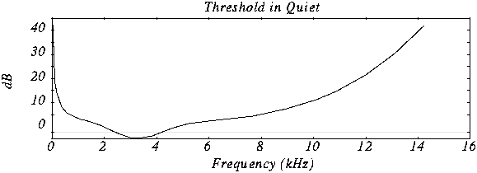
Threshold in quiet
Experiment: Put a person in a quiet room. Raise level of 1 kHz tone until just barely audible. Vary the frequency and plot

Slide 27
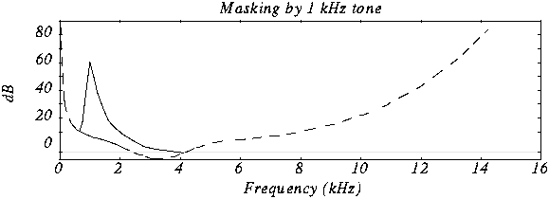
Frequency Masking
Experiment: Play 1 kHz tone (masking tone) at fixed level (60 dB). Play test tone at a different level (e.g., 1.1kHz), and raise level until just distinguishable.
Vary the frequency of the test tone and plot the threshold when it becomes audible

Slide 28
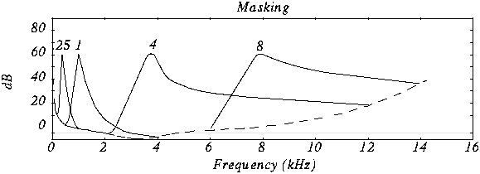
Frequency Masking (cont.)
Repeat for various frequencies of masking tone

Slide 29
Critical Bands
Perceptually uniform measure of frequency, non-proportional to width of masking curve .About 100 Hz for masking frequency < 500 Hz, grow larger and larger above 500 Hz.
The width is called the size of the critical band
Barks
Introduce new unit for frequency called a bark (after Barkhausen) 1 Bark = width of one critical band
For frequency < 500 Hz, 1 Bark=freq/100
For frequency > 500 Hz, 1 Bark=9+4log(freq/1000)

Slide 30
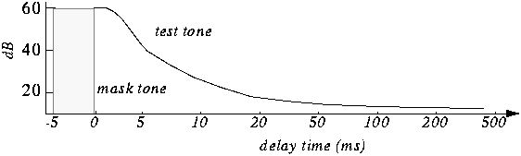
Temporal masking
Experiment: Play 1 kHz masking tone at 60 dB, plus a test tone at 1.1 kHz at 40 dB. Test tone can't be heard (it's masked). Stop masking tone, then stop test tone after a short delay.
Adjust delay time to the shortest time that test tone can be heard (e.g., 5 ms).
Repeat with different level of the test tone and plot

Slide 31
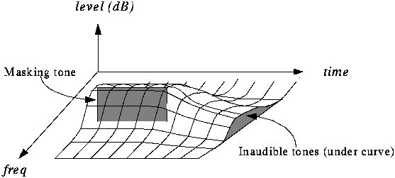
Total effect of masking

Slide 32
Audio compression algorithm
Use convolution filters to divide the audio signal (e.g., 48 kHz sound) into frequency subbands that approximate the 32 critical bands --> sub-band filtering.
Determine amount of masking for each band caused by nearby band using the results shown above (this is called the psychoacoustic model).
If the power in a band is below the masking threshold, don't encode it.
Otherwise, determine number of bits needed to represent the coefficient such that noise introduced by quantization is below the masking effect (Recall that 1 bit of quantization introduces about 6 dB of noise).
Format bitstream

Slide 33
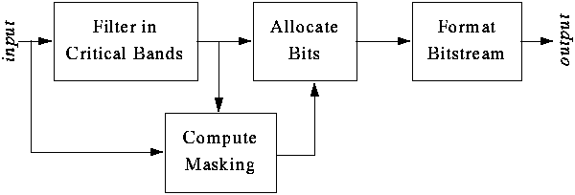
Audio compression algorithm (cont.)

Slide 34
Example
After analysis, the first levels of 16 of the 32 bands are these:
---------------------------------------------------------------------- Band 1 2 3 4 5 6 7 8 9 10 11 12 13 14 15 16
Level (db) 0 8 12 10 6 2 10 60 35 20 15 2 3 5 3 1
----------------------------------------------------------------------
If the level of the 8th band is 60dB, it gives a masking of 12 dB in the 7th band, 15dB in the 9th.
Level in 7th band is 10 dB ( < 12 dB ), so ignore it.
Level in 9th band is 35 dB ( > 15 dB ), so send it. Can encode with up to 2 bits (= 12 dB) of quantization error.

Slide 35
MPEG-1 Layers
MPEG defines 3 layers for audio. Basic model is same, but codec complexity increases with each layer.
Divides data into frames, each of them contains 384 samples, 12 samples from each of the 32 filtered subbands

Slide 36
MPEG-1 Layers (cont.)
Layer 1: DCT type filter with one frame and equal frequency spread per band. Psychoacoustic model only uses frequency masking.
Layer 2: Use three frames in filter (before, current, next, a total of 1152 samples). This models a little bit of the temporal masking.
Layer 3: Better critical band filter is used (non-equal frequencies), psychoacoustic model includes temporal masking effects, takes into account stereo redundancy, and uses Huffman coder.

Slide 37
Effectiveness of MPEG-1 audio
Layer | Target bitrate | Ratio | Quality@ 64 kbits | Quality 128 kbits | Theoretical Min. Delay
layer1 | 192 k | 4:1 |  |  | 19ms
Layer2 | 128 k | 6:1 | 2.1 to 2.6 | 4+ | 35ms
Layer3 | 64 k | 12:1 | 3.6 to 3.8 | 4+ | 59ms
5 = perfect, 4 = just noticeable, 3 = slightly annoying, 2 = annoying, 1 = very annoying
Real delay is about 3 times theoretical delay

