Slide 1
Lecture 12
AVS, MPEG-4 and H.264
Data Compression
LIU Yan

Slide 2
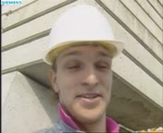
MPEG-4 Encoder
Coder Control
Control data
Inter
-
Transform
Quantization
Inter
Intra
Inter
Decoder
Inverse
DC/AC
DC/AC Prediction
IQ/IT
Entropy Coding
Motion
Compensation
Motion Data
Motion
Estimation

Slide 3
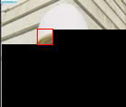
H.264/AVS Encoder
Coder Control
Control data
-
Transform
Quantization
Quantized coefficients
Decoder
Inverse Quantization
Inverse Transformation
Entropy Coding
Intra Prediction
0
Loop filter
Motion
Compensation
Intra/Inter
Motion Data
Motion
Estimation

Slide 4
Outline
Intra Prediction
Inter Prediction
  Variable block size MC
  MV prediction
  Motion interpolation
Transform/Quantization
Entropy Coding

Slide 5
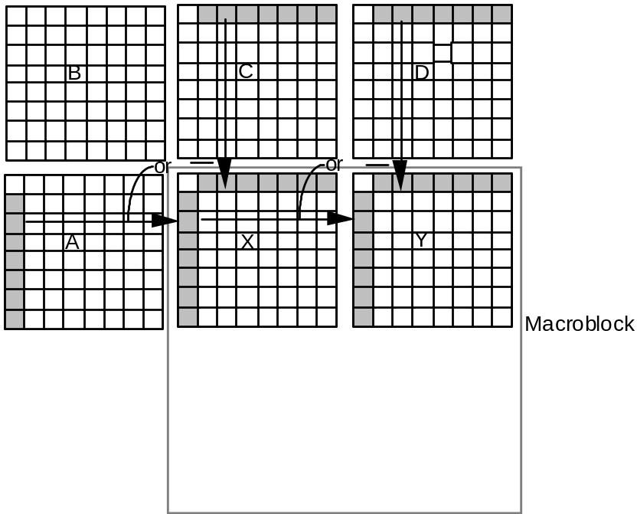
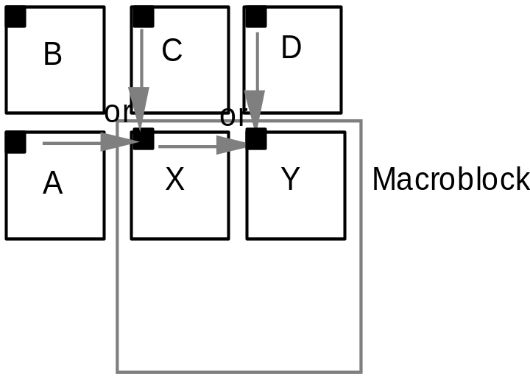
Intra Prediction in MPEG-4
Frequency prediction
Need to save up row, left column dequantized coefficients for following DC/AC prediction.
(a) DC Prediction (b) AC Prediction

Slide 6
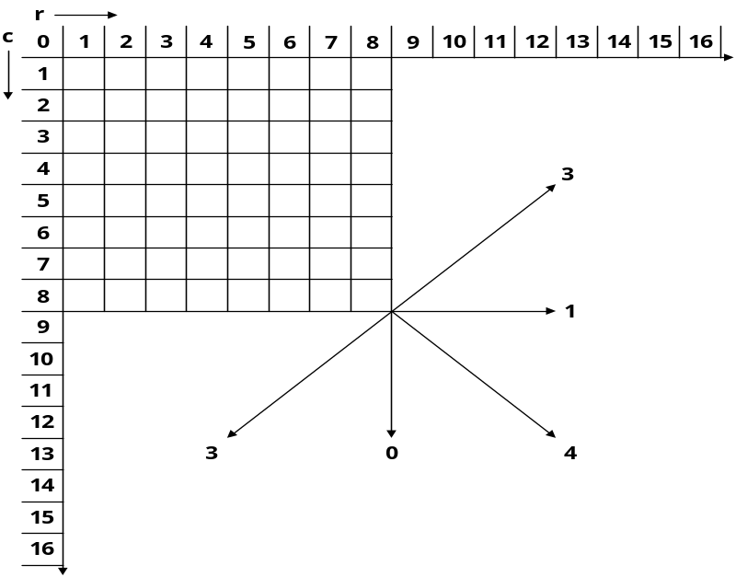
Intra Prediction in AVS/H.264
Forward adaptive prediction
H.264
  4x4 luma prediction 9 modes.
  16x16 luma prediction 4 modes.
  Chroma prediction 4 modes
AVS
  8x8 luma prediction 5 modes
Note: Reconstructed pixel is used to do intra prediction. Mode is coded using a pred mode flag.

Slide 7
Intra Prediction Modes
H.264/AVC supports intra-prediction for blocks of 4 x 4 to help achieve better compression for high motion areas.
  Supports 9 prediction modes.
  Supported only for luminance blocks
H.264/AVC also has a 16 x 16 mode, which is aimed to provide better compression for flat regions of a picture at a lower computational costs.
  Supports 4 direction modes.
  Supported for 16x16 luminance blocks and 8x8 chrominance blocks

Slide 8
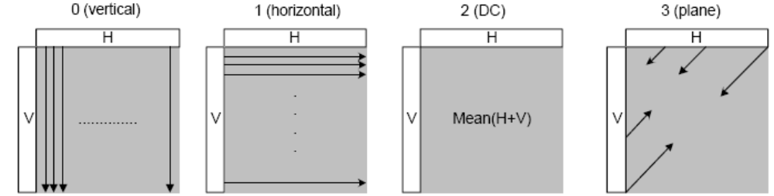
LUMA 16x16 / CHROMA Intra-Prediction Modes
Intra16x16PredMode | Name of Intra16x16PredMode
0 | Vertical (prediction mode)
1 | Horizontal (prediction mode)
2 | DC (prediction mode)
3 | Plane (prediction mode)

Slide 9
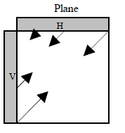
Plane mode
Plane mode is an approximation of bilinear function with only integer arithmetic
x
Pred[y,x] = Clip [((a + b * (x – 7) + c * (y – 7) + 16) >> 5]
a = 16 *(p[-1,15] + p[15,-1])
b = (5 * H + 32) >> 6
c = (5 * V + 32) >> 6
H = Σ (x’+1)*( p[-1,8 + x’] - p[-1, 6- x’]), x’ = 0, 1, 2, 3, 4, 5, 6, 7
V = Σ (y’+1)*( p[8 + y’,-1] - p[ 6- y’,-1]), y’ = 0, 1, 2, 3, 4, 5, 6, 7
y
(the top left, top right, bottom left, and bottom right positions of a MB are denoted as [0,0], [0,15], [15,0], and [15,15], respectively,
Clip(.) is the operator to make the prediction pixel value not smaller than zero and not bigger than 255

Slide 10
Plane mode(cont.)
LT T0 T1 T15
L0
L1
…
L15
H' = 1* (T8 - T6) +
2* (T9 - T5) +
3*(T10 - T4) +
4*(T11 - T3) +
5*(T12 - T2) +
6*(T13 - T1) +
7*(T14 - T0) +
8*(T15 - LT)
V' = 1* (L8 - L6) +
2* (L9 - L5) +
3*(L10 - L4) +
4*(L11 - L3) +
5*(L12 - L2) +
6*(L13 - L1) +
7*(L14 - L0) +
8*(L15 - LT)
H = (5*H' + 32) / 64
V = (5*V' + 32) / 64

Slide 11
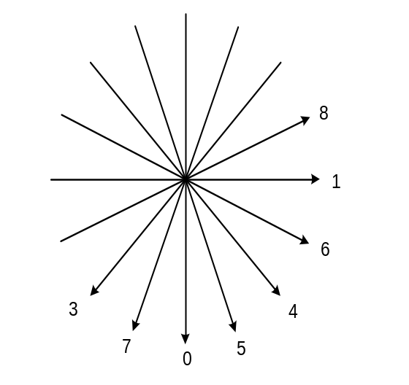
Luma 4x4 Intra-Prediction Modes explained
The H264 /MPEG4 AVC provides for eliminating redundancies in almost all directions using the 9 modes as shown below.
Intra4x4PredMode | Name of Prediction Mode
0 | Vertical
1 | Horizontal
2 | DC
3 | Diagonal_Down_Left
4 | Diagonal_Down_Right
5 | Vertical_Right
6 | Horizontal_Down
7 | Vertical_Left
8 | Horizontal_Up

Slide 12
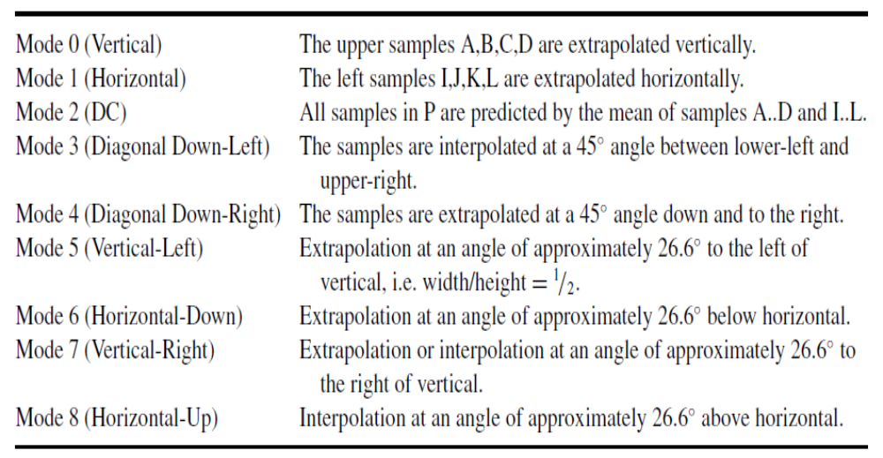
Luma 4x4 Intra-Prediction Modes explained

Slide 13
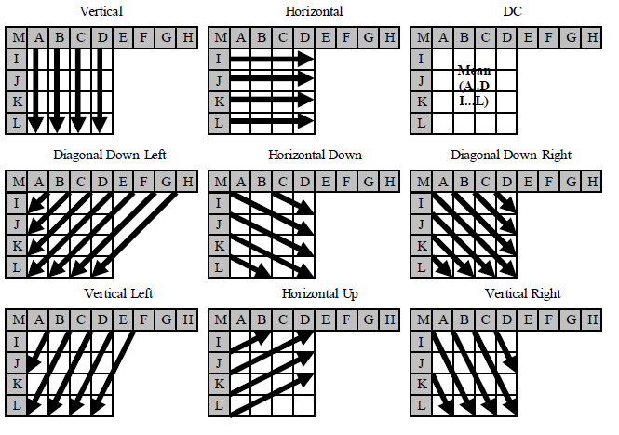
Luma 4x4 Intra-Prediction Modes

Slide 14
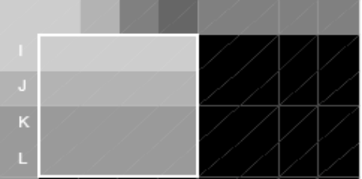
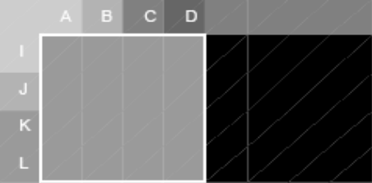
Intra-Prediction Process…
Horizontal prediction mode
M
A
B
C
D
E
F
G
H
I
I
I
I
I
J
J
J
J
J
K
K
K
K
K
L
L
L
L
L
DC prediction mode
M
A
B
C
D
E
F
G
H
I
X
X
X
X
J
X
X
X
X
X = Mean
K
X
X
X
X
L
X
X
X
X

Slide 15
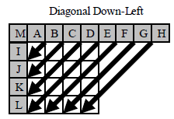
Intra-Prediction Process…(cont.)
Mode3(diagonal down-left)
pred[0, 0] = A + 2B + C + 2 >> 2 pred[0, 1] = B + 2C + D + 2 >> 2
pred[0, 2] = C + 2D + E + 2 >> 2 pred[0, 3] = D + 2E + F + 2 >> 2
pred[1, 0] = B + 2C + D + 2 >> 2 pred[1, 1] = C + 2D + E + 2 >> 2
pred[1, 2] = D + 2E + F + 2 >> 2 pred[1, 3] = E + 2F + G + 2 >> 2
pred[2, 0] = C + 2D + E + 2 >> 2 pred[2, 1] = D + 2E + F + 2 >> 2
pred[2, 2] = E + 2F + G + 2 >> 2 pred[2, 3] = F + 2G + H + 2 >> 2
pred[3, 0] = D + 2E + F + 2 >> 2 pred[3, 1] = E + 2F + G + 2 >> 2
pred[3, 2] = F + 2G + H + 2 >> 2 pred[3, 3] = G + 3H + 2 >> 2

Slide 16
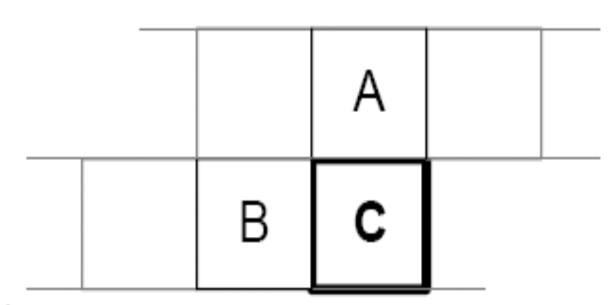
Determining the prediction mode
Most probable mode (MPM) flag in the bit-stream indicates whether prediction mode is present in the bit-stream or it has to be Implicitly calculated.
In case of Implicit mode, MPM is inferred according to the following rules:
if the left neighbouring block or the up neighbouring block is unavailable, the MPM is set to 2(DC)
or else the MPM is set to the minimum of the prediction mode of left neighbouring block and the up neighbouring block.
Notes:
.

Slide 17
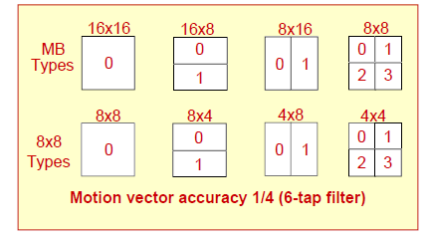
Variable Block Size MC
  MPEG-4: 16x16, 8x8
  AVS: 16x16, 16x8, 8x16, 8x8
  H.264: 16x16, 16x8, 8x16, 8x8, 8x4, 4x8, 4x4
    The minimum block size for motion vector coding is 4x4.
    The minimum block size for reference index coding is 8x8.

Slide 18
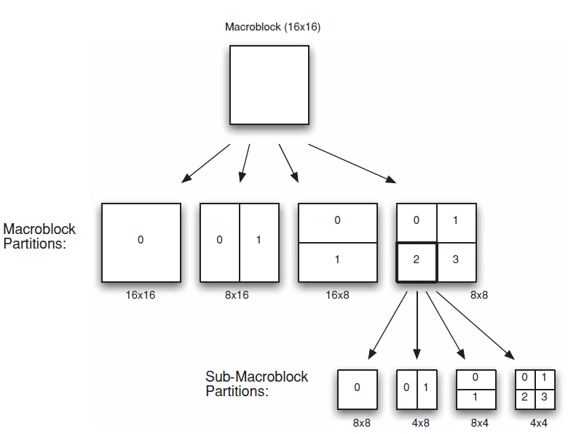
Macroblock partitions and sub-macroblock partitions

Slide 19
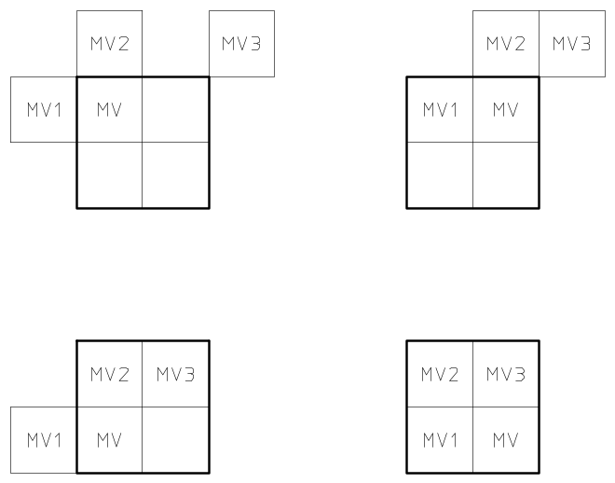
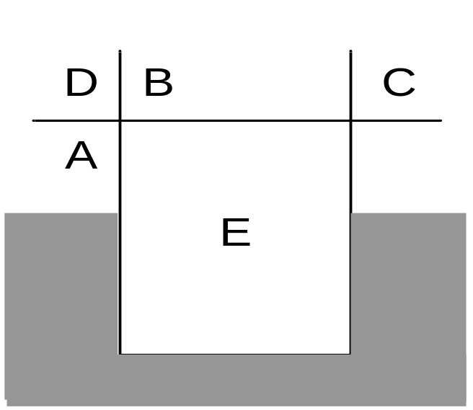
MV Prediction
Need to save up row MVs and left MVs.
For H.264/AVS, reference index for the neighbour blocks should be saved
(a) MPEG-4 (b)H.264/AVS

Slide 20
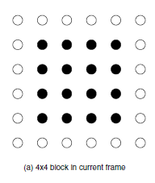
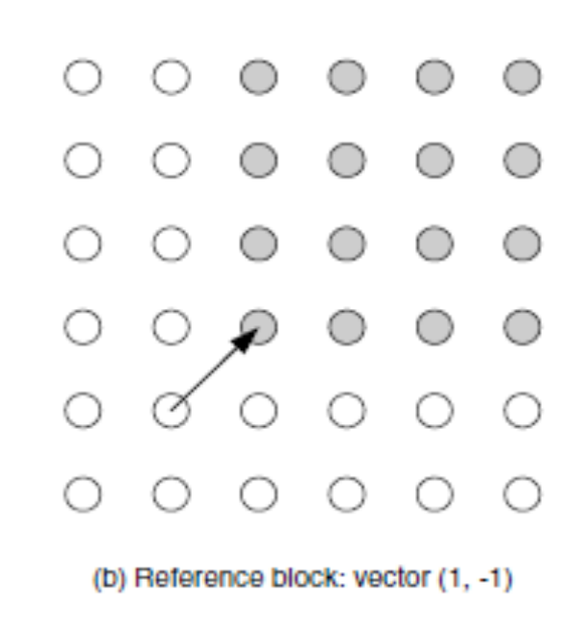
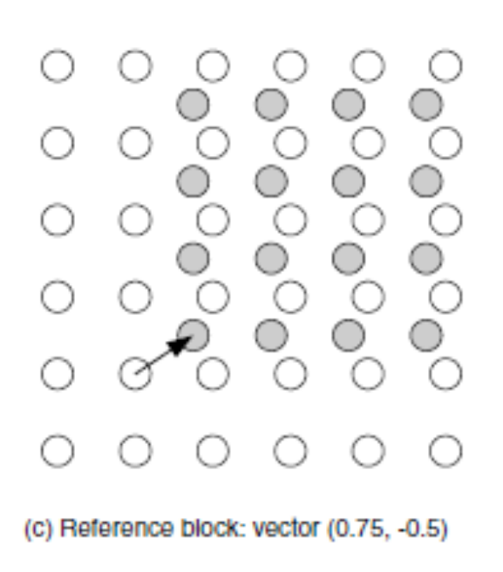
Motion Interpolation

Slide 21
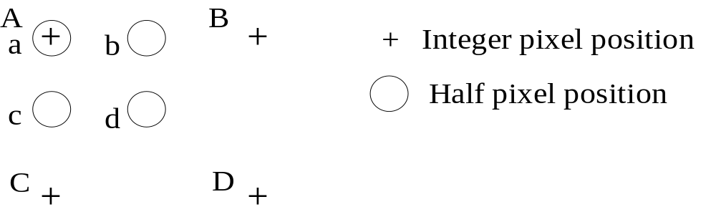
Motion Interpolation in MPEG-4
Half pixel interpolation
  Simple bi-linear interpolation
a = A,
b = (A + B + 1 - rounding_control) / 2
c = (A + C + 1 - rounding_control) / 2,
d = (A + B + C + D + 2 - rounding_control) / 4

Slide 22
Motion Interpolation in MPEG-4
For quarter pixel motion compensation
Half pixel interpolation
  Horizontal/Vertical filter with 8-tap filter (-8, 24, -48, 160, 160, -48, 24, -8)
Quarter pixel interpolation
  Bi-linear interpolation

Slide 23
Motion Interpolation in H.264/AVS
1/4 pixel motion compensation for luma, and 1/8 bi-linear interpolation for chroma
Half pixel interpolation
  Horizontal/Vertical filter with 6-tap filter (1, -5, 20, 20, -5, 1) for H.264
  Horizontal/Vertical filter with 4-tap filter (-1, 5, 5, -1) for AVS
Quarter pixel interpolation
  Average between two nearest integer/half pixel or half/half pixel.
  4-tap filter(1, 7, 7, 1) and 2-tap filter(1,1) on nearest integer/half pixel

Slide 24
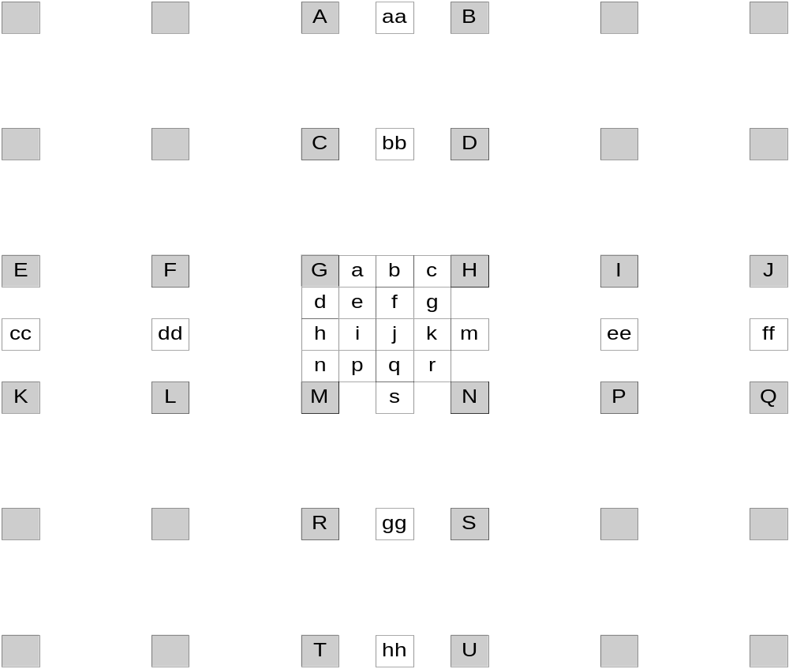
Motion Interpolation in H.264/AVS
j is generated by filtering cc, dd, h, m, ee and ff
3 types ¼ pels:
1) a, c, d, n
2) e, g, p, r
3) i, k

Slide 25
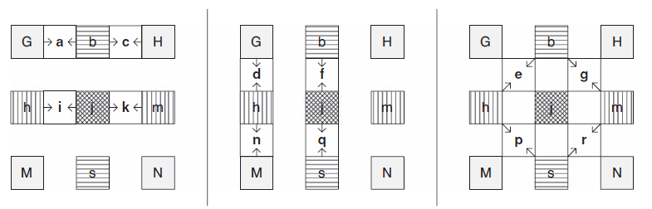
¼ pels Interpolation

Slide 26
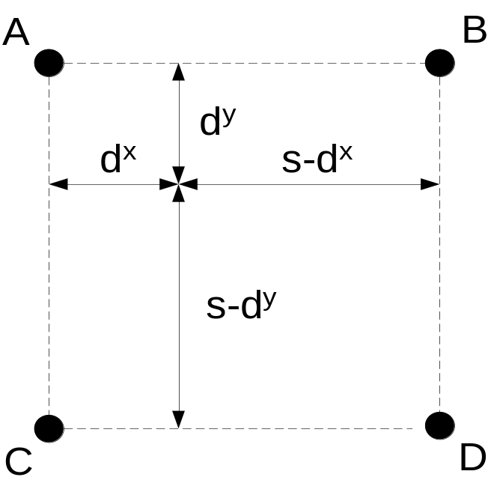
Chroma Motion Interpolation in H.264/AVS
Motion vector is the same as luma.
1/8 bilinear interpolation
v = ( (8-d_{x})×(8-d_{y})×A + d_{x}×(8-d_{y})×B + (8-d_{x})×d_{y}×C + d_{x}×d_{y}×D + 32 ) >> 6

Slide 27
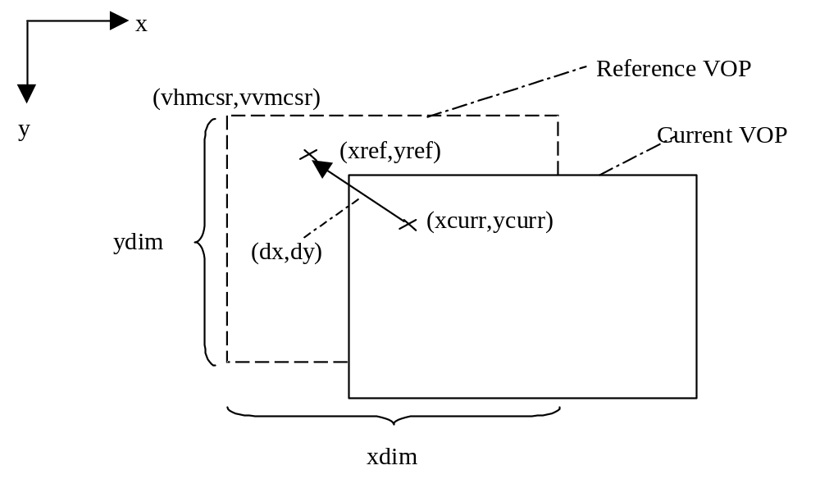
Padding in Motion Compensation
Reference can be out of image. Padding is needed at image boundary.

Slide 28
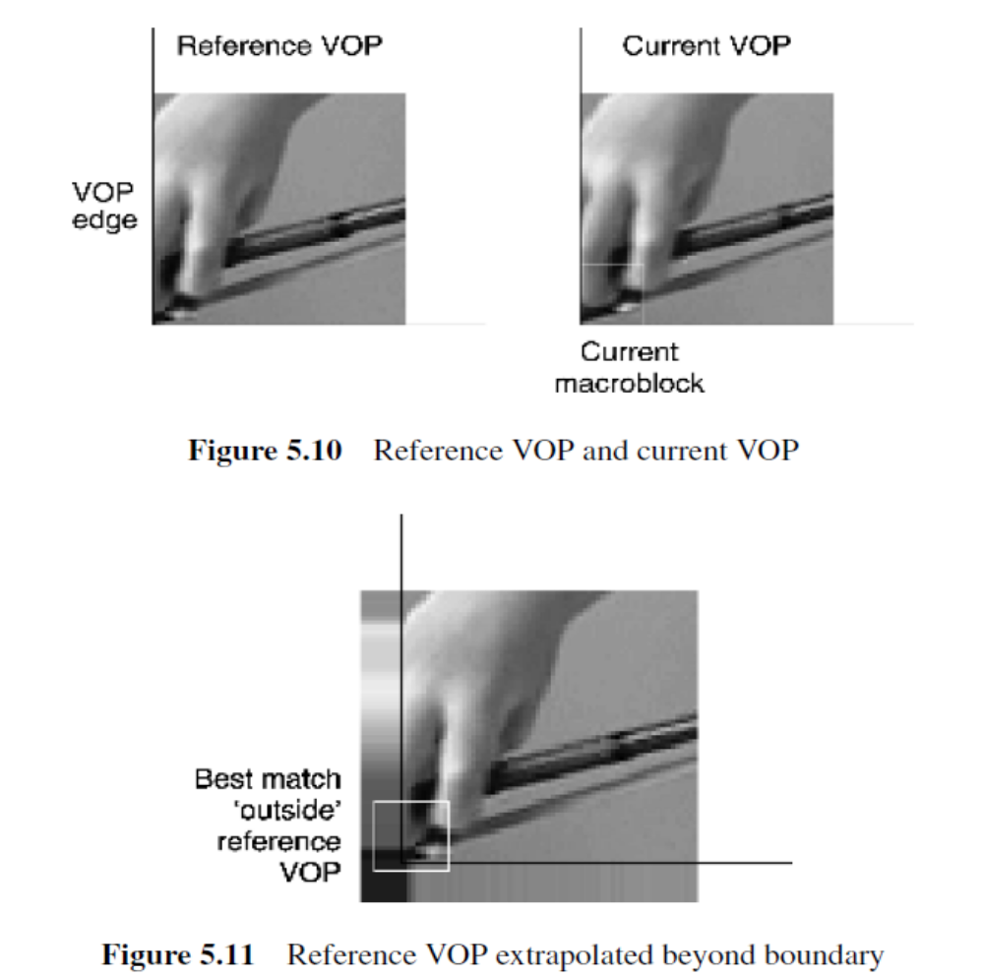
Padding in Motion Compensation

Slide 29



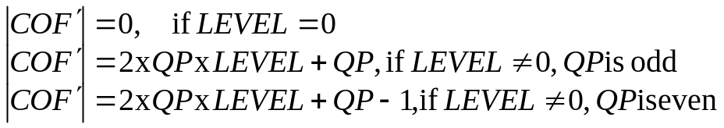
Transform and Quantization in MPEG-4
Float 8x8 DCT.
Quantization/Dequantization:
  H.263 quantization scheme
  For DC coef:
  For AC coef:
  INTRA:
  INTER:
  MPEG quantization scheme

Slide 30
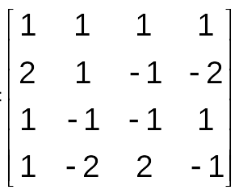
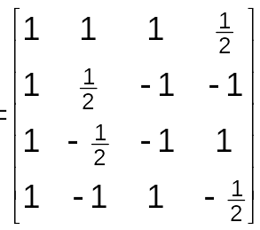
Transform and Quantization in H.264
4x4 Integer Transform
(a) Forward Transform (b)Inverse Tranform
4x4 Hadmad Transform for Intra 16x16 DC
2x2 Hadmad Transform for Chroma DC

Slide 31
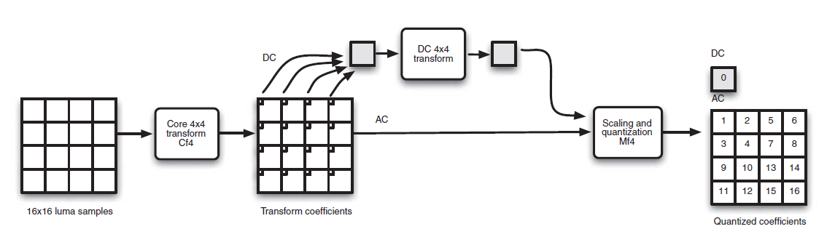
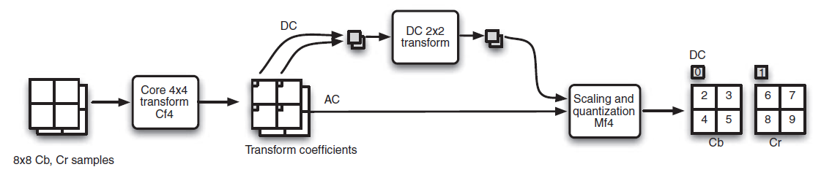
Transform and Quantization in H.264
Luma inverse transform : Intra 16 × 16 mode
Chroma forward transform : 4:2:0 macroblock

Slide 32
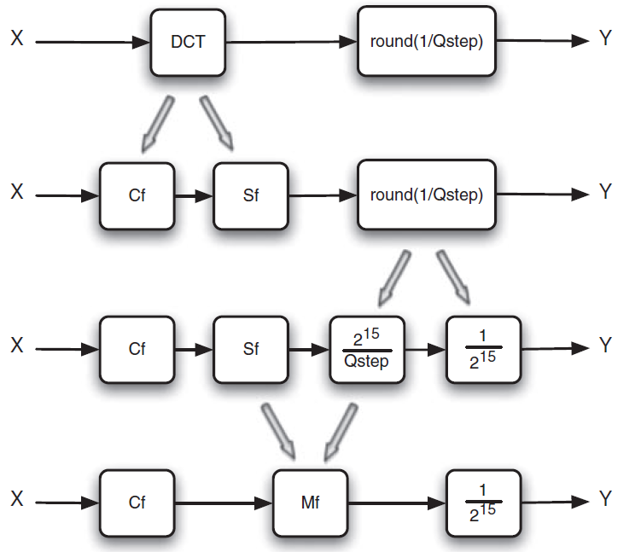
Transform and Quantization in H.264

Slide 33
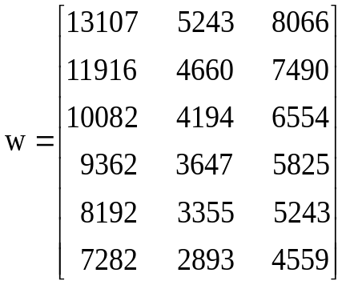
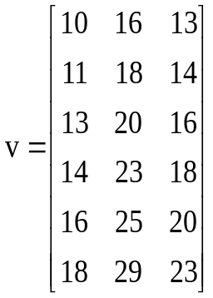
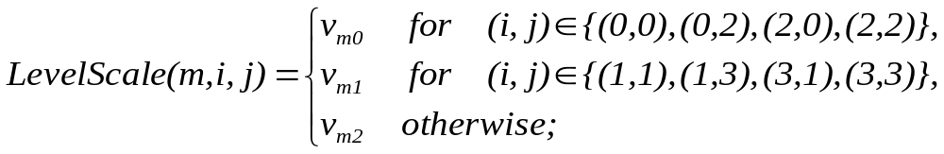
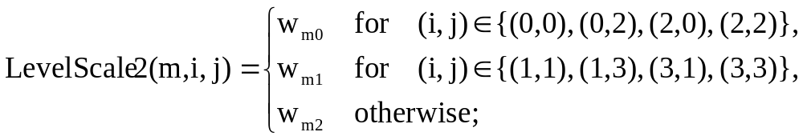
Transform and Quantization in H.264
Division free quantization
(a) Quantization table (b) Dequantization table
Encoder: (coef(i,j)*levelScale2(QP%6, i, j)+2 ^{(15+QP/6 -1)}) >> (15+QP/6)
Decoder: (qcoef(i,j)*levelScale(QP%6, i, j))<<(QP/6)

Slide 34
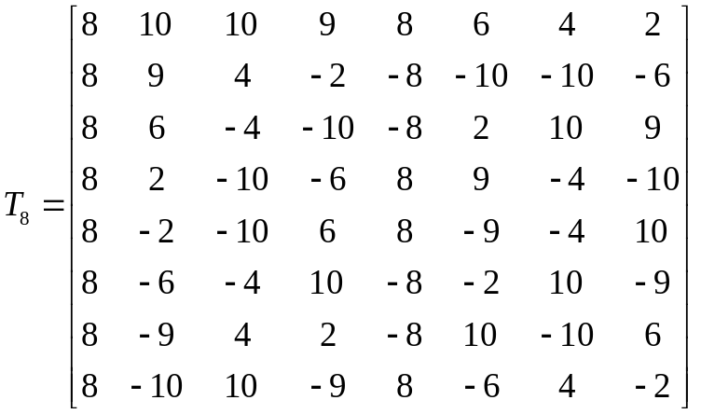
Transform and Quantization in AVS
8x8 Transform
Encoder: ((coef(i,j)*ScaleTable(i,j)+2^¹⁸)>>19) * QuantTable(QP) + const) >>15
Decoder: (qcoef(i,j)*DequantTable(QP)+2 ^{ShiftTable(QP)-1}) >> ShiftTable(QP)
Forward Transform: right shift 5 bits;
Inverse Transform: After row transform, right shift 3 bits,
after column transform, right shift 7bits.

Slide 35
Entropy Coding in MPEG-4
VLC
  DC similar to Mpeg2, AC: 3D, (run, level, last)
  last: 0- there are more coefficients in this block.
  1- this is last coefficient in this block.
  Zig-zag scan, Horizontal/Vertical alternative scan
  Two tables: Inter/Intra table.
  Escape code, extending range of level or run, 4 type: level, run ,fixed length(6,12,1), fixed length(6,8,1)
    Fixed length(6,12,1): run use 6bits,level 12bits
Notes:
Level,run: not in Inter/Intra table
Fixed length code

Slide 36
Entropy Coding in AVS
2D VLC Table is used in AVS, total 19 tables:
  7 tables for Intra luma coefficients, switched adaptively according to the level threshold(0, 1, 2, 3, 5, 8, 10)
  7 tables for Inter luma coefficients , switched adaptively according to the level threshold(0, 1, 2, 3, 5, 8, 10)
  5 tables for chroma coefficients , switched adaptively according to the level threshold(0, 1, 2, 3, 5)
  (run,level) is coded together by a code number coded by Golomb code.
  All this table is switched adaptively based on level value.

Slide 37
Entropy Coding in H.264
CAVLC : Context Adaptive Variable Length Coding
CABAC: Context Adaptive Binary Arithmetic Coding

Slide 38
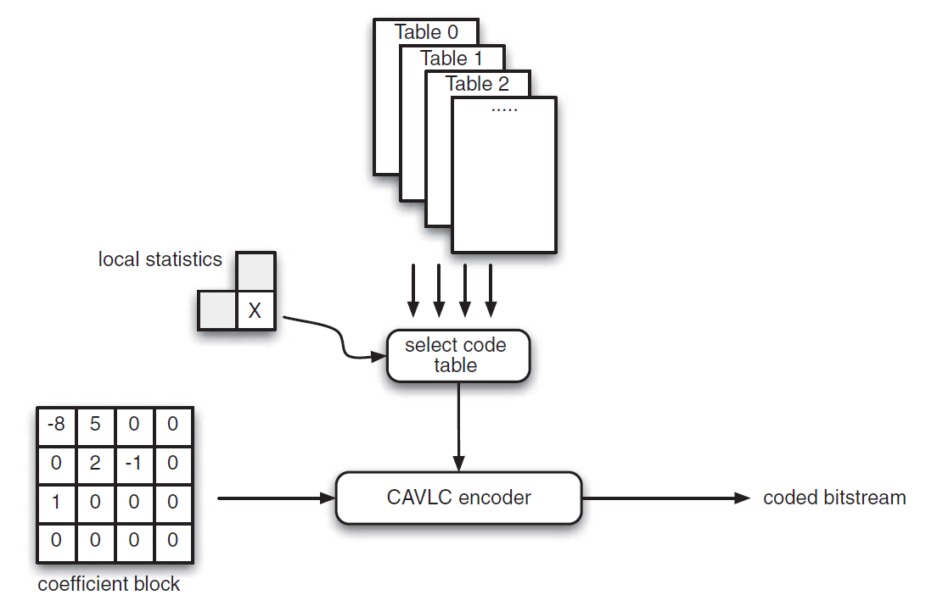

CAVLC overview

Slide 39
Characteristics of quantized coefficient blocks
1. After prediction, transformation and quantization, blocks are typically sparse, often containing mostly zeros.
2. The highest non-zero coefficients after the block scan are often sequences of +/−1
3. The number of non-zero coefficients in neighbouring blocks is correlated.
4. The level or magnitude of non-zero coefficients tends to be larger at the start of the scanned array, near the DC coefficient, and smaller towards the higher frequencies.

Slide 40
CAVLC
  Total coefficients and trailing ones are coded together. 4 tables are switched adaptively according to the none-zero coefficient in neighbour up/left blocks (0, 2, 4, 8).
  Trailing ones sign flag
  Level: 7 tables. Select according to level threshold(0, 3, 6, 12, 24, 48).
  Total zeros: select table according to total non zero coefficients in current block.
  Run: select table according to left zeros

Slide 41
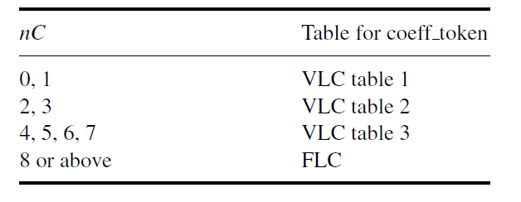
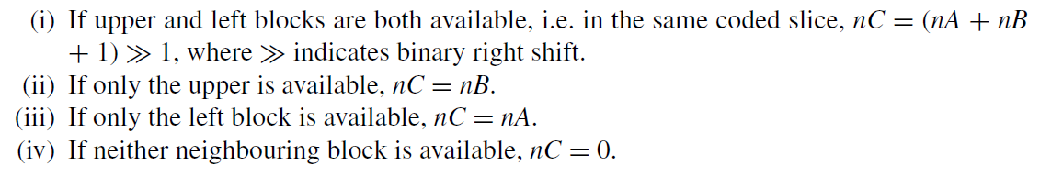
Choice of look-up table
B
A
C

Slide 42
Parsing Example for H.264
Zig-zag order: 0, 3, 1, -1, -1, 0, 1, 0……
Total coeffs = 5,
Total zeros = 3,
Trailing ones = 3,
First, select a table for total coeffs, here we assume the table VLC0 is used, encoding process:
Element Value Code
Coeff_token Totalcoeffs=5, Tralingones=3 0000100
Trailingones sign(4) + 0
Trailingones sign(3) - 1
Trailingones sign(2) - 1
Level(1) +1(VLC0) 1
Level(0) +3(VLC1) 0010
TotalZeros 3 111
Run_before(4) Zerosleft=3; run before=1 10
Run_before(3) Zerosleft=2; run before=0 1
Run_before(2) Zerosleft=2; run before=0 1
Run_before(1) Zerosleft=2; run before=1 01
Run_before(0) Zerosleft=1; run before=1 doesn’t need code
0 | 3 | -1 | 0
0 | -1 | 1 | 0
1 | 0 | 0 | 0
0 | 0 | 0 | 0

Slide 43
Parsing Example for AVS
Luma intra block coeffs:
Zig-zag order: 0, 3, 1, -1, -1, 0, 1, 0……
Run-level: (1, 3), (0, 1), (0, -1), (0, -1), (1, 1)
Encoding:
Element Code Value
(1, 1) 2 110 (2-Golomb VL0_Intra)
(0, -1) 1 101 (2-Golomb VL1_Intra)
(0, -1) 1 101
(0, 1) 0 100
(1, 3) 35 000100111 (If there are left coeffients,
table VLC3_intra will be used)

Slide 44
CABAC
Coding a data symbol involves the following stages:
Binarization
Golomb(Rice) coding, Exp-Golomb Coding
2. Context model selection
  399 model
3 . Adaptive arithmetic encoding

Slide 45
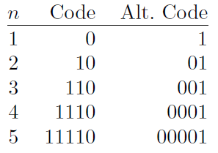
Unary Code
The Unary Code
  The unary code of the positive integer n is defined as n − 1 ones followed by a single 0

Slide 46
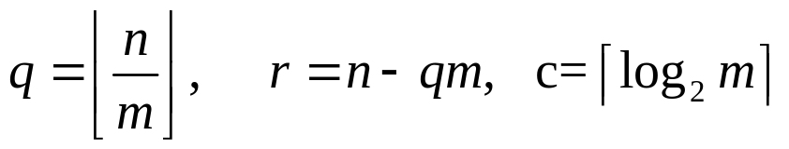
Golomb Codes
Golomb code for nonnegative integers n depends on the choice of a parameter m. (when m=2^{k}, Rice codes)
The first step in computing the Golomb code of the nonnegative integer n is to compute the three quantities q (quotient), r(remainder), and c by
q is coded in unary code,
r is coded in such way: The first (2^{c} − m ) values of r are coded as unsigned integers in c − 1 bits each;
and the rest are coded in c bits each

Slide 47
Exponential Golomb Codes of Order k
k = 0
1
0
0 1 x₀
1-2
0 0 1 x₁ x₀
3-6
0 0 0 1 x₂ x₁ x₀
7-14
k = 1
1 x₀
0-1
0 1 x₁ x₀
2-5
0 0 1 x₂ x₁ x₀
6-13
0 0 0 1 x₃ x₂ x₁ x₀
14-29
k = 2
1 x₁ x₀
0-3
0 1 x₂ x₁ x₀
4-11
0 0 1 x₃ x₂ x₁ x₀
12-27
0 0 0 1 x₄ x₃ x₂ x₁ x₀
28-59
k = 3
1 x₂ x₁ x₀
0-7
0 1 x₃ x₂ x₁ x₀
8-23
0 0 1 x₄ x₃ x₂ x₁ x₀
24-55
0 0 0 1 x₅ x₄ x₃ x₂ x₁ x₀
56-119

Slide 48
Loop Filter in H.264/AVS
Coder Control
Control data
-
Transform
Quantization
Quantized coefficients
Decoder
Inverse Quantization
Inverse Transformation
Entropy Coding
Intra Prediction
0
Loop filter
Motion
Compensation
Intra/Inter
Motion Data
Motion
Estimation

Slide 49
Loop Filter in H.264/AVS
AVS
  8x8 block
  Filter strength –0, 1, 2
H.264
  4x4 block boundary
  Filter strength– 0, 1, 2, 3, 4
Note:
  Filter strength is decided by: macroblock type, reference index, motion vector, quantization parameter

Slide 50
H.264 /AVC adaptive De-blocking filter
Coarse quantization of the block-based image transform produce disturbing blocking artifacts at the block boundaries of the image.
The second source of blocking artifacts is motion compensated prediction. Motion compensated blocks are generated by copying interpolated pixel data from different locations of possibly different reference frames.
When the later P/B frames reference these images having blocky edges, the blocking artifacts further propagate to the interiors of the current blocks worsening the situation further.

Slide 51
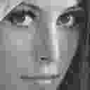

H.264/AVC adaptive de-blocking filter : Impact on Reference frame

Slide 52
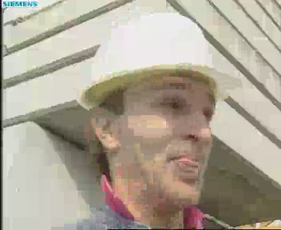

adaptive de-blocking
1) Without Filter 2) with H264/AVC Deblocking

Slide 53
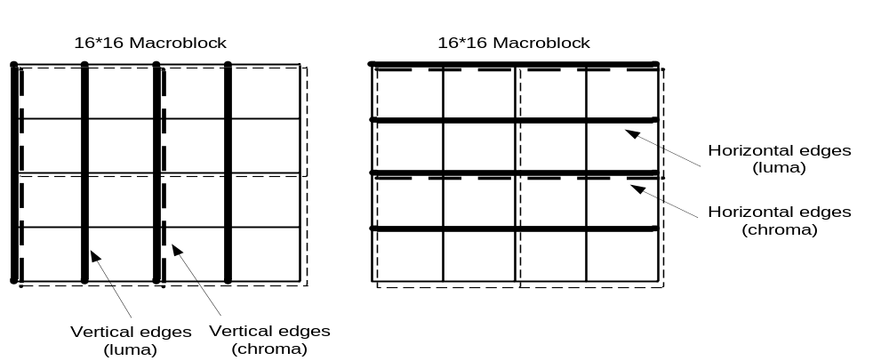
Adaptive De-blocking filter
Last process in the frame decoding, which ensures all the top/left neighbors have been fully reconstructed and available as inputs for de-blocking the current MB.
Applied to all 4x4 blocks except at the boundaries of the picture.
Filtering for block edges of any slice can be selectively disabled by means of flag.
Vertical edges filtered first (left to right) followed by horizontal edges (top to bottom)

Slide 54
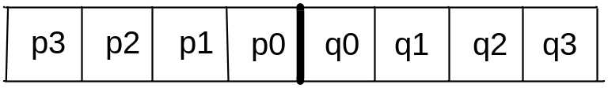
Adaptive De-blocking filter
For de-blocking an edge, 8 pixel samples in all are required in which 4 are from one side of the edge and 4 from the other side.
Of these 8 pixel samples the de-block filter updates 6 pixels for a luminance block and 4 pixels for a chrominance block.
p3
p2’
p1’
p0’
q0’
q1’
q2’
q3
p3
p2
p1’
p0’
q0’
q1’
q2
q3
Luminance pixels after filtering
Chrominance pixels after filtering

Slide 55
Adaptive De-blocking filter
We want to filter only blocking artifacts and not genuine edges!!!
The choice of filtering outcome depends on the boundary strength and on the gradient of image samples across the boundary.
The Boundary strengths are a method of implementing adaptive filtering for a given edge based on certain conditions based on
  MB type
  Reference picture ID
  Motion vector
  Other MB coding parameters
The Boundary strengths for a chrominance block is determined from the boundary strength of the corresponding luminance macro block.

Slide 56
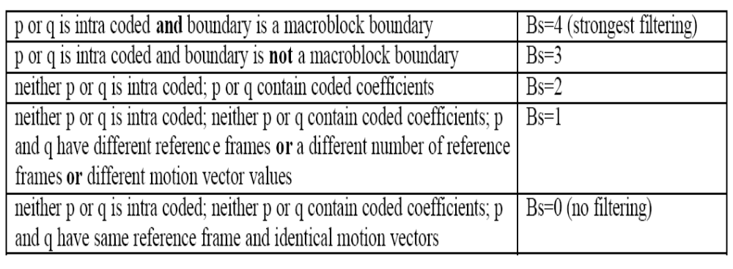
Boundary strengths

Slide 57
Adaptive De-blocking filter
The blocking artifacts are most noticeable in very smooth region where the pixel values do not change much across the block edge.
Therefore, in addition to the boundary strength, a filtering threshold based on the pixel values are used to determine if de-blocking process should be carried for the current edge.

Slide 58
Filter decision
A group of samples from the set (p2,p1,p0,q0,q1,q2) is filtered only if:
  (a) Bs > 0 and
  (b) |p0-q0|, |p1-p0| and |q1-q0| are each less than a threshold

