Slide 1
H.265 (HEVC)

Slide 2
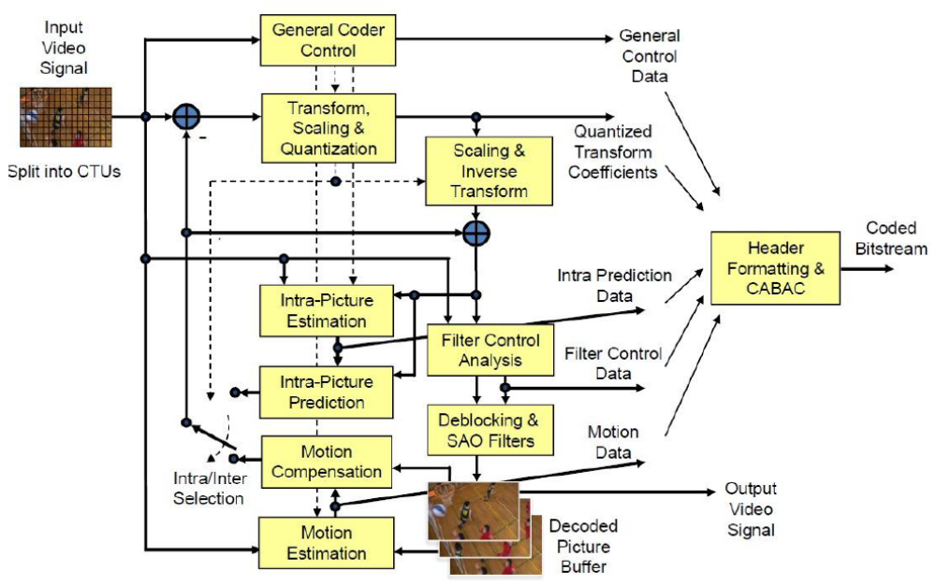
HEVC Encoder

Slide 3
Outline
Picture Structure
Inter Prediction/ Motion Compensation
Intra Prediction
Motion Vector Prediction
Sample Adaptive Offset (SAO)
Paralleling Tools

Slide 4
Bitstream Structure
VPS
SPS
PPS
Slice Header
Slice Data
* * * *
Picture #1
Slice Header
Slice Data
Slice Header
Slice Data
* * * *
Picture #k
  VPS – （Video Parameter Set）, specify multi-layer structure
  SPS – （Sequence Parameter Set ）, specify a single layer:
  Profile, tier, level;
  Picture Size; Max/Min CTU size, CU depth
  Max/Min TU size, TU depth
  …..
  PPS –（Picture Parameter Set ）, specify a single layer, on/off tools:
  Sign Data Hiding; Transform Skip
  Weighted Prediction
  Tiles, WPP
  …

Slide 5
Picture Structure
Coding Tree Block (CTB):
Picture is partitioned into square coding tree blocks (CTBs). The size N of the CTBs is chosen by the encoder (16x16, 32x32, 64x64). Luma CTB covers a square picture area of N ×N samples and the corresponding chroma CTBs cover each (N/2) × (N/2) samples (in 4:2:0 format).
Coding Tree Units (CTU):
The luma CTB and the two chroma CTBs, together with the associated syntax, form a
coding tree unit (CTU). The CTU is the basic processing unit similar to MB in prior standards.
Coding Block (CB):
Each CTB can be further partitioned into multiple coding blocks (CBs). The size of the CB can range from the same size as the CTB to a minimum size (8×8).
Coding Unit (CU)
The luma CB and the chroma CBs, together with the associated syntax, form a coding unit (CU). Each CU can be either Intra or Inter predicted.

Slide 6
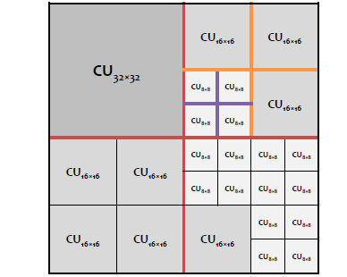
CTU Structure
64x64 CTU

Slide 7
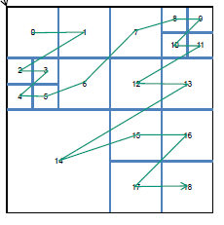
CTU Structure (2)
All CUs in a CTU are encoded (traversed) in Z–Scan order:
64x64 CTU

Slide 8
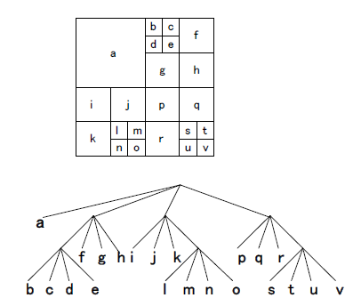
CTU Structure (3)
Formally CTU specifies quad-tree traversed in ‘inorder’.
Note: unlike to prior standards where MB header is followed by data, in HEVC ‘headers are dispersed’:
CTU Header
CU Hdr
CU Data
* * * *
CU Hdr
CU Data
CTU

Slide 9
CU Structure (1)
Prediction Block (PB):
Each CB is partitioned in 1, 2 or 4 prediction blocks (PBs).
Prediction Unit (PU):
The luma PB and the chroma PBs, together with the associated syntax, form a prediction unit (PU).
Intra:
2Nx2N NxN (only if CB size is smallest CB size, i.e. CU = SCU)
Inter:
2Nx2N NxN 2NxN Nx2N
Sub-partitions (e.g. NxN) are allowed if CU = SCU

Slide 10




CU Structure (2)
Inter Assymetric Partitions (conditioned by amp_enabled_flag in SPS):
nLx2N
nRx2N
2NxnU
2NxnD
Why assymetric partitions are beneficial:
2NxnU
2NxnD
nLx2N
nRx2N

Slide 11
CU Structure (3)
Notes:
The smallest luma PB size is 4 × 8 or 8 × 4 samples (where 4x8 and 8x4 are permitted only for uni-directional predictions, no bi-prediction < 8x8 allowed).
Chroma PBs mimic corresponding luma partition with the scaling factor 1/2 for 4:2:0.
Assymetric splitting is also applied to chroma CBs.

Slide 12
CU Structure (4)
Transform Block (TB) :
Each luma CB can be quadtree partitioned into one, four or larger number of TBs.
The number of transform levels is controlled by max_transform_hierarchy_depth_inter
and max_transform_hierarchy_depth_intra.
Example.
CB divided into two TB levels (the block #1 is split into four blocks):
0
1,0
1,1
1,2
1,3
2
3
0
2
3
1,0
1,1
1,2
1,3

Slide 13
CU Structure (5)
Notes
Unlike to H.264/AVC where TB ≤ PB, prediction and transform partitioning are independent, i.e. TB can contain several PBs and vice versa.
Prediction discontinuities on PB boundaries within TB are smoothed by transform and quantization. If PB and TB boundaries coincide then the discontinuities are observed increased.

Slide 14
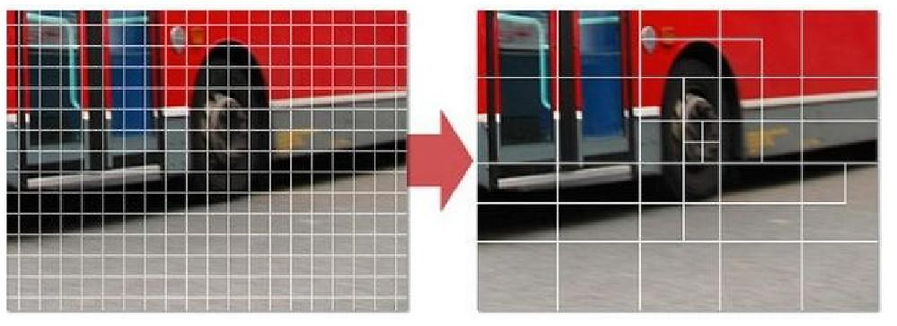
v.s. h.264
h.264
h.265

Slide 15
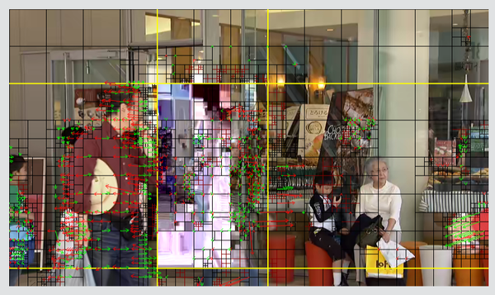

Slide 16
Inter Prediction/ Motion Compensation

Slide 17
Luma Motion Compensation Details (1)
Fractional interpolation for luma samples uses 8-tap filter for both half-pels and quarter-pels (although some positions actually reduced to 7-tap filter).
Notice that in AVC/H.264 the motion compensation is executed in two serial stages:
6-tap filter for half-pels
bilinear filter for quarter-pels
So, AVC/H.264 gives the same complexity as HEVC 8-tap filter but two-stage latency (HEVC motion compensation filter can be executed in one stage).

Slide 18
Chroma Motion Compensation
The fractional interpolation for the chroma is similar to the luma
except that the 4-tap filter is applied instead of 8-taps in luma and accuracy is 1/8-pel.

Slide 19
Notes/Conclusions
Luma interpolation can be performed in two serial stages: half-pel and quarter-pel.
For motion compensation of NxM block it’s required to load (N+7)x(M+7) reference block (3 left/above, 4 right and below).
8 tap filter coefficients: { -1, 4, -11, 40, 40, -11, 4, -1 }
7-tap filter coefficients: { -1, 4, -10, 58, 17, -5, 1 }, non-symmetric.

Slide 20
Intra Prediction

Slide 21
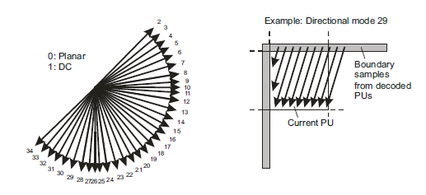
Overview
33 angular predictions for both luma and chroma. Two non-directional
predictions (DC, Planar).
PB sizes from 4×4 up to 64×64.
Like in AVC/H.264 Luma intra prediction mode is coded predictivly and chroma intra mode is derived from the luma one.

Slide 22
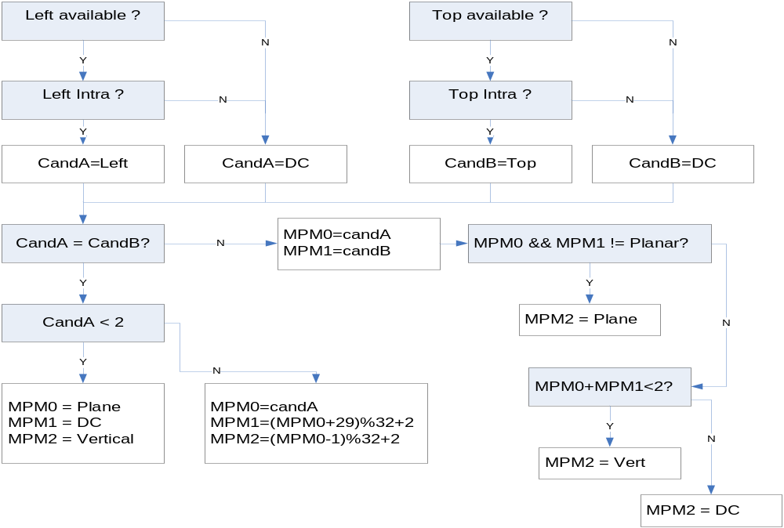
Coding & Derivation Luma Intra Prediction Mode (1)
Unlike to AVC/H.264 three “most probable modes”: MPM0, MPM1 and MPM2 are considered. The following figure reveals the logic for derivation of MPMs:

Slide 23
Coding & Derivation Luma Intra Prediction Mode (2)
Encoder side:
If the current luma intra prediction mode is one of three MPMs, prev_intra_luma_pred_flag set to 1 and the MPM index (mpm_idx) is signaled.
Otherwise, the index of the current luma intra prediction mode excluding
the three MPMs is transmitted to the decoder by using a 5-bit fixed length
code (rem_intra_luma_pred_mode).

Slide 24
Coding & Derivation Luma Intra Prediction Mode (3)
Decoder side:
Upon derivation of MPMs, collect them in candModeList[3]= [MPM0, MPM1, MPM2]. The following code outlines how luma intra mode is derived:
If prev_intra_pred_flag = true then
IntraPredMode = CandList [mpm_idx]
Else
{ sort CandList in ascending order }
if candModeList[0] is greater than candModeList[1], swap two values.
if candModeList[0] is greater than candModeList[2], swap two values.
if candModeList[1] is greater than candModeList[2], swap two values.
Read 5 bits to rem_intra_luma_pred_mode
IntraPredMode = rem_intra_luma_pred_mode
if IntraPredMode >= candList[ 0 ] IntraPredMode ++
if IntraPredMode >= candList[ 1 ] IntraPredMode ++
if IntraPredMode >= candList[ 2 ] IntraPredMode ++
EndElse

Slide 25
Coding & Derivation Chroma Intra Prediction Mode
Unlike AVC/H.264, chroma intra prediction mode is derived from luma and from the syntax element intra_chroma_pred_mode ( signaled each PB ) according to the following table:
intra_chroma_pred_mode | Luma IntraPredMode
 | 0 | 26 | 10 | 1 | X ( 0 <= X <= 34 )
0 | 34 | 0 | 0 | 0 | 0
1 | 26 | 34 | 26 | 26 | 26
2 | 10 | 10 | 34 | 10 | 10
3 | 1 | 1 | 1 | 34 | 1
4 | 0 | 26 | 10 | 1 | X

Slide 26
Implementation Angular Intra Prediction (1)
At most 4N+1 neighbor pixels are required (in contrast to H.264/AVC, below-left samples are exploited in HEVC).
Top CTU
Top-left CTU
16x16
8x8
8x8
Top-left predictor
Top predict.
Top-right predictors
Left CTU
16x16
Current PB
8x8
Left predictors
Current CTU
Below Left predictors

Slide 27
Motion Vector Prediction

Slide 28
Overview
Effective motion data prediction techniques have been adopted in HEVC in order to reduce motion data portion in the stream.
Unlike other standards (e.g. AVC/H.264), the HEVC adopted competitive motion vector prediction for both regular and merge (HEVC replacement of AVC/H.264 skip/direct) modes, i.e. several predictor candidates are competing for the prediction and the right candidate is signaled in the stream.
Unlike AVC/H.264, in regular (advanced motion vector prediction or in AMVP in jargon of HEVC) MV prediction the co-located temporal MV is considered if one of spatial candidates is non-available or redundant.
In merge mode (HEVC replacement of AVC/H.264 skip/direct), the set of merge candidates can include a temporal candidate (if one or more spatial candidates are non-available or redundant).
Spatial and temporal MVP candidates can be derived independently and in parallel

Slide 29
Merge Mode: Removal of Same Motion Candidates (Prunning)
A candidate removed if any of previous candidate has the same motion. When NumMergeCands=5 the detection of all redundant candidates requires 10 comparisons per PU.
To reduce complexity of merge list generation, only 5 comparisons are executed (instead of 5) for detection of duplication and the temporal candidate is excluded from comparisons (for the sake of parallelism).
If merge list is not full (i.e. #candidates<NumMergeCands) then additional “virtual” candidates appended
B2
B1
B0
comparison
A1
A0

Slide 30
Merge Mode: List Construction in Encoding
Derive candidate list
(spatial & temporal )
Prunning Process
remove duplicates (restricted)
If merge list full?
No
Add “virtual” candidates
Yes
Select candidate
for encoding

Slide 31
Merge Mode: List Construction in Decoding
Derive candidate list
(spatial & temporal )
CABAC
Prunning Process
remove duplicates (restricted)
Decode merge_idx
If merge_idx< current list size?
index
No
Add “virtual” candidates
Yes
Use candidate pointed by merge_idx
for decoding

Slide 32
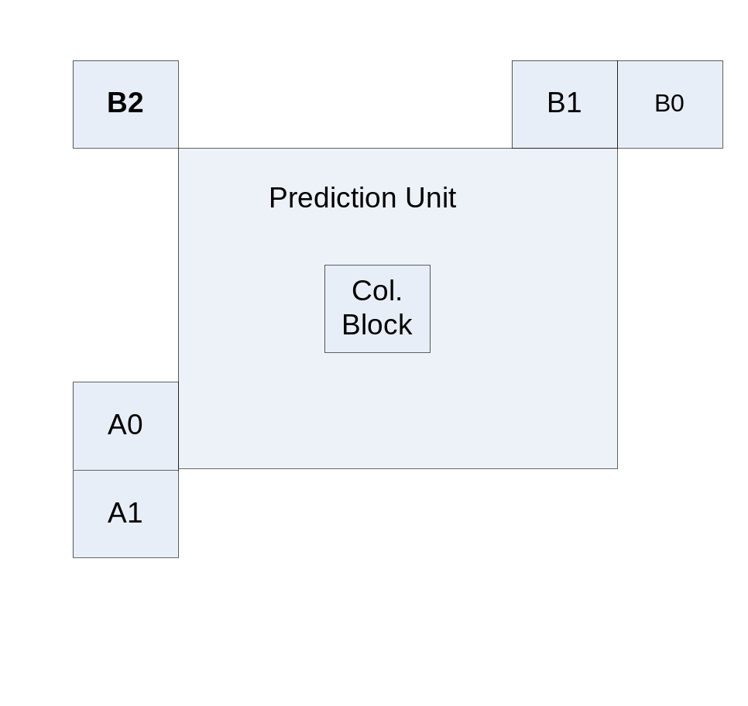
Advanced Motion Vector Prediction (AMVP)
Motion vector is predicted from five spatial neighbors: B0, B1, B2, A0, A1 (see the figure below) and one co-located temporal MV. Only two motion candidates are chosen among six neighbors and the selected predictor is explicitly signaled (mvp_lx_flag).

Slide 33
Advanced Motion Vector Prediction (AMVP) – cont.
The first motion candidate (left candidate) is chosen from {A0, A1}
The second motion candidate (top candidate) is chosen from {B0, B1, B2}
If both candidates are available and have the same motion data, one is excluded
If one of the above candidates is not available then the temporal MV is used unless the temporal prediction mode disabled
If the number of available candidates is less than 2, zero MV is added

Slide 34
Transform

Slide 35
Overview
The standard supports 32x32, 16x16, 8x8 and 4x4 DCT-like transforms and 4x4 DST-like transform. Notice that DST-like 4x4 transform is allowed only for intra mode.
Each transform is specified by 8-bits signed digital transform matrix T. To perform all transform operations it’s required 32-bits precision.
The inverse transform can be executed as follows:
  Z = X’ T, where X is the input matrix of quantized coefficients (16-bits per coefficient, for more detailed analysis refer to JCTVC-L0332)
  Scaling and clipping of Z to guarantee that the output values are within 16-bits.
  Y = Z’ T
Notice that in encoder architecture the step (c) can be “coupled” with quantization: once first row of Y completed the quantization of the first row is started.

Slide 36
4x4 DST (Discrete Sine Transform)
4x4 DST is applied only for Intra prediction.
The 4x4 DST matrix from HEVC spec:
  29 55 74 84
  74 74 0 −74
  84 −29 −74 55
  55 −84 74 −29
Motivation:
Intra prediction is based on the top and left neighbors. Prediction accuracy is more for the pixels located near to top/left neighbors than those away from it. In other words, residual of pixels which are away from the top/left neighbor usually be larger then pixels near to neighbors. Therefore DST transform is more suitable to code such kind of residuals, since DST basis function start with low and increase further which is different from conventional DCT basis function.
Reported 4x4 DST provides some performance gain, about 1%, against DCT. For bigger sizes the gain is negligible.
As well as DCT, DST can be implemented using "fast" form

Slide 37
Entropy Coding

Slide 38
Overview
HEVC specifies only one entropy coding method CABAC, comparing to two CABAC and CAVLC as in H.264/AVC.
HEVC CABAC encoding involves three main functions:
  Binarization - maps the syntax elements to binary symbols (bins).
  Context modeling - estimates the probability of the bins
  Arithmetic coding - compresses the bins to bits based on the estimated probability

Slide 39
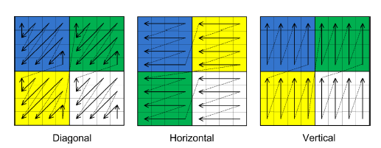
Residual Coding: Overview
Each Transform Block (TB) is divided into 4x4 sub-blocks (coefficient groups).
Processing starts with the last significant coefficient and proceeds to the DC coefficient in the reverse scanning order.
Coefficient groups are processed sequentially in the reverse order (from bottom-right to top-left) as illustrated in the following figure:
Coefficient groups for 8x8 TB, for different scans

Slide 40
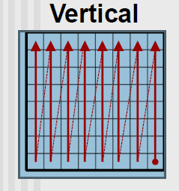
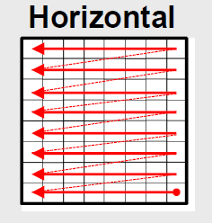
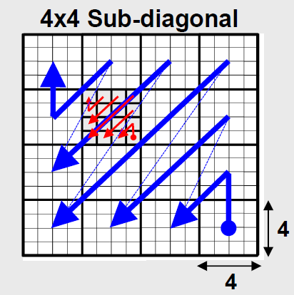
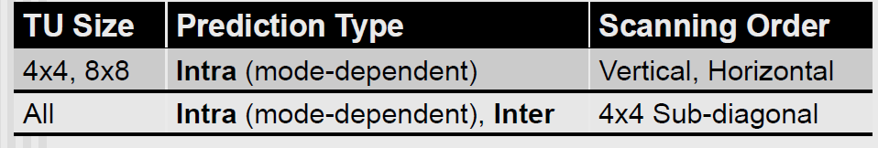
Residual Coding: Scanning Order
Note: Experiments show that including horizontal and vertical scans for large TBs offers little compression efficiency, so vertical and horizontal scans are limited to 4x4 and 8x8 sizes.

Slide 41
Sample Adaptive Offset (SAO)
Page <number>

Slide 42
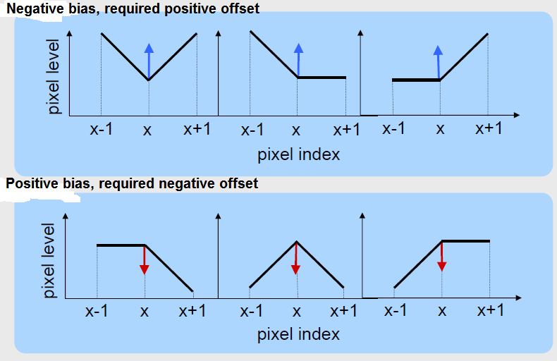
Background
Idea: Quantization makes reconstructed and original blocks differ. The quantization error is not uniformly distributed among pixels. There is a bias in distortion around edges which can be eliminated/reduced.

Slide 43
Background (cont.)
In addition to bias in quantization distortion around edges, systematic errors related to specific ranges of pixel values can also occur.
Both types of the above systematic errors (or biases) are corrected in SAO.

Slide 44
Overview
SAO is the second “post-processing” tool (after deblocking) accepted in HEVC/H.265.
SAO is applied after deblocking. For efficient HW implementation SAO can be coupled with deblocking in MB-loop.
SAO can be optionally turned off or applied only on luma samples or only on chroma samples (regulated by slice_sao_luma_flag and slice_sao_chroma_flag ).
SAO parameters can be either explicitly signalled in CTU header or inherited from left or above CTUs.
As well as deblocking SAO is adaptively applied on pixels. Unlike to deblocking SAO is adaptively applied to all pixels.
There are two types of SAO:
  Edge Type - offset depends on edge mode (signaled by SaoTypeIdx = 2)
  Band Type - offset depends on the sample amplitude (SaoTypeIdx = 1)
Note: chroma CTBs share the same SaoTypeIdx.

Slide 45
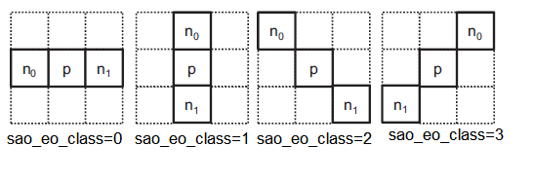
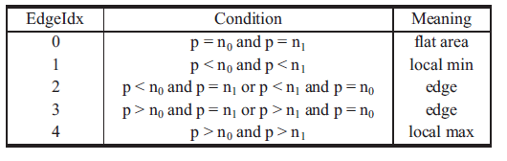
Edge Type SAO
In case of Edge type, the edge is searched across one of following directions ( the direction is signaled by sao_eo_class parameter, once per CTU):
Notes: Sample labeled “p” indicates a current sample. Two samples labeled “n0” and “n1” specify two neighboring samples along the chosen direction.
The edge detection is applied to each sample. According to the results the sample is classified into five categories (EdgeIdx) :

Slide 46
Edge Type SAO (cont.)
According to EdgeIdx the corresponding sample offset (signaled by sao_offset_abs and sao_offset_sign) is added to the current sample.
Up to 12 edge offsets (4 luma, 4 Cb chroma and 4 Cr chroma) are signaled per CTU. To reduce the bit overhead there is a particular merge mode (signaled by sao_merge_up_flag and sao_merge_left_flag flag) which enables a direct inheritance of SAO parameters from top or left CTU.
Reported that SAO reduces ring and mosquitos artifacts and improve subjective quality for low compression ratio video.

Slide 47

Band Type SAO
The pixel range from 0..255 is uniformly split into 32 bands and the sample values belonging to four consecutive bands are modified by adding the
values denoted as band offsets.
Band offsets are signaled in CTU header.
Experiments reveal that Band Type SAO is beneficial in noisy sequences or in sequences with large gradients (e.g. PeopleOnStreet which is abundant in black-white switches).

Slide 48


SAO Impact on Quality
SAO is enabled (QP = 32 ) SAO is disabled (QP = 32 )

Slide 49
Paralleling Tools

Slide 50
Overview
  HEVC adopted three in-built parallel processing tools:
  Slices
  Tiles
  Wavefronts (WPP)

Slide 51
Slices
As in H.264/AVC, slices are groups of CTUs in scan order, separated by start code.
There are two types of slices:
  Dependent
  Non dependent (normal).
Independent Slice
Slice #0
Slice #1
Dependent Slice
Slice #2
Slice #3
Slice #3
Slice #4
Independent Slice

Slide 52
Slices - Dependent Slices
Dependencies of dependent slice include the following:
  Slice Header Dependency: Short slice header is used where the missing elements are copied from the preceding normal slice.
  Context Models Dependency: CABAC context models are not initialized to defaults at the beginning of a dependent slice.
  Spatial Prediction Dependency: No breaking intra and motion vector prediction.

Slide 53
Slices - Dependent Slices
Restriction:
Each dependent slice must be preceded by a non-dependent slice. The picture always starts with a normal slice, followed by zero or more dependent slices.
Rationale for using of dependent slices:
Allow data associated with a particular wavefront thread or tile to be carried in a separate NAL unit, and thus make that data available to a system for fragmented packetization with lower latency than if it were all coded together in one slice.

Slide 54
Slices: Pros and Cons
Pros: Slices are effective for:
  Network packetization (MTU size matching)
  Low-delay applications. Indeed, to start transmission of the encoded data earlier, a current slice may be already transmitted, while encoding the next slice in the picture.
  Parallel processing (slice are self-contained, excepting deblocking) but decoder has to perform some preprocessing to identify entry points.
  Fast resynchronization in case of bitstream errors or packet loss.

Slide 55
Slices: Pros and Cons
Cons:
  Penalty on rate distortion performance is incurred due to the breaking
of dependencies at slice boundaries
  Overhead is added since each slice is preceded by the slice header.

Slide 56
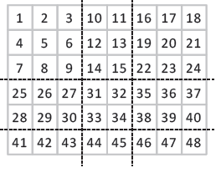
Tiles
Tiles are rectangular groups of CTUs.
Tiles are transmitted in raster scan
order, and the CTUs inside each tile
are also processed in raster scan order.
All dependencies are broken at tile boundaries.
The entropy coding engine is reset at the start of each tile and flushed at the end of the tile.
Only the deblocking filter can be optionally applied across tiles, in order to reduce visual artifacts.

Slide 57
Tiles (cont.)
At the end of each tile CABAC is flushed and consequently the tile ends at byte boundary.
The tile entry points (actually offsets) are signaled at the start of picture in order to enable to a decoder to process tiles in parallel.
Due to high area/perimeter ratio square tiles are more beneficial than
rectangular ones (since the perimeter represents the boundaries where the
dependencies are broken).

Slide 58
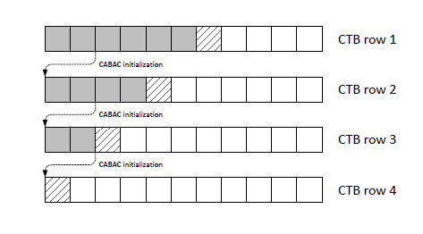
Wavefronts (WPP)
Picture is divided into rows of CTUs.
The first row is processed in an ordinary way.
The second row can be delayed until two first CTUs of the first row completed.
The third row can be processed after two first CTUs of the second row have been made, etc.

Slide 59
Wavefronts (WPP)
The context models of the entropy coder in each row are inferred from those in the
preceding row with a small fixed processing lag. Actually the context models are inherited from the second CTU of the previous row.
CABAC is flushed after the last CTU of each row, making each row to end at byte boundary.
No breaking of dependencies across rows of CTUs.

Slide 60
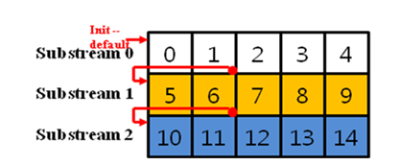
Wavefronts (Cont.)
CABAC is flushed at the end of each CTU row in order to make each row to end at byte boundary and to facilitate parallel processing.
CABAC is reset at the end of each CTU row in order to enable parallel processing.

Slide 61
Wavefronts (Cont.)
At the start of each CTU row CABAC contexts are inherited from the above row (after the second CTU of the above row finished, in order to minimize training penalty). In other words cabac context derivation crosses row boundaries. It requires some synchronization among cores.
Entry points of each CTU row are explicitly signaled in picture/slice header.

