Slide 1


A Method to Identify and Correct Problematic Software Activity Data:
Exploiting Capacity Constraints and Data Redundancies
Qimu Zheng
Peking University
Audris Mockus
University of Tennessee
Minghui Zhou
Peking University

Slide 2

Software repository data are important.

Slide 3








More Available Data
Code
Bug report
Mailing list
Social media

Slide 4



Empirical SE Research
Software Repository Data
Statistical Model
Research Result

Slide 5
Various Topics
Measure Productivity[1]
Duplicate Bug Report Prediction[2]
Bug-fix Time Prediction[3]
…
[1] W. F. Boh, S. A. Slaughter, and J. A. Espinosa. Learning from experience in software development: A multilevel analysis.
[2] Chengnian Sun; Lo, D.; Siau-Cheng Khoo; Jing Jiang, Towards more accurate retrieval of duplicate bug reports
[3] P. Bhattacharya and I. Neamtiu. Bug-fix time prediction models: Can we do better?

Slide 6
However …
?
?
Software Repository Data
Statistical Model
Research Result

Slide 7
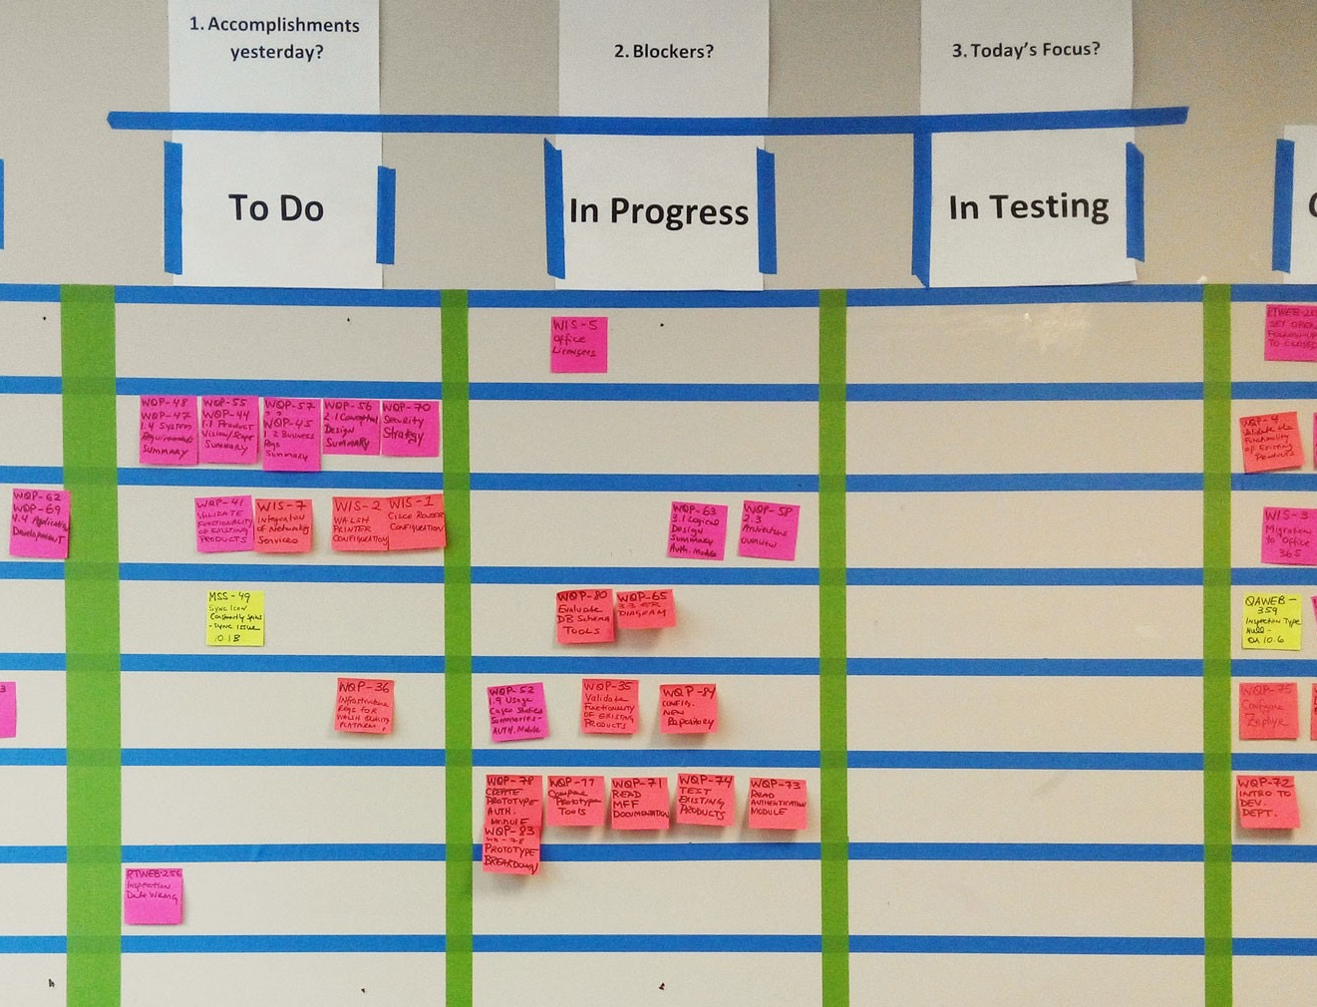
We do find some
real issues

Slide 8
Some real issues
Task completion time is important
For both research and practical development
Count #bugs fixed by each dev on each day
Experiment on official data from Mozilla

Slide 9
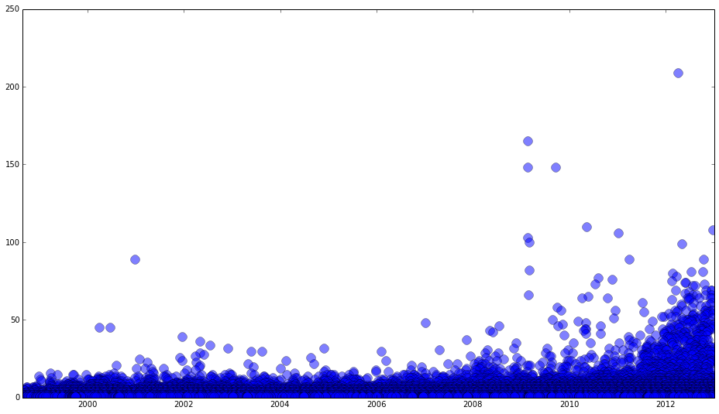
Some real issues
#bugs fixed by
each individual
Fix more than 50 bugs on one day!
Mean:1.92

Slide 10

Research on data quality?
Limited amount of work can be found.
Research mentioning data quality?
Data quality consideration is a minority practice [1][2].
[1] Michael Franklin Bosu and Stephen G. MacDonell. 2013. Data quality in empirical software engineering: a targeted review.
[2] Gernot A. Liebchen and Martin Shepperd. 2008. Data sets and data quality in software engineering.

Slide 11
Research on Data Quality?
Researchers love data.
Yet few cares about
their quality.
Limited amount of work can be found.
Research mentioning Data Quality?
Data quality consideration is a minority practice [1][2].
[1] Michael Franklin Bosu and Stephen G. MacDonell. 2013. Data quality in empirical software engineering: a targeted review.
[2] Gernot A. Liebchen and Martin Shepperd. 2008. Data sets and data quality in software engineering.

Slide 12
So we try to fix the problem
Method to identify & correct problematic data
Application
Generalization

Slide 13

Before that…
Two observations about software repository data

Slide 14

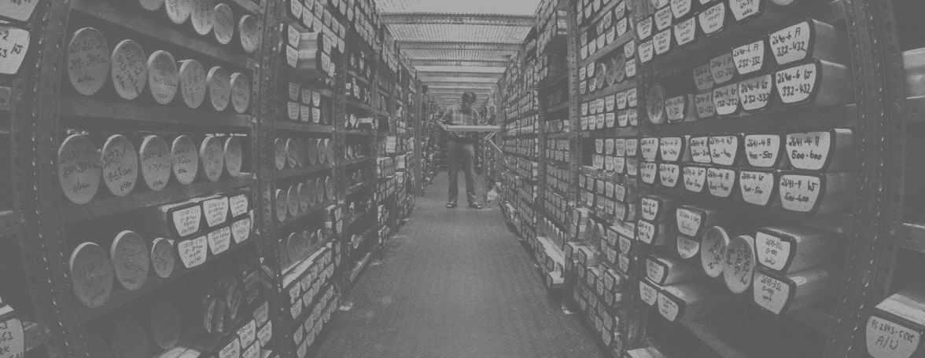
Capacity constraints
Data redundancies

Slide 15
Method
for identifying and correcting
problematic software repository data

Slide 16
Gather events from available sources
Choose primary type to represent the desired task completion time
Choose a set of redundant event types that approximate the desired task completion time
Obtain event times ti,k for task i and event k.
Use the distribution of tik for each k to identify problematic values. Define the method isProblematic(ti,k) that returns the likelihood that the observed value tik is incorrect.
Obtain values of isProblematic(tik) for each redundant observation type k.
Correct problematic data. Choose observations via:

Slide 17
Application
of the proposed method

Slide 18

Data Gathering
Official Bugzilla dump from Mozilla (January 2013)
All code commits data from Mozilla (February 2014)

Slide 19
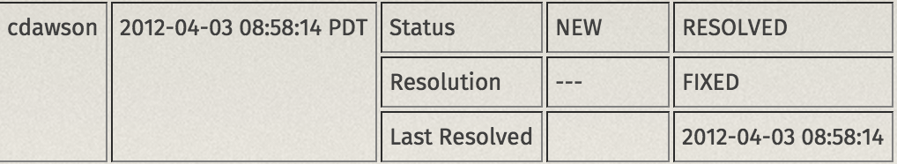
Primary Event Type
Bug-fix time recorded in issue tracking system.
Redundant Event Types?
Choose by understanding error mechanisms!

Slide 20

Redundant Event Types
Investigation of error mechanism
Development Process Tracked By Other System
Dormant issues
Closing issues with committed patches
Good substitutes:
Last comment time
Last code commit time

Slide 21

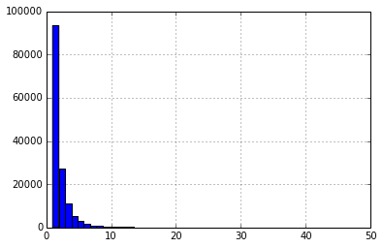
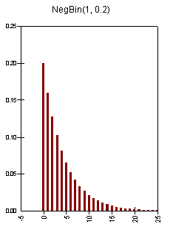
Problematic Data Identification
Data
Histogram
10 as cut-off
0-truncated negative
binomial distribution

Slide 22
Problematic Data Correction
Available options:
Last comment time
Last commit time
Since last commit time will be used for testing, we use last comment time for correction:

Slide 23
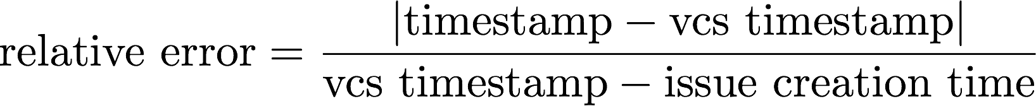
Data accuracy?
16% of the issues are fixed with a link pointing to a commit in version control system (VCS)
We take the timestamp in VCS as gold standard for evaluation
Absolute Error
Relative Error
Quantile | Uncorrected | Corrected
0.50 | 0d 07:17:13 | 0d 01:08:17
0.75 | 1d 00:16:33 | 1d 11:03:00
0.80 | 1d 08:52:50 | 0d 21:21:03
0.90 | 5d 21:59:42 | 4d 12:40:42
0.99 | 75d 03:43:39 | 72d 11:18:15
Quantile | Uncorrected | Corrected
0.50 | 0.0205 | 0.0073
0.75 | 0.2105 | 0.0777
0.80 | 0.3700 | 0.1544
0.90 | 1.6504 | 0.8502
0.99 | 148.2818 | 73.3260

Slide 24

Impacts on research
Time until fix
New
Fixed
time until fixed
time
Existing research
Summary
Severity
Priority
Product
Description
New
Fixed
Time until fixed

Slide 25
Impacts on Research
 | Estimate | p-value
(Intercept) | 4.91 | 0.00
Critical | 0.39 | 0.00
Major | 0.64 | 0.00
Normal | 0.80 | 0.00
Minor | 1.02 | 0.00
Trivial | 0.75 | 0.00
Enhancement | 1.23 | 0.00
ln(attachments+1) | -0.16 | 0.00
ln(depends+1) | 0.62 | 0.00
ln(assignee+1) | 0.32 | 0.00
Reputation | -1.04 | 0.00
P1 | -0.22 | 0.00
P2 | 0.08 | 0.11
P3 | 0.32 | 0.00
P4 | 0.52 | 0.00
P5 | 1.33 | 0.00
ln(comments+1) | 0.54 | 0.00
Resolver | -0.22 | 0.00
Late | -0.72 | 0.00
 | Estimate | p-value
(Intercept) | -2.23 | 0.02
Critical | 0.28 | 0.01
Major | 0.43 | 0.00
Normal | 0.60 | 0.00
Minor | 0.75 | 0.00
Trivial | 0.75 | 0.00
Enhancement | 1.12 | 0.00
ln(attachments+1) | -0.12 | 0.00
ln(depends+1) | 0.41 | 0.00
ln(assignee+1) | 0.45 | 0.00
Reputation | -0.52 | 0.00
P1 | -0.09 | 0.05
P2 | 0.20 | 0.00
P3 | 0.43 | 0.00
P4 | 0.49 | 0.00
P5 | 0.85 | 0.00
ln(comments+1) | 1.08 | 0.00
Resolver | -0.21 | 0.00
Late | -0.20 | 0.00

Slide 26
Impacts on Research
R2: 0.381 => 0.452
Predictors: 4 significancy changes
Correction of data makes a substantial difference.
 | Estimate | p-value
(Intercept) | 4.91 | 0.00
Critical | 0.39 | 0.00
Major | 0.64 | 0.00
Normal | 0.80 | 0.00
Minor | 1.02 | 0.00
Trivial | 0.75 | 0.00
Enhancement | 1.23 | 0.00
ln(attachments+1) | -0.16 | 0.00
ln(depends+1) | 0.62 | 0.00
ln(assignee+1) | 0.32 | 0.00
Reputation | -1.04 | 0.00
P1 | -0.22 | 0.00
P2 | 0.08 | 0.11
P3 | 0.32 | 0.00
P4 | 0.52 | 0.00
P5 | 1.33 | 0.00
ln(comments+1) | 0.54 | 0.00
Resolver | -0.22 | 0.00
Late | -0.72 | 0.00
 | Estimate | p-value
(Intercept) | -2.23 | 0.02
Critical | 0.28 | 0.01
Major | 0.43 | 0.00
Normal | 0.60 | 0.00
Minor | 0.75 | 0.00
Trivial | 0.75 | 0.00
Enhancement | 1.12 | 0.00
ln(attachments+1) | -0.12 | 0.00
ln(depends+1) | 0.41 | 0.00
ln(assignee+1) | 0.45 | 0.00
Reputation | -0.52 | 0.00
P1 | -0.09 | 0.05
P2 | 0.20 | 0.00
P3 | 0.43 | 0.00
P4 | 0.49 | 0.00
P5 | 0.85 | 0.00
ln(comments+1) | 1.08 | 0.00
Resolver | -0.21 | 0.00
Late | -0.20 | 0.00

Slide 27
Generalization

Slide 28

Generalization
Data Quality Improvements
Error Identification
Error Correction
Constraints
Redundancies

Slide 29
Generalization
Exceptionally “Productive” Individuals
(Based on Issue Report Events)
Exceptionally “Productive” Individuals
(Based on Code Commit Events)
Date | User ID | Count
2012-10-01 | 452624 | 542
1999-11-22 | 4415 | 277
2011-06-24 | 12809 | 116
2009-12-16 | 24572 | 110
2012-01-27 | 148348 | 93
2012-10-12 | 384312 | 90
2011-12-14 | 24572 | 87
2010-10-13 | 164048 | 87
2012-06-01 | 24572 | 86
2000-07-08 | 41 | 86
Date | User ID | Count
2013-03-21 | Bobby Holley | 1160
2013-08-22 | Ms2ger | 1029
2013-02-25 | Gregory Szorc | 1024
2014-01-27 | B2G Bumper Bot | 998
2012-08-04 | Ms2ger | 991
2013-07-24 | Ms2ger | 986
2013-01-08 | ffxbld | 981
2011-07-21 | ffxbld | 964
2013-08-06 | ffxbld | 945
2013-02-20 | ffxbld | 907

Slide 30
Thank you.

