Slide 1

Classification and analysis of countries
Shulin Zheng
May 15, 2020

Slide 2
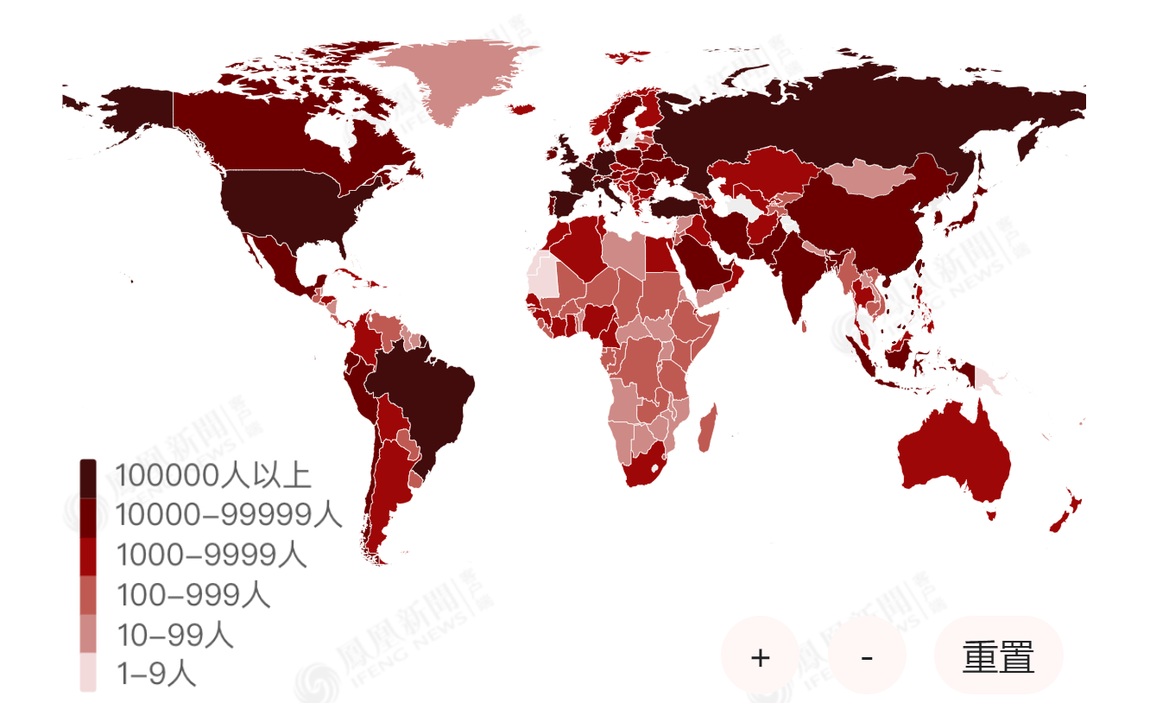
Background
01
In March this year, the epidemic broke out all over the world, which has a huge impact on people's lives and work. The epidemic spread rapidly, affected a wide range, high mortality, affecting all aspects, such as economy, education and so on. At present, research shows that the spread of the epidemic is related to the level of medical treatment and the elderly in the country. We hope to cluster countries according to relevant data and medical indicators, so that countries in the same cluster can learn from each other's governance experience.
2020.5.6 15：41

Slide 3
Data sources
02
Data sources | Indexs
Johns Hopkins real time statistics (as of April 10) | Cumulative number of confirmed cases, number of deaths, death rate, number of cured cases, cure rate, number of confirmed cases per million population
Website of the United Nations and national statistical offices | Population density (km2)
The report issued by the lancet refers to the study of global burden of disease. Taking 195 countries and regions as the objects, the report calculates the specific health care access and quality index (HAQ) for 32 evaluation indexes. The score is between 0-100. The higher the score, the better the quality and accessibility of medical care. | Medical quality index (HQA)
World Bank (https://data.worldbank.org.cn/) | Hospital beds (per thousand), ageing (as a percentage of the total population), international migrants (as a percentage of the population)
International Statistical Yearbook 2018 | Number of doctors per thousand population (person), number of beds per thousand population (piece), proportion of medical expenditure in GDP (%), per capita medical expenditure (USD)

Slide 4
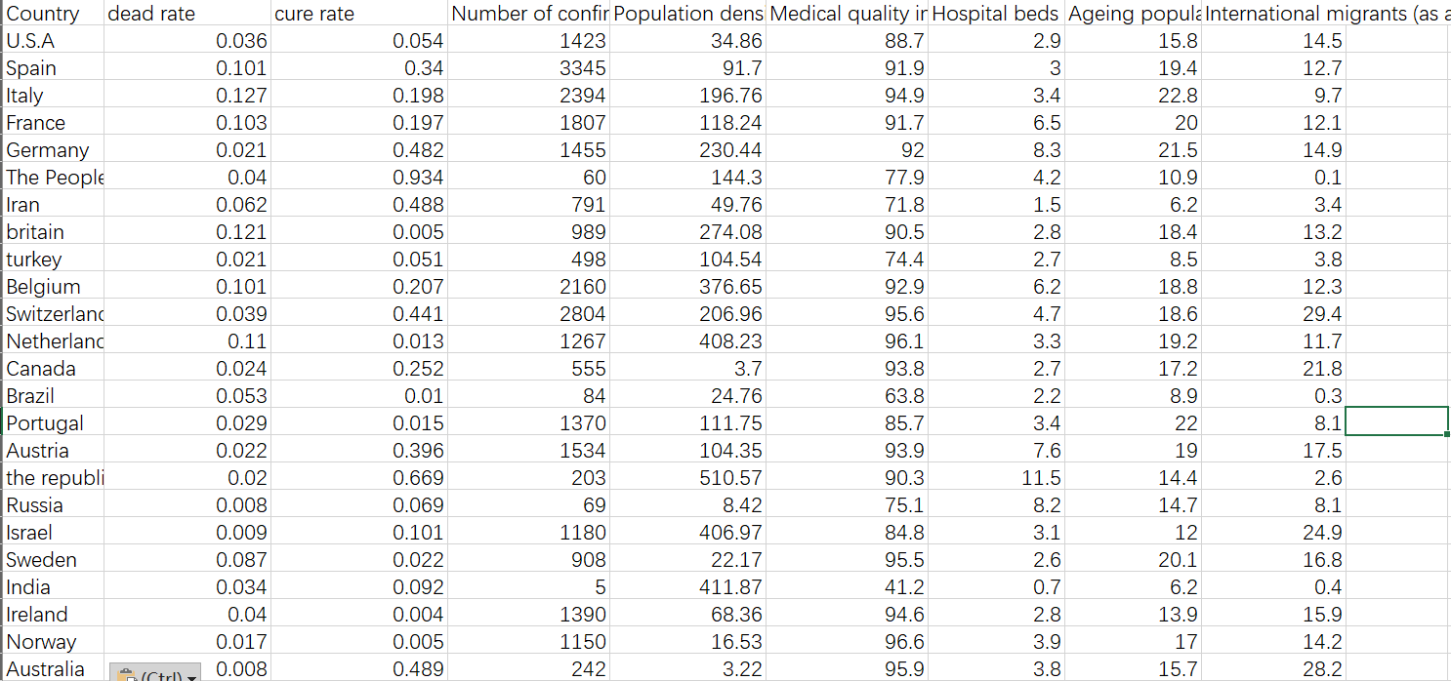
Data cleaning
02
Eliminate duplicate indicators
2. Remove indicators with missing value more than 70%
3. Missing values for individual countries are replaced with similar country values
4, except for novel coronavirus pneumonia data, data from countries with missing indicators are excluded from the country's data.
5. 134 countries, 8 data indicators

Slide 5
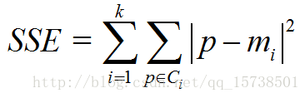
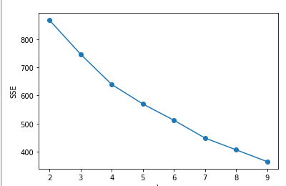
Selection of K value elbow method
03
01
When k is less than the real cluster number, the aggregation degree of each cluster will be greatly increased with the increase of K, so the decrease range of SSE will be large. When k reaches the real cluster number, the aggregation degree return will be rapidly reduced with the increase of K, so the decrease range of SSE will be sharply reduced, and then it will become gentle with the increase of K value, that is to say, the relationship between SSE and K is an elbow Shape, and the K value corresponding to this elbow is the real clustering number of the data.
The K value of elbow is 4, so the best cluster number should be 4.

Slide 6
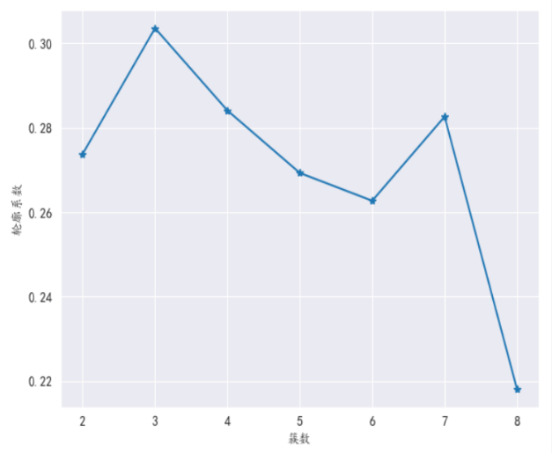
Selection of K value -- contour coefficient method
04
The maximum K value of contour coefficient is 3, which means that our optimal clustering number is 3. However, it is worth noting that from the elbow diagram of K and SSE, we can see that when k is taken as 3, SSE is still relatively large, so we go back to find the second, considering the K value 4 of the second largest contour coefficient, at this time SSE value is smaller than that when K is taken as 3, so the best clustering coefficient should be taken as 4 instead of 3.
01

Slide 7
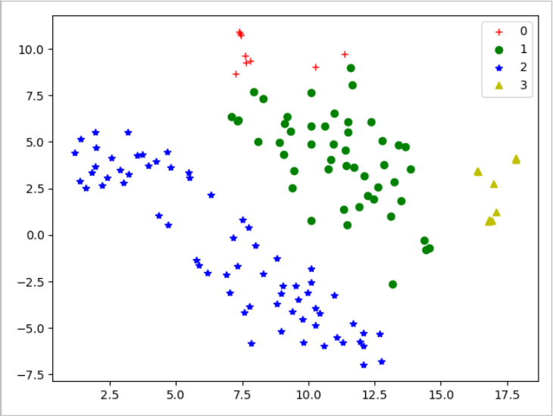
Analysis and discussion
05
Using the integrated k-means algorithm in Python's machine learning library sklearn, 134 countries are grouped into four categories.
At the same time, tsne is used to visualize the clustering results.

Slide 8
分析与讨论
05
The novel coronavirus pneumonia is not very serious in the first country: but the national medical situation is relatively low.
The second category of countries: China, the United States, Japan, South Korea, northern Europe, Australia and other countries, the epidemic situation is relatively serious, the medical level is medium to high, and the aging population also exists.
The novel coronavirus pneumonia is the third country: most of the countries are backward in developing countries such as Africa, the Middle East and Southeast Asia. The number of confirmed cases of new crown pneumonia epidemic is less than the time limit. However, due to poor medical quality, the shortage of medical resources, the low cure rate and high mortality rate.
The fourth kind of countries: countries with more serious epidemic situation in Europe, with serious aging and high mortality, but with high medical level, sufficient medical resources and relatively high cure rate.

Slide 9
Thank you
for watching ！

