Slide 1


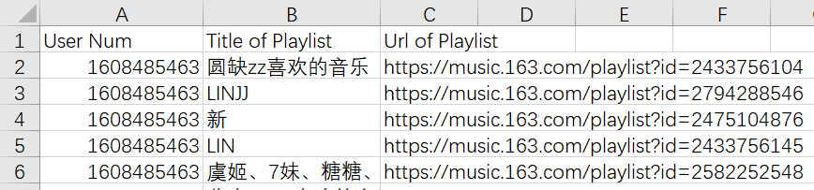
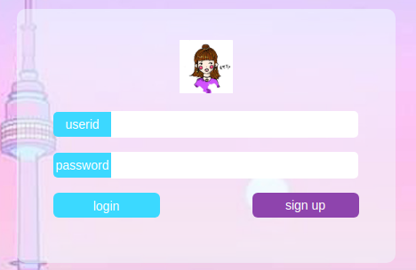
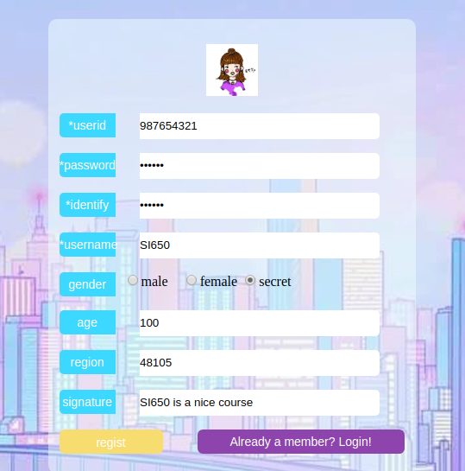
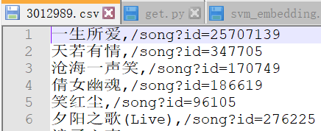
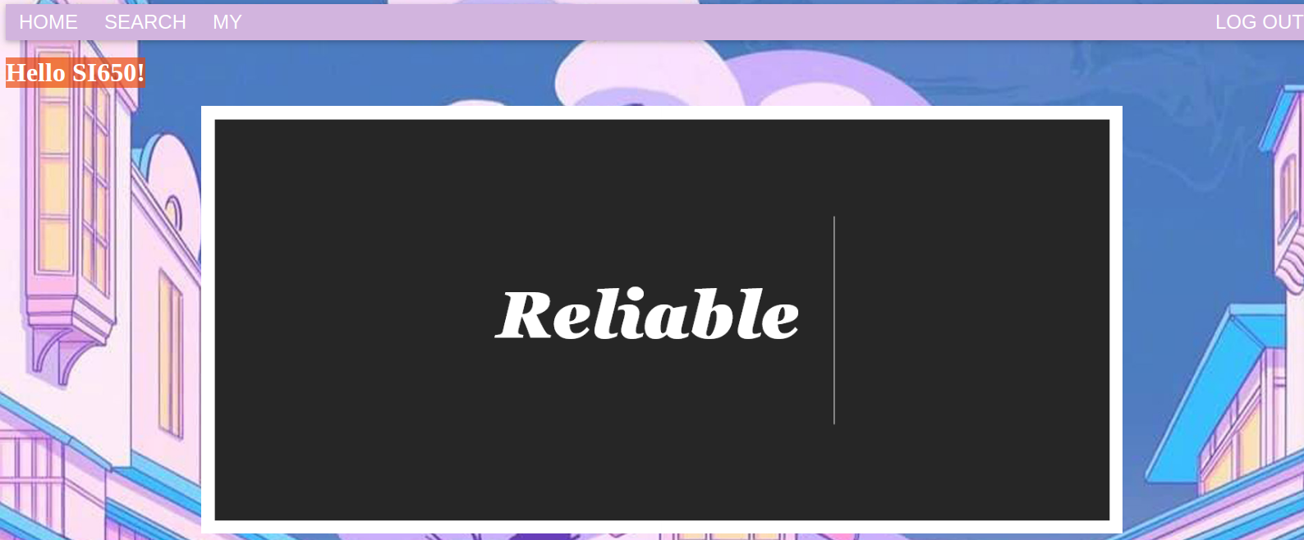

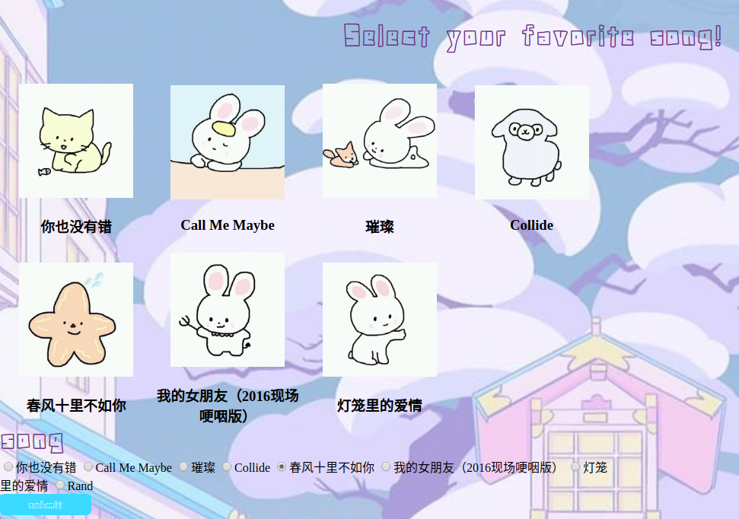
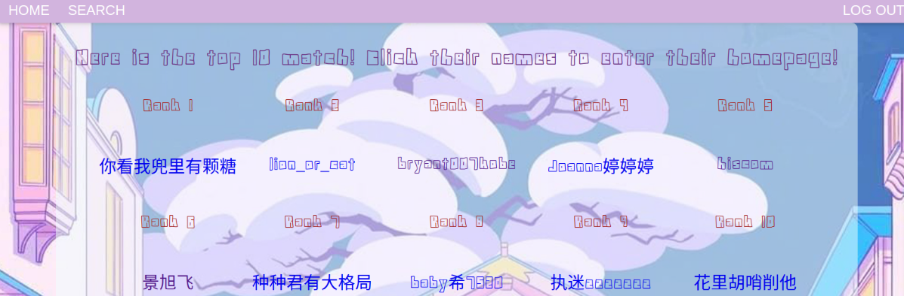
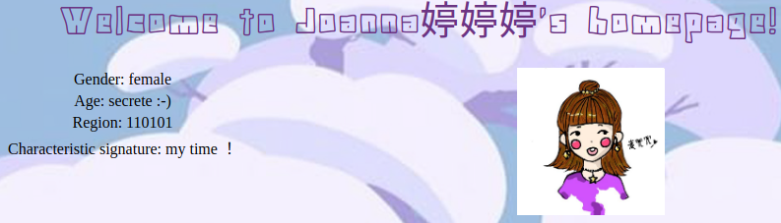
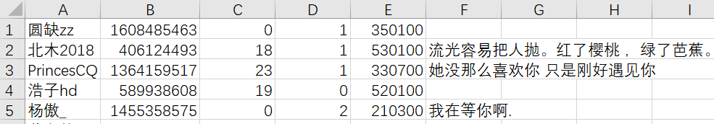
Soulmate Recommendation System
Minjia Qian, Siyi Zheng, Yuankun Zhu
¹ School of Information, University of Michigan
Motivation
When people are doing exercises, cooking, or driving a car for a long trip, almost everyone listens to music by a music software more or less. Music is an indivisible part of life that helps people feel relaxed in such a fast-paced life. For those who share the similar
Fig 2. The users and their playlists. (The columns are users id, title of the playlists, url of the playlists, respectively.)
Fig 5. Login page.
preference of the songs, they may have more things in common. It’s really exiting to find a soulmate through the magic of music.
Fig 6. User homepage.
Fig 7. Register page.
Fig 3. The songs in the playlists of one user. (The columns are the name and id of the songs, respectively.)
Objectives
Modeling and Analysis
Fig 8. Search page.
Fig 9. Result ranking page.
Collect the data from NetEase Cloud Music, including the users’ personal information, users’ playlists, the reviews of the songs.
Analyze the relationship between the users and the kinds of songs that they tend to put in the playlists. Vectorize every user according to their preference.
The system will recommend a list of ranked soulmates to the user based on the users’ playlists and provide the basic personal information of the recommended soulmate.
For the validation and demonstration purpose, design a simple UI that takes users’ basic information like age, gender, and the users may also mark their music type preference to find their soulmates.
After we crawled the reviews, a python library called jieba, which helps handle Chinese text segmentation, is applied on the data. After the text segmentation, we also remove the stop words from it. The stop words list is downloaded from the internet, and we also edit and add a few stop words according to the reviews situation, such as “哈哈哈” (Hahaha), “这首” (this song), “觉得” (think), “评论” (review), which are frequently appeared but are meaningless in expressing the feeling or attitude towards the songs. For each song, tf-idf is used to extract the most important words in all the reviews and we keep the first 20 of them. In the end, each song is vectorized by a vector of dimension 20. For the users, they’re also vectorized depends on the contents of their playlists or the search history. By measuring the distance between the vector which represents the two users, we are able to provide a soulmate recommendation list for each search.
Contact: qminjia@umich.edu
Fig 10. User information page.
Conclusion
Using our soulmate recommendation system, the user will be recommended ten users based on the rankings of them. The user is able to register and log in on our website so that their information will be recorded. Then, they can choose several songs of their favourite, which can be played online, among the listed songs on the UI. After submitting their choices, the system can recommend several users who have the most similar song list with the user and provide their homepages so that the user can know more about the recommended soulmates. We measure the accuracy of our system by controling the playlist of one user and choose the same songs on our website. Our recommendation system is able to predict that user. The way of deciding accuracy of our system deserves further improvements. Also, we can find soulmate, taking the gender and region of users into consideration in the future.
Data Collection
The first step is to get several existed users’ information. We chose several songs randomly on the NetEase Cloud Music and got the users’ id from the reviews. Then we crawled the users’ personal information page to get the name, gender, their playlists and the corresponding songs in the playlists. To characterize each songs, we crawled the reviews under the songs. Due to the fact that crawling was really slow, we crawled 5393 songs in total and at most 800 reviews for each of the songs. The screenshots of our data are as followed.
UI Design
For UI design part, we use Jinja html template and Flask frame. There are six pages for our project, login, sign up, user homepage, user information page, searching page, and searching result page.
‘GET’ and ‘POST’ methods are frequently used. HTML pages request data from DB Browser according to users’ action.
Here is the structure of our UI design.
Acknowledgement
Prof. Qiaozhu Mei and Wei Ai from the University of Michigan School of Information;
GSIs [Shiyan Yan, Xinyan Zhao] for SI 650 at University of Michigan School of Information.
Request page
GET
Render
HTML
User
Submit data
Flask frame
Page info
Jinja
Read
DB Browser
Fig 1. The users’ information. (The columns are name, id, age, gender, region, review, respectively.)
POST
Write
Contact:
Fig 4. Overview of UI designing structure.
This is a final project presentation of SI 650: Information Retrieval

