Slide 1


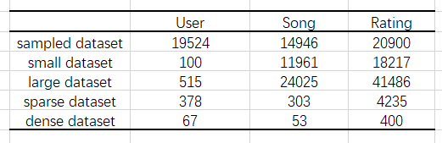

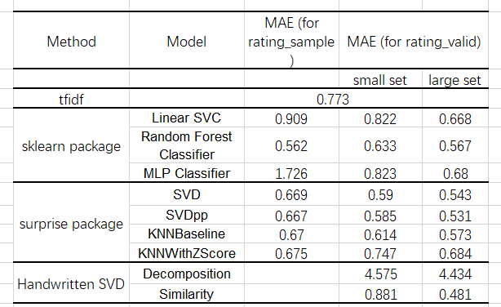

Digital Music Recommendation System
Minjia Qian, Siyi Zheng
¹ School of Information, University of Michigan
Motivation
SVD decomposition and reconstruction: Using SVD decomposition and picking an appropriate rank, the features of the matrix will be extracted. Reconstructing the prediction matrix by multiplying ${UΣV}^{T}$ is not accurate enough, thus our method doing previous steps recursively and write back the known values, until the prediction matrix converges.
Similarity based SVD: Use SVD to extract features from the original matrix and reconstruct the matrix with selected rank. Compute the cosine distance between item ratings as the similarity, and compute the estimated rating by$\frac{\text{Σsim}\text{(}\text{u}\text{, }\text{v}\text{)*}\text{rating}\text{(}\text{u}\text{)}}{\text{Σsim}\text{(}\text{u}\text{, }\text{v}\text{)}}.$
When people shopping on the internet, they may easily refer to the items recommended by the website. On the other hand, the shops are always trying to recommend products to the customers to earn more money. Thus, a well trained recommendation system is necessary for all of us. Among all kinds of the
Fig 2. Data Information After Pre-processing
Digital_Music_5.json: The json file contains the information about reviewerID, itemID, reviewerName, whether it's helpful, reviewText, summary and review time. The review time is not used either. As we want to get more useful information from customers' reviews, we will pay more attention to the reviewText and its corresponding rating.
items in the shops, we will focus on the digit music in this project. For those who share the similar preference of the songs, they may have more things in common.
Objectives
Methodology
Cluster all the songs into different groups and extract some features / tags to characterize each song. Analyze the relationship between the users and their music preferences.
Experiment with four different methods, including machine learning algorithms in sklearn and surprise, tfidf and traditional SVD. We may also compare the performance among these methods.
For the validation and demonstration purpose, we will divide our data set into the training set and the validation set. After we build the model, we will apply it to the validation set and calculate the mean absolute error as the judgement of the performance.
Tf-idf vectorization: Tf-idf is short for term frequency–inverse document frequency. Term frequency refers to how common does a word occur in one document, while inverse document frequency refers to how common does a word occur across a set of documents. It’s a statistical measurement that "evaluate show relevant a word is to a document in a collection of documents“.
Sklearn package: The Linear SVC refers to the linear support vector classification. The Regularization parameter tells the SVM optimization "how much you want to avoid misclassifying each training example". The random forest is composed of a number of decision trees, which takes the advantage of the wisdom of crowds. The MLP Classifier relies on an underlying Neural Network to perform the task of classification
Surprise package: The SVD and SVDpp methods are matrix factorization based algorithms. They extract user features and item features by gradient descent method. In addition, they add user bias, item bias and data set bias to optimize the prediction results. KNN-Baseline and KNNWithZScore are methods related to similarity based clustering.
Validation and Analysis
We split our data set into the training set and the validation set with the proportion 3:1 in the pre-process. The experiment results are shown in the table below:
Conclusion
Data Description
The Random Forest method is the most stable one. The similarity based SVD method has the best performance on a large data set, but the similarity based SVD method still needs experiments on larger data set to prove its efficiency. Machine Learning methods in the Surprise package all works well and the performance doesn’t vary much when the dataset changes. SVD decomposition and reconstruction method highly relies on the quality of data set.
We use the digital music part of a public Amazon Data set from http://jmcauley.ucsd.edu/data/amazon/. There are two files we will use in this project：
ratings_Digital_Music.csv: The four columns in this table are user, item, rating and timestamp. There are 478235 unique users, 836006 ratings, and 266414 unique songs. The data is quite sparse. To solve the problem, we sample 0.025 * 836006 no repeated data entries from the original data as the simplified data and extract users who have given more than or equal to 40 or 100 ratings as the valid data。 After splitting and filtering, the details of the final data sets is shown in Fig. 1.
Acknowledgement
Prof. Paramveer Dhillon from the University of Michigan School of Information; GSIs [Kwame Robinson, Lingyun Guo] for SI 671 at University of Michigan School of Information.
Contact:
This is a final project presentation of SI 671: Data Mining

