Slide 1
Explore and visualize your data using Graphpad Prism
Zhengtao Xiao
8.26.2019
zhengtao.xiao@duke.edu

Slide 2
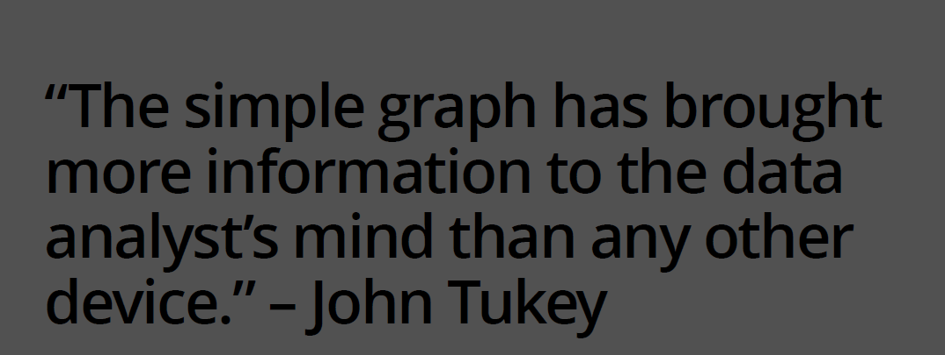

Slide 3
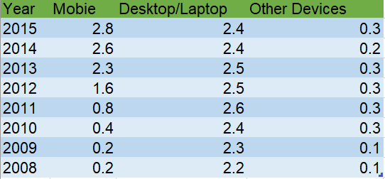
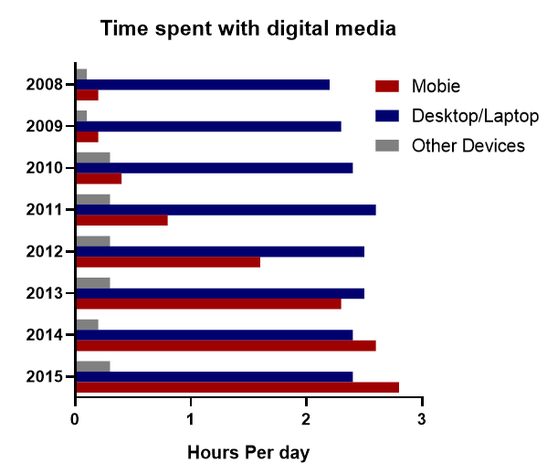
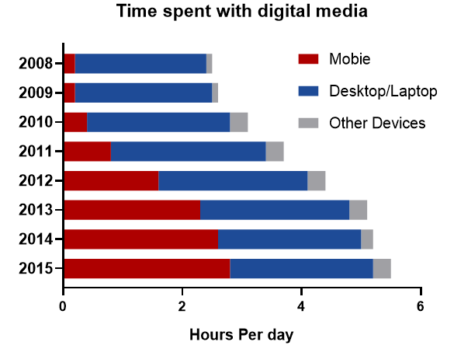
Graph help us interpret scientific data more efficiently
Time spent with digital media
When to use what

Slide 4

Choose the most appropriate graph for your data
https://www.data-to-viz.com/

Slide 5
Why Graphpad Prism?
Easy and fast
Commonly used statistical methods
Graphs and data are automatically updated in real time
Reusable graph template
… …

Slide 6
Three steps to generate a graph
Prepare data
Perform analysis
Choose the type of graph

Slide 7
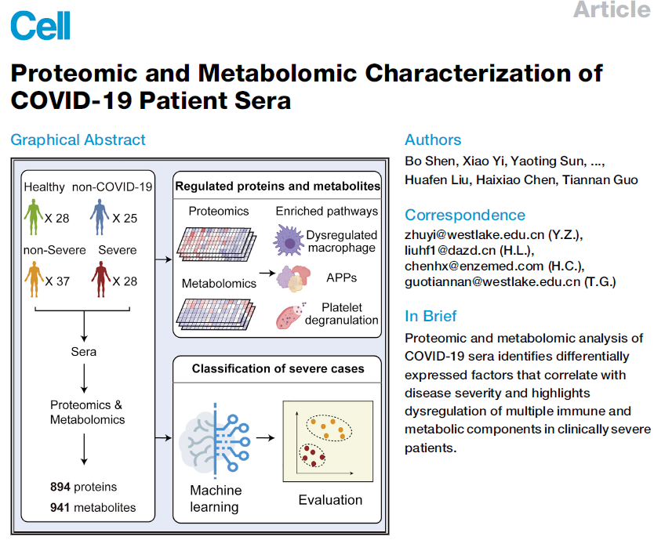
Dataset for practice

Slide 8
Distribution of metabolites’ concentration
Correlation of metabolomics across patients
T-test (comparison of two groups)
One-way anova (comparing more groups)

Slide 9
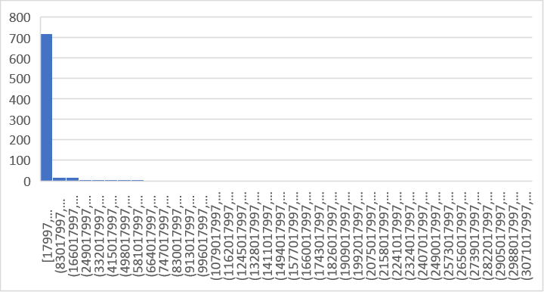
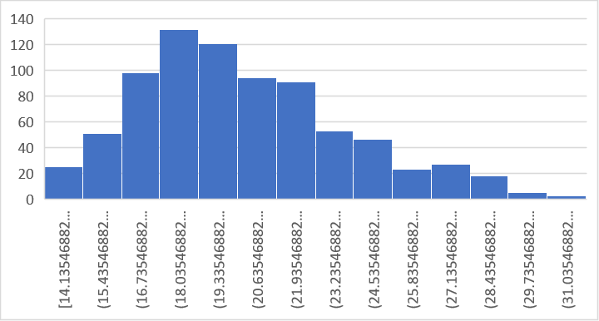
Practice: Transform the data to log2 scale
“log2” changes the distribution to normal-like distribution
“log2” brings the up- and down-regulated genes/metabolites to same scale
Control = 20
Treatment = 160
Control = 160
Treatment = 20
Fold change = 8
Fold change = 0.125
Log2 fold change = 3
Log2 fold change = -3

Slide 10
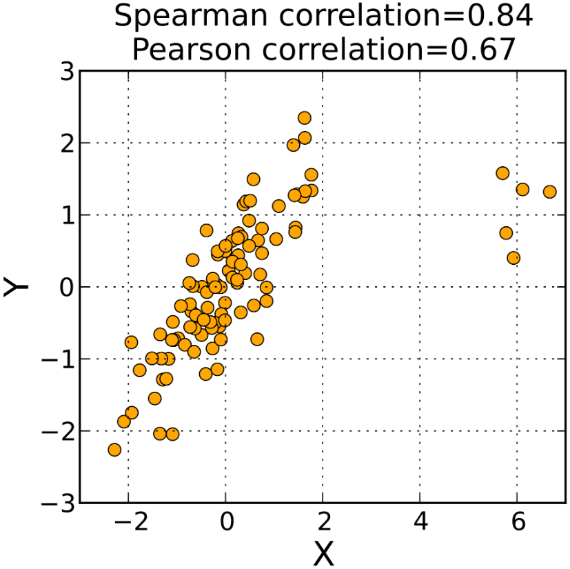
Practice: calculate correlation
Correlation (pearson or spearman?)
The Spearman correlation is less sensitive than the Pearson correlation to strong outliers
Notes:
+

Slide 11
Practice: correlation matrix
Notes:
+

Slide 12
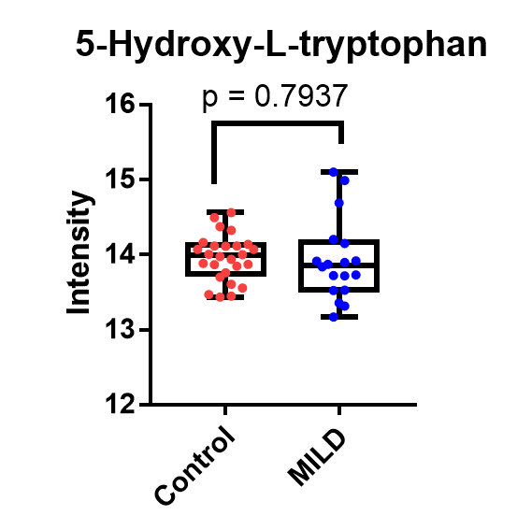
Practice: using t-test to compare two groups

Slide 13


Advice: when to plot SEM vs. SD
SD: standard deviation, quantifies how much the values vary from one another
SEM: standard error of the mean, represents the accuracy of the true mean for the population. SEM = SD/(square root of sample size)
SD: If you want to show the variation of your data. For example, if you want to present that one metabolite is much more stable than another one by stimulus.
SEM: If you want to show how precisely you determine the true mean. For example, you want to present that one metabolite is up regulated after infection.
M1
M2

Slide 14
Practice: using anova to compare multiple groups
We want to see if selected metabolite significantly changed after infected.
One-way anova (you can simply think it as a multiple t-test):
determine whether there are any statistically significant differences between the means of two or more independent (unrelated)
Null and Alternative hypotheses
H0: µ(control) == µ (mild) == µ(moderate) == µ(severe)
H1: not all µ are equal
We want to see the relative intensities to control group.

Slide 15
Practice: Group Bar Graph
We want to see the relative intensities of all metabolites in TCA cycle

Slide 16
Practice: volcano plot
Volcano plot: significance vs magnitude of changes in metabliltes

Slide 17
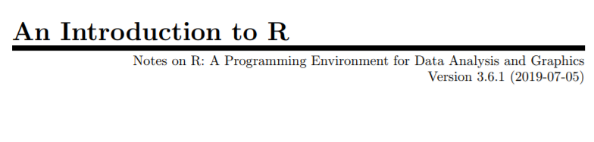
More information
Prism user guide
Prism statistics guide
Prism Tips
zhengtao.xiao@duke.edu
Next lecture
https://cran.r-project.org/doc/manuals/r-release/R-intro.pdf
https://github.com/zhengtaoxiao/NCSU_R

