Slide 1
Distributed Systems
COMP90015 2015 SM1
Tutorial 8
Nikolay Grozev
Email: nikolay.grozev@unimelb.edu.au
Date: 7/May/2015

Slide 2
Assignment 2 - Basics
LMS Discussion Board > Email;
Form teams of 3-4 people;
Will be demonstrated in person:
15-20 minutes per team;
All members must be present;
Explain what you did and the respective part of the code;
Team mates may receive different scores;
More liberal than Assignment 1;
Application 70%, Report 30%;
Extra credit of up to 15%;

Slide 3
Assignment 2 - Overview
Job Management System;
Master-Worker architecture;
Master to Worker = Many to Many;
Job:
Provided by the end user;
Runnable Jar file;
Input file;
Generates an output file in the given location;
java –jar job.jar input.csv output.csv

Slide 4
Assignment 2 - Master
Initialisation – list of workers (address & port);
Deployed on your PC;
Communicates with Workers via SSL sockets;
User Interface (GUI or CLI):
Submit job;
Monitor the states of the submitted jobs;
Fetch the result or stdout and stderr if failed;
List all workers and their statuses;
Dynamically add a worker;
Worker selection for a job – Round Robin;

Slide 5
Assignment 2 - Worker
Deployed in a VM in Nectar or another cloud;
Connect to VM via SSH to deploy and start;
Can serve multiple masters;
Responds to inquiries from the masters;
Jobs are run in new processes (not threads!):
Use ProcessBuilder and Process classes;
http://tinyurl.com/mmg9log;
http://tinyurl.com/nkvhyms;
http://tinyurl.com/pvpowne;
Deployed in a jar file over SSH/SCP;

Slide 6
Assignment 2 - Report
1500 words <;
Architectural model with a diagram;
Master-Worker communication with UML seq. diagram;
What processes and threads are used;
Failure handling;
Who did what?

Slide 7
Assignment 2 – Extra Credit
Graphical User Interface (GUI) – 5%;
Place jobs in the least utilised worker – 5%;
Deadline for each job – 2%;
Max RAM per job – 3%;

Slide 8
Cloud Computing - IaaS

Slide 9
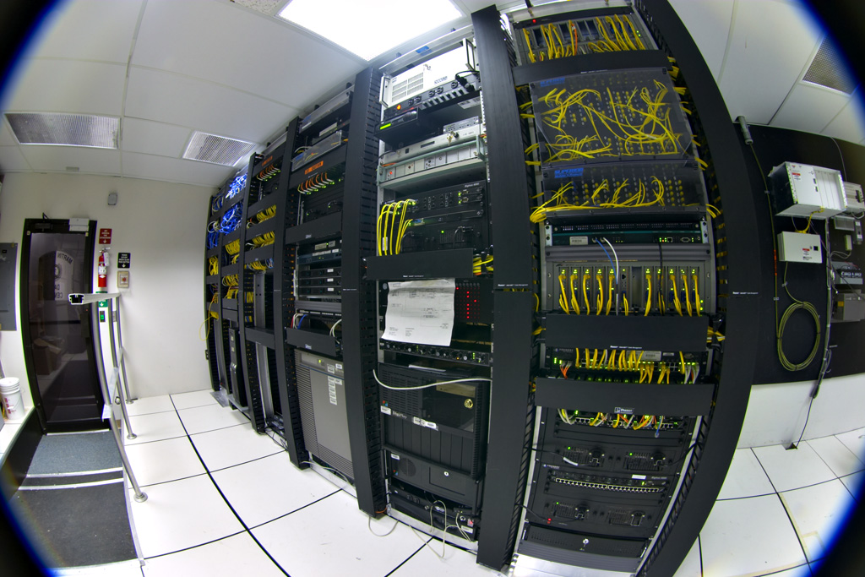
Cloud Computing – Overview
Cloud computing is a model for enabling ubiquitous, convenient, on-demand network access to a shared pool of configurable computing resources (e.g., networks, servers, storage, applications, and services) that can be rapidly provisioned and released with minimal management effort or service provider interaction. Source: NIST definition
Cloud basically means someone else’s computer ☺ . Source: The web
Infrastructure as a Service (IaaS);
Platform as a Service (PaaS);
Software as a Service (SaaS);
image from Wikipedia

Slide 10
Cloud Computing – Nectar
Research Community Cloud;
Well documented:
http://support.rc.nectar.org.au/docs/technical-guides;
All students have an account and limit of 2 cores;
Use Melbourne Uni Credentials;
Online Dashboard - https://dashboard.rc.nectar.org.au;

Slide 11
Creating a VM on Nectar – step by step
Define Security Group:
Firewall rules;
Open the ports for your application!
Create key-pair:
Allows SSH to the VM;
Save the pem file!
Create VM instance – specify key-pair, sec. group, flavor, OS:
Login, install, configure;
Create a snapshot;

Slide 12
Common commands
SSH/SCP basics:
ssh -i demokeypair.pem ubuntu@144.6.227.142
scp -i demokeypair.pem hellocloud.jar ubuntu@144.6.227.142:~
Install Java 8 in Ubuntu:
sudo add-apt-repository ppa:webupd8team/java -y
sudo apt-get update
sudo apt-get install -y oracle-java8-installer
sudo apt-get update
sudo apt-get install -y oracle-java8-installer
sudo update-java-alternatives -s java-8-oracle
sudo apt-get install -y oracle-java8-set-default

Slide 13
SSH tricks
Windows:
[Option 1] Git Bash:
Download - http://msysgit.github.io/
[Option 2] Cygwin:
Download - https://www.cygwin.com/
Install SSH support - https://www.youtube.com/watch?v=CwYSvvGaiWU
Mac/Linux error – “WARNING: UNPROTECTED PRIVATE KEY FILE!”:
chmod 400 demokeypair.pem

