Slide 1
Database for Hospital
Tianqi Zheng
NUID: 001213047

Slide 2
Normalization Steps
Define the major entities (tables) in 1NF
Define the tables represent relationships between entities
Normalize entities and relation tables into 2NF
Normalize tables to satisfy 3NF, change all transaction dependency

Slide 3
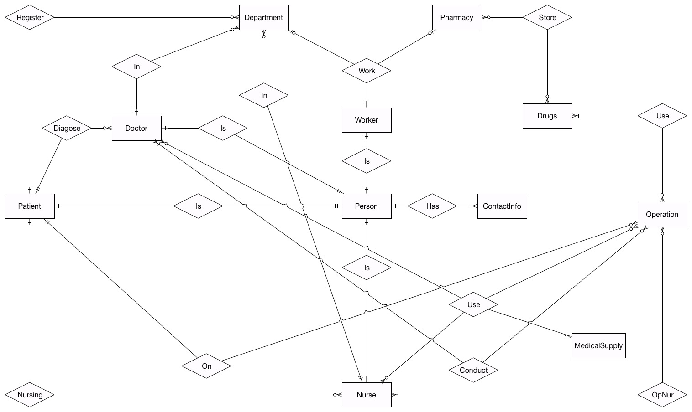
Entity Relationship Diagram

Slide 4
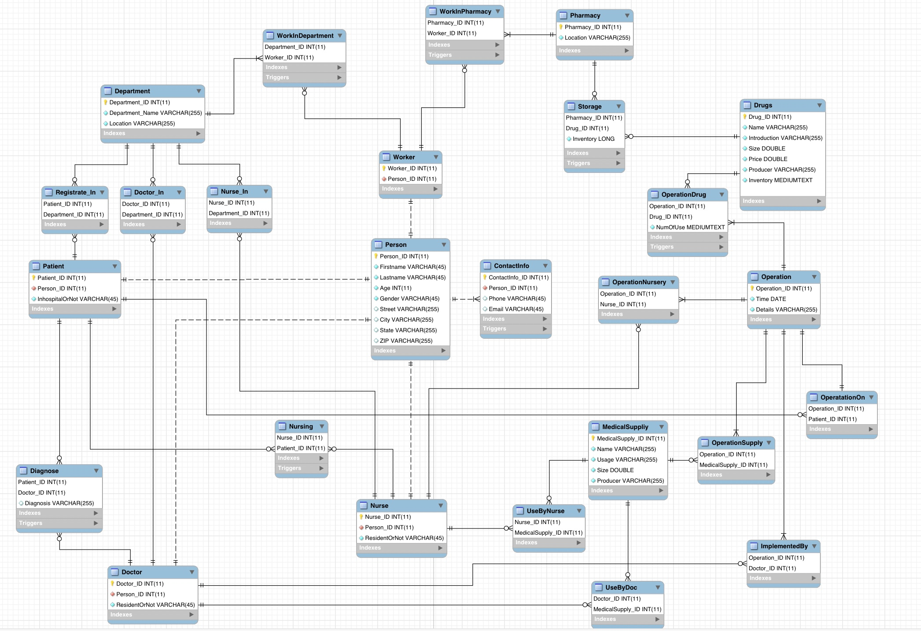
Enhanced Entity Relationship Diagram

Slide 5
Triggers
WorkInDepartment: Before insert/update
WorkInPharmacy: Before insert/update
ContactInfo: Before insert/update
Diagnose: Before insert/update
Nursing: Before insert/update
Storage: Before insert/update, After insert/update

Slide 6
Triggers
OperationDrug: Before insert/update, After insert/update
Doctor: Before insert/update
Nurse: Before insert/update
Worker: Before insert/update

Slide 7
Stored Procedures
GetPharamacyInventorywithLocation: IN varchar
GetPersonDetailswithName: IN varchar, varchar
GetPatientHistorywithID: IN int
GetOperationDrugswithPatientID: IN int
GetNurseDetailswithName: IN varchar, varchar
GetDoctorDetailswithName: IN varchar, varchar

Slide 8
Q & A
Thank You!

