Slide 1
Database for Hospital
Tianqi Zheng
NUID: 001213047

Slide 2
Normalization Steps
Define the major entities (tables) in 1NF
Define the tables represent relationships between entities
Normalize entities and relation tables into 2NF, get rid of functional dependency
Normalize tables to satisfy 3NF, change all transaction dependency

Slide 3
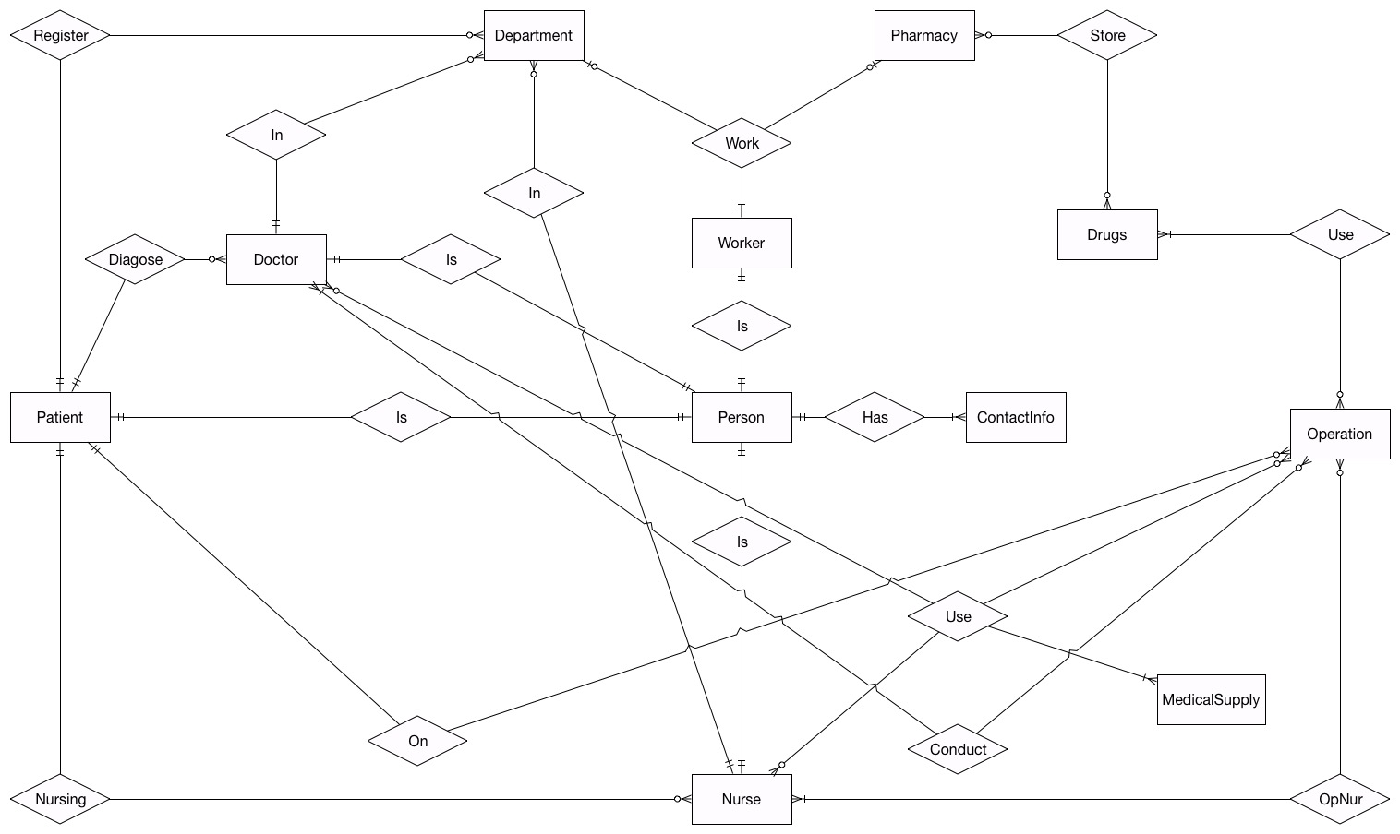
Entity Relationship Diagram

Slide 4
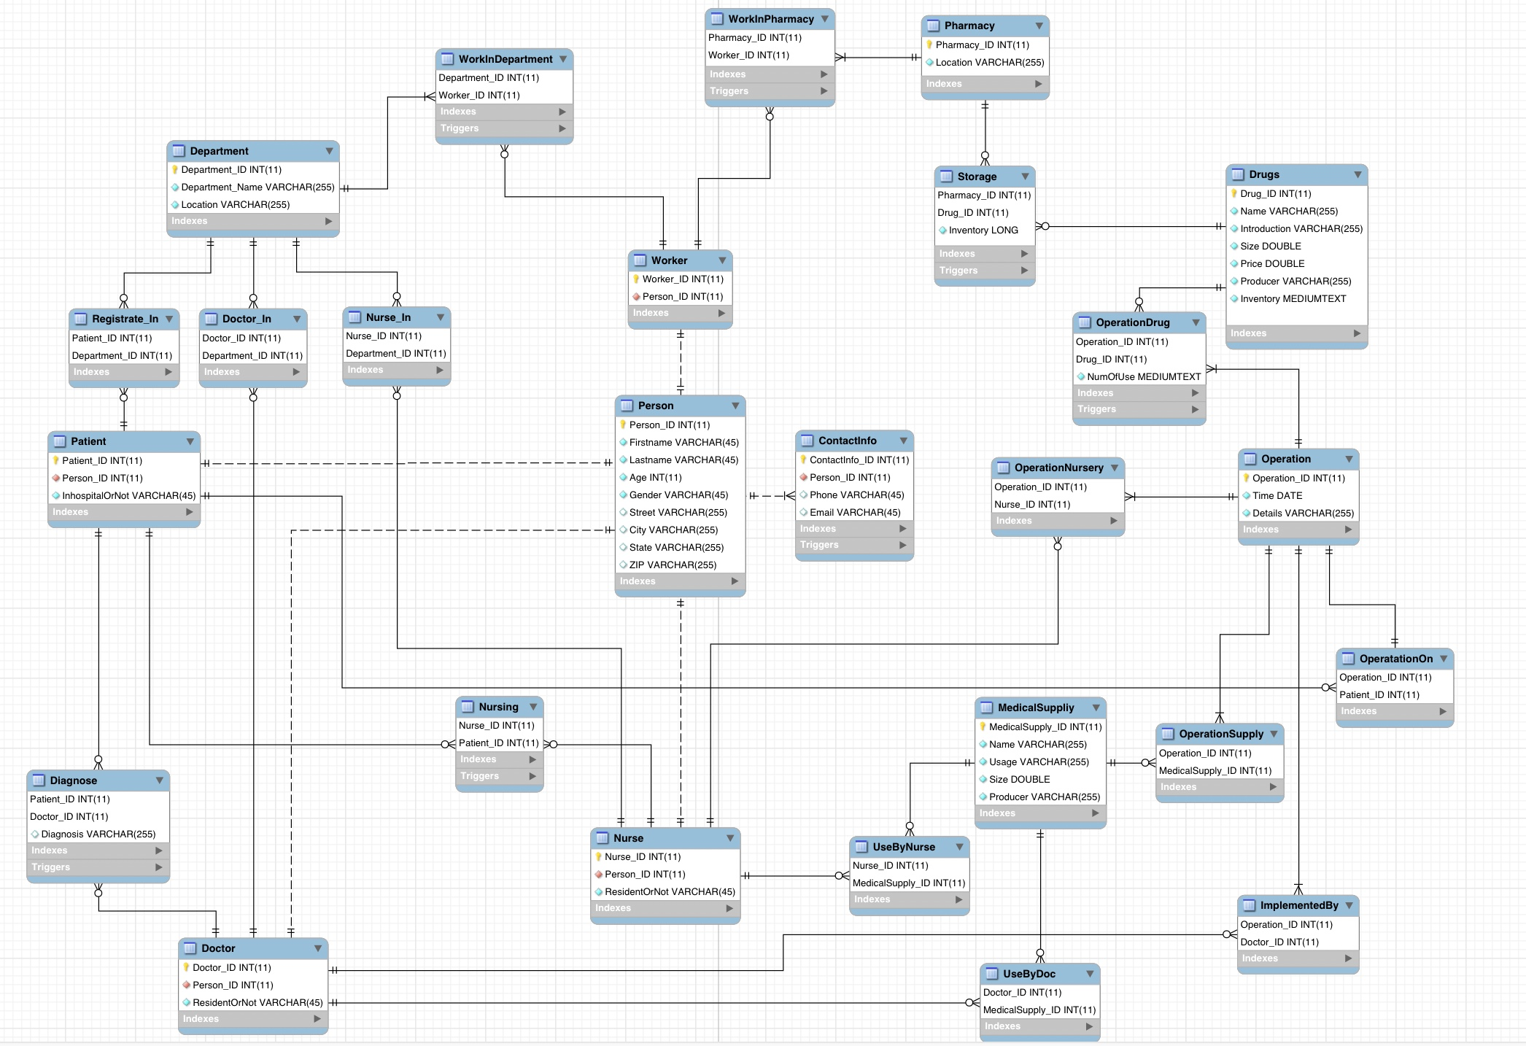
Enhanced Entity Relationship Diagram

Slide 5
Stored Procedures
GetPharamacyInventorywithLocation: IN varchar
GetPersonDetailswithName: IN varchar, varchar
GetPatientHistorywithID: IN int
GetOperationDrugswithPatientID: IN int
GetNurseDetailswithName: IN varchar, varchar
GetDoctorDetailswithName: IN varchar, varchar

Slide 6
Q & A
Thank You!

