Slide 1
Database for Hospital
Tianqi Zheng
NUID: 001213047

Slide 2
Description
In this project, I developed a relational database system for hospital, users could use it to store records of patients, doctors, nurses, workers and departments, pharmacy, drugs and operations as entity with detailed information, together with tables to define their relatinships. The database has been normalized to meet 3NF. Besides, I have defined triggers and procedures for a better use.

Slide 3
Normalization Steps
Define the major entities (tables) in 1NF
Define the tables represent relationships between entities
Normalize entities and relation tables into 2NF
Normalize tables to satisfy 3NF, change all transaction dependency

Slide 4
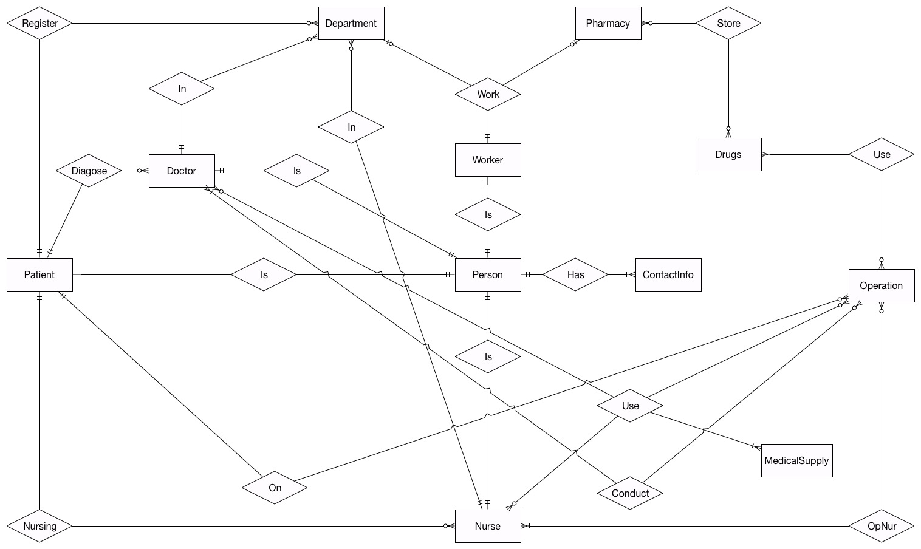
Entity Relationship Diagram

Slide 5
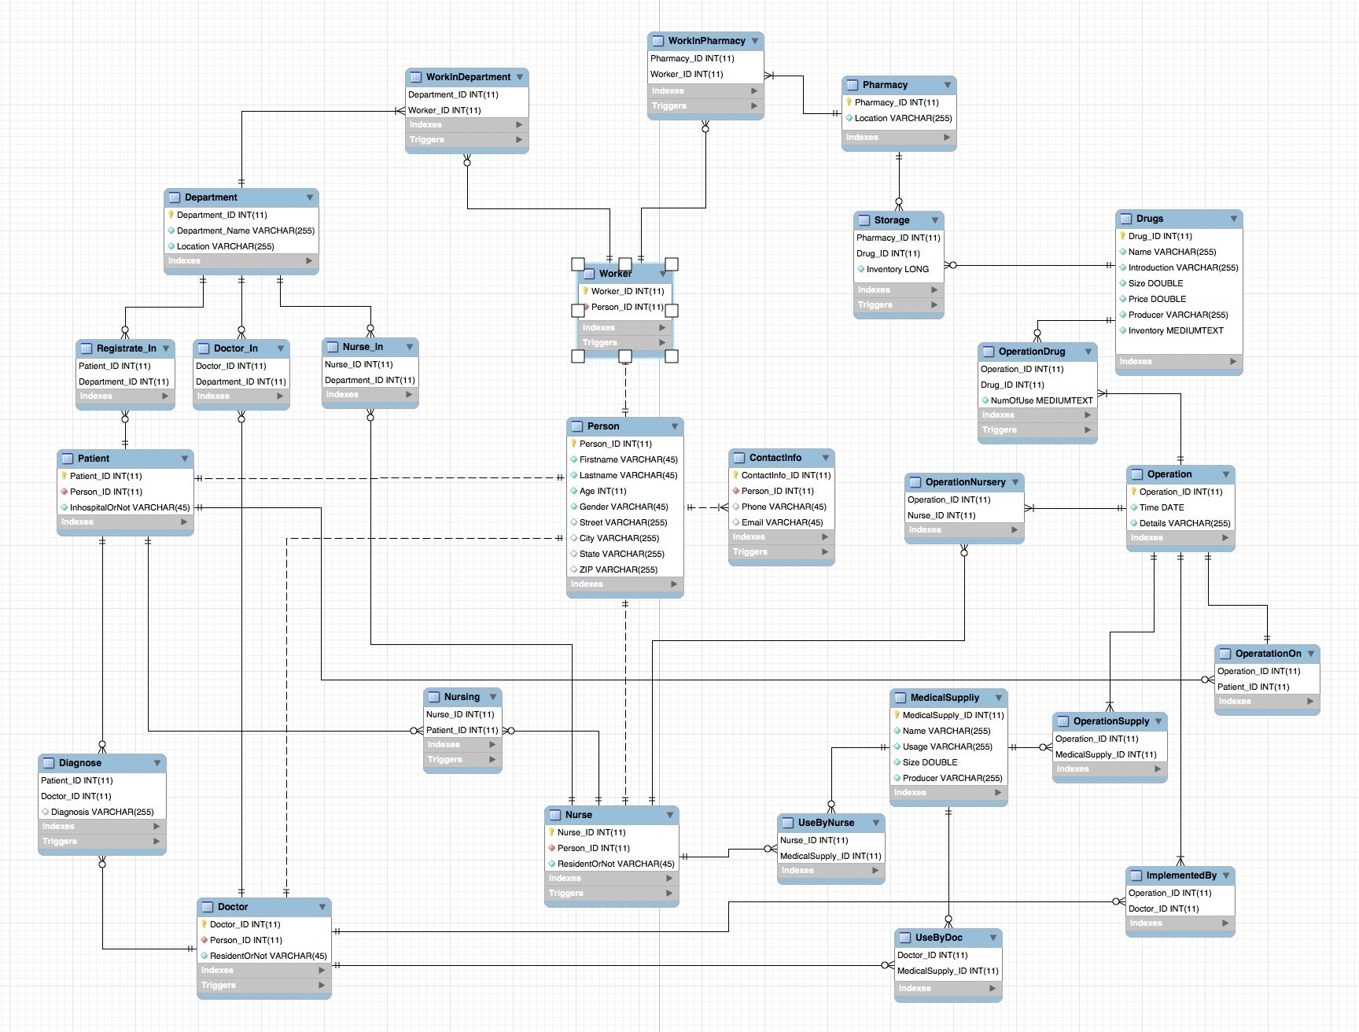
Enhanced Entity Relationship Diagram

Slide 6
Triggers
Before insert/update on WorkInDepartment: check if the inserted/updated worker can work in the department
Before insert/update on WorkInPharmacy: check if the inserted/updated worker can work in the pharmacy
Before insert/update on ContactInfo: check if the new email address satisfies the correct form
Before insert/update on Diagnose: check if the doctor and the patient are in the same inpatient status
Before insert/update Nursing: check if the nurse and the patient are in the same inpatient status

Slide 7
Triggers
Before insert/update on Storage: After insert/update, check if the new drug storage information applies to current inventory, and update inventory after change
Before insert/update on OperationDrug: After insert/update, check if the new drug used in operation information applies to current inventory, and update inventory after change
Before insert/update on Doctor: check if the doctor satisfy his own person status, that is he can only be a doctor
Before insert/update on Nurse: check if the doctor satisfy his own person status, that is he can only be a doctor
Before insert/update on Worker: check if the doctor satisfy his own person status, that is he can only be a doctor

Slide 8
Stored Procedures
GetPharamacyInventorywithLocation(varchar): get a table of a pharmacy’s inventory with given location
GetPersonDetailswithName(varchar, varchar): get a person’s information with his full name
GetPatientHistorywithID(int): get a patient’s history with his patient_ID
GetOperationDrugswithPatientID(int): get drug usage detail in an operation with the patient_ID
GetNurseDetailswithName(varchar, varchar): get a nurse’s detailed information with his full name
GetDoctorDetailswithName(varchar, varchar): get a doctor;s detailed information with his full name

Slide 9
Q & A
Thank You!

