Slide 1
Database for Hospital
Tianqi Zheng
NUID: 001213047

Slide 2
Description
In this project, I developed a relational database system for hospital.
It stores records of patients, doctors, nurses, workers and departments, pharmacy, drugs and operations as entity with detailed information, together with tables to define their relationships.
Triggers and procedures are defined inside to help management the database, also for better use.
The database has been normalized to meet 3NF.

Slide 3
Normalization Steps
Define the major entities (tables) in 1NF
Define the tables represent relationships between entities
Normalize entities and relation tables into 2NF, no none-key field can depend another field in each table
Normalize tables to satisfy 3NF, change all transaction dependency

Slide 4
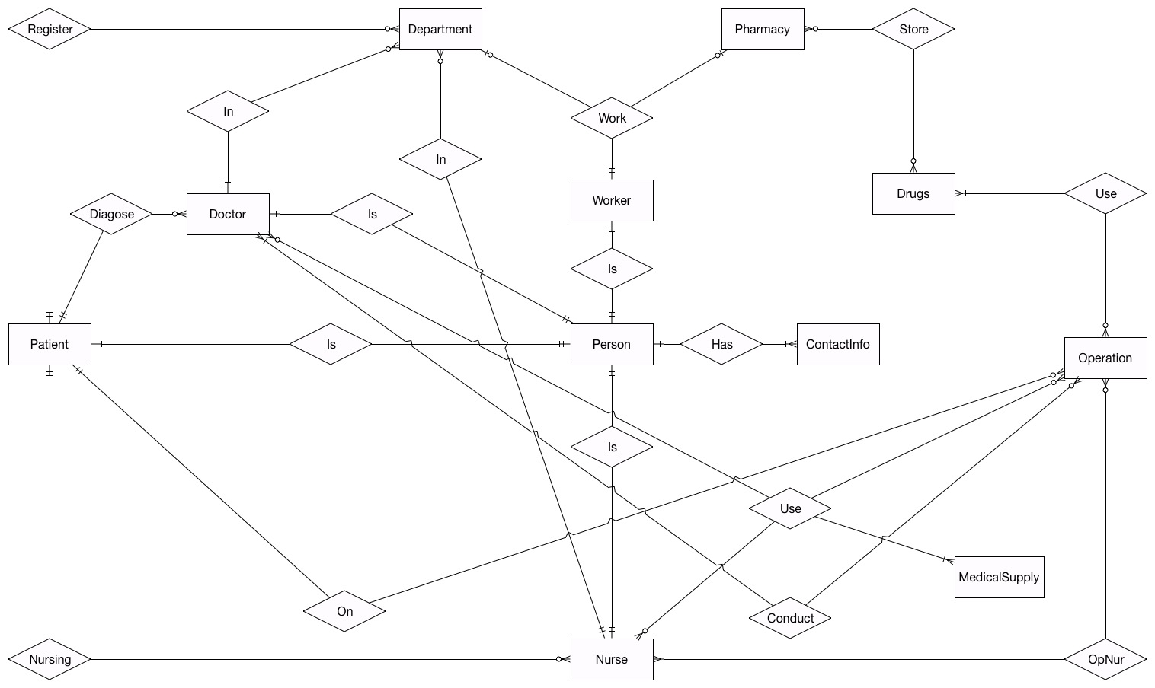
Entity Relationship Diagram

Slide 5
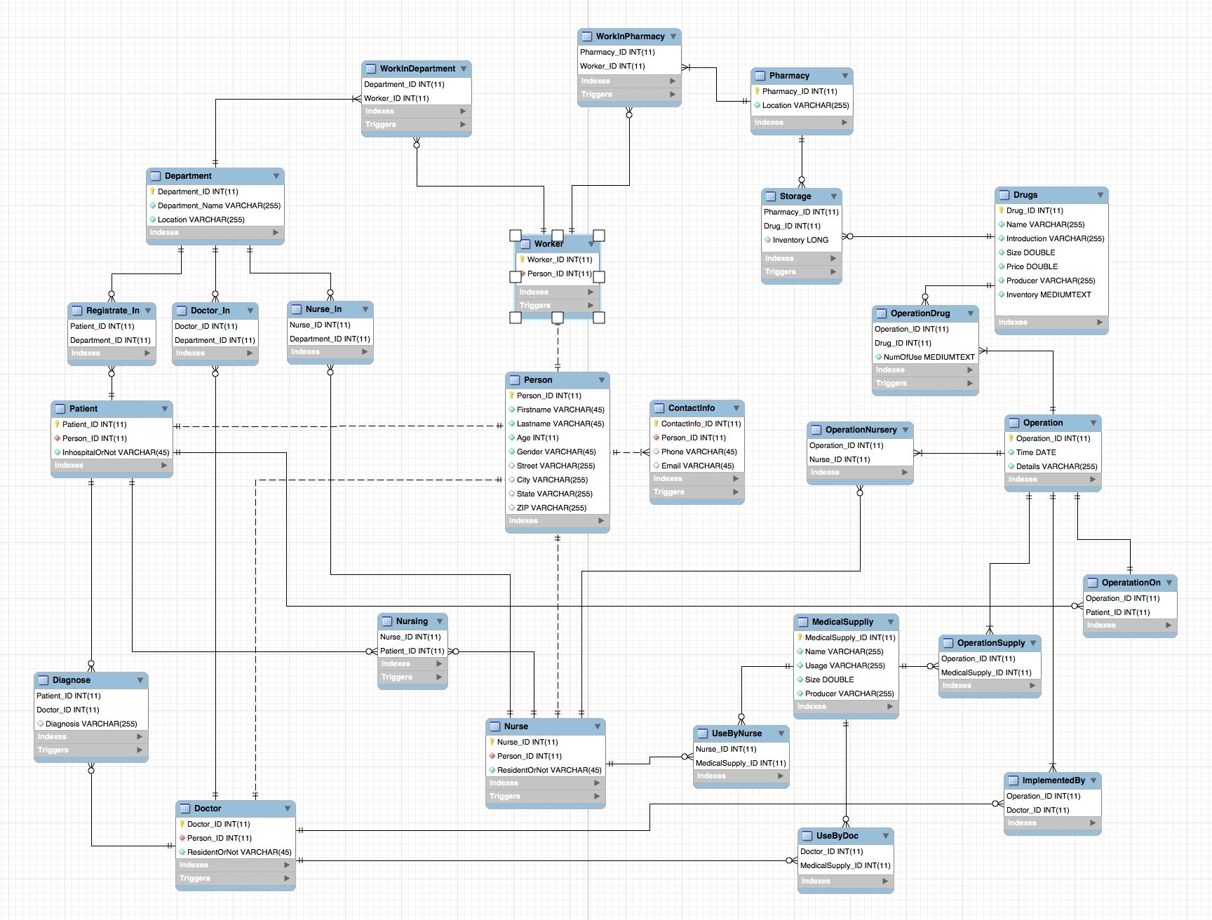
Enhanced Entity Relationship Diagram

Slide 6
Triggers
Before insert/update on WorkInDepartment: check if the inserted/updated worker can work in the department
Before insert/update on WorkInPharmacy: check if the inserted/updated worker can work in the pharmacy
Before insert/update on ContactInfo: check if the new email address satisfies the correct form
Before insert/update on Diagnose: check if the doctor and the patient are in the same inpatient status
Before insert/update Nursing: check if the nurse and the patient are in the same inpatient status

Slide 7
Triggers
Before insert/update on Storage: After insert/update, check if the new drug storage information applies to current inventory, and update inventory after change
Before insert/update on OperationDrug: After insert/update, check if the new drug used in operation information applies to current inventory, and update inventory after change
Before insert/update on Doctor: check if the doctor satisfy his own person status, that is he can only be a doctor
Before insert/update on Nurse: check if the doctor satisfy his own person status, that is he can only be a doctor
Before insert/update on Worker: check if the doctor satisfy his own person status, that is he can only be a doctor

Slide 8
Triggers - Example
CREATE
DEFINER=`root`@`localhost`
TRIGGER `mydb`.`OperationDrug_BEFORE_INSERT`
BEFORE INSERT ON `mydb`.`OperationDrug`
FOR EACH ROW
BEGIN
declare inventory_remain long;
set inventory_remain = (select Drugs.Inventory from Drugs where New.Drug_ID = Drugs.Drug_ID);
if(inventory_remain - new.NumOfUse < 0)
Then
signal sqlstate value '40007’
set message_text = 'Not valid drug inventory!';
end if;
How it works: If the drugs are updated with invalid inventory, error code 40007 will apear

Slide 9
Triggers - Example
CREATE
DEFINER=`root`@`localhost`
TRIGGER `mydb`.`OperationDrug_BEFORE_INSERT`
BEFORE INSERT ON `mydb`.`OperationDrug`
FOR EACH ROW
BEGIN
declare inventory_remain long;
set inventory_remain = (select Drugs.Inventory from Drugs where New.Drug_ID = Drugs.Drug_ID);
if(inventory_remain - new.NumOfUse < 0)
Then
signal sqlstate value '40007’
set message_text = 'Not valid drug inventory!';
end if;
How it works: If the drugs are updated with invalid inventory, error code 40007 will apear

Slide 10
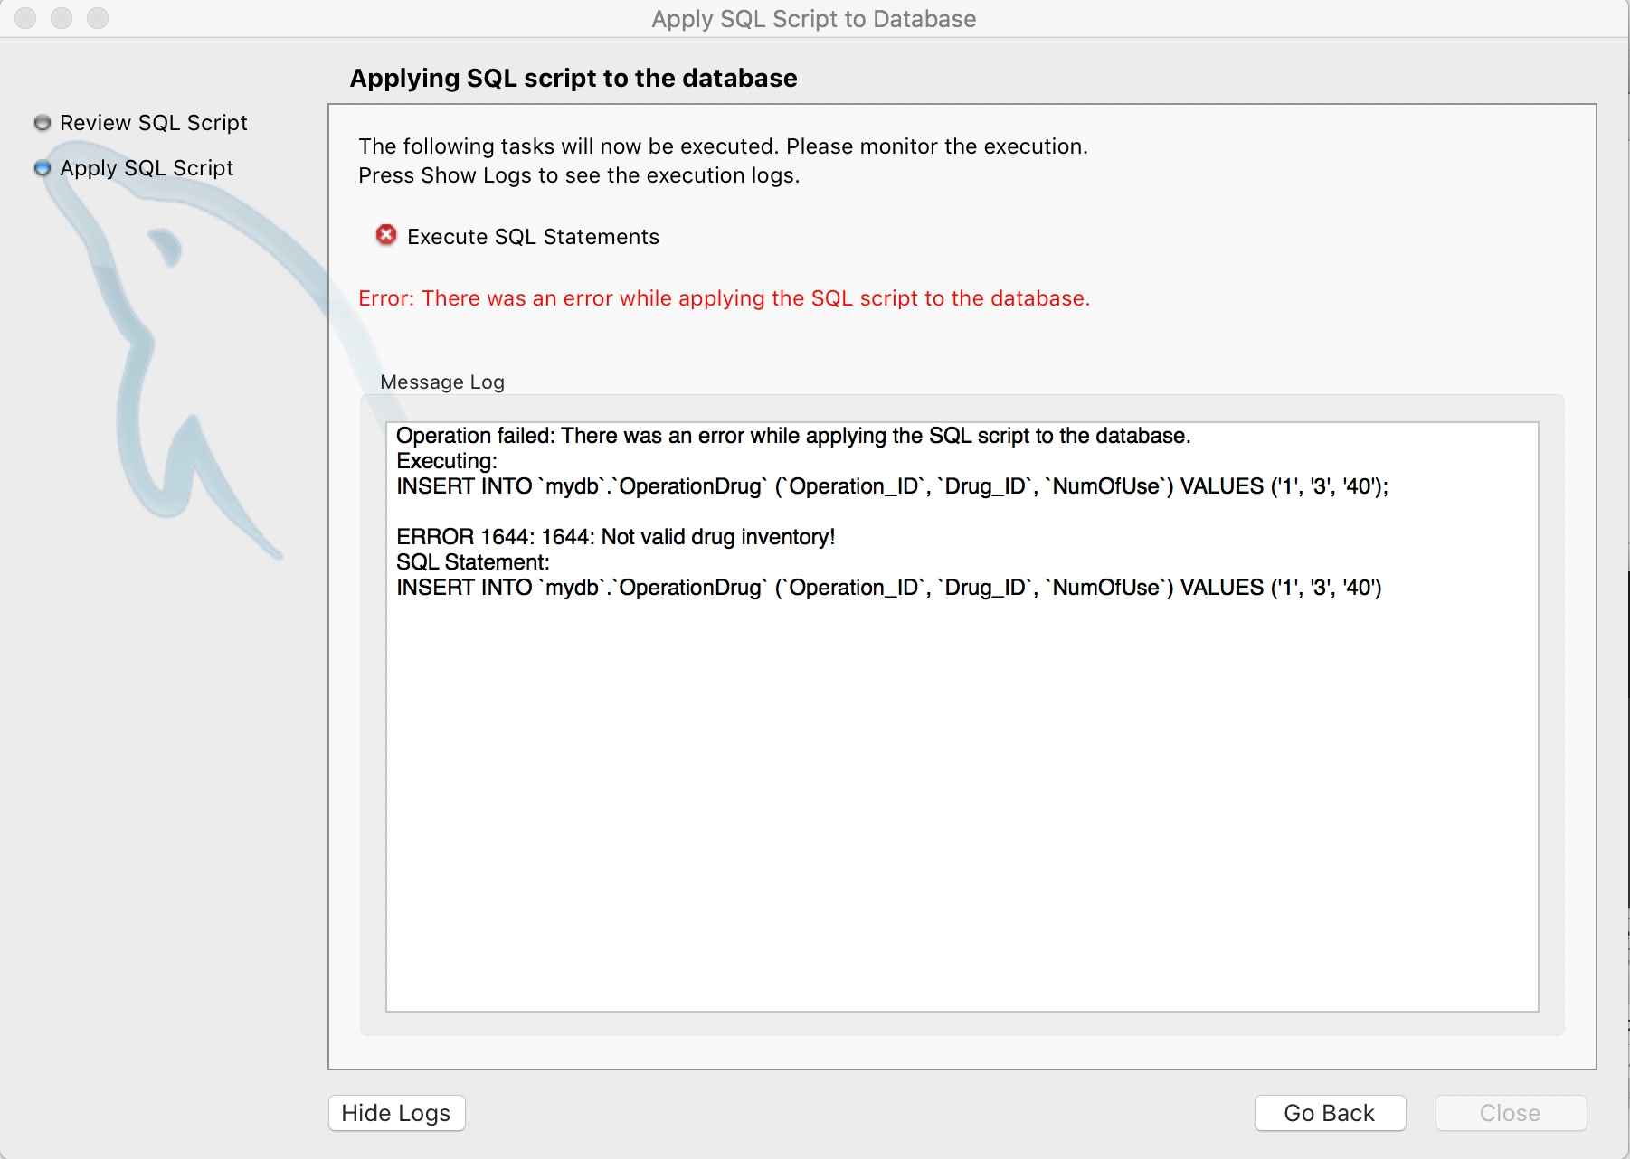
Triggers - Example

Slide 11
Stored Procedures
GetPharamacyInventorywithLocation(varchar): get a table of a pharmacy’s inventory with given location
GetPersonDetailswithName(varchar, varchar): get a person’s information with his full name
GetPatientHistorywithID(int): get a patient’s history with his patient_ID
GetOperationDrugswithPatientID(int): get drug usage detail in an operation with the patient_ID
GetNurseDetailswithName(varchar, varchar): get a nurse’s detailed information with his full name
GetDoctorDetailswithName(varchar, varchar): get a doctor;s detailed information with his full name

Slide 12
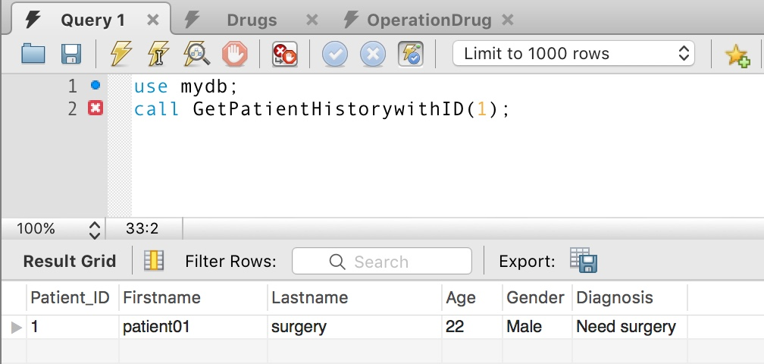
Procedure - Example

Slide 13
Q & A
Thank You!

