Slide 1

PM 2.5 Mapper
Team1
Tianqi Zheng
Xiajie Zhang
Ruofan Lyu
Zihan Zhang

Slide 2
Background
PM2.5 refers to atmospheric particulate matter (PM) that have a diameter less than 2.5 micrometers. People may be affected by particle pollution and caught heart or lung diseases.
It will cause some environmental problems such as: reduction of visibility, stain or damage on buildings and increasing rate of acidity in the water.

Slide 3
Goals of the project
Based on the PM 2.5 data provided by the user, make a prediction to the PM concentrate of the newest year and make a comparison between the original data and the predicted data. Get the annually tendency of the PM 2.5 of a certain area.
With the parsed data we would use Ploty ( https://plot.ly ) as our tool to draw a map, with the concentration of each point.

Slide 4
Use cases
User should provide his username, API key and the location of source data file ( required to be .csv files ), then the mapper will give the result to his Ploty account.
Give the prediction diagram online to the user based on the given PM2.5 data, which can be a reference for people to take some possible actions to deal with the excessive PM2.5.

Slide 5
Data sources
From EPA(United States Environmental Protection Agency)
http://aqsdr1.epa.gov/aqsweb/aqstmp/airdata/download_files.html#Daily
Up to 706.1 MB data from 2011 – 2016

Slide 6
Data USED
We parsed approximately 2,100,000 records of data to generate the presentation graph on Ploty, which we will present.
The whole data is under our Teambition file repository, we made a shared folders on Google Drive: https://drive.google.com/open?id=0B6I0NdrY55kOeGdNRGwyZWhUM3M
The Test20xx.csv files under GitHub repository are examples for users to prepare their source data

Slide 7
Techniques
Functional Programming Language Scala ( ingest, form dataset, GUI )
Spark ( parsing )
Machine learning ( MLlib )
Ploty (Graphing in Scala )

Slide 8
Methodology
Data parse
using Spark to do some pre-process for the data. Parse the date in the original data, delete missing record, out form record, etc. And extract the data we need.
Data analysis
ingest the data extracted and find the arithmetic mean, using MLlib from Apache Spark to make a linear regression prediction. Store these data in dataset.
Draw graph
draw a graph based on the dataset, with date local, and arithmetic mean of PM 2.5 using Ploty.

Slide 9
Milestones
3.14 ~ 3.22 | Source data analyze and decide the require information
3.23 ~ 4.7 | Parsing data using Scala and Spark, form dataset, do the prediction with machine learning
4.8 ~ 4.14 | Draw graph with dataset and reactive part
4.15 ~ 4.19 | Test and fix functions

Slide 10
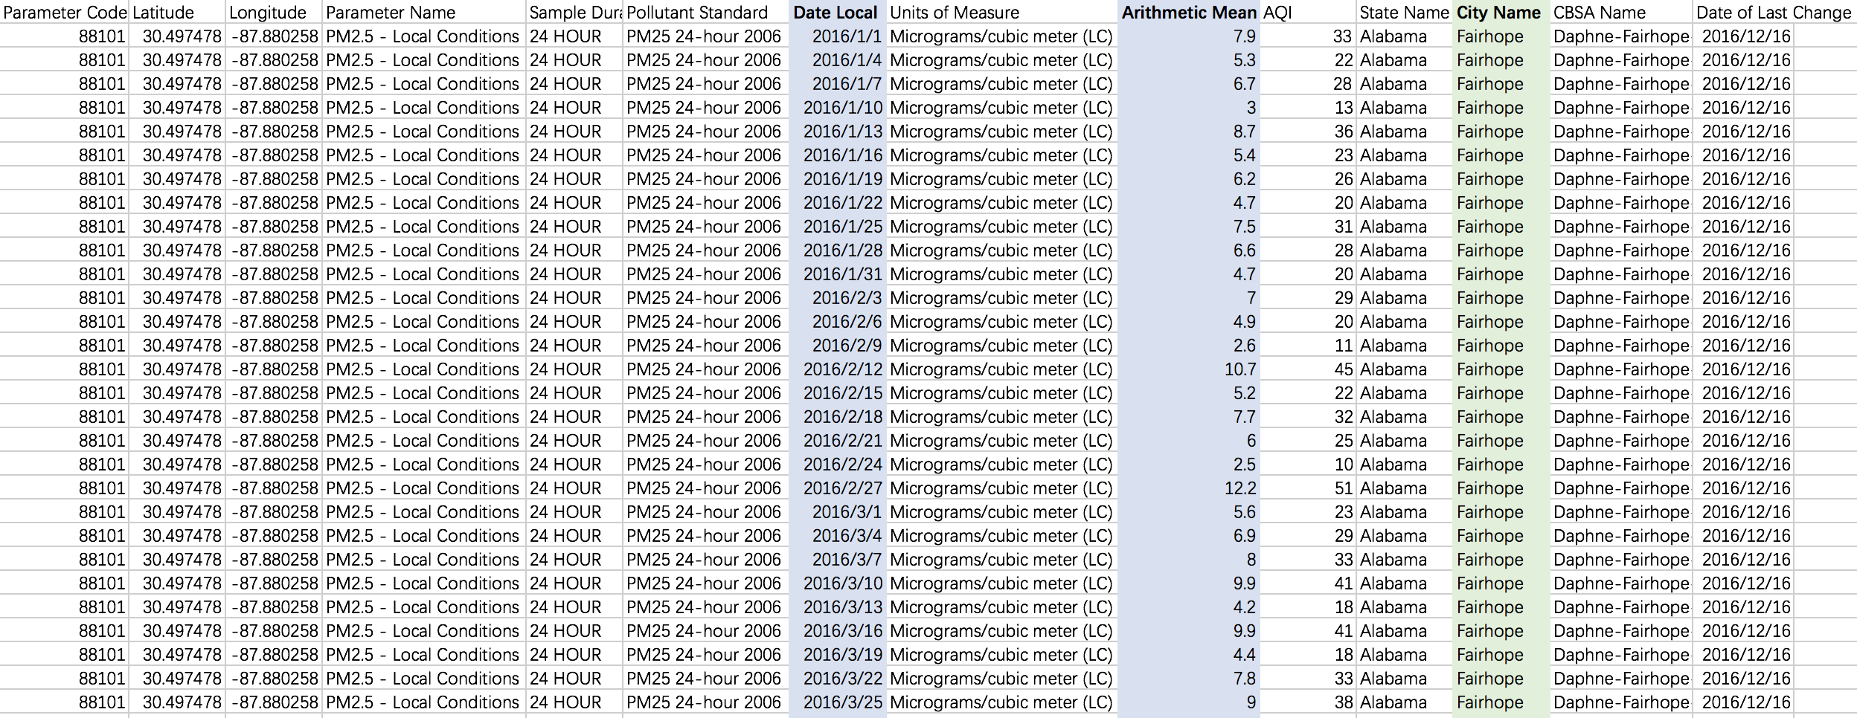
Data Analyze

Slide 11
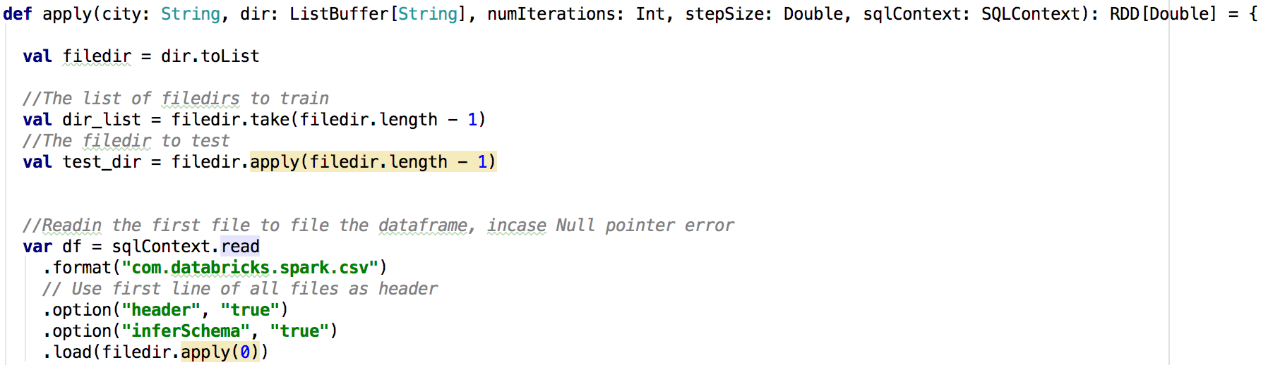

Load data
Use the csv reader from databricks in spark and extract the information we need from the original .csv files

Slide 12
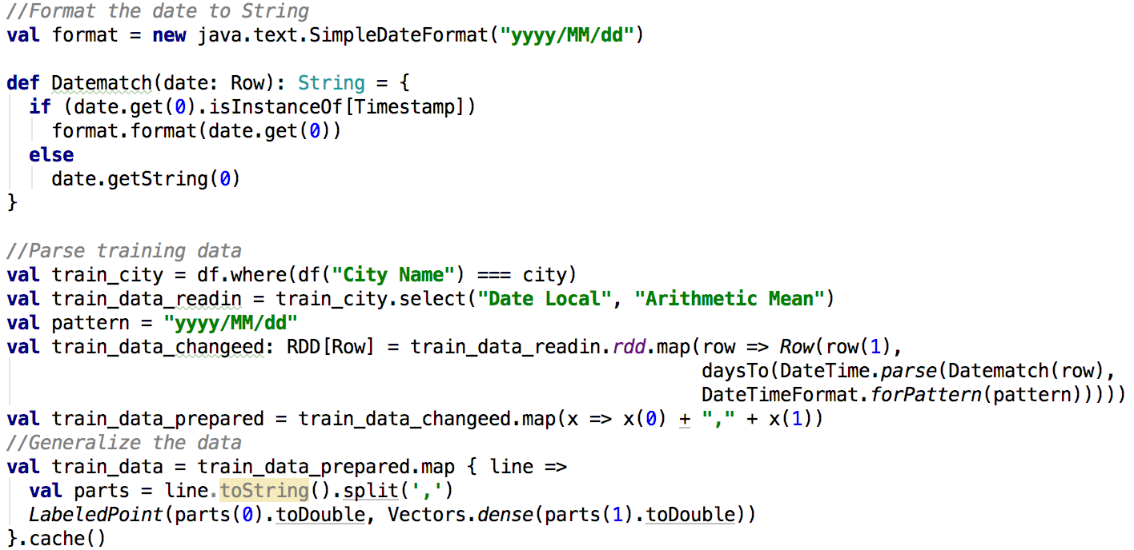
Data parsing
In order to make the date become a measurable value for our graph, we format the date to string first.

Slide 13
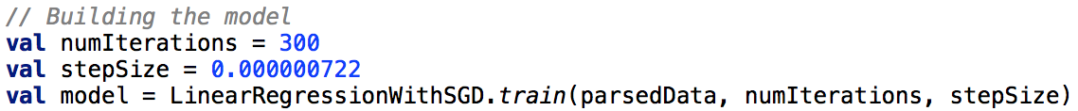
Training model
LinearRegressionWithSGD
Get the linear regression model to predict the PM 2.5 value
The model should be corrected by setting the proper iteration times and step size

Slide 14
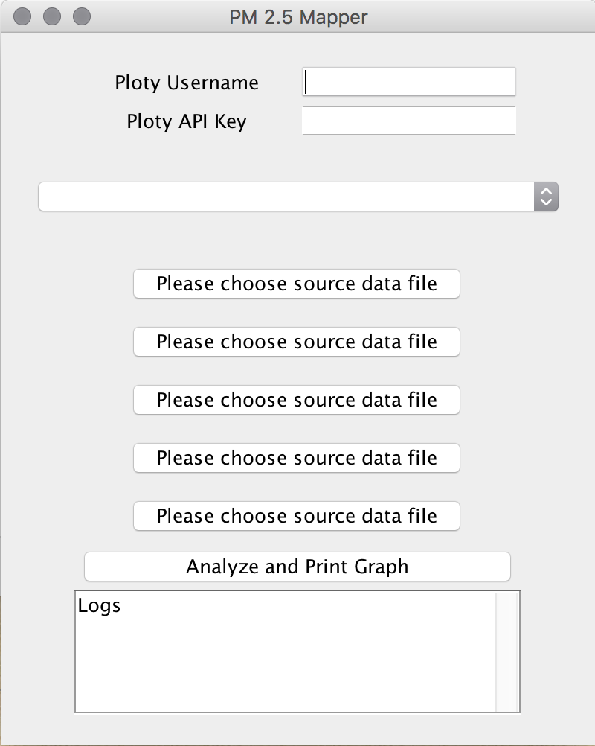

Mapper User Interface
We’ve imported the scala.swing._ package to build a panel for user to operate the mapper system.

Slide 15
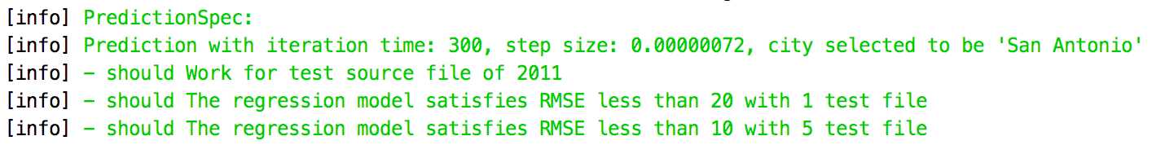
Specification PredictionSPEC
We’ve added 3 tests for our project to determine the accuracy of our prediction model:
Valid reading data files
The Mean squared error (mse) of one single file’s prediction.
The Mean squared error (mse) of five data files’ prediction.

Slide 16
Acceptance criteria
Successfully parse all data and form the dataset, draw the graph
With missing data up to 2 months out of 12 months per year, machine learning could successfully make the prediction.
Prediction MSE < 10

Slide 17
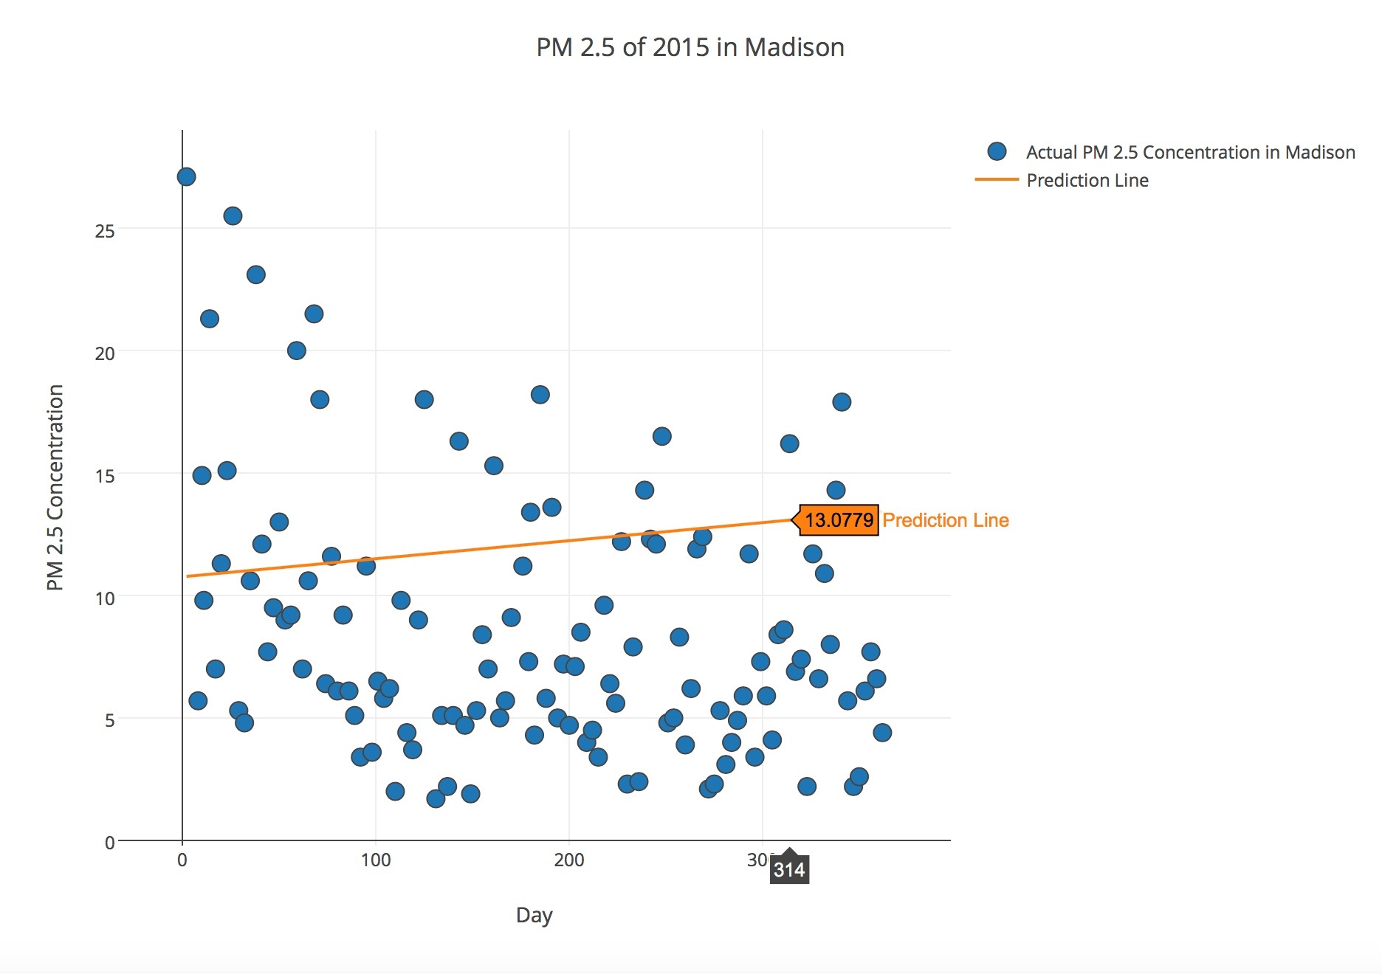

Sample Linear Regression RESULT

Slide 18
Thank You!
Q & A

