Slide 1

Betting on traffic jams in the Texas power grid
Group name : Multiple nations
Group Member : Eric He
Zheng Wai Hong Ben,
Hargun Chawla,
Pun chin For
Notes:
30 sec. Hook: in Texas, the price of electricity depends on where you are on the grid. When a power line gets jammed, prices on both sides split apart. We want to trade that gap, with an algorithm, without owning a single power plant.

Slide 2
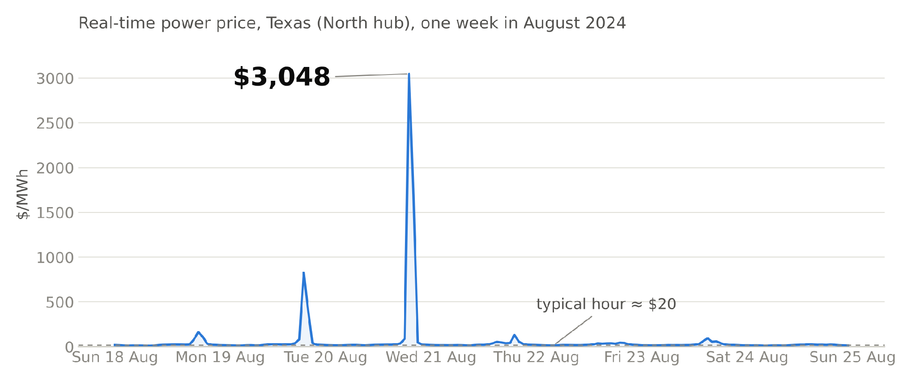






Electricity is a weird commodity
ANY POWER MARKET
Can't be stored cheaply
Supply = demand, every second
Prices jump 150× in an hour
TEXAS, EXTRA
Island grid: no imports when short
Extreme weather: heat waves, winter storms
37% wind & solar: supply follows the weather
Notes:
1 min. Real data, North Texas hub, August 2024. Most hours cost about $20 per megawatt-hour. On one hot evening the price hit $3,048, 150 times the normal price, because electricity cannot be stored and demand has to be met right now. Texas is more extreme than most: its grid is an island, so when it runs short it cannot import from neighbours; the weather is extreme, heat waves in summer and winter storms like Uri in 2021; and 37% of its energy came from wind and solar in 2025, so supply itself swings with the weather. This volatility is what makes the market interesting for trading.

Slide 3

Two ways to run a power market
Hong Kong
Texas
Regulated monopoly
Competitive market
1,900+ market participants compete: plants, retailers, traders
CLP Power
Kowloon & New Territories
HK Electric
HK Island & Lamma
$336
North
$141
West
Profit capped by government: they charge operating cost + a margin of at most 8% of their asset value
Fixed price per kWh: same at any hour, any day, any season
$120
South
$150
Houston
No market, nothing to trade.
New price every 5 minutes. Plenty to trade.
Notes:
1 min. Hong Kong: two private companies, CLP and HK Electric, each with its own territory and no competitor. The government caps their profit: they may charge their operating cost plus a margin of at most 8% of their asset value. Consumers pay a fixed price per kilowatt-hour, the same at any hour of any day in any season, reviewed once a year. There is no auction, no hourly price, no wholesale market, so there is nothing to trade. Texas is the opposite: more than 1,900 market participants, plants, retailers and traders, all compete, and the grid operator publishes a new price every 5 minutes at every point on the grid. Germany sits in between: a competitive market, but one price for the whole country.

Slide 4

Why Texas
Its own grid, its own rules
Prices up to $5,000 per MWh
Isolated from the rest of the US: one operator (ERCOT), one rulebook
No safety payments to power plants, so scarcity shows up in the price
Pure financial bets are allowed
Congestion is built in
You can trade without owning a plant or serving a customer. Not allowed in most markets
Wind and solar in the empty West, demand in the cities, and not enough lines in between
Notes:
1 min. Four reasons. Texas runs its own grid, so one set of rules. It pays power plants only for the energy they produce, no capacity payments, so when power is scarce the price goes all the way to $5,000. Financial-only trading is explicitly allowed, which most markets do not permit; in Germany, for example, betting on the imbalance price is prohibited. And the geography guarantees congestion: the wind and solar are in West Texas, the people are in Dallas and Houston, and the lines between them fill up regularly. That is the gap we trade. Bonus: all the data is free and public.

Slide 5
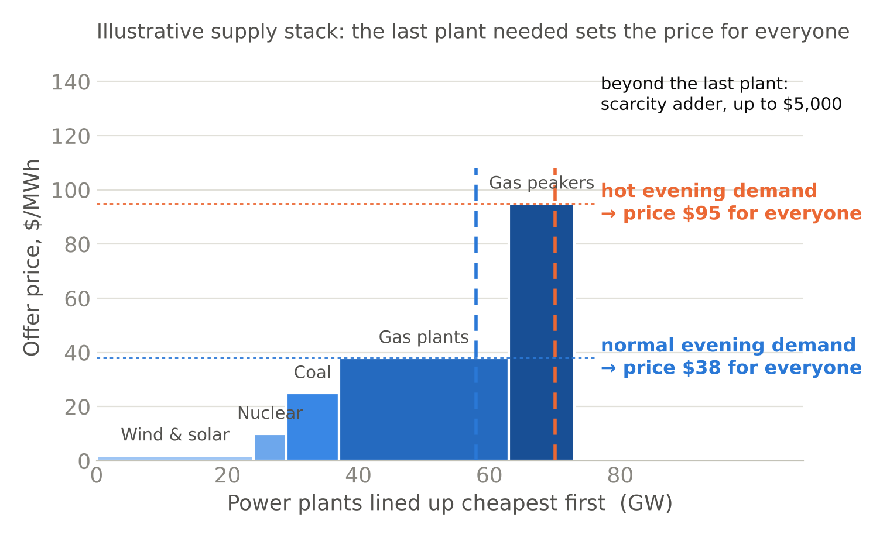


An open market: everyone bids, the price clears
How to read it
1
Each block is a group of plants
width = how much they can produce, height = the price they ask for
2
Lined up cheapest first
wind and solar at ~$0, then nuclear, coal, gas, and the expensive peakers
3
The dashed line is demand
walk right until the blocks cover it
4
The last block reached sets the price
and every plant gets that price, even the wind farm that asked $0
Day-ahead auction day before, 10:00: the plan
Real time every 5 min on the day: reality
One auction for all of Texas, yet the price can differ by location → next slide
Notes:
1 min 15. Texas is an open market, and this chart is how the price gets set. Every block is a group of power plants: the width is how much they can produce, the height is the price they ask for. ERCOT lines them up cheapest first: wind and solar at almost zero, then nuclear, coal, gas, and at the far right the expensive gas peakers. The dashed line is demand. Walk from the left until the blocks cover demand. The last block you reach sets the price, and every plant gets that price, even the wind farm that asked for zero. On a normal evening the last block is a gas plant, $38. On a hot evening demand is higher, you need the peakers, and everyone is paid $95. Beyond the last plant, a scarcity premium kicks in, up to $5,000. Two rounds of this: a day-ahead auction the day before, which is the plan, and real time every 5 minutes, which is reality. One more thing: it is one auction for all of Texas, yet the price can differ by location. Next slide shows why.

Slide 6
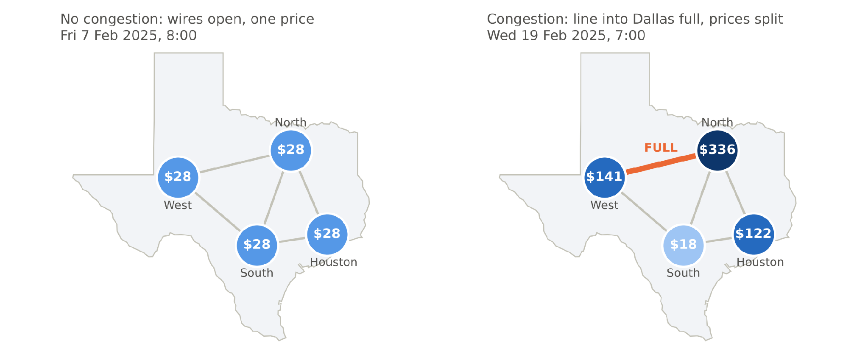


Why prices differ: congestion
Usually one price. If power is cheaper in A than in B, A produces for B too and it travels over the grid. The cheapest plant anywhere serves everyone.
Congestion: a wire has a physical limit. Once it is full, B cannot get more from A and must run its own, more expensive plants. B's price goes up and A's falls below it.
Notes:
1 min 15. Both maps are real hours. Left: a normal Friday morning. Usually there is one price: if power is cheaper in the West than in Dallas, the West simply produces for Dallas too and the electricity travels over the grid. The cheapest plant anywhere serves demand anywhere, so every hub clears at $28. Right: twelve days later, congestion. That is the key term: a wire has a physical limit. The line into Dallas is full, so Dallas cannot get any more cheap West power and has to run its own, more expensive plants: $336. The West is stuck with power it cannot export, so its price drops relative to Dallas. A natural objection: could the prices differ just because different plants sit near each hub? No. It is one auction, and with open wires the local plants are irrelevant, as the left map shows. ERCOT's price at a location is the system price plus a congestion component, nothing else, so the gap between two hubs is by definition the cost of the jam. Local plants only decide how big the jam gets. Three facts from our data: in 30% of hours all four hubs are within $2 of each other; in one hour out of six the gap is over $20.

Slide 7

Our instrument: what a PTP bid looks like
Submitted by 10:00
PTP OBLIGATION BID
ERCOT day-ahead market
through our broker (a QSE), as a few lines of data
Source
HB_WEST
where the power is cheap
Cleared if the auction gap ≤ our max
we pay the auction's expected gap, e.g. $16
Sink
HB_NORTH
where it is expensive
Settled next day in cash
Hour
19 Feb 2025, 7:00–8:00
one hour at a time
ERCOT pays us the real-time gap, e.g. $195
Quantity
10 MW
size of the bet
Where congestion is traded
PTP: ERCOT day-ahead auction only, daily, hourly
CRR: ERCOT monthly and annual auctions, a whole month at once
Hub futures: ICE, Nodal Exchange; cash-settled on hub prices
Max price
$25 / MWh
most we pay for the expected gap
Notes:
1 min 15. This is what our instrument actually looks like: a point-to-point obligation bid in ERCOT's day-ahead market. Five fields: where the power is cheap, where it is expensive, which hour, how many megawatts, and the most we are willing to pay for the expected gap. It is submitted by 10am through a broker, called a QSE, as a few lines of data. If the auction's gap is at or below our max price, the bid clears and we pay that gap, $16 in our example. The next day ERCOT pays us the real-time gap, $195, and the cash difference lands in our account. Congestion is traded in three places: the PTP in the daily auction, the CRR in monthly and annual auctions for a whole month at a time, and hub futures on exchanges like ICE. We use the PTP because it is daily, so our algorithm gets a decision every day.

Slide 8


How the PTP pays: a bet on the gap
A bet on the congestion gap between two points
Zero physical involvement
West
North
No power plant
10 MW
No customers, no wires
Day-ahead auction
we pay the expected gap
$16 × 10 = −$160
Not one electron delivered
Real time
ERCOT pays us the actual gap
$195 × 10 = +$1,950
A trading account with ERCOT
Collateral on deposit
Net, one hour on 19 Feb 2025
+$1,790
Bids by 10:00, cash settled next day
We win if real congestion is bigger than the auction expected. We lose if it is smaller.
Notes:
1 min 15. The instrument is a point-to-point obligation, PTP. You pick two points and a size, say 10 megawatts from West to North. In the day-ahead auction you pay the gap the market expects for that hour: $16. The next day ERCOT pays you the gap that actually happened: $195. Net plus $1,790 for one hour, real prices from 19 Feb 2025. If the real jam is smaller than expected, you lose the difference. Crucially, nothing physical happens: no plant, no customers, no electricity moves because of us. We need a trading account with ERCOT through a broker, collateral, and a script that submits bids by 10am. Everything is settled in cash automatically. The CRR is the monthly subscription version of the same bet; we mention it only for completeness.

Slide 9
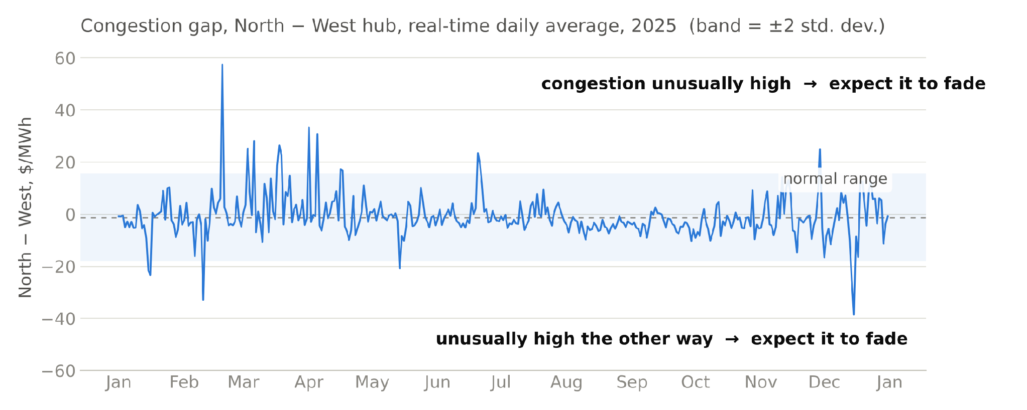





Our edge: predicting tomorrow's congestion
The auction's gap is the market's congestion forecast. Our model makes its own and bets on the difference.
What predicts congestion
Recent congestion
it fades: mean reversion
Wind forecast, West
more wind, more congestion
Demand forecast, North
hot evening, more congestion
Line outages
maintenance, more congestion
Trading rule, every day by 10:00
More congestion than the auction prices → bet over (PTP West → North)
Less congestion than priced → bet under (PTP North → West)
No clear edge → stay out
Notes:
1 min 30. Here is the edge. The day-ahead auction already contains a forecast of tomorrow's jam. Our job is to forecast it better. The chart is the real daily West-North gap over 2025: most of the time near zero, sometimes it jumps, and it comes back. The simplest predictor is exactly that: an unusually wide gap tends to fade, so we measure how unusual today's gap is with a z-score. On top of that we can add the things that physically cause the jam: a strong wind forecast in West Texas, a hot evening in Dallas, a transmission line out for maintenance. All of this is public data. The rule is simple: if our forecast says the jam will be bigger than the auction expects, buy the PTP West to North; smaller, buy the reverse; no edge, stay out.

Slide 10
We do not bet a flat 10 MW
The 10 MW on the last slide is an example, ticket not the rule. Size follows the edge, then a hard cap.
1
Edge
2
Gate
3
Size
Our forecast of tomorrow’s real-time West–North gap, minus the gap the day-ahead auction is already charging.
Trade only if the edge is larger than about $5/MWh and the signal is clear. Otherwise stay out. No edge, no bid.
MW rises with the edge, then stops. Half-Kelly in spirit: use half the formula, because the win rate is only an estimate.
Hard rules, before any backtest
Cap per hour 10 MW on one path. A bigger edge does not mean a bigger plant.
Cap Per day 40 MW across hours. Hours on the same line are one congestion bet, not 24 independent bets.
Direction Forecast gap > auction: PTP West → North. Forecast gap < auction: reverse the path
After a loss Same size, or smaller. Never double. Martingale fails when the tail is a winter storm, not a coin flip.

Slide 11






This trade cannot be stopped at 3pm
A PTP obligation is submitted by 10:00 and cash-settled the next day. The loss limit has to be decided before the auction.
Bid Cap
Reversal risk
Daily Stop
Max price on the PTP is the entry stop. We will not pay more than $25/MWh for the expected gap. If the auction wants more, the bid does not clear.
Paying $16 does not cap the loss. If real-time congestion flips, settlement can be largely negative. The cap is on size, not on a wish.
If yesterday’s settled loss is over 2% of capital, cut size in half. Over 5%, no bids next day. Review, don’t revenge-trade.
Strategy stop
Weather filter
What we report
Pause the whole book at a 15% drawdown. Same idea as the lecture’s portfolio stop: one bad regime should not spend the account.
Half size, or flat, on an ERCOT conservation notice, extreme-heat watch, or freeze warning. Uri is the fat tail, not a 2-standard-deviation day.
For November: win rate, average win versus average loss, max drawdown, and Sharpe. One lucky hour on 19 Feb is an illustration, not a result.

Slide 12
FROM SIGNAL TO SIZE
We do not bet a flat 10 MW
The 10 MW on the last slide is an example, ticket not the rule. Size follows the edge, then a hard cap.
Edge
Our forecast of tomorrow’s real-time West–North gap, minus the gap the day-ahead auction is already charging.
2. Gate
Trade only if the edge is larger than about $5/MWh and the signal is clear. Otherwise stay out. No edge, no bid.
3. Size
MW rises with the edge, then stops. Half-Kelly in spirit: use half the formula, because the win rate is only an estimate.
Hard rules, before any backtest
Cap per hour Cap Per day
10 MW on one path. A bigger edge does not mean a bigger plant. 40 MW across hours. Hours on the same line are
one congestion bet, not 24 independent bets.
Direction After a loss
Forecast gap > auction: PTP West → North. Forecast gap Same size, or smaller. Never double. Martingale fails
< auction: reverse the path when the tail is a winter storm, not a coin flip.

Slide 13
RISK · THE STOP IS IN THE BID
This trade cannot be stopped at 3pm
A PTP obligation is submitted by 10:00 and cash-settled the next day. The loss limit has to be decided before the auction.
Bid Cap
Max price on the PTP is the entry stop. We will not pay more than $25/MWh for the expected gap. If the auction wants more, the bid does not clear.
Reversal risk
Paying $16 does not cap the loss. If real-time congestion flips, settlement can be largely negative. The cap is on size, not on a wish.
Daily Stop
If yesterday’s settled loss is over 2% of capital, cut size in half. Over 5%, no bids next day. Review, don’t revenge-trade.
Strategy stop
Pause the whole book at a 15% drawdown. Same idea as the lecture’s portfolio stop: one bad regime should not spend the account.
Weather filter
Half size, or flat, on an ERCOT conservation notice, extreme-heat watch, or freeze warning. Uri is the fat tail, not a 2-standard-deviation day.
What we report
For November: win rate, average win versus average loss, max drawdown, and Sharpe. One lucky hour on 19 Feb is an illustration, not a result.

