Slide 1

Compound Analysis using Graph Representation Learning
Group35: Zheng Wang, Zizhong Meng, Kaiqiang Yu

Slide 2
Motivation and Description
Motivation: various applications, e.g., drug discovery, compound activity prediction and protein function prediction.
Description:
Provide a framework to learn representations of molecular graphs by considering both graph structures and some statistical information.
Do chemical molecules classification and biomolecules classification, and compare with three baseline models.

Slide 3
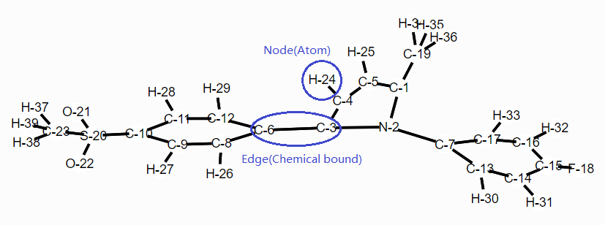
Dataset: COX2, BZR and DHFR^{[1]}
Compound classification is based on their pIC₅₀. Set a threshold for each dataset to classify each compound’s activity
Compound can be represented as graph. Graph label represent its activity.
[1] https://ls11-www.cs.tu-dortmund.de/staff/morris/graphkerneldatasets

Slide 4
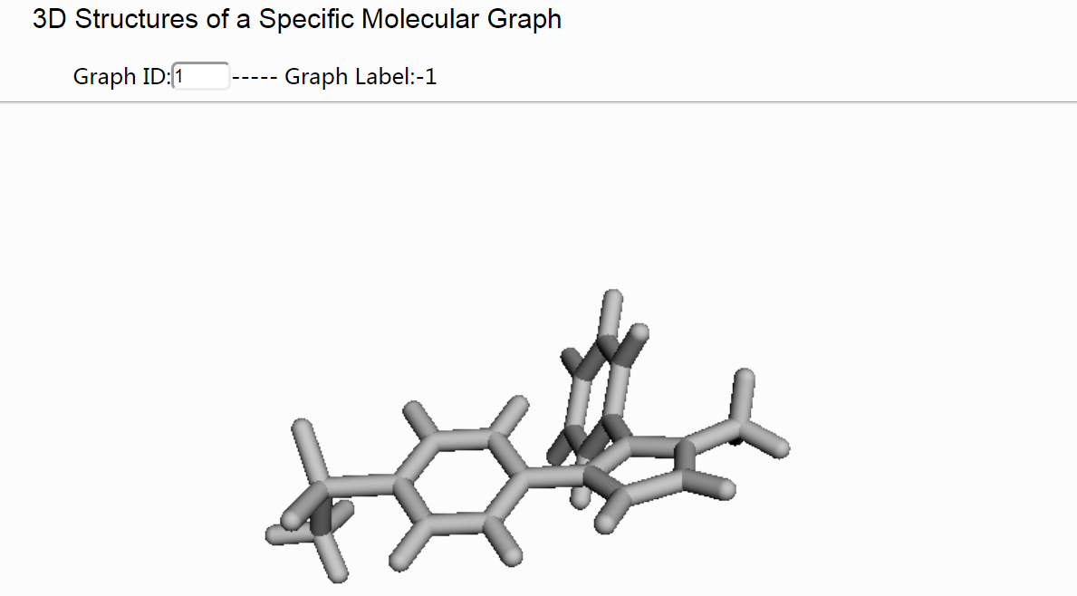
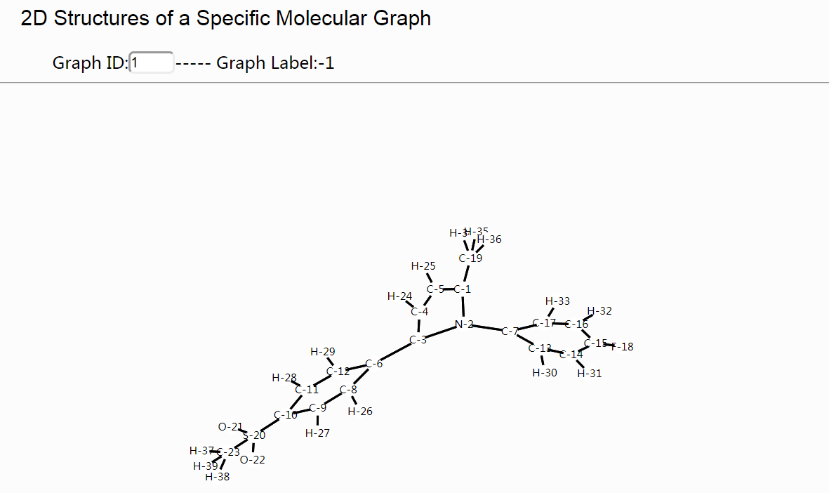
Data Exploration
Demo: http://155.69.150.48:8050/

Slide 5
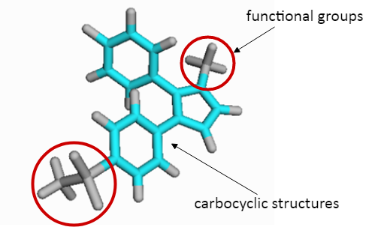
Proposed Algorithm: Pattern Mining in Compound
The carbocyclic structures can be considered as skeletons and other functional groups are connected to the carbon bonds on the ring.
Carbocyclic structures: Loop search algorithm in a graph.
Functional groups: deduct loops + find maximal connected components.
Pattern = Carbocyclic structures + functional groups.

Slide 6
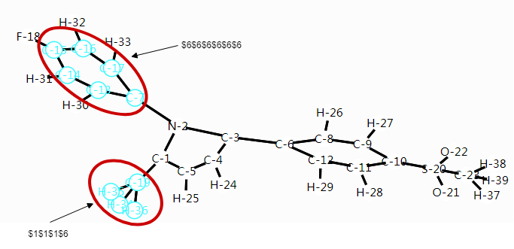
Proposed Algorithm: Building Corpus
Pattern representation
We represent each pattern as an ascending string according to element number, and identify each element by char ‘$‘. For example, Carbocyclic structure = $6$6$6$6$6$6, Methyl group = $1$1$1$6.
Why? The string representation is distinguishable and easily to build pattern corpus by Hash Map.

Slide 7
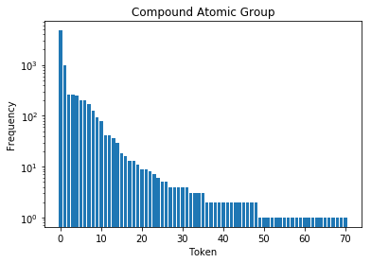
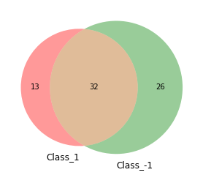
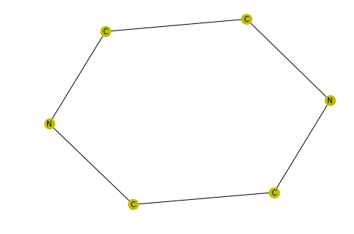
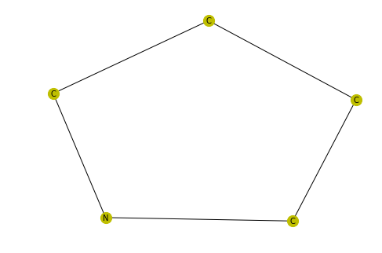
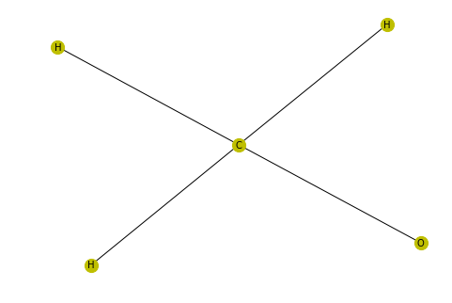
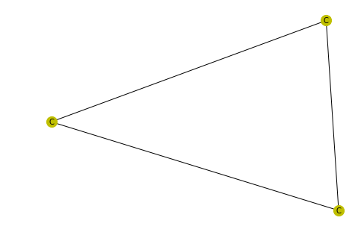
Proposed Algorithm: Insights (e.g. COX2)
There are 71 distinguishable patterns in COX2.
The occurrence frequency of pattern tokens in COX2 is like a power-law distribution, and the finding is consistent with textual data such as “Wikipedia Article Text” discussed by DeepWalk paper.
13 unique patterns in Class 1 (pIC50 > 6.5), and 26 unique patterns in Class -1 (pIC50 < 6.5), such as for Class 1:
DeepWalk: Online Learning of Social Representations, KDD'14.

Slide 8
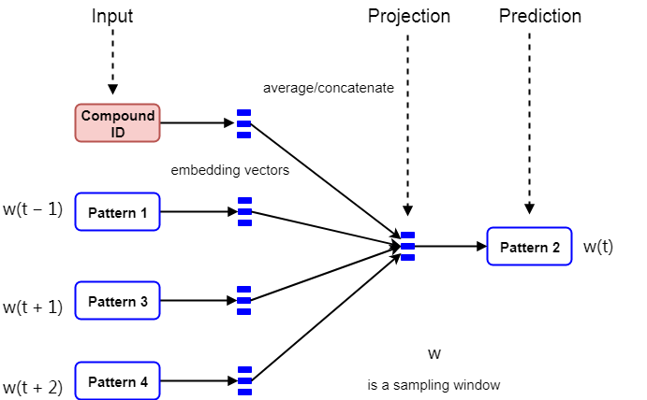
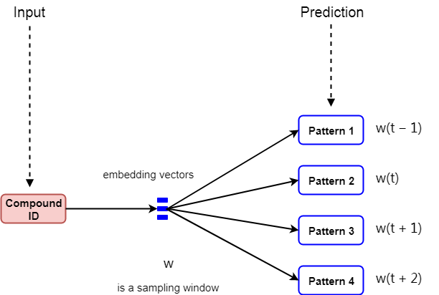
Proposed Algorithm: Graph Representation Learning
Based on the above findings, we use a data-driven method “graph representation learning” to learn embedding vectors of each compound.
Unsupervised deep representation learning + captures higher order structures (compound patterns).
Two deep learning framework: DBOW model and DM model with negative sampling (2 samples).
DM: The concatenation or average of vectors with a context of compound patterns is used to predict another pattern. The compound vector represents the missing information from the current context sampled by a window.
DBOW: Ignore the context patterns in the input, but force the model to predict patterns randomly sampled from the compound in the output.

Slide 9
Proposed Algorithm: Classification Task
The embedding vectors can be used in many machine learning tasks. Here, we take the classification as an example to train a SVM classifier.
We randomly sample 60% data to train a SVM classifier with Radial Basis Function (RBF) kernel, and use the other 40% data to test embedding performance.

Slide 10
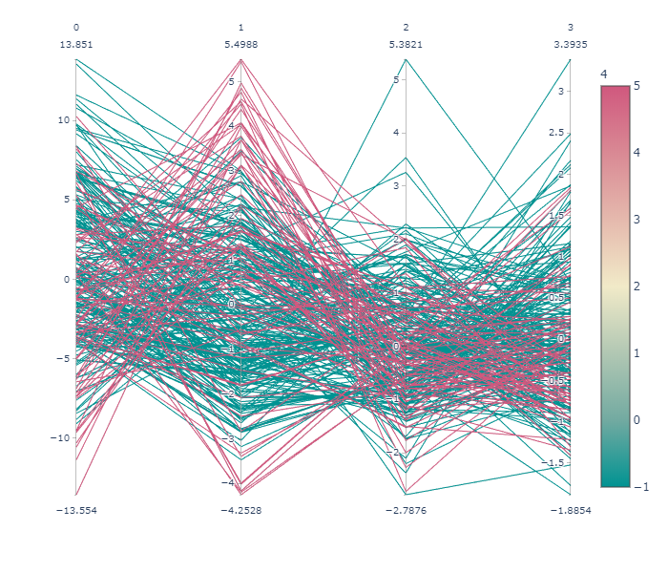
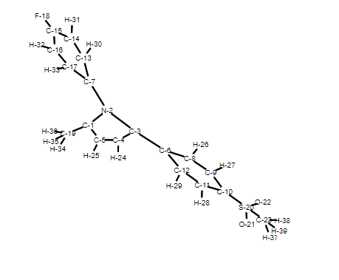
Baseline 1: PCA Embedding
Employ the pre-defined vector incorporating statistical information based on the observation. Specifically, each element of vector denotes the number of a specific kind of atom.
[H C N O F S Cl Br ]
[16 18 1 2 1 1 0 0 ]
We use PCA to reduce the irrelevant dimensions and then generate the embeddings. We use the embedding result to represent a graph. Then use the representation to do SVM classification task.

Slide 11
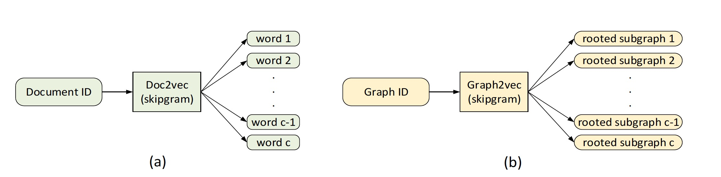
Baseline 2: graph2vec
Graph2vec is similar with Doc2vec. In particular, given a graph G, it samples c rooted subgraphs around different nodes that occur in G and uses them analogous to doc2vec’s context words and thus learns G’s representation.
We use the mean of elements’ embedding results to represent a graph. Then use the representation to do SVM classification task.

Slide 12
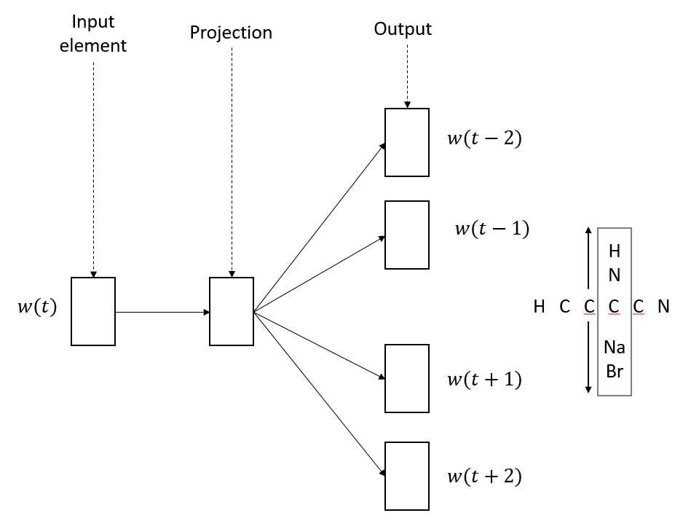
Baseline 3: Element-based Representation Learning (EbR)
Compound can be considered as sentence. Different element can be considered as different word. Based on this observation, we can use Word2Vec to learn embedding vector of each element. Here, we use skip-gram model with negative sampling.
We use the mean of elements’ embedding results to represent a graph. Then use the representation to do SVM classification task.
Skip-gram

Slide 13
Analysis of Results
Algorithm | Accuracy | Precision | Recall | F1-score
Ours(DBOW) | 0.845 | 0.852 | 0.980 | 0.912
Ours(DM) | 0.813 | 0.855 | 0.928 | 0.890
PCA | 0.818 | 0.818 | 1.000 | 0.900
Graph2vec | 0.808 | 0.808 | 1.000 | 0.893
EbR | 0.791 | 0.856 | 0.895 | 0.875
Our model has better performance than all baseline models
Pattern has stronger chemical properties than element

Slide 14
Contributions
Zheng Wang: graph pattern mining, graph representation learning, data insights
Zizhong Meng: literature study, data analysis, EbR model
Kaiqiang Yu: data visualization and analysis, graph2vec model, PCA embedding
Thanks!
Q&A
This project is available at GitHub and Google Drive:
GitHub: https://github.com/zhengwang125/CE7454_Compound_Embedding
Google Drive: https://drive.google.com/drive/folders/1PQ7HtAw41N6bIJxPTUPzsmLUFUjhXlct

