Slide 1
Welcome Message
Large Generative Models Meet Multimodal Applications (LGM3A)

Slide 2
Introduction
Background
Workshop explores LLMs for multimodal interaction
Growing need to use LLMs with increasing multimodal data
Workshop welcomes professionals to explore multimodal model trends and practices
Scope and Topics:
A platform to present latest works
Foster discussions on current challenges and opportunities
Identify emerging trends in LMM
Potential impact on future research and development

Slide 3
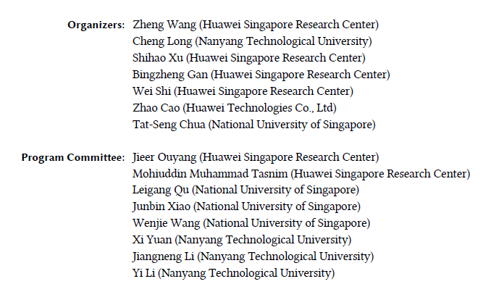
Acknowledgments
Workshop Organization
Workshop Statistics:
3 invited keynotes + 8 accepted long papers
Acceptance rate: 50%

Slide 4
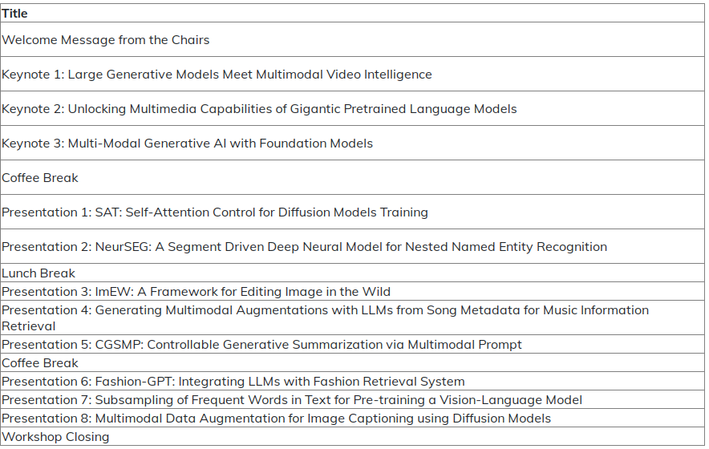
Schedule

