Slide 1
EMG-RAG: Crafting Personalized Agents through Retrieval-Augmented Generation on Editable Memory Graphs
Zheng Wang, Zhongyang Li, Zeren Jiang,
Dandan Tu, Wei Shi
Huawei Technologies, Co., Ltd.

Slide 2
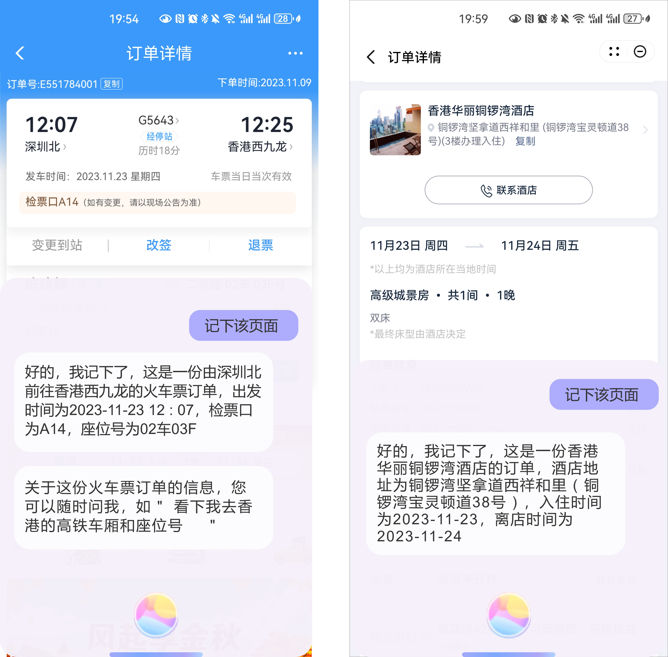
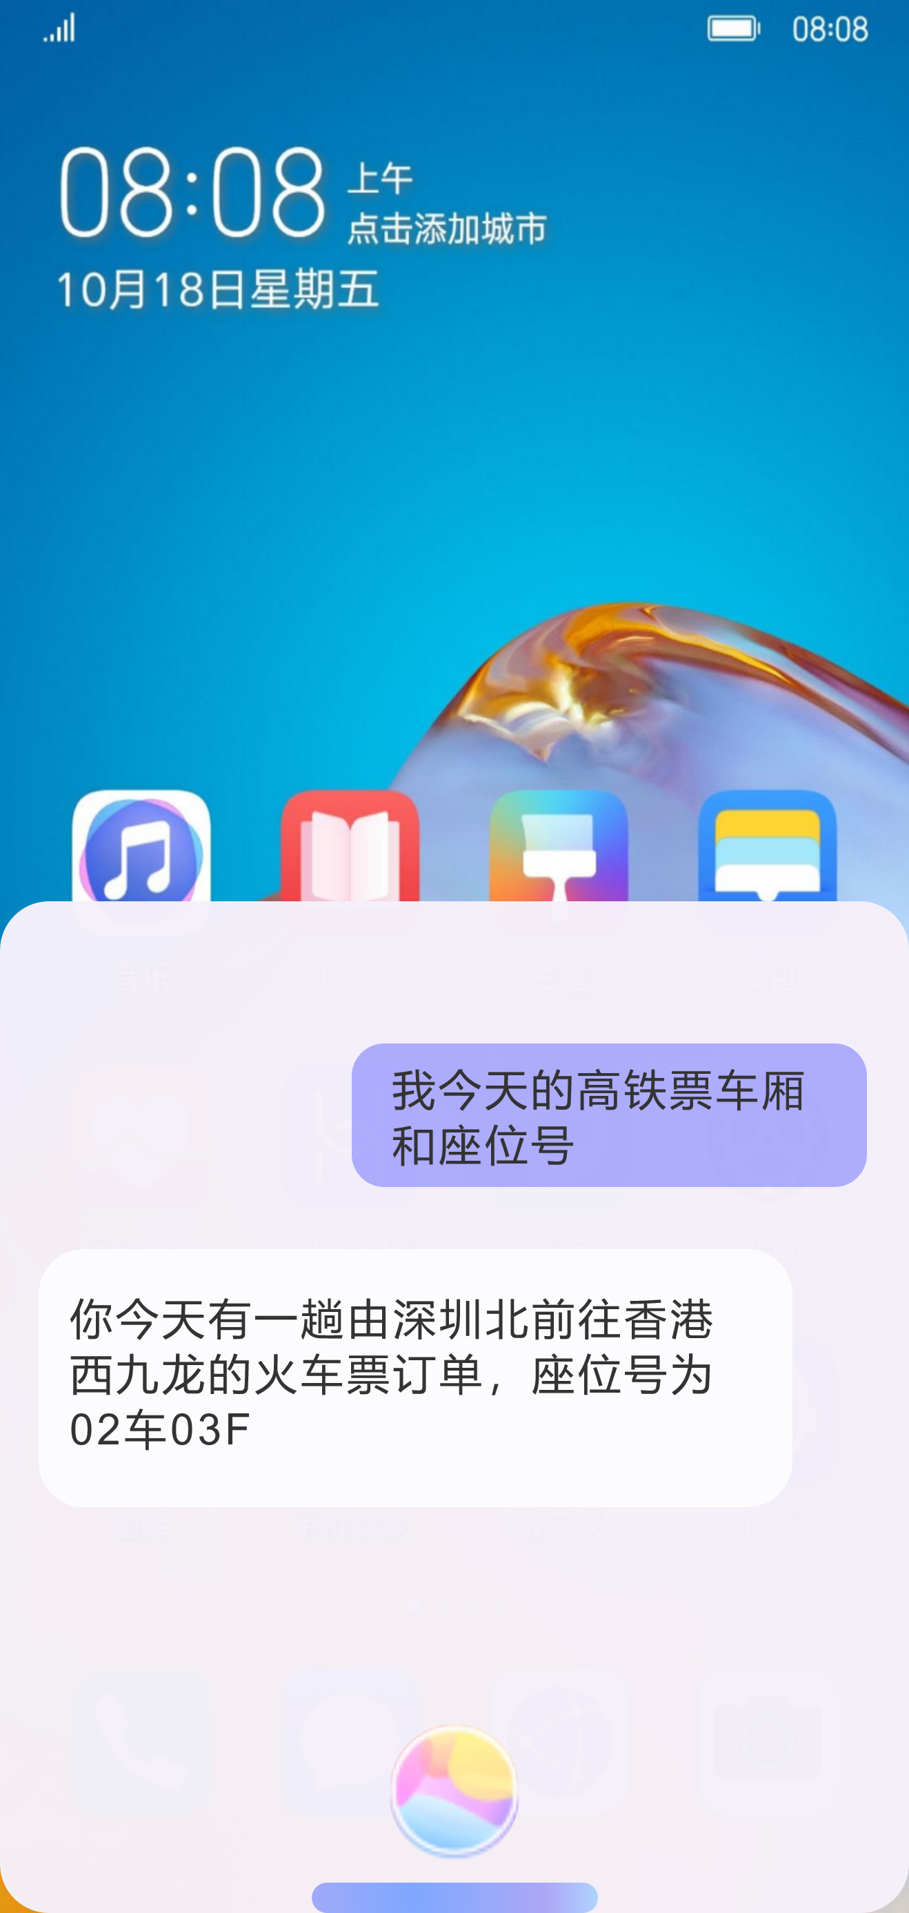
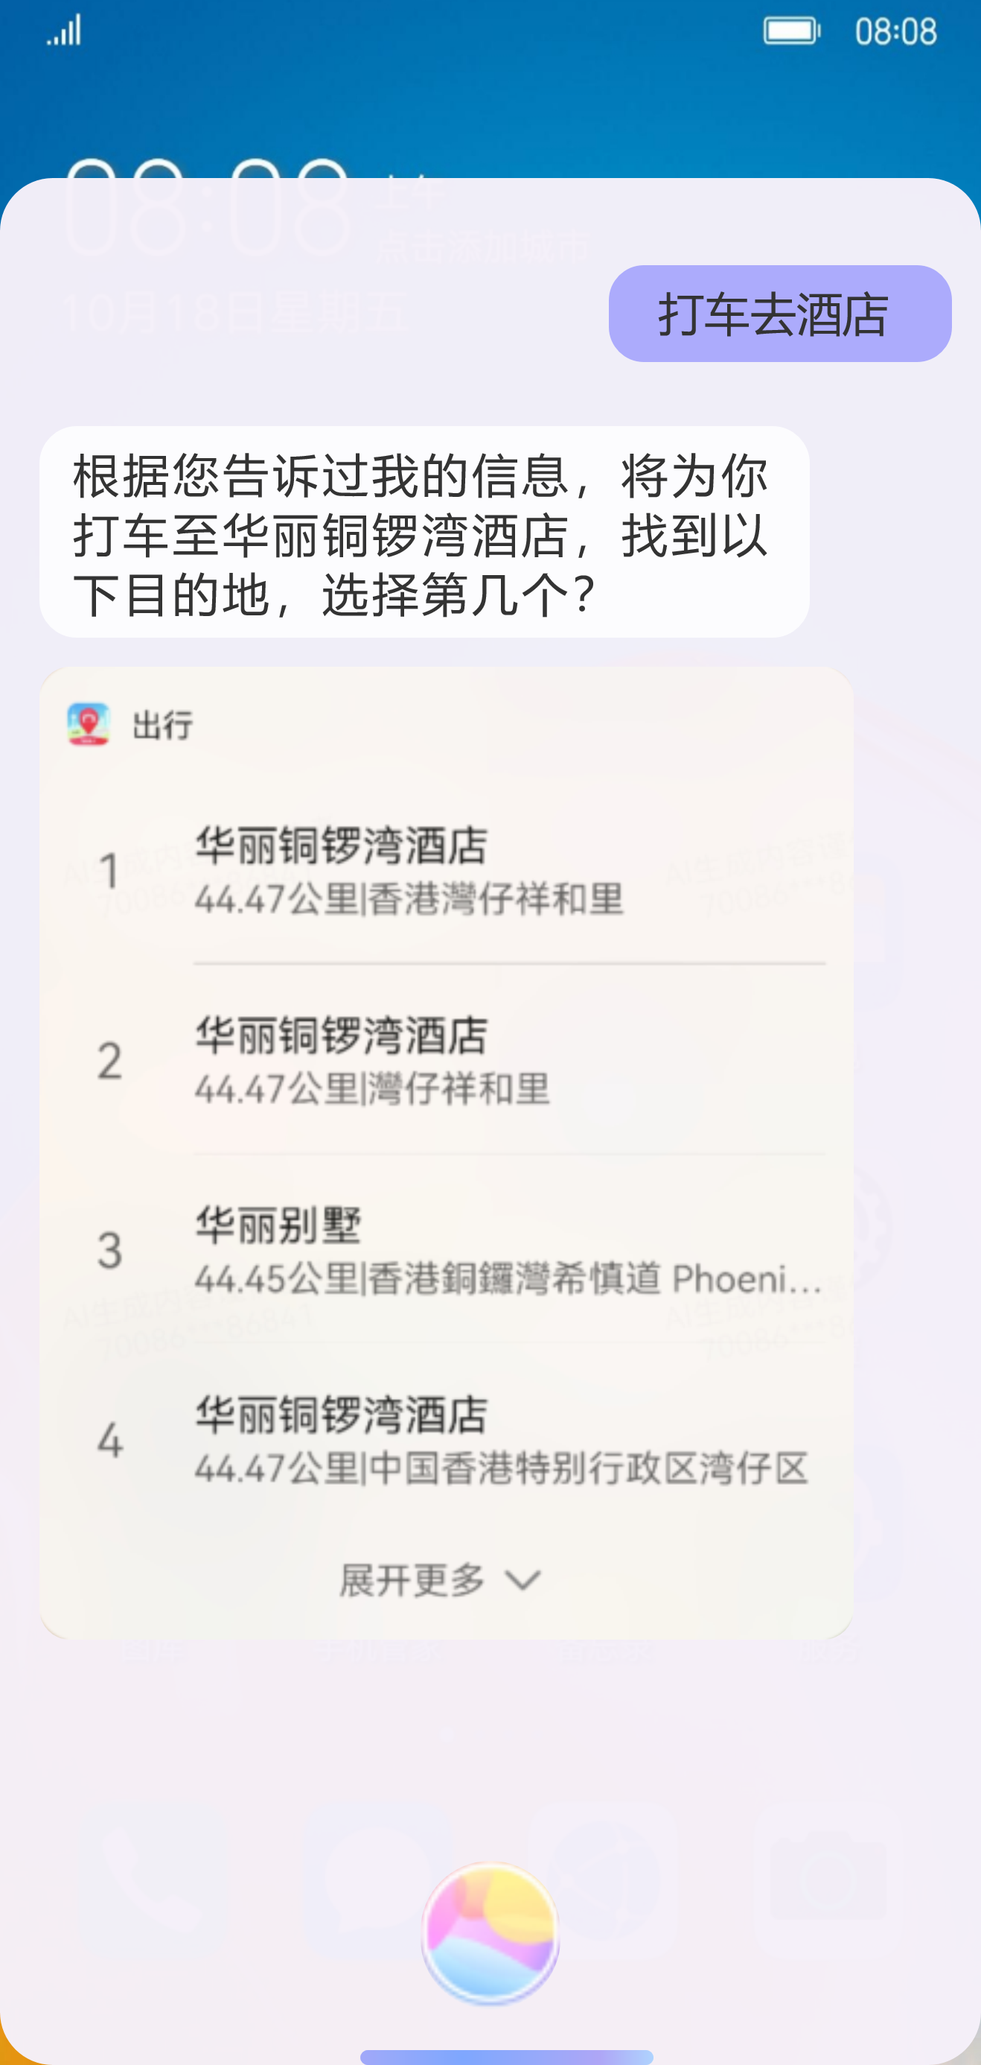
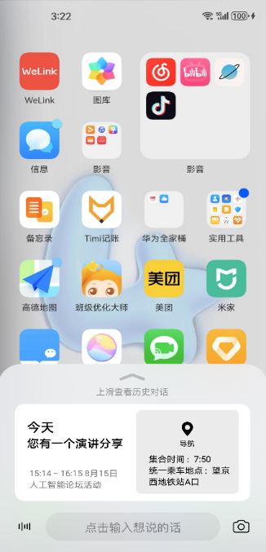
Background: LLM-based Personalized AI Assistant
Scenarios
Challenges & Literature
Data: AI Assistant Conversations
or App Screenshots
Scenarios: An intelligent memory add-on for users
Challenges：
① Memory data collection（Training & Inference）
Existing Datasets (Unsuitable): personalized chats [1], psychological dialogues [2]
Properties: identifying high-value user information, forming standardized memory, and labels for subsequent training use
Data is gathered on smartphone AI assistant platforms, e.g., everyday conversations, and screenshot contents by OCR
Applications based on Memories:
Question Answering, Autofill Forms, User Services (Travel & Reminder)
② Memory Editability（Inset, Delete, Replace）
Editable Memory Graph for Data Management: personal memory is dynamic evolving, involving three types of editing operations: insertion, deletion, and replacement
Properties: ease to extend & capture semantic relationship
③ Memory Selection (RAG)
Solution 1 — Needles in a Haystack: limited context window & noise caused hallucination [3]
Solution 2 — Advanced RAG: relying on Top-K retrieval, but this scenario requires diverse memory combinations [4][5]
[1] Personalizing dialogue agents: I have a dog, do you have pets too, ACL 2018
[2] Memorybank: Enhancing large language models with long-term memory, AAAI 2024
[3] Searching for needles in a haystack: On the role of incidental bilingualism in palm’s translation capability, arXiv 2023
[4] Query rewriting for retrieval-augmented large language models, EMNLP 2023
[5] M-RAG: Reinforcing large language model performance through retrieval-augmented generation with multiple partitions, ACL 2024
App Screenshots
Question Answering
Slot Filling (Travel)
Slot Filling (Reminder)

Slide 3
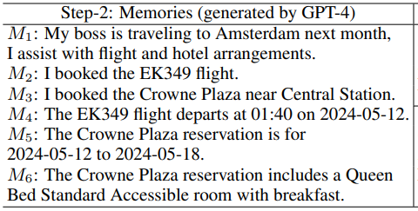
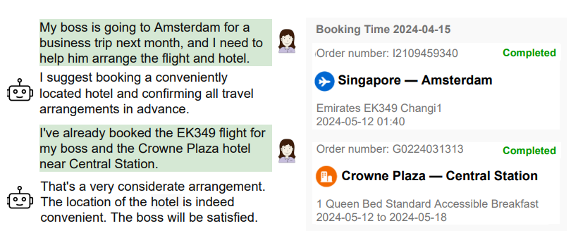
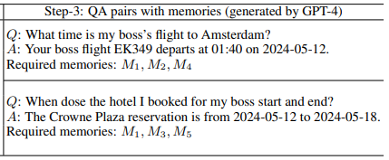
For Challenge 1: Data Collection
Format to memories
Step-1:
Raw Data Collection
(Conversations or App Screenshots)
Step-2:
Memories Generation
Step-3:
QA Pairs Generation
(with required memories)
Raw data filtering based
on the business scope
The QA pairs and the required memories
are used for further RL training

Slide 4
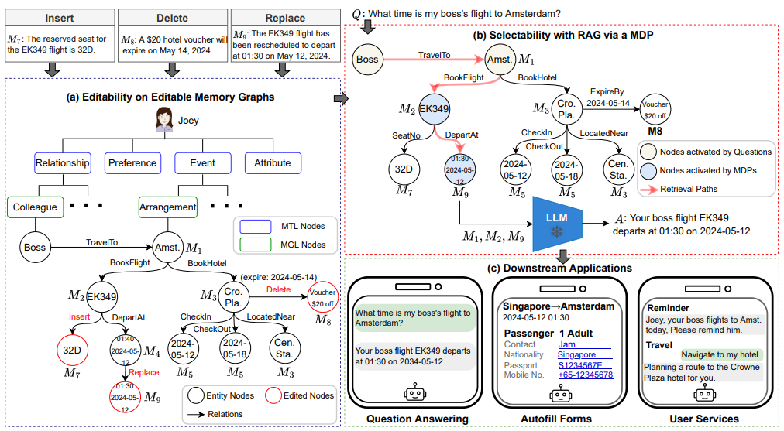
For Challenge 2 & 3: Editability and Selectability
Step 1: Search from the nodes activated by questions
Insert，Delete，Replace
Memory in Ticket Scenario :
Collect new seat numbers (insert), change the departure time of the ticket (replace), coupon expiration (delete)
Step 2: Graph traversal to decide whether to include critical memories
Multilayered EMG
Tree: The first two layers are pre-defined based on the business scope
Graph: Supports locating nodes to be modified and then performing edit operations, where in-degree nodes are with their corresponding memories
Step 3: Integrate the results of natural language generation into three downstream applications

Slide 5
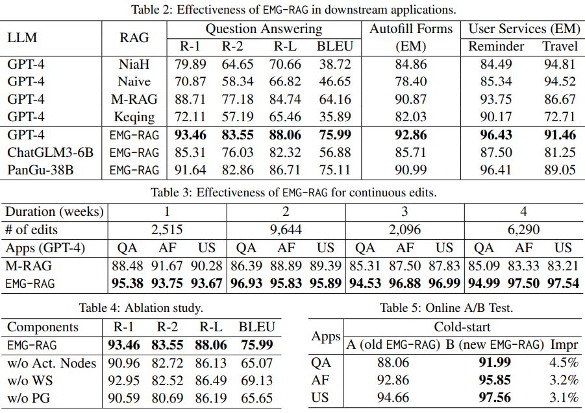
Experiments: Question Answering, Autofill Forms, and User Services
Downstream Applications
Improvements：EMG-RAG can incorporate different LLM architectures, and achieve 18.4%, 2.2%, 3.7% (2.9% and 5.5%）improvements on QA, AF, US (Reminder and Travel).
Editing & Cold-start
Continuous Edits：Compared with the best baseline，EMG-RAG illustrates a good editability, and achieves 10.6%, 9.5%, 9.7% on QA, AF, and QS.
Ablation study & Cold-start：Warm-start and Policy Gradient both contribute to the end-to-end results；EMG-RAG incorporates online learning for the cold-start issue，based on real online queries and human labelled answers for optimization.

Slide 6

Q & A

