Slide 1
M-RAG: Reinforcing Large Language Model Performance through Retrieval-Augmented Generation with Multiple Partitions
Zheng Wang, Shu Xian Teo, Jieer Ouyang,
Yongjun Xu, Wei Shi
Huawei Technologies, Co., Ltd.
Notes:
Hello everyone,
I am presenting the paper titled "M-RAG: Reinforcing Large Language Model Performance through Retrieval-Augmented Generation with Multiple Partitions" at ACL 2024. The authors are from Huawei Singapore Research Center.

Slide 2

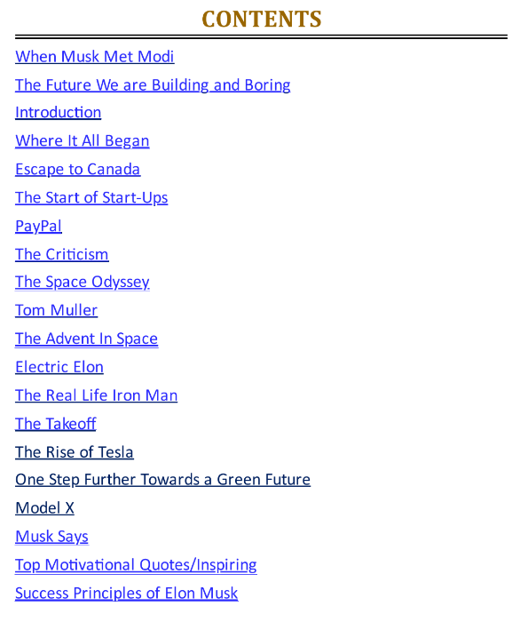

Background: An Example of a Large Model Application
Problem
Elon Musk
Tesla CEO and sole owner of Twitter
Film actor, film producer, and playwright
Biography:https://www.theworkingjourney.com/wp-content/uploads/2017/06/The-Working-Journey-of-Elon-Musk.pdf
Existing RAG Answer
In which episode of "The Big Bang Theory" does Elon Musk appear, and what is the plot?
Search database
"The Big Bang Theory" is a television show centered around several scientists. Elon Musk, as an entrepreneur and technology innovator, despite his high profile in the tech industry, would require specific episode information to determine if he appears in the series and to discuss the plot surrounding his appearance.
Retrieved Memory
Zip2 partition
Insight 1
Multiple Partition RAG: execution aligns better with search intuition and improves effectiveness
Paypal partition
Elon Reeve Musk is an entrepreneur, business magnate, and the founder, chairman, CEO, and chief engineer of SpaceX. He is also an investor, CEO, and product designer at Tesla, and the former chairman. Additionally, he is the founder of The Boring Company, and a co-founder of Neuralink and OpenAI. Musk also serves as the chief technical officer and chairman of X Company. In 2022, Musk became the world's richest person with a fortune of $219 billion.
Multiple Partition RAG Answer
Tesla partition
Insight 2
Challenges: How to partition? How to select partitions? How to utilize memory?
Search partition
Film
partition
"The Big Bang Theory" Season 9, Episode 9 - In this episode of the American TV series, he portrays himself. On Thanksgiving, he volunteers at a shelter with NASA engineer Howard Wolowitz and invites Howard Wolowitz to work with him.
Notes:
We begin with an example of a large model application for background context. Consider Elon Musk, the CEO of Tesla and owner of Twitter, who is also a film actor, producer, and playwright. We input his biography into a Large Language Model (LLM) to answer the question: "In which episode of 'The Big Bang Theory' does Elon Musk appear, and what is the plot?" Existing RAG methods struggle to provide relevant answers because the retrieved information is not targeted. However, by partitioning his biography into sections such as Zip2, PayPal, Tesla, and film, and directing the film-related partition to the LLM, we obtain the correct answer: "The Big Bang Theory" Season 9, Episode 9. This example demonstrates that multi-partition RAG aligns better with intuitive search patterns and improves effectiveness. However, it introduces unique challenges: how to partition, select partitions, and utilize memory effectively. We discuss our developed techniques to address these challenges.

Slide 3
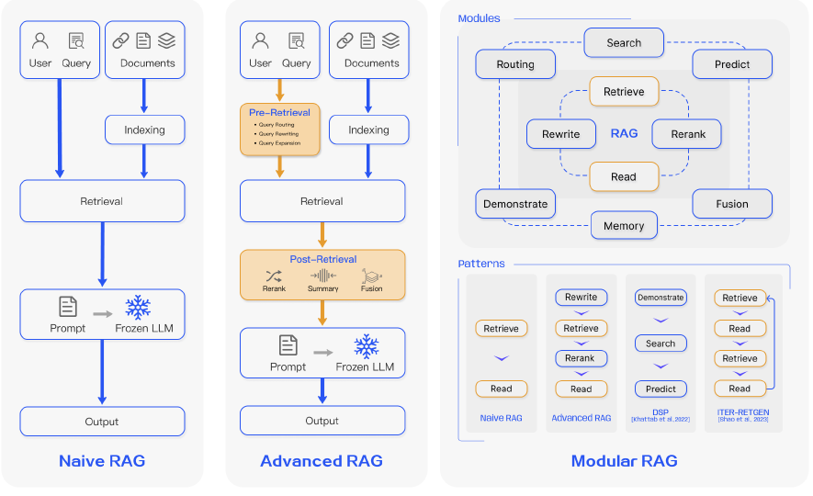
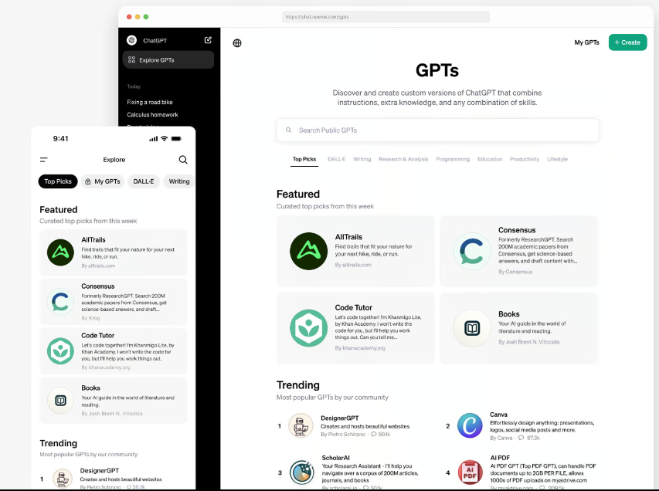
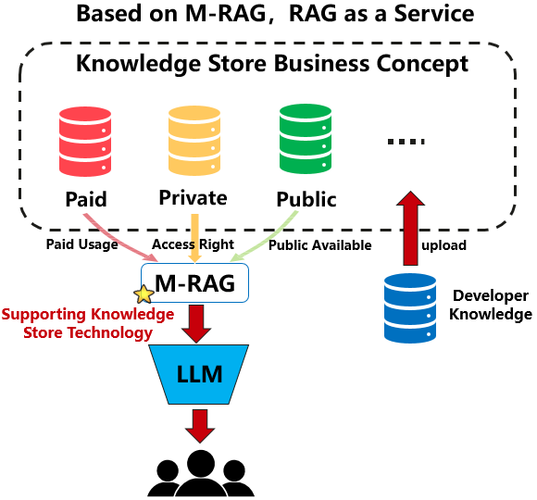
Idea: Considering a Partition as a Basic Unit for RAG Execution (a New RAG Paradigm)
Existing Techniques
Business Insights
Naive RAG: Indexing-Retrieval-Generation process; inherent flaws include hallucination
Modular RAG: Enhancing RAG further by introducing external modules such as search modules and task adapters
Advanced RAG: Overcoming the shortcomings of naive RAG, used techniques include pre- and post-retrieval adjustments
*Knowledge Store has achieved a potential high-value patent
Difference 3: From selling models to selling data, based on M-RAG, treating the data required for RAG as a new service
Difference 1: Partition as a basic unit for RAG rather than a database
Difference 2: A new multi-agent framework which optimizes end-to-end metric instead of retrieval accuracy
Knowledge Store
Notes:
We introduce how M-RAG differs from existing RAG techniques. Traditional RAG methods can be categorized into three types:
Naive RAG: follows an Indexing-Retrieval-Generation process but suffers from hallucination.
Advanced RAG: aims to overcome the shortcomings of Naive RAG using pre- and post-retrieval adjustments.
Modular RAG: enhances RAG with external modules like search and task adapters.
In contrast, M-RAG treats partitions as basic units for RAG rather than databases. We also propose a multi-agent framework that optimizes end-to-end metrics instead of retrieval accuracy. Furthermore, we explore the concept of RAG as a Service. Inspired by OpenAI's GPTs, which function as LLMs as a Service through an App Store, we propose a Knowledge Store where developers can upload various types of knowledge. This knowledge can be public, private, or require payment, and with more precise knowledge, users can obtain more accurate answers via M-RAG, justifying the payment for the service.

Slide 4
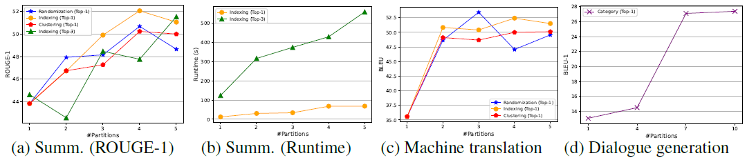
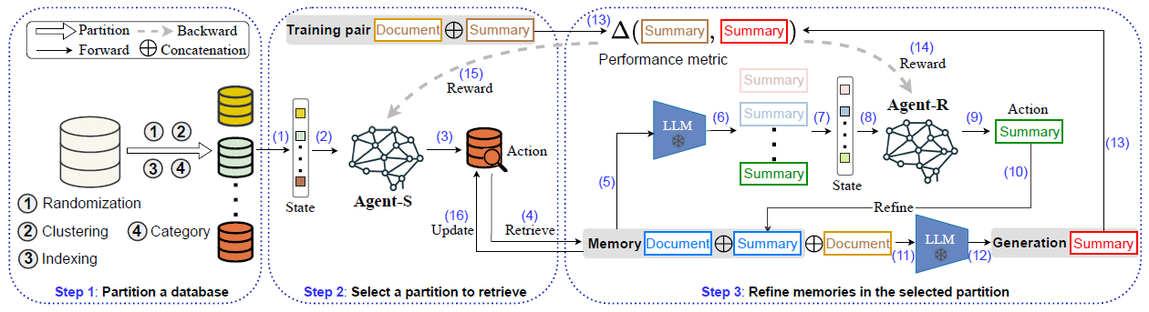
M-RAG: A Multi-Agent based End-to-End Optimization Solution
Challenge 1: Selecting the best strategy and partition number based on a validation set for a specific text generation task
① How to partition (Empirical)
Strategy：LSH，Clustering，Graph partition，Category
#of Partitions：Setting from 1 to 5
The best setting is selected based on a validation set
Challenge 2 (Main Idea of Agent-S): Selecting a partition, a good choice → high reward (feedback from task metrics like ROUGE), does not focus on local retrieval precision and recall
② How to select (Agent-S)
Multi-armed Bandit：similarities from the partitions (State)；select a partition (Action)；text generation metric (Reward)
③ How to use memory (Agent-R)
Constructing a Memory Pool：similarities from the pool (State); select a refined memory (Action); text generation metric shared with Agent-S (Reward)
Jointly optimize Agent-S and Agent-R, setting end-to-end metrics as the reinforcement learning feedback rewards
Challenge 3 (Main Idea of Agent-R): Agent-R refines the retrieved memory; good memory → good generated text → high reward → good memory (positive feedback loop)
Notes:
We address three main challenges in M-RAG:
Partitioning: We conduct an empirical study to determine the best partitioning strategy (e.g., LSH, clustering, graph partition, category) and the optimal number of partitions based on a validation set for a specific text generation task.
Partition Selection: We introduce a reinforcement learning (RL) agent called Agent-S, modeled in a Multi-armed Bandit setup. If Agent-S selects a good partition, it receives a high reward based on task metrics like ROUGE for text summarization. We focus on end-to-end RAG performance rather than local retrieval precision or recall.
Memory Utilization: We introduce another agent called Agent-R, which refines the retrieved memory from Agent-S. With refined memory, the LLM generates better text, providing a high reward that informs Agent-S for future memory retrieval. This creates a positive feedback loop. Agent-S and Agent-R are integrated through multi-agent reinforcement learning, jointly optimized to enhance text generation for given input queries.

Slide 5
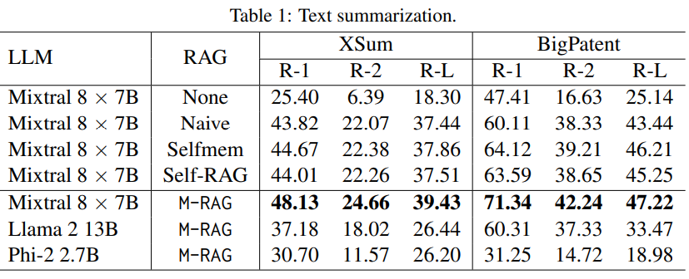
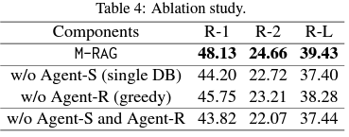
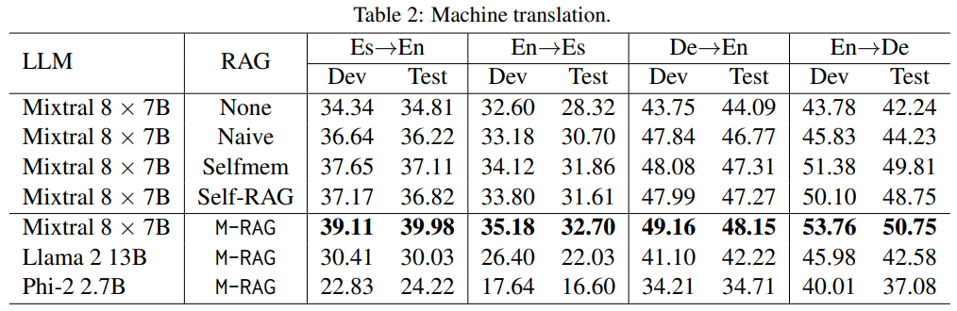
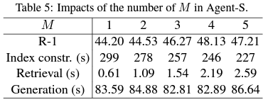
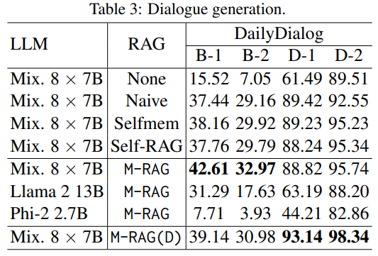
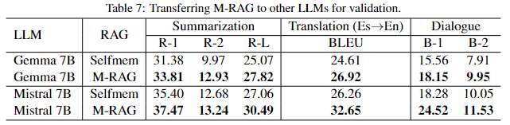
Experiments: Text summarization, Machine translation, and Dialogue generation
Index & Transferability
Text generation
Ablation & Index Construction: Data partitioning and memory refinement both contribute to end-to-end performance; M-RAG supports faster index construction and maintenance functionality.
Transferability Test:
Compared to the best baseline methods, M-RAG demonstrates excellent transferability across different underlying large model architectures in three text generation tasks.
Improvements:
Based on the MOE 8×7B, it achieves the improvements of 11%, 8%, and 12% in text summarization, machine translation, and dialogue generation tasks, respectively.
Notes:
We conduct comprehensive experiments on three language generation tasks: text summarization, machine translation, and dialogue generation, using three distinct language model architectures. Based on the recent MOE 8×7B model, M-RAG achieves improvements of 11%, 8%, and 12% in the respective tasks compared to the best baseline methods. Additionally, we observe that data partitioning and memory refinement both contribute to end-to-end performance, and M-RAG supports faster index construction and maintenance. M-RAG demonstrates excellent transferability across different underlying large model architectures in these text generation tasks.

Slide 6

Q & A

