Slide 1
Crafting Personalized Agents through Retrieval-Augmented Generation on Editable Memory Graphs
Zheng Wang, Zhongyang Li, Zeren Jiang, Dandan Tu, Wei Shi
Huawei Technologies Co., Ltd.
Notes:
Hello everyone, I present our paper titled “Crafting Personalized Agents through Retrieval-Augmented Generation on Editable Memory Graphs” in EMNLP 2024.

Slide 2
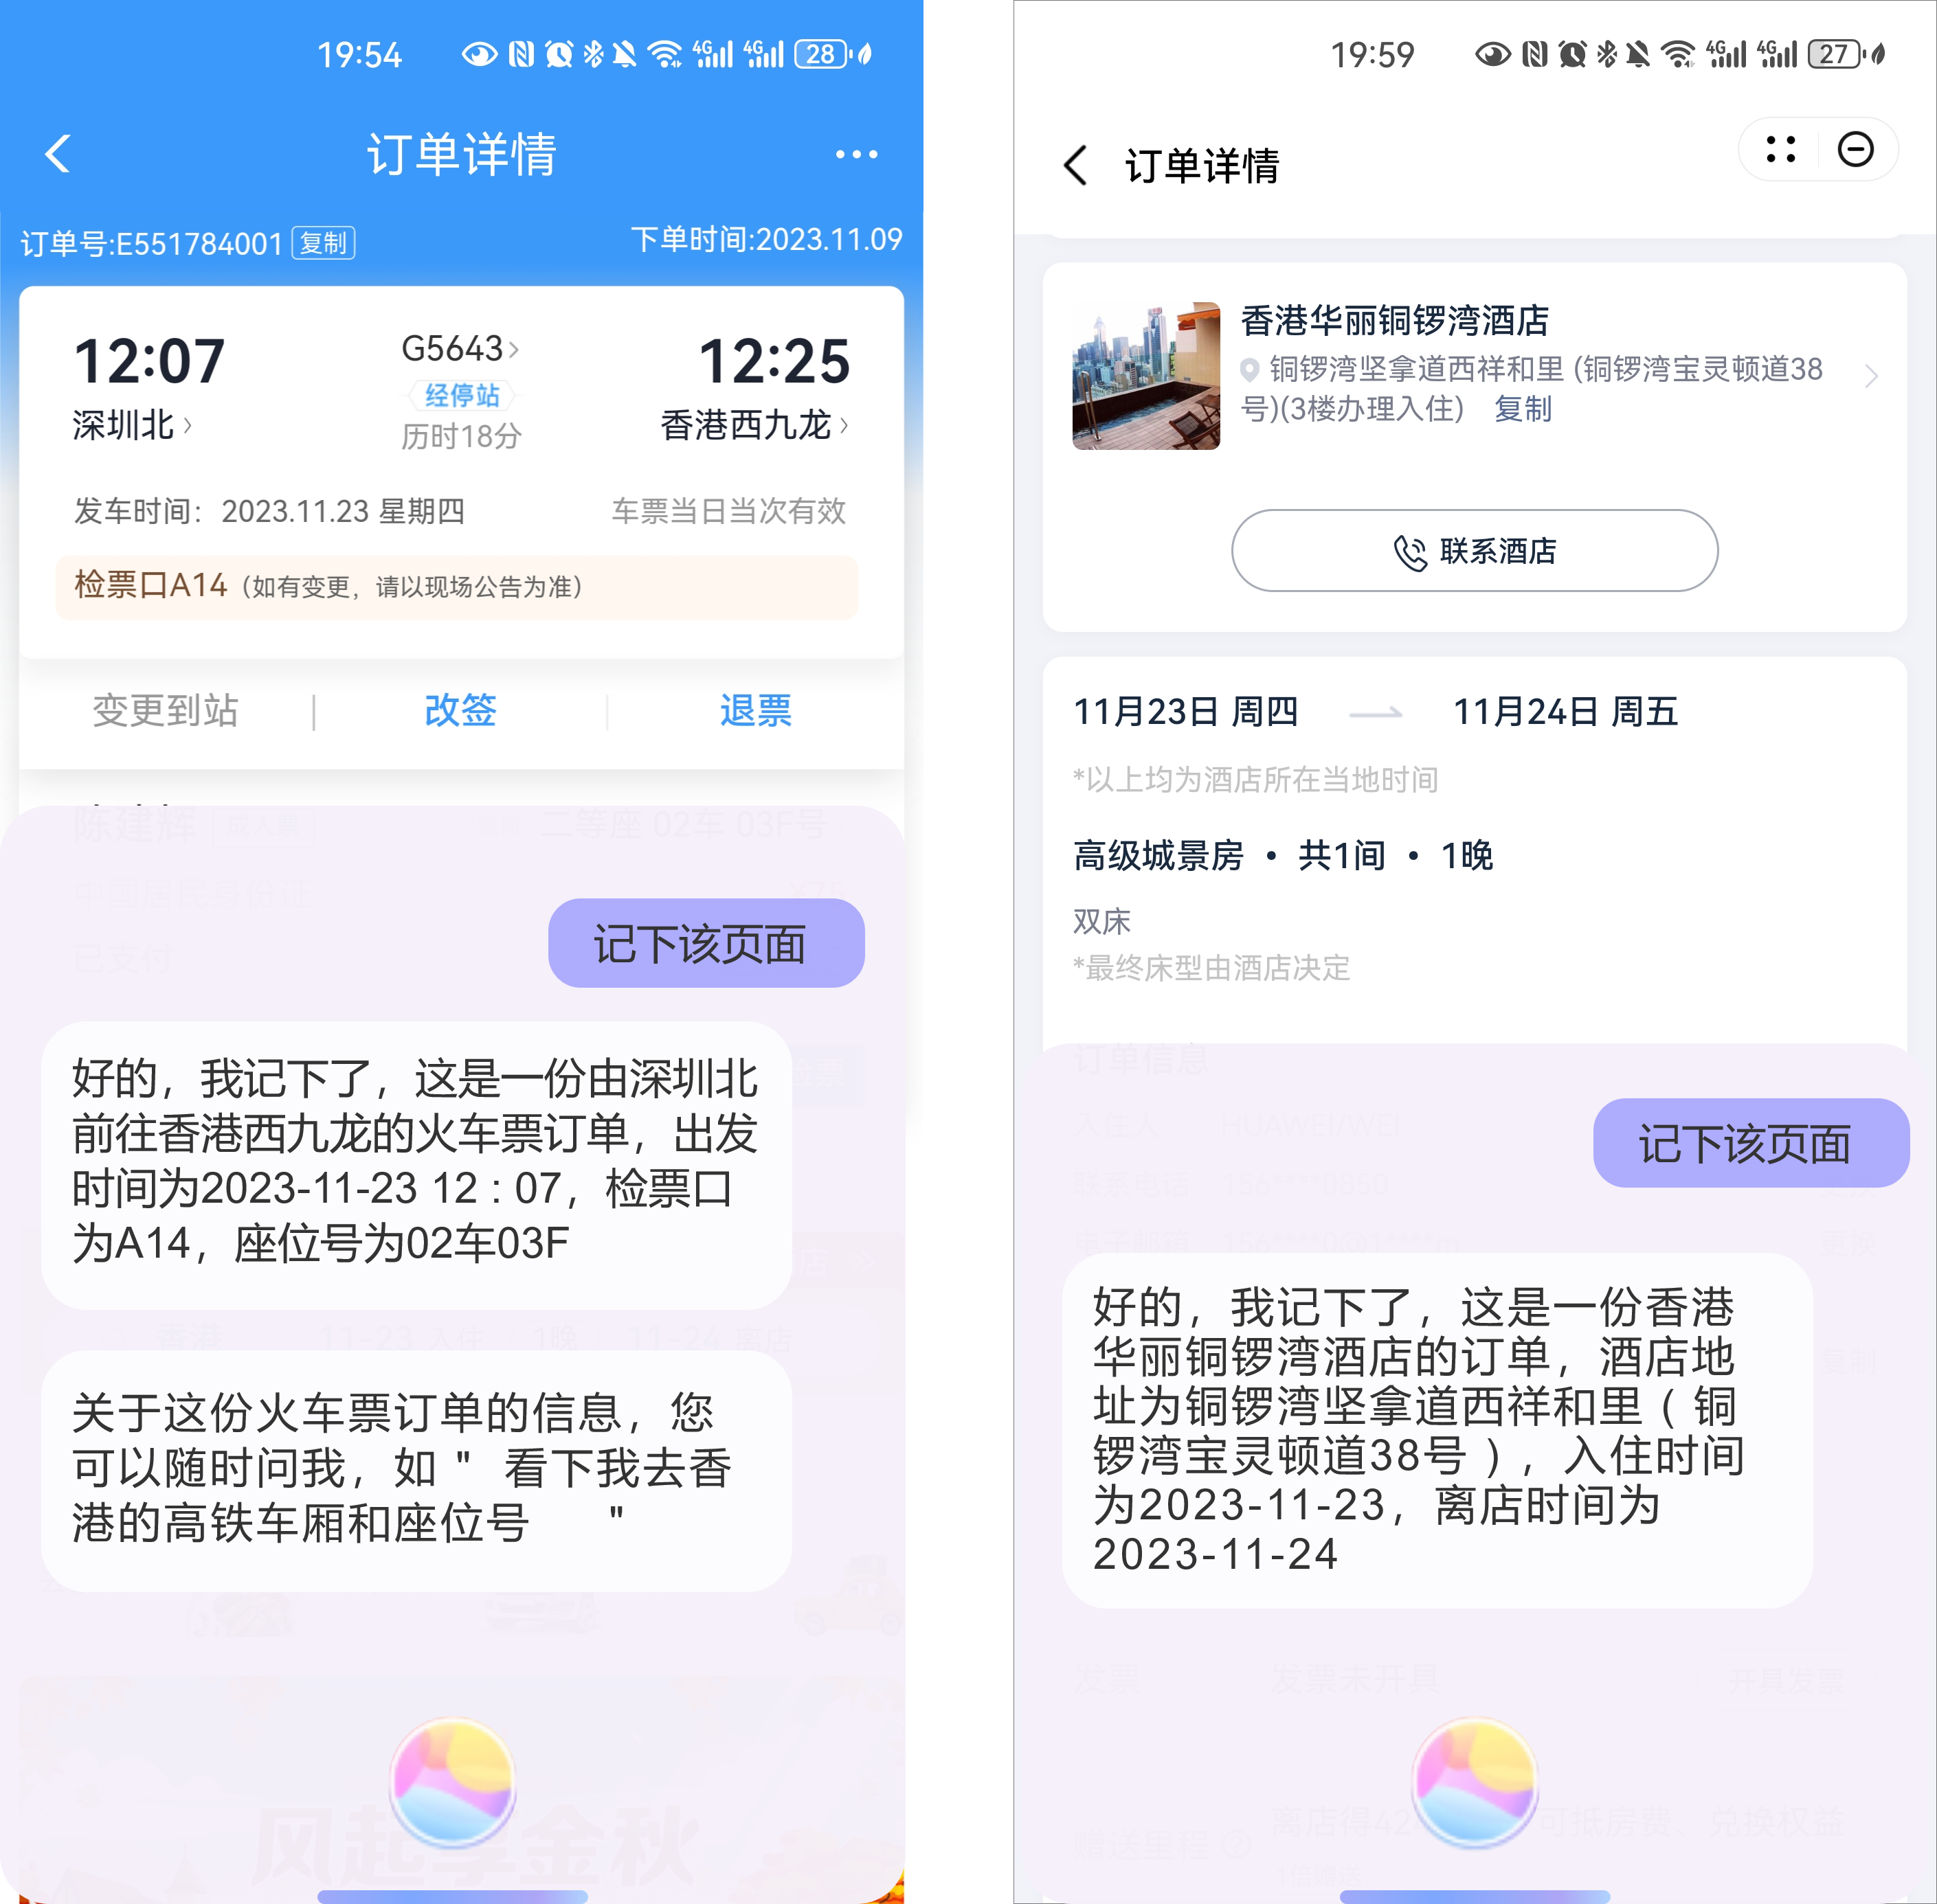
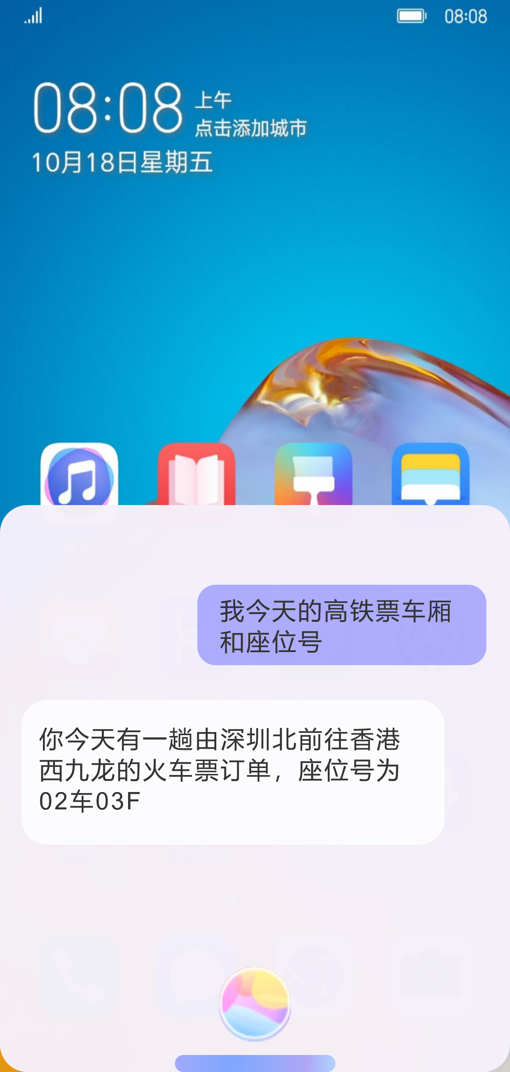
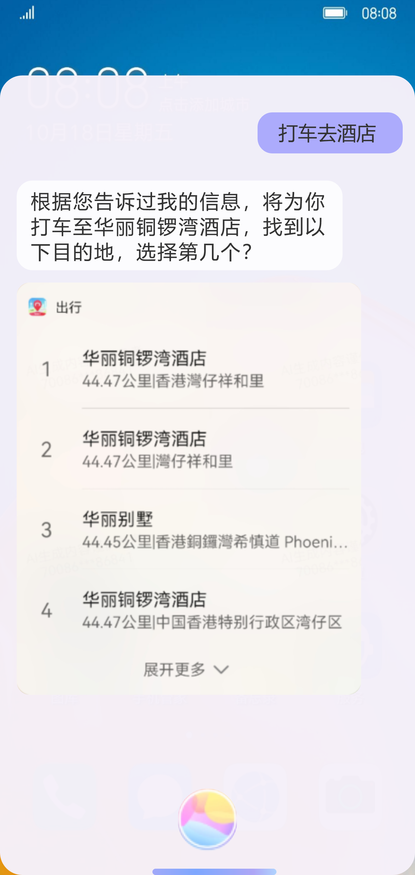
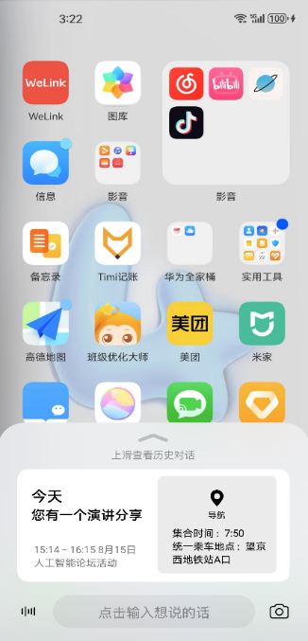
Background: LLM-based Personalized AI Assistant
Scenarios
Challenges & Literature
Data: AI Assistant Conversations
or App Screenshots
Scenarios: An intelligent memory add-on for users
Challenges：
① Memory data collection（Training & Inference）
Existing Datasets (Unsuitable): personalized chats [1], psychological dialogues [2]
Properties: identifying high-value user information, forming standardized memory, and labels for subsequent training use
Data is gathered on smartphone AI assistant platforms, e.g., everyday conversations, and screenshot contents by OCR
Applications based on Memories:
Question Answering, Autofill Forms, User Services (Travel & Reminder)
② Memory Editability（Inset, Delete, Replace）
Editable Memory Graph for Data Management: personal memory is dynamic evolving, involving three types of editing operations: insertion, deletion, and replacement
Properties: ease to extend & capture semantic relationship
③ Memory Selection (RAG)
Solution 1 — Needles in a Haystack: limited context window & noise caused hallucination [3]
Solution 2 — Advanced RAG: relying on Top-K retrieval, but this scenario requires diverse memory combinations [4][5]
[1] Personalizing dialogue agents: I have a dog, do you have pets too, ACL 2018
[2] Memorybank: Enhancing large language models with long-term memory, AAAI 2024
[3] Searching for needles in a haystack: On the role of incidental bilingualism in palm’s translation capability, arXiv 2023
[4] Query rewriting for retrieval-augmented large language models, EMNLP 2023
[5] M-RAG: Reinforcing large language model performance through retrieval-augmented generation with multiple partitions, ACL 2024
App Screenshots
Question Answering
Slot Filling (Travel)
Slot Filling (Reminder)
Notes:
I give a background of a new application, LLM-based personalized AI Assistant. In smartphone AI Assistant (for example Siri in IPhone or Xiaoyi in Huawei), we can collect data from everyday conversations, or screenshot contents by OCR. We identify the data with high-value user information and formalize these to memories. Then we can manage the memories, and use the memories for many downstream applications, including question answering, slot filling (by identifying places or date information writing into a LLM’s prompt) through RAG.
The task has some unique challenges than existing studies. First, Memory data collection, to our best knowledge, public datasets like personalized chats or psychological dialogues are not situable for this scenario, which needs user information, and some labels for training the personalized agent. Second, memory editability, we note that the personal memory is dynamic evolving, involved three types of editing operations: insertion, deletion and replacement, and we should capture the semantic relationship of the user with the memories. Third, memory selection, we discuss two potential solutions for the downstream tasks. One is to feed all memories into a LLM for answering the question, but a LLM may has a limited context window, and there are many noisy memories for answering the question. Second is to try some advanced RAG methods, but many solutions here are relying on Top-K retrieval, but this scenario requires diverse memory combinations.

Slide 3
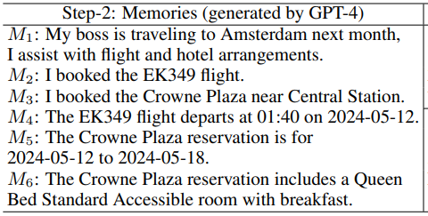
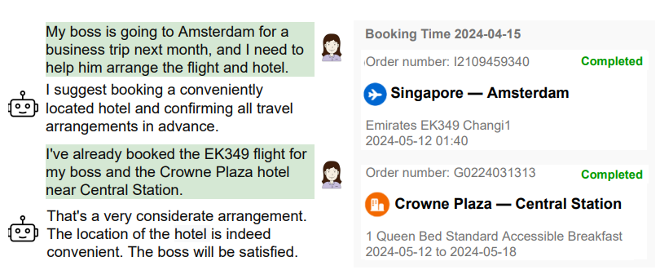
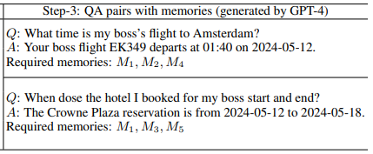
For Challenge 1: Data Collection*
Format to memories
Step-1:
Raw Data Collection
(Conversations or App Screenshots)
Step-2:
Memories Generation
Step-3:
QA Pairs Generation
(with required memories)
Raw data filtering based
on the business scope
The QA pairs and the required memories are used for further RL training
* We have published the GPT-4 prompts for generating the dataset
Notes:
Next, we discuss our proposed solution called EMG-RAG. For data collection, we utilize a business dataset collected from
a real AI assistant, which includes daily conversations with the assistant, and users’ app screenshots, to extract personal memories. Specifically, we leverage the capabilities of GPT-4 to clean the raw data into memories. We organize the memories chronologically, and then use GPT-4 to generate QA pairs within each session (a set of consecutive memories). We also tag the memories involved in generating these QA pairs, which are then used for subsequent training purposes. We have published the GPT-4 prompts for generating the dataset in our paper.

Slide 4
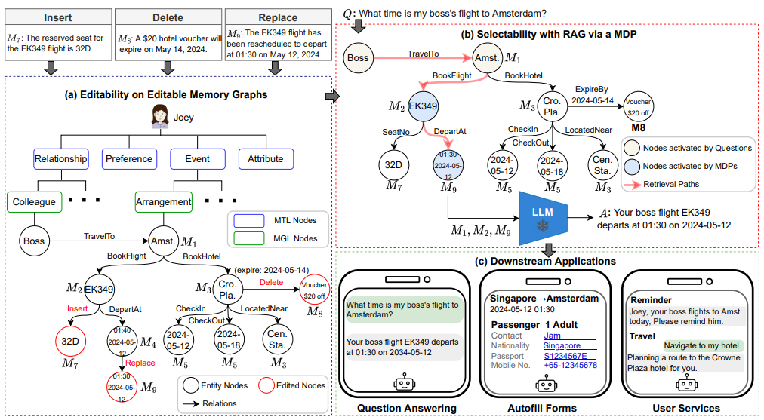
For Challenge 2 & 3: Editability and Selectability
Step 1: Search from the nodes activated by questions
Insert，Delete，Replace
Memory in Ticket Scenario:
Collect new seat numbers (insert), change the departure time of the ticket (replace), coupon expiration (delete)
Step 2: Graph traversal to decide whether to include critical memories
Multilayered EMG
Tree: The first two layers are pre-defined based on the business scope
Graph: Supports locating nodes to be modified and then performing edit operations, where in-degree nodes are with their corresponding memories
Step 3: Integrate the results of natural language generation into three downstream applications
Notes:
For editability, we propose a data structure to manage the data, where the first two levels are a tree defined based on the business scope, then the third level is a graph to capture the user’s semantic relationship, and each node is associated with a memory. To edit the graph, we first locate the nodes to be modified, and then performing edit operations (insertion, deletion, and replacement) accordingly.
For selectability. There are two steps. We first search from the nodes activated by questions based on their similarities, and then conduct graph traversal with an RL-Agent to decide whether to include a visited memory.

Slide 5
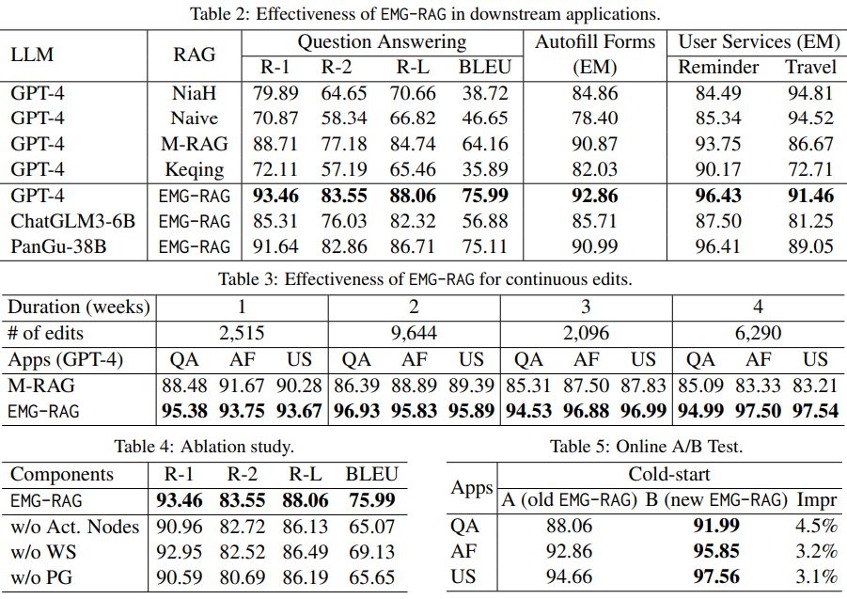
Experiments: Question Answering, Autofill Forms, and User Services
Downstream Applications
Improvements：EMG-RAG can incorporate different LLM architectures, and achieve 18.4%, 2.2%, 3.7% (2.9% and 5.5%）improvements on QA, AF, US (Reminder and Travel).
Editing & Cold-start
Continuous Edits：Compared with the best baseline，EMG-RAG illustrates a good editability, and achieves 10.6%, 9.5%, 9.7% on QA, AF, and QS.
Ablation study & Cold-start：Warm-start and Policy Gradient both contribute to the end-to-end results；EMG-RAG incorporates online learning for the cold-start issue，based on real online queries and human labelled answers for optimization.
Notes:
We conduct extensive experiments on a real-world business dataset across various LLM architectures and RAG methods for three downstream applications: question answering, autofill forms, and user services. Our approach demonstrates improvements of approximately 10% over the best existing approach for these tasks.
We evaluate the effectiveness of EMG-RAG in supporting continuous edits over a period of 4 weeks. The results, in terms of R-L for question answering (QA), and exact match accuracy for autofill forms (AF) and user services (US, combining reminder and travel results), are presented in Table 3. We observe that EMG-RAG consistently outperforms MRAG, by approximately 10.6%, 9.5%, and 9.7% for QA, AF, and US, respectively. This is owing to the editability of EMG-RAG.
To evaluate the effectiveness of different components in EMG-RAG, we conduct an ablation study. We note that all components contribute to the overall performance. We transfer the technique into a real AI assistant platform, and use the real user data to fine-tune the model, and conduct a A/B test. We observe that the performance can be further improved based on human labelled answers for optimization.

Slide 6

Q & A

