Slide 1
Multimodal Query Suggestion with Multi-Agent Reinforcement Learning from Human Feedback
Zheng Wang, Bingzheng Gan, Wei Shi
Huawei Singapore Research Center

Slide 2
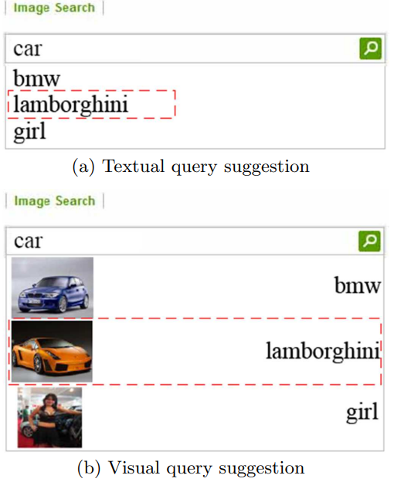
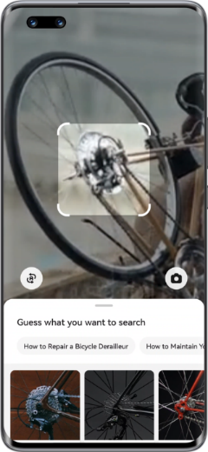
Query Suggestion: TQS, VQS, and MMQS
Multimodal Query Suggestion (MMQS):
Input: query image
Output: textual suggestions
Characteristics: Intentionality & Diversity

Slide 3
RL4Sugg Pipeline
RLHF-based Framework
Input:
Image
Step-1:
Data Labeling
Step-2:
RewardNet
Step-3:
PolicyNet
Step-4:
Diversity
Output:
Suggs
GPT-assisted Labeling
Reinforcement
Learning from Human Feedback
Diversity Enhancement
Labelling：0 or 1 label for users’search intent
GPT-assisted：labeled by GPT if conf < thre, and labeled by human otherwise
Reward Network：0-1 scoring for image-sugg pairs, image-sugg representation learning
Policy Network：image-to-sugg generative learning based on a LLM (sugg-adapter)
Priority-based Clustering：
clustering centers will be selected for suggs, and centers are formed based on ranking priorities
Diversity Enhancement Agent
Intentionality
Diversity

Slide 4
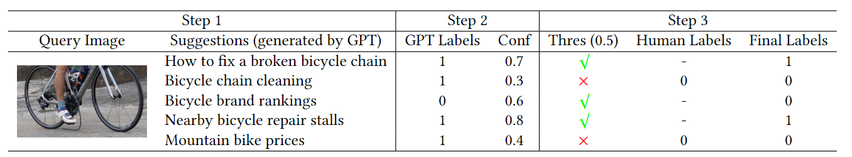
Data Collection
Step 1: GPT-4 generates multiple candidate suggestions from a query image
Step 2: The model assigns a label (1 or 0) to each suggestion, indicating user click intent, along with a confidence (0 to 1)
Step 3: Suggestions with low confidence are filtered out using a threshold (e.g., 0.5) and then undergo human annotation to produce the final labels

Slide 5
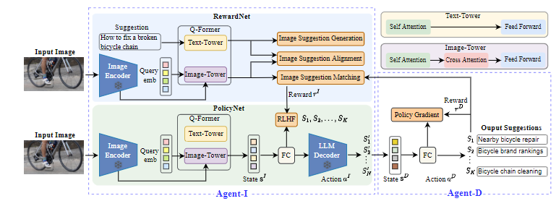
Training Overview of Agent-I and Agent-D
Multi-Agent Reinforcement Learning from Human Feedback
Agent-I (RewardNet & PolicyNet) for Intentionality
Agent-D for Diversity

Slide 6
Experimental Setup
Applications: Generation-based & Retrieval-based Search Engines
Generation-based: generate suggestions from LLMs
Retrieval-based: construct a suggestion database, domain-specific (fashion, sports, animal, shopping) scenarios, high efficiency
Ground Truth & Evaluation: human annotations for search intent
Baselines: techniques in
Metrics: vision-language pretraining models
Generation: DCG/NDCG, GSB
Retrieval : PNR, Recall@K

Slide 7
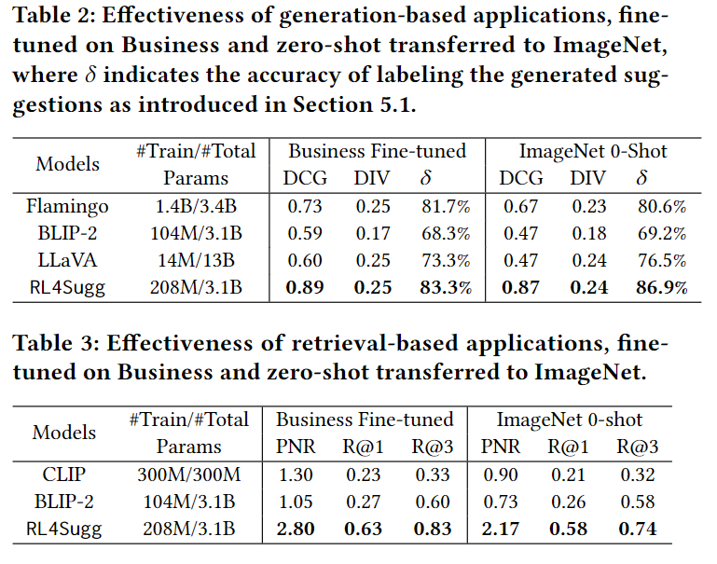
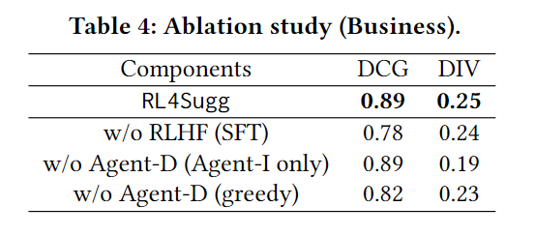
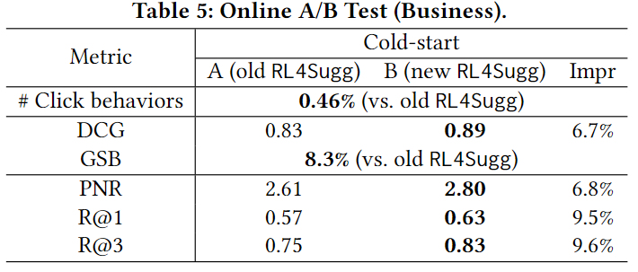
Experimental Results
Intentionality and diversity
Ground truth quality verification
Handling the cold-start problem

Slide 8
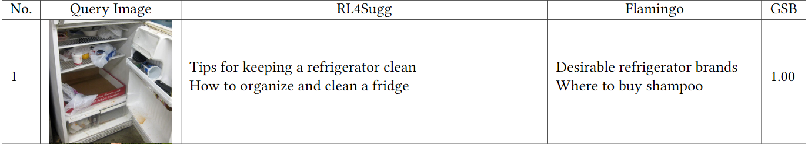
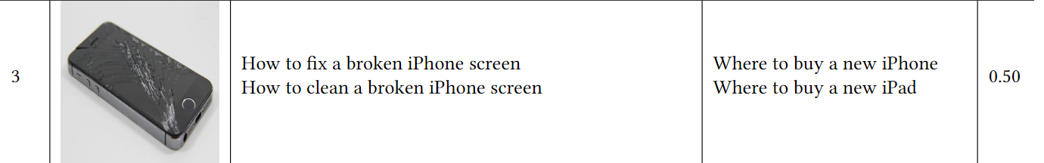
Qualitative results
Cover various intentions of the query image

Slide 9

Q & A

