Slide 1

InstructRAG: Leveraging Retrieval-Augmented Generation on Instruction Graphs for LLM-Based Task Planning
Zheng Wang, Shu Xian Teo, Jun Jie Chew, Wei Shi
Huawei Singapore Research Center
Notes:
Hello everyone, thanks for the talk invitation, my presentation is “Advancing a Development Platform for Large Language Model Applications”

Slide 2
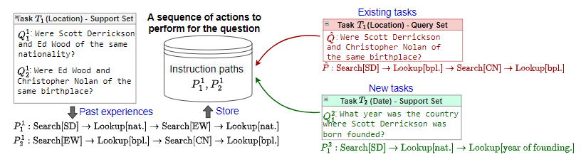
Background & Motivation
Background
LLMs as Agents for complex task planning, relying on a Thought-Action-Observation (TAO) process: (e.g., ReAct, KnowAgent, WKM, Reflexion, Fire-Act, NAT, and ETO) Observation → Environment Thought and Action → LLMs
Motivation
RAG helps the LLM planning by leveraging external databases (which is less explored) Property 1 (Enlargeability): Pre-built databases are limited to the scope of the data they cover Property 2 (Transferability): Task planning involves developing models that can quickly adapt to new tasks in practice
Limited knowledge of LLMs on complex tasks
Enlargeability: combine existing instructions to solve a new question
Transferability: rapid adaptation to new tasks
Notes:
We can take LLMs as Agents for complex task planning, relying on a sequence of Thought-Action-Observation processes proposed by ReAct, where the observation is provided by environment, and the thought and action are provided by LLMs. We note that a LLM may have limited knowledge on complex tasks, leading to reduced performance. We want to use retrieval help the LLM planning by leveraging external databases. We discuss two properies of the idea. Suppose we have many questions and their instruction paths to solve the questions from past experiences, and we store them into a database. Now, we have some new questions. If the questions corresponding to the existing tasks of the database, the pre-built databases are limited to the scope of the data they cover, and we may learn to combine existing instructions to solve a new question. This is enlargeability. If the questions corresponding to the new tasks, we note that task planning involves developing models that can quickly adapt to new tasks in practice. This is transferability requirement in this task.

Slide 3
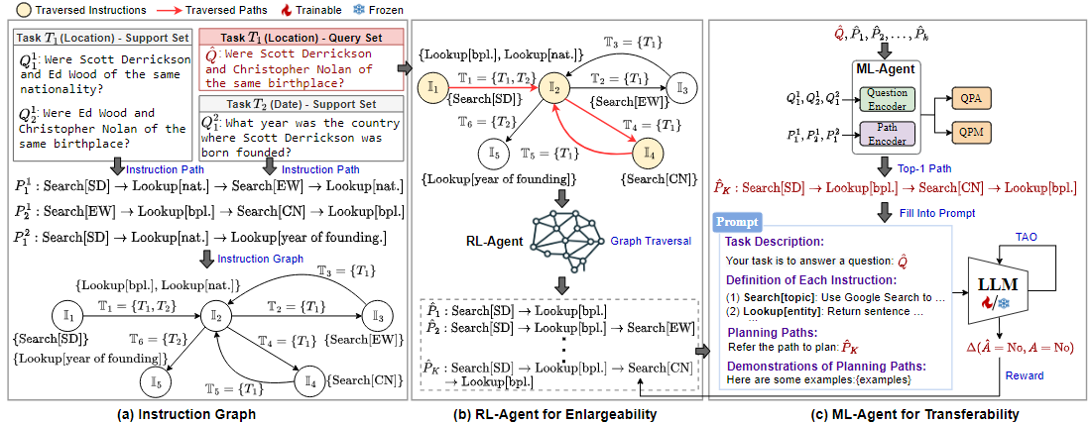
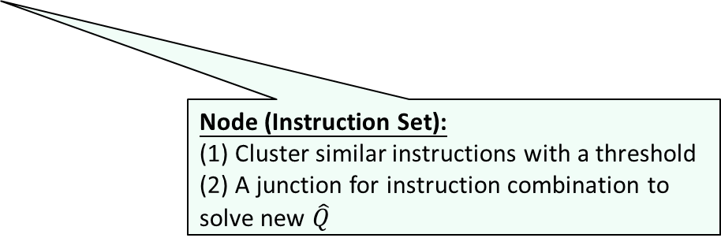
Multi-Agent Meta-Reinforcement Learning Framework
Edge (Task Set): keep task-specific info into the structure
Instruction Graph: a directed graph that organizes instruction paths
Step-1: Generate instruction paths from past successful experiences
Step-2: Insert instructions step-by-step with a threshold 𝛿
Node (Instruction Set):
(1) Cluster similar instructions with a threshold
(2) A junction for instruction combination to solve new $\hat{Q}$
Notes:
Here, we build an instruction graph to organize the instruction paths. We treat the node as an instruction set, where we cluster similar instructions with a threshold into the nodes, which can be considered as a junction for instruction combination to solve new questions, and we treat the edge as a task set, to keep task-specific information into the structure.

Slide 4
Multi-Agent Meta-Reinforcement Learning Framework
RL-Agent (Enlargeability): it utilizes RL to identify candidate paths on the graph, with the goal of optimizing effectiveness
Notes:
We design a RL-Agent to find candidate paths on the graph, with the goal of optimizing end-to-end effectiveness.

Slide 5
Multi-Agent Meta-Reinforcement Learning Framework
ML-Agent (Transferability): prompt with in-context learning exemplars
(1) Training: seen tasks + support (warm-start) & query (training) sets
(2) Few-shot Learning: unseen tasks + support set (adapted models per task)
(3) Testing: unseen tasks + query set (testing wrt the corresponding task)
Notes:
We then design a ML-Agent with meta-learning, including training, few-shot learning, and testing stages. The goal is to quickly learn an adapted model per task at testing.

Slide 6
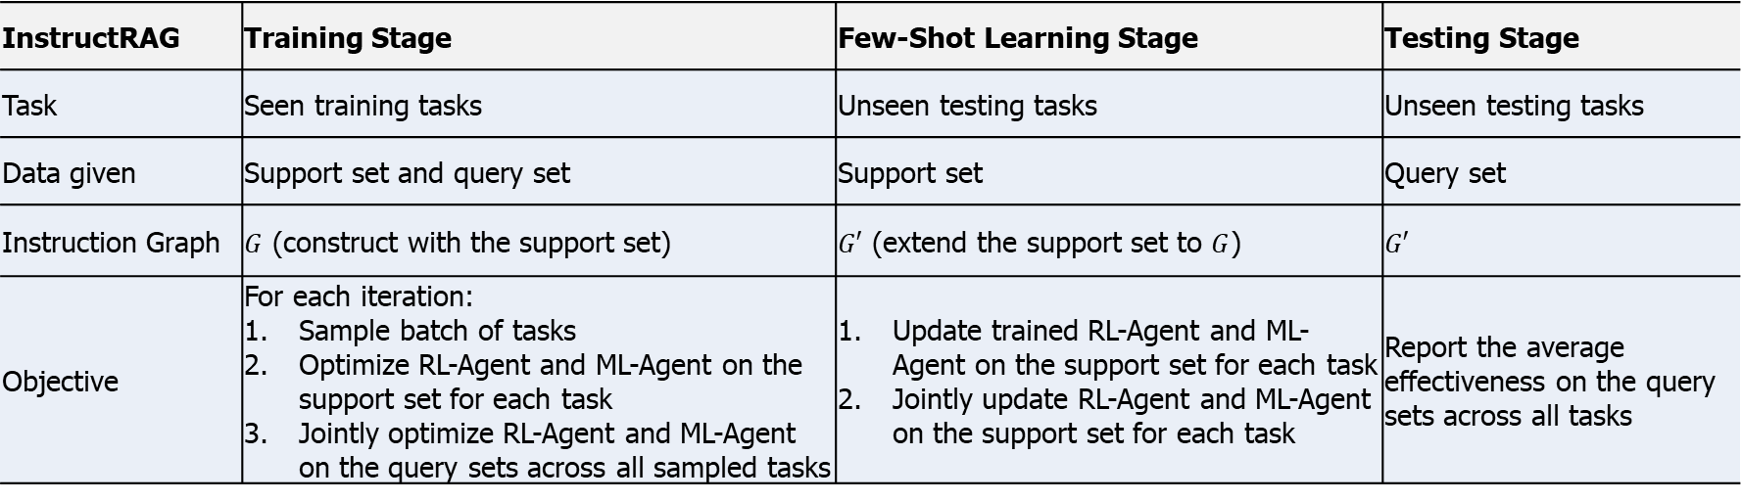
Overview of InstructRAG in Three Stages
InstructRAG | Training Stage | Few-Shot Learning Stage | Testing Stage
Task | Seen training tasks | Unseen testing tasks | Unseen testing tasks
Data given | Support set and query set | Support set | Query set
Instruction Graph | $G$ (construct with the support set) | $G′$ (extend the support set to $G$) | $$G′$$
Objective | For each iteration: Sample batch of tasks Optimize RL-Agent and ML-Agent on the support set for each task Jointly optimize RL-Agent and ML-Agent on the query sets across all sampled tasks | Update trained RL-Agent and ML-Agent on the support set for each task Jointly update RL-Agent and ML-Agent on the support set for each task | Report the average effectiveness on the query sets across all tasks
Notes:
We then design a ML-Agent with meta-learning, including training, few-shot learning, and testing stages. The goal is to quickly learn an adapted model per task at testing.

Slide 7
Experimental Setup
Datasets: HotpotQA, ALFWorld, Webshop, ScienceWorld
Domains: multi-hop reasoning, embodied tasks, web shopping, and scientific reasoning
Baselines: ReAct, WKM, Reflexion, GenGround, RAP
Same Setups and Retrievers
Same LLM backbones: GLM-4, GPT-4o mini, DeepSeek-V2
Evaluation Metrics: Higher values indicate better
HotpotQA: F1 score
ALFWorld: Success rate (0 or 1)
WebShop and ScienceWorld: Reward score
Notes:
We conduct experiments for two types of search engines: (1) generation-based is to generate suggestions from LLMs, and retrieval-based is to retrieval suggestions from a domain-specific suggestion database. The ground truth comes from human annotations for search intent. We compare vision-language pretraining models in terms of the two tasks.

Slide 8
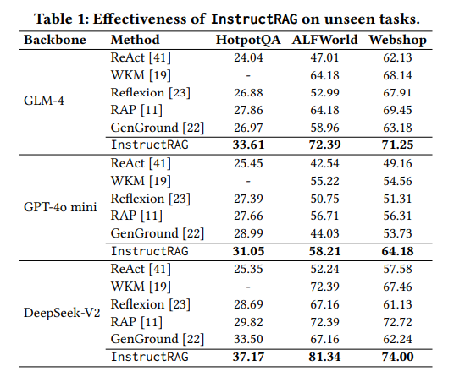
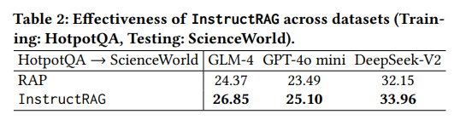
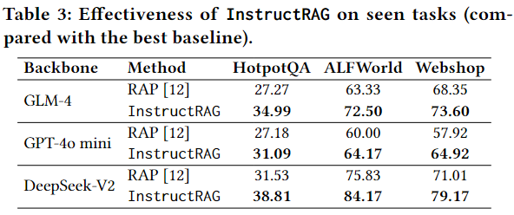
Experimental Results - Effectiveness
An improvement of approximately 11.5% over the best existing approach
Generalization capabilities across datasets:
6%-10% improvements than the best baseline
performance on seen training tasks (three datasets):
average improvements of 21.9%, 10.8 %, 10.4%
Notes:
Overall, RL4Sugg captures the intentionality and diversity effectively. We explain the result from ablation study. If we drop the Agent-D, and use the Agent-I for both properties, we note that the diversity becomes worse. In this case, the model is to lazily generate some similar suggestions because these suggestions correspond to a high reward but with a worse diversity. And this is why we use the multi-agent to optimize the two objectives.

Slide 9
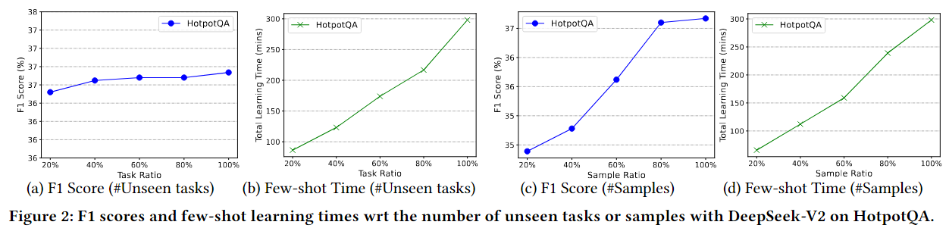
Experimental Results - Efficiency
Few-shot learning time & effectiveness:
Rapidly adapts to a new task through few-shot learning in 27.1 minutes
Notes:
Overall, RL4Sugg captures the intentionality and diversity effectively. We explain the result from ablation study. If we drop the Agent-D, and use the Agent-I for both properties, we note that the diversity becomes worse. In this case, the model is to lazily generate some similar suggestions because these suggestions correspond to a high reward but with a worse diversity. And this is why we use the multi-agent to optimize the two objectives.

Slide 10
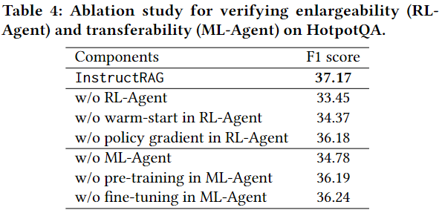
Experimental Results – Ablation Study
Contributions of the two Agents:
Improvements of 11.1% (RL-Agent) and 6.9% (ML-Agent), respectively
Notes:
Overall, RL4Sugg captures the intentionality and diversity effectively. We explain the result from ablation study. If we drop the Agent-D, and use the Agent-I for both properties, we note that the diversity becomes worse. In this case, the model is to lazily generate some similar suggestions because these suggestions correspond to a high reward but with a worse diversity. And this is why we use the multi-agent to optimize the two objectives.

Slide 11
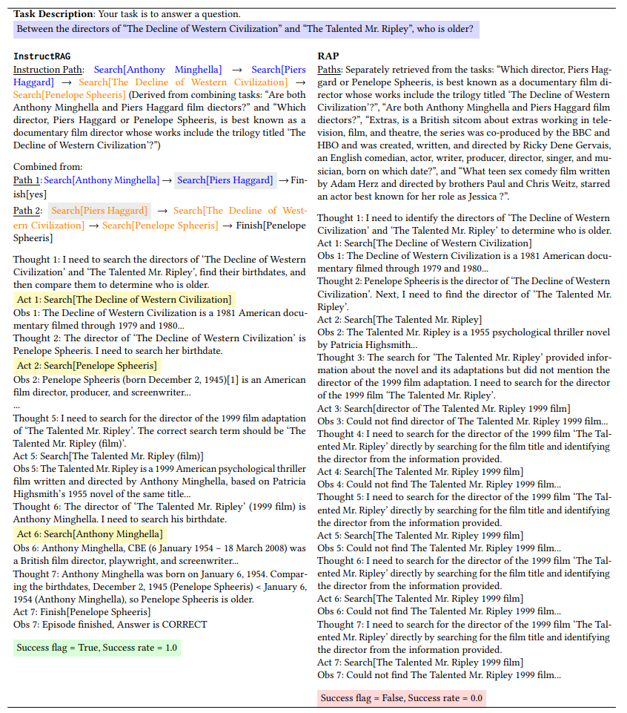
Experimental Results – Case Study
InstructRAG combines multiple paths from related tasks into an instruction path
linking two key items —
Anthony Minghella (novel)
Piers Haggard (film adaptation)
RAP struggles to produce a correct query, failed query formulation
These connections help the LLM generate correct queries to retrieve the film director in its thoughts (e.g., Thought 5).
Notes:
Overall, RL4Sugg captures the intentionality and diversity effectively. We explain the result from ablation study. If we drop the Agent-D, and use the Agent-I for both properties, we note that the diversity becomes worse. In this case, the model is to lazily generate some similar suggestions because these suggestions correspond to a high reward but with a worse diversity. And this is why we use the multi-agent to optimize the two objectives.

Slide 12

Q & A

