Slide 1
Welcome Message
The First Workshop on Information Seeking with Big Models
(BigIS 2024)

Slide 2
Introduction
Background:
Big models are reshaping data mining and information seeking.
Language models like ChatGPT enhance understanding and generation.
The workshop unites experts to explore big model applications.
Scope and Topics:
How big models transform information-seeking tasks like retrieval, recommendation, and QA.
The importance of trustworthiness and ethical compliance in applying big models.
The development of robust evaluation frameworks to assess the impact of big models.

Slide 3
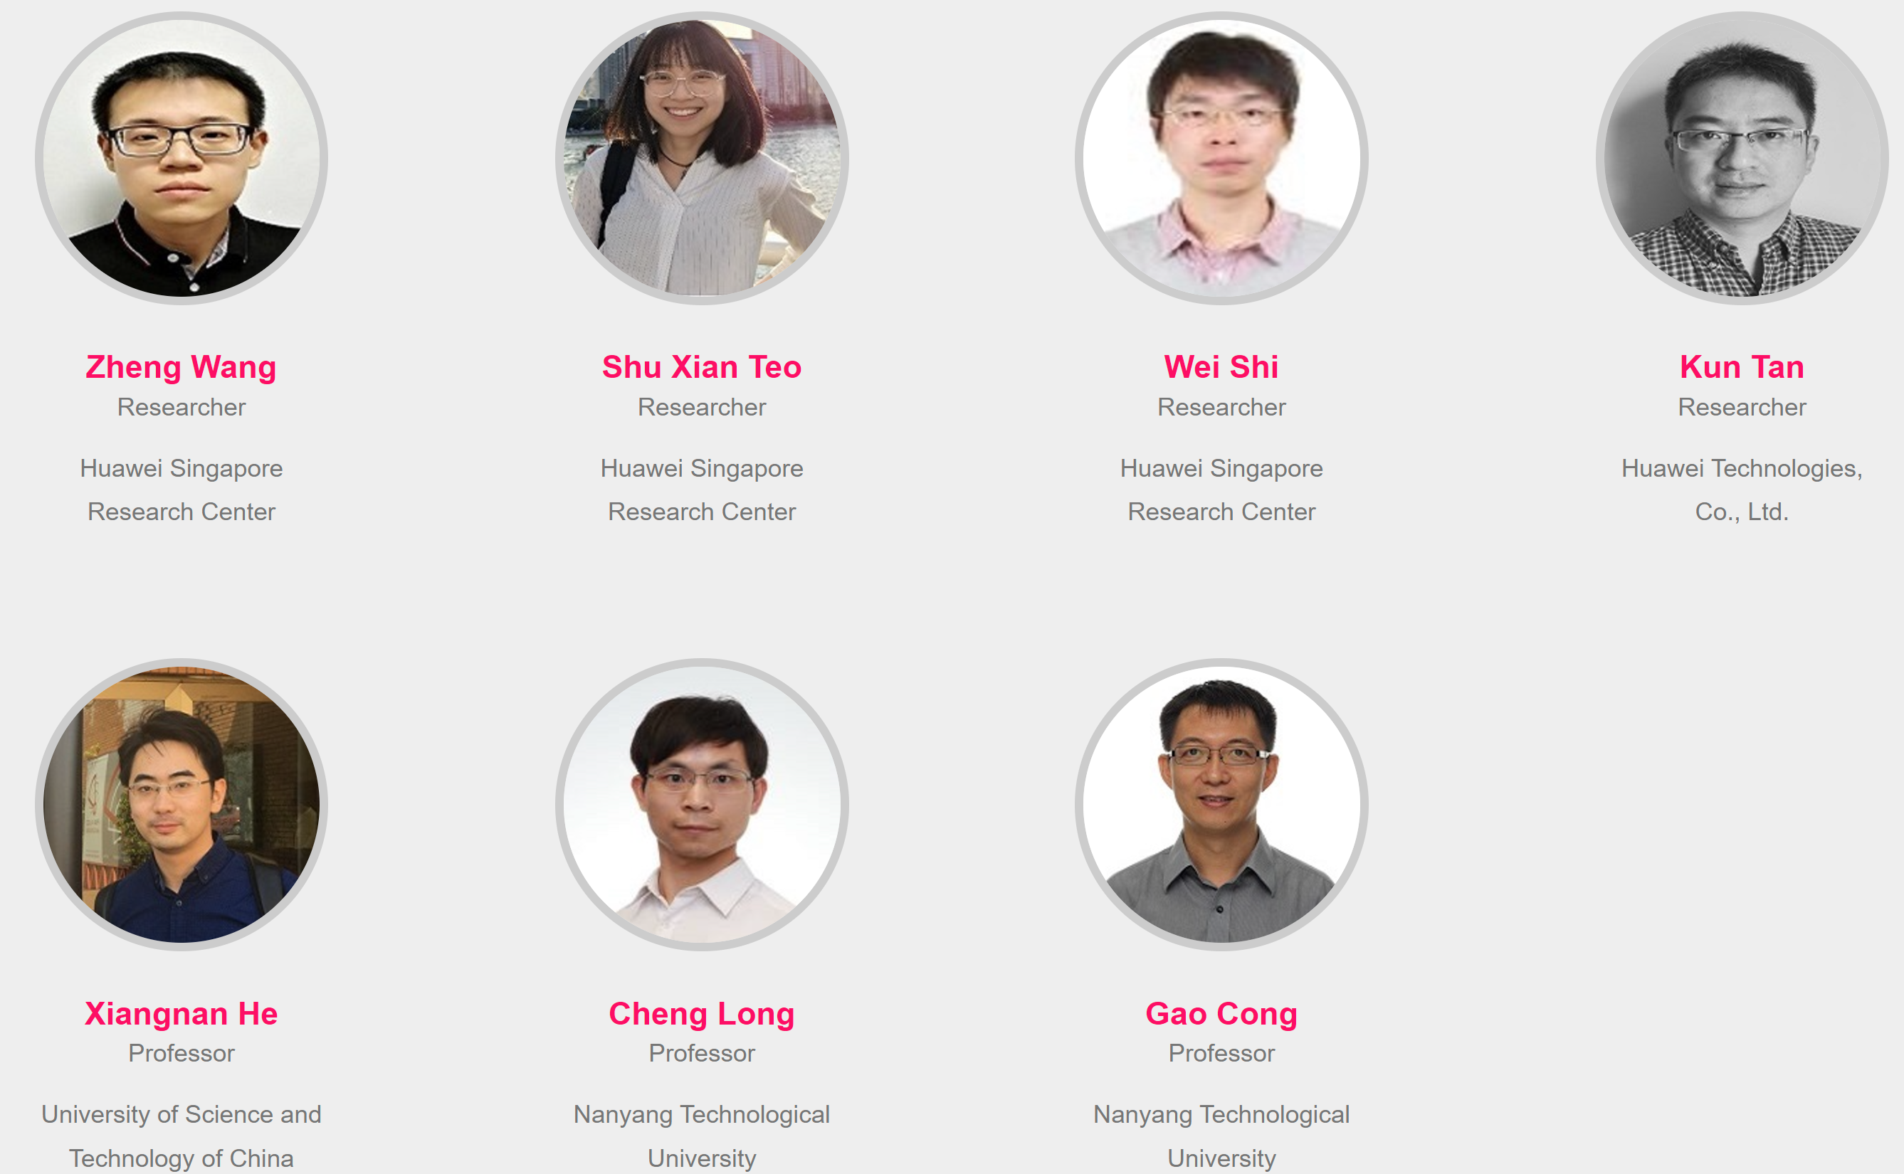
Acknowledgments
Workshop Organization (Huawei + USTC + NTU)
Workshop Statistics:
3 invited keynotes + 5 accepted long papers (with 3 oral presentations)
Acceptance rate: 45%

Slide 4
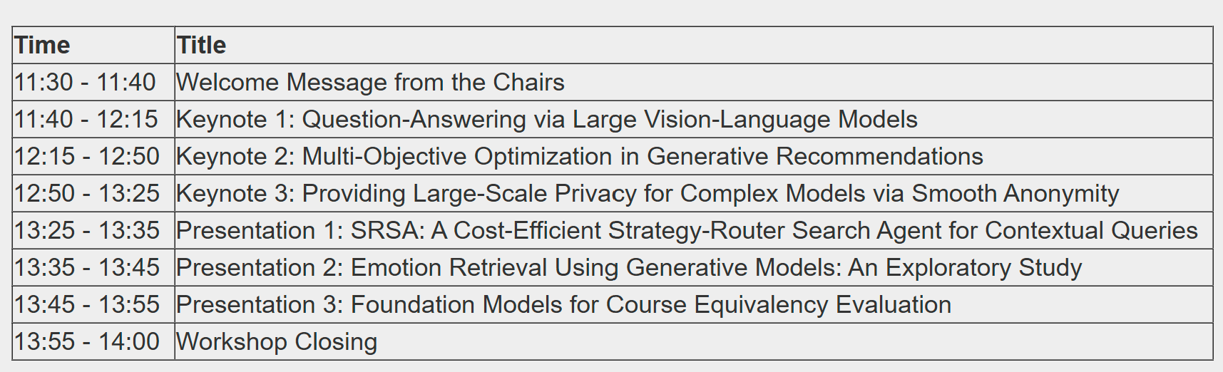
Schedule

