Slide 1

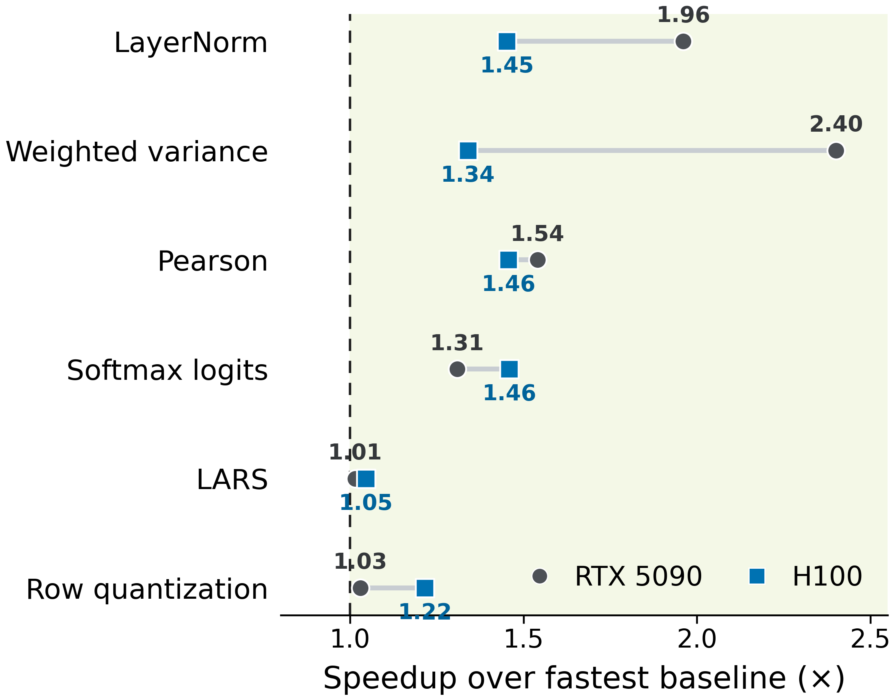
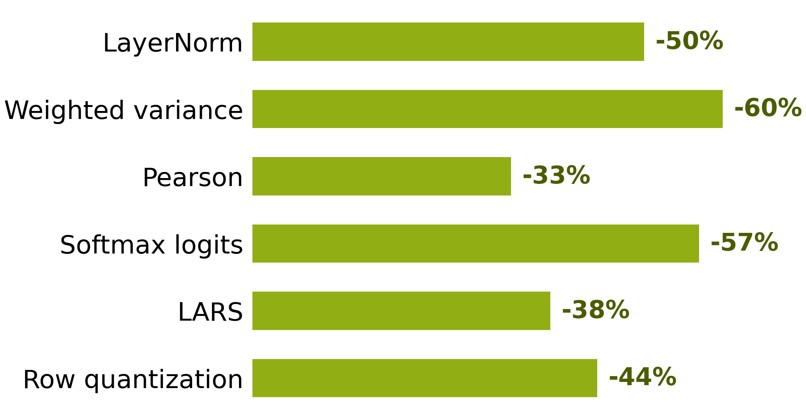
DAC Young Fellows
63
CREDIT: Cost-Guided DSMEM Tiling
for Wide Reduction-Reuse GPU Kernels
Zhengxiong Li | Fellow ID: ______ | Advisors: Tsung-Wei Huang & Umit Ogras | University of Wisconsin-Madison
1
THE PROBLEM
2
CREDIT
3
CROSS-GPU EVIDENCE
Wide rows hit the memory wall
KEEP BULK DATA LOCAL
EXCHANGE ONLY SCALAR PARTIALS
ALL 6 WORKLOADS WIN AT 64K
Conventional multi-pass schedule
best of torch.compile, Triton, and CUDA
REDUCE
pass 1
REDUCE
pass 2
OUTPUT
pass 3
Partition one row across a thread-block cluster
ROW SLICE 0
ROW SLICE 1
ROW SLICE 2
ROW SLICE 3
read
reread
reread
CTA 0
local SMEM
CTA 1
local SMEM
CTA 2
local SMEM
CTA 3
local SMEM
HBM: reload the same wide row
One CTA cannot retain a wide row
ρ0
ρ1
ρ2
ρ3
Later stages reread bulk data
DSMEM replicated push: compact partials only
Naive clusters add barriers + remote traffic
DSMEM IS NOT FREE
Local SMEM
30-34 cyc
reuse local
slice → output
reuse local
slice → output
reuse local
slice → output
reuse local
slice → output
1.466×
RTX 5090 geomean
1.318×
H100 geomean
55 / 60
CUDA profit signs
Remote DSMEM
191-216 cyc
O(N/P)
local bytes / CTA
O(P² Σq)
remote bytes / row
ZERO
remote bulk reads
DRAM
688-930 cyc
Cluster synchronization
MEASURED DRAM TRAFFIC ELIMINATED
404 cycles | RTX 5090
851 cycles | H100
COST-GUIDED GENERATION
RTX 5090, N = 65,536
Can avoided rereads repay
cluster overhead?
Predicted benefit =
saved
reread
-
cluster
control
-
local
replay
-
DSMEM
transport
WHY WIDTH HELPS
GENERATE DSMEM KERNEL iff ΔT > 0
avoided reread ∝ N
cluster cost
1 baseline timing + primitive profiles + static traffic counts
No DSMEM candidate timing
crossover N*
N
LayerNorm at N = 65,536
≈768 KiB HBM avoided vs. 896 B DSMEM exchanged
MODEL VALIDATION
90.0% RTX 5090 | 93.3% H100
Every crossover within one tested 2× width interval
4
DEPLOYMENT RULE
REREADS INPUT
after reduction?
BULK STAYS
owner-local?
REMOTE STATE
stays compact?
ΔT > 0
USE DSMEM
Any NO → keep the non-DSMEM baseline
USE DSMEM
AVOID DSMEM
Wide row + reduction + reuse
One-pass reduction
Bulk slice stays owner-local
Scan / selection
Remote state stays compact
Bulk halo exchange
LayerNorm | softmax backward | pairwise statistics | quantization
Width amortizes overhead; width alone is not predictive.
Wide rows amortize overhead; width alone is not a selection rule.
DSMEM is a selective reduction-reuse mechanism, not a general fusion fabric.
UNIVERSITY OF
WISCONSIN-MADISON
zhengxiong.li@wisc.edu
RTX 5090 + NVIDIA H100
CUDA 13 | FP32

