Slide 1
Evaluation of Information Retrieval Systems
Lecture by Shangsong Liang
Sun Yat-sen University
Thanks to Marti Hearst, Ray Larson, Chris Manning

Slide 2
Today: Evaluation of IR Systems
Performance evaluations
Retrieval evaluation
Quality of evaluation - Relevance
Measurements of Evaluation
  Precision vs recall
  F number
  others
Test Collections/TREC

Slide 3
Performance of the IR or Search Engine
Relevance
Coverage
Recency
Functionality (e.g. query syntax)
Speed
Availability
Usability
Time/ability to satisfy user requests
Basically “happiness”

Slide 4
Evaluation of Search Engines
Besides relevance, other measures
  Speed of index
  Coverage of topic (usually dependent on coverage of crawlers)

Slide 5
Query Engine
Index
Evaluation
Interface
Indexer
Users
Crawler
Web
A Typical Web Search Engine

Slide 6
User’s
Information
Need
Collections
Pre-process
text input
Parse
Query
Index
Rank or Match
Evaluation
Query Reformulation

Slide 7
Evaluation Workflow
Information
Need (IN)
Query
IR
Retrieval
Docs
Improve
Query?
Evaluation
IN satisfied

Slide 8
What does the user want?
Restaurant case
The user wants to find a restaurant serving sashimi. User uses 2 IR systems. How we can say which one is better?

Slide 9
Evaluation
Why Evaluate?
What to Evaluate?
How to Evaluate?

Slide 10
Why Evaluate?
Determine if the system is useful
Make comparative assessments with other methods/systems
  Who’s the best?
Test and improve systems
Marketing
Others?

Slide 11
What to Evaluate?
How much of the information need is satisfied.
How much was learned about a topic.
Incidental learning:
  How much was learned about the collection.
  How much was learned about other topics.
How easy the system is to use.
Usually based on what documents we retrieve

Slide 12
Relevance as a Measure
Relevance is everything!
How relevant is the document retrieved
  for the user’s information need.
Subjective, but one assumes it’s measurable
Measurable to some extent
  How often do people agree a document is relevant to a query
    More often than expected
How well does it answer the question?
  Complete answer? Partial?
  Background Information?
  Hints for further exploration?

Slide 13
Relevance
Evaluation metric: relevance
Relevance of the returned results indicates how appropriate the results are in satisfying your information need
Relevance of the retrieved documents is a measure of the evaluation.

Slide 14
Relevance
In what ways can a document be relevant to a query?
Simple - query word or phrase is in the document.
  Problems?
Answer precise question precisely.
Partially answer question.
Suggest a source for more information.
Give background information.
Remind the user of other knowledge.
Others ...
Search for cobra

Slide 15
What to Evaluate?
What can be measured that reflects users’ ability to use system? (Cleverdon 66)
  Coverage of Information
  Form of Presentation
  Effort required/Ease of Use
  Time and Space Efficiency
  Effectiveness
  Recall
    proportion of relevant material actually retrieved
  Precision
    proportion of retrieved material actually relevant
Effectiveness!

Slide 16
How do we measure relevance?
Measures:
  Binary measure
    1 relevant
    0 not relevant
  N-nary measure
    3 very relevant
    2 relevant
    1 barely relevant
    0 not relevant
  Negative values?
N=? consistency vs. expressiveness tradeoff

Slide 17
Given: we have a relevance ranking of documents
Have some known relevance evaluation
  Query independent – based on information need
  Experts (or you)
Apply binary measure of relevance
  1 - relevant
  0 - not relevant
Put in a query
  Evaluate relevance of what is returned
What comes back?
  Example: lion

Slide 18
Relevant vs. Retrieved Documents
Retrieved
Relevant
All docs available
Set approach

Slide 19
Contingency table of relevant and retrieved documents
relevant
Rel
NotRel
Ret_{Rel}
Ret_{NotRel}
Ret
Ret = Ret_{Rel} + Ret_{NotRel}
retrieved
NotRet_{Rel}
NotRet_{NotRel}
NotRet = NotRet_{Rel} + NotRet_{NotRel}
NotRet
Relevant = Ret_{Rel} + NotRet_{Rel}
Not Relevant = Ret_{NotRel} + NotRet_{NotRel}
Total # of documents available N = Ret_{Rel} + NotRet_{Rel} + Ret_{NotRel} + NotRet_{NotRel}
Precision: P= Ret_{Rel} / Retrieved
Recall: R = Ret_{Rel} / Relevant
P = [0,1]
R = [0,1]

Slide 20
Contingency table of classification of documents
Actual Condition
Present
Absent
tp
fp
type1
fp type 1 error
Positive
Test result
fn
type2
tn
Negative
fn type 2 error
present = tp + fn
positives = tp + fp
negatives = fn + tn
Total # of cases N = tp + fp + fn + tn
False positive rate α = fp/(negatives)
False negative rate β = fn/(positives)

Slide 21
Retrieval example
Documents available: D1,D2,D3,D4,D5,D6,D7,D8,D9,D10
Relevant: D1, D4, D5, D8, D10
Query to search engine retrieves: D2, D4, D5, D6, D8, D9
 | relevant | not relevant
retrieved
not retrieved

Slide 22
Example
Documents available: D1,D2,D3,D4,D5,D6,D7,D8,D9,D10
Relevant: D1, D4, D5, D8, D10
Query to search engine retrieves: D2, D4, D5, D6, D8, D9
 | relevant | not relevant
retrieved | D4,D5,D8 | D2,D6,D9
not retrieved | D1,D10 | D3,D7

Slide 23
Precision and Recall – Contingency Table
Retrieved
Not retrieved
w=3
x=2
Relevant
Relevant = w+x= 5
y=3
z=2
Not relevant
Not Relevant = y+z = 5
Retrieved = w+y = 6
Not Retrieved = x+z = 4
Total documents N = w+x+y+z = 10
Precision: P= w / w+y =3/6 =.5
Recall: R = w / w+x = 3/5 =.6

Slide 24
Contingency table of relevant and retrieved documents
relevant
Rel
NotRel
Ret_{Rel}=3
Ret_{NotRel}=3
Ret
Ret = Ret_{Rel} + Ret_{NotRel}
= 3 + 3 = 6
retrieved
NotRet_{Rel}=2
NotRet_{NotRel}=2
NotRet
NotRet = NotRet_{Rel} + NotRet_{NotRe}
= 2 + 2 = 4
Relevant = Ret_{Rel} + NotRet_{Rel}
= 3 + 2 = 5
Not Relevant = Ret_{NotRel} + NotRet_{NotRel}
= 2 + 2 = 4
Total # of docs N = Ret_{Rel} + NotRet_{Rel} + Ret_{NotRel} + NotRet_{NotRel}= 10
Precision: P= Ret_{Rel} / Retrieved = 3/6 = .5
Recall: R = Ret_{Rel} / Relevant = 3/5 = .6
P = [0,1]
R = [0,1]

Slide 25
What do we want
Find everything relevant – high recall
Only retrieve those – high precision

Slide 26
Relevant vs. Retrieved
All docs
Retrieved
Relevant

Slide 27
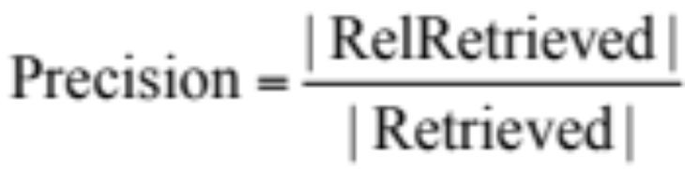
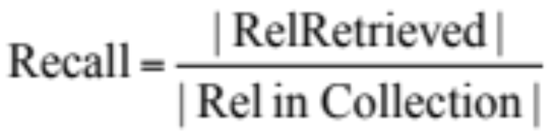
Precision vs. Recall
All docs
Retrieved
Relevant

Slide 28
Retrieved vs. Relevant Documents
Very high precision, very low recall
retrieved
Relevant

Slide 29
Retrieved vs. Relevant Documents
High recall, but low precision
Relevant
retrieved

Slide 30
Retrieved vs. Relevant Documents
Very low precision, very low recall (0 for both)
retrieved
Relevant

Slide 31
Retrieved vs. Relevant Documents
High precision, high recall (at last!)
retrieved
Relevant

Slide 32
Why Precision and Recall?
Get as much of what we want while at the same time getting as little junk as possible.
Recall is the percentage of relevant documents returned compared to everything that is available!
Precision is the percentage of relevant documents compared to what is returned!
What different situations of recall and precision can we have?

Slide 33
Experimental Results
Much of IR is experimental!
Formal methods are lacking
  Role of artificial intelligence
Derive much insight from these results

Slide 34
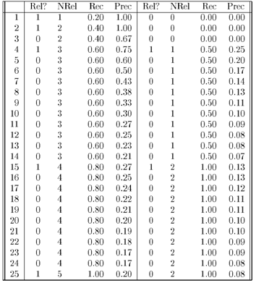
Rec- recall NRel - # relevant
Prec - precision
Retrieve one document at a time without replacement and in order.
Given: only 25 documents of which 5 are relevant (D1, D2, D4, D15, D25)
Calculate precision and recall after each document retrieved
Retrieve D1
Have D1
Retrieve D2
Have D1, D2
Retrieve D3
Now have D1, D2, D3

Slide 35
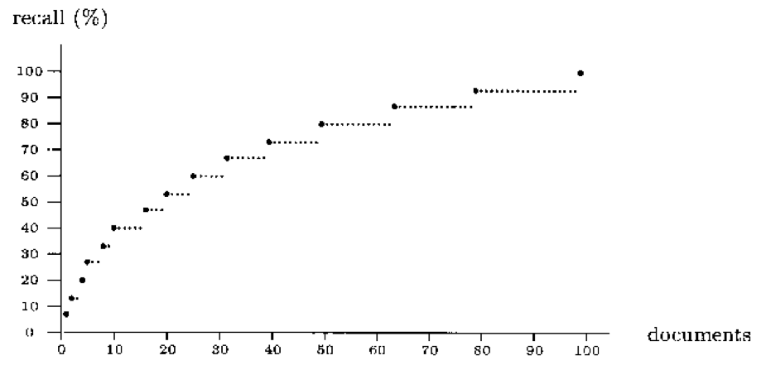
Recall Plot
Recall when more and more documents are retrieved.
Why this shape?

Slide 36
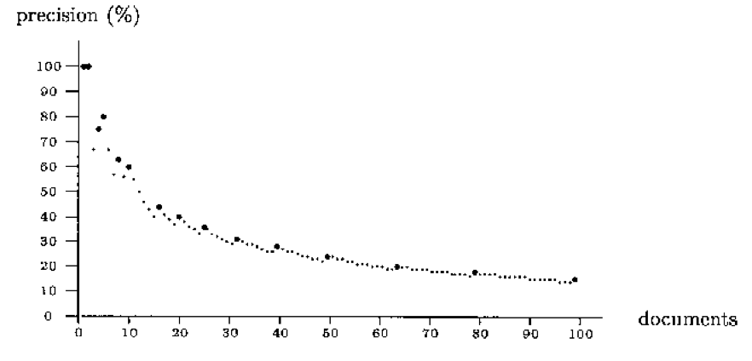
Precision Plot
Precision when more and more documents are retrieved.
Note shape!

Slide 37
Precision/recall plot
Sequences of points (p, r)
Similar to y = 1 / x:
  Inversely proportional!
  Sawtooth shape - use smoothed graphs
How we can compare systems?

Slide 38
Recall/Precision Curves
There is a tradeoff between Precision and Recall
  So measure Precision at different levels of Recall
Note: this is usually an AVERAGE over MANY queries
Note that
there are
two separate
entities plotted on the x axis, recall and numbers of
Documents.
precision
n₁
n₂
n₃
n₄
recall
n_{i} is number of documents retrieved, with n_{i} < n_{i+1}

Slide 39
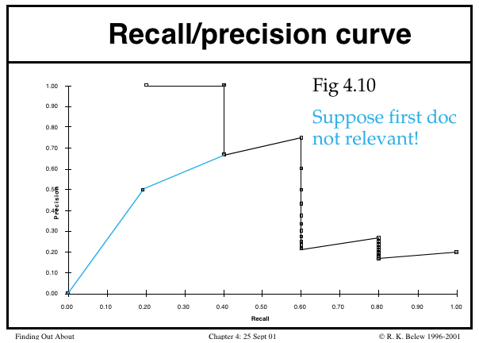
Actual recall/precision curve for one query

Slide 40
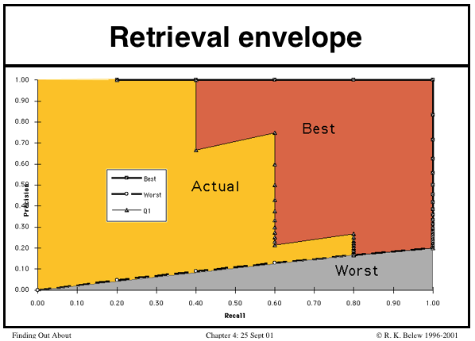
Best versus worst retrieval

Slide 41
Precision/Recall Curves
Sometimes difficult to determine which of these two hypothetical results is better:
precision
x
x
x
x
recall

Slide 42
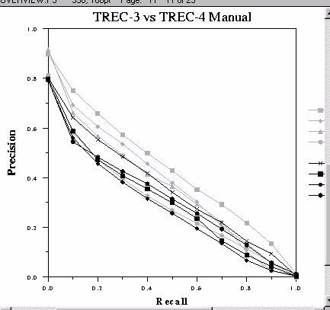
Precision/Recall Curve Comparison
Best
Worst

Slide 43
Document Cutoff Levels
Another way to evaluate:
  Fix the number of documents retrieved at several levels:
    top 5
    top 10
    top 20
    top 50
    top 100
    top 500
  Measure precision at each of these levels
  Take (weighted) average over results
This is a way to focus on how well the system ranks the first k documents.

Slide 44
Problems with Precision/Recall
Can’t know true recall value (recall for the web?)
  except in small collections
Precision/Recall are related
  A combined measure sometimes more appropriate
Assumes batch mode
  Interactive IR is important and has different criteria for successful searches
Assumes a strict rank ordering matters.

Slide 45
Recall Under various retrieval assumptions
Buckland & Gey, JASIS: Jan 1994
1.0
0.9
0.8
0.7
0.6
0.5
0.4
0.3
0.2
0.1
0.0
Perfect
Tangent
Parabolic
Recall
R
E
C
A
L
L
Parabolic
Recall
1000 Documents
100 Relevant
Random
Perverse
0.0 0.1 0.2 0.3 0.4 0.5 0.6 0.7 0.8 0.9 1.0
Proportion of documents retrieved

Slide 46
Precision under various assumptions
1.0
0.9
0.8
0.7
0.6
0.5
0.4
0.3
0.2
0.1
0.0
Perfect
P
R
E
C
I
S
I
O
N
Tangent
Parabolic
Recall
1000 Documents
100 Relevant
Parabolic
Recall
Random
Perverse
0.0 0.1 0.2 0.3 0.4 0.5 0.6 0.7 0.8 0.9 1.0
Proportion of documents retrieved

Slide 47
Recall-Precision
Perfect
1.0
0.9
0.8
0.7
0.6
0.5
0.4
0.3
0.2
0.1
0.0
P
R
E
C
I
S
I
O
N
Tangent
Parabolic
Recall
1000 Documents
100 Relevant
Parabolic Recall
Random
Perverse
0.0 0.1 0.2 0.3 0.4 0.5 0.6 0.7 0.8 0.9 1.0
RECALL
IS 240 – Spring 2011

Slide 48
Relation to Contingency Table
 | Doc is Relevant | Doc is NOT relevant
Doc is retrieved | a | b
Doc is NOT retrieved | c | d
Accuracy: (a+d) / (a+b+c+d) =1-错误率（对的没检索到、错的检索到了）
Precision: a/(a+b)
Recall: a/(a+c)
Why don’t we use Accuracy for IR?
  (Assuming a large collection)
    Most docs aren’t relevant
    Most docs aren’t retrieved
    Inflates the accuracy value

Slide 49
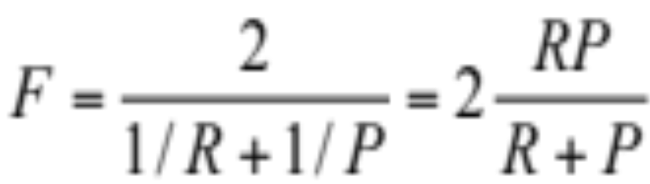
The F-Measure
Combine Precision and Recall into one number
P = precision
R = recall
F = [0,1]
F = 1; when all ranked documents are relevant
F = 0; no relevant documents have been retrieved
Harmonic mean – average of rates
AKA
F₁ measure,
F-score

Slide 50
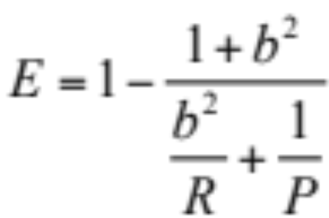
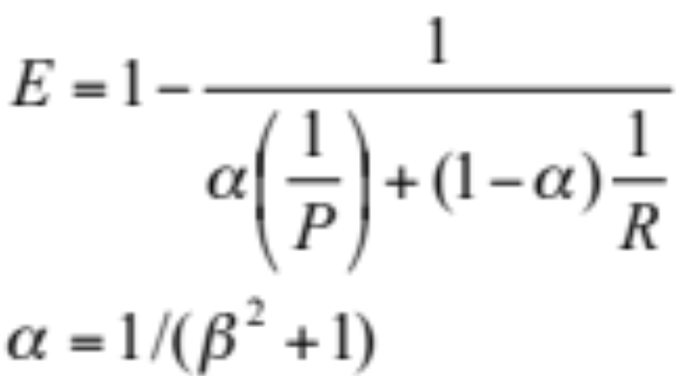
The E-Measure
Other ways to combine Precision and Recall into one number (van Rijsbergen 79)
P = precision
R = recall
b = measure of relative importance of P or R
For example,
b = 0.5 means user is twice as interested in
precision as recall

Slide 51
Interpret precision and recall
Precision can be seen as a measure of exactness or fidelity
Recall is a measure of completeness
Inverse relationship between Precision and Recall, where it is possible to increase one at the cost of reducing the other.
  For example, an information retrieval system (such as a search engine) can often increase its Recall by retrieving more documents, at the cost of increasing number of irrelevant documents retrieved (decreasing Precision).
  Similarly, a classification system for deciding whether or not, say, a fruit is an orange, can achieve high Precision by only classifying fruits with the exact right shape and color as oranges, but at the cost of low Recall due to the number of false negatives from oranges that did not quite match the specification.

Slide 52
Measures for Large-Scale Eval
Typical user behavior in web search systems has shown a preference for high precision
Also graded scales of relevance seem more useful than just “yes/no”
Measures have been devised to help evaluate situations taking these into account

Slide 53
Cumulative Gain measures
If we assume that highly relevant documents are more useful when appearing earlier in a result list (are ranked higher)
And, highly relevant documents are more useful than marginally relevant documents, which are in turn more useful than non-relevant documents
Then measures that take these factors into account would better reflect user needs

Slide 54
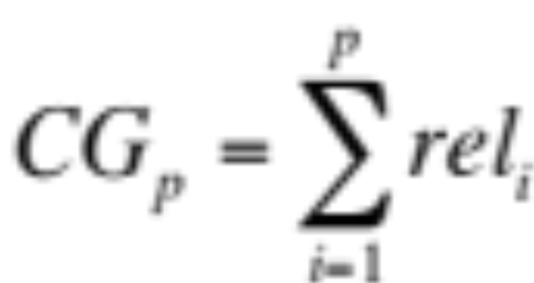
Simple CG
Cumulative Gain is simply the sum of all the graded relevance values the items in a ranked search result list
The CG at a particular rank p is
Where i is the rank and rel_{i} is the relevance score
IS 240 – Spring 2011

Slide 55
Discounted Cumulative Gain
DCG measures the gain (usefulness) of a document based on its position in the result list
  The gain is accumulated (like simple CG) with the gain of each result discounted at lower ranks
The idea is that highly relevant docs appearing lower in the search result should be penalized proportion to their position in the results

Slide 56
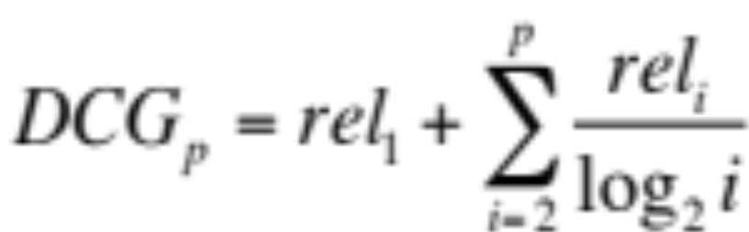
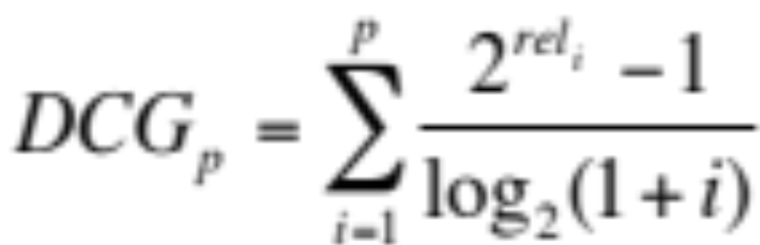
Discounted Cumulative Gain
The DCG is reduced logarithmically proportional to the position (p) in the ranking
Why logs? No real reason except smooth reduction. Another formulation is:
Puts a stronger emphasis on high ranks

Slide 57
Normalized DCG
Because search results lists vary in size depending on the query, comparing results across queries doesn’t work with DCG alone
To do this DCG is normalized across the query set:
  First create an “ideal” result by sorting the result list by relevance score
  Use that ideal value to create a normalized DCG

Slide 58
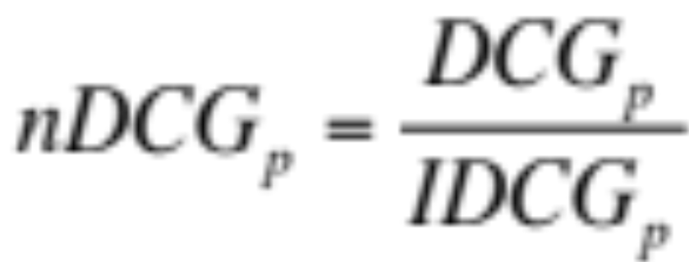
Normalized DCG
Using the ideal DCG at a given position and the observed DCG at the same position
The nDCG values for all test queries can then be averaged to give a measure of the average performance of the system
If a system does perfect ranking, the IDCG and DCG will be the same, so nDCG will be 1 for each rank (nDCG_{p} ranges from 0-1)
IS 240 – Spring 2011

Slide 59
Types of queries
Simple information searches
Complex questions
How to evaluate?

Slide 60
Rank-Based Measures
Binary relevance
  Precision@K (P@K)
  Mean Average Precision (MAP)
  Mean Reciprocal Rank (MRR)
Multiple levels of relevance
  Normalized Discounted Cumulative Gain (NDCG)

Slide 61

Precision@K
Set a rank threshold K
Compute % relevant in top K
Ignores documents ranked lower than K
Ex:
  Prec@3 of 2/3
  Prec@4 of 2/4
  Prec@5 of 3/5
In similar fashion we have Recall@K

Slide 62
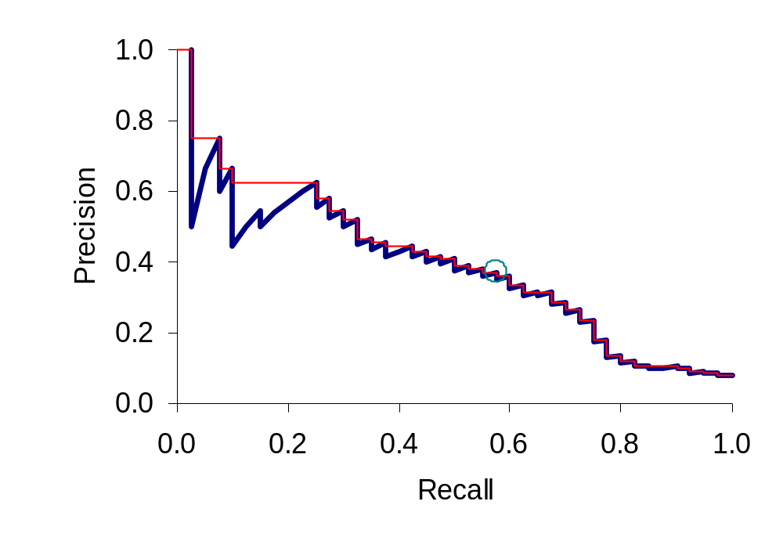
A precision-recall curve
Sec. 8.4

Slide 63

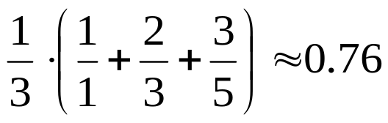
Mean Average Precision (MAP)
Consider rank position of each relevant doc
  K₁, K₂, … K_{R}
Compute Precision@K for each K₁, K₂, … K_{R}
Average precision = average of P@K
Ex: has AvgPrec of
MAP is Average Precision across multiple queries/rankings

Slide 64
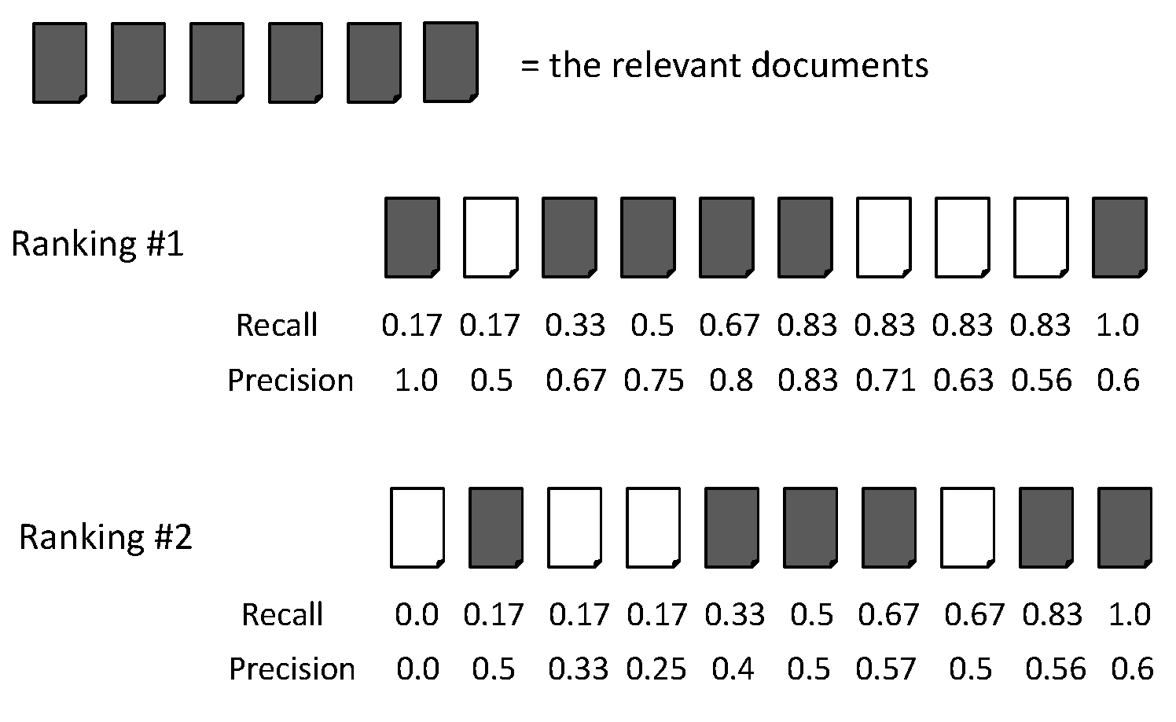
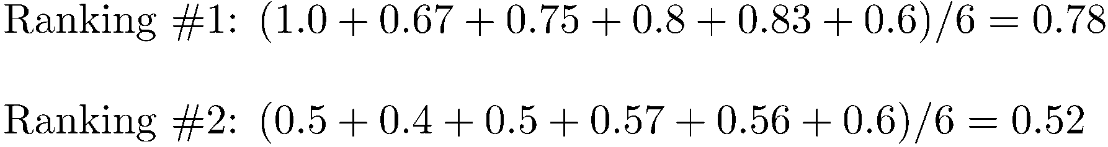
Average Precision

Slide 65
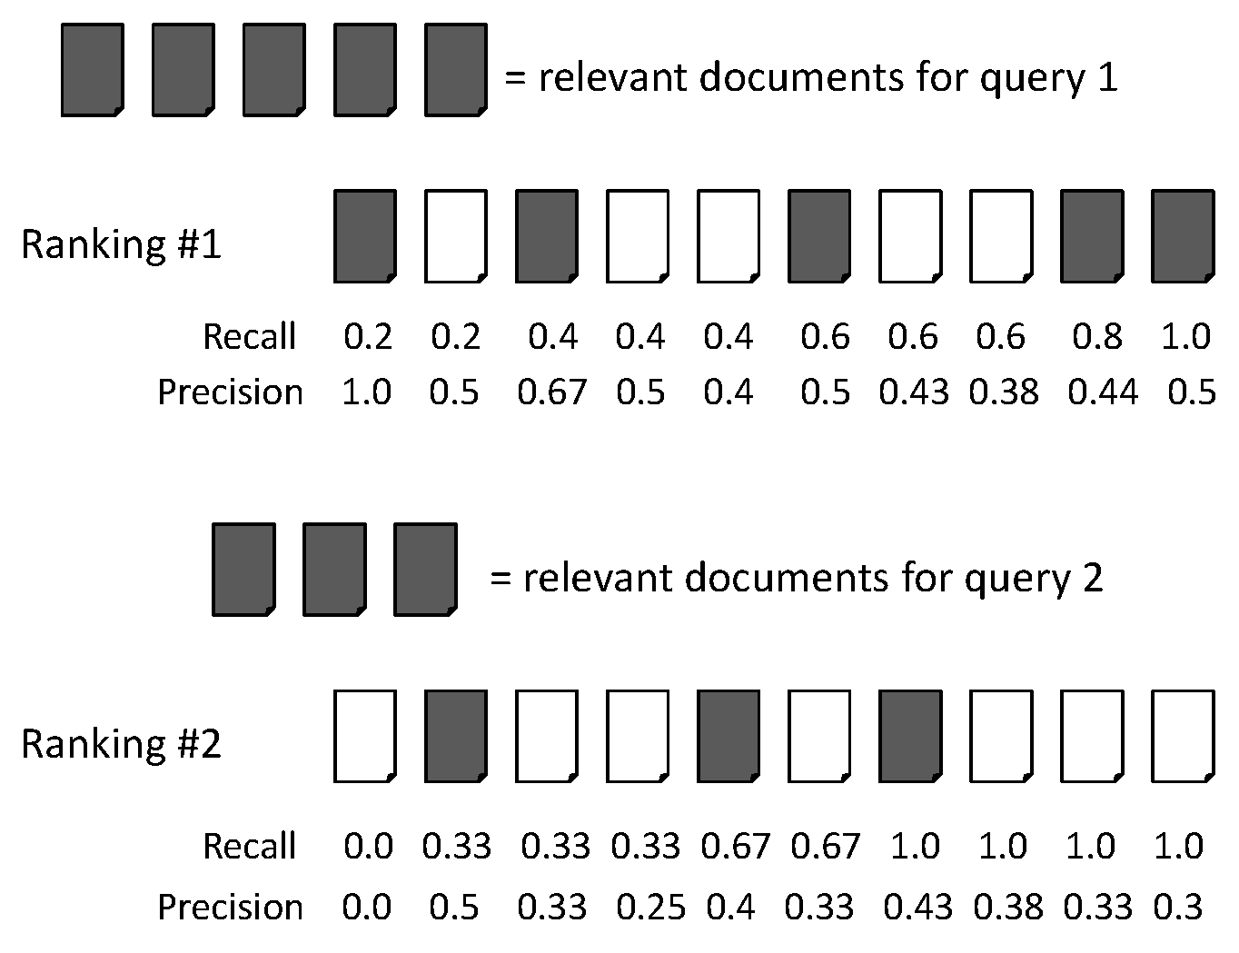
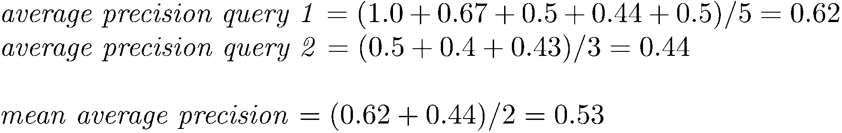
MAP

Slide 66
Mean average precision
  If a relevant document never gets retrieved, we assume the precision corresponding to that relevant doc to be zero
  MAP is macro-averaging: each query counts equally
  Now perhaps most commonly used measure in research papers
  Good for web search?
  MAP assumes user is interested in finding many relevant documents for each query
  MAP requires many relevance judgments in text collection

Slide 67
BEYOND BINARY RELEVANCE

Slide 68
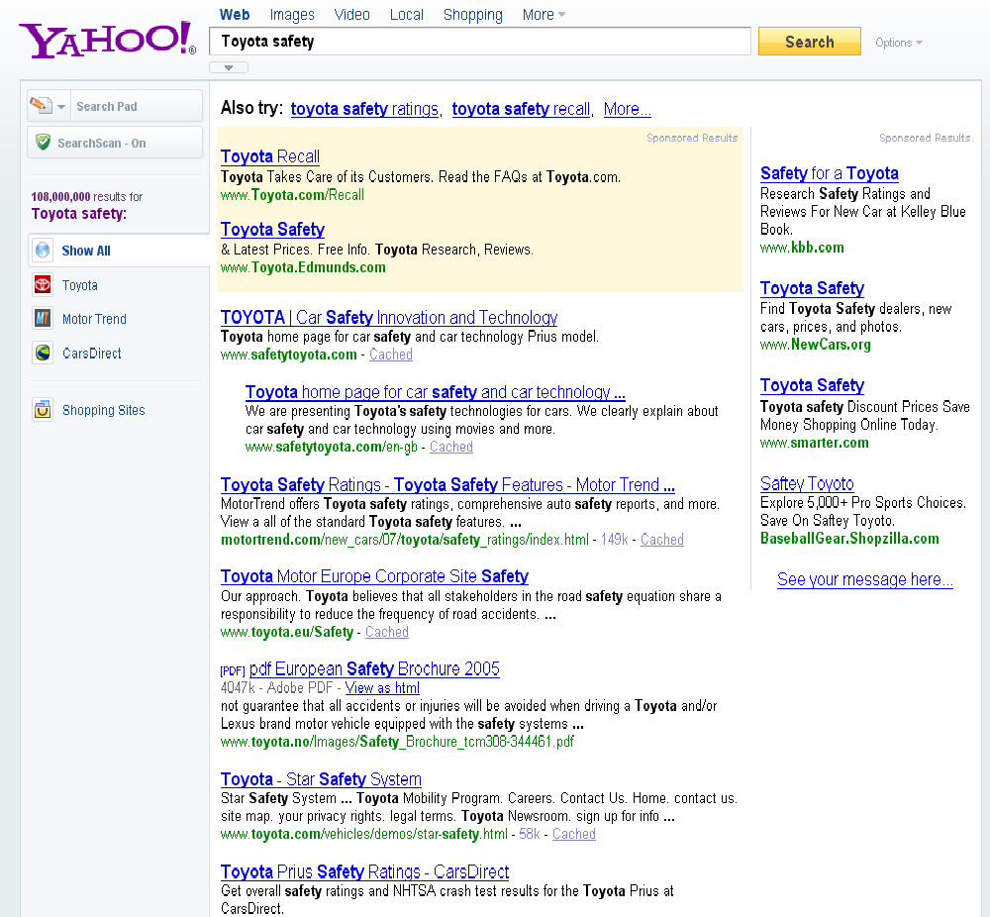
fair
fair
Good

Slide 69
Discounted Cumulative Gain (DCG)
Popular measure for evaluating web search and related tasks
Two assumptions:
  Highly relevant documents are more useful than marginally relevant documents
  The lower the ranked position of a relevant document, the less useful it is for the user, since it is less likely to be examined

Slide 70
Discounted Cumulative Gain
Uses graded relevance as a measure of usefulness, or gain, from examining a document
Gain is accumulated starting at the top of the ranking and may be reduced, or discounted, at lower ranks
Typical discount is 1/log (rank)
  With base 2, the discount at rank 4 is 1/2, and at rank 8 it is 1/3

Slide 71
Summarize a Ranking: DCG
What if relevance judgments are in a scale of [0,r]? r>2
Cumulative Gain (CG) at rank n
  Let the ratings of the n documents be r₁, r₂, …r_{n} (in ranked order)
  CG = r₁+r₂+…r_{n}
Discounted Cumulative Gain (DCG) at rank n
  DCG = r₁ + r₂/log₂2 + r₃/log₂3 + … r_{n}/log₂n
    We may use any base for the logarithm
Notes:
For rank positions above b, do not discount

Slide 72
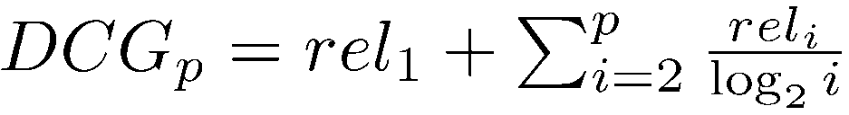
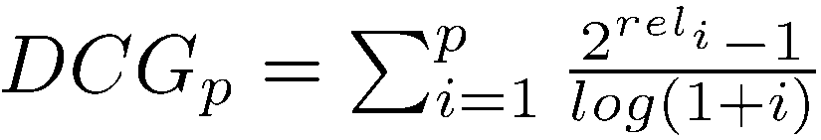
Discounted Cumulative Gain
DCG is the total gain accumulated at a particular rank p:
Alternative formulation:
  used by some web search companies
  emphasis on retrieving highly relevant documents

Slide 73
DCG Example
10 ranked documents judged on 0-3 relevance scale:
  3, 2, 3, 0, 0, 1, 2, 2, 3, 0
discounted gain:
  3, 2/1, 3/1.59, 0, 0, 1/2.59, 2/2.81, 2/3, 3/3.17, 0
  = 3, 2, 1.89, 0, 0, 0.39, 0.71, 0.67, 0.95, 0
DCG:
  3, 5, 6.89, 6.89, 6.89, 7.28, 7.99, 8.66, 9.61, 9.61
Notes:
Normalized DCG:
DCG values are often normalized by comparing the DCG at each rank with the DCG value for the perfect ranking
makes averaging easier for queries with different numbers of relevant documents

Slide 74
Summarize a Ranking: NDCG
Normalized Discounted Cumulative Gain (NDCG) at rank n
  Normalize DCG at rank n by the DCG value at rank n of the ideal ranking
  The ideal ranking would first return the documents with the highest relevance level, then the next highest relevance level, etc
Normalization useful for contrasting queries with varying numbers of relevant results
NDCG is now quite popular in evaluating Web search
Notes:
Perfect ranking:
3, 3, 3, 2, 2, 2, 1, 0, 0, 0
ideal DCG values:
3, 6, 7.89, 8.89, 9.75, 10.52, 10.88, 10.88, 10.88, 10
Actual DCG:
3, 5, 6.89, 6.89, 6.89, 7.28, 7.99, 8.66, 9.61, 9.61
NDCG values (divide actual by ideal):
1, 0.83, 0.87, 0.76, 0.71, 0.69, 0.73, 0.8, 0.88, 0.88
NDCG ≤ 1 at any rank position

Slide 75
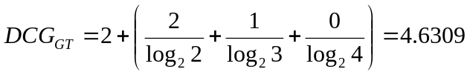
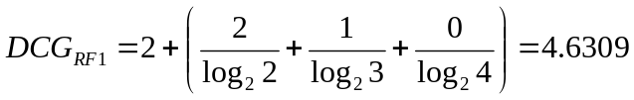
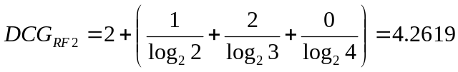

NDCG – Example 1
4 documents: d₁, d₂, d₃, d₄
i | Ground Truth |  | Ranking Function₁ |  | Ranking Function₂
 | Document Order | r_{i} | Document Order | r_{i} | Document Order | r_{i}
1 | d4 | 2 | d3 | 2 | d3 | 2
2 | d3 | 2 | d4 | 2 | d2 | 1
3 | d2 | 1 | d2 | 1 | d4 | 2
4 | d1 | 0 | d1 | 0 | d1 | 0
 | NDCG_{GT}=1.00 |  | NDCG_{RF1}=1.00 |  | NDCG_{RF2}=0.9203

Slide 76

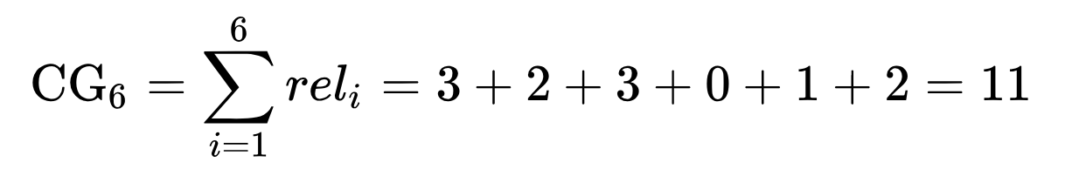
NDCG – Example 2
For the documents ordered by the ranking algorithm as
The user provides the following relevance scores:
  3, 2, 3, 0, 1, 2
The cumulative Gain of this search result list is:

Slide 77
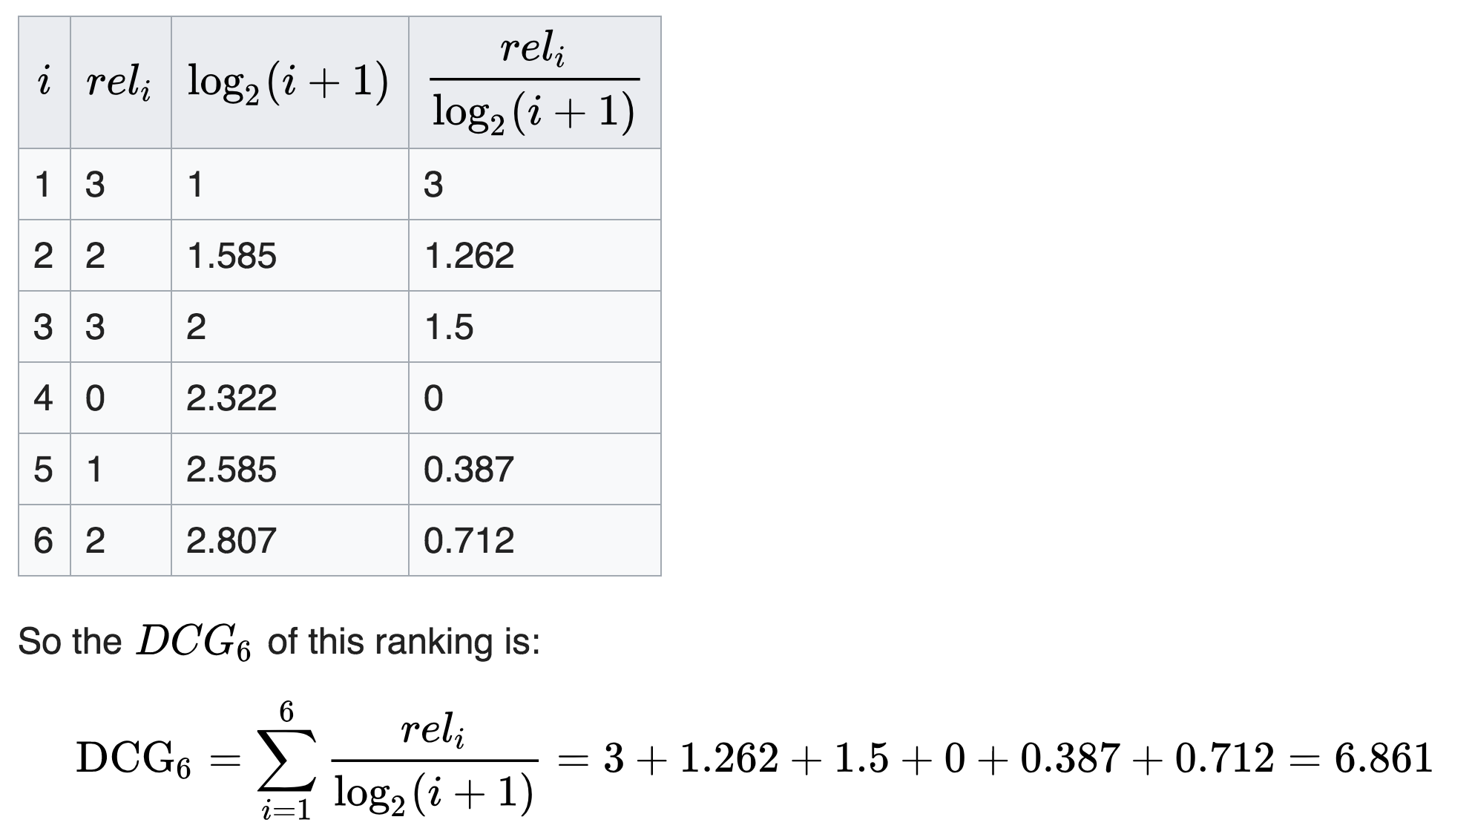
NDCG – Example 2

Slide 78
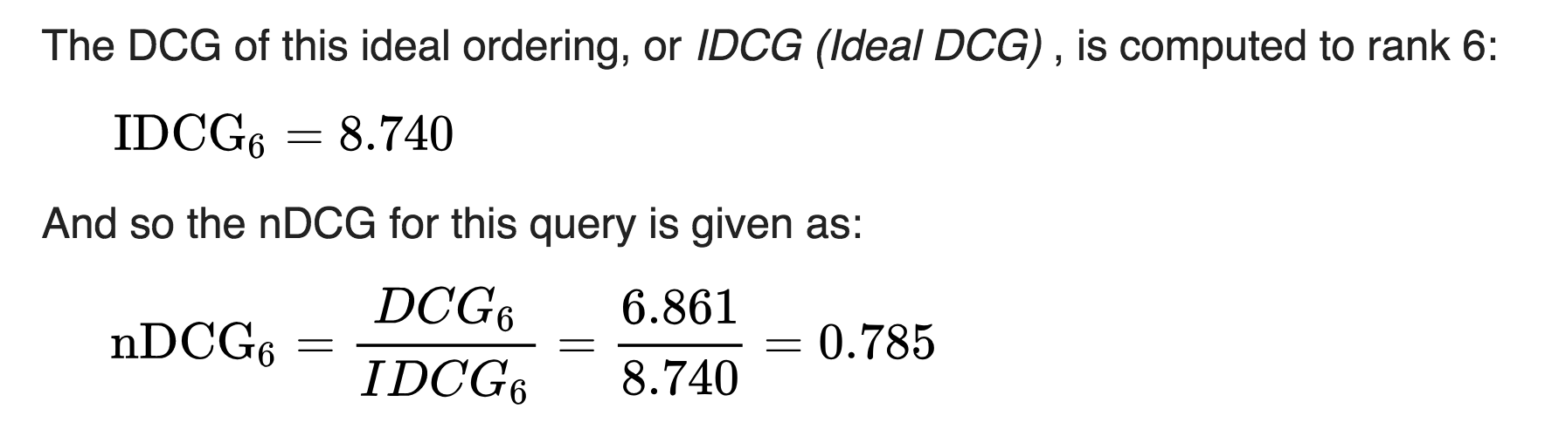
NDCG – Example 2
The ideal ordering is:
  3, 3, 3, 2, 2, 2, 1, 0

Slide 79
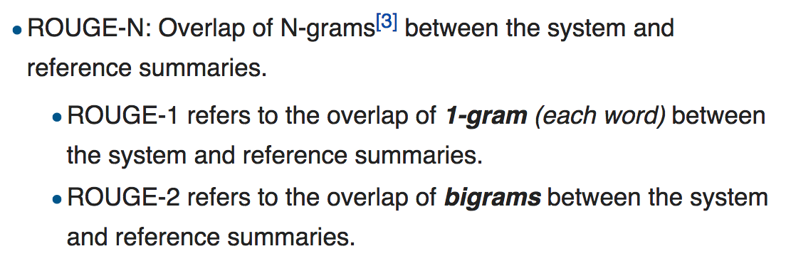
ROUGE (Recall-Oriented Understudy for Gisting Evaluation)

Slide 80
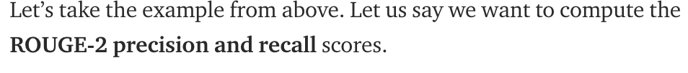
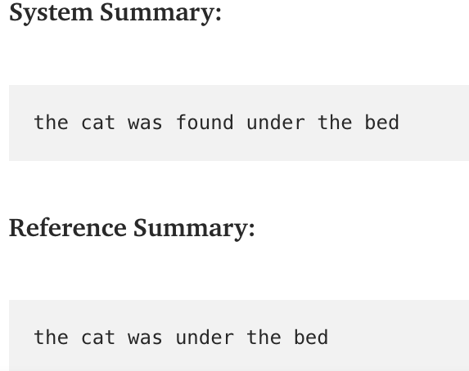
ROUGE (Recall-Oriented Understudy for Gisting Evaluation)

Slide 81
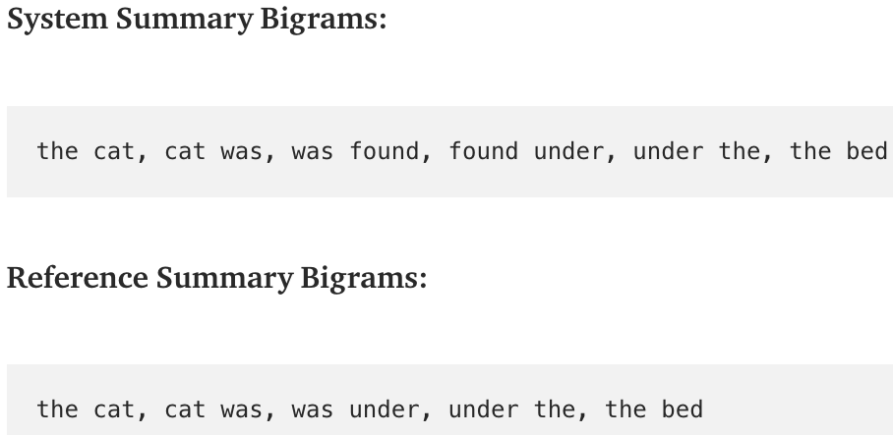
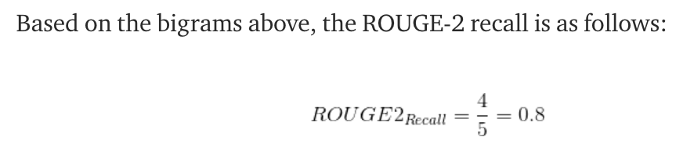
ROUGE (Recall-Oriented Understudy for Gisting Evaluation)

Slide 82
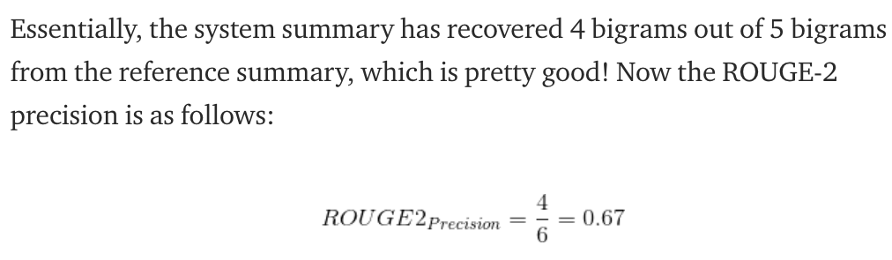
ROUGE (Recall-Oriented Understudy for Gisting Evaluation)

Slide 83
What if the results are not in a list?
Suppose there’s only one Relevant Document
Scenarios:
  known-item search
  navigational queries
  looking for a fact
Search duration ~ Rank of the answer
  measures a user’s effort

Slide 84
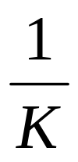
Mean Reciprocal Rank (平均倒数排名)
Consider rank position, K, of first relevant doc
  Could be – only clicked doc
Reciprocal Rank score =
MRR is the mean RR across multiple queries

Slide 85
How to Evaluate IR Systems?
Test Collections

Slide 86
Test Collections

Slide 87
Old Test Collections
Cranfield 2 –
  1400 Documents, 221 Queries
  200 Documents, 42 Queries
INSPEC – 542 Documents, 97 Queries
UKCIS -- > 10000 Documents, multiple sets, 193 Queries
ADI – 82 Document, 35 Queries
CACM – 3204 Documents, 50 Queries
CISI – 1460 Documents, 35 Queries
MEDLARS (Salton) 273 Documents, 18 Queries
Somewhat simple

Slide 88
Modern Well Used Test Collections
Text Retrieval Conference (TREC) .
  The U.S. National Institute of Standards and Technology (NIST) has run a large IR test bed evaluation series since 1992. In more recent years, NIST has done evaluations on larger document collections, including the 25 million page GOV2 web page collection. From the beginning, the NIST test document collections were orders of magnitude larger than anything available to researchers previously and GOV2 is now the largest Web collection easily available for research purposes. Nevertheless, the size of GOV2 is still more than 2 orders of magnitude smaller than the current size of the document collections indexed by the large web search companies.
NII Test Collections for IR Systems ( NTCIR ).
  The NTCIR project has built various test collections of similar sizes to the TREC collections, focusing on East Asian language and cross-language information retrieval , where queries are made in one language over a document collection containing documents in one or more other languages. NTCIR
Cross Language Evaluation Forum ( CLEF ).
  Concentrated on European languages and cross-language information retrieval. CLEF
Reuters-RCV1.
  For text classification, the most used test collection has been the Reuters-21578 collection of 21578 newswire articles; see Chapter 13 , page 13.6 . More recently, Reuters released the much larger Reuters Corpus Volume 1 (RCV1), consisting of 806,791 documents. Its scale and rich annotation makes it a better basis for future research.
20 Newsgroups .
  This is another widely used text classification collection, collected by Ken Lang. It consists of 1000 articles from each of 20 Usenet newsgroups (the newsgroup name being regarded as the category). After the removal of duplicate articles, as it is usually used, it contains 18941 articles.

Slide 89
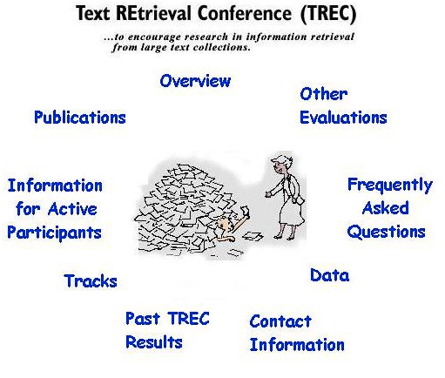
TREC
Text REtrieval Conference/Competition
  http://trec.nist.gov
  Run by NIST (National Institute of Standards & Technology)
Collections: > Terabytes,
Millions of entities
  Newswire & full text news (AP, WSJ, Ziff, FT)
  Government documents (federal register, Congressional Record)
  Radio Transcripts (FBIS)
  Web “subsets”

Slide 90

Tracks change from year to year

Slide 91
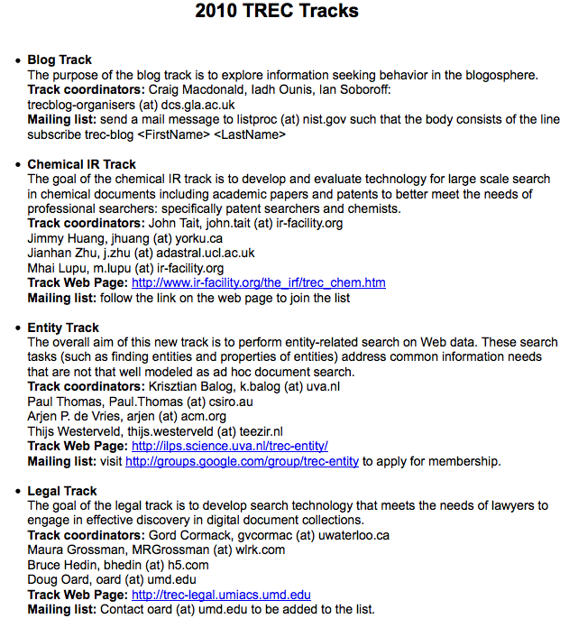
Tracks change from year to year

Slide 92
TREC (cont.)
Queries + Relevance Judgments
  Queries devised and judged by “Information Specialists”
  Relevance judgments done only for those documents retrieved -- not entire collection!
Competition
  Various research and commercial groups compete (TREC 6 had 51, TREC 7 had 56, TREC 8 had 66)
  Results judged on precision and recall, going up to a recall level of 1000 documents

Slide 93
Sample TREC queries (topics)
<num> Number: 168
<title> Topic: Financing AMTRAK
<desc> Description:
A document will address the role of the Federal Government in financing the operation of the National Railroad Transportation Corporation (AMTRAK)
<narr> Narrative: A relevant document must provide information on the government’s responsibility to make AMTRAK an economically viable entity. It could also discuss the privatization of AMTRAK as an alternative to continuing government subsidies. Documents comparing government subsidies given to air and bus transportation with those provided to aMTRAK would also be relevant.

Slide 94
TREC
Benefits:
  made research systems scale to large collections (pre-WWW)
  allows for somewhat controlled comparisons
Drawbacks:
  emphasis on high recall, which may be unrealistic for what most users want
  very long queries, also unrealistic
  comparisons still difficult to make, because systems are quite different on many dimensions
  focus on batch ranking rather than interaction
  no focus on the WWW until recently

Slide 95
TREC evolution
Emphasis on specialized “tracks”
  Interactive track
  Natural Language Processing (NLP) track
  Multilingual tracks (Chinese, Spanish)
  Filtering track
  High-Precision
  High-Performance
  Topics
http://trec.nist.gov/

Slide 96
TREC Results
Differ each year
For the main (ad hoc) track:
  Best systems not statistically significantly different
  Small differences sometimes have big effects
    how good was the hyphenation model
    how was document length taken into account
  Systems were optimized for longer queries and all performed worse for shorter, more realistic queries

Slide 97
Evaluating search engine retrieval performance
Recall?
Precision?
Order of ranking?

Slide 98
Evaluation Issues
To place information retrieval on a systematic basis, we need repeatable criteria to evaluate how effective a system is in meeting the information needs of the user of the system.
This proves to be very difficult with a human in the loop. It proves hard to define:
• the task that the human is attempting
• the criteria to measure success

Slide 99
Evaluation of Matching:
Recall and Precision
  If information retrieval were perfect ...
  Every hit would be relevant to the original query, and every relevant item in the body of information would be found.
  Precision: percentage (or fraction) of the hits that are
  relevant, i.e., the extent to which the set of hits
  retrieved by a query satisfies the requirement that
  generated the query.
Recall: percentage (or fraction) of the relevant items that are
found by the query, i.e., the extent to which the query
found all the items that satisfy the requirement.

Slide 100
Recall and Precision with Exact Matching: Example
Collection of 10,000 documents, 50 on a specific topic
Ideal search finds these 50 documents and reject all others
Actual search identifies 25 documents; 20 are relevant but 5 were on other topics
Precision: 20/ 25 = 0.8 (80% of hits were relevant)
Recall: 20/50 = 0.4 (40% of relevant were found)

Slide 101
Measuring Precision and Recall
Precision is easy to measure:
A knowledgeable person looks at each document that is identified and decides whether it is relevant.
In the example, only the 25 documents that are found need to be examined.
Recall is difficult to measure:
To know all relevant items, a knowledgeable person must go through the entire collection, looking at every object to decide if it fits the criteria.
In the example, all 10,000 documents must be examined.

Slide 102
Evaluation: Precision and Recall
Precision and recall measure the results of a single query using a specific search system applied to a specific set of documents.
Matching methods:
Precision and recall are single numbers.
Ranking methods:
Precision and recall are functions of the rank order.

Slide 103
Evaluating Ranking:
Recall and Precision
  If information retrieval were perfect ...
  Every document relevant to the original information need would be ranked above every other document.
  With ranking, precision and recall are functions of the rank order.
  Precision(n): fraction (or percentage) of the n most highly
  ranked documents that are relevant.
  Recall(n) : fraction (or percentage) of the relevant items that
  are in the n most highly ranked documents.

Slide 104
Precision and Recall with Ranking
Example
"Your query found 349,871 possibly relevant documents. Here are the first eight."
Examination of the first 8 finds that 5 of them are relevant.

Slide 105
Graph of Precision with Ranking: P(r) as we retrieve the 8 documents.
Relevant? Y N Y Y N Y N Y
Precision P(r)
1
1/1 1/2 2/3 3/4 3/5 4/6 4/7 5/8
0
1 2 3 4 5 6 7 8
Rank r

Slide 106
What does the user want?
Restaurant case
The user wants to find a restaurant serving Sashimi. User uses 2 IR systems. How we can say which one is better?

Slide 107
User - oriented measures
Coverage ratio:
  known_relevant_retrieved / known_ relevant
Novelty ratio:
  new_relevant / Relevant
Relative recall
  relevant_retrieved /wants_to_examine
Recall Effort:
  wants_to_examine / had_to_examine

Slide 108
From query to system performance
Average precision and recall
  Fix recall and count precision!
    Three-point average (0.25, 0.50 and 0.75)
    11-point average (0, 0.1, ….. 0.9)
  Same can be done for recall
If finding exact recall points is hard, it is done at different levels of document retrieval
    10, 20, 30, 40, 50 relevant retrieved documents

Slide 109
Evaluating the order of documents
Results of search is not a set, but a sequence
    Affects usefulness
    Affects satisfaction (relevant first!)
Normalized Recall
  Recall graph
  1 - Difference/Relevant(N - Relevant)
Normalized precision - same approach

Slide 110
Human judgments are
Expensive
Inconsistent
  Between raters
  Over time
Decay in value as documents/query mix evolves
Not always representative of “real users”
  Rating vis-à-vis query, vs underlying need
So – what alternatives do we have?

Slide 111
USING USER CLICKS

Slide 112
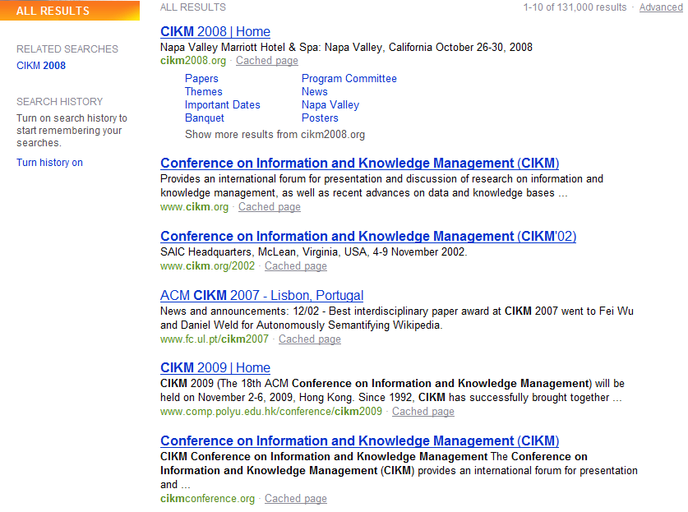
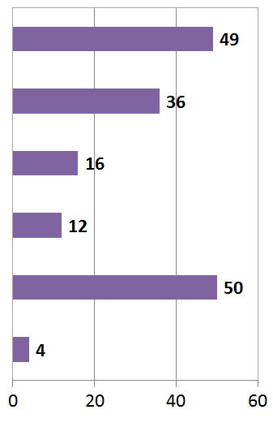
What do clicks tell us?
# of clicks received
Strong position bias, so absolute click rates unreliable

Slide 113
Relative vs absolute ratings
User’s click
sequence
Hard to conclude Result1 > Result3
Probably can conclude Result3 > Result2

Slide 114
Pairwise relative ratings
Pairs of the form: DocA better than DocB for a query
  Doesn’t mean that DocA relevant to query
Now, rather than assess a rank-ordering wrt per-doc relevance assessments
Assess in terms of conformance with historical pairwise preferences recorded from user clicks
BUT!
Don’t learn and test on the same ranking algorithm
  I.e., if you learn historical clicks from nozama and compare Sergey vs nozama on this history …

Slide 115
Comparing two rankings via clicks
(Joachims 2002)
Query: [support vector machines]
Ranking A
Ranking B
Kernel machines
Kernel machines
SVM-light
SVMs
Lucent SVM demo
Intro to SVMs
Royal Holl. SVM
Archives of SVM
SVM software
SVM-light
SVM tutorial
SVM software

Slide 116
Interleave the two rankings
Kernel machines
Kernel machines
SVMs
This interleaving
starts with B
SVM-light
Intro to SVMs
Lucent SVM demo
Archives of SVM
Royal Holl. SVM
SVM-light
…

Slide 117
Remove duplicate results
Kernel machines
Kernel machines
SVMs
SVM-light
Intro to SVMs
Lucent SVM demo
Archives of SVM
Royal Holl. SVM
SVM-light
…

Slide 118
Count user clicks
Kernel machines
A, B
Kernel machines
Clicks
SVMs
Ranking A: 3
Ranking B: 1
SVM-light
A
Intro to SVMs
Lucent SVM demo
A
Archives of SVM
Royal Holl. SVM
SVM-light
…

Slide 119
Interleaved ranking
Present interleaved ranking to users
  Start randomly with ranking A or ranking B to evens out presentation bias
Count clicks on results from A versus results from B
Better ranking will (on average) get more clicks

Slide 120
A/B testing at web search engines
Sec. 8.6.3
Purpose: Test a single innovation
Prerequisite: You have a large search engine up and running.
Have most users use old system
Divert a small proportion of traffic (e.g., 1%) to an experiment to evaluate an innovation
  Interleaved experiment
  Full page experiment

Slide 121
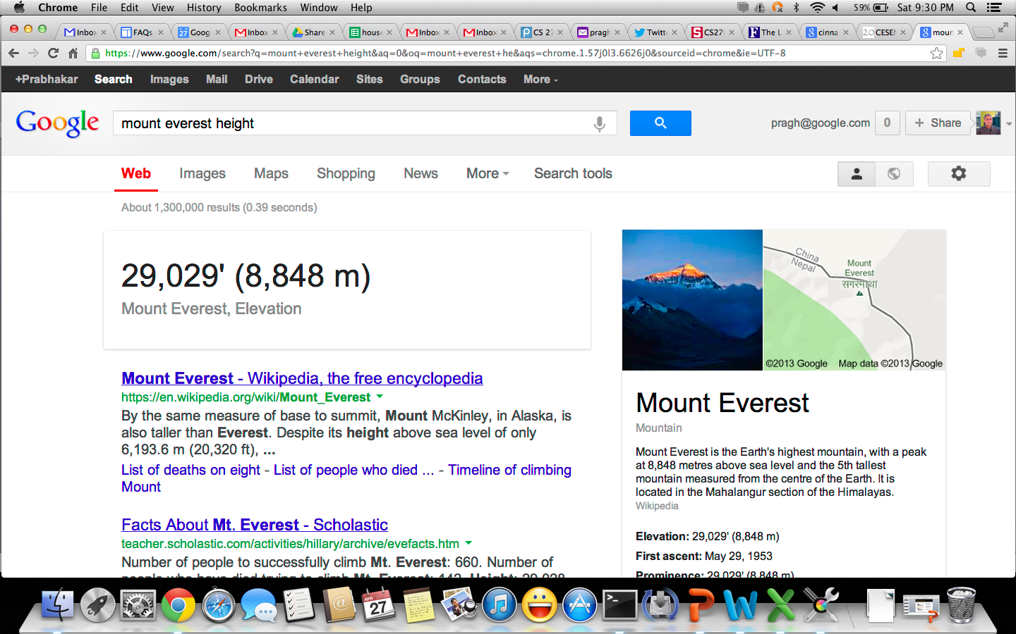
Facts/entities (what happens to clicks?)

Slide 122
RECAP

Slide 123
For ad hoc IR evaluation, need:
A document collection
A test suite of information needs, expressible as queries
A set of relevance judgments, standardly a binary assessment of either relevant or nonrelevant for each query-document pair.

Slide 124
Precision/Recall
You can get high recall (but low precision) by retrieving all docs for all queries!
Recall is a non-decreasing function of the number of docs retrieved
In a good system, precision decreases as either number of docs retrieved or recall increases
  A fact with strong empirical confirmation

Slide 125
Difficulties in using precision/recall
Should average over large corpus/query ensembles
Need human relevance assessments
  People aren’t reliable assessors
Assessments have to be binary
  Nuanced assessments?
Heavily skewed by corpus/authorship
  Results may not translate from one domain to another

Slide 126
What to Evaluate?
Want an effective system
But what is effectiveness
  Difficult to measure
  Recall and Precision are standard measures
    F measure frequently used
    Google stressed precision!

Slide 127
Evaluation of IR Systems
Performance evaluations
Retrieval evaluation
Quality of evaluation - Relevance
Measurements of Evaluation
  Precision vs recall
Test Collections/TREC

