Slide 1
AXA Data Challenge
Yellow

Slide 2
Summary
Data pre-processing
Feature engineering
Data visualization & Preliminary analysis
Our approaches:
A first simple approach
A generalized version: Linear LinEx Regression
Random Forest
Failed attempts & Possible better approaches
Conclusion

Slide 3
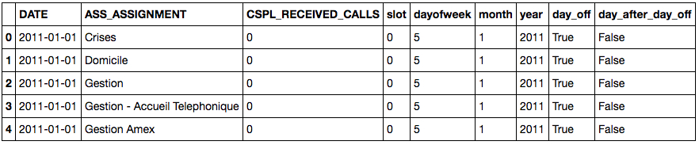
Data pre-processing

Slide 4
Feature engineering

Slide 5
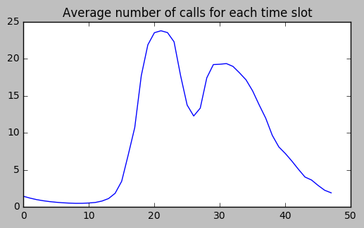
Data visualization

Slide 6
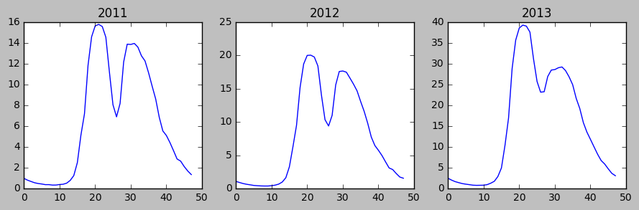
Data visualization

Slide 7
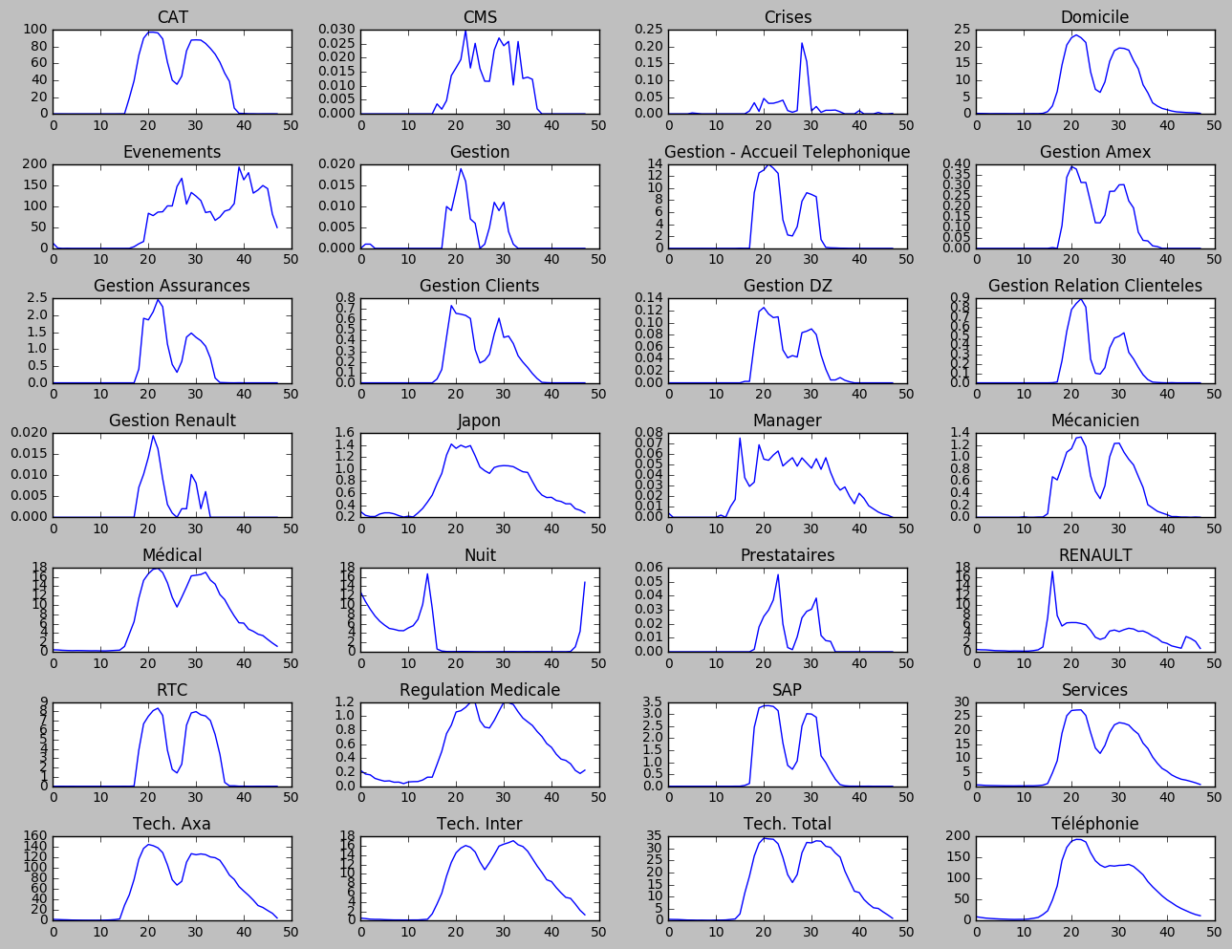

Slide 8
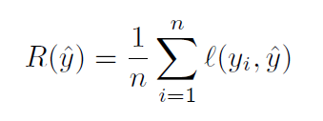
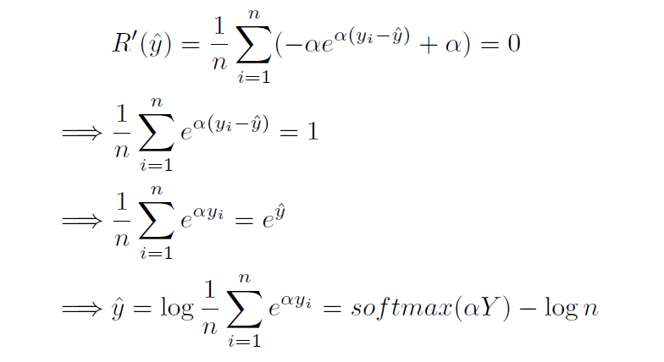
1st Approach – simple approach

Slide 9
1st Approach – simple approach
Advantages:
Simple model
Explainable
Use the real loss function LinEx
Disadvantages:
Too many parameters (about 10000 lines in predict_table)
Many of these parameters are correlated
Might have large variance
Result:
2.55 on the leader board

Slide 10
2nd approach – generalized version

Slide 11
2nd approach – generalized version
Advantages:
The loss function is convex
Very general, containing many possible approaches as special case
Explainable
Use the real loss function LinEx
Disadvantages:
Many parameters (about 150000 of them)
Hard to optimize
Result:
1.99 on the leader board

Slide 12
3rd approach – Random Forest

Slide 13
3rd approach – Random Forest

