Slide 1
Watercolor Paintings
Original
by
Mary Mack
Use the Page Down button to advance slides

Slide 2
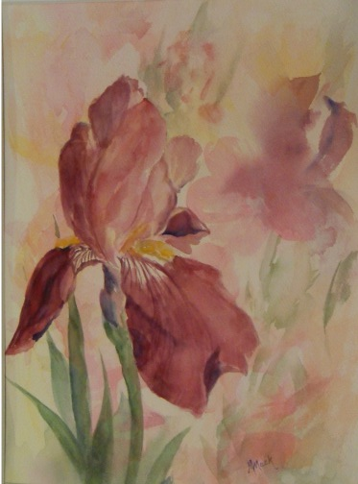
Watercolors by Mary Mack
Title: Nancy’s Iris
Mat size: 12 x 16
Painting: 11 x 14
(c) Copyright 2010 by Mary Mack. All rights reserved. May not be reproduced without prior written consent.

Slide 3
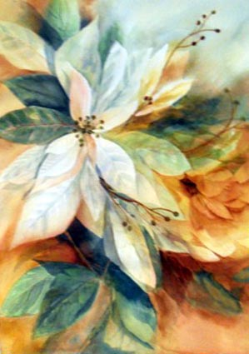
Watercolors by Mary Mack
Subject: White Poinsettias
Painting: 15” x 20”
(c) Copyright 2010 by Mary Mack. All rights reserved. May not be reproduced without prior written consent.

Slide 4
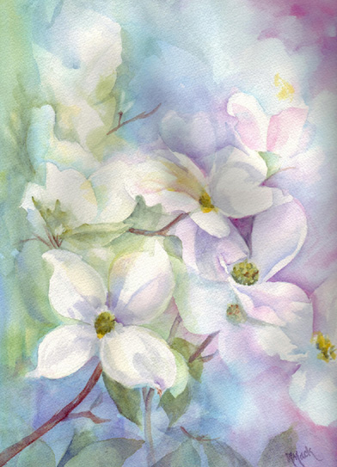
Watercolors by Mary Mack
Subject: Dogwood
Mat size: 12 x 16
Painting: 11 x 14
(c) Copyright 2005-2009 by Mary Mack. All rights reserved. May not be reproduced without prior written consent.

Slide 5
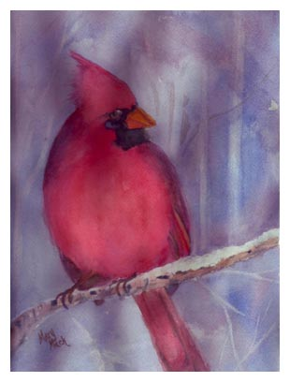
Watercolors by Mary Mack
Subject: Cardinal
Mat size: 12 x 16
Painting: 11 x 14
(c) Copyright 2005-2009 by Mary Mack. All rights reserved. May not be reproduced without prior written consent.

Slide 6
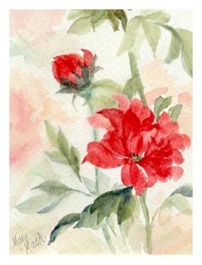
Watercolors by Mary Mack
Title: Grace’s Garden
Mat size: 8 x 10
Painting: 5 x 7
(c) Copyright 2005-2009 by Mary Mack. All rights reserved. May not be reproduced without prior written consent.

Slide 7
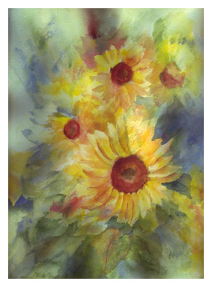
Watercolors by Mary Mack
Subject: Sunflowers
Mat size: 12 x 16
Painting: 11 x 14
(c) Copyright 2005-2009 by Mary Mack. All rights reserved. May not be reproduced without prior written consent.

Slide 8
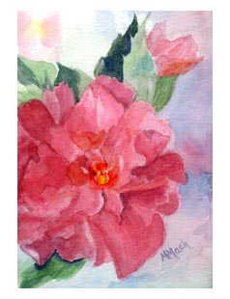
Watercolors by Mary Mack
Title: Confederate Rose
Mat size: 8 x 10
Painting: 5 x 7
(c) Copyright 2005-2009 by Mary Mack. All rights reserved. May not be reproduced without prior written consent.

Slide 9
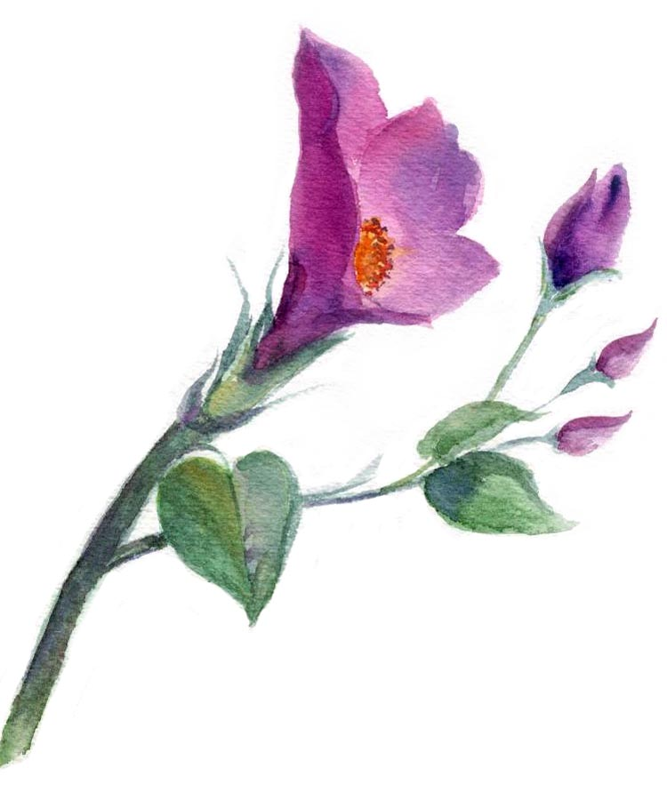
Watercolors by Mary Mack
Subject: Special “buds”
Mat: 8 x 10 with Oval Opening
Painting: 5 x 7 approx.
(c) Copyright 2005-2009 by Mary Mack. All rights reserved. May not be reproduced without prior written consent.

Slide 10
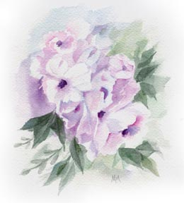
Watercolors by Mary Mack
Title: Little Beauties
Mat size: 8 x 10
Painting: 6 x 7
(c) Copyright 2005-2009 by Mary Mack. All rights reserved. May not be reproduced without prior written consent.

Slide 11
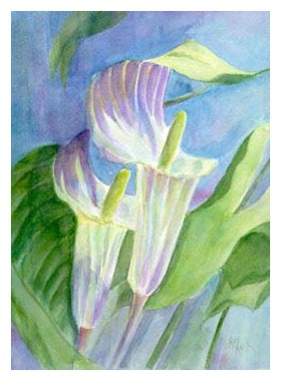
Watercolors by Mary Mack
Subject: Jack in the Pulpit
Mat size: 12 x 16
Painting: 11 x 14
(c) Copyright 2005-2009 by Mary Mack. All rights reserved. May not be reproduced without prior written consent.

Slide 12
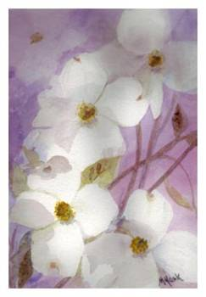
Watercolors by Mary Mack
Title: Dogwood II
Mat size: 8 x 10
Painting: 5 x 7
(c) Copyright 2005-2009 by Mary Mack. All rights reserved. May not be reproduced without prior written consent.

Slide 13
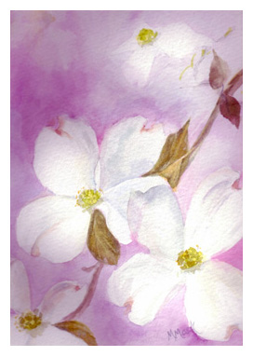
Watercolors by Mary Mack
Subject: Dogwood III
Mat size: 8 x 10
Painting: 5 x 7
(c) Copyright 2005-2009 by Mary Mack. All rights reserved. May not be reproduced without prior written consent.

Slide 14
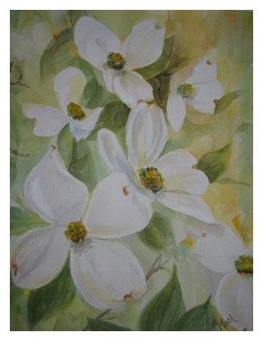
Watercolors by Mary Mack
Title: Dogwood IV
Mat size: 16 x 20
Painting: 11 x 14
(c) Copyright 2005-2009 by Mary Mack. All rights reserved. May not be reproduced without prior written consent.

Slide 15
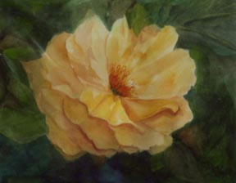
Watercolors by Mary Mack
Title: Yellow Rose
Mat size: 12 x 16
Painting: 11 x 14
(c) Copyright 2005-2009 by Mary Mack. All rights reserved. May not be reproduced without prior written consent.

Slide 16
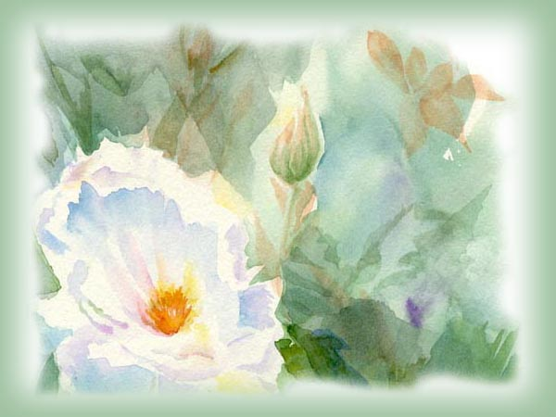
Watercolors by Mary Mack
Thanks for viewing
marymack.watercolors@gmail.com
(c) Copyright 2005-2010 by Mary Mack. All rights reserved. May not be reproduced without prior written consent.

