Slide 1
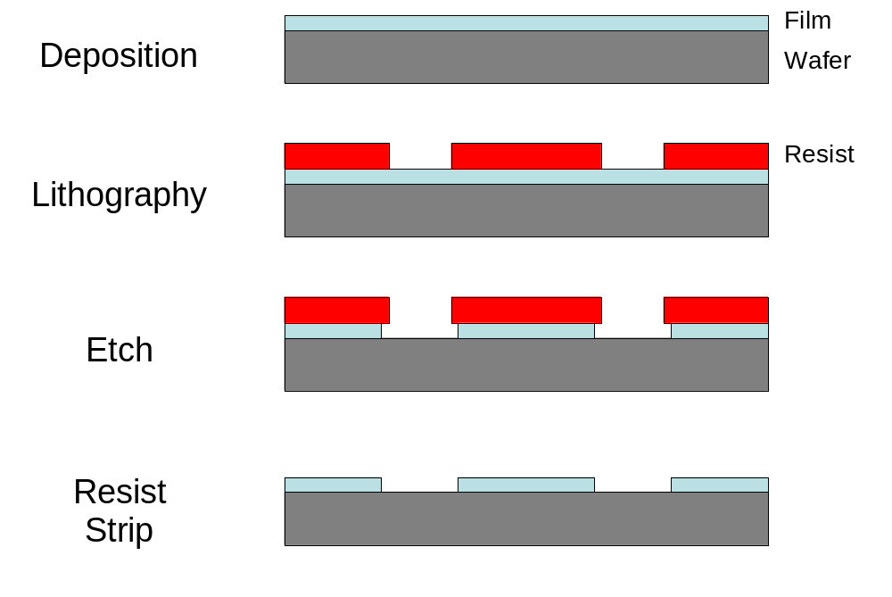
Figure 1.1 Diagram of a simple subtractive patterning process.

Slide 2
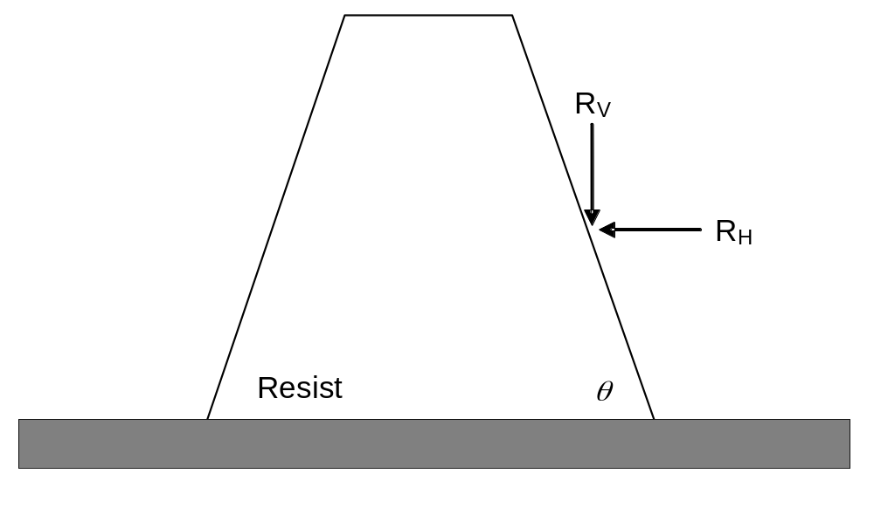
Figure 1.2 Erosion of a photoresist line during etching, showing the vertical and horizontal etch rate components.

Slide 3
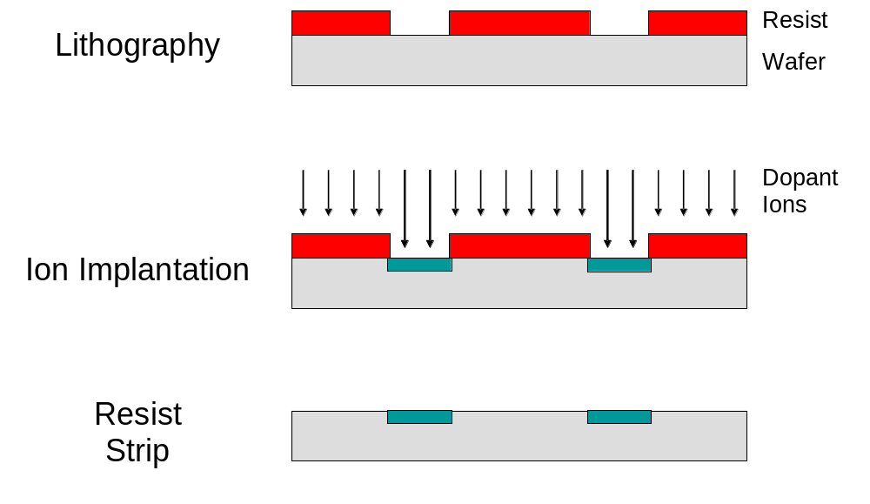
Figure 1.3 Patterning as a means of selective doping using ion implantation.

Slide 4
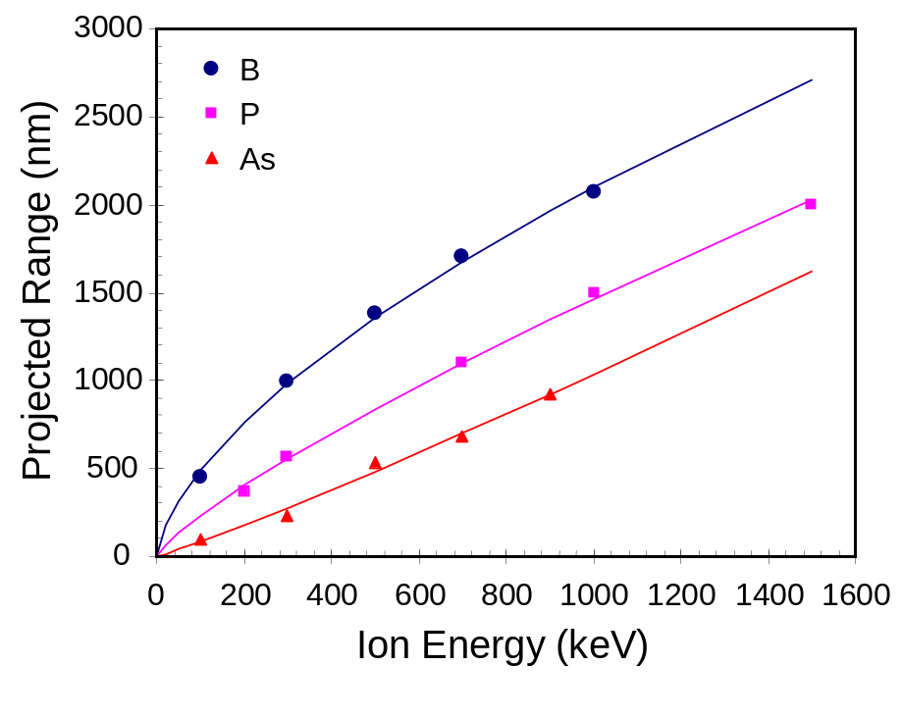
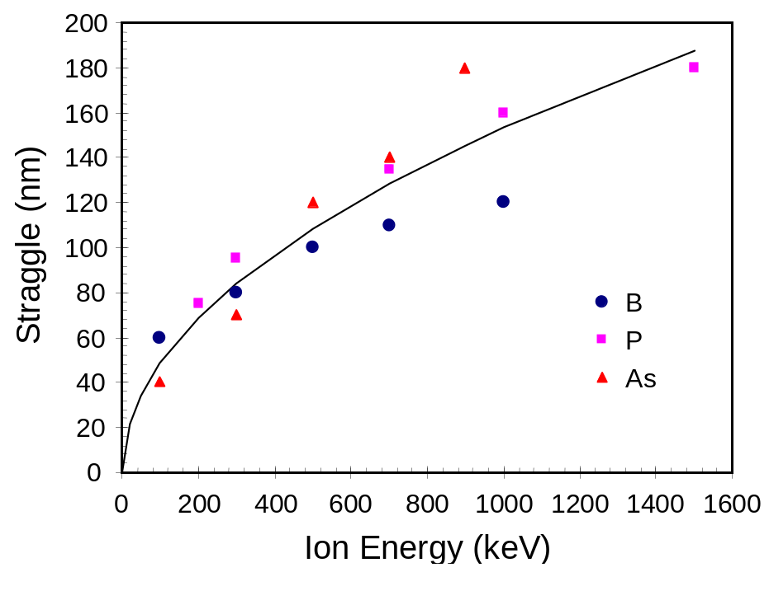
(a)
(b)
Figure 1.4 Measured and fitted ion implantation penetration depths for boron, phosphorous and arsenic in AZ 7500 resist: a) projected range, and b) straggle. Symbols are data and curves are power-law fits to the data as described in Table 1.1. For the straggle data, the empirical model fit is ΔR_{p} = 4.8E^{0.5} where E is the ion energy in keV and ΔR_{p} is the straggle in nm.

Slide 5
Table 1.1 Empirical model of ion implanted projected range (R_{p}, in nm) into photoresist versus ion energy (E, in keV) as R_{p} = aE^{b}.
Dopant | Coefficient a | Power b
Boron | 26.9 | 0.63
Phosphorous | 5.8 | 0.80
Arsenic | 0.49 | 1.11

Slide 6
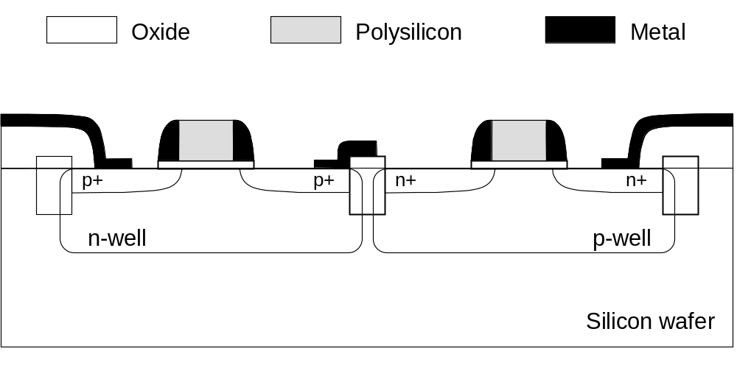
Figure 1.5 Cross-section of a pair of CMOS transistors showing most of the layers through metal 1.

Slide 7
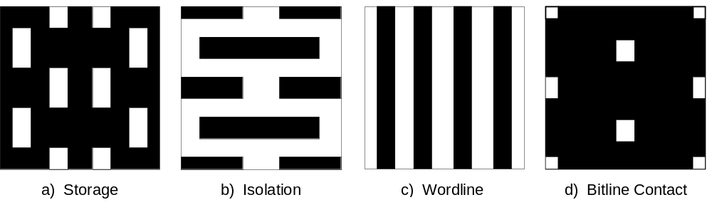
Figure 1.6 Critical mask level patterns for a 1Gb DRAM chip. Each pattern repeats in both x and y many times to create the DRAM array.

Slide 8
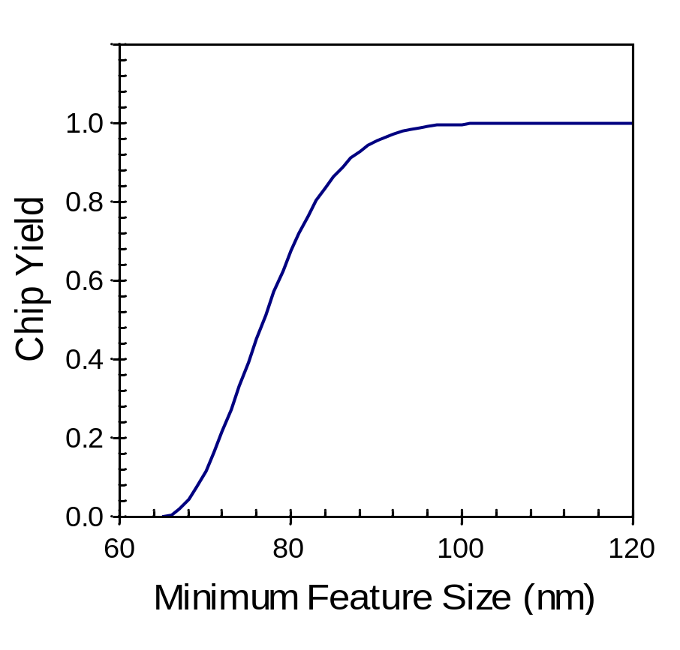
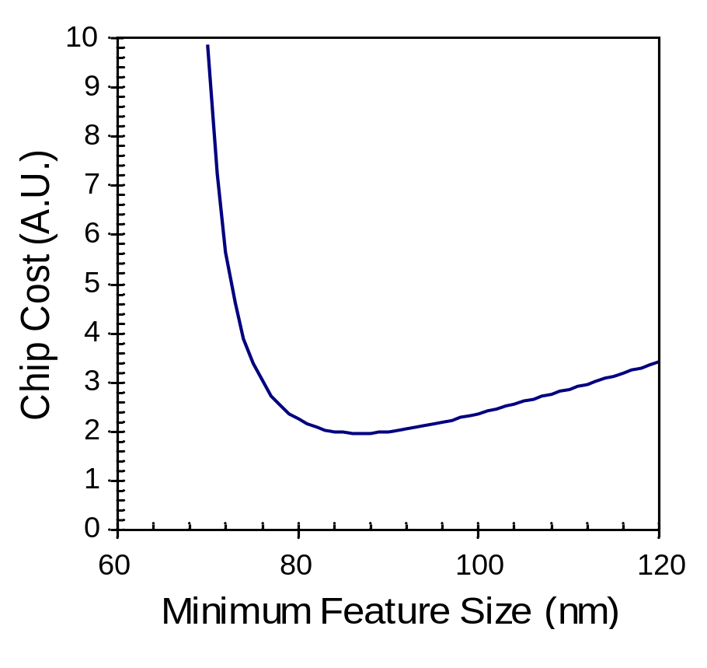
Figure 1.7 A very simple yield and cost model shows the feature size that minimizes chip cost (w₀ = 65 nm, σ = 10 nm). Lowest chip cost occurs, in this case, when w = 87 nm, corresponding to a chip yield of about 90%.

Slide 9
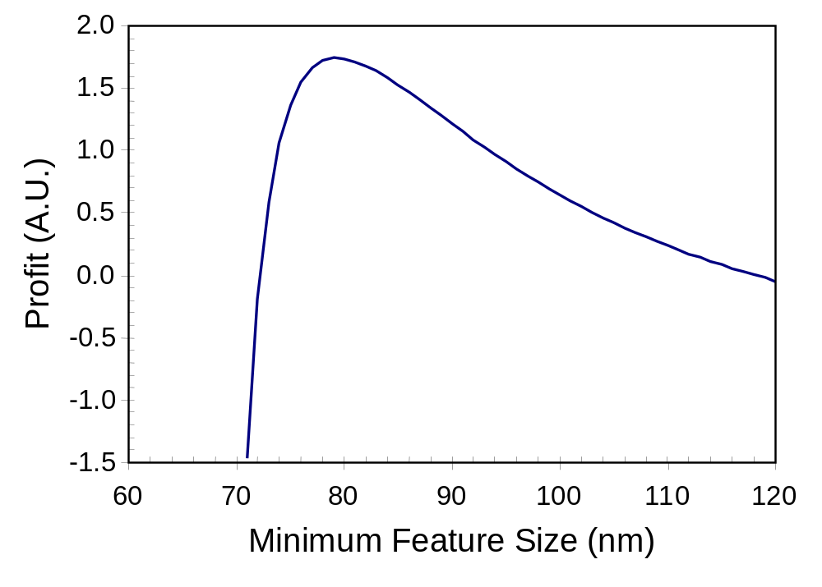
Figure 1.8 Example fab profit curve using the yield and cost models of Figure 1.7 and assuming the value of the chip is inversely proportional to the minimum feature size. For this example, maximum profit occurs when w = 80 nm, even though the yield is only 65%.

Slide 10
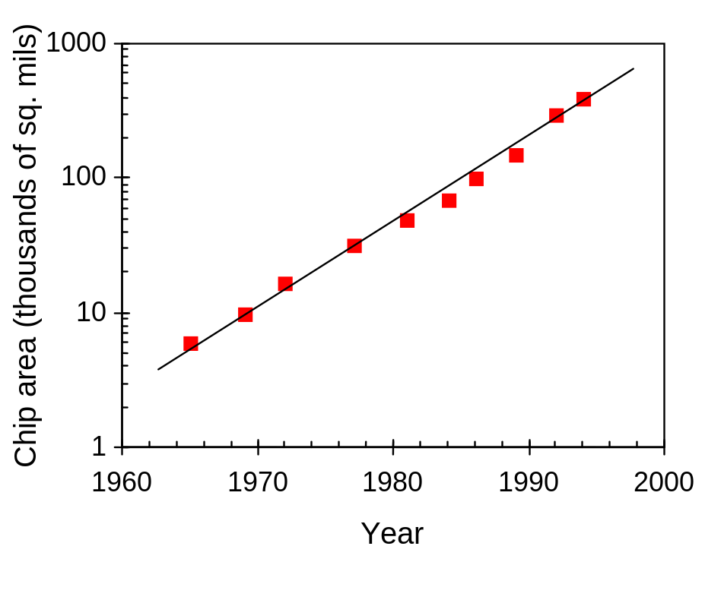
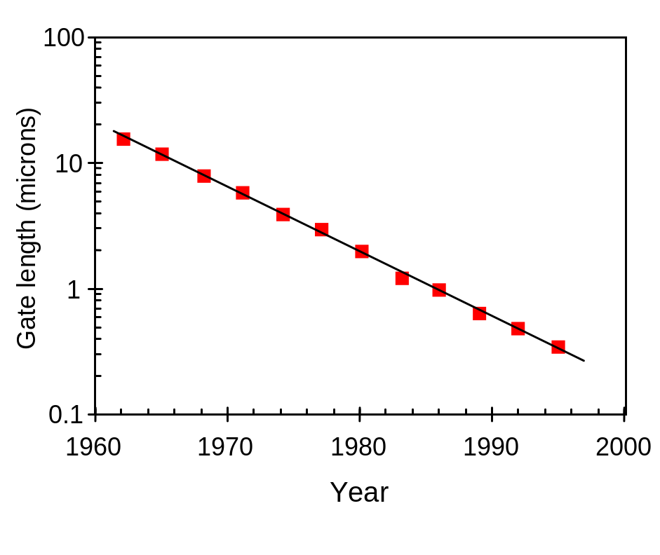
(a)
(b)
Figure 1.9 Moore’s Law showing a) an exponential increase (about 15% per year) in the area of a chip, and b) an exponential decrease (about 11% per year) in the minimum feature size on a chip (shown here for DRAM initial introduction).

Slide 11
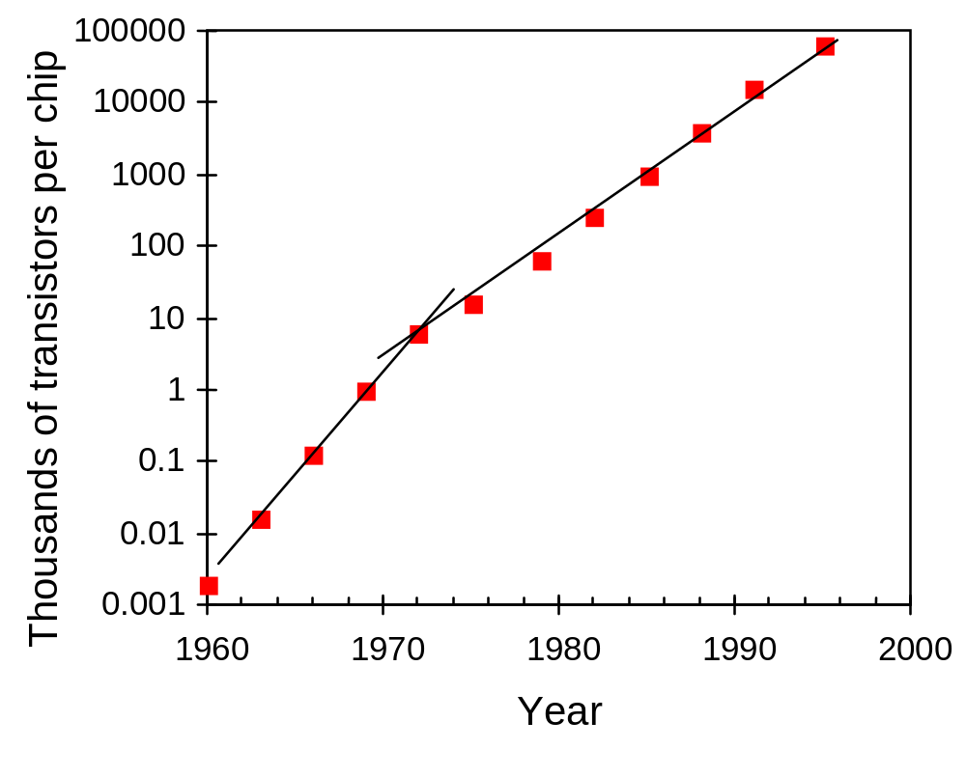
Figure 1.10 Moore’s Law showing an exponential increase in the number of transistors on a semiconductor chip over time (shown here for DRAM initial introduction).

Slide 12
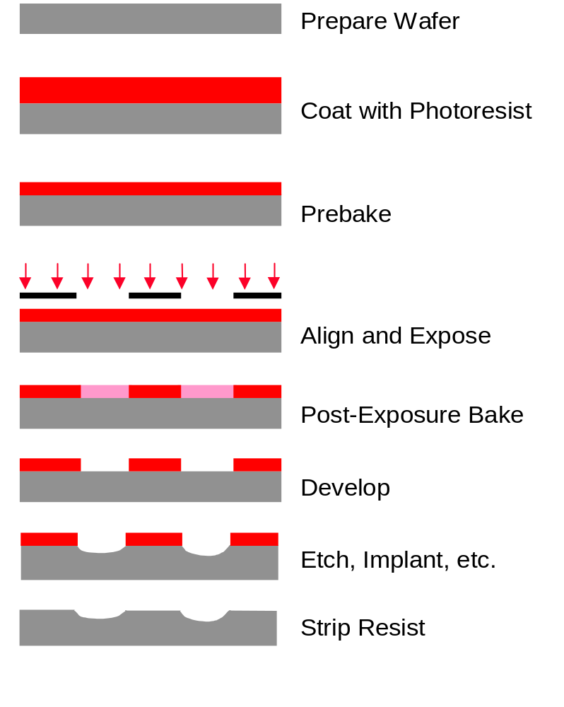
Figure 1.11 Example of a typical sequence of lithographic processing steps, illustrated for a positive resist.

Slide 13
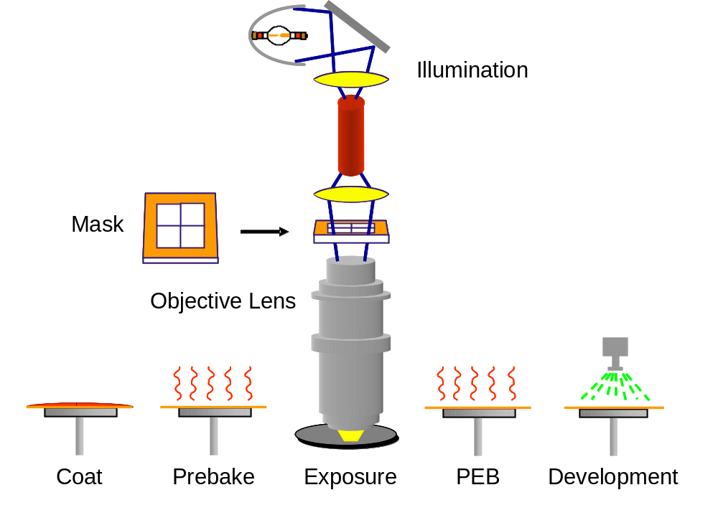
Figure 1.12 Iconic representation of the integration of the various lithographic process steps into a photolithography cell. Many steps, such as chill plates after the bake steps, have been omitted.

Slide 14
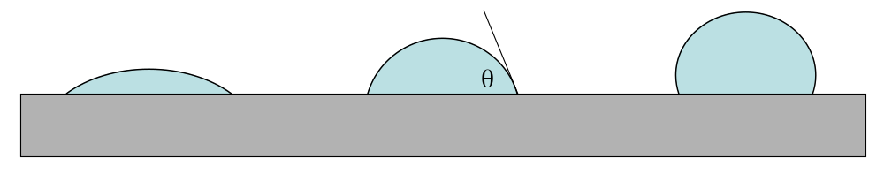
Figure 1.13 A water droplet on the surface of the wafer indicates the hydrophobicity of the wafer: the left-most drop indicates a hydrophilic surface, the right-most drop shows an extremely hydrophobic surface. The middle case, with a contact angle of 70°, is typically about optimum for resist adhesion.

Slide 15
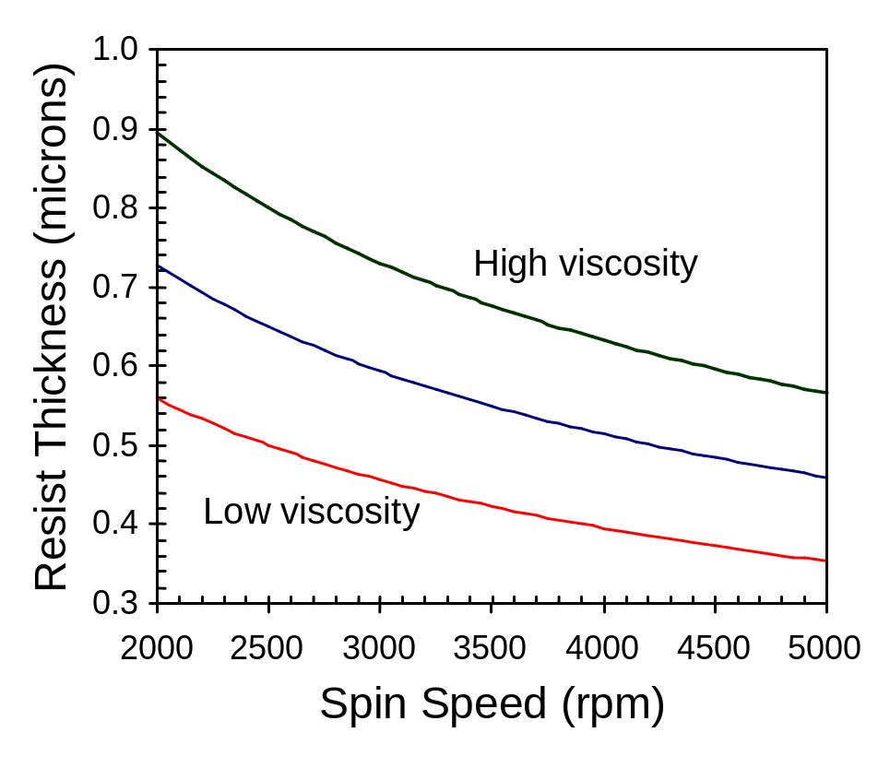
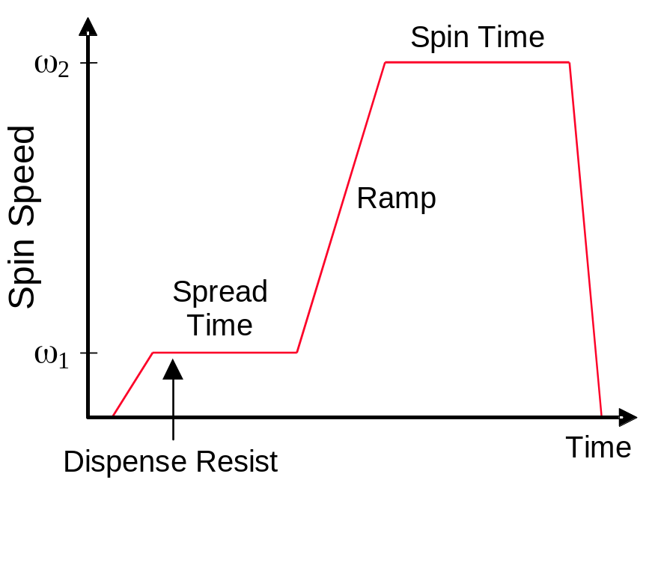
(a)
(b)
Figure 1.14 Photoresist spin coat cycle: a) Pictorial representation (if ω₁ > 0, the dispense is said to be dynamic), and b) photoresist spins speed curves for different resist viscosities showing how resist thickness after post-apply bake varies as (spin speed)^{-1/2}.

Slide 16
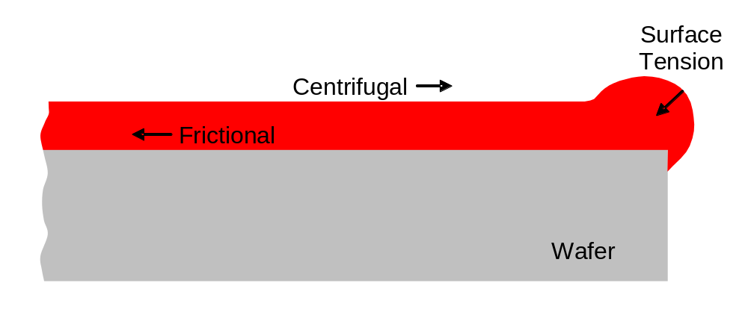
Figure 1.15 A balance of spin-coat forces at the wafer edge leads to the formation of a resist edge bead.

Slide 17
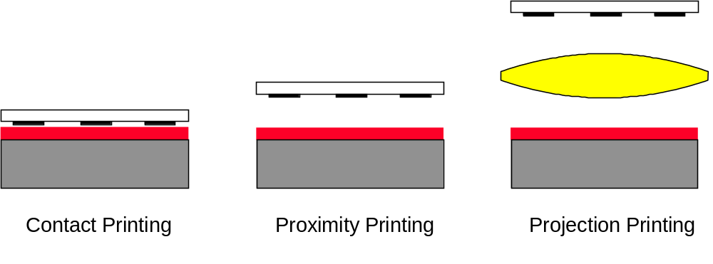
Figure 1.16 Lithographic printing in semiconductor manufacturing has evolved from contact printing (in the early 1960s) to projection printing (from the mid 1970s to today).

Slide 18
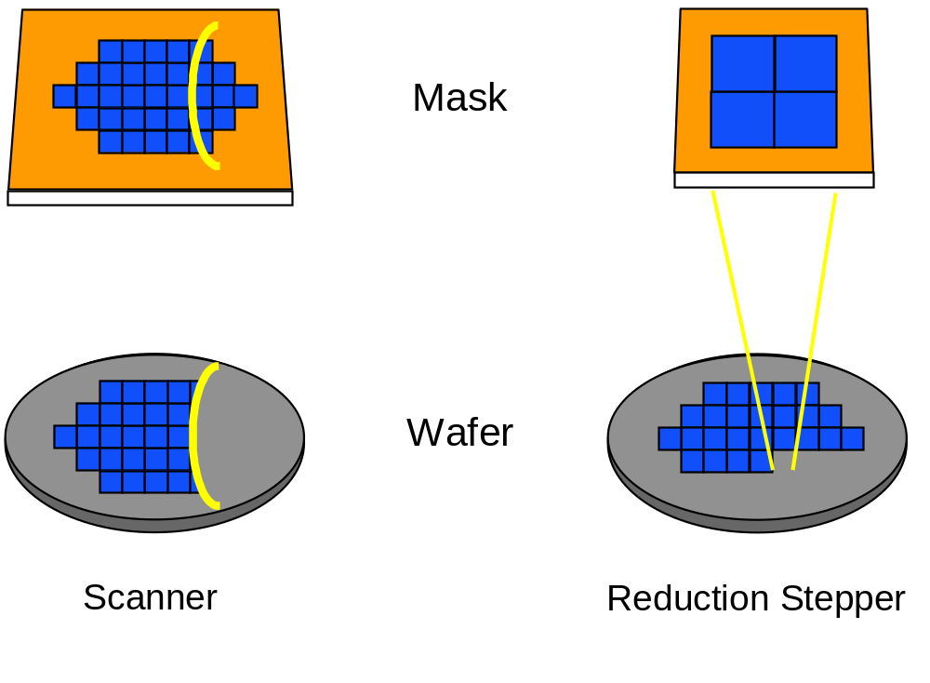
Figure 1.17 Scanners and steppers use different techniques for exposing a large wafer with a small image field.

Slide 19
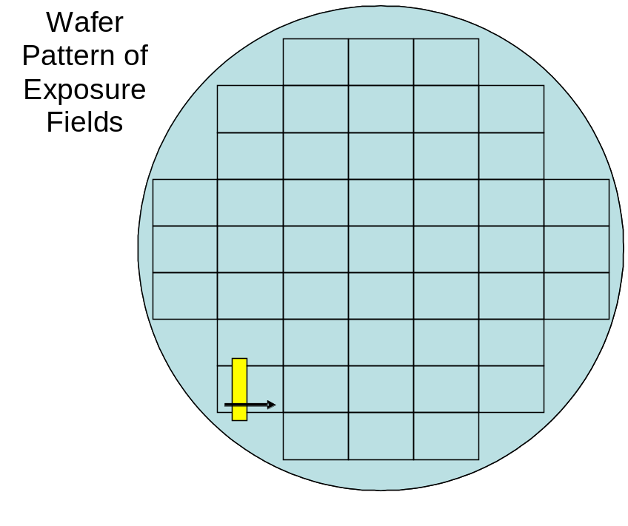
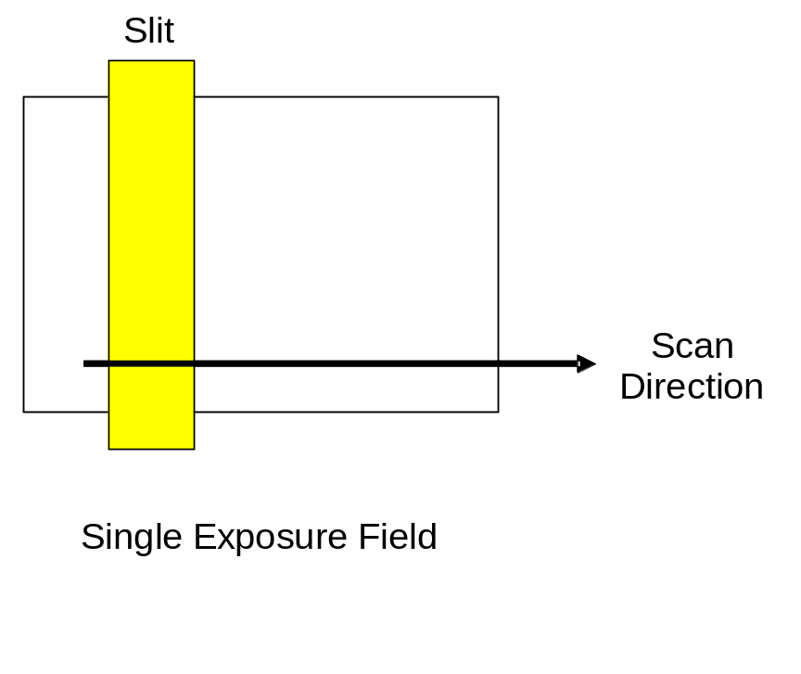
Figure 1.18 In step-and scan imaging, the field is exposed by scanning a slit that is about 25mm x 8mm across the exposure field.

Slide 20
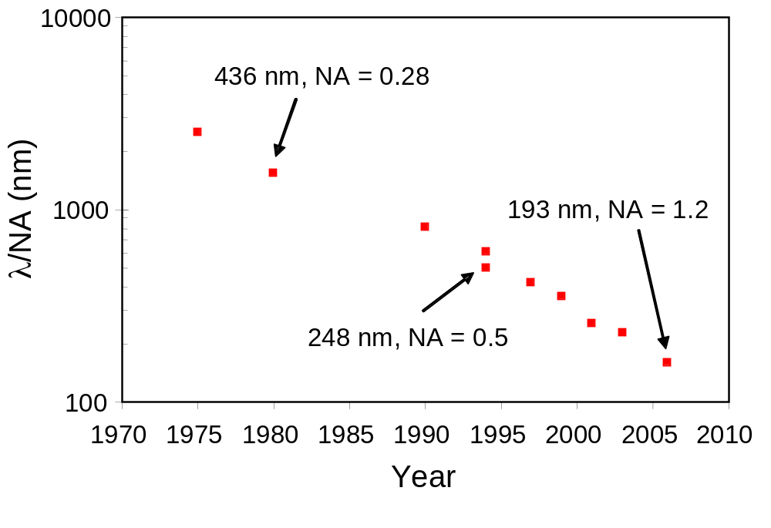
Figure 1.19 The progression of λ/NA of lithographic tools over time (year of first commercial tool shipment).

Slide 21
Table 1.2 The change in projection tool specifications over time.
 | First Stepper (1978) | Immersion Scanner (2006)
Wavelength | 436 nm | 193 nm
Numerical Aperture | 0.28 | 1.2
Field Size | 10 mm X 10 mm | 26 mm X 33 mm
Reduction Ratio | 10 | 4
Wafer size | 4” (100 mm) | 300 mm
Throughput | 20 wafers per hour (0.44 cm²/s) | 120 wafers per hour (24 cm²/s)

Slide 22
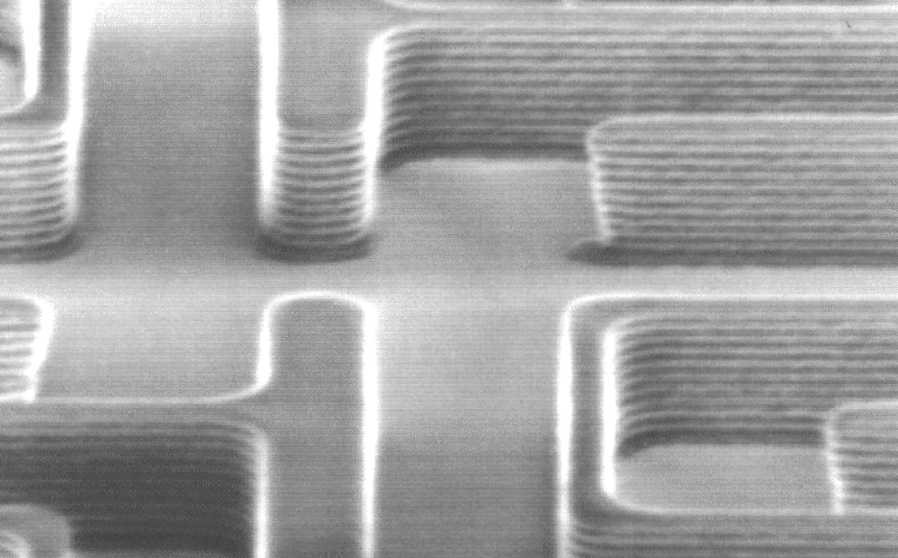
Figure 1.20 Photoresist pattern on a silicon substrate (i-line exposure pictured here) showing prominent standing waves.

Slide 23



(a)
(b)
(c)
Figure 1.21 Diffusion during a post-exposure bake is often used to reduce standing waves. Photoresist profile simulations as a function of the PEB diffusion length: (a) 20 nm, (b) 40 nm, and (c) 60 nm.

Slide 24
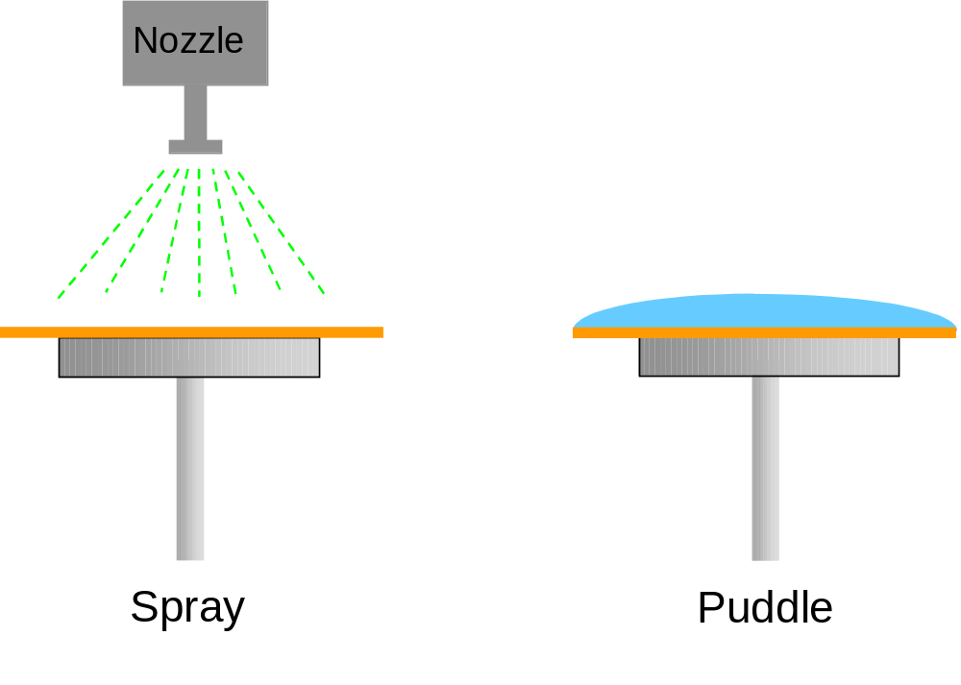
Figure 1.22 Different developer application techniques are commonly used.

