Slide 1
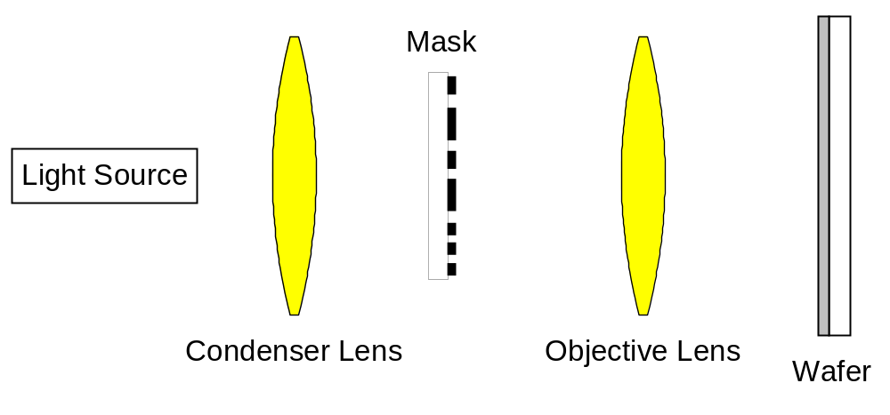
Figure 2.1 Block diagram of a generic projection imaging system.

Slide 2
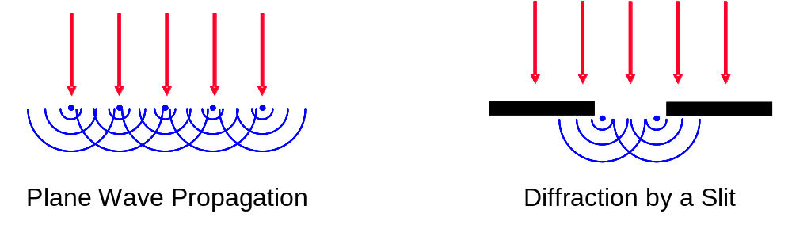
Figure 2.2 Pictorial representation of Huygens’ principle, where any wavefront can be thought of as a collection of point sources radiating spherical waves.

Slide 3
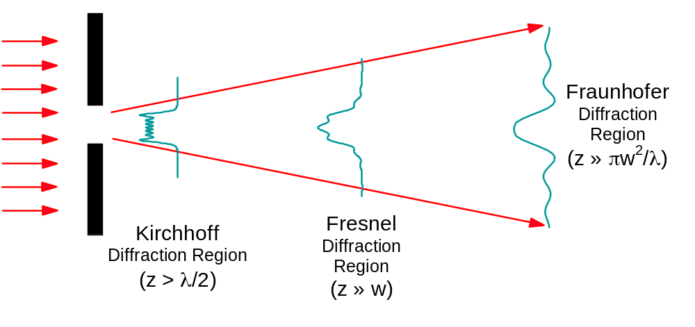
Figure 2.3 Comparison of the diffraction ‘regions’ where various approximations become accurate. Diffraction is for a slit of width w illuminated by light of wavelength λ, and z is the distance away from the mask.

Slide 4
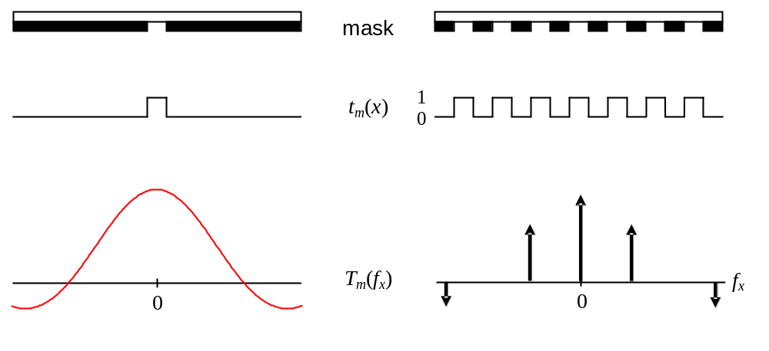
Figure 2.4 Two typical mask patterns, an isolated space and an array of equal lines and spaces, and the resulting Fraunhofer diffraction patterns assuming normally incident plane wave illumination. Both t_{m} and T_{m} represent electric fields.

Slide 5
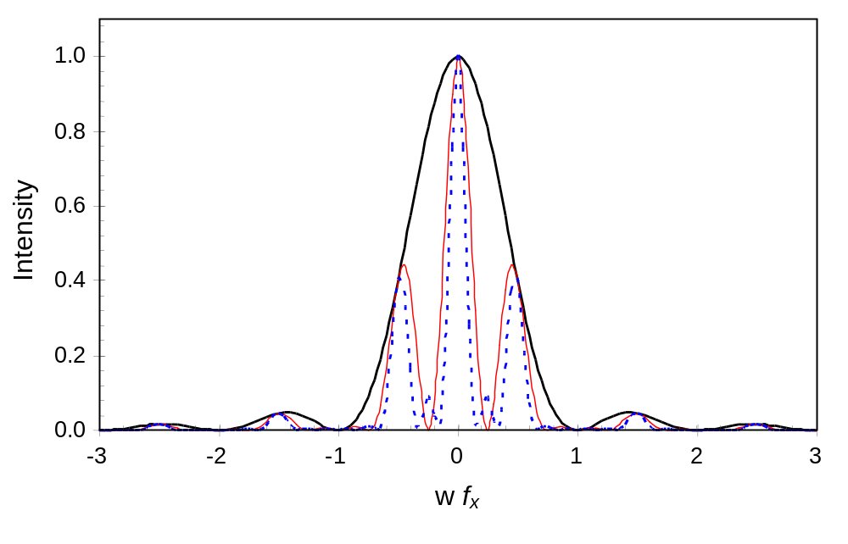
Figure 2.5 Magnitude of the diffraction pattern squared (intensity) for a single space (thick solid line), two spaces (thin solid line), and three spaces (dashed lines) of width w. For the multiple-feature cases, the linewidth is also equal to w.

Slide 6
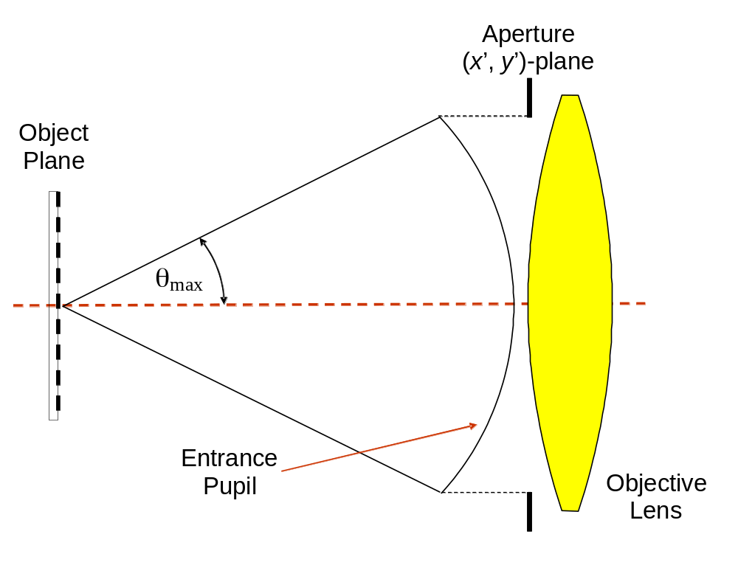
Figure 2.6 The numerical aperture is defined as NA = nsinθ_{max} where θ_{max} is the maximum half-angle of the diffracted light that can enter the objective lens, and n is the refractive index of the medium between the mask and the lens.

Slide 7
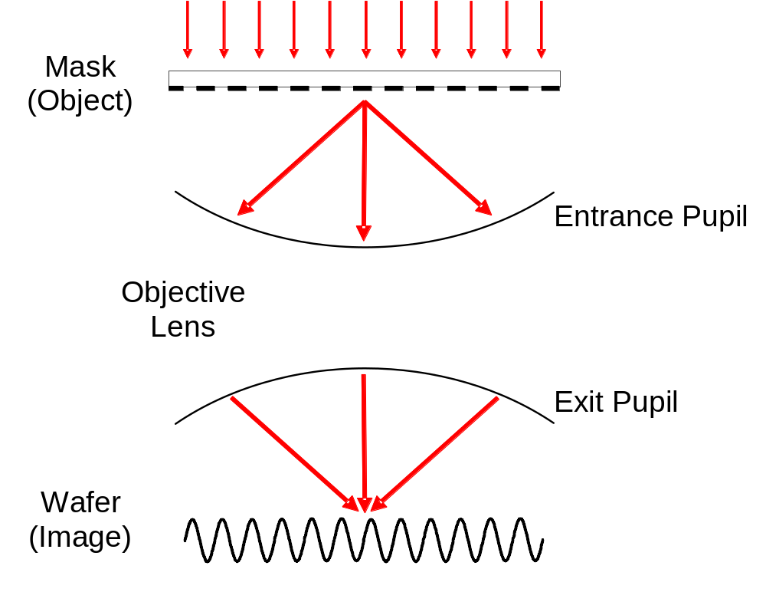
Figure 2.7 Formation of an aerial image: a pattern of lines and spaces produces a diffraction pattern of discrete diffraction orders (in this case, three orders are captured by the lens). The lens turns these diffraction orders into plane waves projected onto the wafer, which interfere to form the image.

Slide 8
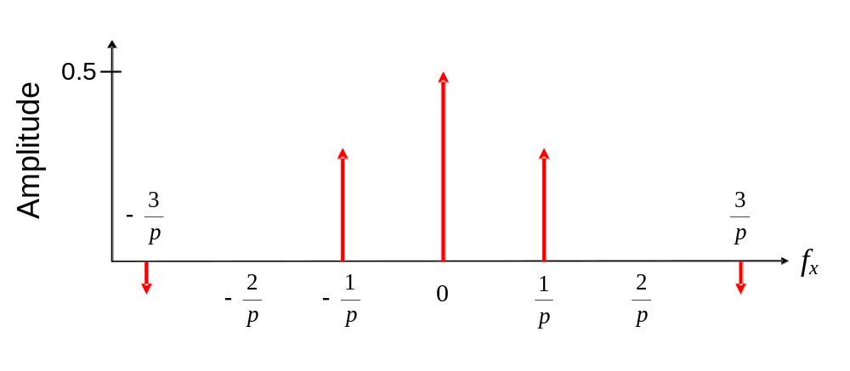
Figure 2.8 Graph of the diffraction pattern for equal lines and spaces plotted out to ±3rd diffraction orders. For graphing purposes, the delta function is plotted as an arrow, the height equal to the amplitude multiplier of the delta function.

Slide 9
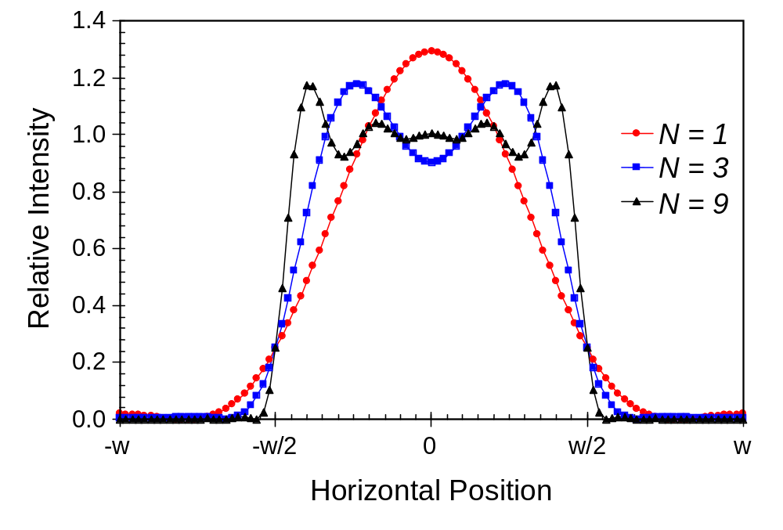
Figure 2.9 Aerial images for a pattern of equal lines and spaces of width w as a function of the number of diffraction orders captured by the objective lens (coherent illumination). N is the maximum diffraction order number captured by the lens.

Slide 10
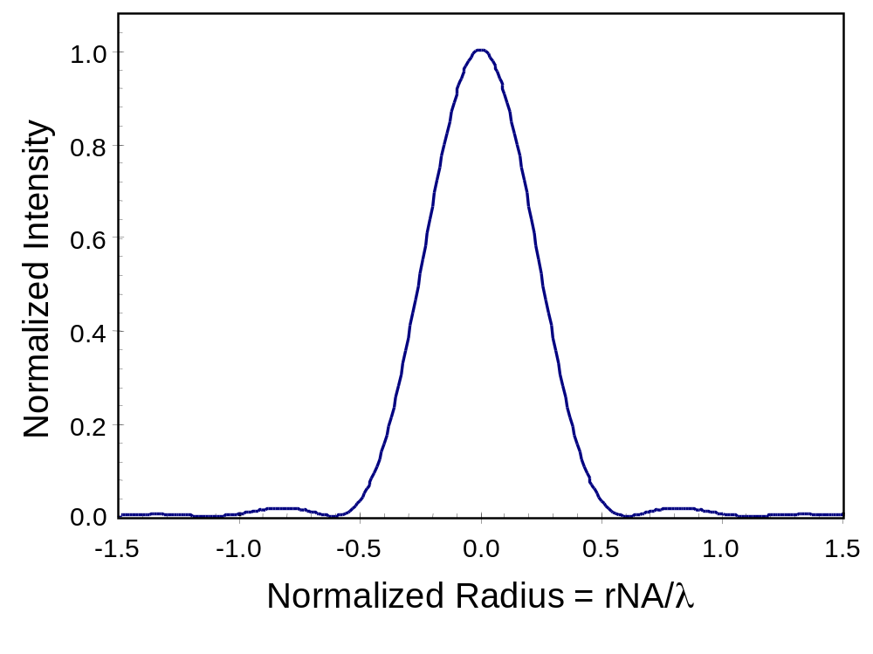
Figure 2.10 Ideal point spread function (PSF), the normalized image of an infinitely small contact hole. The radial position is normalized by multiplying by NA/λ.

Slide 11
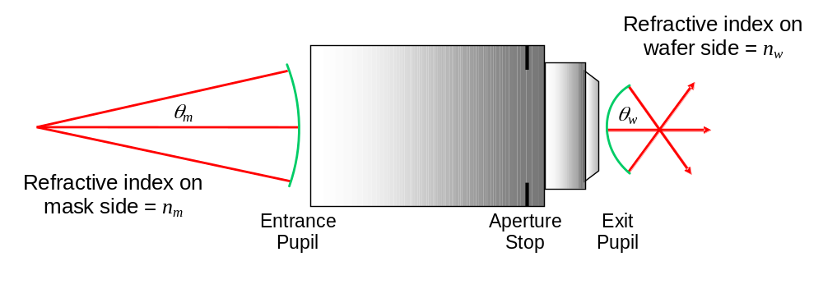
Figure 2.11 An imaging lens with reduction R scales both the lateral dimensions and the sine of the angles by R.

Slide 12
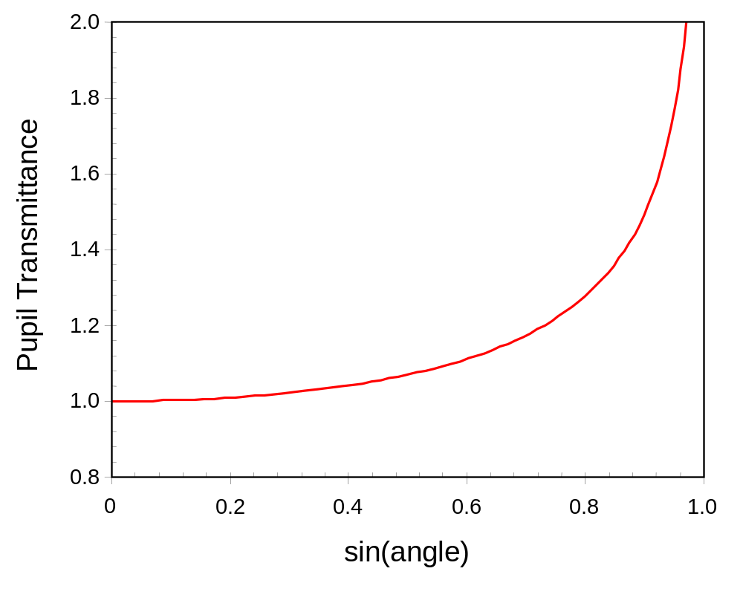
Figure 2.12 A plot of the radiometric correction as a function of the wafer-side diffraction angle (R = 4, n_{w}/n_{m} = 1).

Slide 13
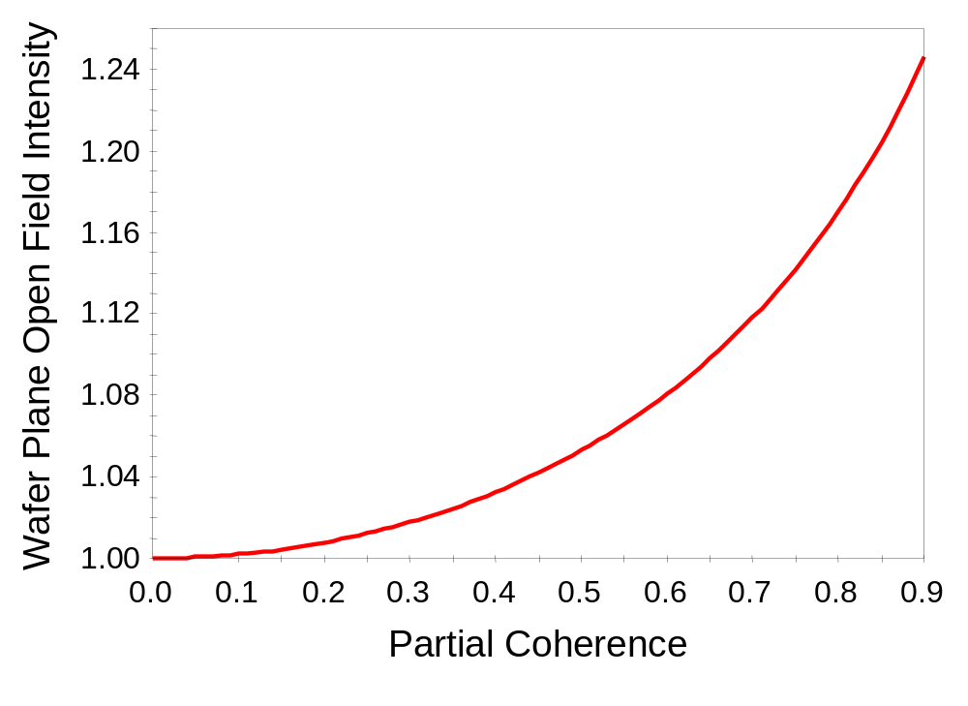
Figure 2.13 One impact of the radiometric correction: the intensity at the wafer plane for a unit amplitude mask illumination as a function of the partial coherence factor (R = 4, NA = 0.9).

Slide 14
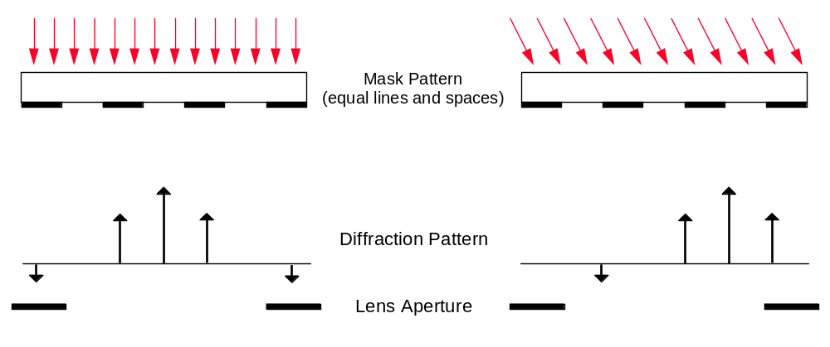
Figure 2.14 The effect of changing the angle of incidence of plane wave illumination on the diffraction pattern is simply to shift its position in the lens aperture. A positive illumination tilt angle is depicted here.

Slide 15
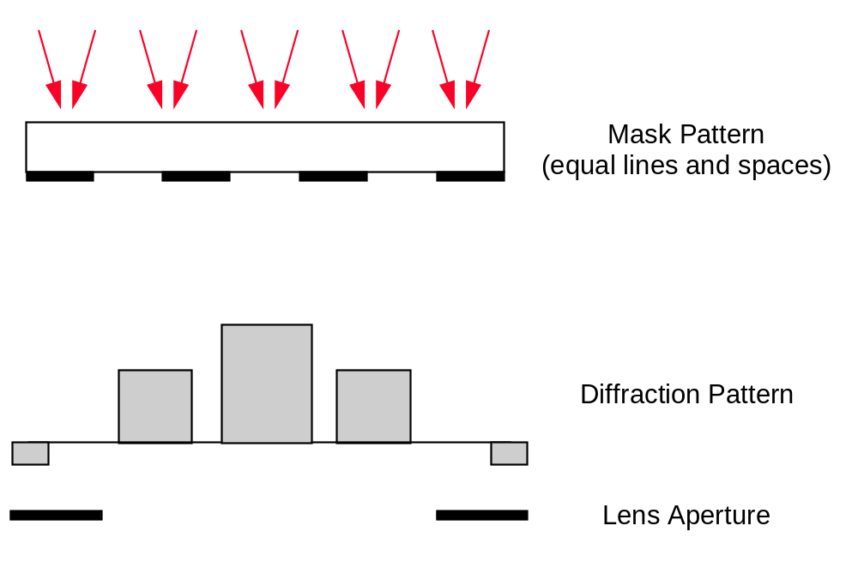
Figure 2.15 The diffraction pattern is broadened by the use of partially coherent illumination (plane waves over a range of angles striking the mask).

Slide 16
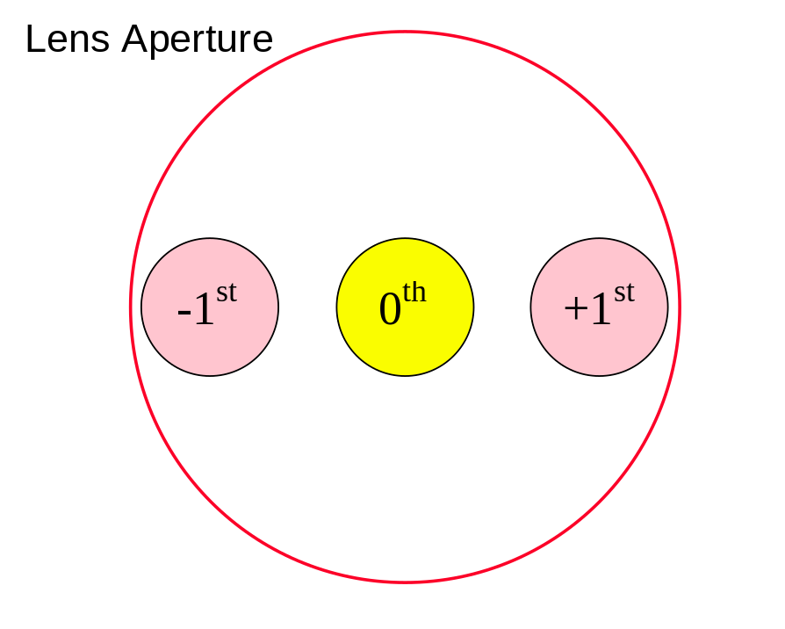
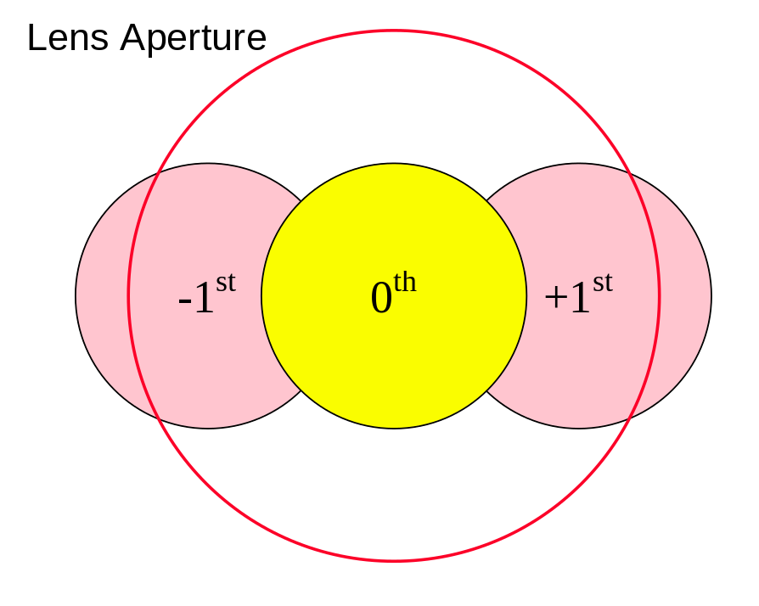
(a)
(b)
Figure 2.16 Top-down view of the lens aperture showing the diffraction pattern of a line/space pattern when partially coherent illumination is used: a) σ = 0.25; and b) σ = 0.5.

Slide 17
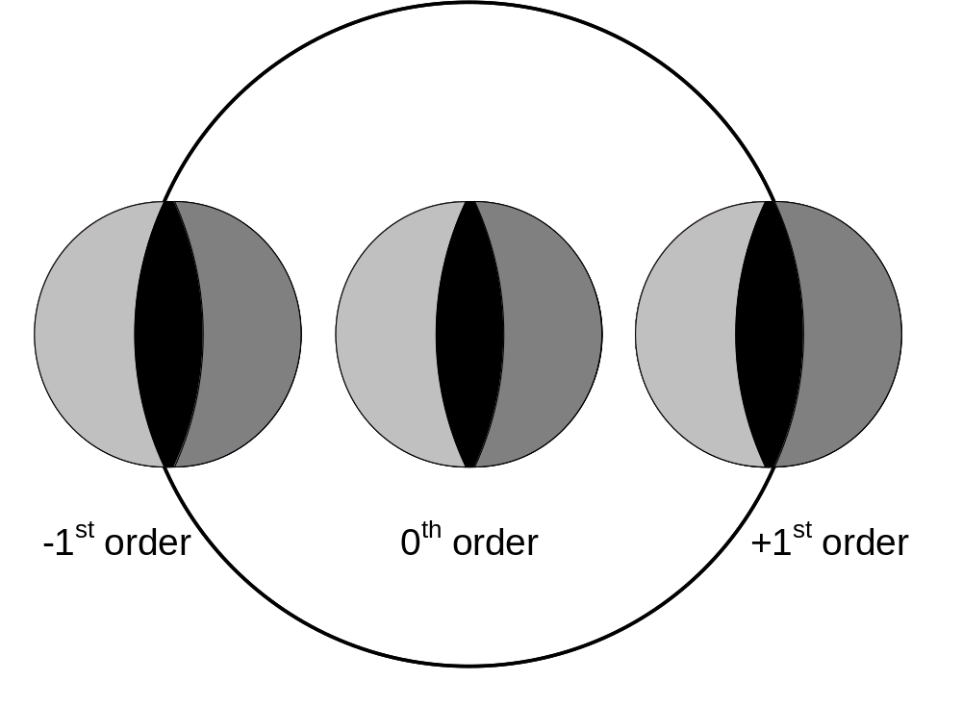
Figure 2.17 Example of dense line/space imaging where only the zero and first diffraction orders are used. Black represents three beam imaging, lighter and darker grays show the area of two beam imaging.

Slide 18
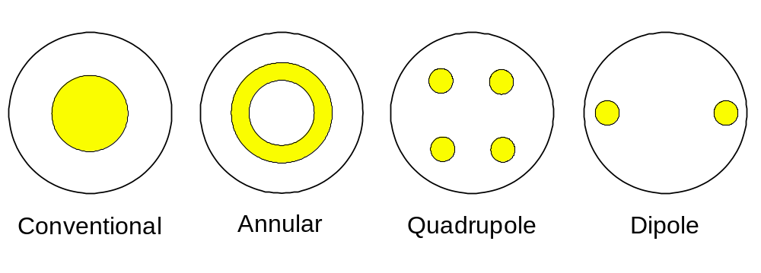
Figure 2.18 Conventional illumination source shape, as well as the most popular off-axis illumination schemes, plotted in spatial frequency coordinates. The outer circle in each diagram shows the cut-off frequency of the lens.

Slide 19
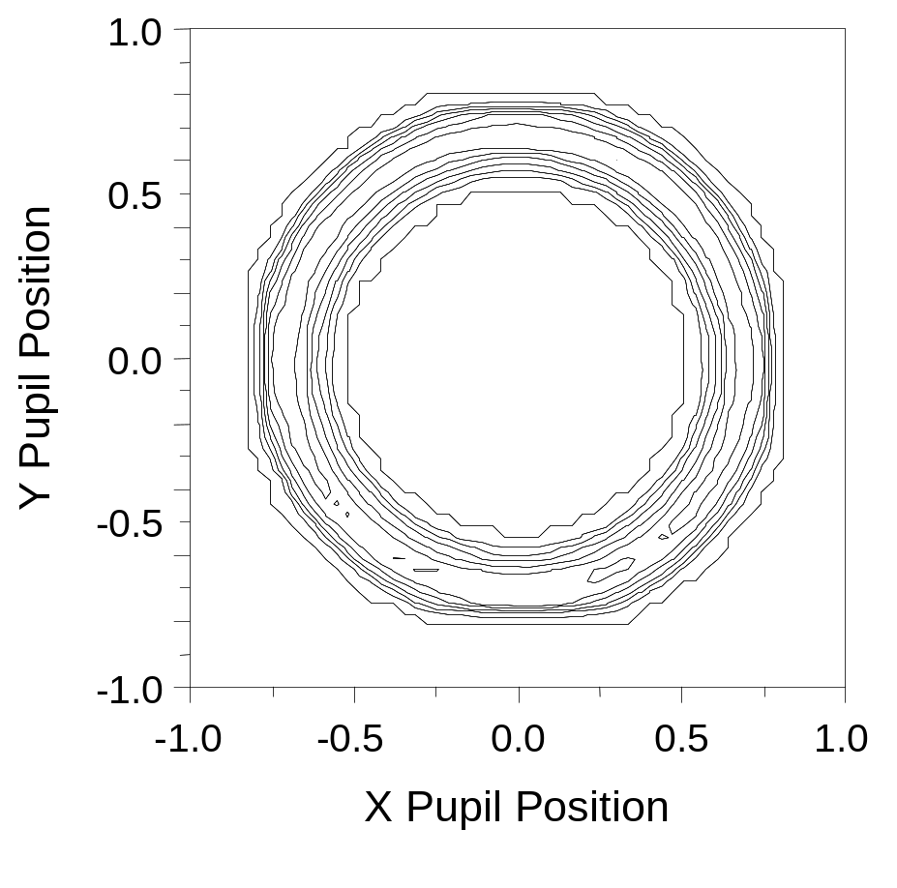
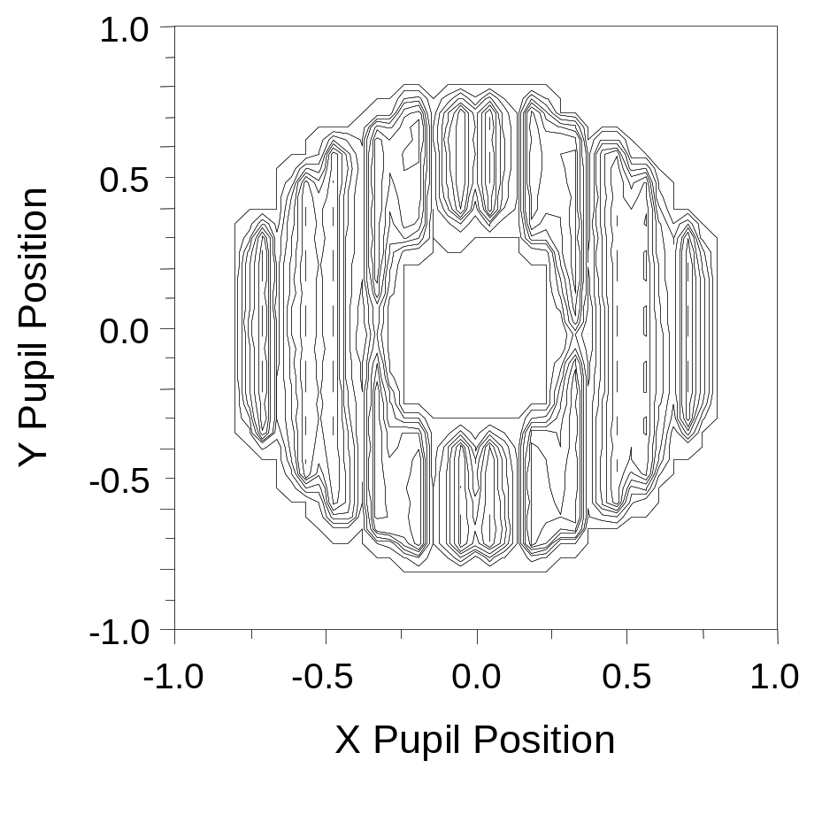
(a)
(b)
Figure 2.19 Examples of measured annular source shapes (contours of constant intensity) from two different lithographic projection tools showing a more complicated source distribution than the idealized ‘top-hat’ distributions.

Slide 20
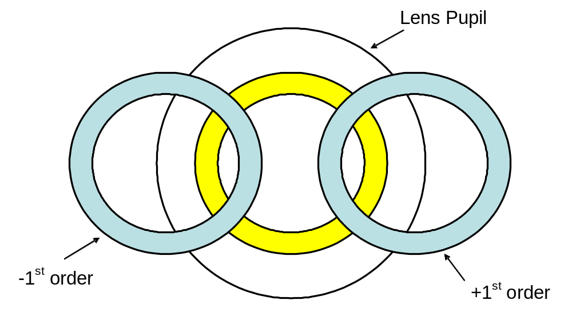
Figure 2.20 Annular illumination example where only the 0th and ±1st diffracted orders pass through the imaging lens.

Slide 21
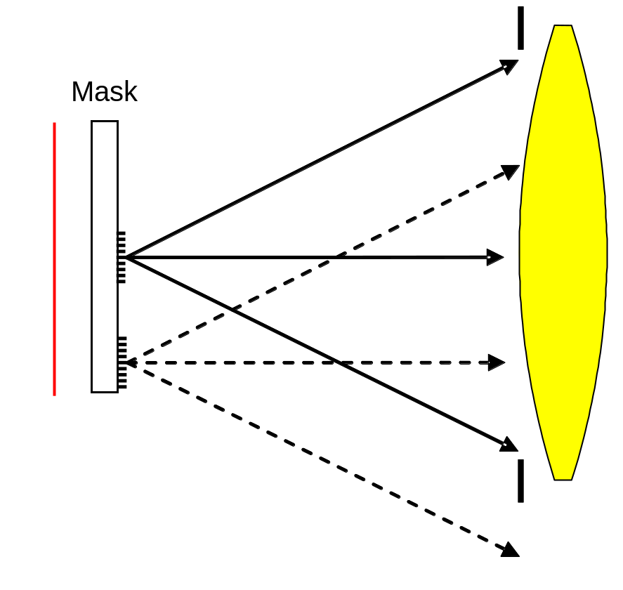
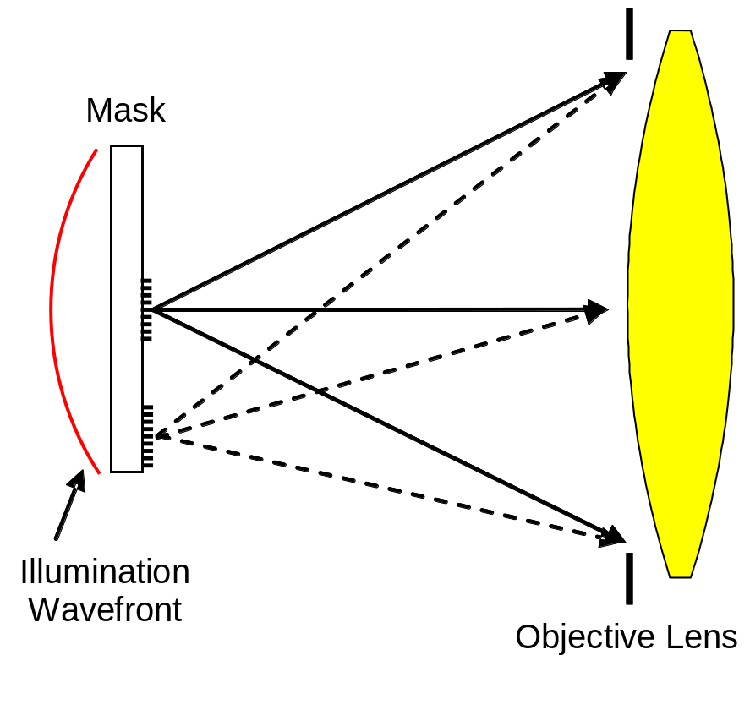
(a)
(b)
Figure 2.21 The impact of illumination: a) when illuminated by a plane wave, patterns at the edge of the mask will not produce diffraction patterns centered in the objective lens pupil, but b) the proper converging spherical wave produces diffraction patterns that are independent of field position.

Slide 22
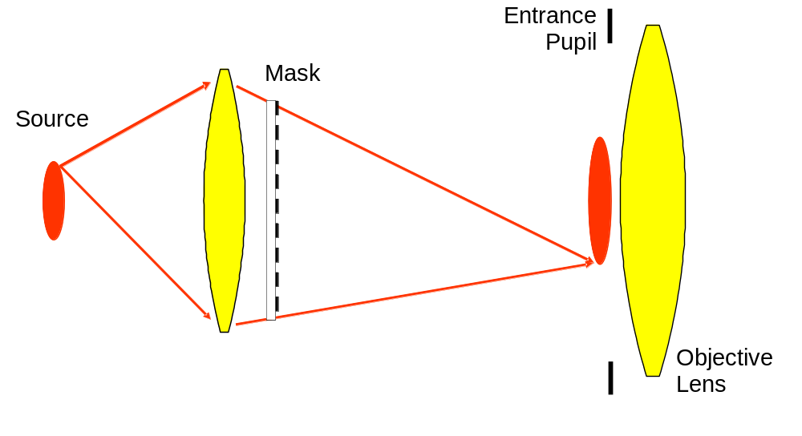
Figure 2.22 Köhler illumination where the source is imaged at the entrance pupil of the objective lens and the mask is placed at the exit pupil of the condenser lens.

Slide 23
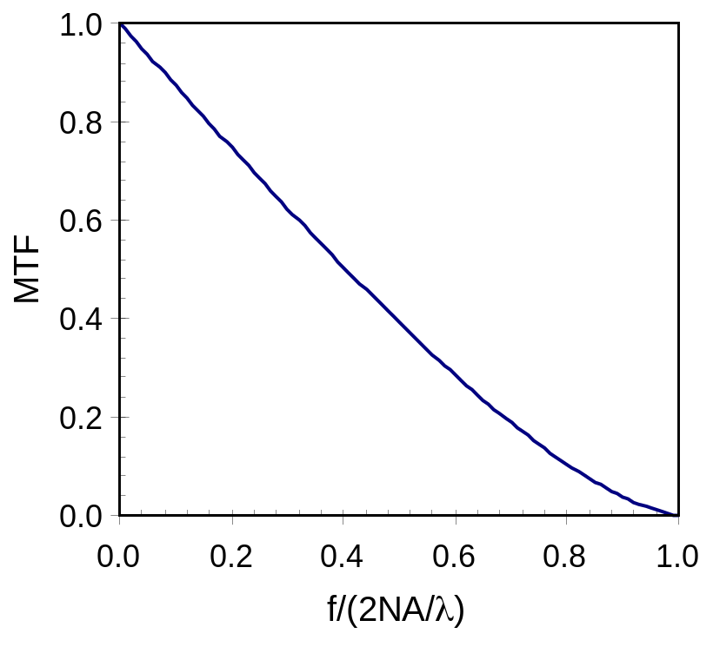
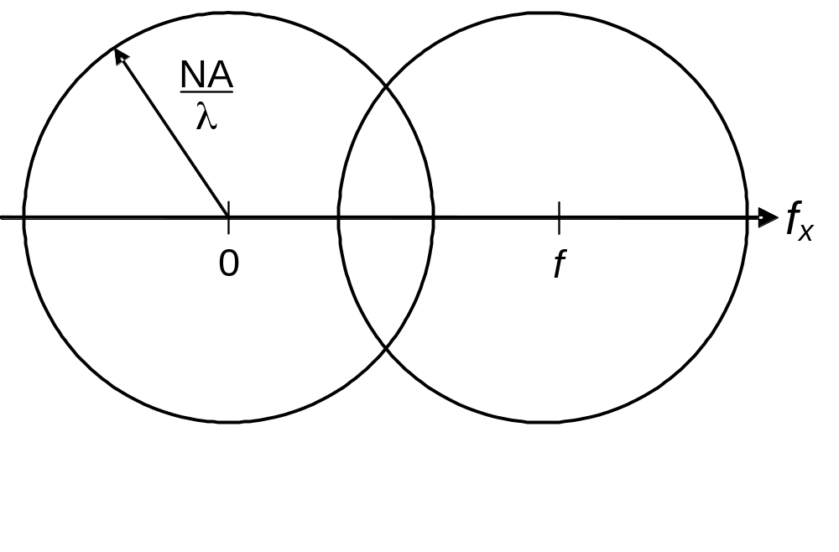
(a)
(b)
Figure 2.23 The MTF(f) is the overlapping area of two circles of diameter NA/λ separated by an amount f, as illustrated in a) and graphed in b).

Slide 24
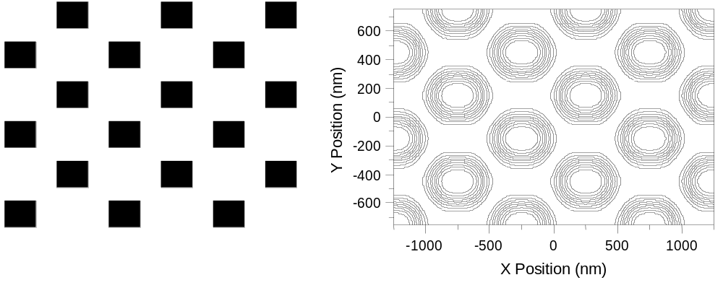
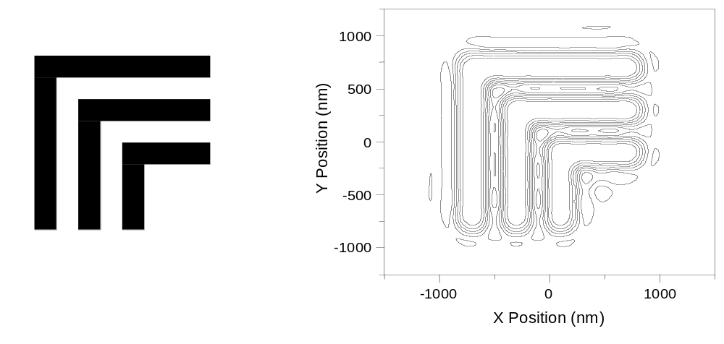
Figure 2.24 Some examples of two-dimensional aerial image calculations (shown as contours of constant intensity), with the mask pattern on the left (dark representing chrome).

Slide 25
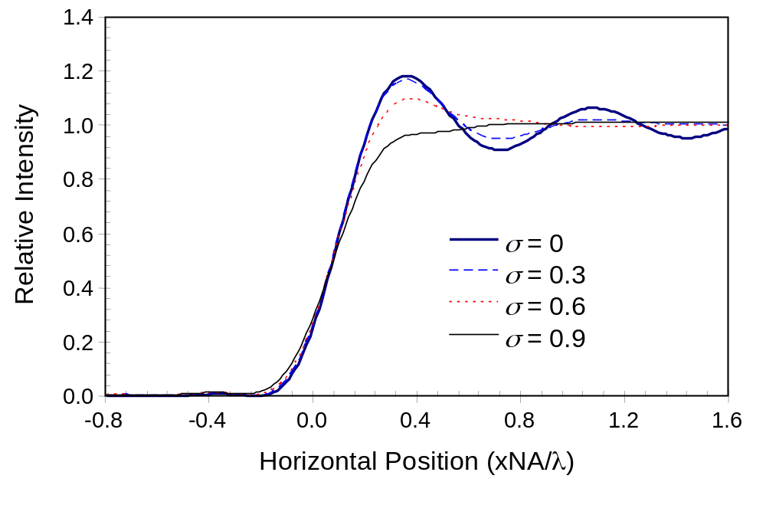
Figure 2.25 Aerial images of an isolated edge as a function of the partial coherence factor.

