Slide 1
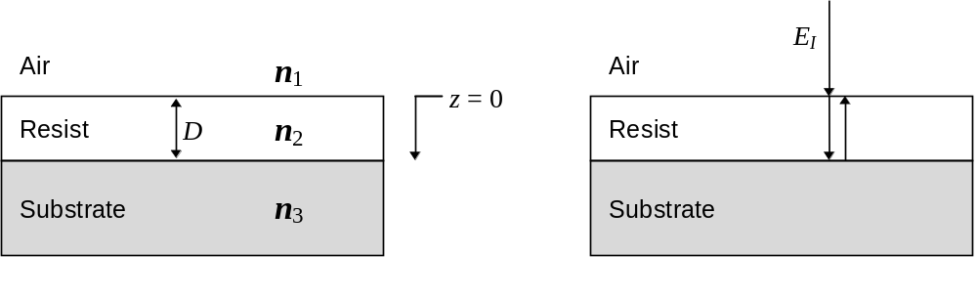
(a)
(b)
Figure 4.1 Film stack showing (a) the geometry for the standing wave derivation, and (b) a normally incident electric field E_{I}.

Slide 2
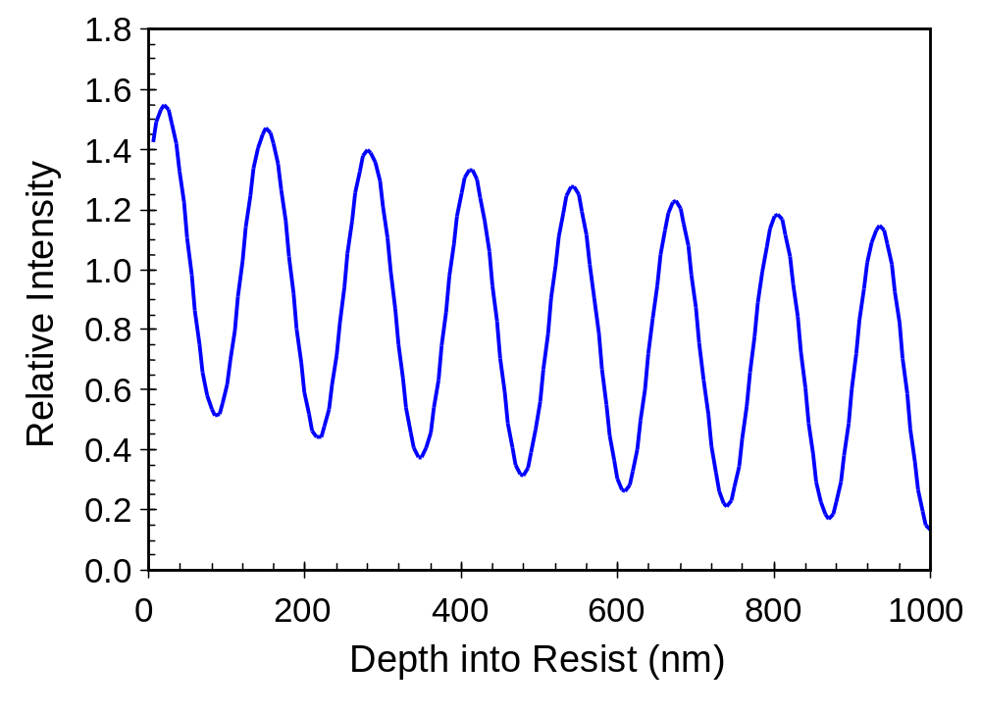
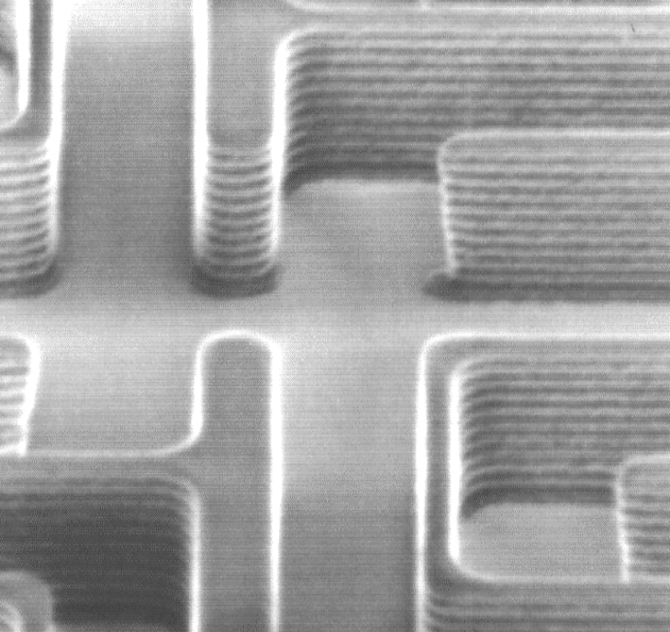
Figure 4.2 Standing wave intensity in one micron of photoresist on a silicon substrate for an i-line exposure.

Slide 3
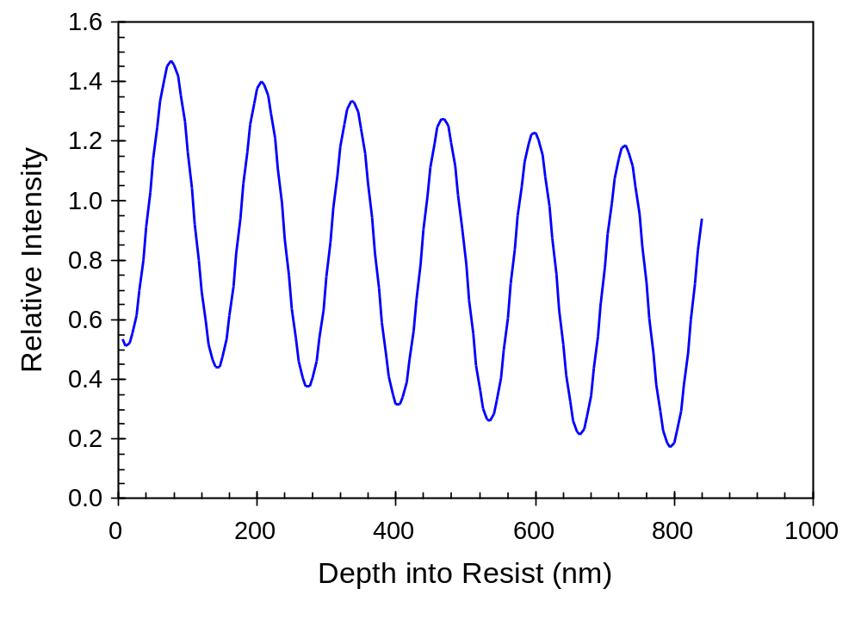
Figure 4.3 Standing wave intensity within a photoresist film at the start of exposure (850nm of resist on 100nm SiO₂ on silicon, λ = 436nm). Note the impact of the oxide film on the phase of the effective substrate reflectivity, which affects the intensity at the bottom of the resist.

Slide 4
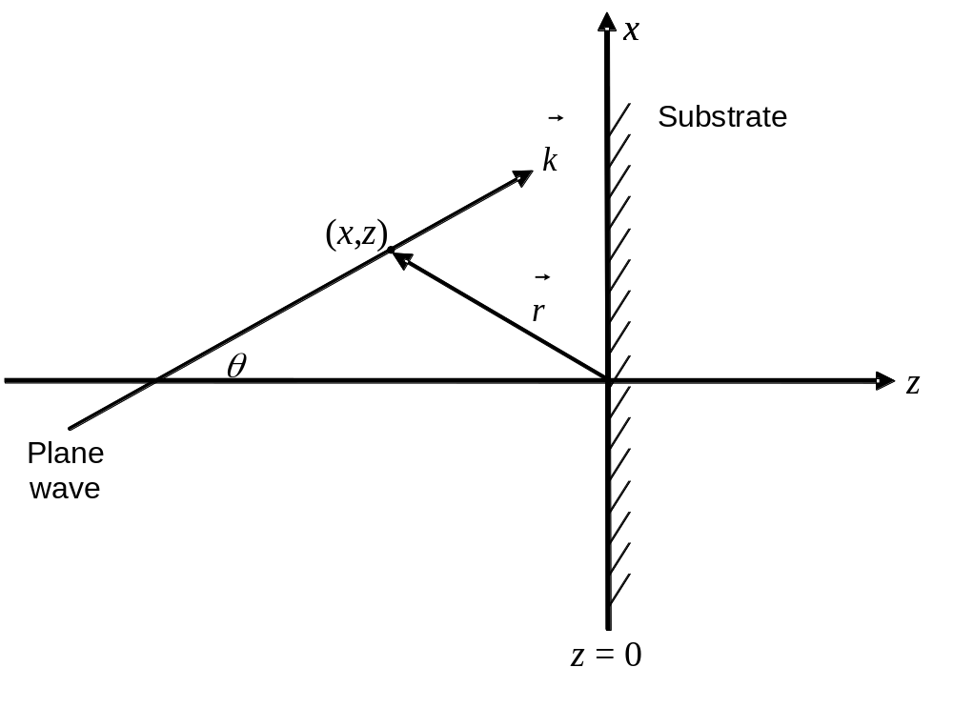
Figure 4.4 Geometry used for describing plane waves and standing waves for oblique incidence.

Slide 5
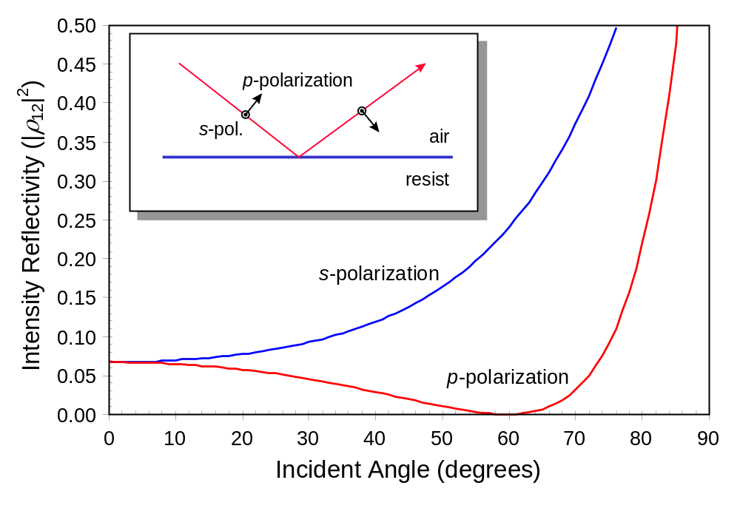
Figure 4.5 Reflectivity (square of the reflection coefficient) as a function of the angle of incidence showing the difference between s- and p-polarization (n₁ = 1.0, n₂ = 1.7). Both air and resist layers are assumed to be infinitely thick.

Slide 6
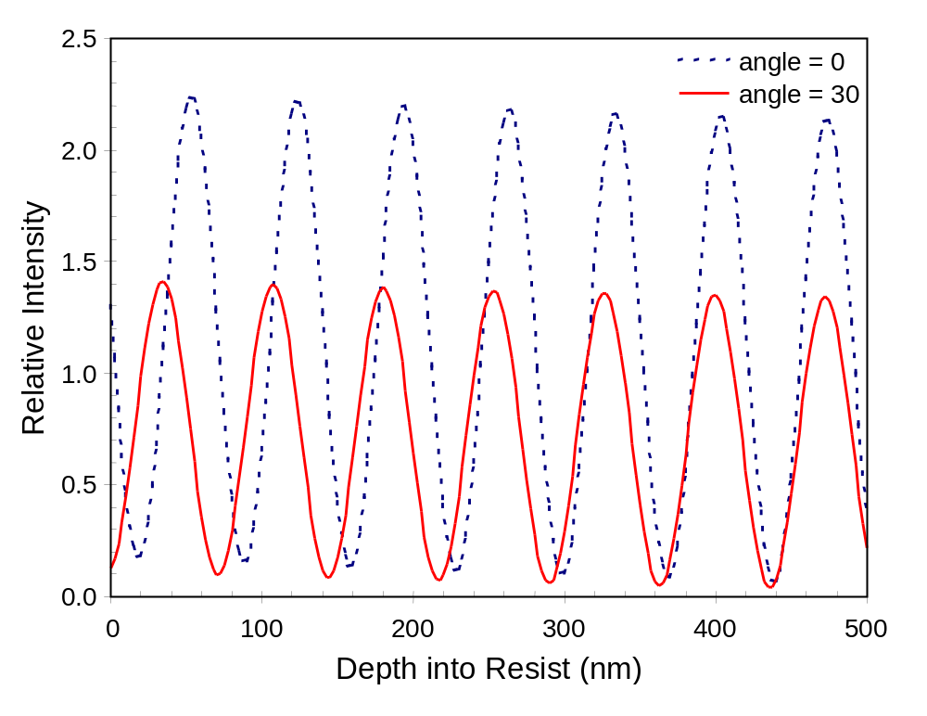
Figure 4.6 Standing wave intensity within a photoresist film (500 nm of resist on silicon, λ = 248 nm) as a function of incident angle (s-polarization assumed).

Slide 7
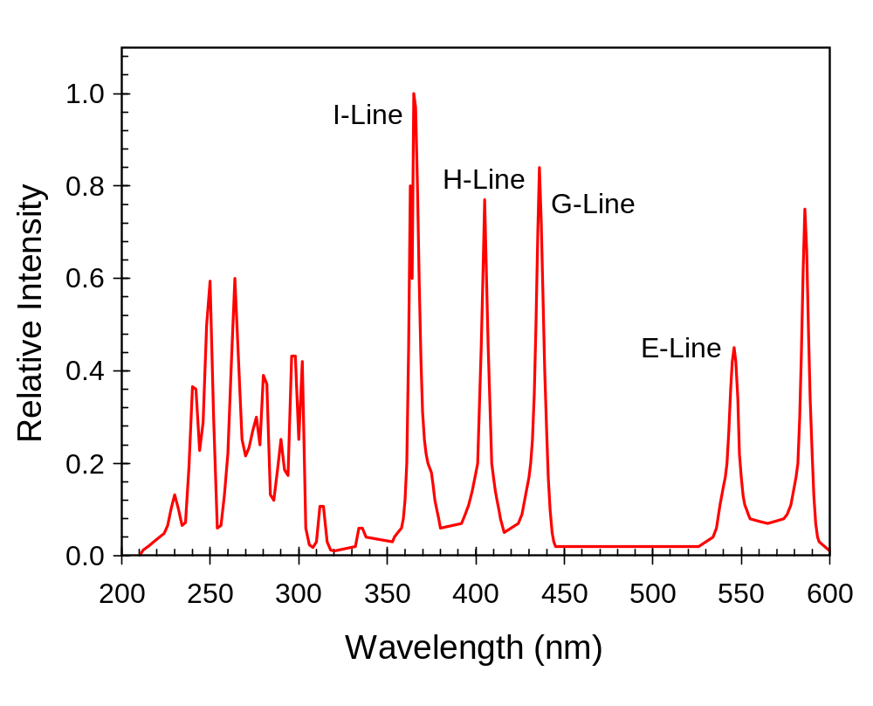
Figure 4.7 Spectral output of a typical high-pressure mercury arc lamp. The illumination spectrum of an i-line or g-line lithographic exposure tool is usually a filtered portion of this lamp spectrum.

Slide 8
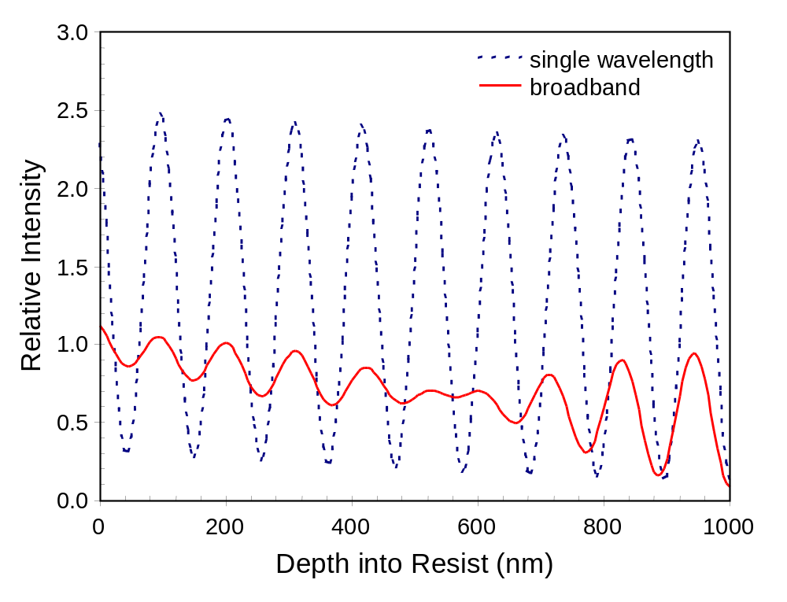
Figure 4.8 Standing wave intensity within a photoresist film (1000 nm of resist on silicon), for monochromatic (λ = 365 nm) and broadband illumination (350 – 450 nm range of the mercury spectrum).

Slide 9
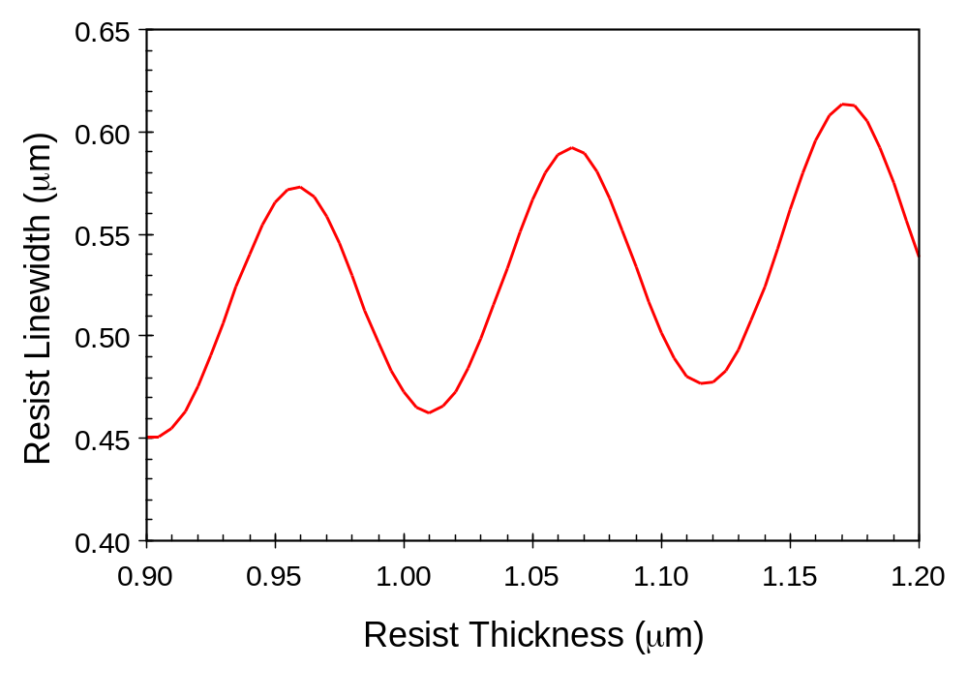
Figure 4.9 CD swing curve showing a sinusoidal variation in the resist linewidth with resist thickness (i-line exposure of resist on silicon).

Slide 10
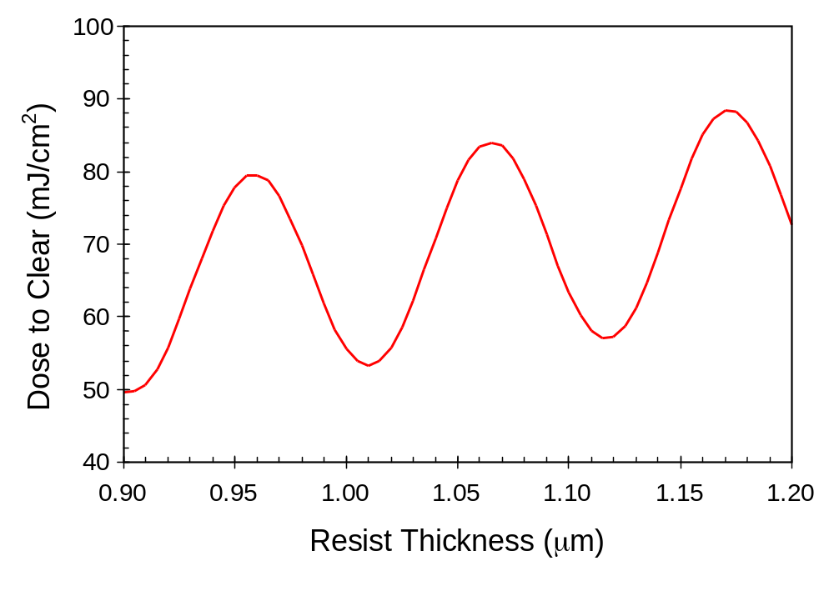
Figure 4.10 E_{o} swing curve showing a sinusoidal variation in the resist dose-to-clear with resist thickness (i-line exposure of resist on silicon).

Slide 11
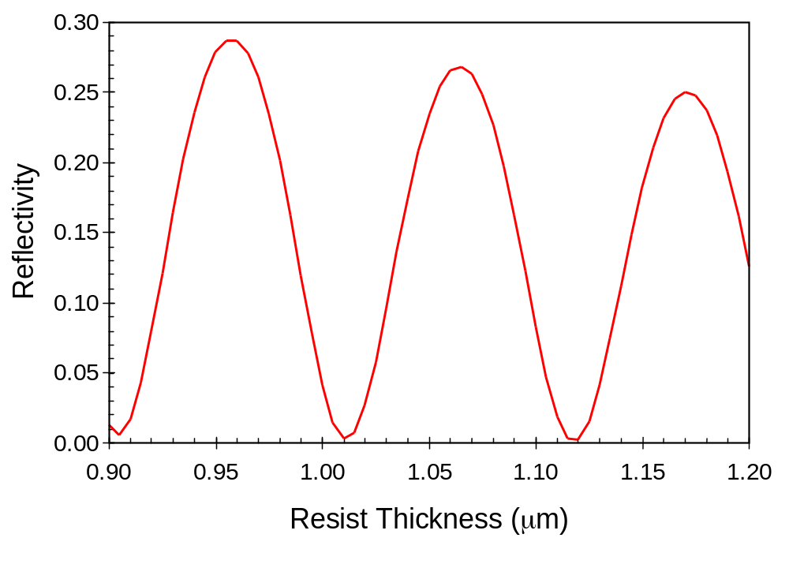
Figure 4.11 Reflectivity swing curve showing a sinusoidal variation in the resist coated wafer reflectivity with resist thickness (i-line exposure of resist on silicon).

Slide 12
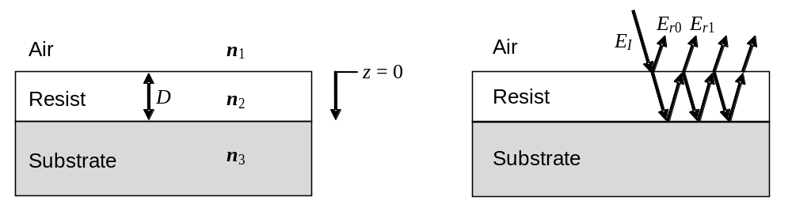
Figure 4.12 Film stack showing (a) geometry for swing curve derivation, and (b) incident, transmitted, and reflected waves (oblique angles are shown for diagrammatical purposes only).

Slide 13
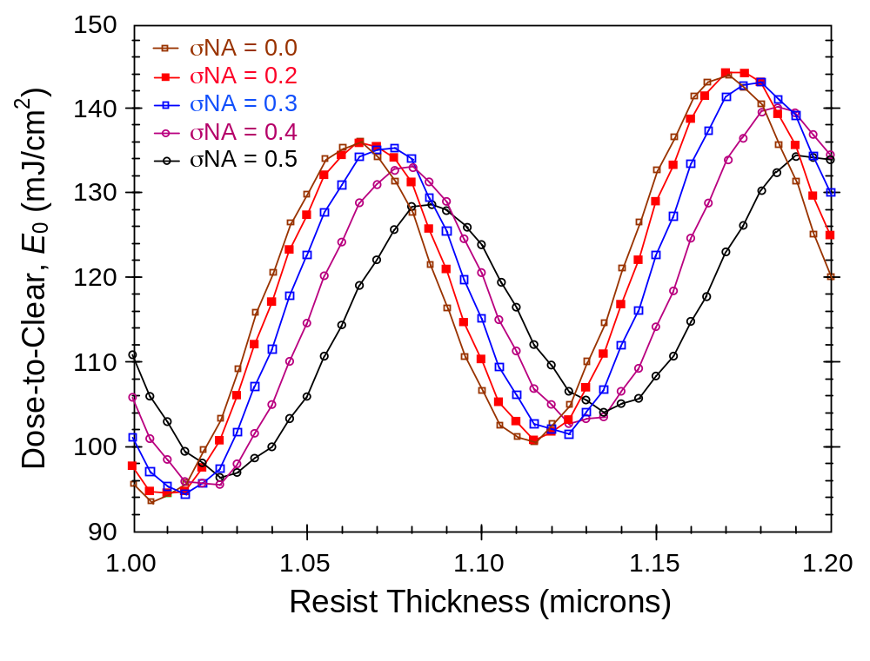
Figure 4.13 The phase and amplitude of a dose-to-clear swing curve are affected by the range of angles striking the resist, which is controlled by the product of the partial coherence and the numerical aperture (σNA) for conventional illumination.

Slide 14
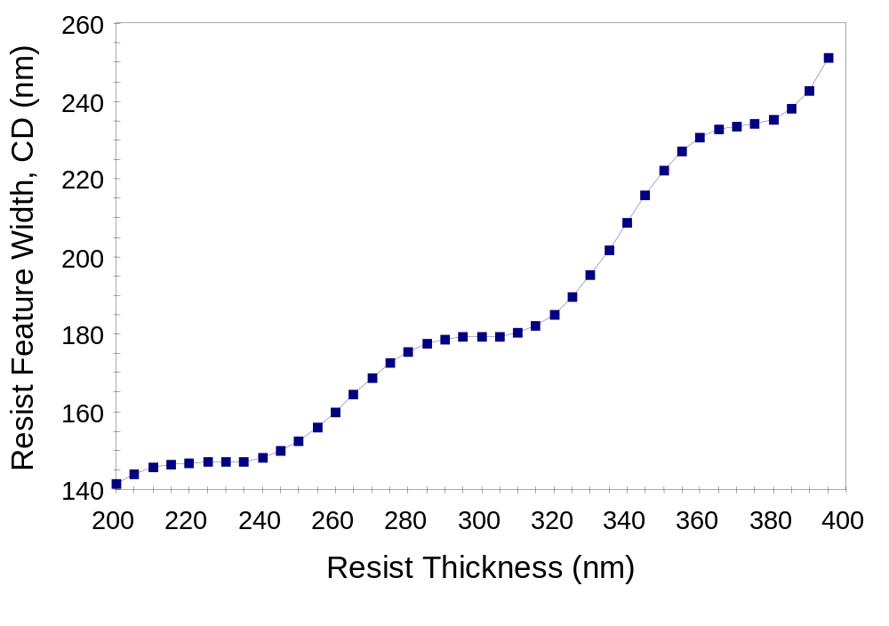
Figure 4.14 Proper balancing of absorption and reflectivities can make the minimum of a swing curve (D = 310 nm) achieve the same CD as the previous swing curve maximum (D = 280 nm).

Slide 15
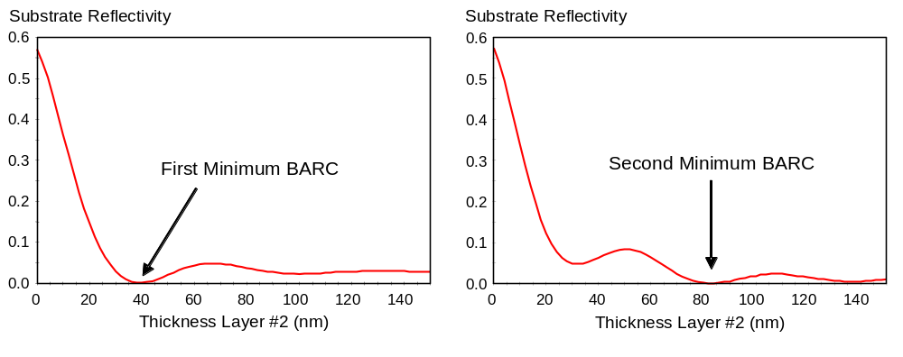
Figure 4.15 Typical examples of substrate reflectivity versus BARC thickness for different resist/BARC/substrate stacks.

Slide 16
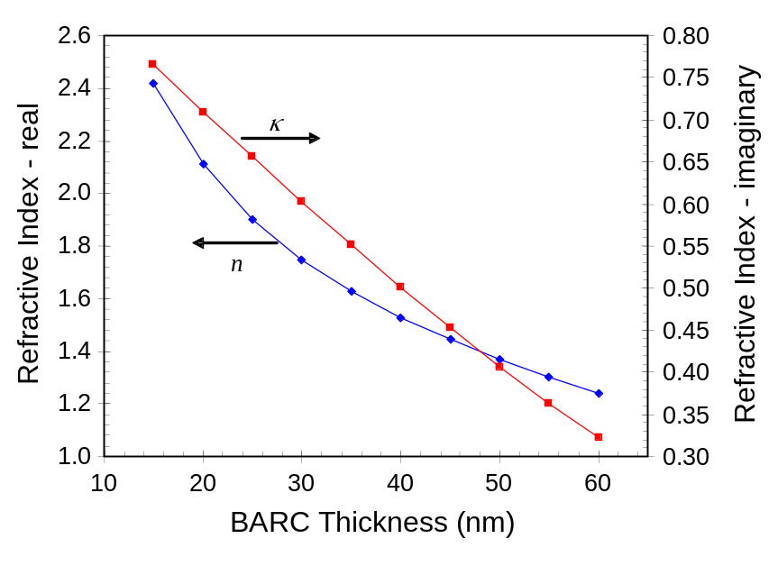
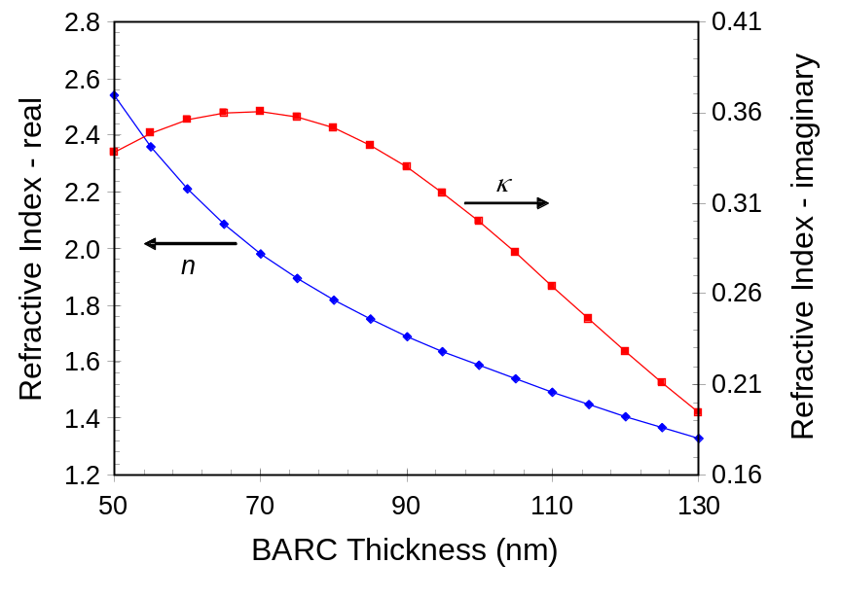
(a)
(b)
Figure 4.16 Optimum BARC refractive index (real and imaginary parts, n and k) as a function of BARC thickness for normal incidence illumination (resist index = 1.7 + i0.01536 and silicon substrate index = 0.8831 + i2.778) at 193 nm. a) First minimum BARCs, and b) second minimum BARCs.

Slide 17
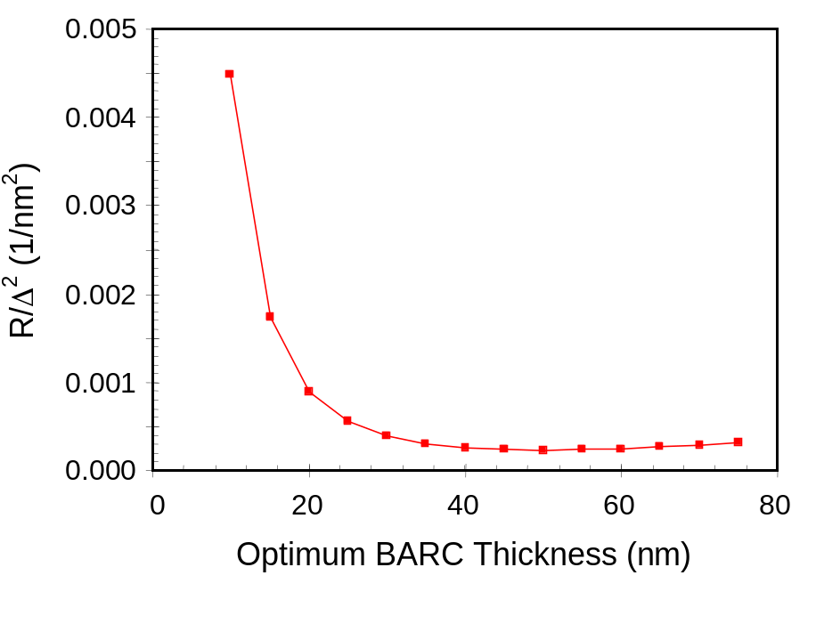
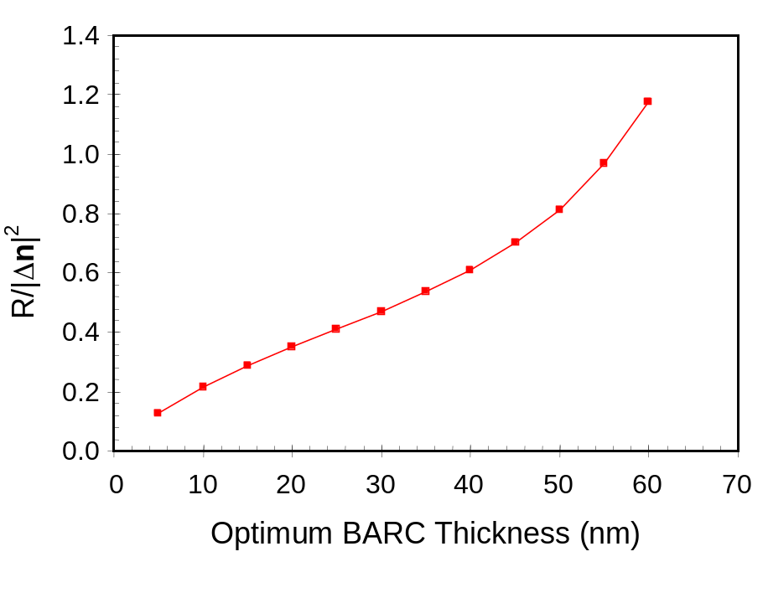
(a)
(b)
Figure 4.17 Sensitivity of substrate reflectivity for the optimum first minimum BARCs of Figure 4.16a as a function of a) BARC thickness errors, or b) BARC refractive index errors.

Slide 18
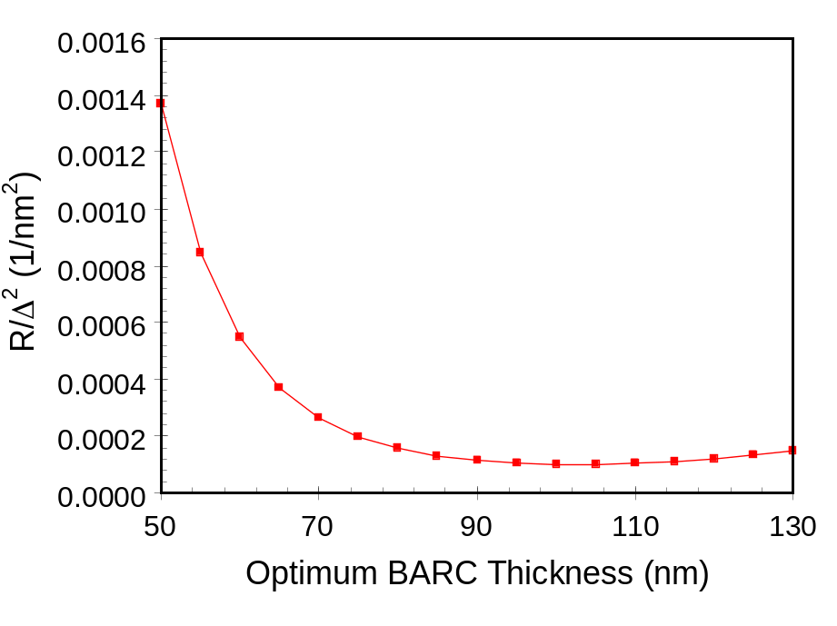
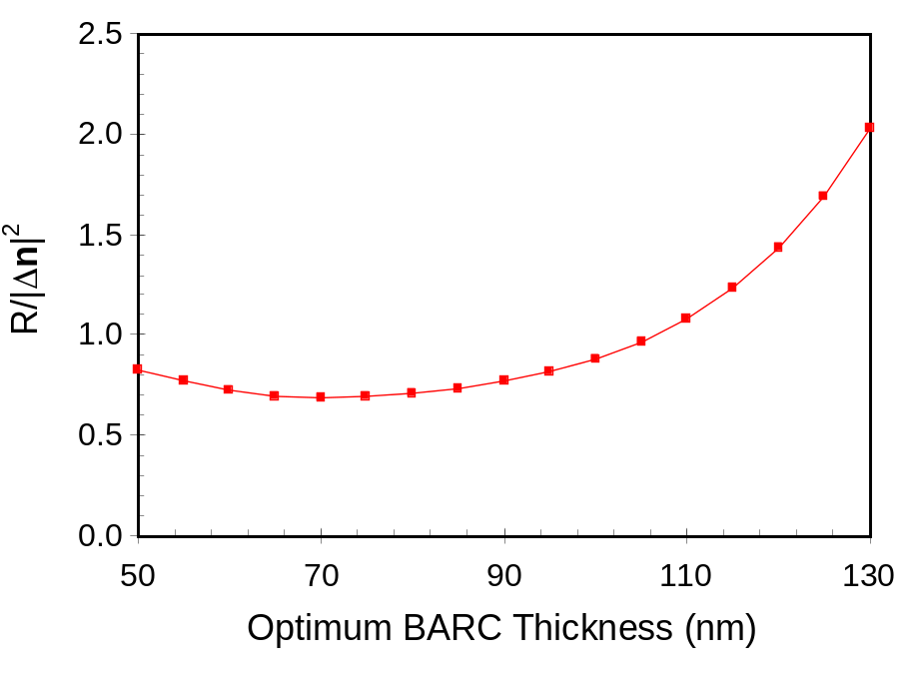
(a)
(b)
Figure 4.18 Sensitivity of substrate reflectivity for the optimum second minimum BARCs of Figure 4.16b as a function of a) BARC thickness errors, or b) BARC refractive index errors.

Slide 19
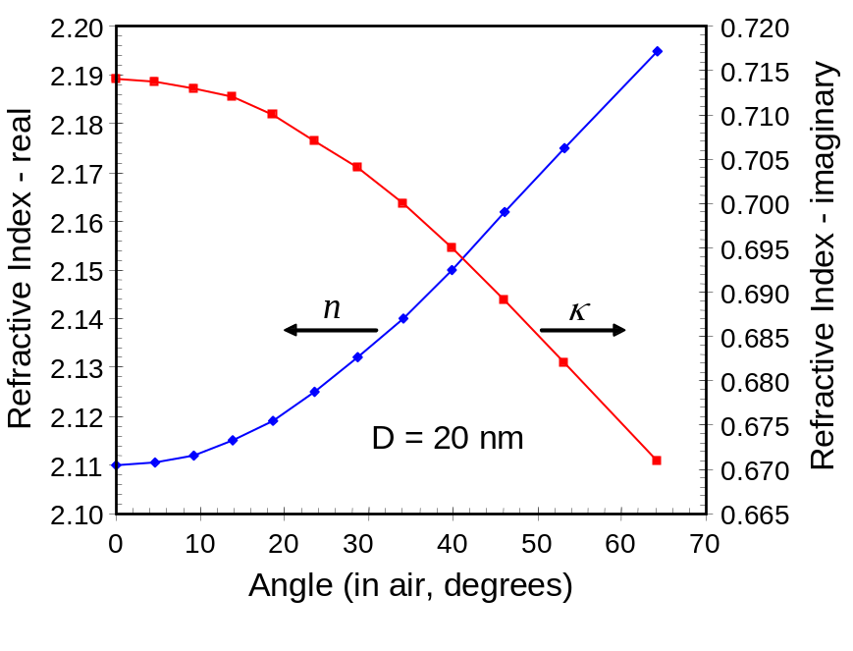
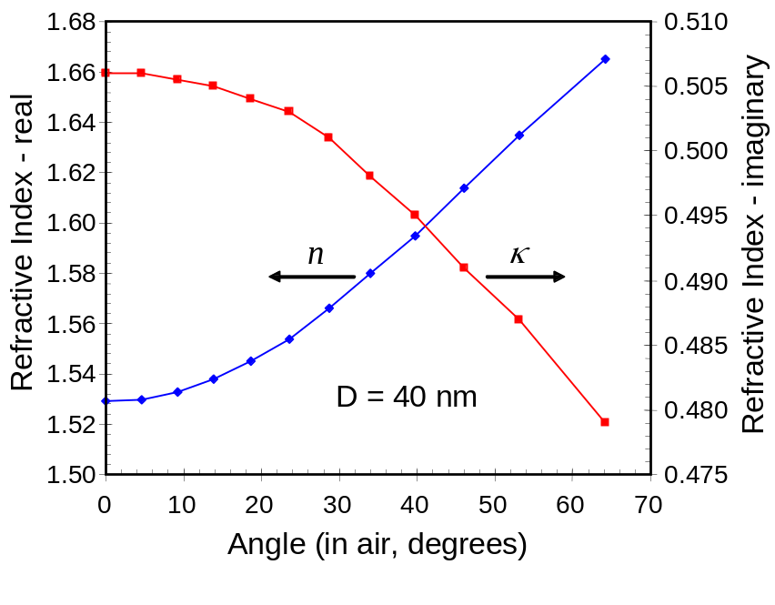
(a)
(b)
Figure 4.19 Optimum BARC parameters to achieve minimum substrate reflectivity as a function of incident angle (angle defined in air, before entering the photoresist) for two different BARC thicknesses (resist index = 1.7 + i0.01536 and silicon substrate index = 0.8831 + i2.778) at 193 nm exposure: a) 20 nm BARC thickness, and b) 40 nm BARC thickness.

Slide 20
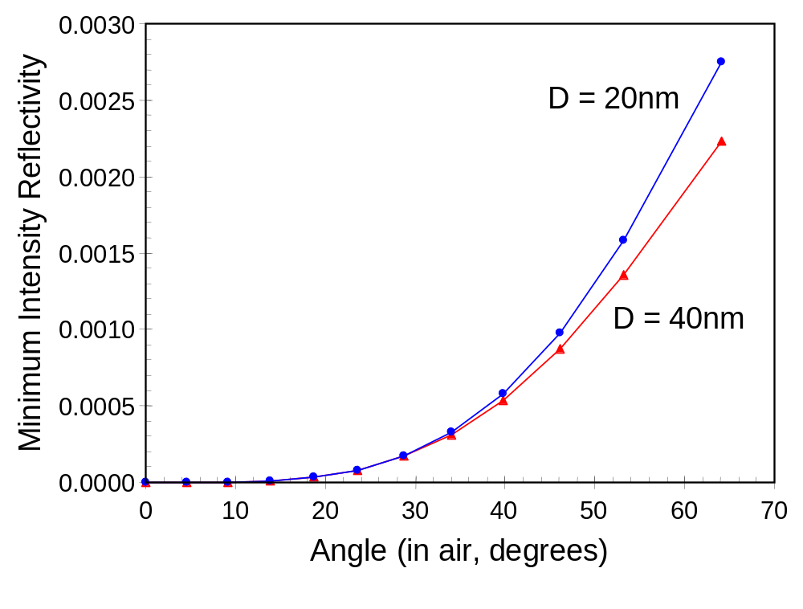
Figure 4.20 The best case (minimum) reflectivity (using the BARC parameters shown in Figure 4.19) of the substrate as a function of incident angle for 20nm and 40nm thick BARC films. Note that 60º corresponds to the maximum angle in air allowed for NA = 0.866.

Slide 21
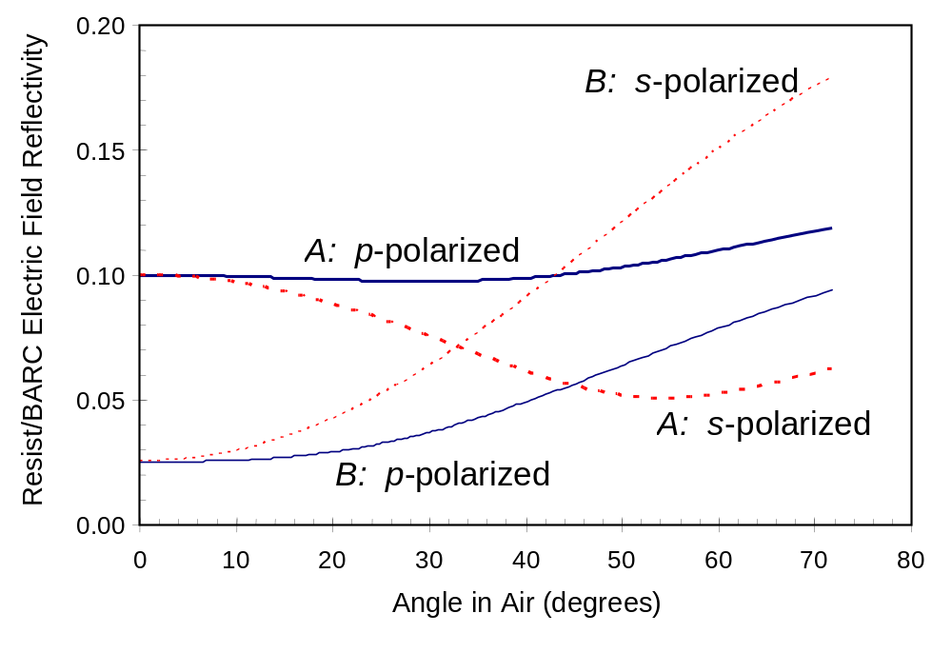
Figure 4.21 An example of the variation of BARC reflectivity as a function of light angle and polarization for two different BARCs. The intensity reflectivity is the square of the electric field reflectivity plotted here, but interference makes the field reflectivity a better measure of the standing wave effects. (Resist index = 1.7 + i0.01536, silicon substrate index = 0.8831 + i2.778, BARC A index = 1.80 + i0.48, BARC A thickness = 30 nm, BARC B index = 1.53 + i0.54, BARC B thickness = 39 nm.)

Slide 22
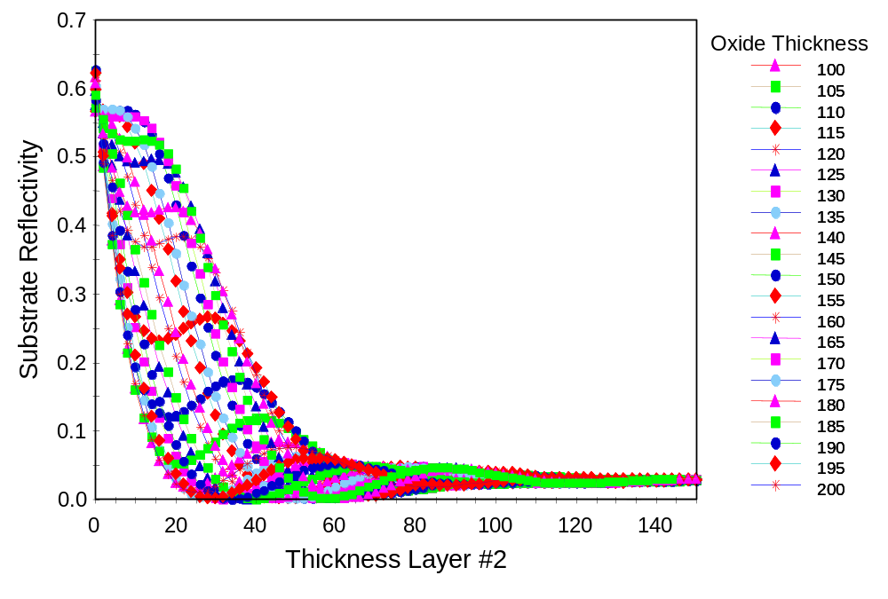
Figure 4.22 Substrate reflectivity versus BARC thickness over a range of underlying oxide thicknesses (oxide on top of a silicon substrate).

Slide 23
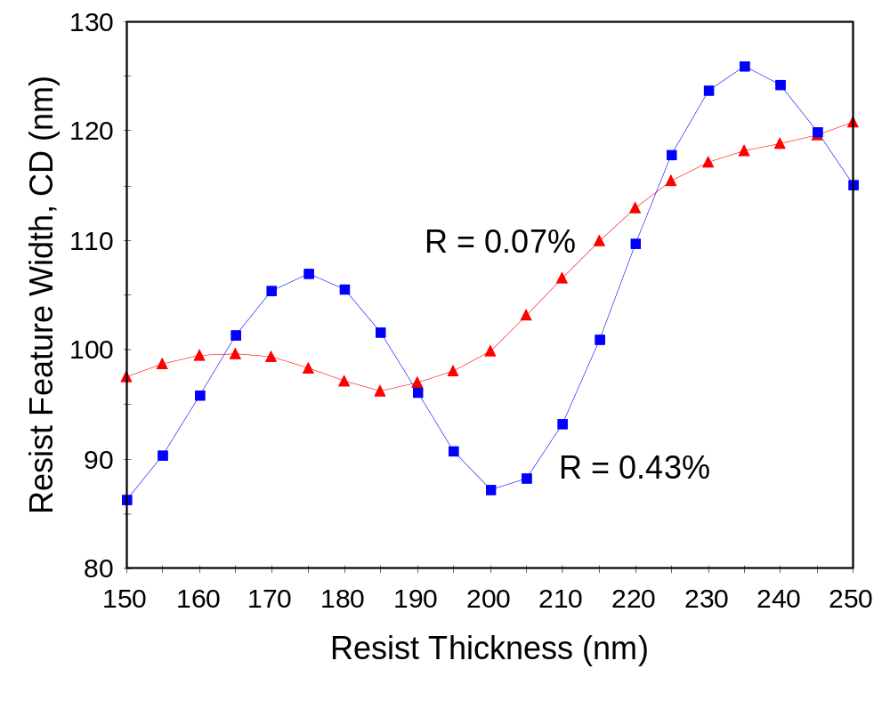
Figure 4.23 CD swing curves (100nm lines with a 280nm pitch are printed with a stepper using annular illumination, with a center sigma given by σNA = 0.54) for two different BARCs with different levels of optimization, as given by the resulting substrate reflectivity R.

Slide 24
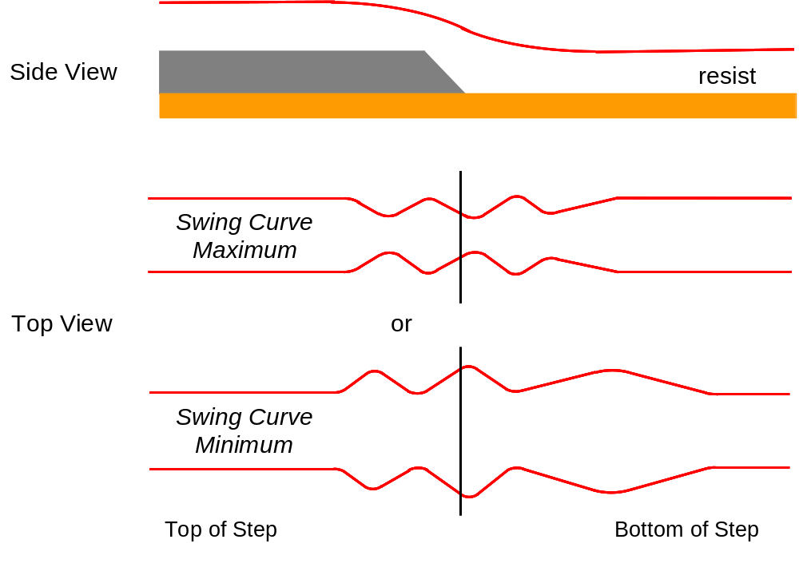
Figure 4.24 Example of how resist thickness variations over topography produce linewidth variations due to swing curve effects when a BARC is not used.

Slide 25
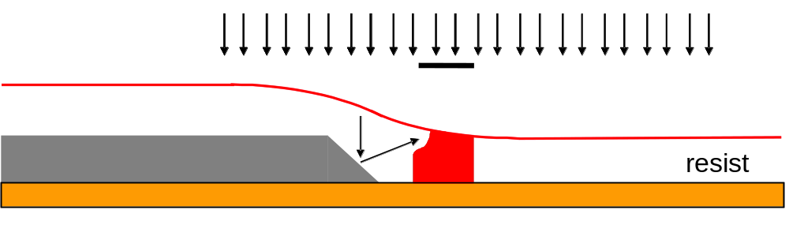
Figure 4.25 Reflective notching occurs when nearby topography reflects light obliquely into an adjacent photoresist feature.

Slide 26
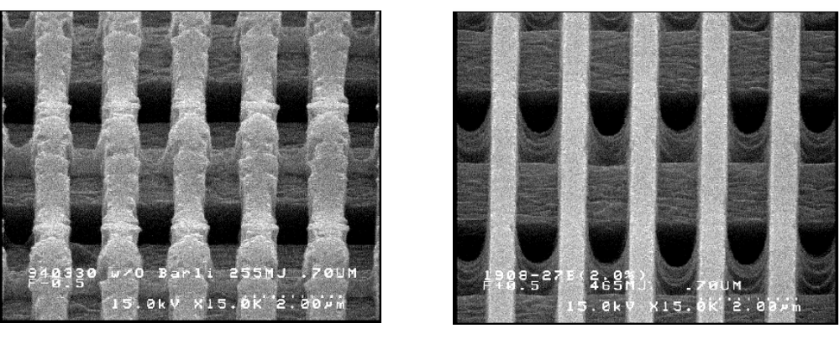
Figure 4.26 Imaging of lines and spaces over reflective topography without BARC (left) showing reflective notching, and with BARC (right) showing the reflective notching effectively suppressed (photos courtesy of AZ Photoresist, used with permission).

Slide 27
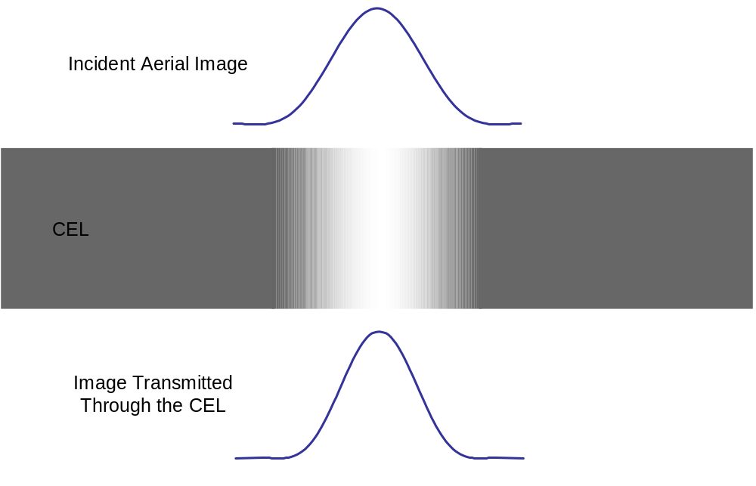
Figure 4.27 Contrast Enhancement Layer (CEL) bleaching improves the quality of the aerial image transmitted into the photoresist.

Slide 28
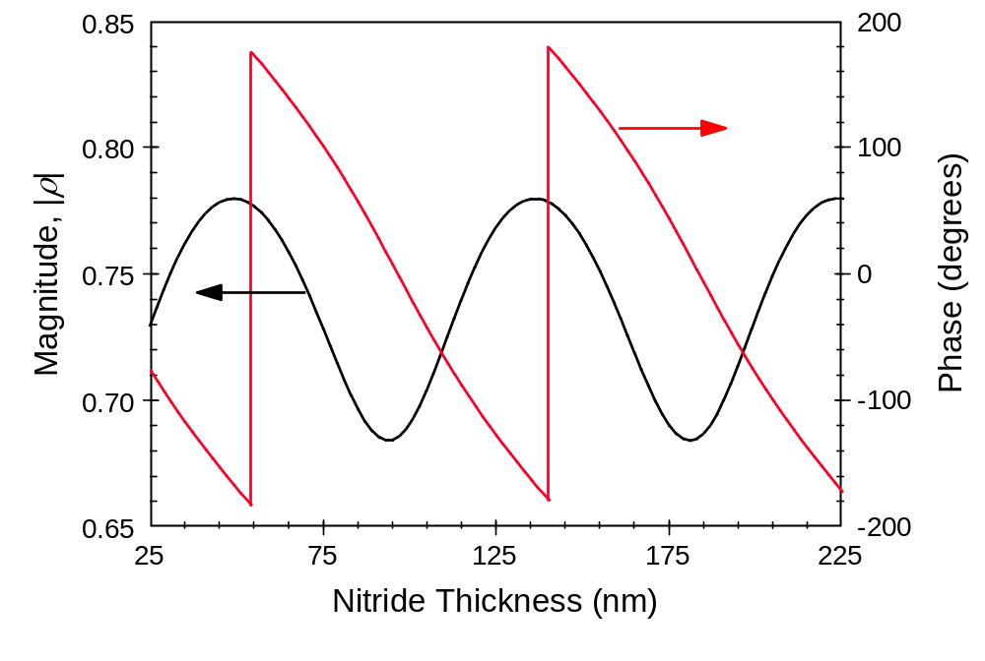
Figure 4.28 Variation of the magnitude and phase of the resist/substrate reflection coefficient as a function of silicon nitride thickness for a film stack of resist on nitride on 40 nm of oxide on silicon.

Slide 29
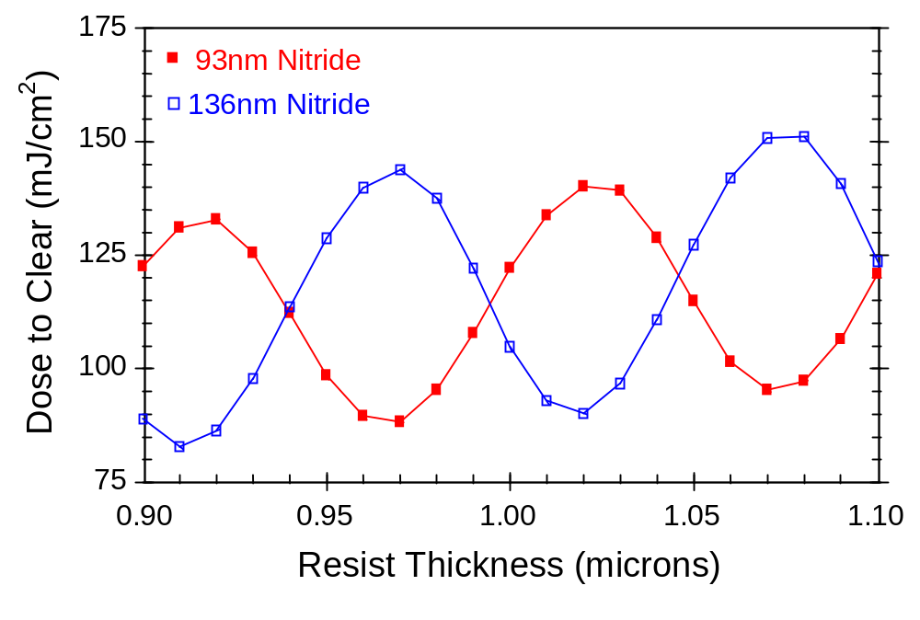
Figure 4.29 Changes in nitride thickness cause a shift in the phase of the resist swing curve, making nitride thickness control as critical as resist thickness control.

Slide 30
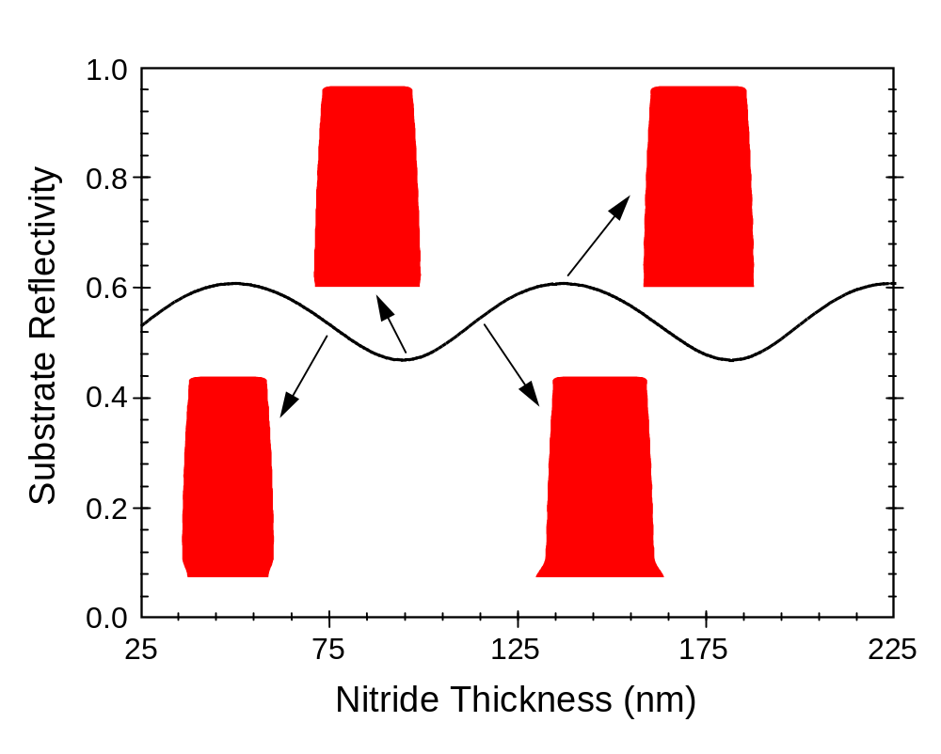
Figure 4.30 Nitride thickness also affects the shape of the resist profile, causing resist footing, undercuts, or vertical profiles. Substrate reflectivity (the square of the magnitude of the reflection coefficient) is shown for comparison.

Slide 31
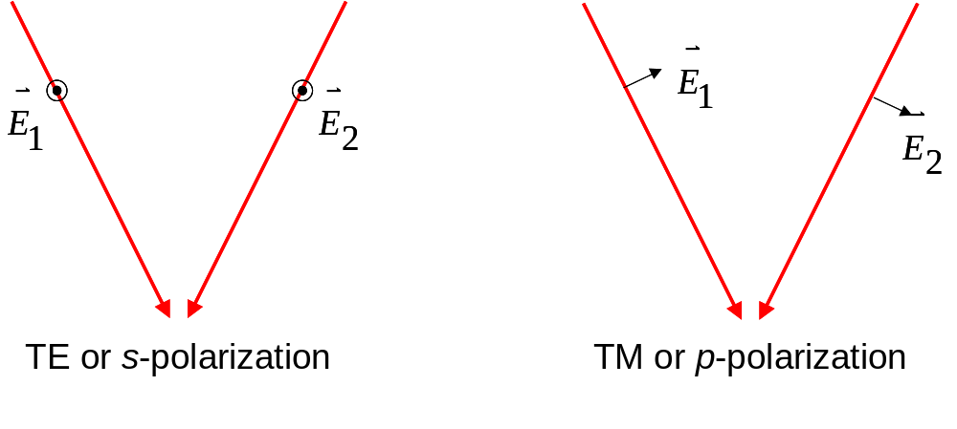
Figure 4.31 Two plane waves with different polarizations will interfere very differently. For transverse electric (TE) polarization (electric field vectors pointing out of the page), the electric fields of the two vectors overlap completely regardless of the angle between the interfering beams.

Slide 32
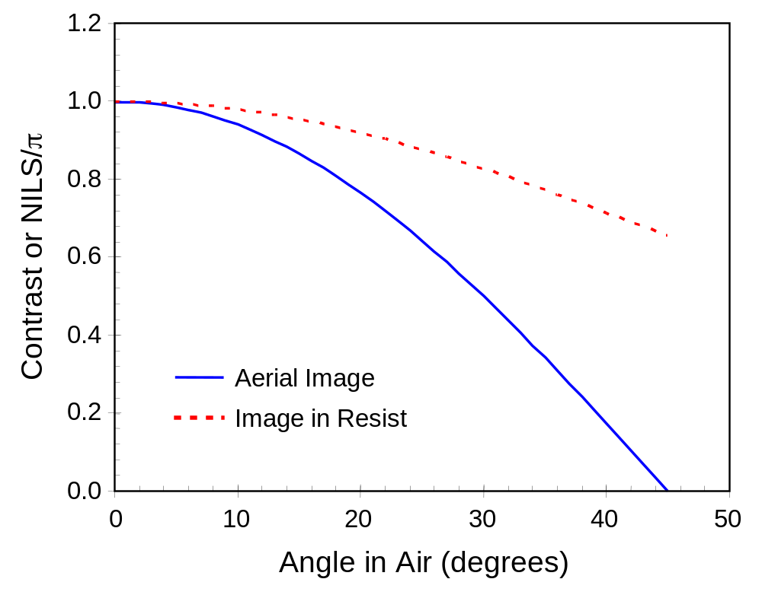
Figure 4.32 The interference between two TM polarized planes waves produces an image whose contrast and NILS depends on the angle. Since the angle in resist is reduced by refraction, the contrast and NILS of the image in resist is better than the aerial image.

Slide 33
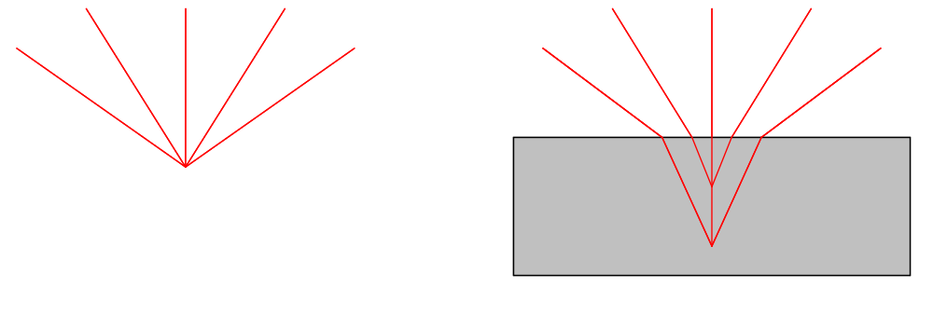
(a)
(b)
Figure 4.33 Focusing of plane waves arriving at different angles a) in air, and b) in resist, showing that the resist induces spherical aberration.

Slide 34
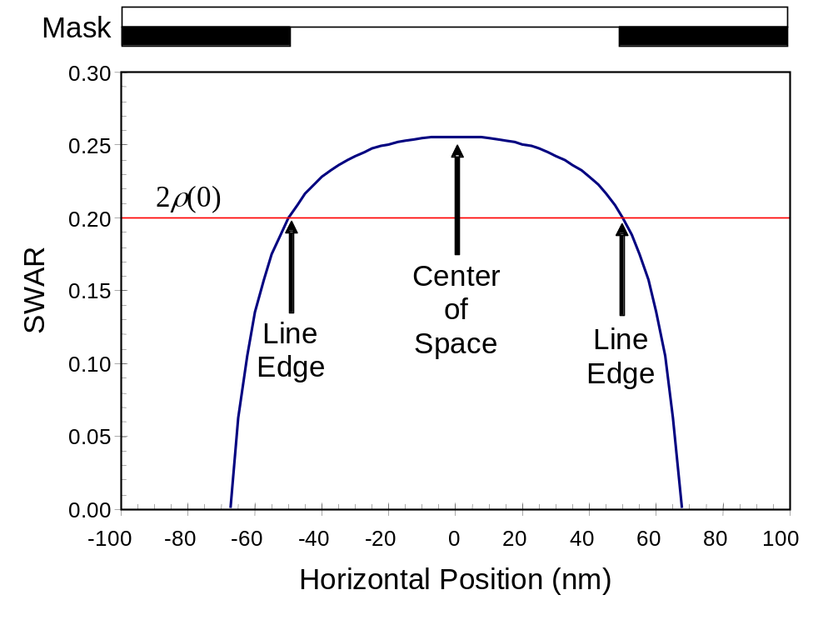
Figure 4.34 The standing wave amplitude ratio (SWAR) at different positions on the feature for coherent three-beam imaging and s-polarization. For this example of three-beam imaging of 100 nm lines and spaces, a_{o} = 0.5, a₁ = 0.3183.

Slide 35
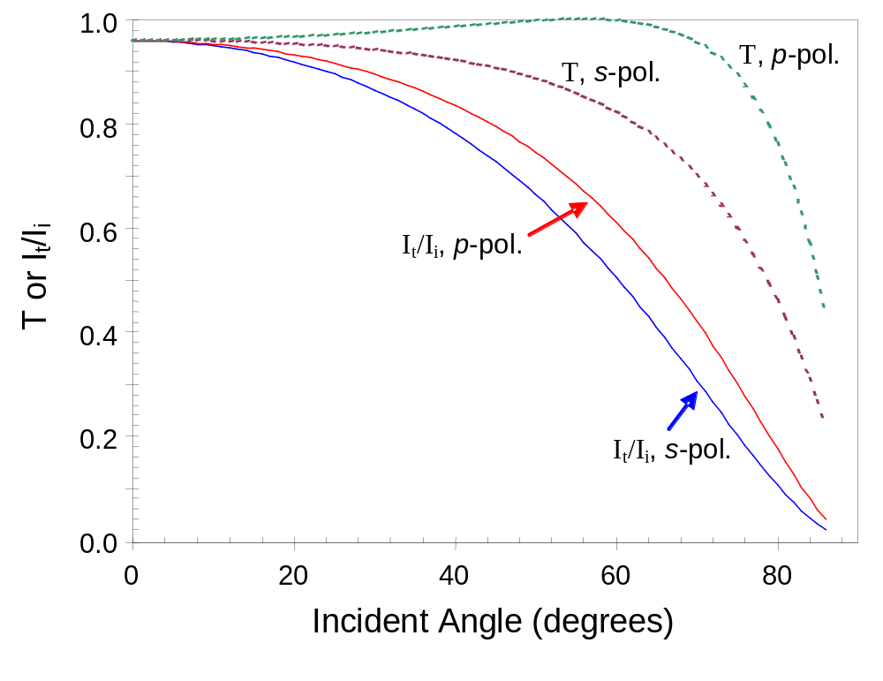
Figure 4.35 Intensity transmitted into layer 2 relative to the incident intensity (solid lines) and the transmittance T (dashed lines) as a function of the angle of incidence for both s and p polarization (n₁ = 1.0, n₂ = 1.5).

