Slide 1
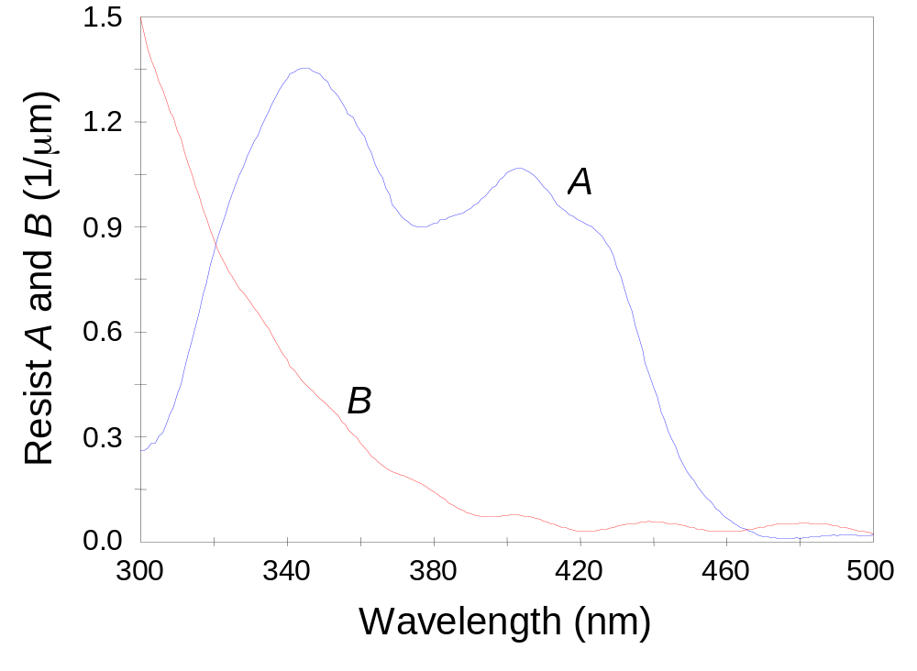
Figure 5.1 Resist parameters A and B as a function of wavelength measured with a UV spectrophotometer for a typical g-line resist (a 5-arylsulfonate DNQ).

Slide 2
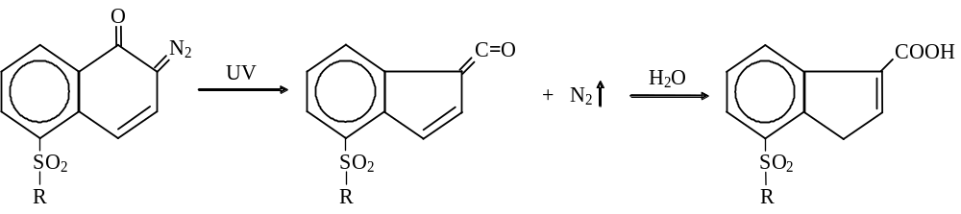
Equation (5.21) – DNQ exposure mechanism

Slide 3
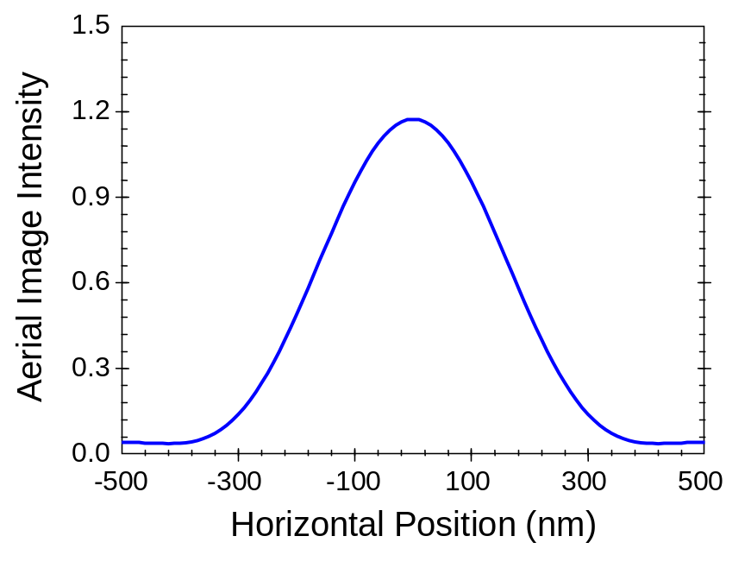
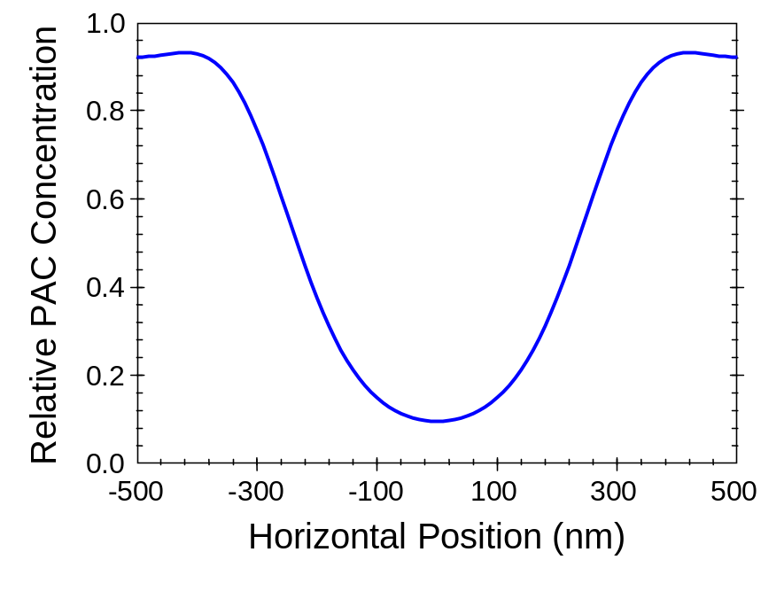
(a)
(b)
Figure 5.2 The exposure process takes an aerial image (a) and converts it into a latent image (b).

Slide 4
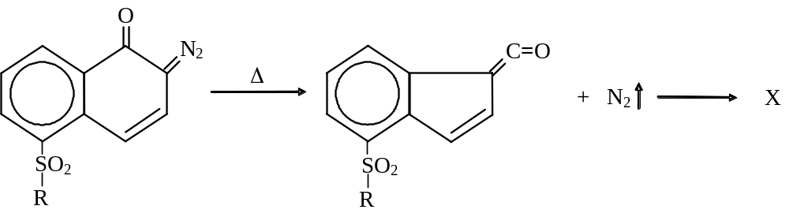
Equation (5.36) – Thermal decomposition of DNQ

Slide 5
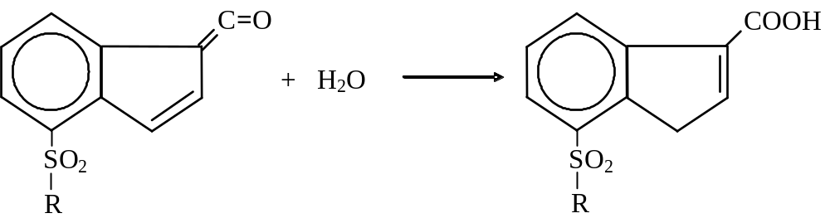
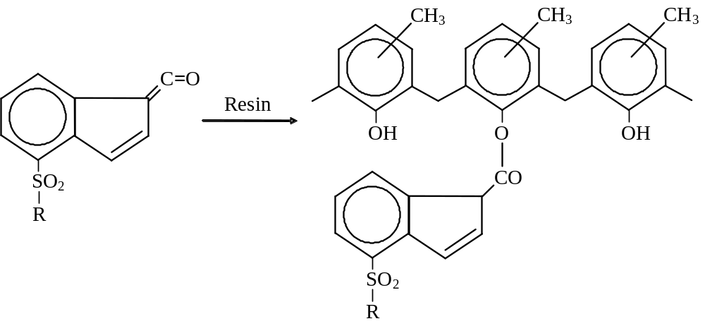
Equations (5.46) and (5.47) – DNQ thermal decomposition products

Slide 6
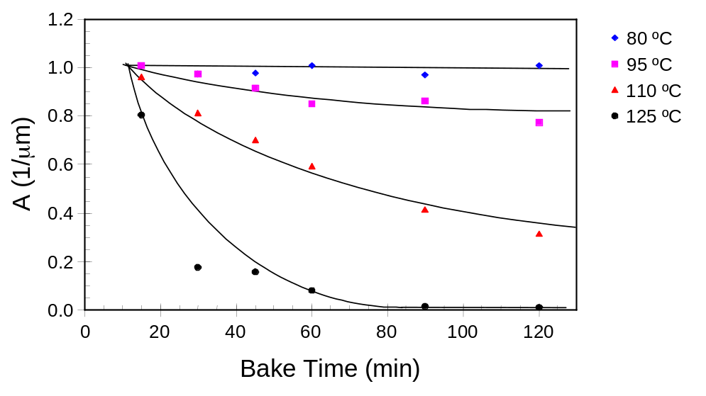
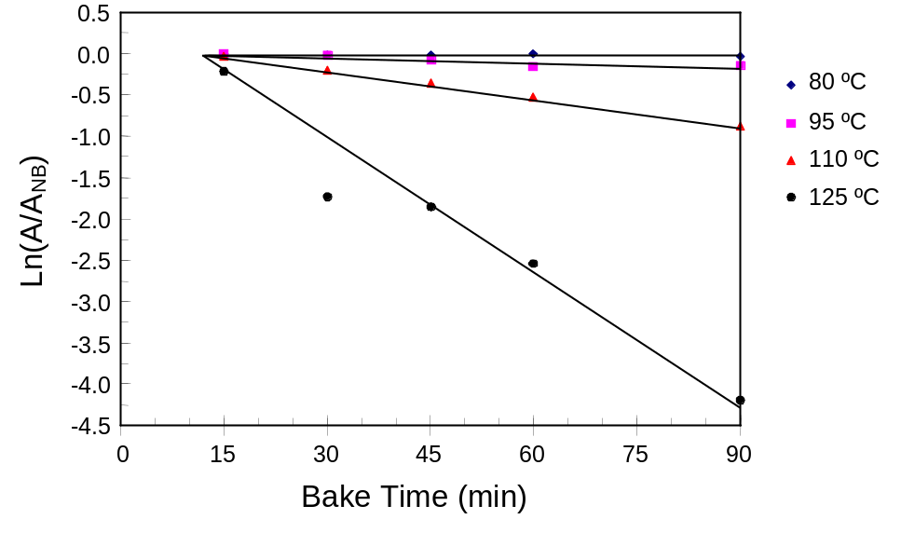
(a)
(b)
Figure 5.3 The variation of the resist absorption parameter A with post-apply bake time and temperature for Kodak 820 resist at 365 nm (a convection oven bake was used): a) linear plot, and b) logarithmic plot.

Slide 7
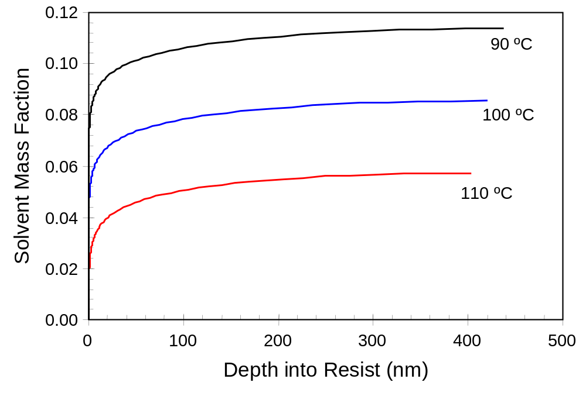
Figure 5.4 Predicted variation of solvent concentration as a function of depth into the resist at the end of a 60 s post-apply bake.

Slide 8
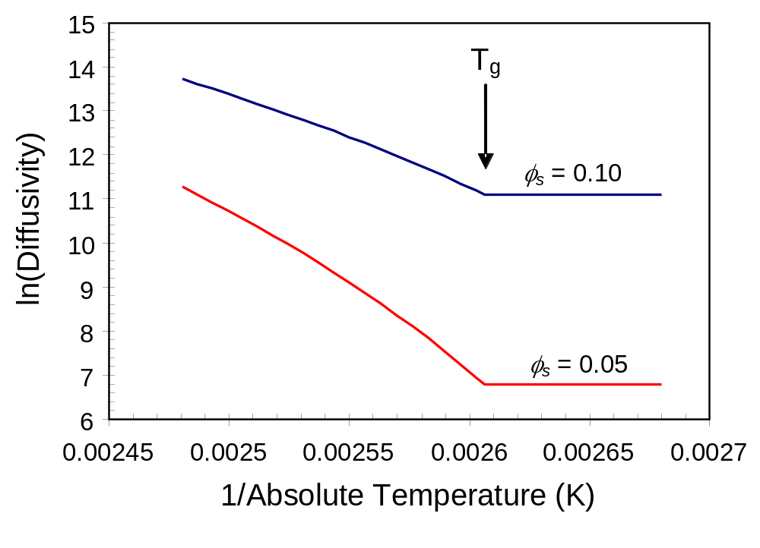
Figure 5.5 Temperature dependence of solvent diffusivity (using the parameters from Table 5.1 and assuming a solvent mass fractions of 0.05 and 0.1) showing an essentially fixed diffusivity below the glass transition temperature.

Slide 9
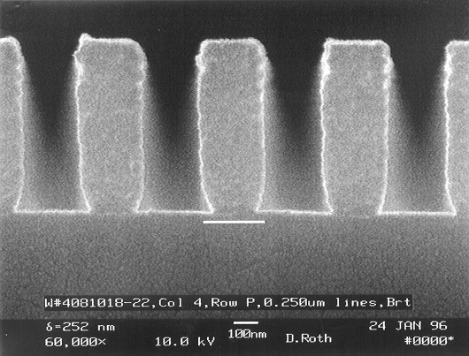
Figure 5.6 Lower solvent content at the top of this 248 nm resist leads to reduced acid diffusion during PEB, and thus the presence of standing waves only at the top of the resist (photo courtesy of John Petersen, used with permission).

Slide 10


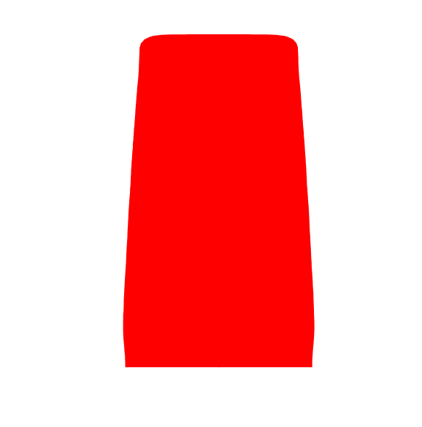
(a)
(b)
(c)
Figure 5.7 Typical i-line photoresist profile simulations (using PROLITH) for resist on silicon as a function of the PEB diffusion length: (a) 20nm, (b) 40nm, and (c) 60nm.

Slide 11
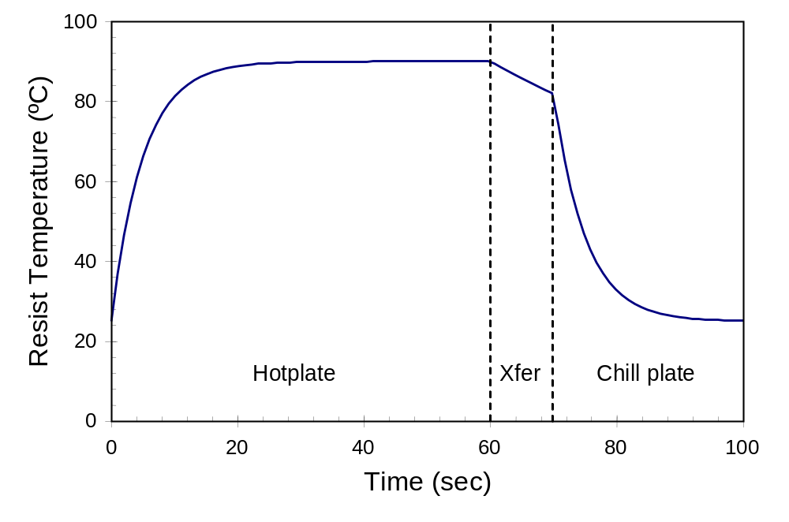
Figure 5.8 Typical wafer bake profile (60 s bake followed by a 10 s transfer to a chill plate).

Slide 12
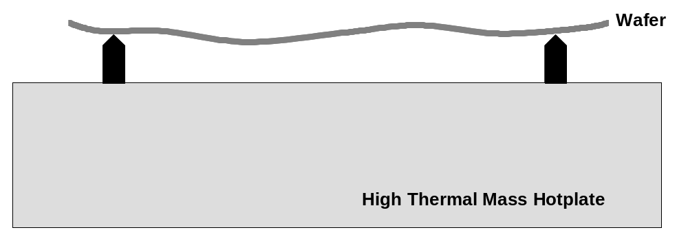
Figure 5.9 Proximity bake of a wafer on a hot plate showing (in a highly exaggerated way) how wafer warpage leads to a variation in proximity gap (drawing not to scale).

Slide 13
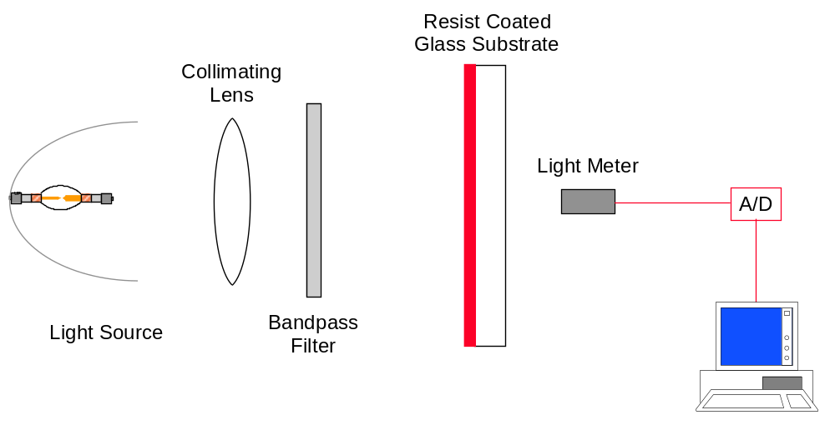
Figure 5.10. Experimental configuration for the measurement of the ABC parameters.

Slide 14
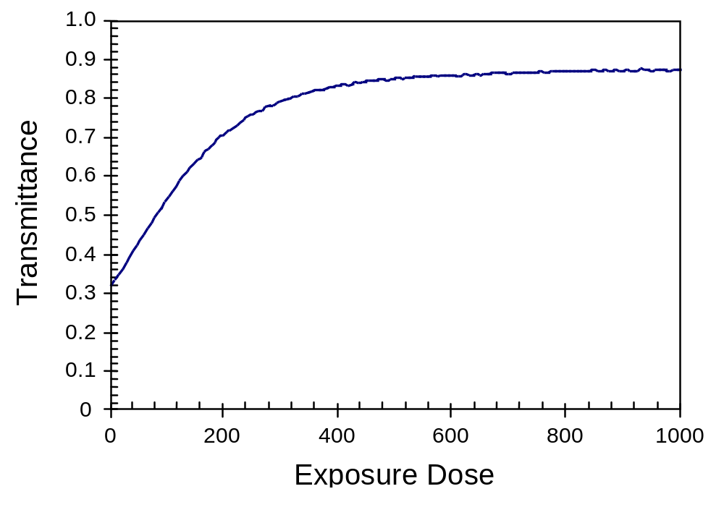
Figure 5.11. Typical transmittance curve of a positive g- or i-line bleaching photoresist measured using an apparatus similar to that pictured in Figure 5.10.

Slide 15
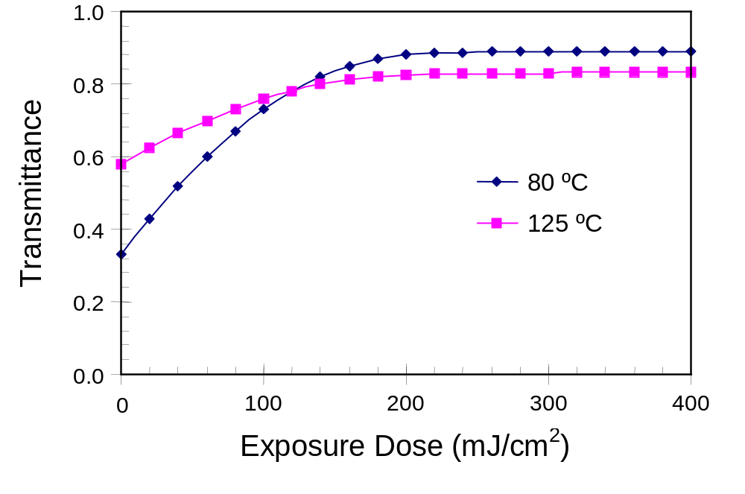
Figure 5.12. Two transmittance curves for Kodak 820 resist at 365 nm. The curves are for a convection oven post-apply bake of 30 minutes at the temperatures shown.

