Slide 1
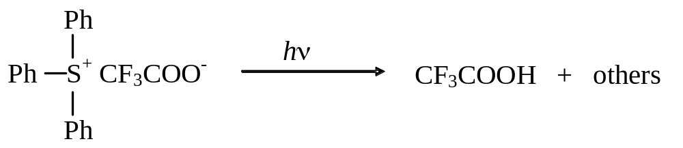
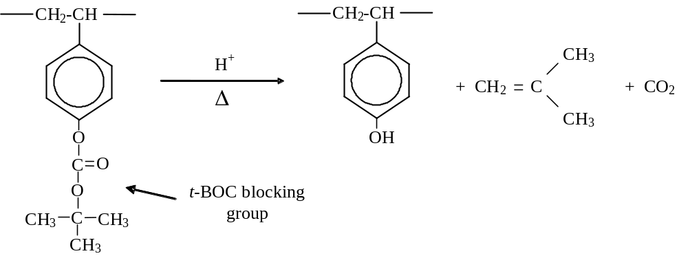
PAG Exposure:
(6.1)
Deprotection:
(6.5)

Slide 2
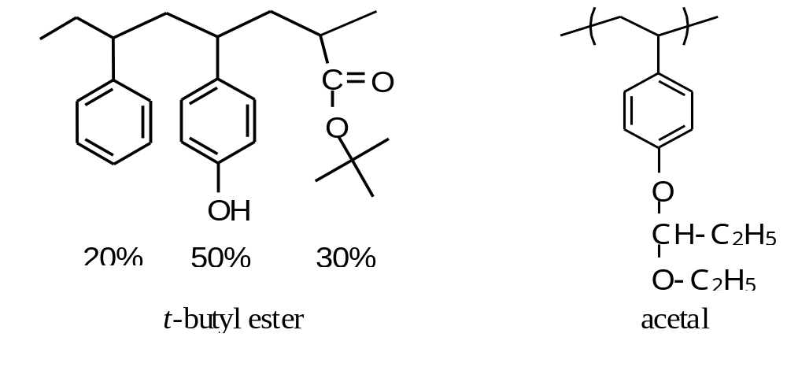
Figure 6.1. Examples of 248-nm blocking groups: the high activation t-butyl ester; and the low activation acetal.

Slide 3
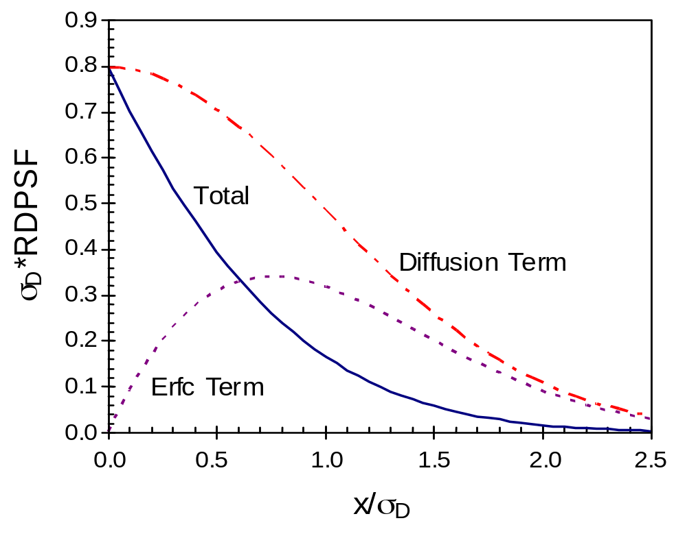
Figure 6.2. The 1D reaction−diffusion point spread function (RDPSF) and its component terms.

Slide 4
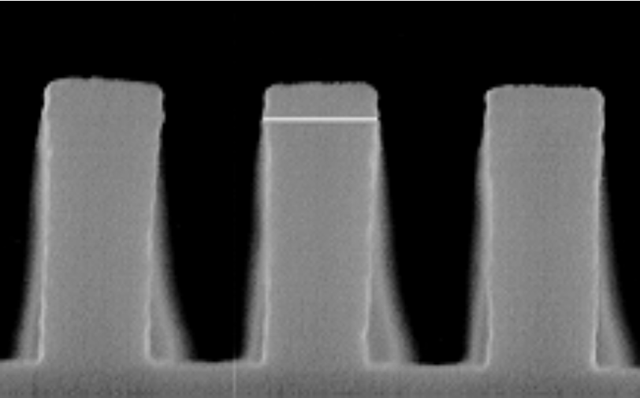
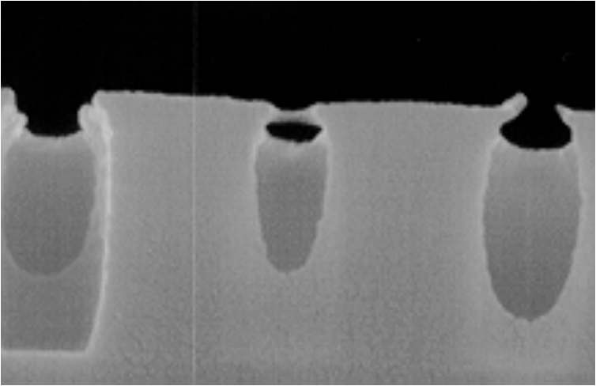
(a)
(b)
Figure 6.3. Atmospheric base contamination leads to T-top formation. Shown are line/space features printed in APEX-E for: (a) 0.275 mm features with no delay; and (b) 0.325 mm features with 10 minute delay between exposure and post-exposure bake (courtesy of SEMATECH).

Slide 5
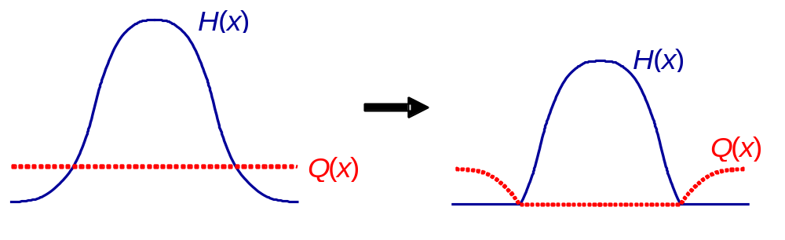
(a)
(b)
Figure 6.4. The effect of quencher (Q) on the acid latent image H(x): (a) after exposure but before the quenching reaction; and (b) after the quenching reaction (assuming K_{quench} » K_{amp}).

Slide 6
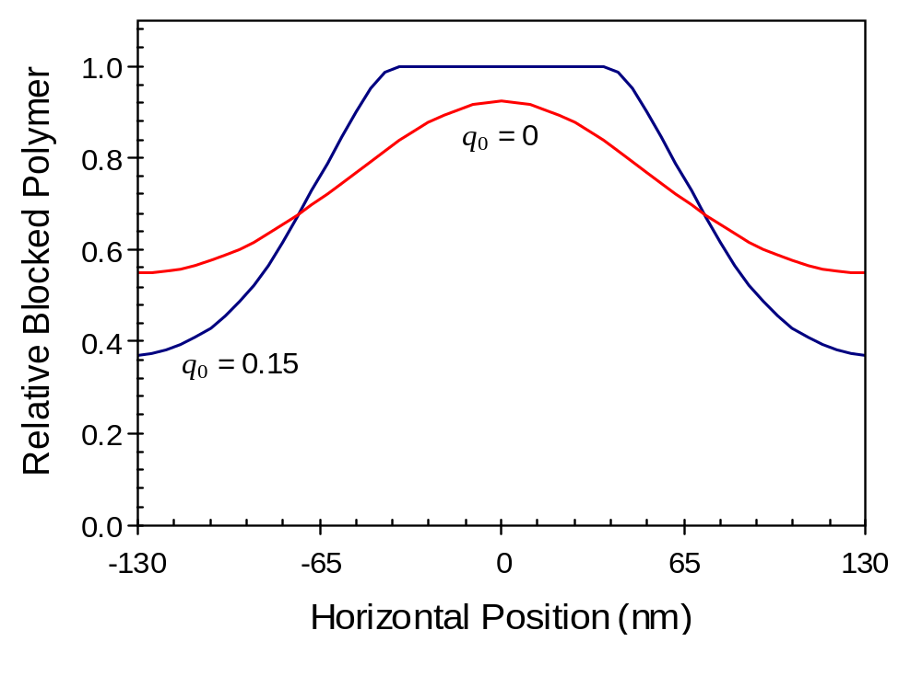
Figure 6.5. The effect of quencher on the shape of the latent image. Both resists have identical processing, except that the dose for each is adjusted to be the dose to size (130 nm lines and spaces).

Slide 7
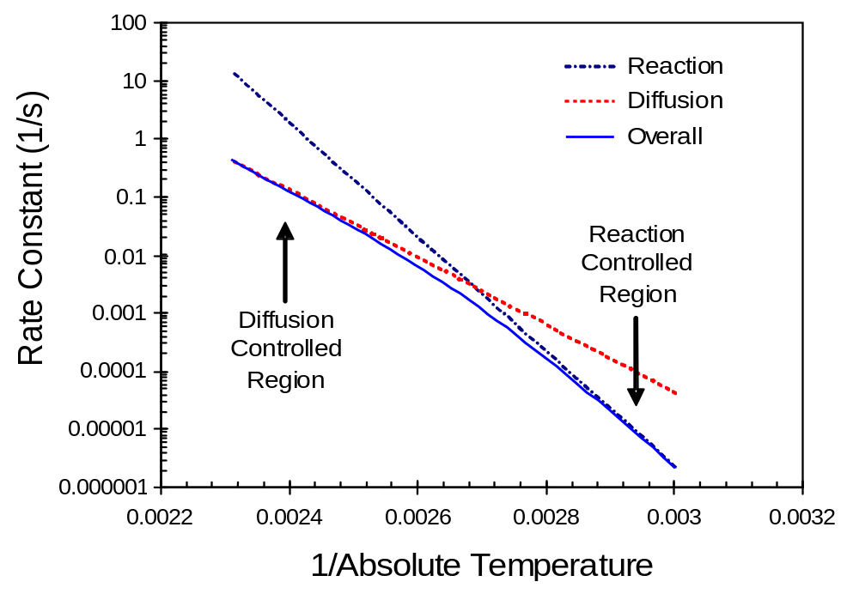
Figure 6.6. An Arrhenius plot (log of the rate constant versus the inverse of absolute temperature) for K_{amp} when the diffusion and amplification rate constants have different activation energies (diffusion activation energy = 26.5 kcal/mol, reaction activation energy = 45 kcal/mol).

Slide 8
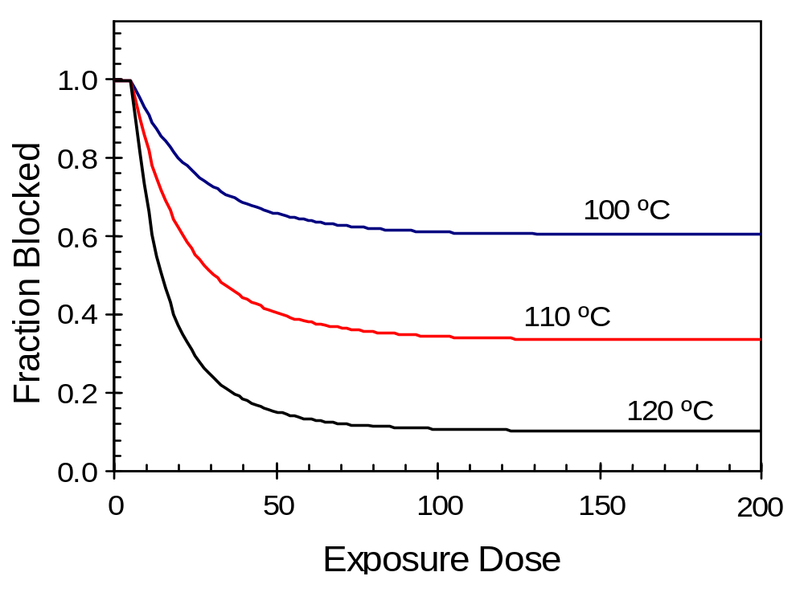
Figure 6.7. Example of PEB amplification kinetics measured by using thickness loss after PEB to estimate the fraction of polymer that remains blocked.

Slide 9
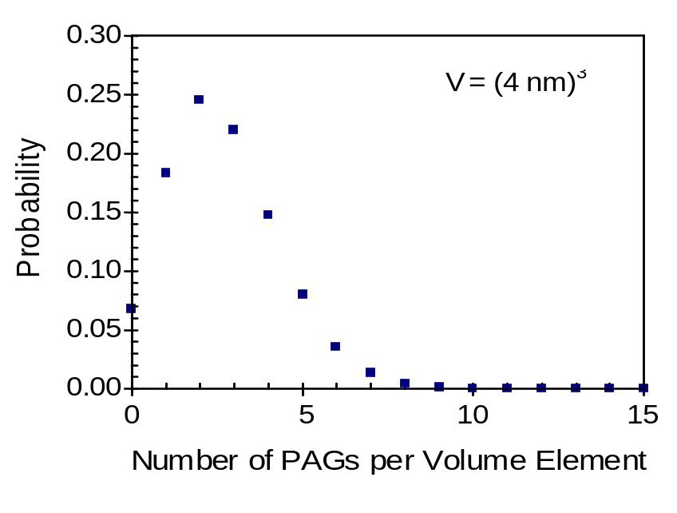
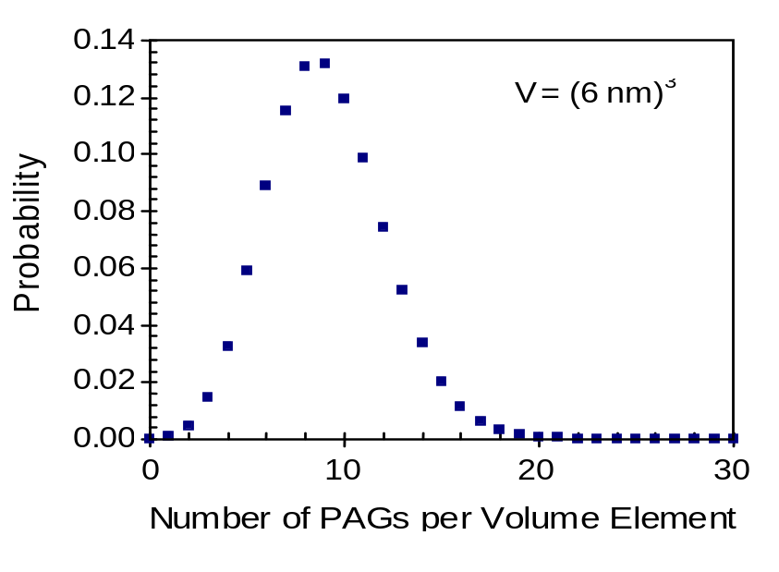
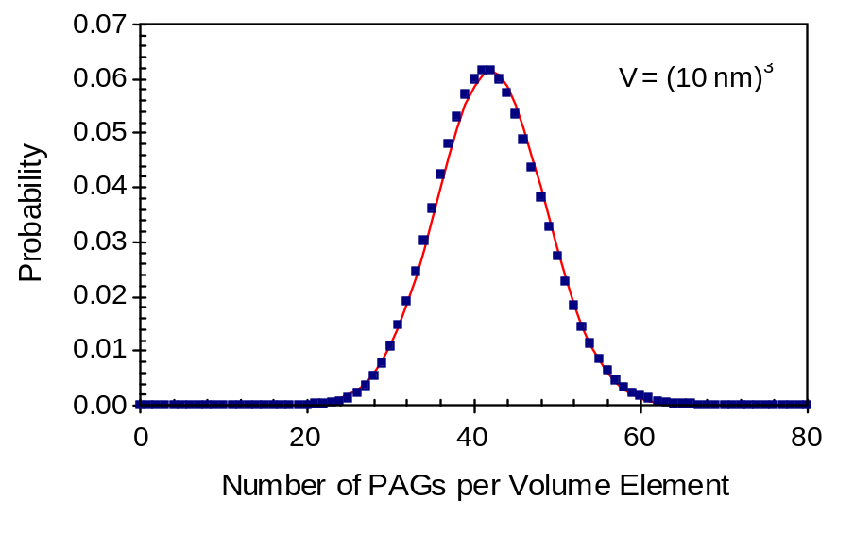
Figure 6.8. Example Poisson distributions for a typical 193-nm resist (G₀NA = 0.042 /nm³): a) volume of 64 nm³; b) volume of 216 nm³; and c) volume of 1000 nm³. For (c), a Gaussian distribution with the same standard deviation as the Poisson distribution is shown as a solid line.

Slide 10
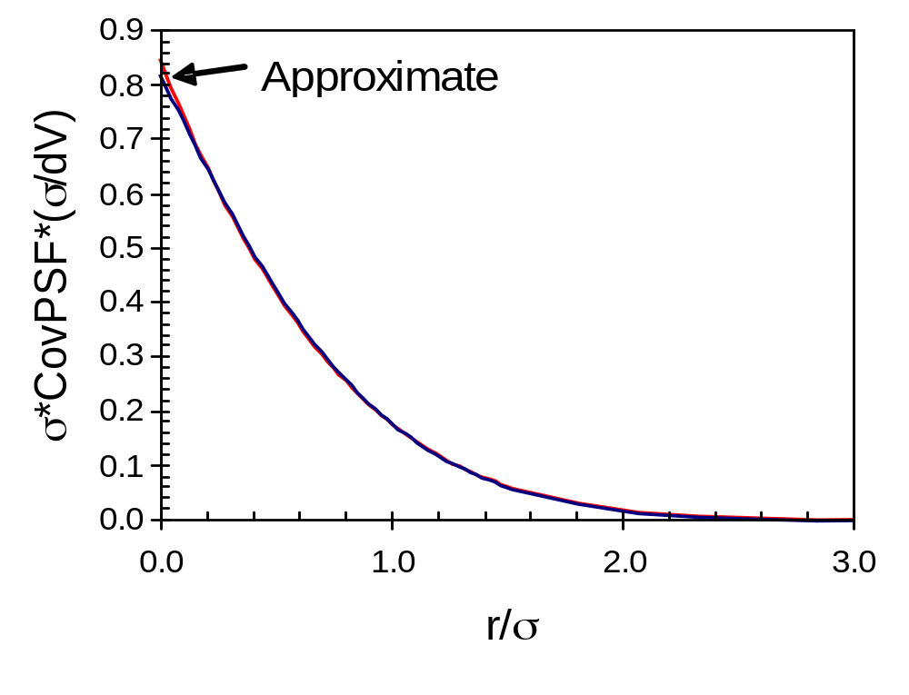
Figure 6.9. Comparison of the approximate 1D CovPSF of equation (6.97) with a numerical evaluation of the defining integral in equation (6.94).

Slide 11
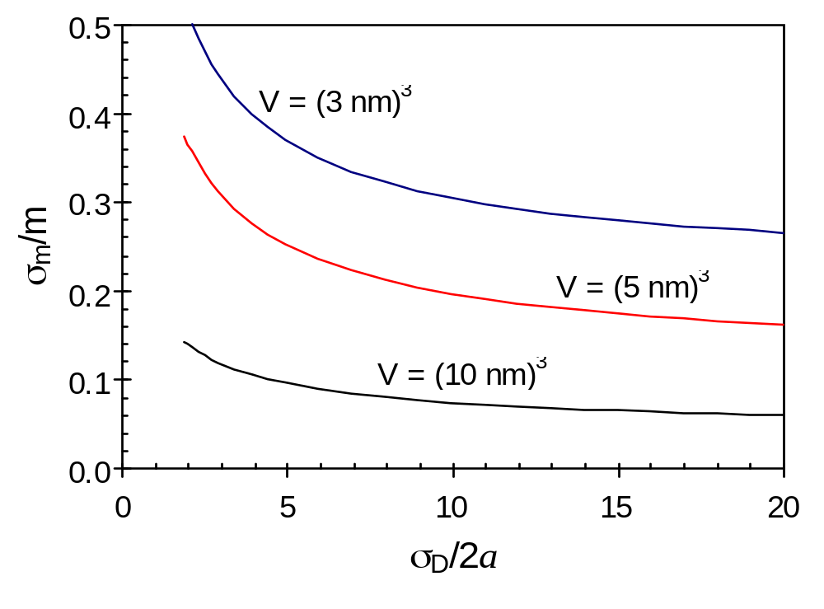
Figure 6.10. The relative uncertainty of the relative blocked polymer concentration as a function of the volume (= length cubed) under consideration and the diffusion length of acid for a two-dimensional problem. Typical 193-nm resist values were used: G₀NA = 0.042 /nm³, M₀NA = 1.2 /nm³, K_{amp}t_{PEB} = 2, and for an exposure such that <h> = 0.4.

