Slide 1
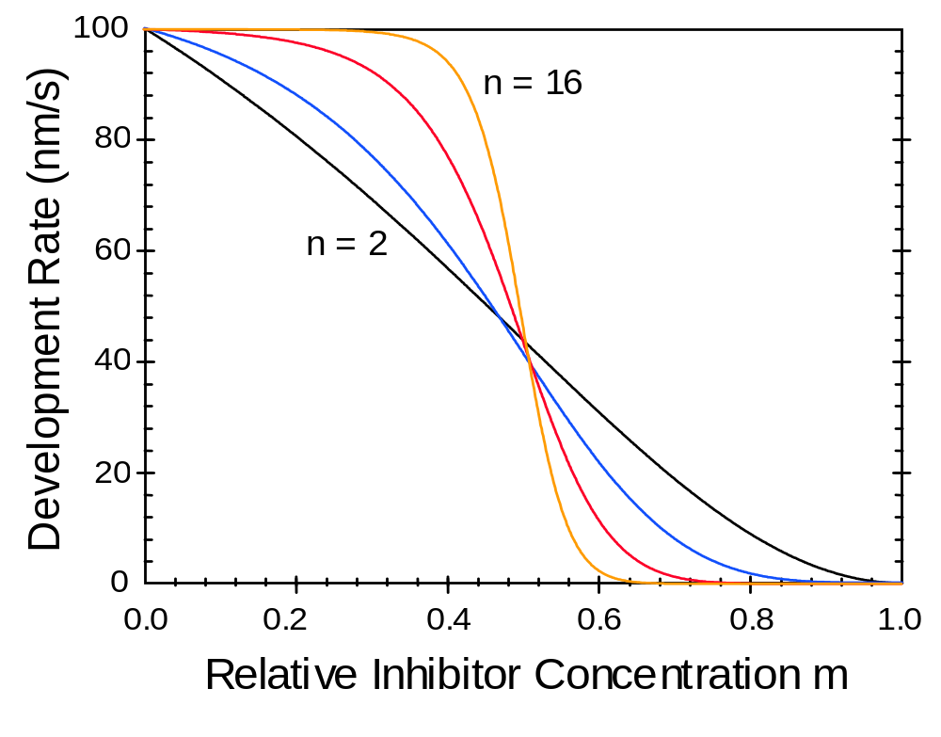
Figure 7.1 Development rate plot of the original kinetic model as a function of the dissolution selectivity parameter (r_{max} = 100 nm/s, r_{min} = 0.1 nm/s, m_{th} = 0.5, and n = 2, 4, 8, and 16).

Slide 2
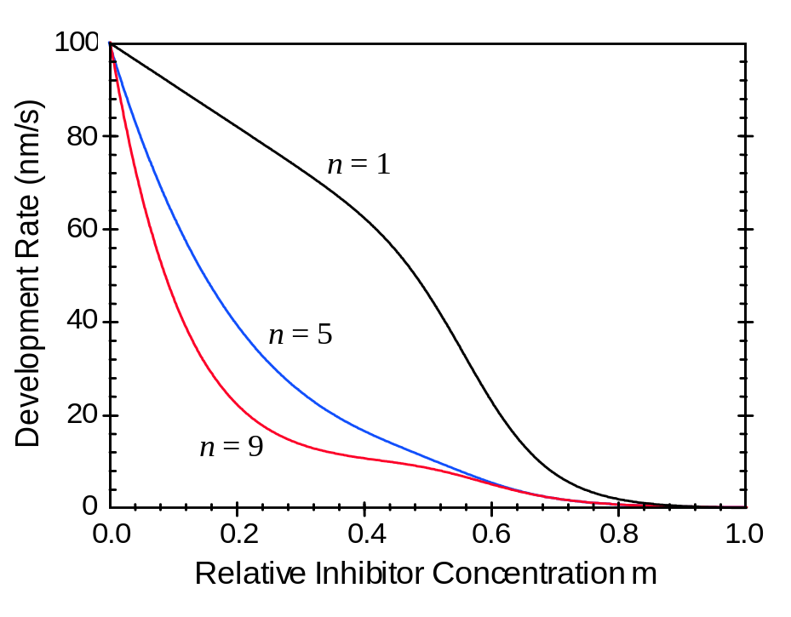
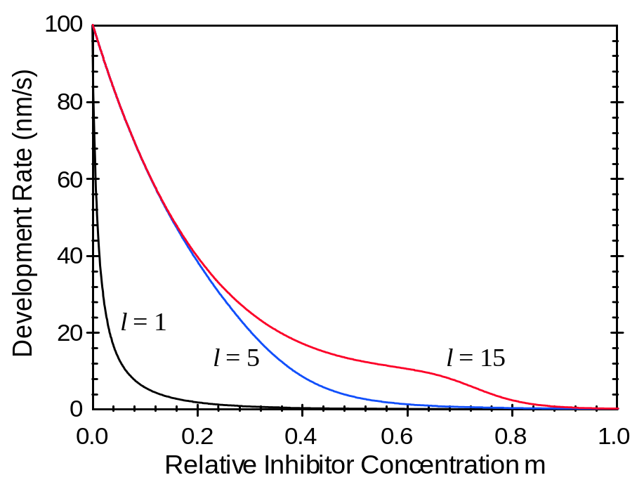
(a)
(b)
Figure 7.2 Plots of the enhanced kinetic development model for r_{max} = 100 nm/s, r_{resin} = 10 nm/s, r_{min} = 0.1 nm/s with: (a) l = 9; and (b) n = 5.

Slide 3
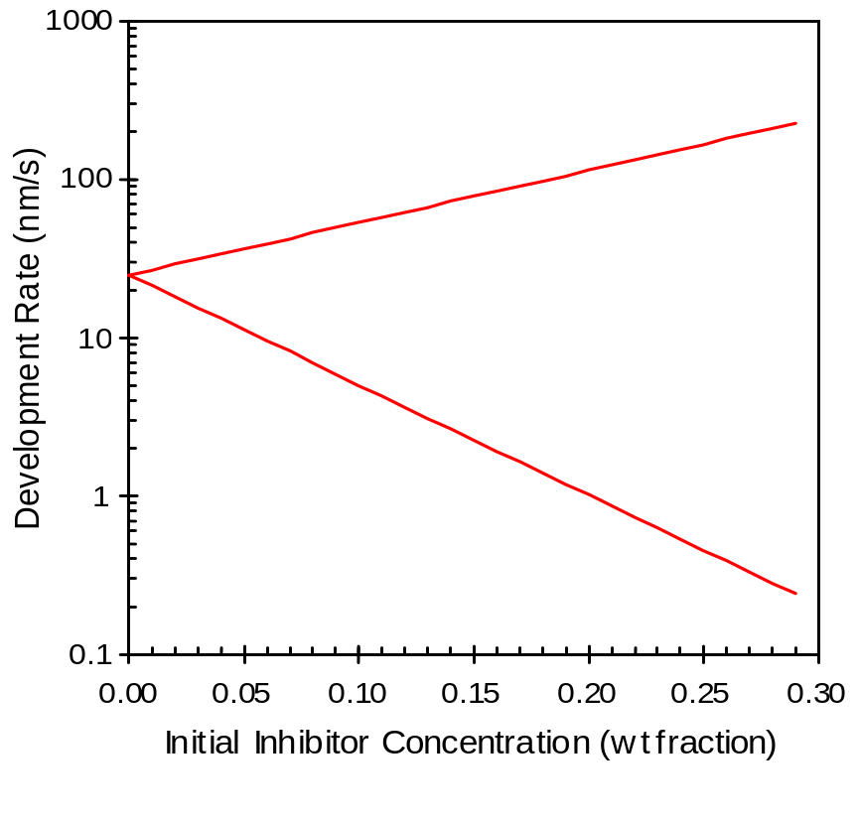
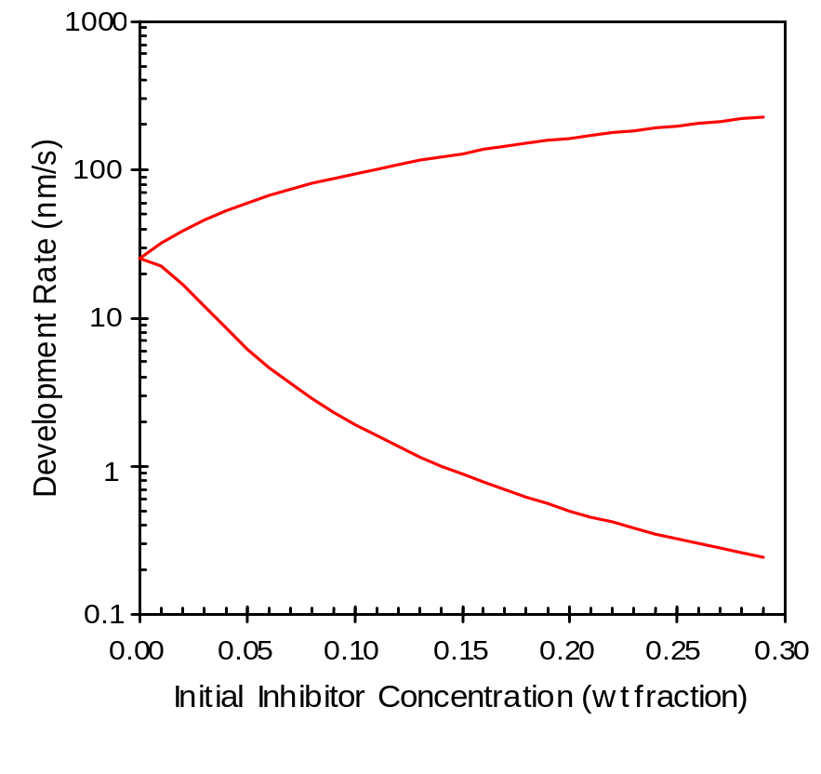
(a)
(b)
Figure 7.3 An example of a Meyerhofer plot, showing how the addition of increasing concentrations of inhibitor increases r_{max} and decreases r_{min}: a) idealized plot showing a log-linear dependence on initial inhibitor concentration, and b) the enhanced kinetic model assuming k_{enh} ∝ M₀ and k_{inh} ∝ M₀².

Slide 4
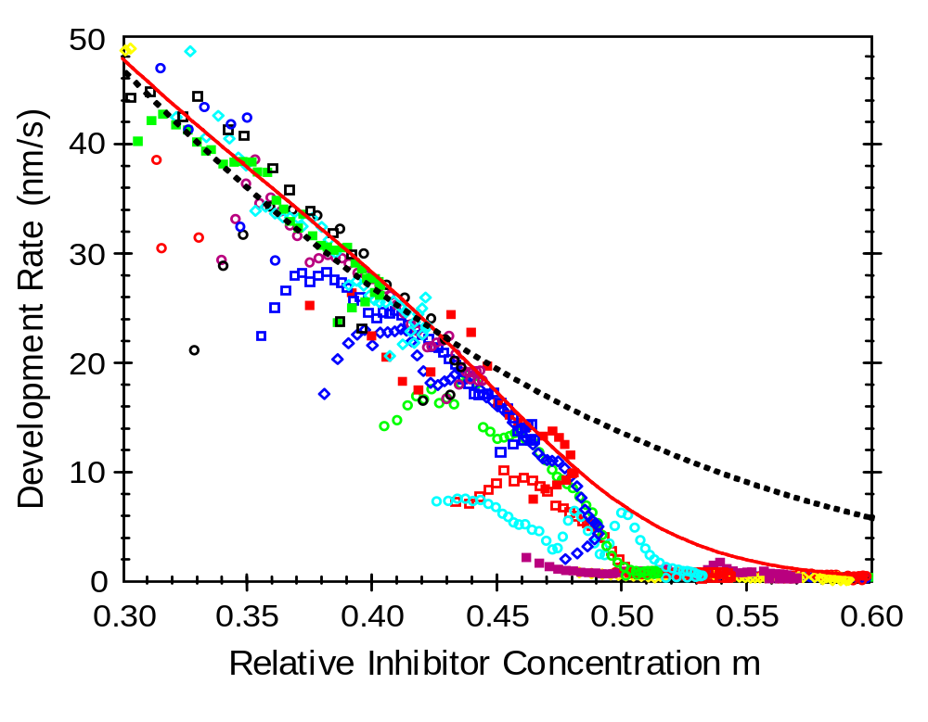
Figure 7.4 Comparison of experimental dissolution rate data (symbols) exhibiting the so-called ‘notch’ shape to best fits of the original (dotted line) and enhanced (solid line) kinetic models. The data shows a steeper drop in development rate at about 0.5 relative inhibitor concentration than either model predicts.

Slide 5
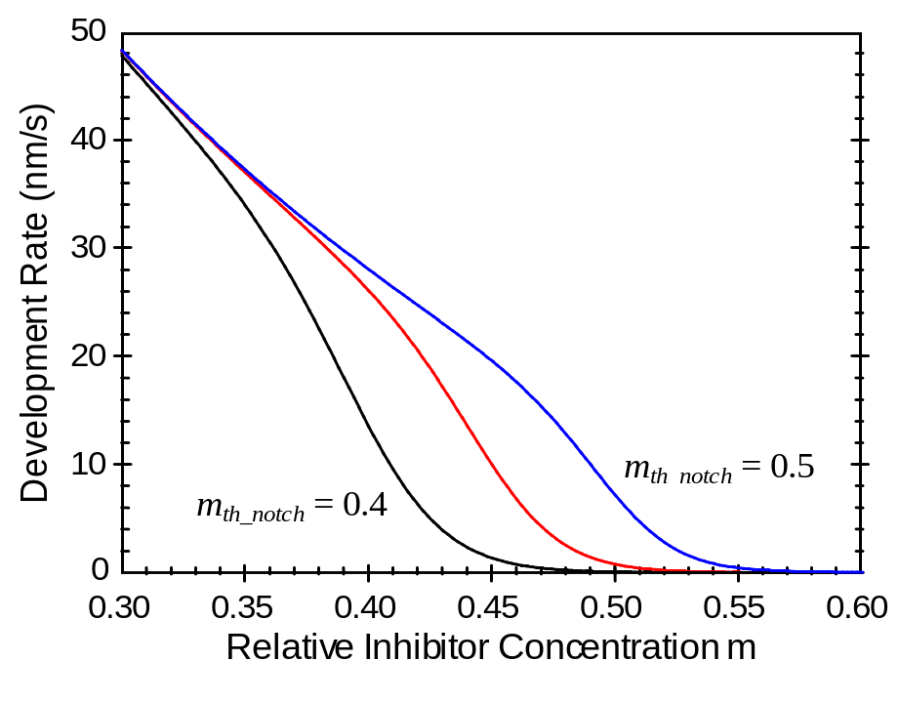
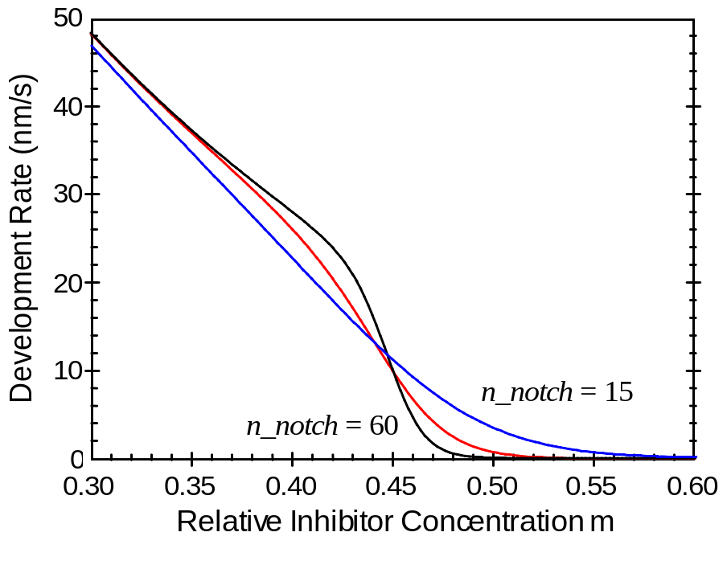
(a)
(b)
Figure 7.5 Plots of the notch model: (a) m_{th_notch} equal to 0.4, 0.45, and 0.5 with n_notch equal to 30; and (b) n_notch equal to 15, 30, and 60 with m_{th_notch} equal to 0.45.

Slide 6
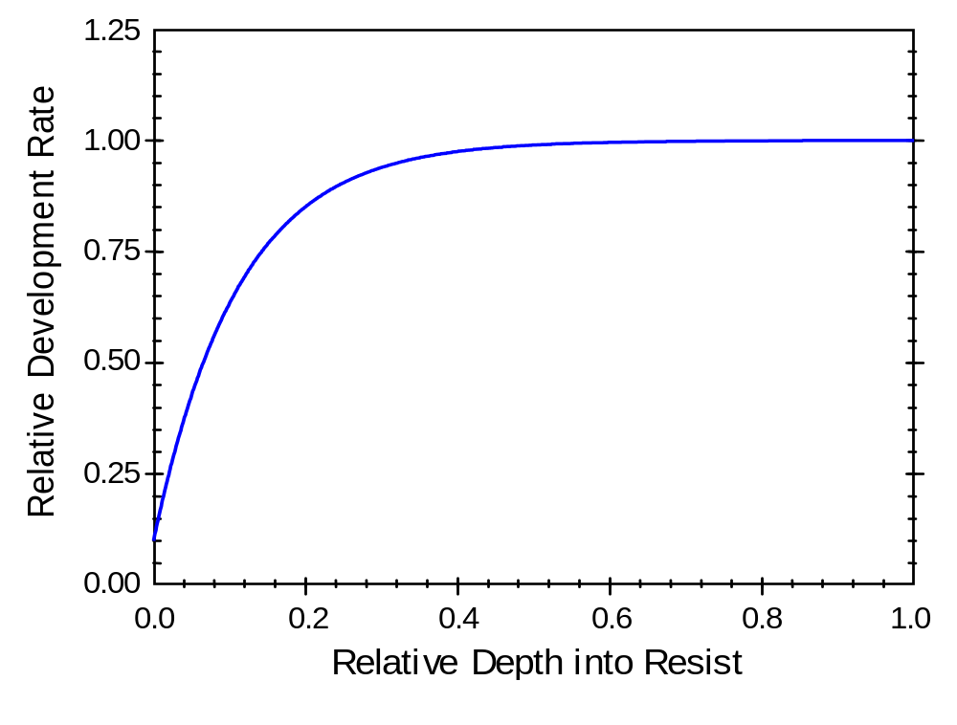
Figure 7.6 Example surface inhibition with r₀ = 0.1 and d = 100 nm for a 1000 nm thick resist.

Slide 7
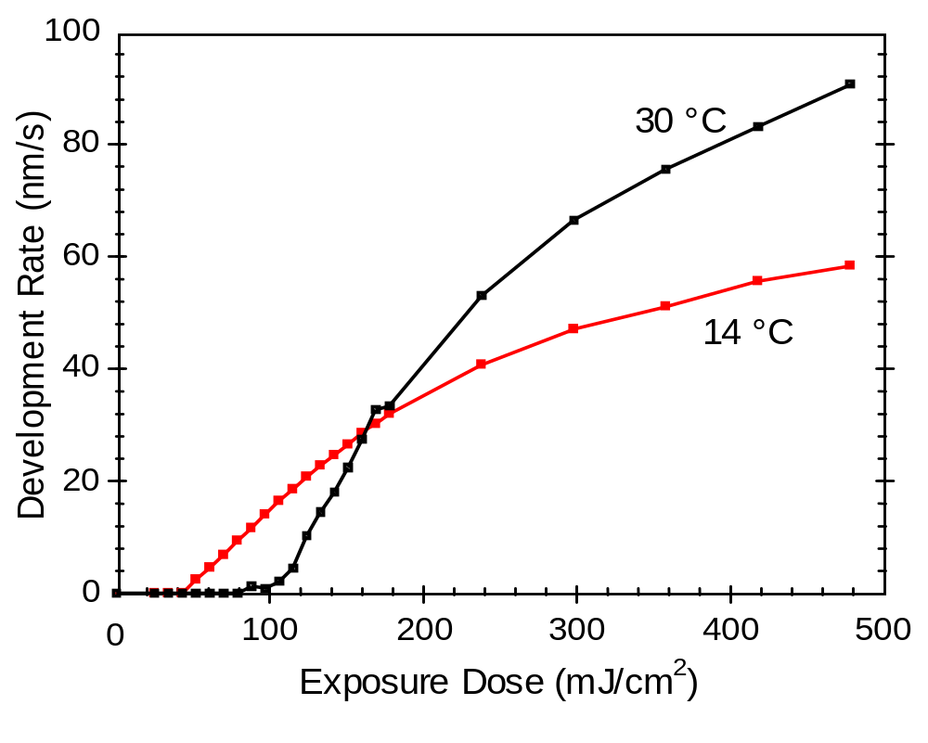
Figure 7.7 Development rate of THMR-iP3650 (averaged through the middle 20% of the resist thickness) as a function of exposure dose for different developer temperatures shows a change in the shape of the development dose response.

Slide 8
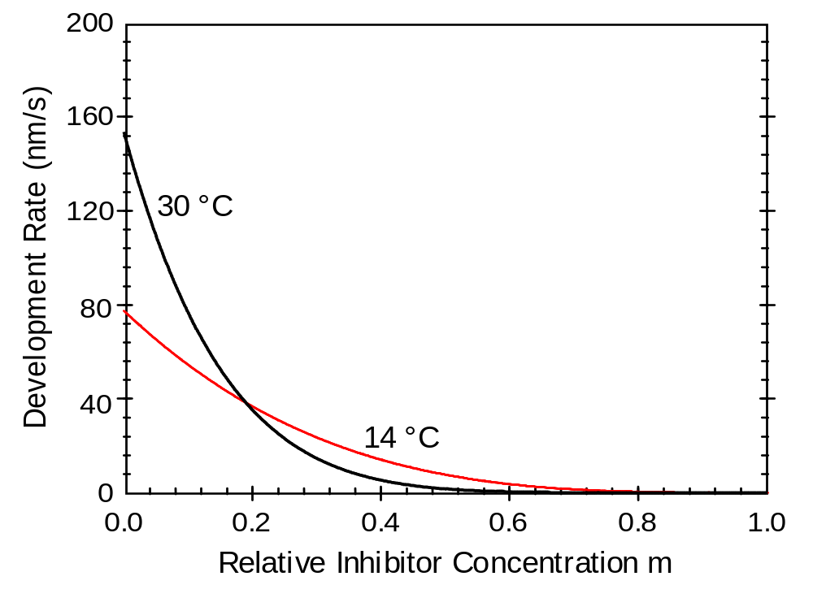
Figure 7.8 Comparison of the best-fit models of THMR-iP3650 for different developer temperatures shows the effect of increasing r_{max} and increasing dissolution selectivity parameter n on the shape of the development rate curve.

Slide 9
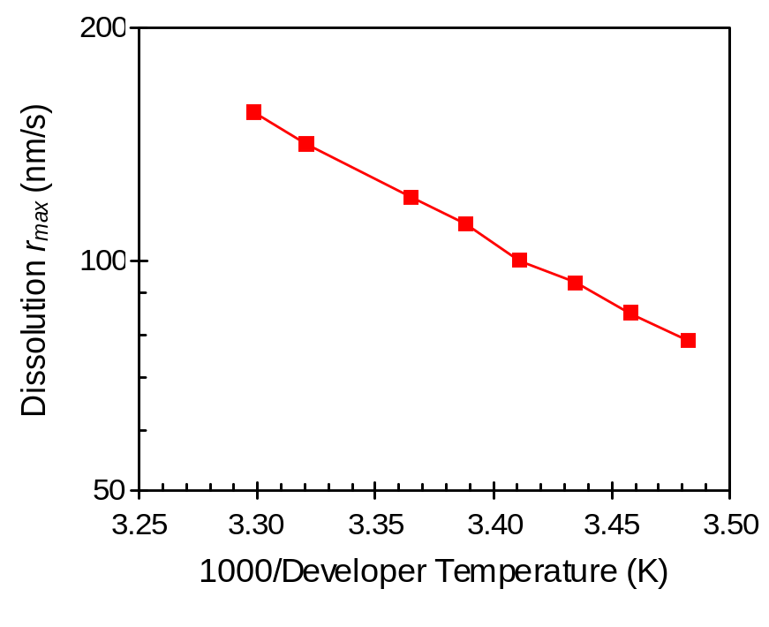
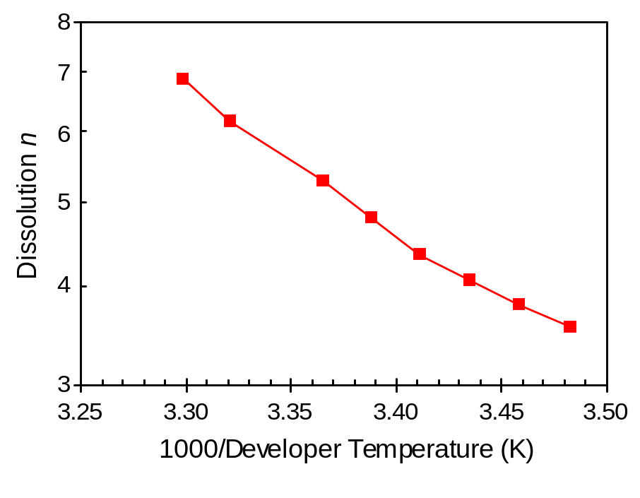
(a)
(b)
Figure 7.9 Arrhenius plots of the maximum dissolution rate r_{max} and the dissolution selectivity parameter n for THMR-iP3650.

Slide 10
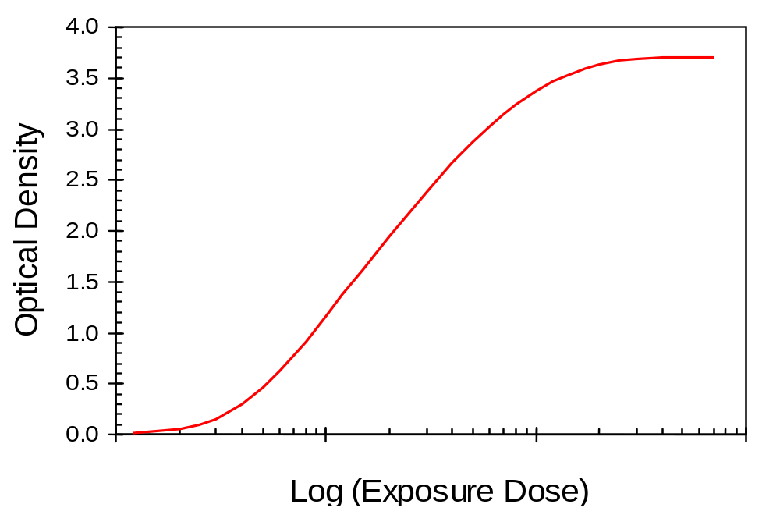
Figure 7.10 An example Hurter-Driffield (H-D) curve for a photographic negative.

Slide 11
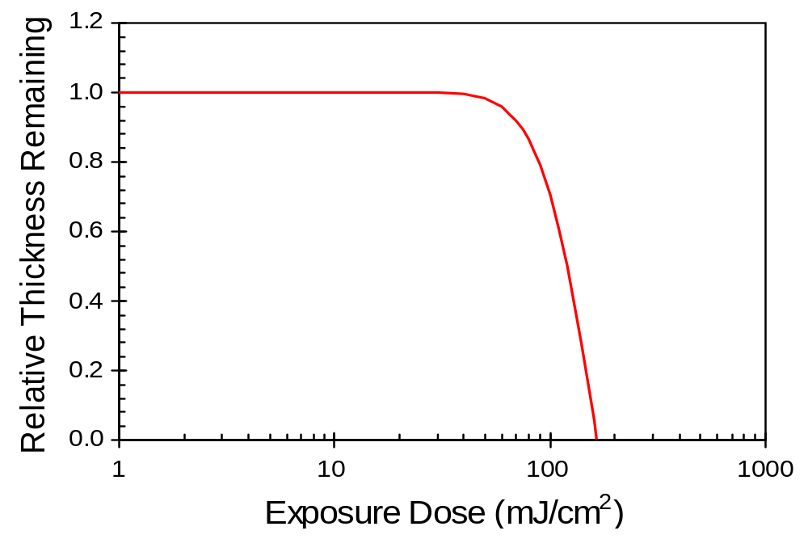
Figure 7.11 Positive resist characteristic curve used to measure contrast.

Slide 12
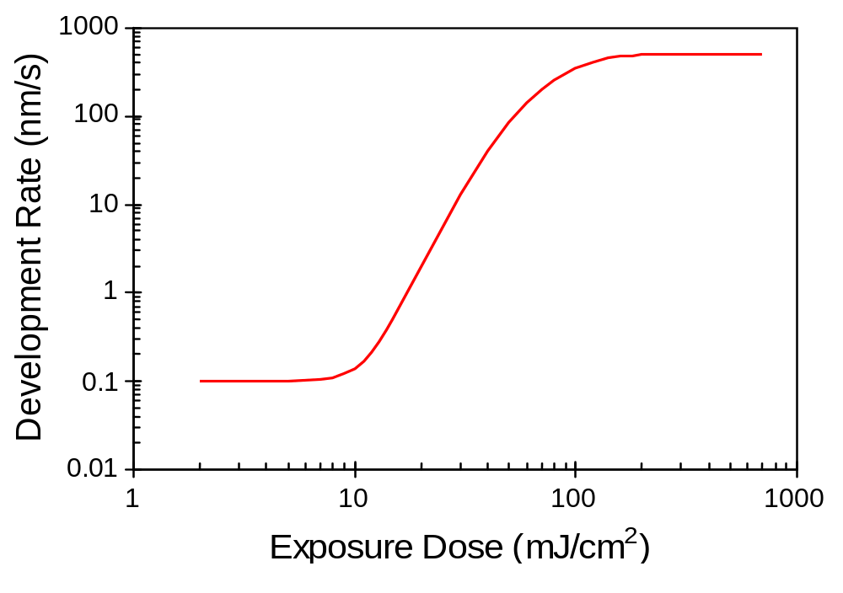
Figure 7.12 A lithographic H-D curve used to define the theoretical contrast.

Slide 13
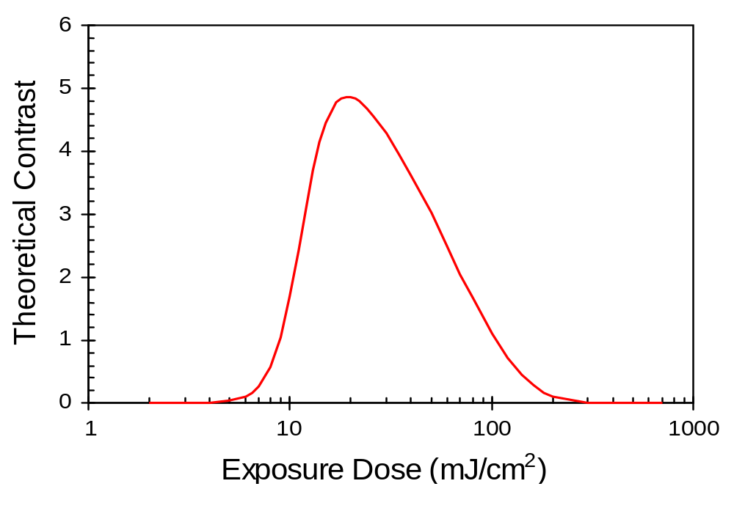
Figure 7.13 A typical variation of theoretical contrast with exposure dose. For this data, the FWHM dose ratio is about 5.5.

Slide 14
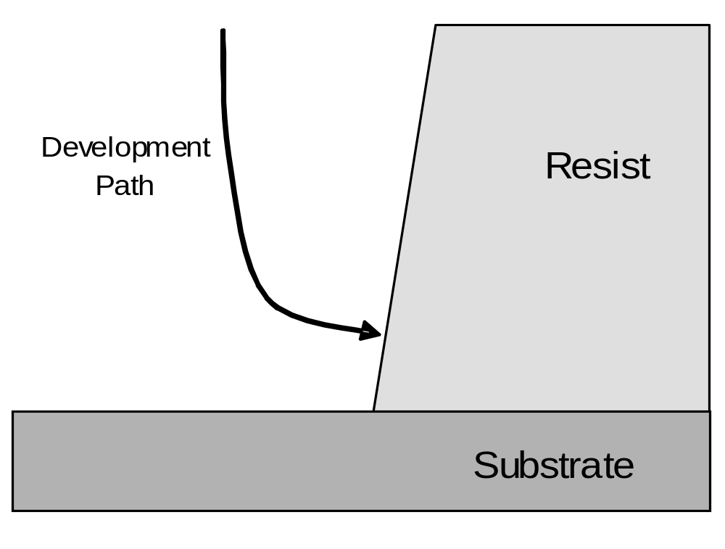
Figure 7.14 Typical development path.

Slide 15
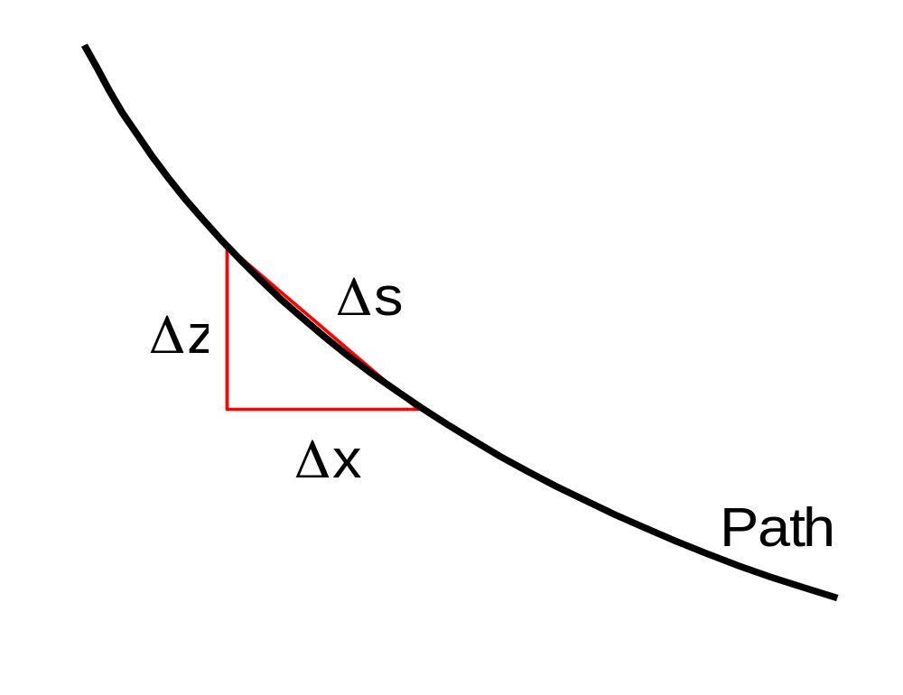
Figure 7.15 Section of a development path relating path length s to x and z.

Slide 16
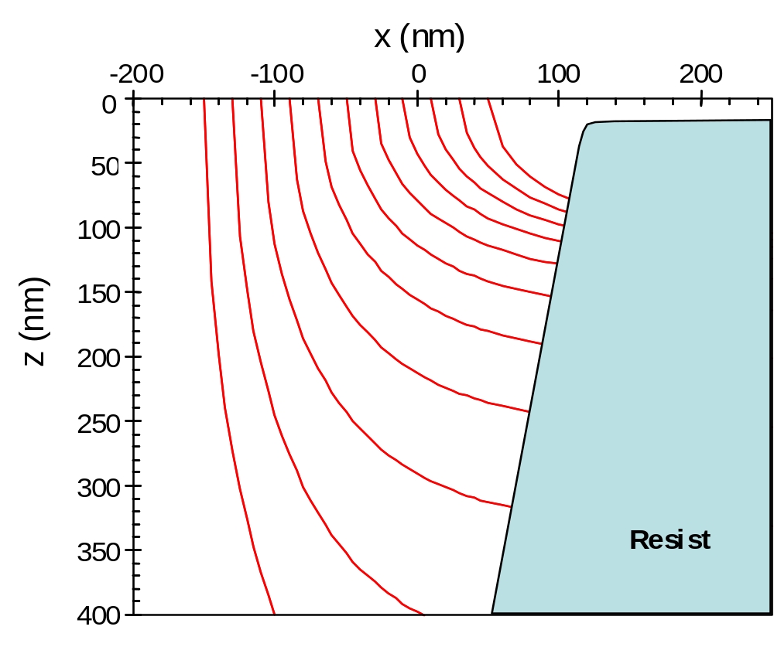
Figure 7.16 Example of how the calculation of many development paths leads to the determination of the final resist profile.

Slide 17
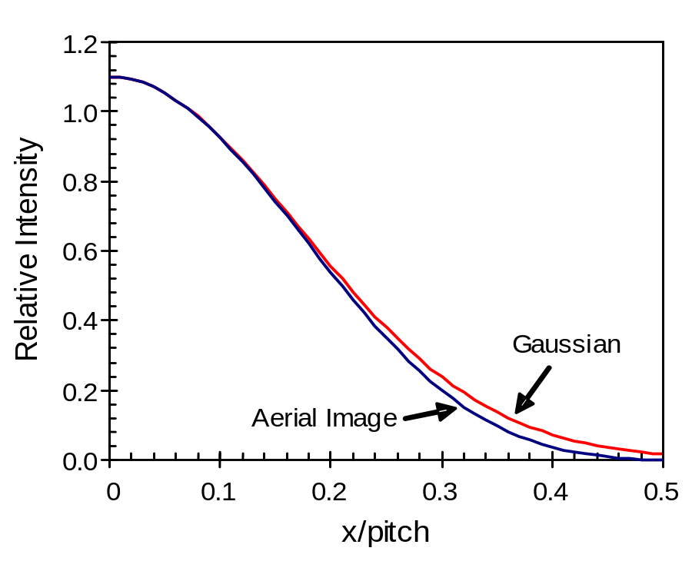
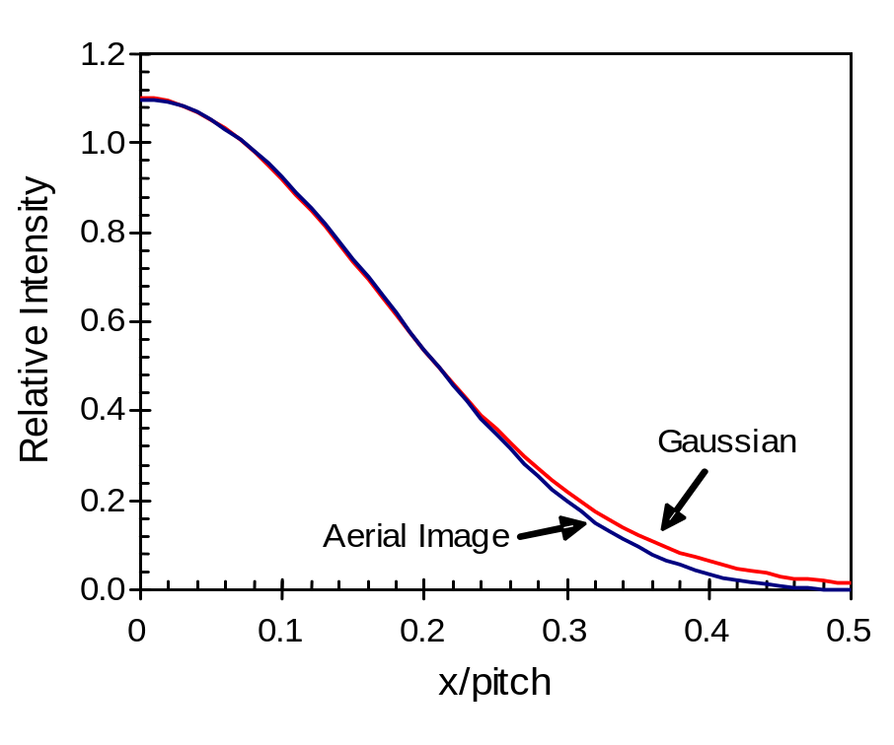
(a)
(b)
Figure 7.17 Matching a three-beam image (a₀ = 0.45, a₁ = 0.55, a₂ = 0.1) with a Gaussian using a) a value of s given by equation (7.91); and b) the best fit s. Note the goodness of the match in the region of the space (x/pitch < 0.25).

Slide 18
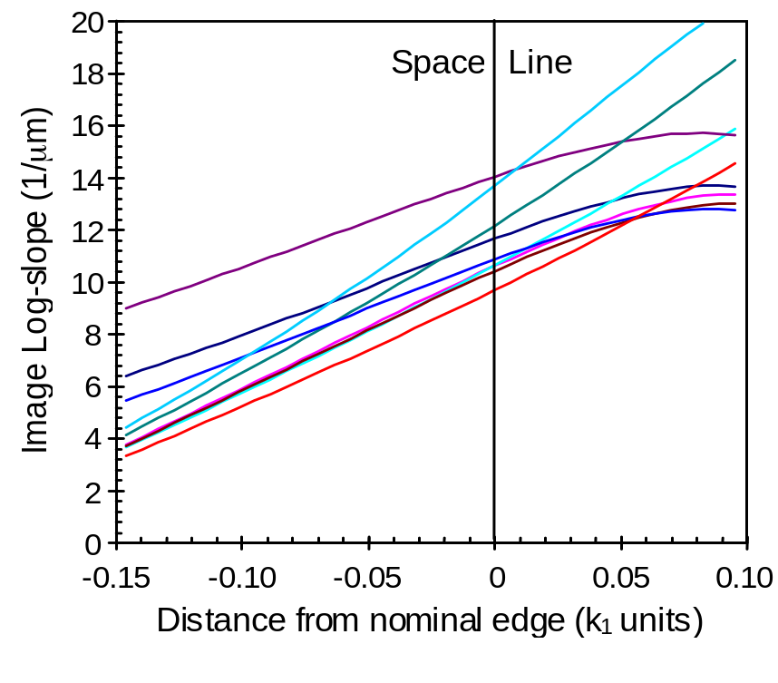
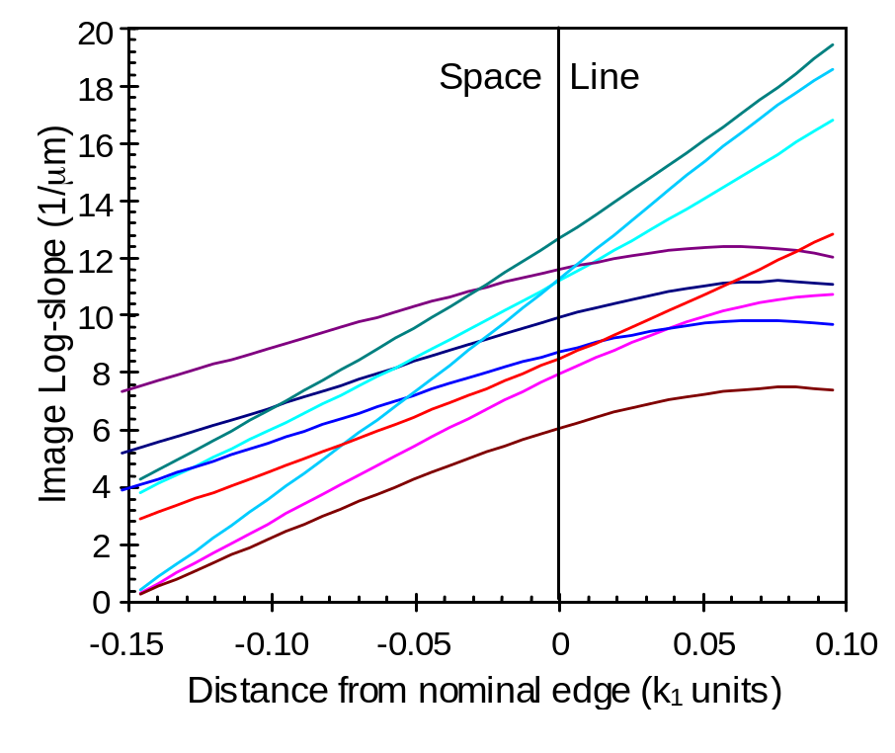
(a)
(b)
Figure 7.18 Simulated aerial images over a range of conditions show that the image log-slope varies about linearly with distance from the nominal resist edge in the region of the space: a) k₁ = 0.46 and b) k₁ = 0.38 for isolated lines, isolated spaces, and equal lines and spaces and for conventional, annular and quadrupole illumination.

Slide 19
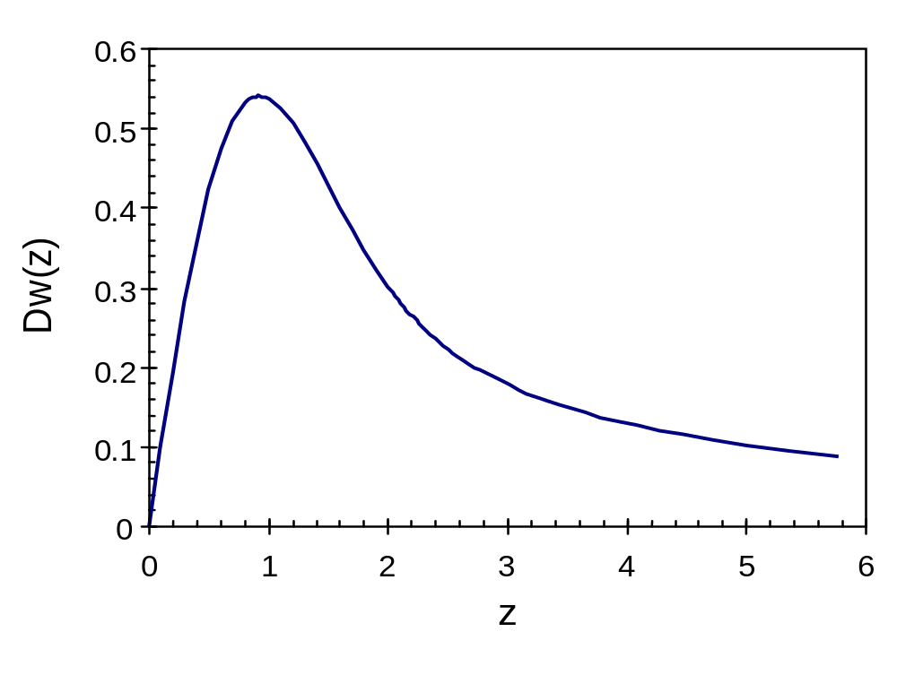
Figure 7.19 A plot of Dawson’s Integral, D_{w}(z).

Slide 20
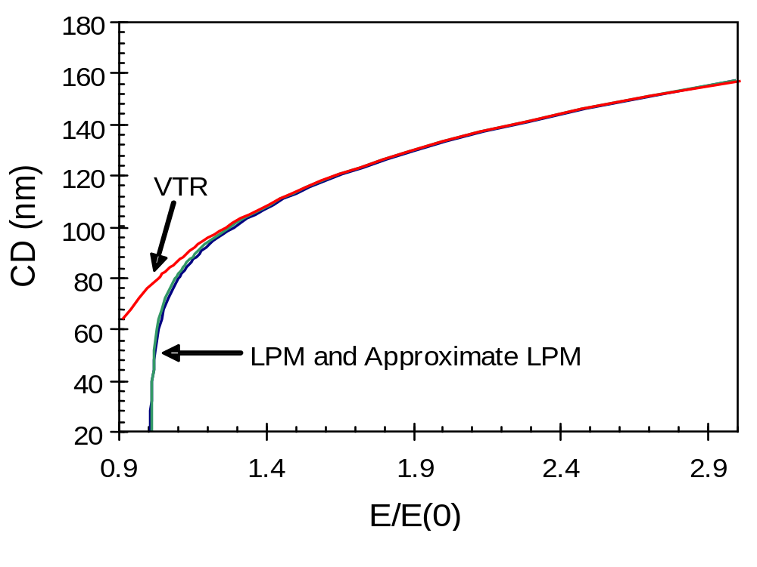
Figure 7.20 CD versus dose curves as predicted by the LPM equation (7.98), the LPM using the approximation for the Dawson’s integral, and the VTR. All models assumed a Gaussian image with g = 0.0025 1/nm² (NILS₁ = 2.5 and CD₁ = 100 nm), γ = 10, and D_{eff} = 200 nm.

Slide 21
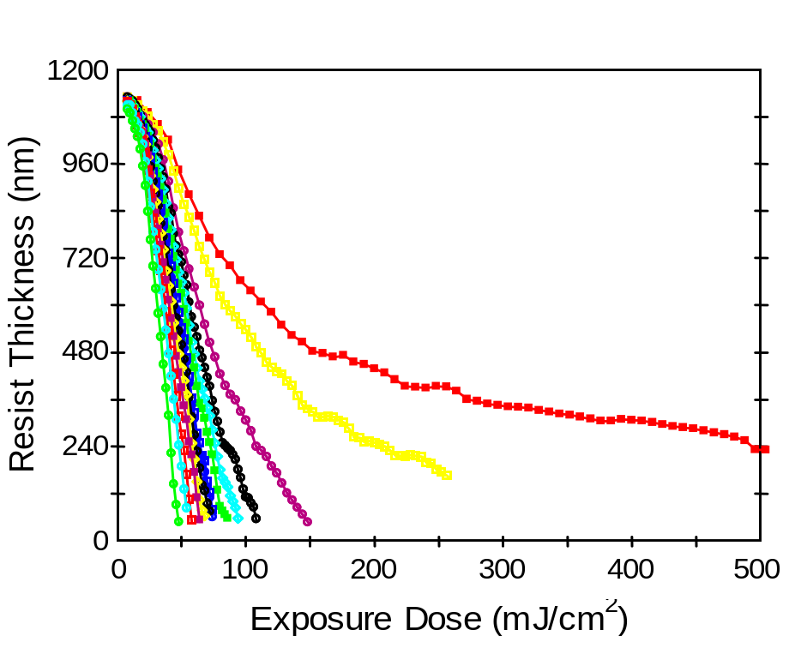
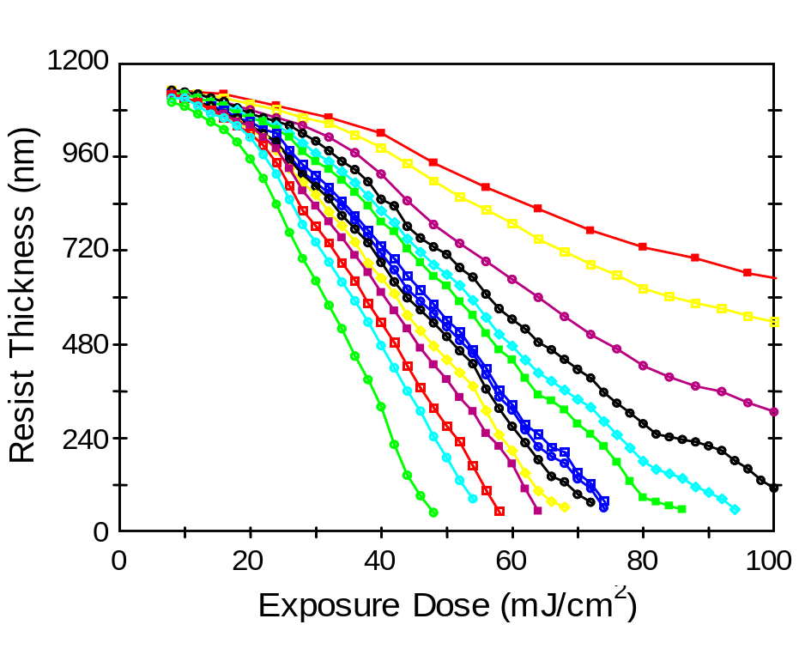
(a)
(b)
Figure 7.21 Measured contrast curves for an i-line resist at development times ranging from 9 to 201 seconds (shown here over two different exposure scales).

Slide 22
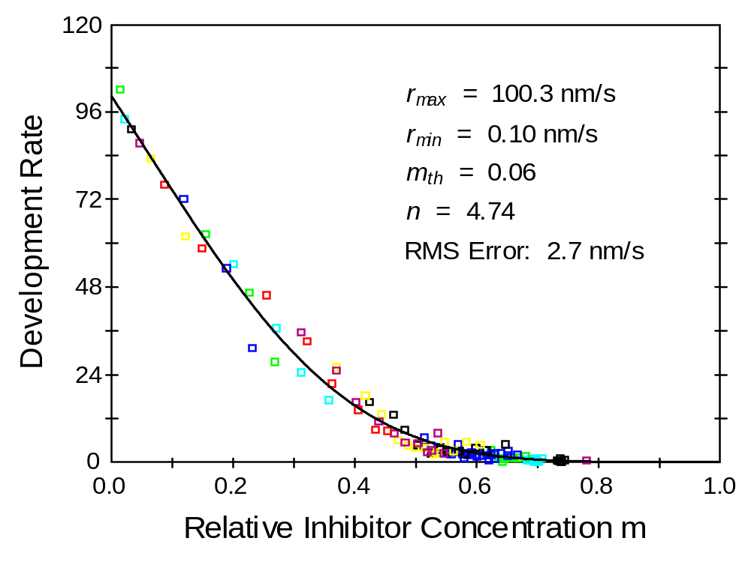
Figure 7.22 Analysis of the contrast curves generates an r(m) data set, which was then fit to the original kinetic development model (best fit is shown as the solid line).

