Slide 1
Design
Mask
Aerial Image
Image in Resist
Latent Image
PEB Latent Image
Developed Resist Image
Figure 9.1 The lithography process expressed as a sequence of information transfer steps.

Slide 2
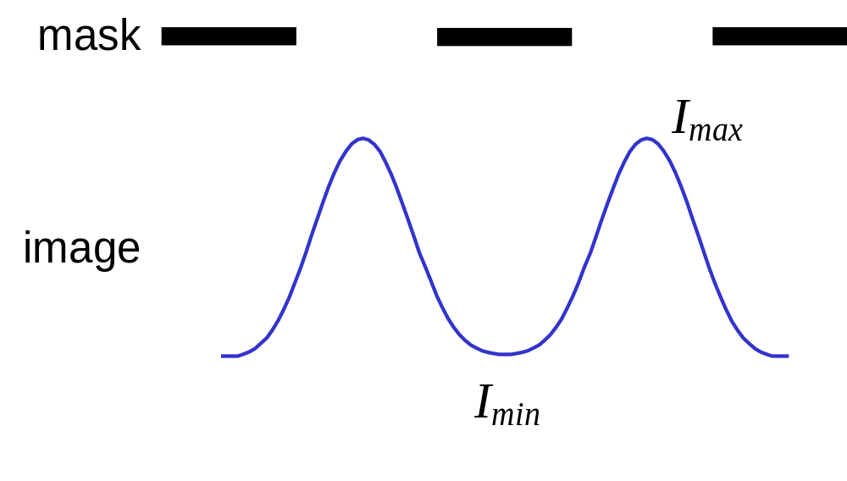
Figure 9.2 Image contrast is the conventional metric of image quality used in photography and other imaging applications, but is not directly related to lithographic quality.

Slide 3
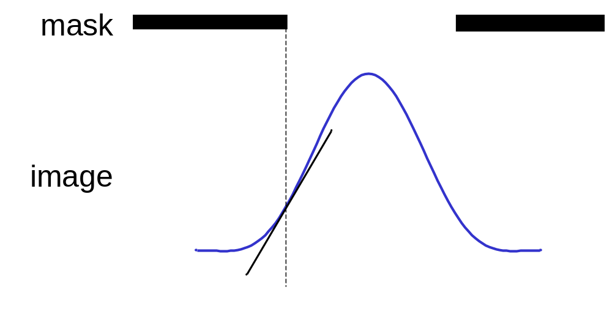
Figure 9.3 Image Log-Slope (or the Normalized Image Log-Slope, NILS) is the best single metric of image quality for lithographic applications.

Slide 4
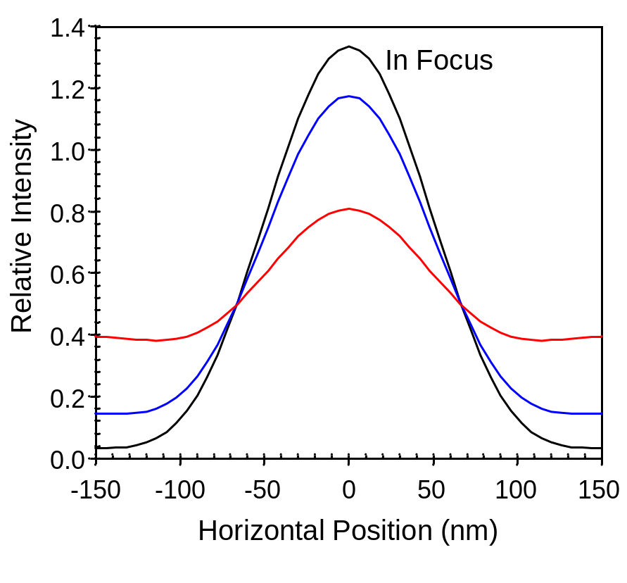
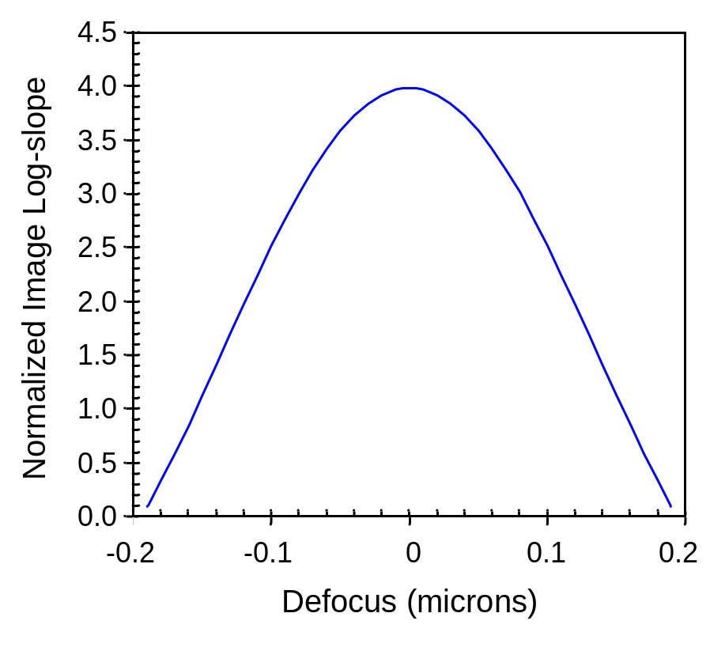
(a)
(b)
Figure 9.4 The effect of defocus is to (a) ‘blur’ an aerial image, resulting in (b) reduced log-slope as the image goes out of focus (150 nm space on a 300 nm pitch, NA = 0.93, λ = 193 nm).

Slide 5
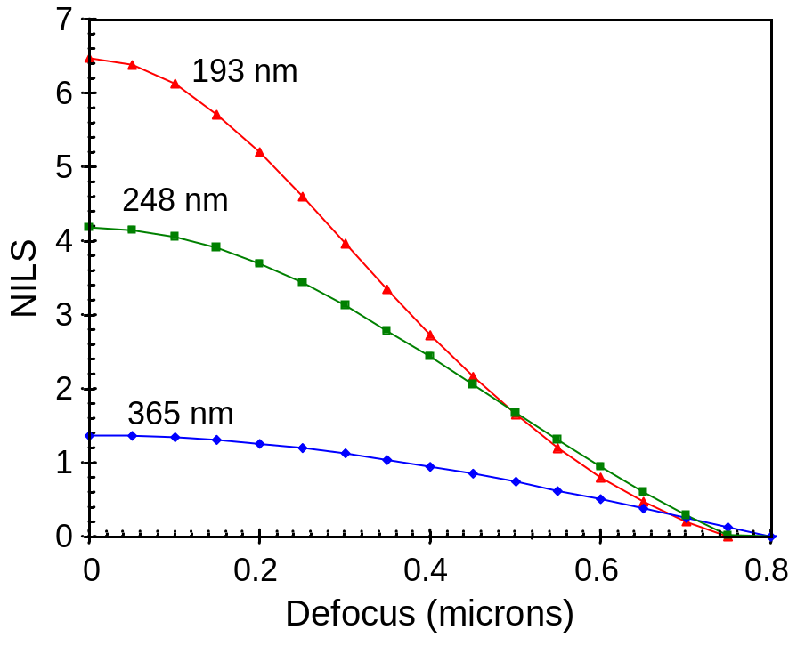
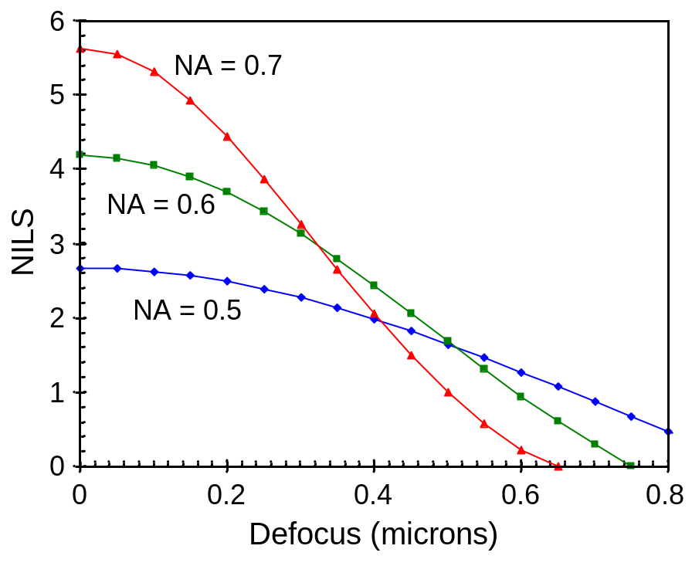
(a)
(b)
Figure 9.5 Using the log-slope defocus curve to study lithography: (a) lower wavelengths give better depth of focus (NA = 0.6, σ = 0.5, 250 nm lines and spaces), and (b) there is an optimum NA for maximizing depth of focus (λ = 248 nm, σ = 0.5, 250 nm lines and spaces).

Slide 6
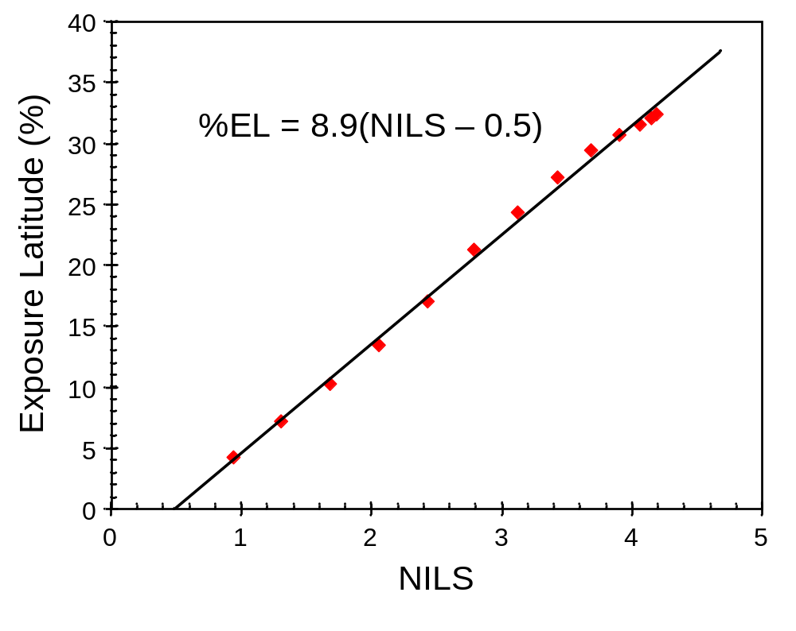
Figure 9.6 Typical correlation between NILS and exposure latitude (simulated data, λ = 248 nm, NA = 0.6, σ = 0.5, 500 nm of UV6 on ARC on silicon, printing 250 nm lines and spaces through focus).

Slide 7
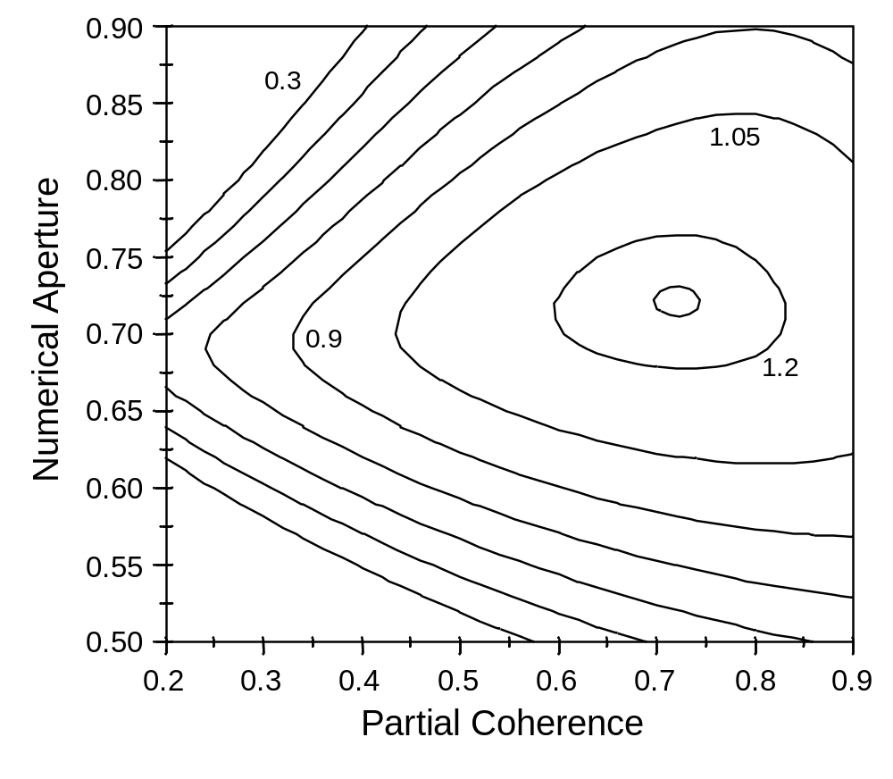
Figure 9.7 One approach to the optimum stepper problem is the pick a fixed amount of defocus (0.2 μm) and find the settings that maximize the NILS (λ = 248 nm, 130 nm lines on a 360 nm pitch, contours of constant NILS).

Slide 8
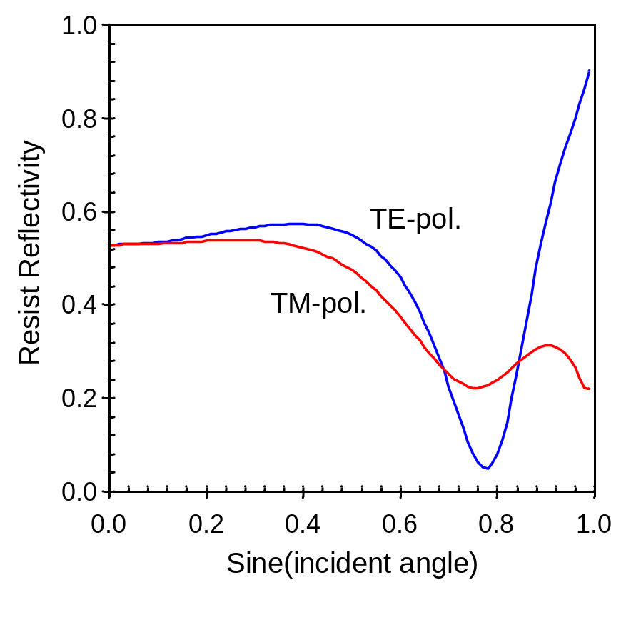
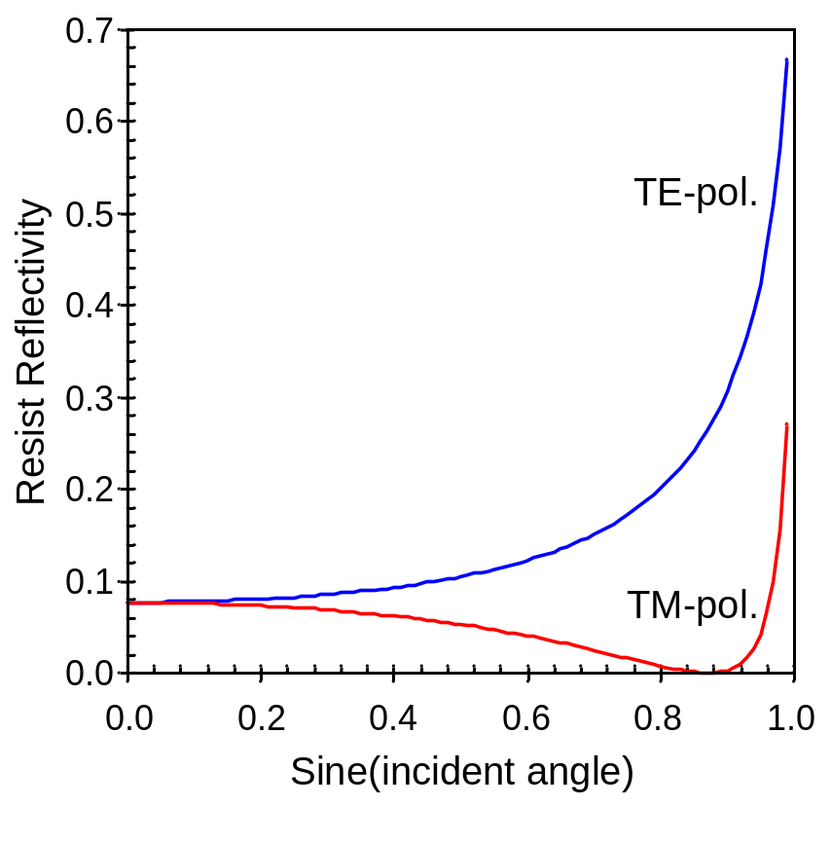
(a)
(b)
Figure 9.8 Intensity reflectivity between air and resist of plane waves as a function of incident angle and polarization for a) resist on silicon, and b) resist on an optically matched substrate (λ = 248 nm, resist n = 1.768 + i0.009868).

Slide 9
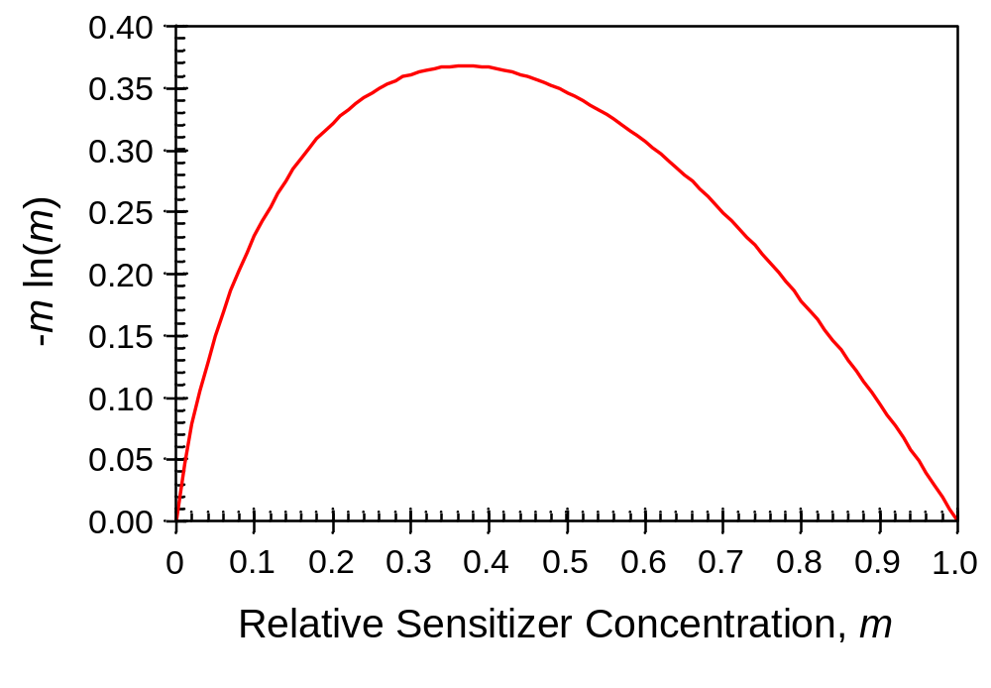
Figure 9.9 Plot revealing the existence of an optimum exposure, the value of m at which the latent image gradient is maximized. Note that m = 1 corresponds with unexposed resist, while m = 0 is completely exposed resist.

Slide 10
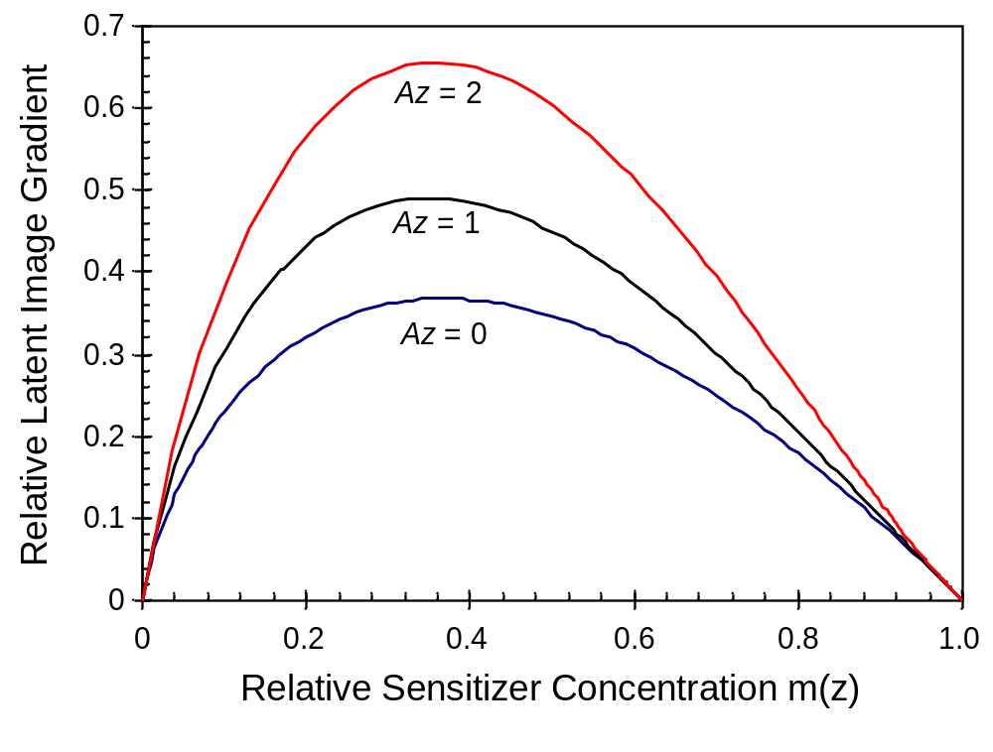
Figure 9.10 Bleaching (increasing values of Az) results in increased latent image gradient at the bottom of the resist (shown here is the special case where B = 0).

Slide 11
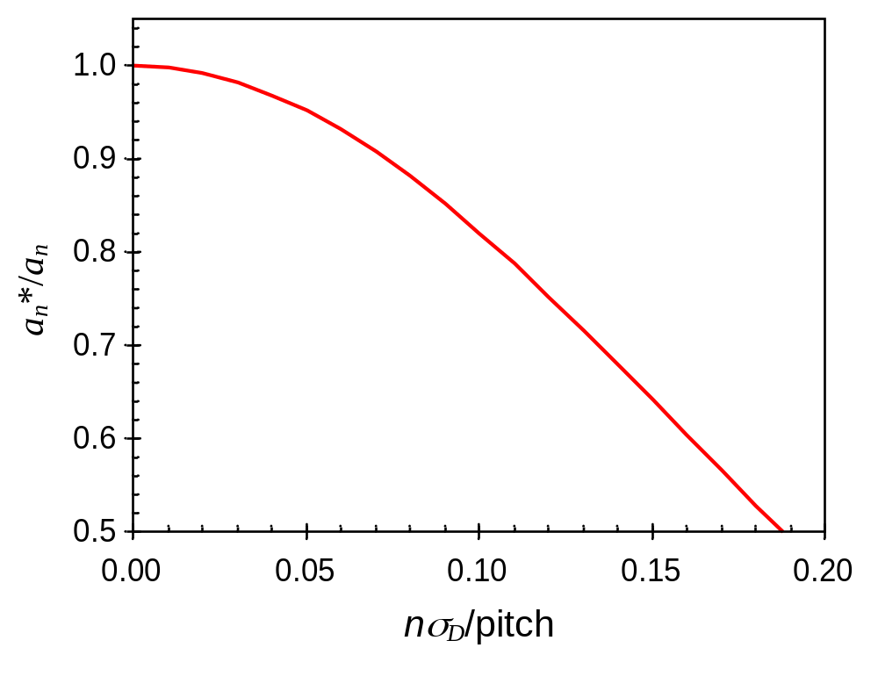
Figure 9.11 Effect of diffusion on the latent image frequency components for a dense line.

Slide 12
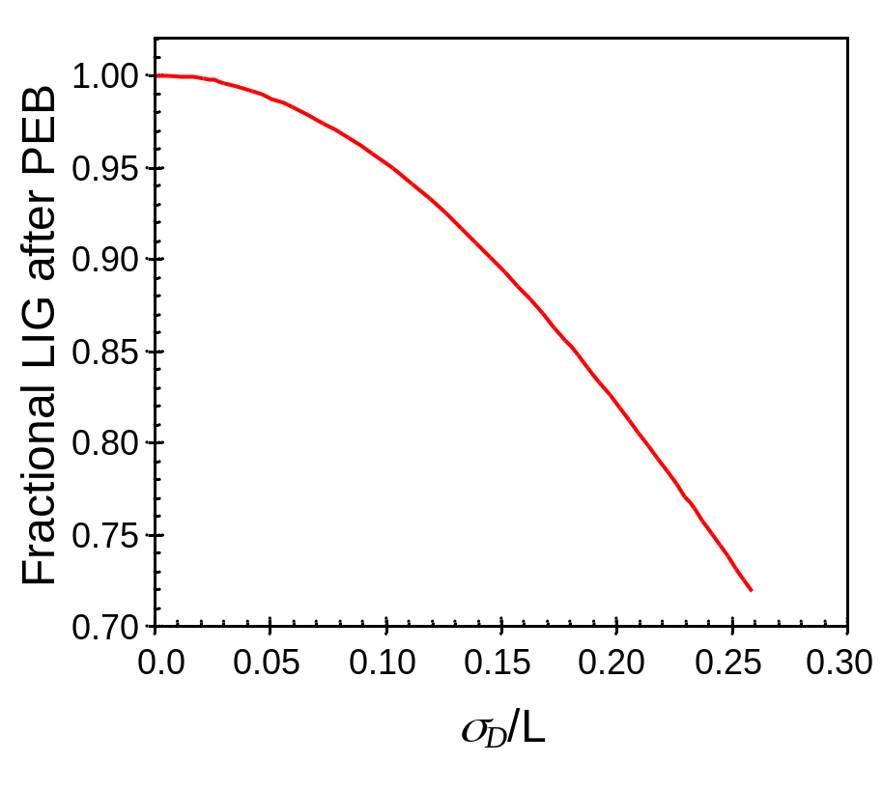
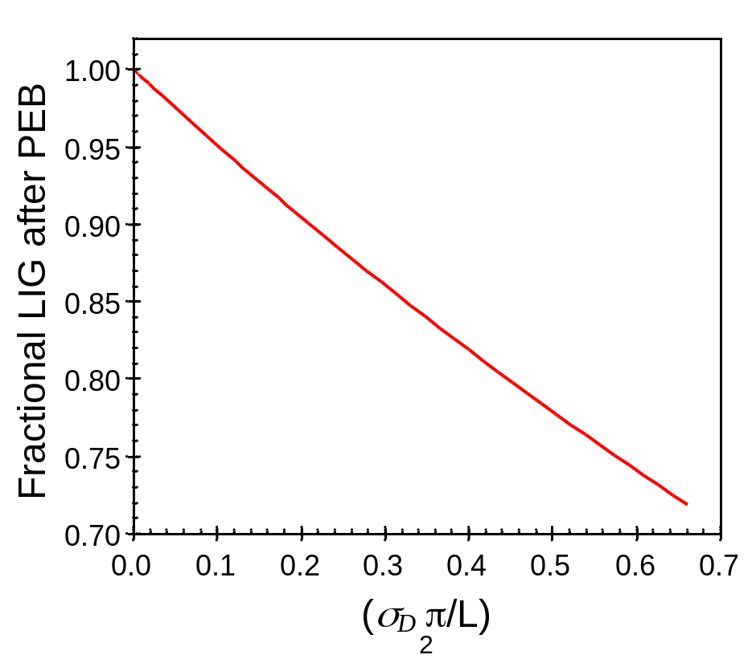
(a)
(b)
Figure 9.12 Increased diffusion (shown by the dimensionless quantity σ_{D}/L, the diffusion length over the width of the edge region) causes a decease in the latent image gradient (LIG) after PEB.

Slide 13
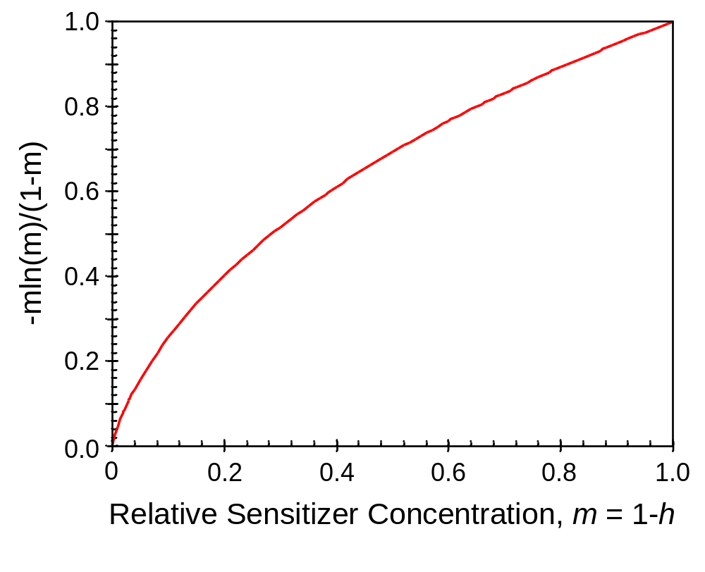
Figure 9.13 For a chemically amplified resist with a given required amount of amplification, the exposure dose (and thus relative sensitizer concentration m) is optimum as the dose approaches zero (m → 1), assuming negligible diffusion.

Slide 14
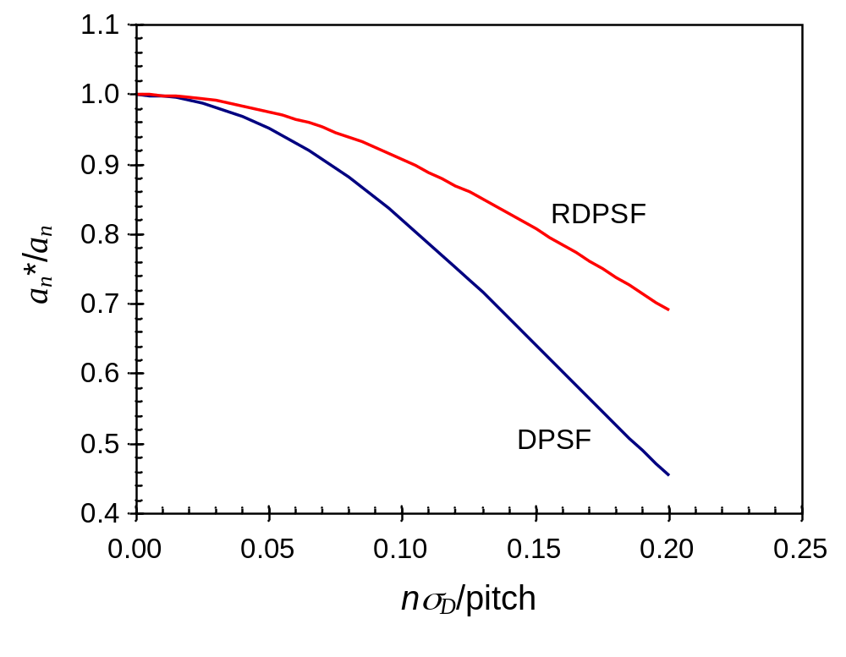
Figure 9.14 Effect of diffusion on the latent image frequency components for a dense line, comparing pure diffusion (DPSF) to reaction diffusion (RDPSF).

Slide 15
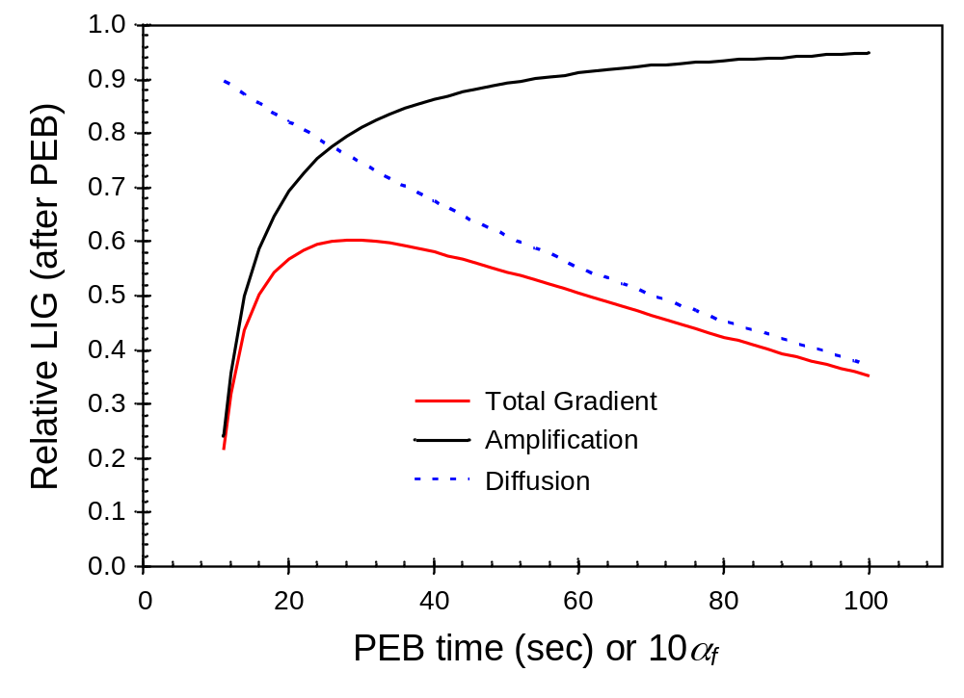
Figure 9.15 Including diffusion with amplification, there is an optimum PEB to maximize the latent image gradient (LIG), shown here relative to the maximum possible LIG. For this example, K_{amp} = 0.1 s⁻¹, τ = 200 s and the exposure dose is chosen to give the maximum gradient for each PEB time.

Slide 16
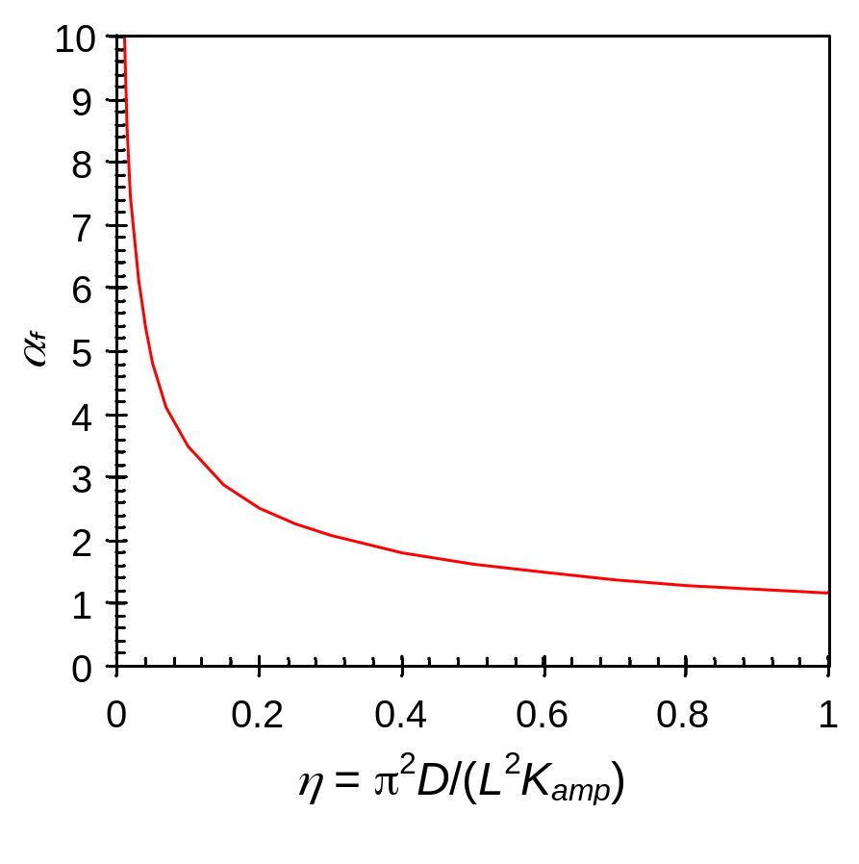
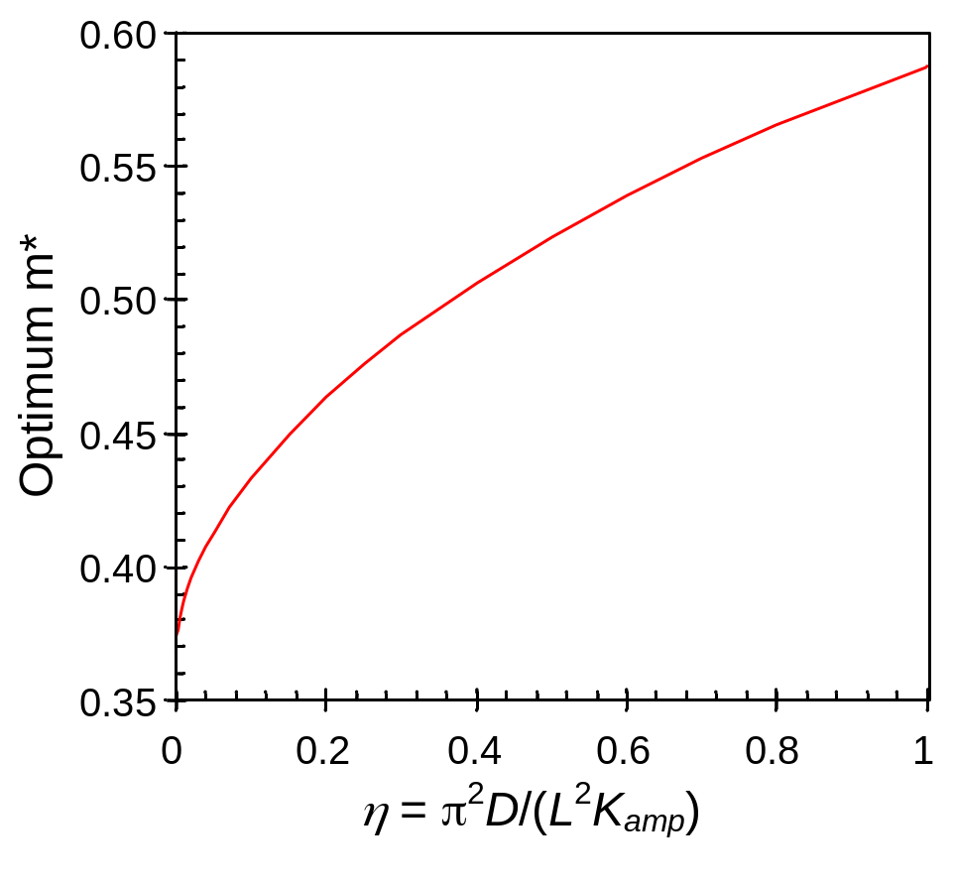
(a)
(b)
Figure 9.16 The optimum value of a) the amplification factor, and b) the deblocked concentration in order to maximize the final latent image gradient, as a function of η.

Slide 17
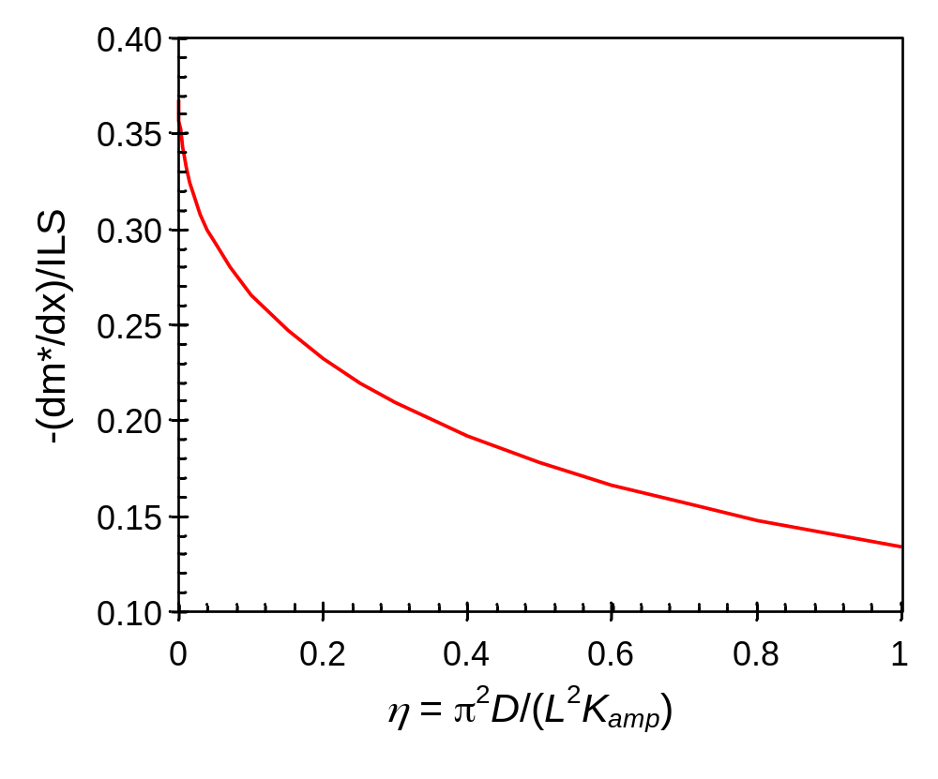
Figure 9.17 The optimum value of the final latent image gradient (relative to the image log-slope), as a function of η.

Slide 18
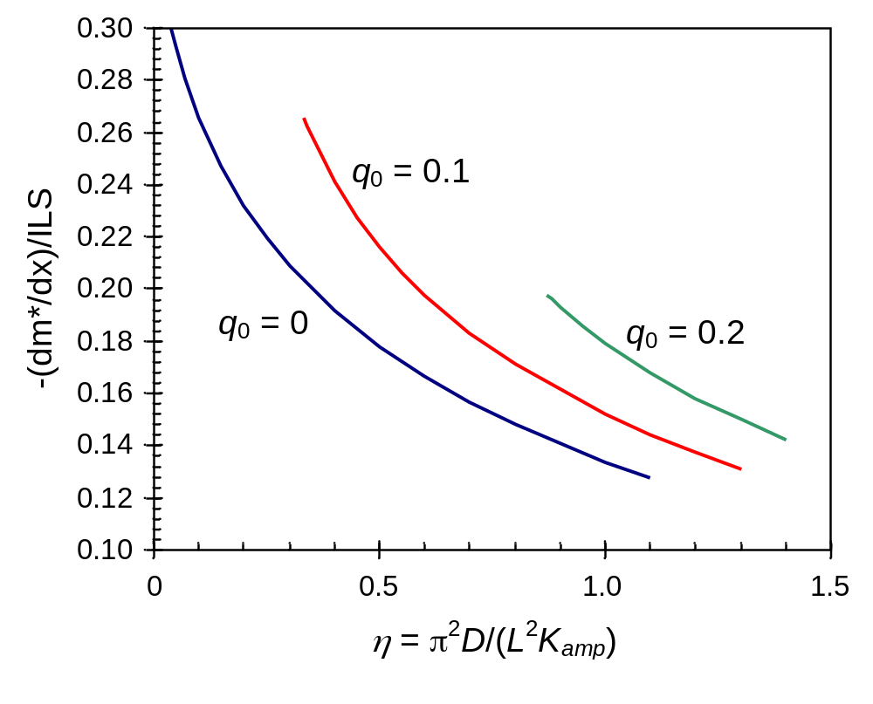
Figure 9.18 The optimum value of the final latent image gradient (relative to the image log-slope), as a function of η for cases with and without quencher.

Slide 19
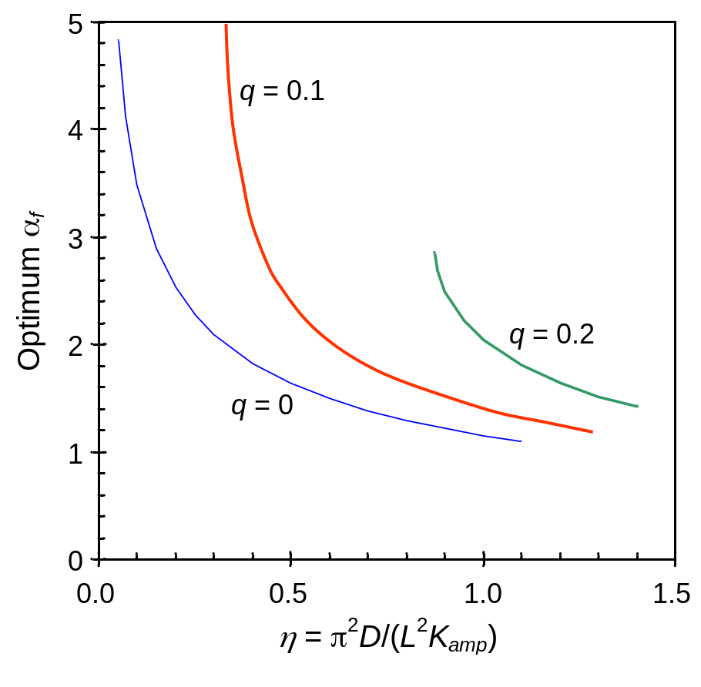
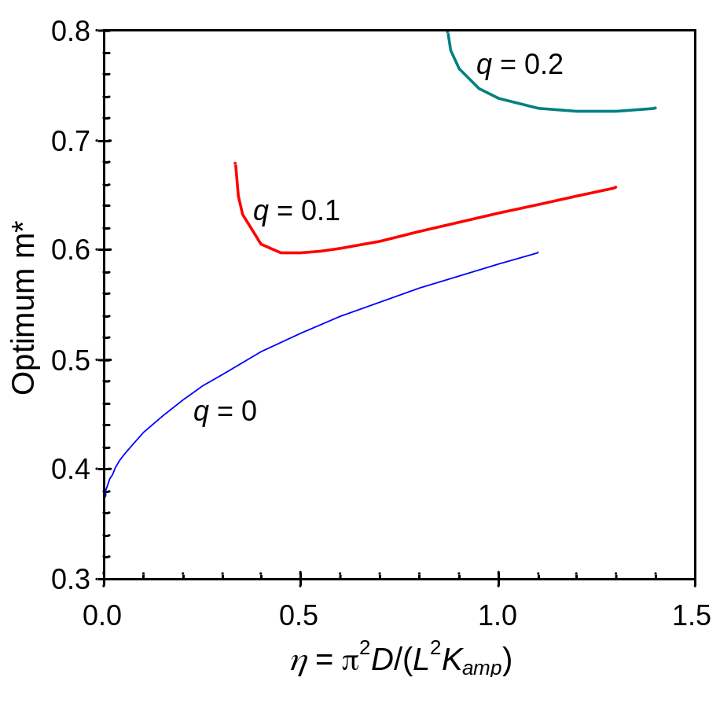
(a)
(b)
Figure 9.19 The optimum value of a) the amplification factor, and b) the deblocked concentration in order to maximize the final latent image gradient, as a function of η for different quencher loadings.

Slide 20
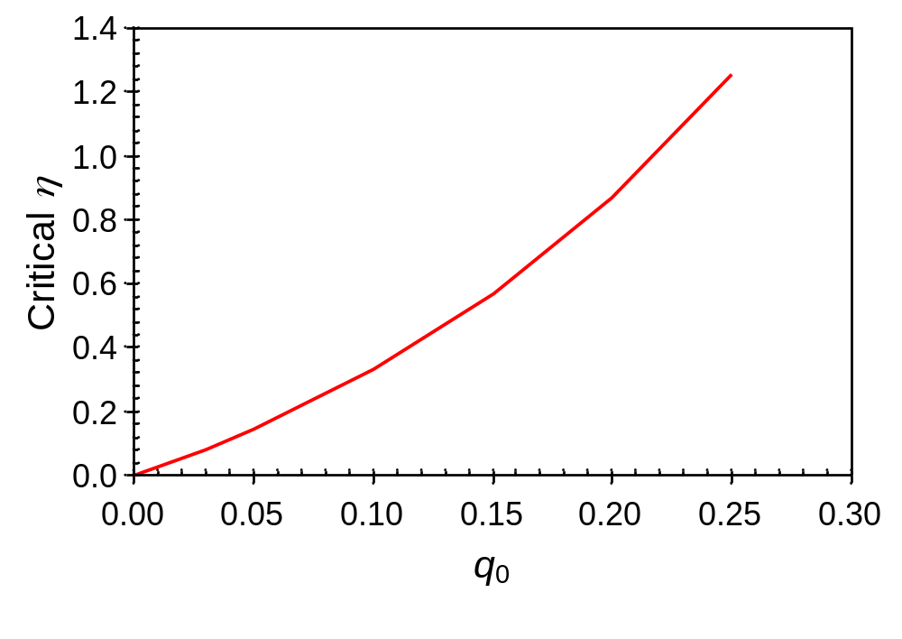
Figure 9.20 Numerically determined values of the critical η value (η_{c}) for different quencher loadings.

Slide 21
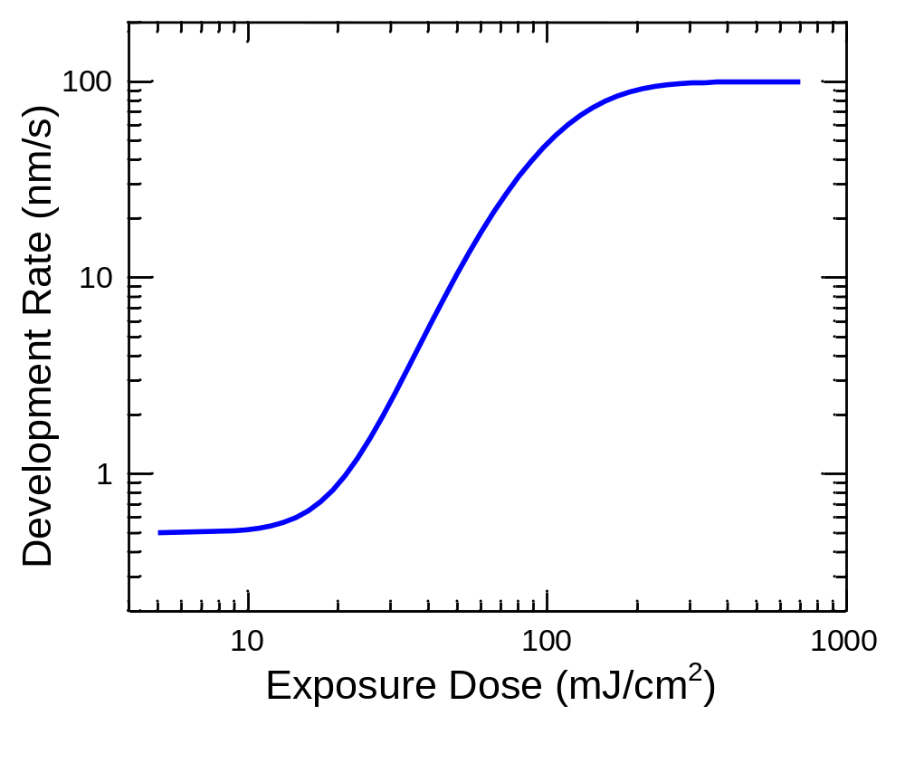
Figure 9.21 Typical development rate function of a positive photoresist (one type of Hurter−Driffield curve).

Slide 22
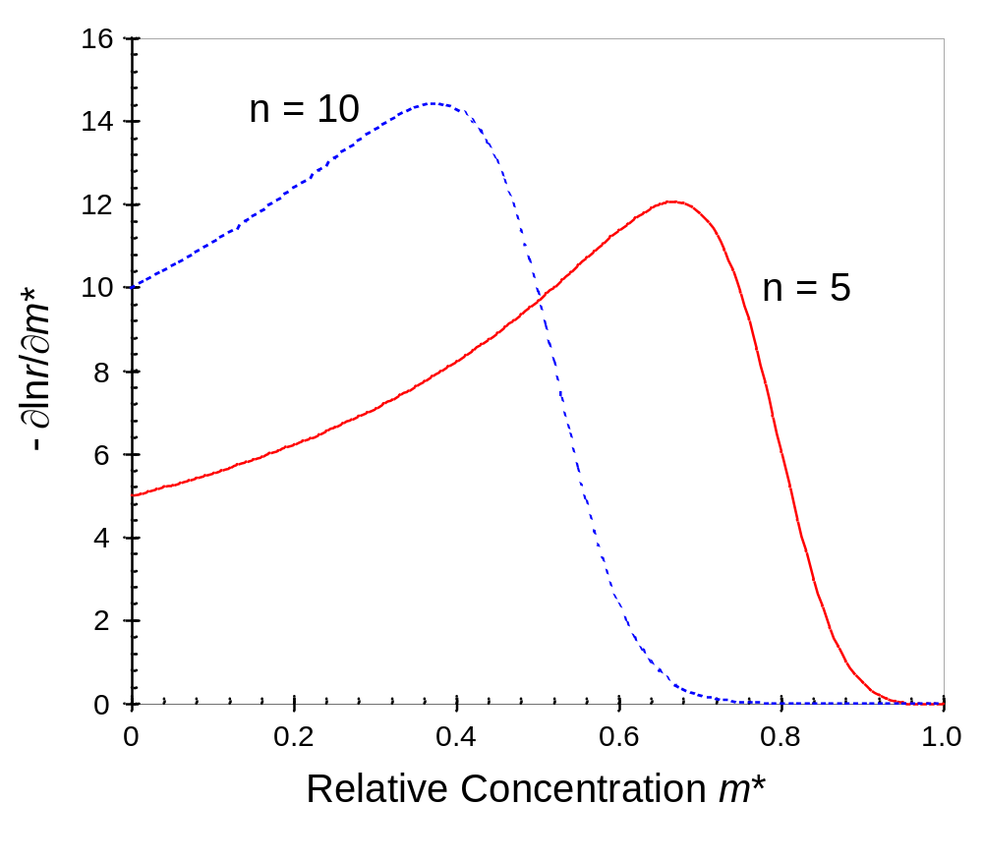
Figure 9.22 One component of the overall photoresist contrast is the variation in development rate r with chemical species m*, shown here for the reaction-controlled version of the original kinetic development rate model (r_{max} = 100 nm/s, r_{min} = 0.1 nm/s).

Slide 23
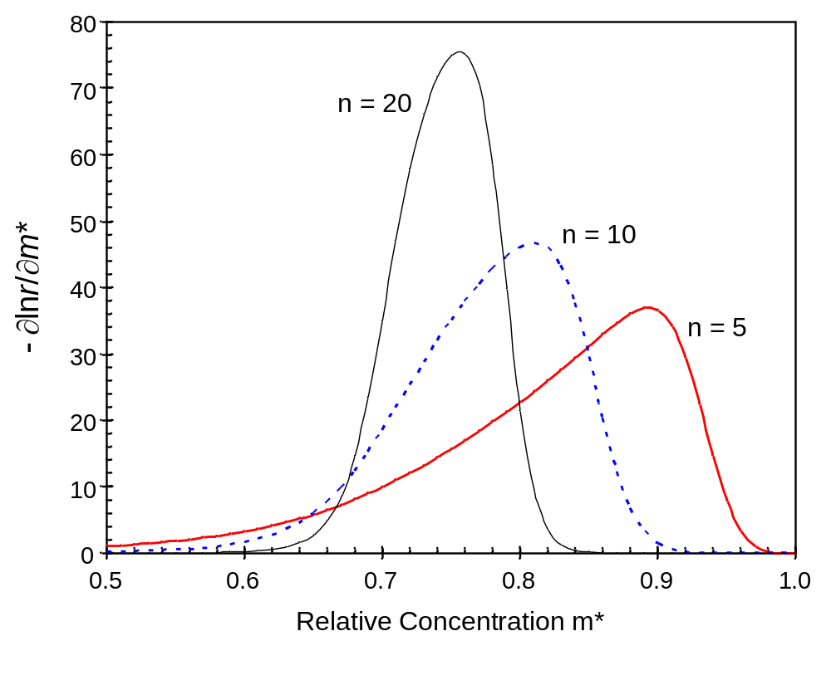
Figure 9.23 Development rate gradient with inhibitor concentration for the original kinetic development rate model (r_{max} = 100 nm/s, r_{min} = 0.1 nm/s, m_{th} = 0.7).

Slide 24
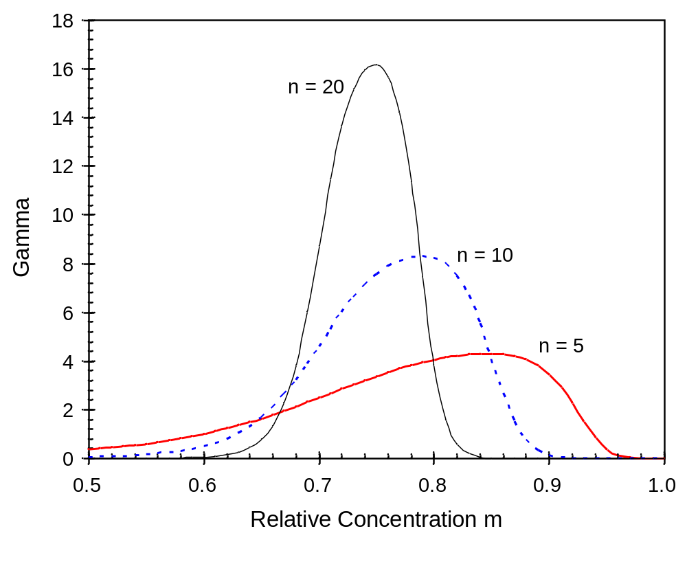
Figure 9.24 Photoresist contrast as a function of inhibitor concentration for the original kinetic development rate model, assuming no diffusion (r_{max} = 100 nm/s, r_{min} = 0.1 nm/s, m_{th} = 0.7) and different values of the dissolution selectivity parameter n.

Slide 25
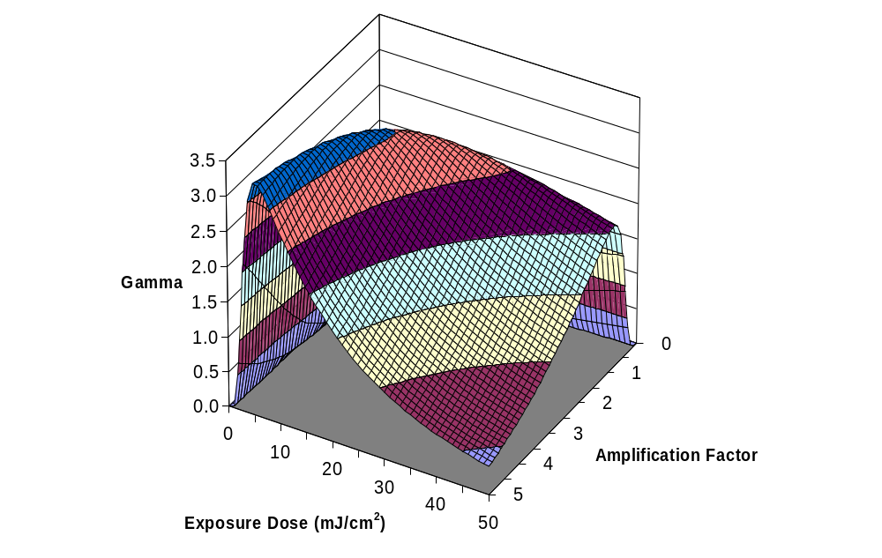
Figure 9.25 The overall photoresist contrast (gamma) as a function of exposure dose (E) and amplification factor (α_{f}) for a chemically amplified resist with no diffusion (η = 0, r_{max} = 100 nm/s, r_{min} = 0.1 nm/s, n = 5, C = 0.05 cm2/mJ).

Slide 26
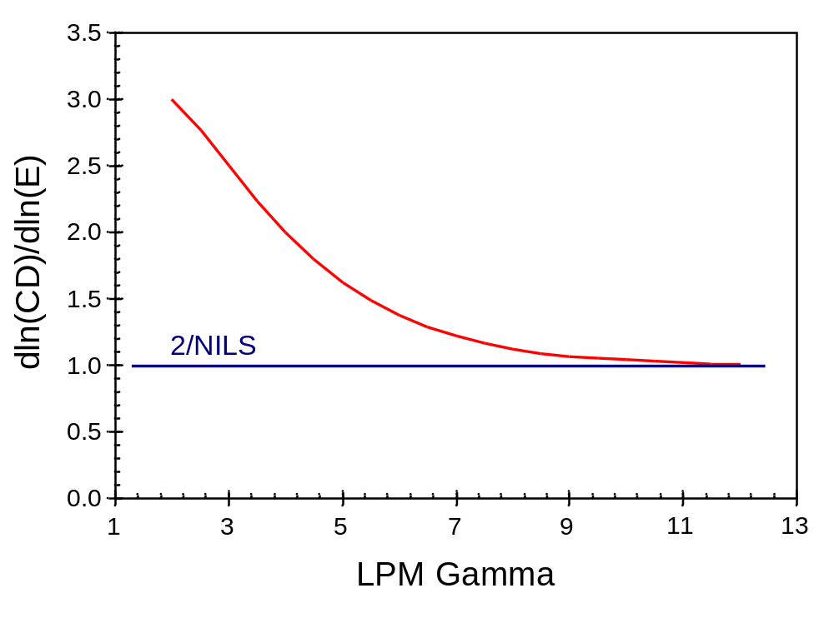
Figure 9.26 A plot of equation (9.88) showing how the exposure latitude term approaches its limiting value of 2/NILS as the lumped photoresist contrast increases. In this case, the resist aspect ratio is 2, the ratio I(CD/2)/I(0) is 0.5 and the NILS is 2.

Slide 27

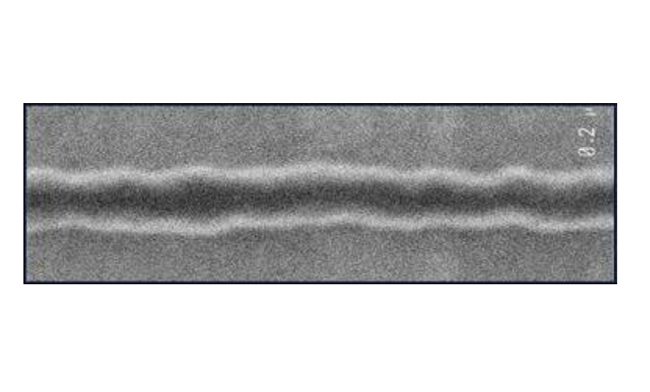
Figure 9.27 SEM pictures of photoresist features exhibiting line edge roughness.

Slide 28
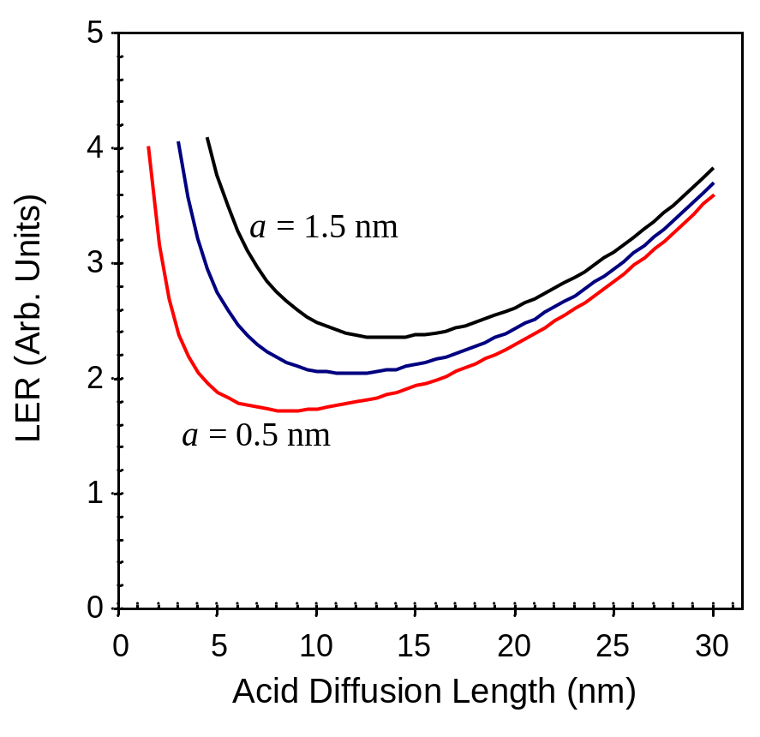
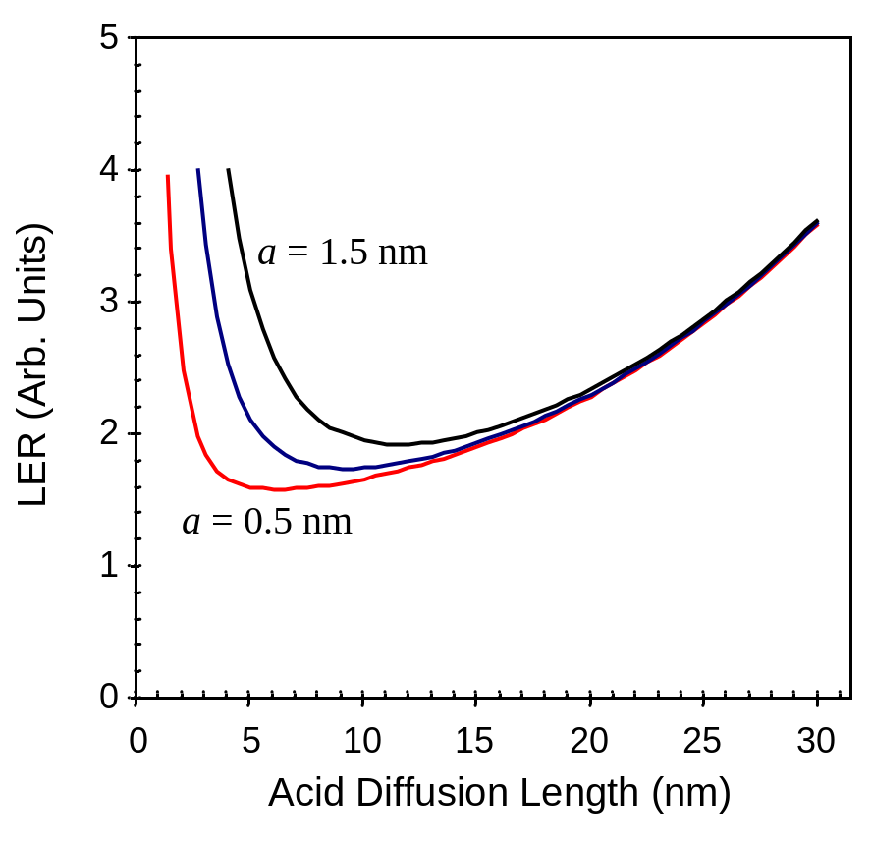
(a)
(b)
Figure 9.28 Prediction of LER trends for a 45 nm feature using the generic conditions found in equation (9.99) and using three values of the deblocking reaction capture range a (0.5, 1, and 1.5 nm): a) assuming a 2-dimensional problem, and b) for a 3-dimensional problem.

Slide 29
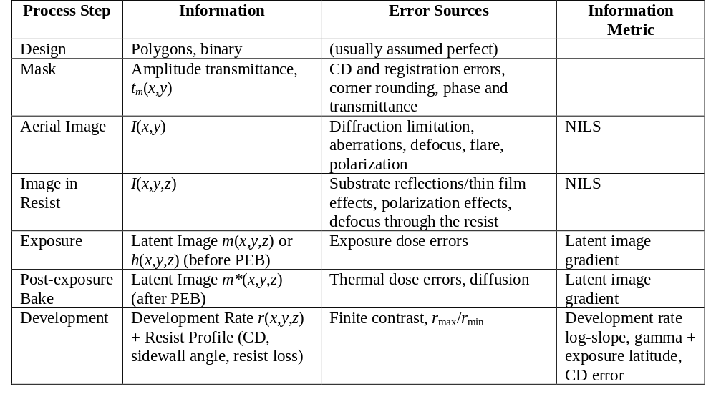
Table 9.1 Summary of lithography process steps and their corresponding information metrics.

